Slide 1
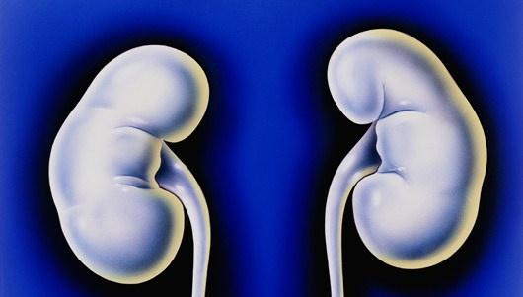
DEVELOPMENT
OF
KIDNEYS & URETES
Prof. Ahmed Fathalla Ibrahim

Slide 2
OBJECTIVES
At the end of the lecture, students should be able to:
Identify the embryological origin of kidneys & ureters.
Differentiate between the 3 systems of kidneys during development.
Describe the development of collecting & excretory parts of permanent kidney.
Describe the fetal kidney & identify the pre- and postnatal changes that occur in the kidney.
Enumerate the most common anomalies of kidneys & ureters.

Slide 3
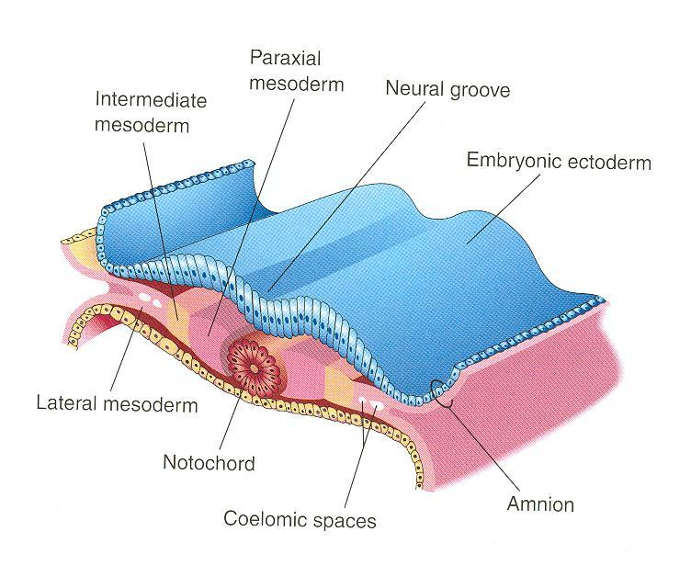
KIDNEYS & URETERS
EMBRYOLOGICAL ORIGIN
from

Slide 4
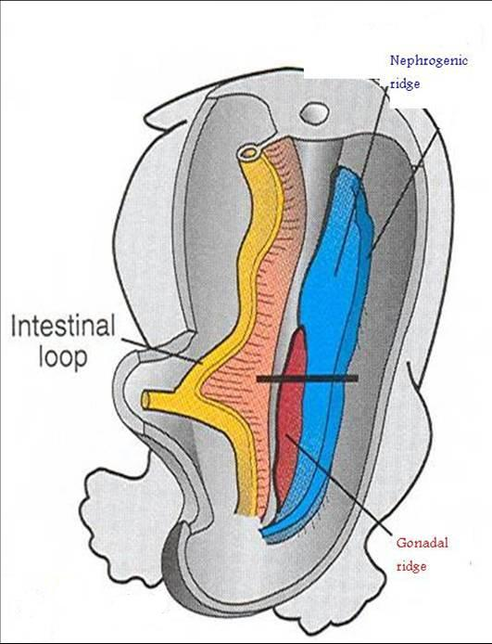
INTERMEDIATE MESODERM
Divides into:
Nephrogenic ridge (cord):
forms kidneys & ureters
2. Gonadal ridge: forms
gonads (testes or ovaries)

Slide 5
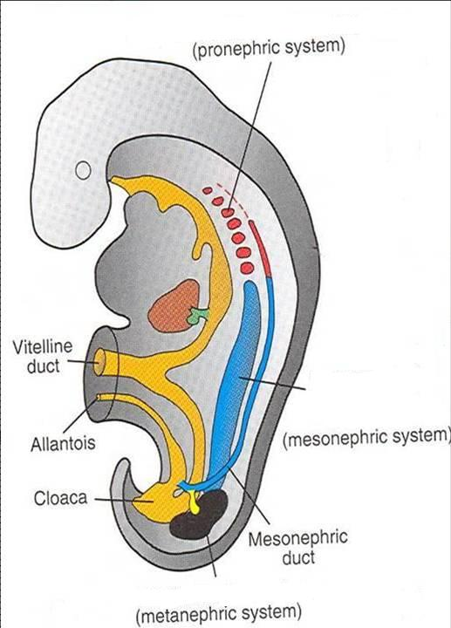
DEVELOPMENT OF KIDNEYS
Three systems of kidneys develop:
Pronephric system:
- appears at beginning of 4th week
in cervical region
- analogous to kidney of fish
- formed of tubules & a duct
- not function in human
- disappears
Mesonephric system:
- appears at end of 4th week
in thoracic & abdominal regions
- analogous to kidney of amphibians
- formed of tubules & a duct
- function temporarily
- In male: forms genital duct
- In both sexes: forms ureteric bud
Metanephric system:
- appears at 5th week in pelvis
- starts to function at 9th week
Ureteric bud

Slide 6
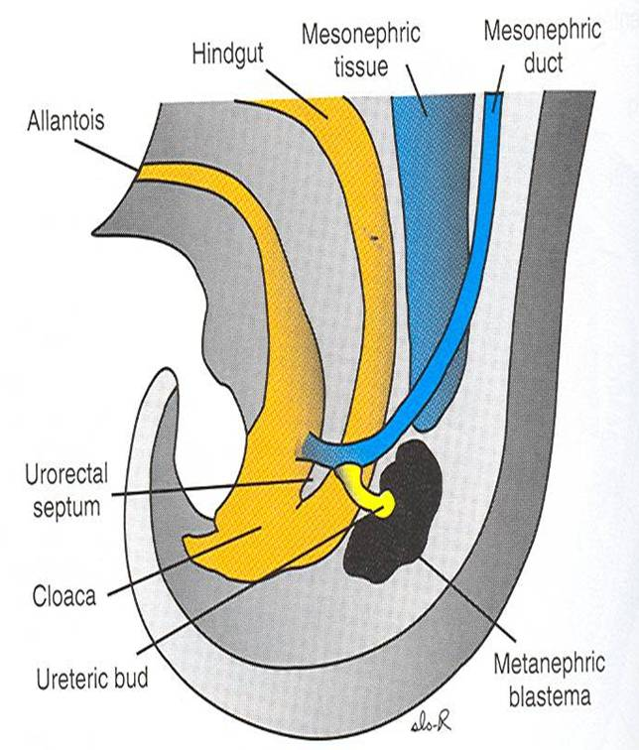
METANEPHROS
(PERMANENT KIDNEY)
Formed of 2 origins:
Ureteric bud (derived from mesonephric duct): gives collecting part of kidney
Metanephric blastema (mass): gives excretory part of kidney

Slide 7
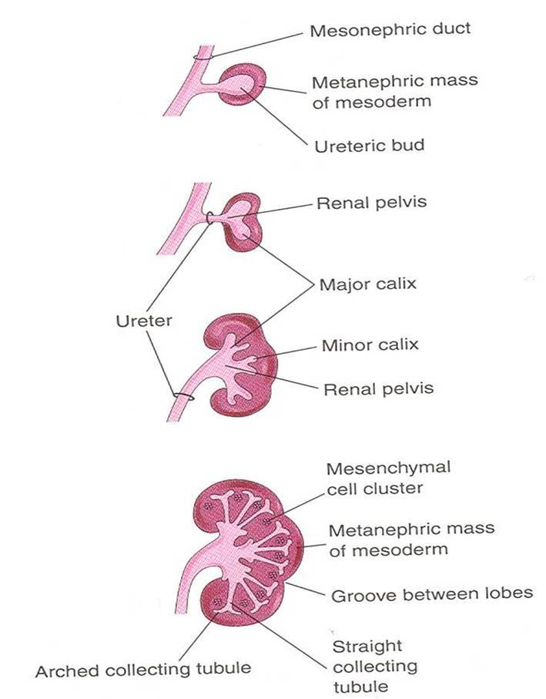
COLLECTING PART
A- Ureteric bud elongates & penetrates metanephric mass.
B- Stalk of ureteric bud forms ureter & cranial end forms renal pelvis.
C- Branching of renal pelvis gives 3 major calices. Branching of major calyces gives minor calyces.
D- Continuous branching gives straight then arched collecting tubules
A
B
C
D

Slide 8
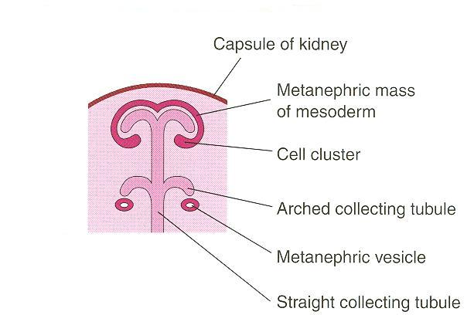
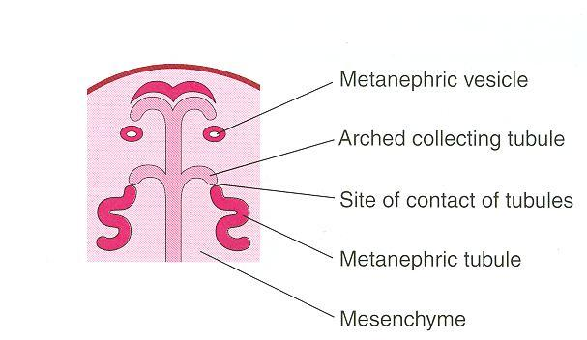
EXCRETORY PART
Each arched collecting tubule is surrounded by a cap of metanephric mass.
The metanephric cap forms the metanephric vesicle.
The metanephric vesicle elongates to form an S-shaped metanephric tubule.

Slide 9
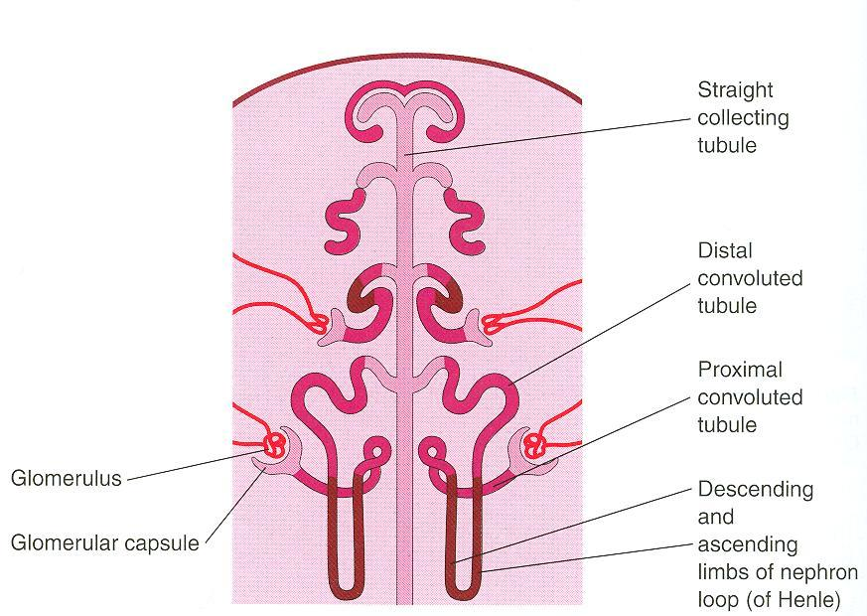
EXCRETORY PART
The end of each tubule forms glomerular (Bowman’s) capsule.
Each glomerular capsule is invaginated by capillaries (glomerulus).
The tubule lengthens to form: proximal & distal convoluted tubules + loop of Henle

Slide 10
THE NEPHRON
FUNCTIONAL UNIT OF KIDNEY
The nephron is formed by fusion of:
Excretory tubule formed of metanephric mass (cap).
Arched collecting tubule formed of ureteric bud.
At full term, each kidney contains: 800000 – 1000000 nephrons.
2)
1)

Slide 11
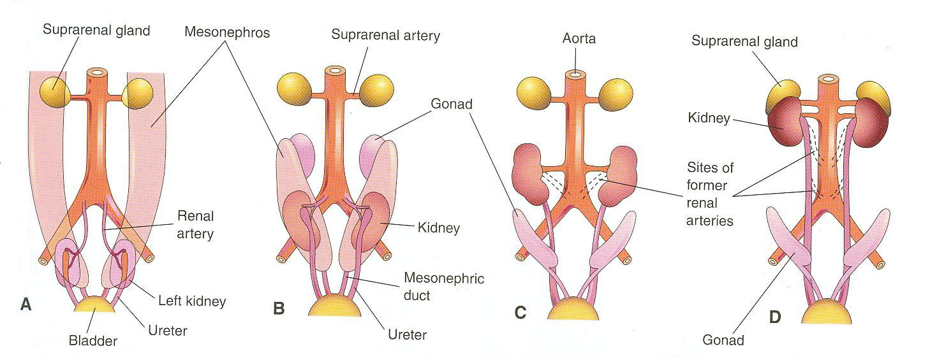
CHANGES DURING DEVELOPMENT
(BY 9TH WEEK)
Abdominal aorta
Common iliac
artery
Change in position: The kidney ascends from pelvis to abdomen & attains its adult position, caudal to suprarenal gland.
Change in blood supply: As the kidney ascends, its blood supply changes from renal branches of common iliac arteries into renal branches of abdominal aorta.
Rotation: Initially, hilum (site of entry & exit of vessels & nerves) is ventral then rotates medially about 90° & becomes medial.

Slide 12
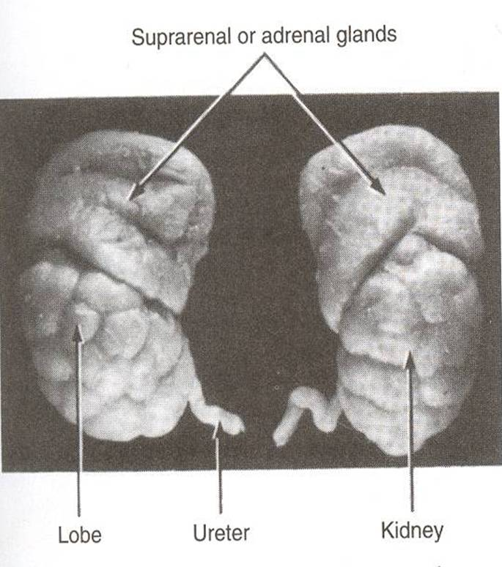
THE FETAL KIDNEY
Glomerular filatration begins at 9th week.
At 9th week, kidney attains its adult position & receives its supply from renal artery, its hilum is rotated medially.
Kidney is subdivided into lobes that are visible externally. Lobulation diminishes at the end of fetal period.
Nephron formation is complete at birth.

Slide 13
CHANGES AFTER BIRTH
Increase in size: due to elongation of tubules and increase in connective tissue between tubules (not due to increase in number of nephrons)
Disappearance of kidney lobulation

Slide 14
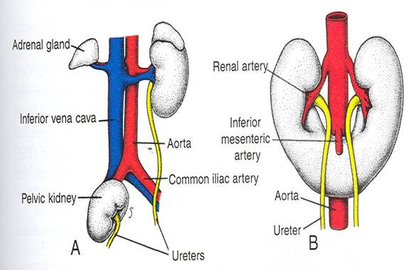
ANOMALIES
Pelvic kidney: failure of ascent of one kidney (ureter is short)
Horseshoe kidney: the poles of both kidneys (usually the lower poles) fuse: the kidneys have a lower position than normal but have normal function

Slide 15
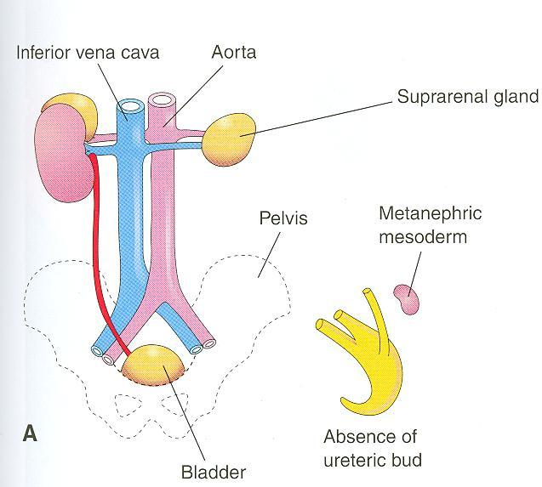
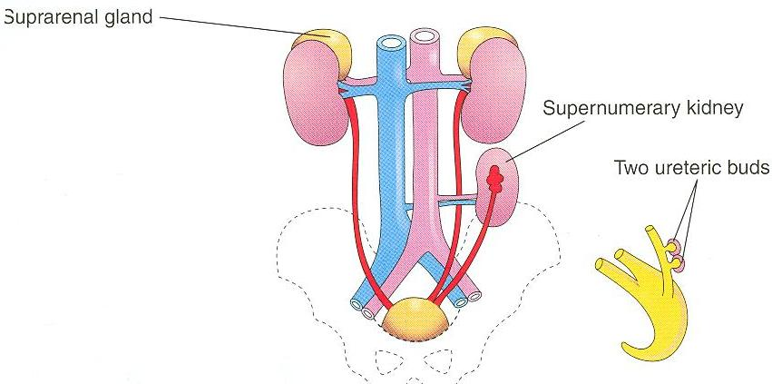
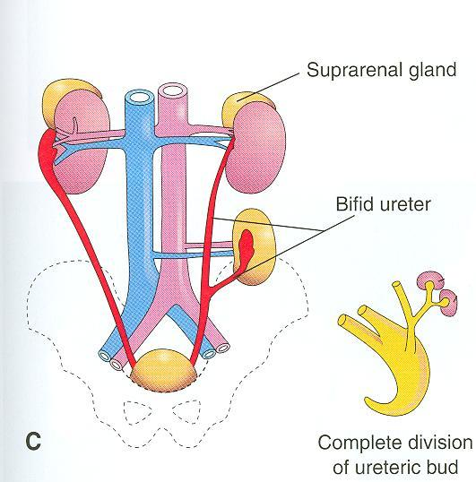
ANOMALIES
B
A- Unilateral renal agenesis: due to
absence of one ureteric bud
B- Supernumerary kidney: due to
development of 2 ureteric buds
C- Right side: malrotation of kidney
Left side: bifid ureter &
supernumerary kidney

Slide 16
SUMMARY - 1
Kidneys & ureters originates from nephrogenic ridge (cord) of intermediate mesoderm.
During development, 3 systems appear:
  Pronephric: in cervical region, not function.
  Mesonephric: in thorax & abdomen, function temporarily, mesonephric duct gives ureteric bud.
  Metanephric: in pelvis, permanent kidney.

Slide 17
SUMMARY - 2
Ureteric bud gives: ureter + collecting part of kidney (calyces, straight & arched collecting tubules).
Metanephric mass gives: excretory part of kidney (Bowman capsule, proximal & distal convoluted tubules, loop of Henle).
By 9th week:
Glomerular filtration begins.
Kidney attains its adult position.
Kidney receives its arterial supply from aorta.
Kidney completes rotation.

Slide 18
SUMMARY - 3
At full term:
Nephron formation is complete.
Lobulation of kidney diminishes.
After birth:
Lobulation of kidney disappears.
Kidney increases in size due to elongation of existing tubules not due to increase in number of nephrons.

Slide 19

QUESTIONS

Slide 20
QUESTION 1
Which one of the following events happens by 9th week?
Nephron formation is complete
Disappearance of kidney lobulation
Kidney attains its adult position
Metanephric system appears

Slide 21
QUESTION 2
Which one of the following structures is a derivative of the ureteric bud?
Major calyces
Loop of Henle
Glomerulus
Proximal convoluted tubule

Slide 22
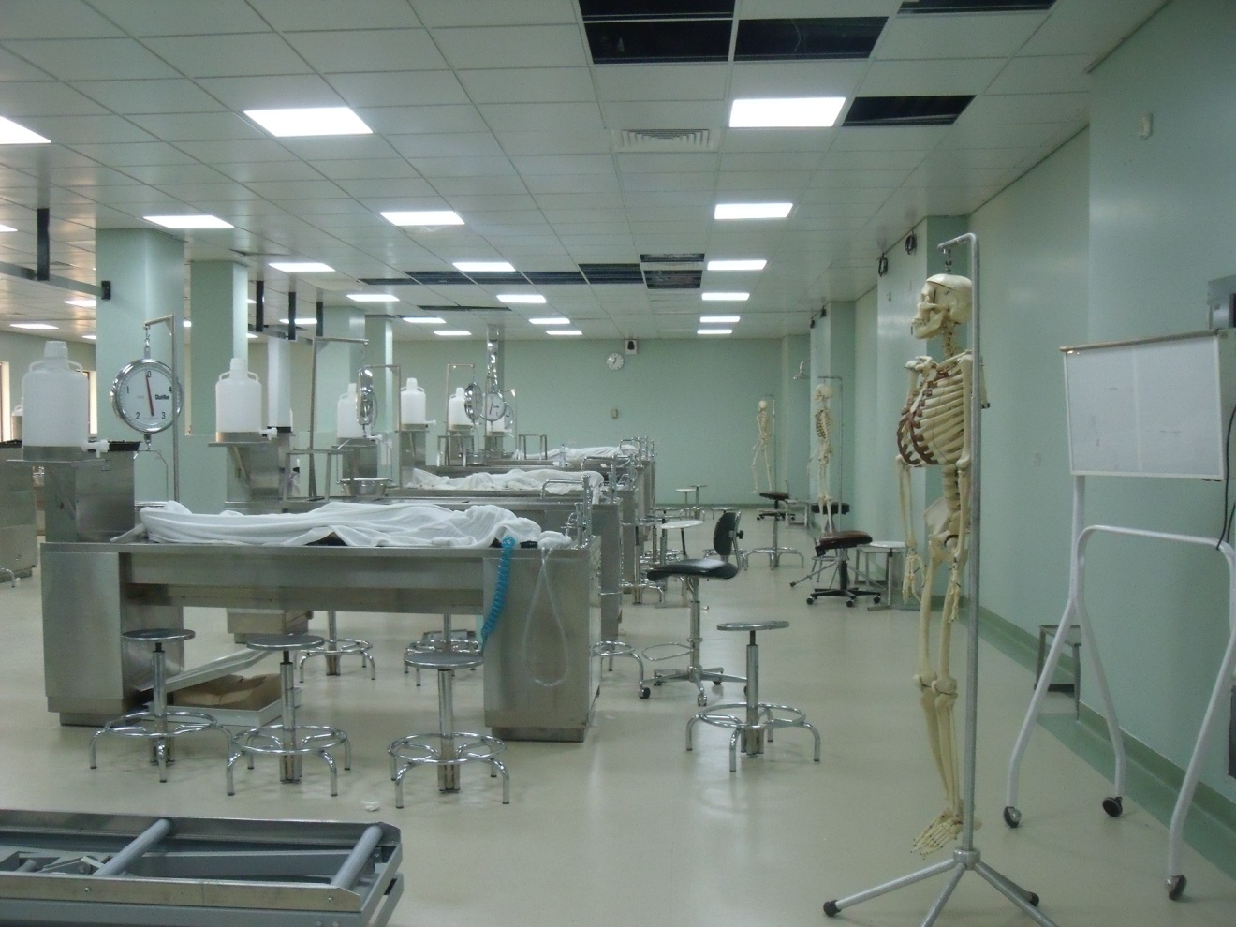
THANK YOU

