Slide 1
Renal block
Abdulrhman Aleisa
Radiology department

Slide 2
objective
Modality used for assessment of the urinary system
X-ray
us
Ct
MRI
Nuclear
Normal anatomy
Common pathologies
Kidney
Ureter
Bladder
Urethra

Slide 3
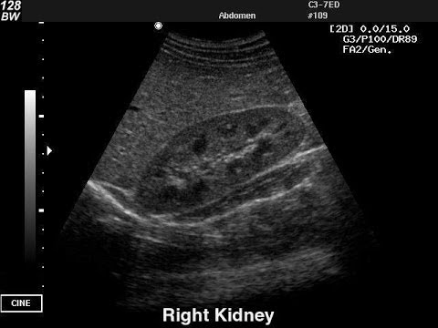
Modalities used
US
Pros ( no ionizing radiation , inexpensive , portable)
Cons (operator dependent, time consuming , )

Slide 4
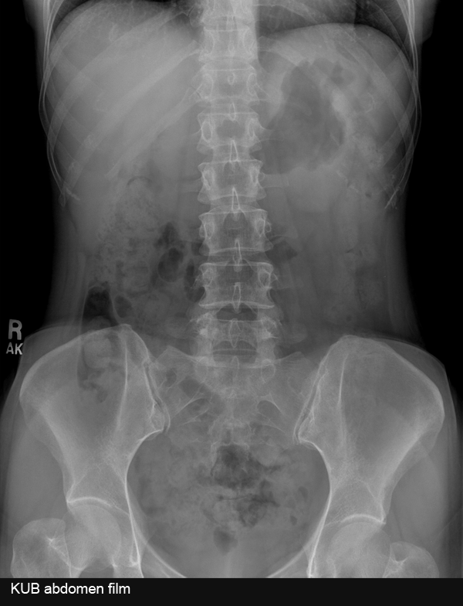
Modalities used
X rays
Pros (inexpensive , quick )
Cons ( ionizing radiation , not definitive )

Slide 5
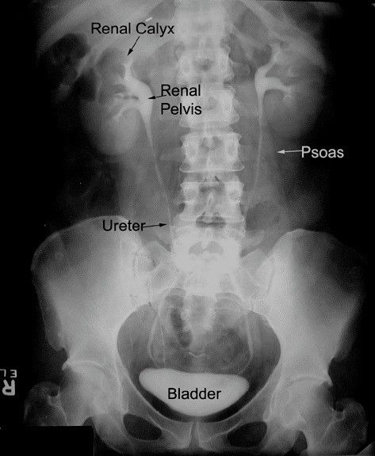

Slide 6
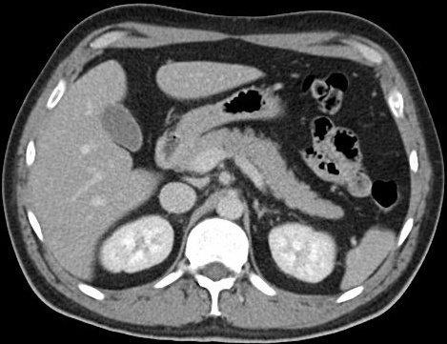
Modalities used
CT
Pros ( quick , a lot of information )
Cons ( ionizing radiation , expensive )

Slide 8
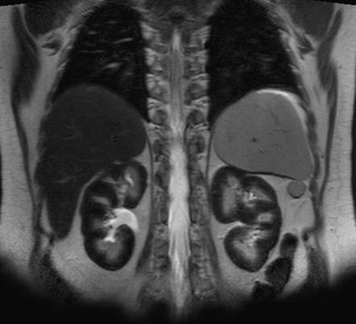
Modalities used
MRI
Pros (no ionizing radiation , a lot of information )
Cons ( expensive , time consuming )

Slide 10
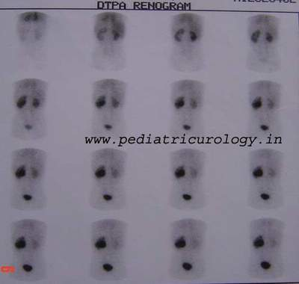
Modalities used
Nuclear scans
Pros ( assess the function )
Cons (time consuming , radioactive materials )

Slide 11
Anatomy of the urinary system

Slide 12
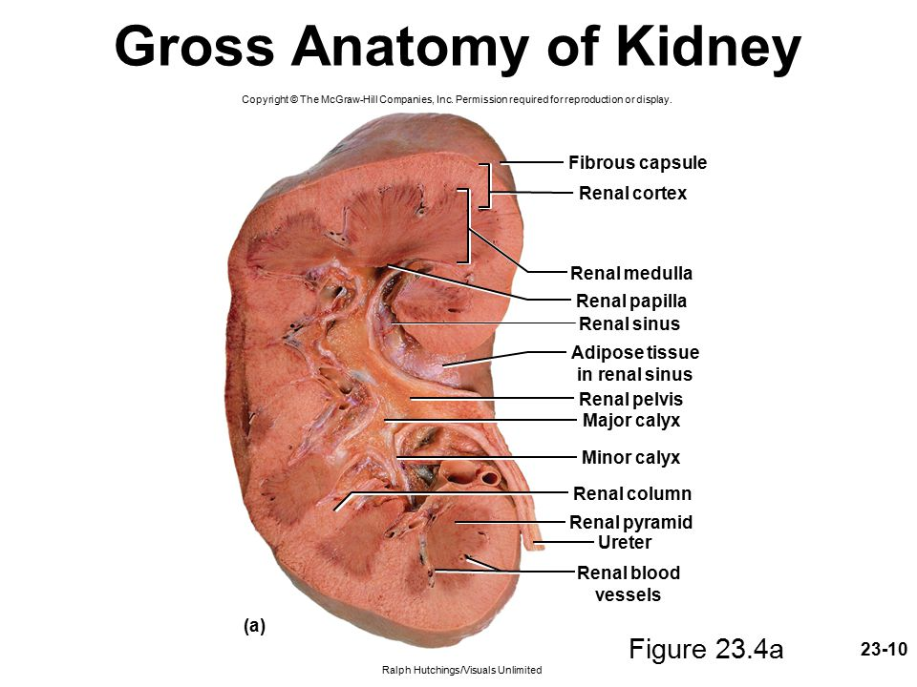
kidneys

Slide 13
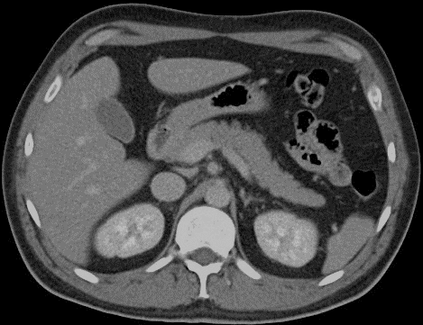
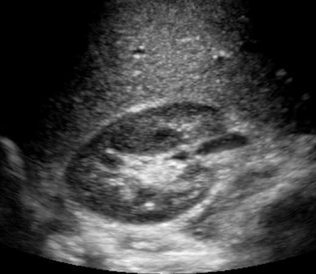
kidneys

Slide 14
ureters

Slide 15
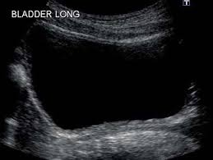
Urinary bladder

Slide 16
Urinary bladder

Slide 17
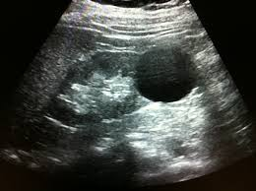
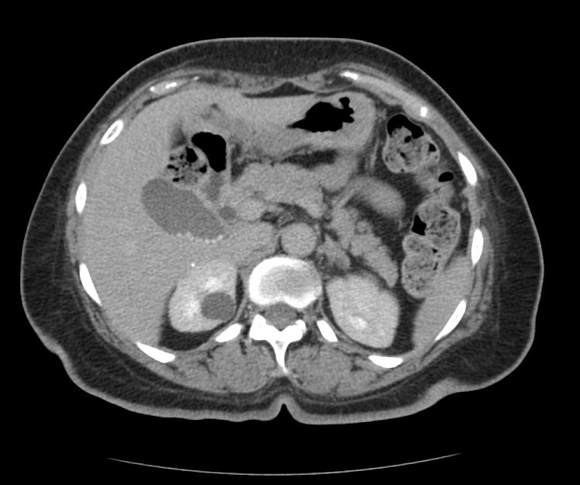
Common Kidney pathologies
Cysts (benign , common , bosniak classification )

Slide 18
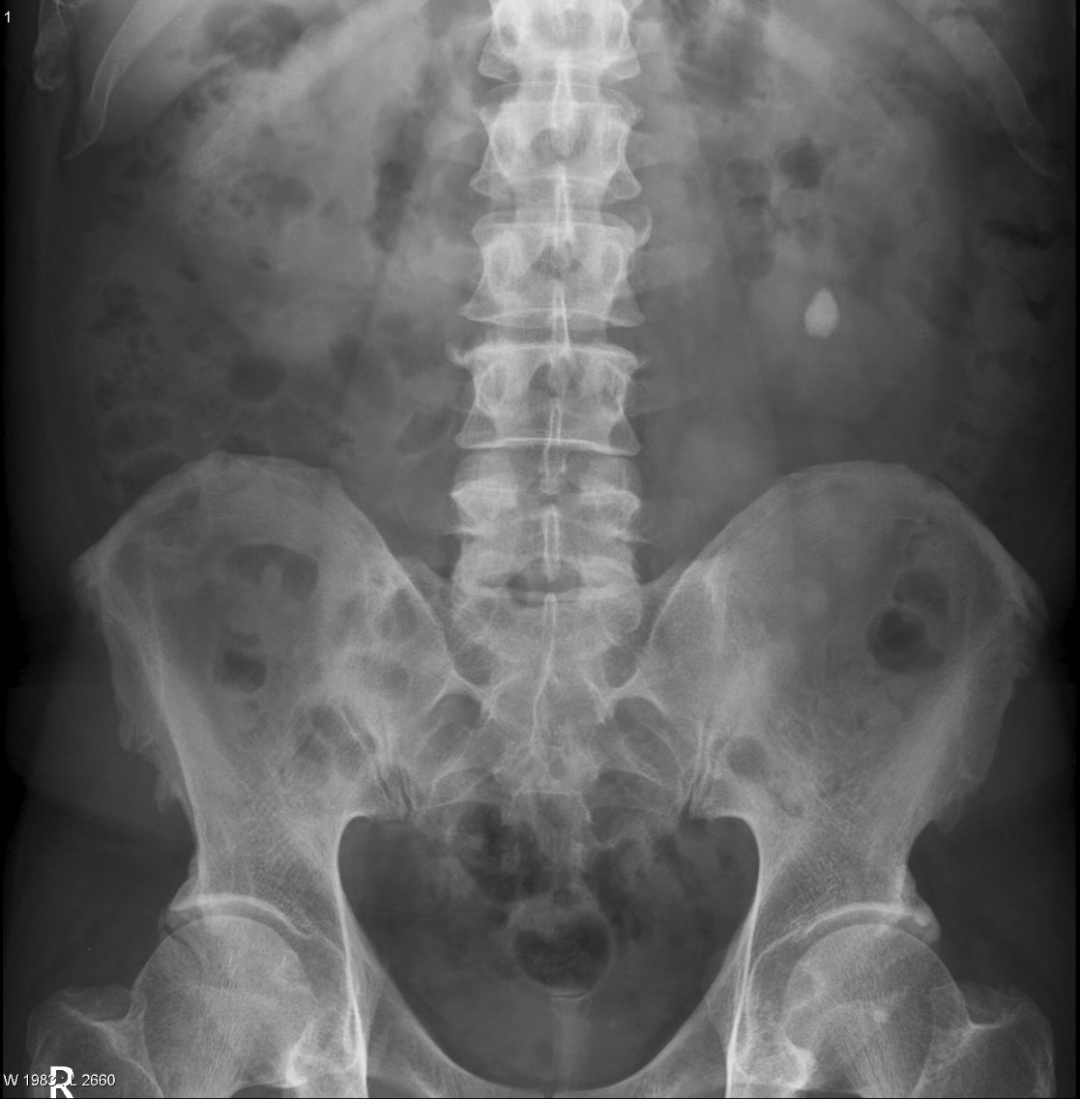
Common Kidney pathologies
Stones :
Radio-opaque (calcium , struvite )
Radio-lucent (uric acid , cysteine )

Slide 19
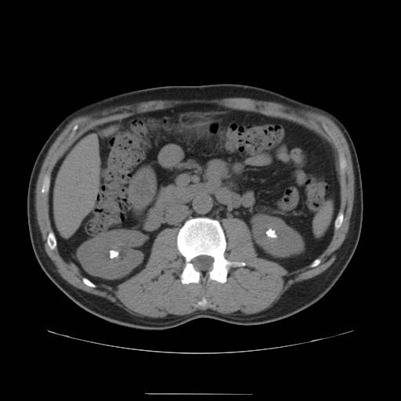

Slide 20
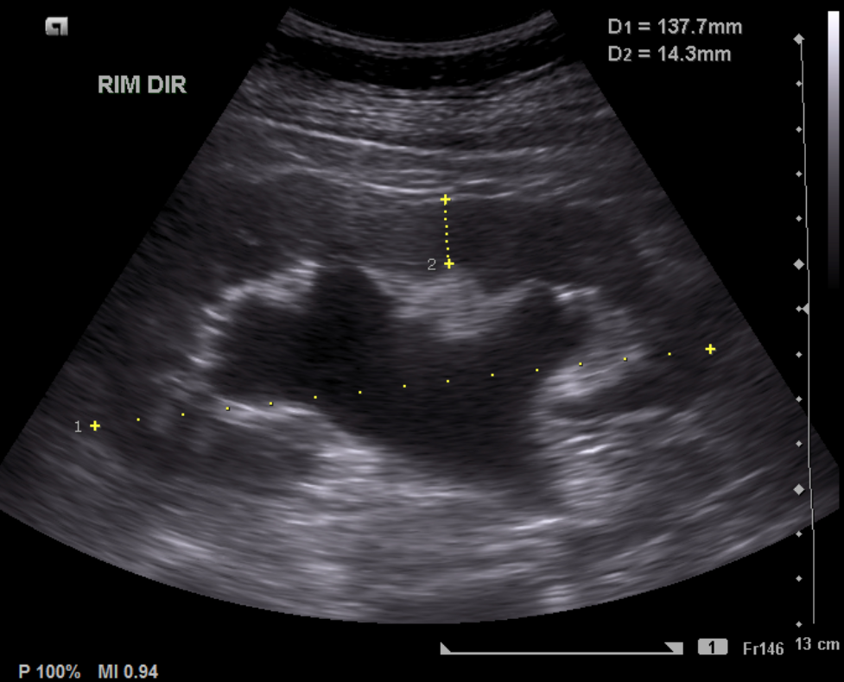
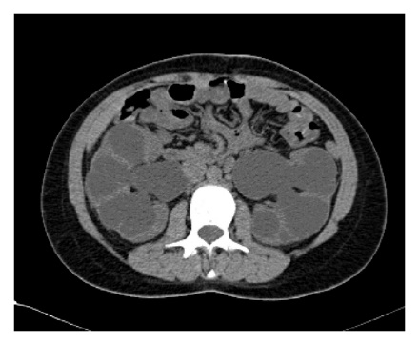
Common Kidney pathologies
hydronephrosis

Slide 21
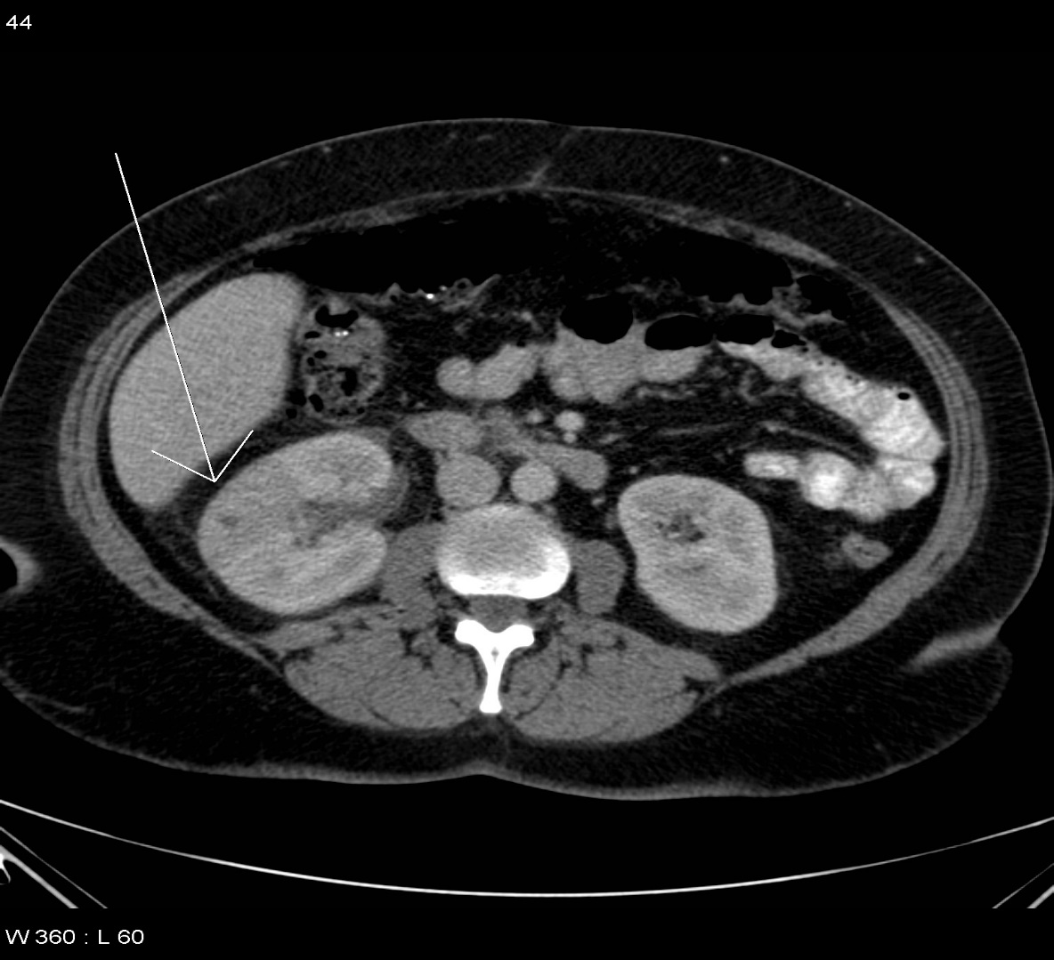
Common Kidney pathologies
Pyelonephritis

Slide 22
Common Kidney pathologies

Slide 23
Common Kidney pathologies

Slide 24
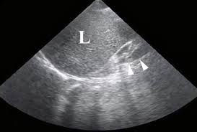
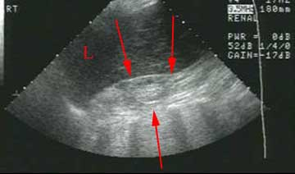
Common Kidney pathologies
ESRD

Slide 25
Common Kidney pathologies

Slide 26
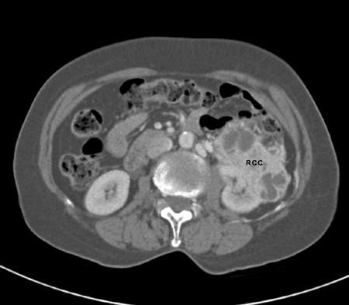
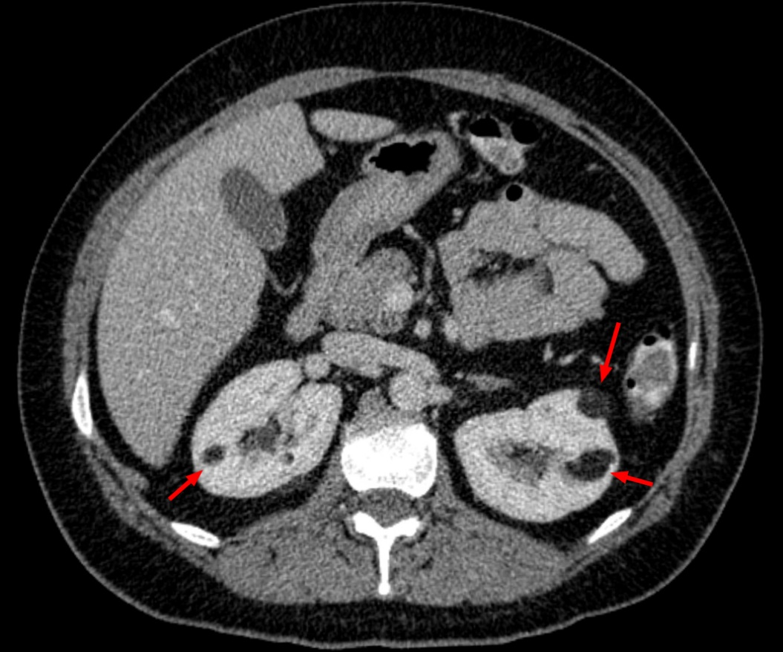
Common Kidney pathologies
tumors

Slide 27
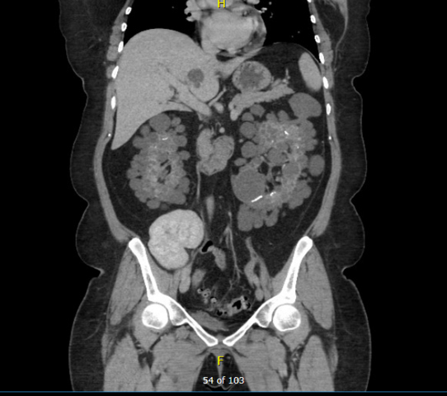
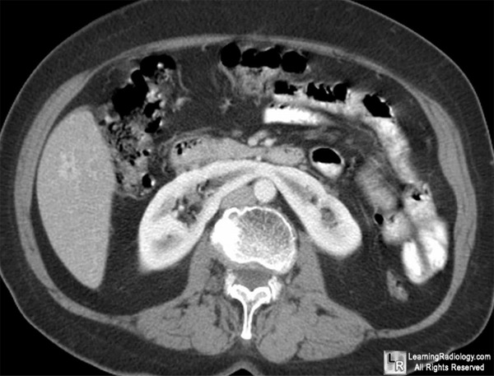
Common Kidney pathologies
Congenital

Slide 28
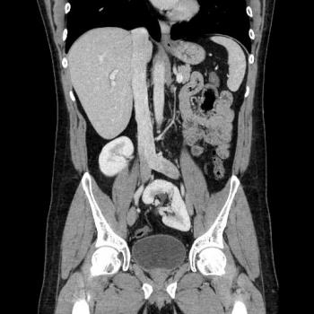

Slide 29
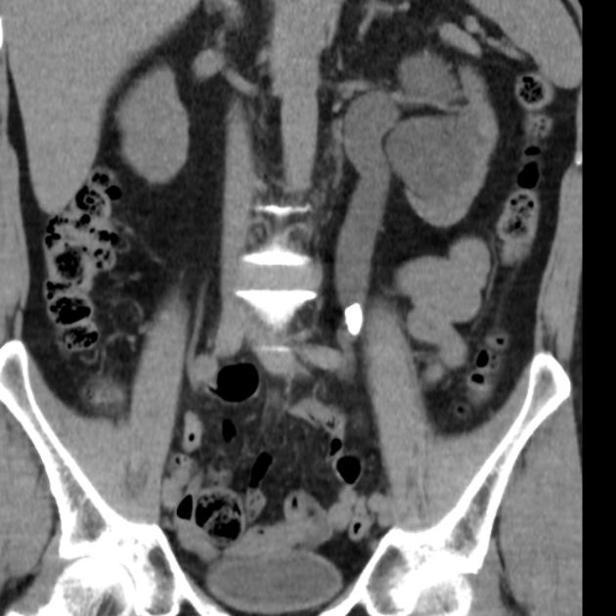
Common pathologies

Slide 30
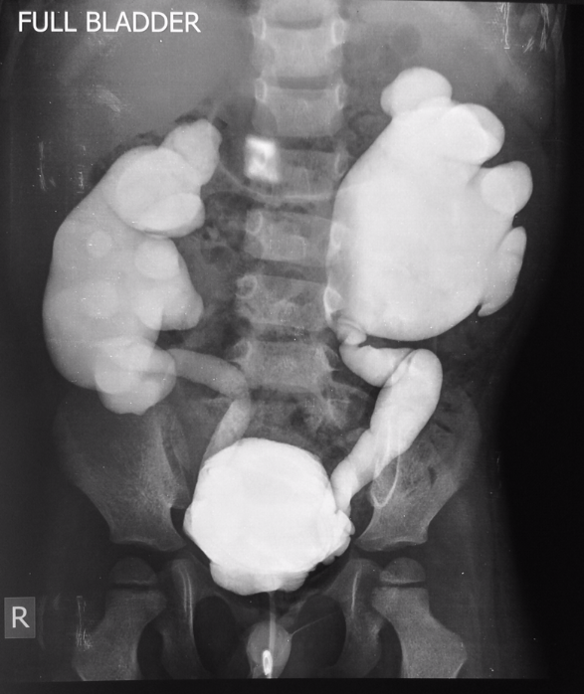
Common pathologies
vesicoureteral reflux disease

Slide 32
Urinary bladder

Slide 33
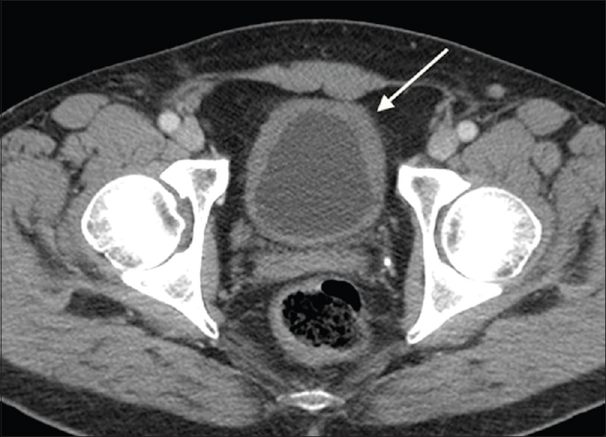
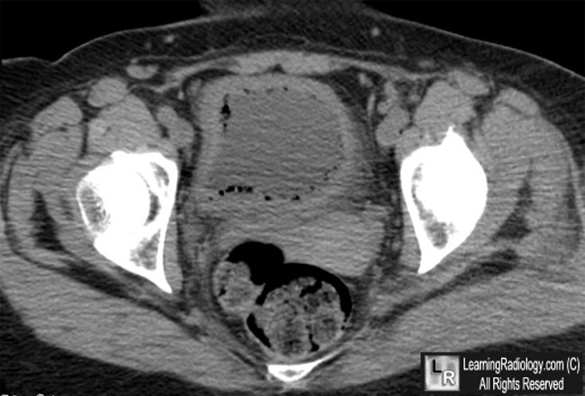
Common urinary bladder pathologies
Cystitis

Slide 34
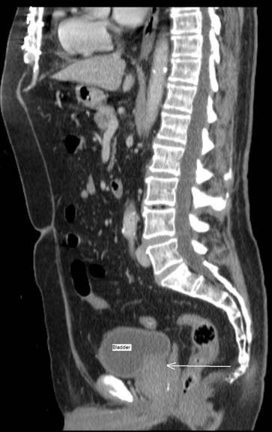

Slide 36
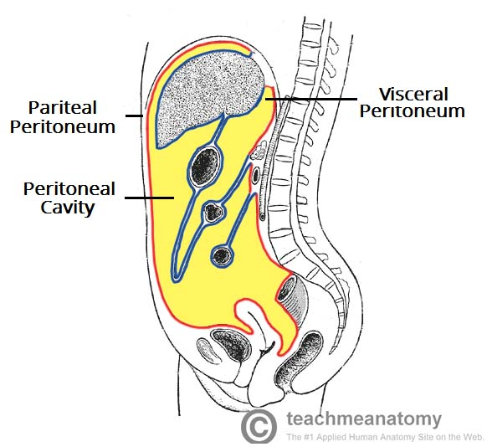
Common urinary bladder pathologies
Bladder rupture

Slide 37
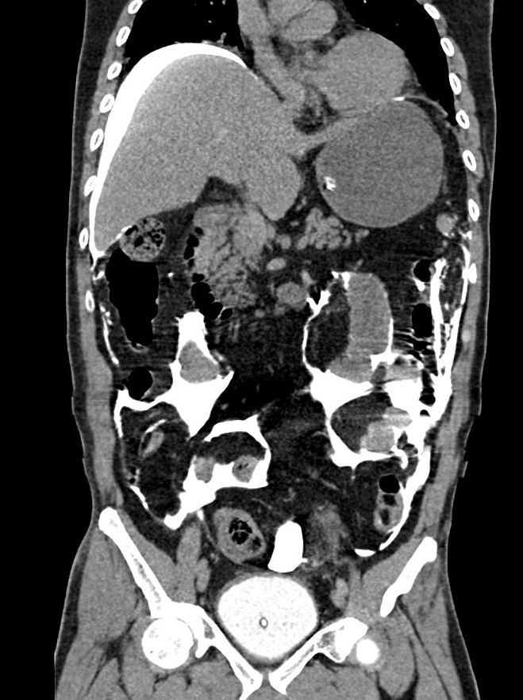
Common urinary bladder pathologies

Slide 38
Urethra

