Slide 1
ABDOMEN
GENERAL ARRANGEMENT
Prof. Ahmed Fathalla Ibrahim El Fouhil
Professor of Anatomy
College of Medicine
King Saud University
E-mail: ahmedfathala@gmail.com

Slide 2
ABDOMEN
Peritoneal cavity
Posterior abdominal wall
Anterior abdominal wall
Peritoneal fold
(Mesentery OR
Omentum)
Retroperitoneal
structure

Slide 3
ABDOMEN

Slide 4
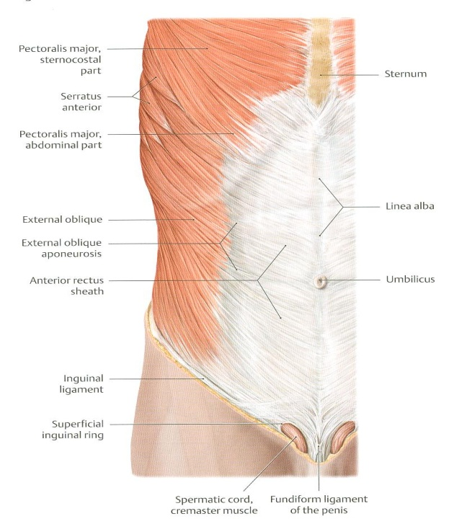
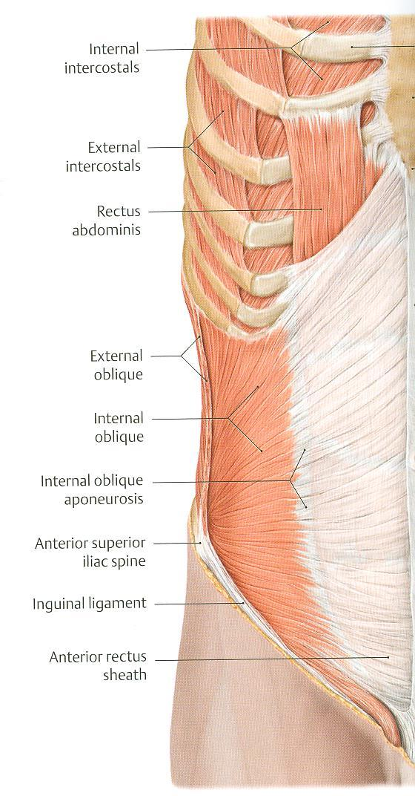
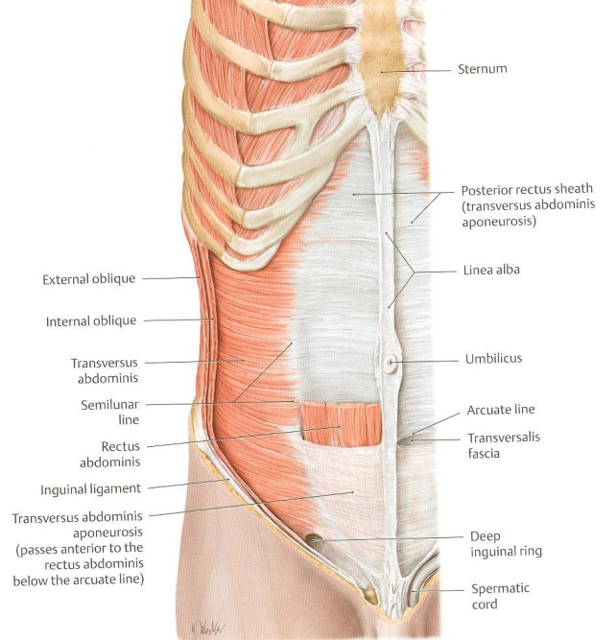
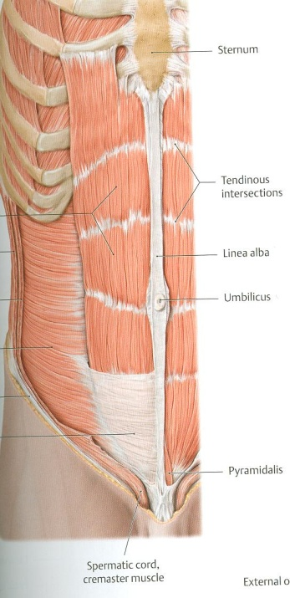
EXTERNAL OBLIQUE
INTERNAL OBLIQUE
TRANSVERSUS ABDOMINIS
OUTER LAYER
MIDDLE LAYER
INNER LAYER
MUSCLES OF ANTERIOR ABDOMINAL WALL
RECTUS ABDOMINIS
MUSCLE ENCLOSED IN A SHEATH FORMED BY APONEUROSES OF THE 3 MUSCLES

Slide 5
POSTERIOR ABDOMINAL WALL
P.M.=Psoas major; Q.L.= Quadratus lumborum; I.=Iliacus; T.A.=Transversus abdominis

Slide 6
IMPORTANT CONTENTS OF ABDOMEN
GIT:
A part of esophagus
Stomach
Small intestine: duodenum, jejunum, ileum
A part of large intestine: caecum, appendix, ascending colon, transverse colon, descending colon
Liver, gall bladder & biliary ducts
Pancreas

Slide 7
IMPORTANT CONTENTS OF ABDOMEN
OTHER ORGANS:
Spleen
Kidneys, ureters & suprarenal glands
VESSELS:
Vessels of GIT: celiac trunk, superior mesenteric vessels, inferior mesenteric vessels & portal vein
Large vessels: abdominal aorta & inferior vena cava
NERVES:
Somatic nerves: branches of lumbar plexus
Autonomic nerves: sympathetic trunks, parasympathetic (from vagus & pelvic splanchnic nerves).
LYMPHATICS

Slide 8
ARRANGEMENT OF ABDOMINAL CONTENTS
LAYER ONE: PART OF GIT INVAGINATING THE PERITONEAL CAVITY (COMPLETELY SURROUNDED BY PERITONEAL CAVITY): LIVER, STOMACH, TRANSVERSE COLON, JEJUNUM & ILEUM
LAYER TWO: REST OF GIT (PARTIALLY SURROUNDED BY PERITONEUM: FRONT & SIDES) + SPLEEN
LAYER THREE: REST OF CONTENTS OF ABDOMEN (RETROPERITONEAL STRUCTURES)

Slide 9
ABDOMEN - LAYER 1
LIVER
STOMACH
OMENTUM
JEJUNUM
&
ILEUM

Slide 10
ABDOMEN – LAYER 1
OMENTUM
TRANSVERSE
COLON
JEUNUM
&
ILEUM

Slide 11
ABDOMEN – LAYER 2
SPLEEN
PANCREAS
DUODENUM
DESCENDING
COLON
ASCENDING COLON

Slide 12
ABDOMEN – LAYER 3 (IN BLACK) + PART OF LAYER 2 (IN BLUE)
Left suprarenal
gland
Right suprarenal
gland
Duodenum
Pancreas
Left kidney
Right kidney
Abdominal aorta
Inferior vena cava
Right psoas major
Left psoas major

Slide 13
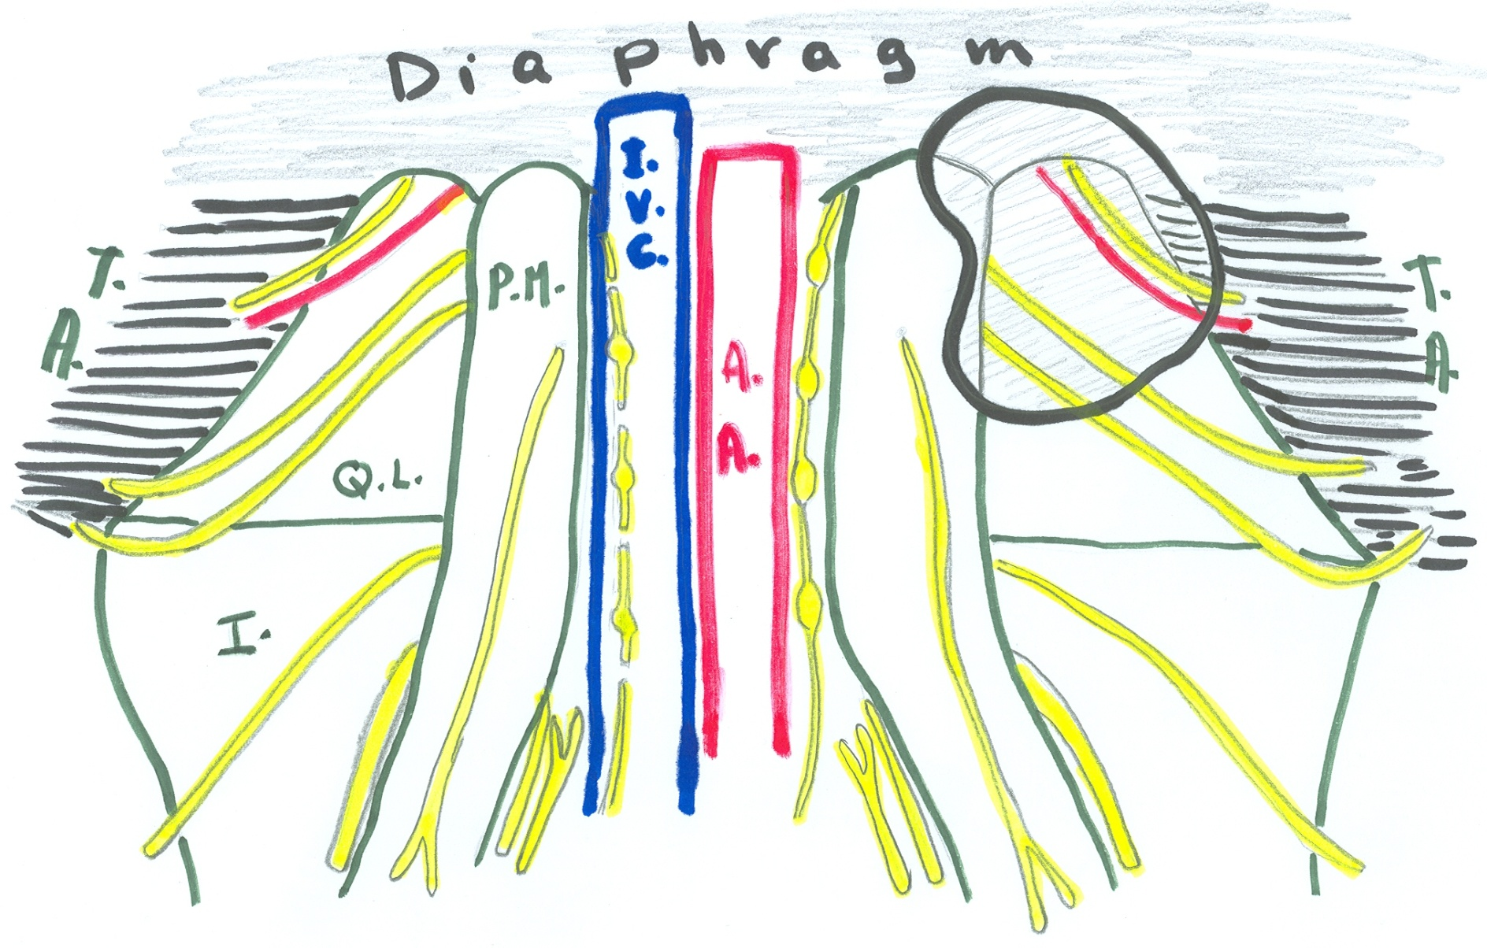
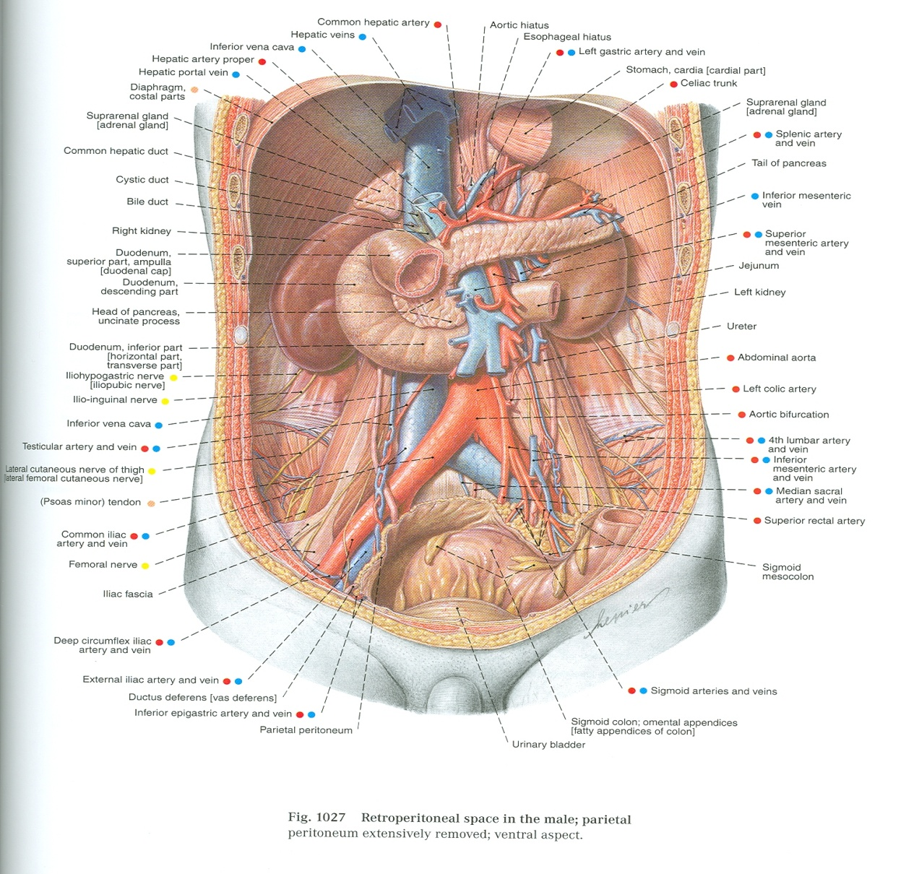
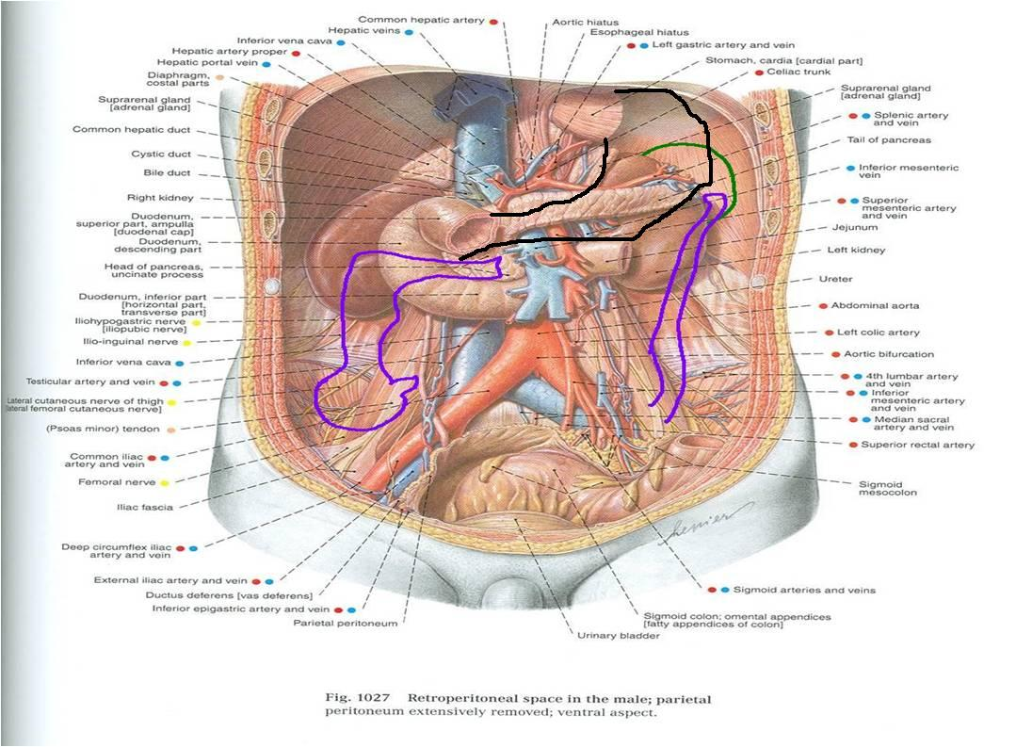
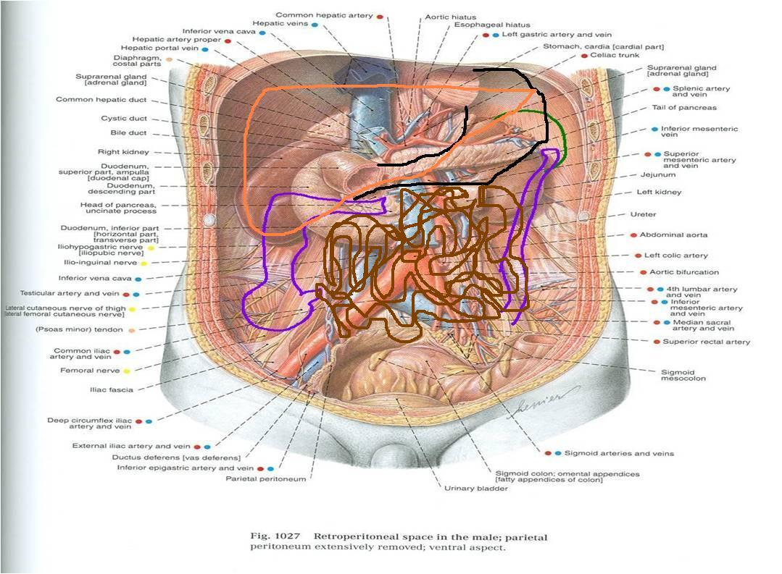

Slide 14
Covered by
Diaphragm
Covered by
Anterior
abdominal
wall

Slide 15
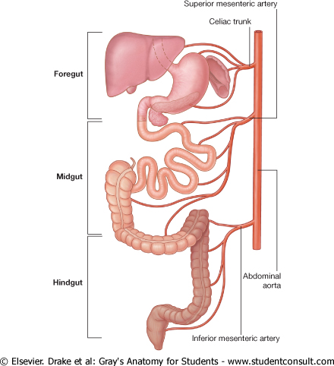
RELATION BETWEEN EMBRYOLOGICAL ORIGIN OF GUT & ITS ARTERIAL SUPPLY

Slide 16
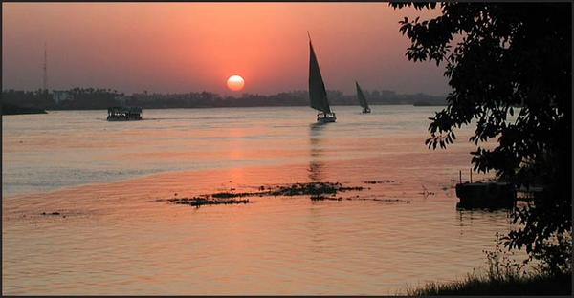
Thank you

