Slide 1
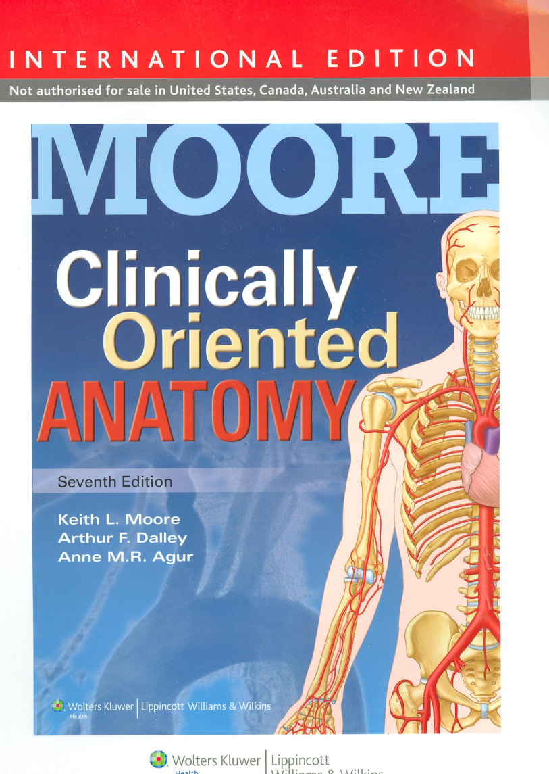
Introduction to the Clinically Oriented Anatomy
Dr. Mohammad Saeed Vohra

Slide 2
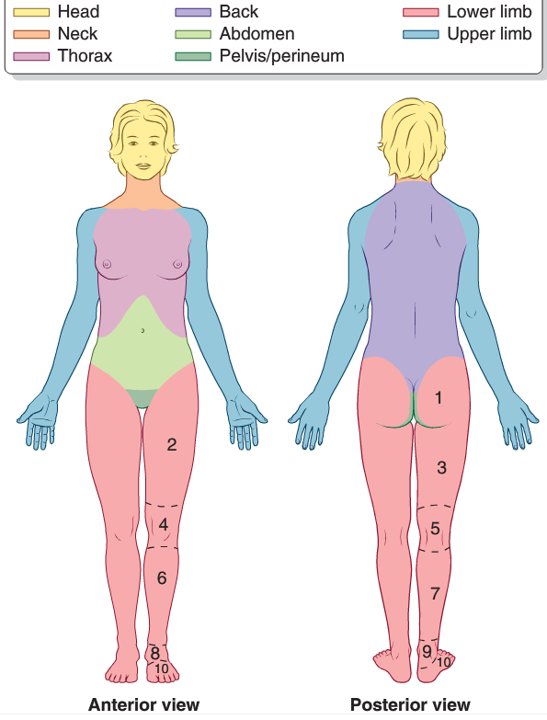
APPROACHES TO STUDYING ANATOMY
Regional Anatomy
Systemic Anatomy
Clinical Anatomy
study of the body’s organ systems that work together to carry out complex functions.
It incorporates the regional and systemic approaches to studying anatomy and stresses clinical application.
Integumentary system (dermatology)
The skeletal system (osteology)
Articular system (arthrology)
Muscular system (myology)
Nervous system (neurology)
Circulatory system (angiology)
Cardiovascular system
Lymphatic system
Alimentary or digestive system
Respiratory system
Urinary system
Genital (reproductive) system
Endocrine system
Clinical anatomy often involves inverting or reversing the thought process. For example, instead of thinking, “The . . . nerve provides innervation to this area of skin,” clinical anatomy asks, “Numbness in this area indicates a lesion of which nerve?”
Surface Anatomy Radiographic Anatomy Endoscopic Anatomy Sectional Anatomy

Slide 3
The Bottom Line
STUDYING ANATOMY
Anatomy is the study of the structure of the human body.
♦ Regional anatomy considers the body as organized into segments or parts.
♦ Systemic anatomy sees the body as organized into organ systems.
♦ Surface anatomy provides information about structures that may be observed or palpated beneath the skin.
♦ Radiographic, sectional, and endoscopic anatomy allows appreciation of structures in living people, as they are affected by muscle tone, body fluids, pressures, and gravity.
♦ Clinical anatomy emphasizes application of anatomical knowledge to the practice of medicine

Slide 4
ANATOMICOMEDICAL TERMINOLOGY
Express yourself clearly, using the proper terms in the correct way specially during your presentations in PBLs
For example use axillary fossa instead of armpit and clavicle instead of collarbone or beauty bone
Enables precise communication among healthcare professionals
Anatomical Planes

Slide 5
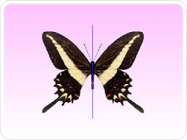
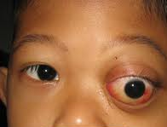
Terms of Relationship and Comparison
Superior | Inferior | Cranial | Caudal
Anterior | Posterior | Medial | Lateral
Terms of Laterality
Bilateral Unilateral Ipsilateral Contralateral
Both sides
one side only unilateral exophthalmos
two parts that are on the same
For example left arm and left leg are ipsilateral to one another
opposite side
For example left arm and right leg are contralateral to one another

Slide 6
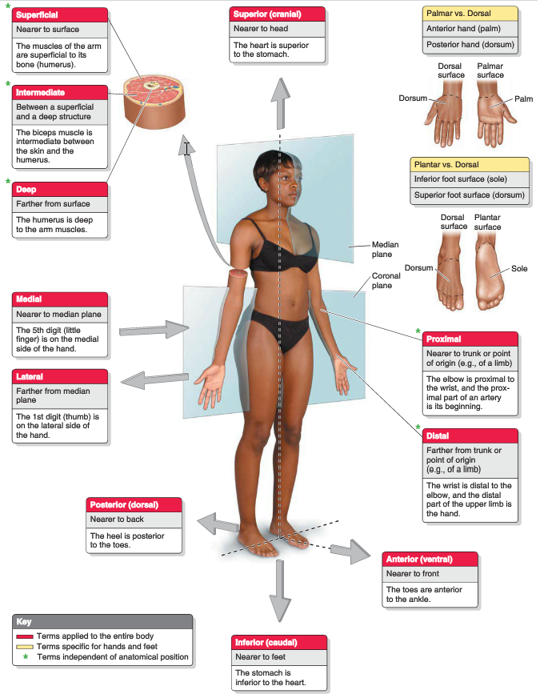
Terms of Relationship and Comparison

Slide 7
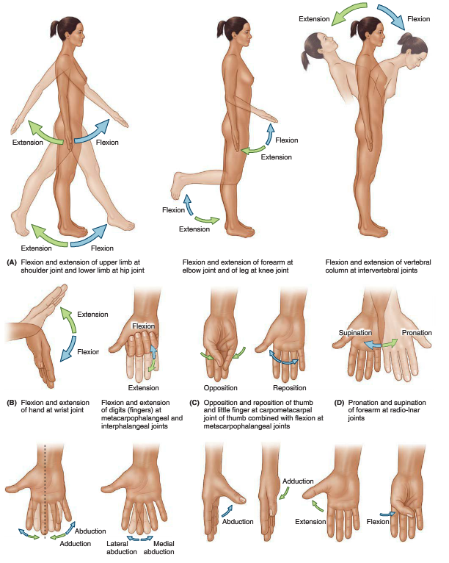
Terms of Movement

Slide 8
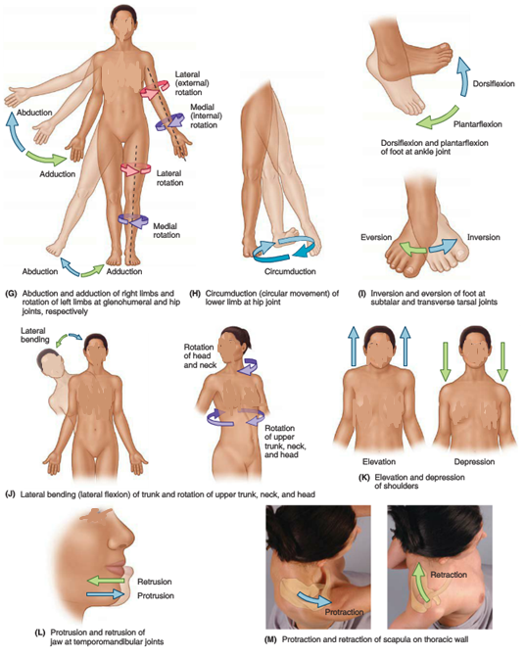
Terms of Movement

Slide 9
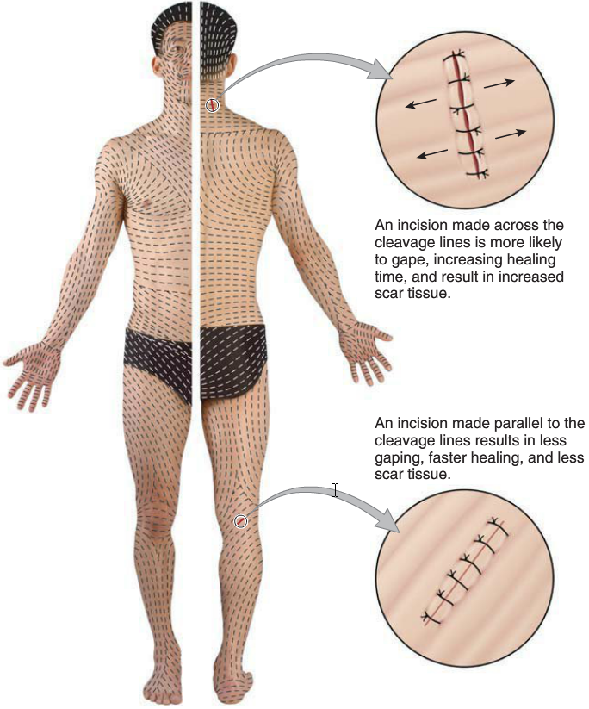
The tension lines
The tension lines (also called cleavage lines or Langer lines) tend to spiral longitudinally in the limbs and run transversely in the neck and trunk. Tension lines at the elbows, knees, ankles, and wrists are parallel to the transverse creases that appear when the limbs are flexed. The elastic fibers of the dermis deteriorate with age and are not replaced; consequently, in older people, the skin wrinkles and drops as it loses its elasticity.

Slide 10
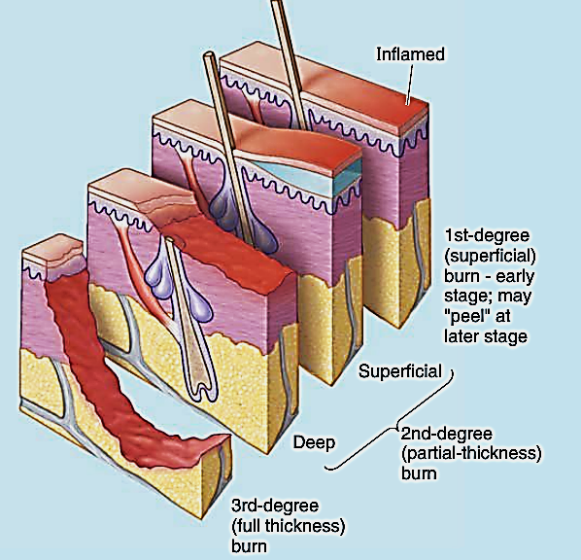
Integumentary System
1st-degree burn (e.g., sunburn): damage is limited to the epidermis
2nd-degree burn: epidermis & superficial dermis are damaged, nerve endings are dam-aged, making this variety the most painful
3rd-degree burn: the entire skin is damaged and perhaps underlying muscle. Burned area is numb since sensory endings are destroyed.

Slide 11
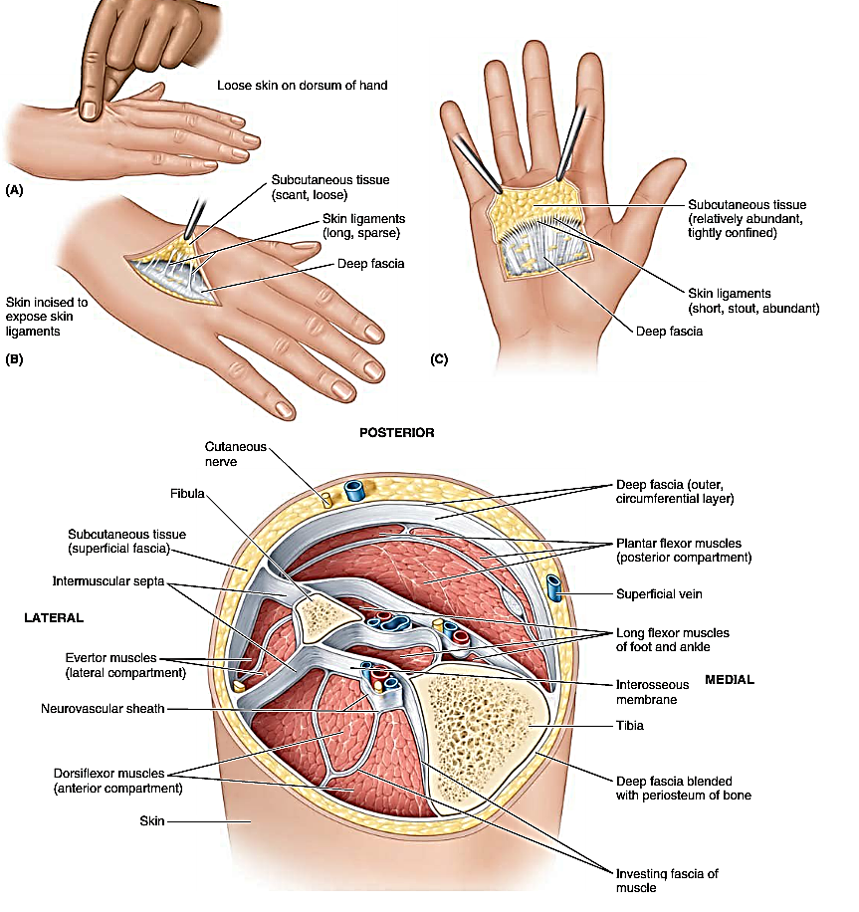
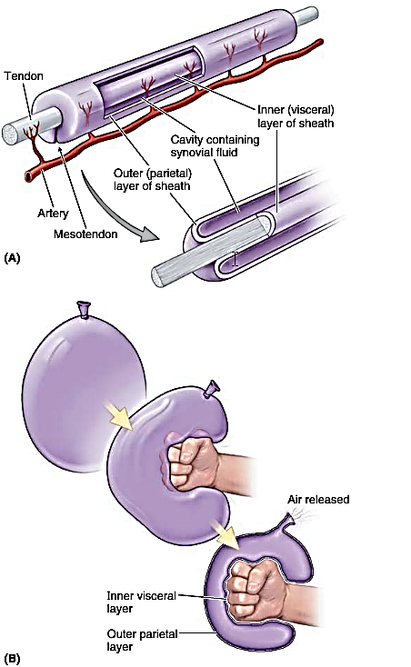
Fascias, Fascial Compartments, Bursae, & Potential Spaces

Slide 12
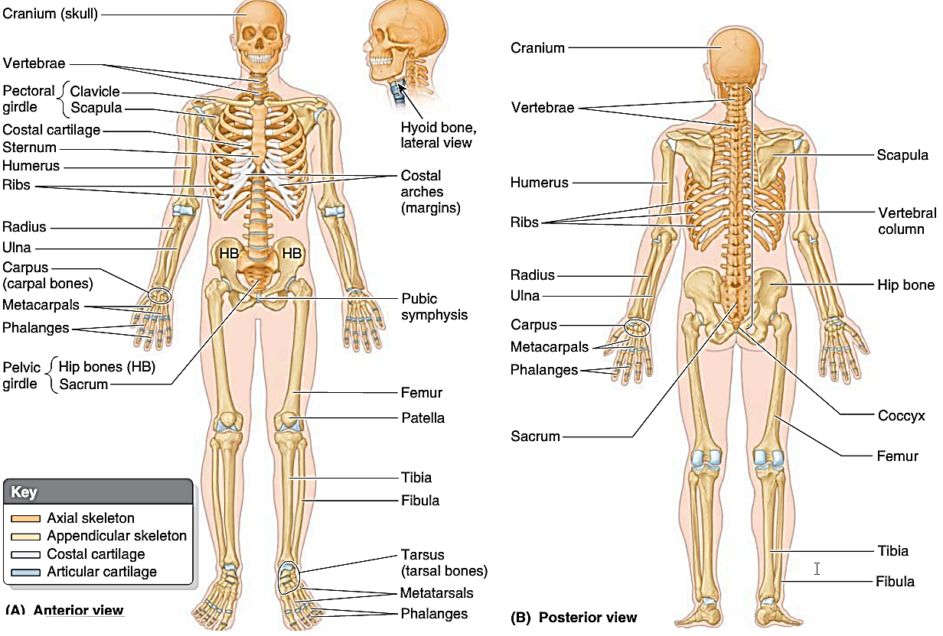
SKELETAL SYSTEM

Slide 13
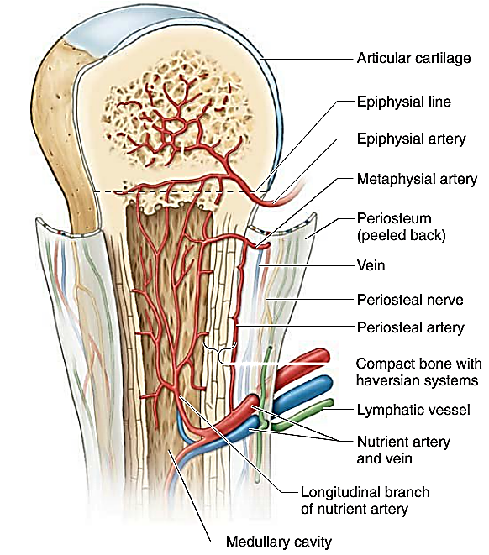
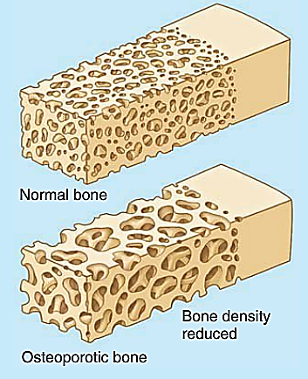
SKELETAL SYSTEM
ASCULATURE AND INNERVATION OF BONES
nutrient arteries
divides in the medullary cavity
branches from the periosteal arteries
a bone from which the periosteum has been removed dies

Slide 14
SKELETAL SYSTEM
The Bottom Line
CARTILAGE AND BONES
The skeletal system can be divided into:
The axial (bones of the head, neck, and trunk)
The appendicular skeletons (bones of the limbs).
The skeleton is composed:
♦ Cartilage, a semirigid CT
♦ Bone, a hard form of CT that provides support, protection, movement, storage (of certain electrolytes), and synthesis of blood cells;
♦ Periosteum, which surrounds bones,
♦ Perichondrium, which surrounds cartilage, provide nourishment
Types
Spongy & Compact,
Classification
Long, Short, Flat, Irregular, or Sesamoid.
Bones grow through the processes of
♦ intramembraneous ossication
♦ endochon-dral ossication

Slide 15
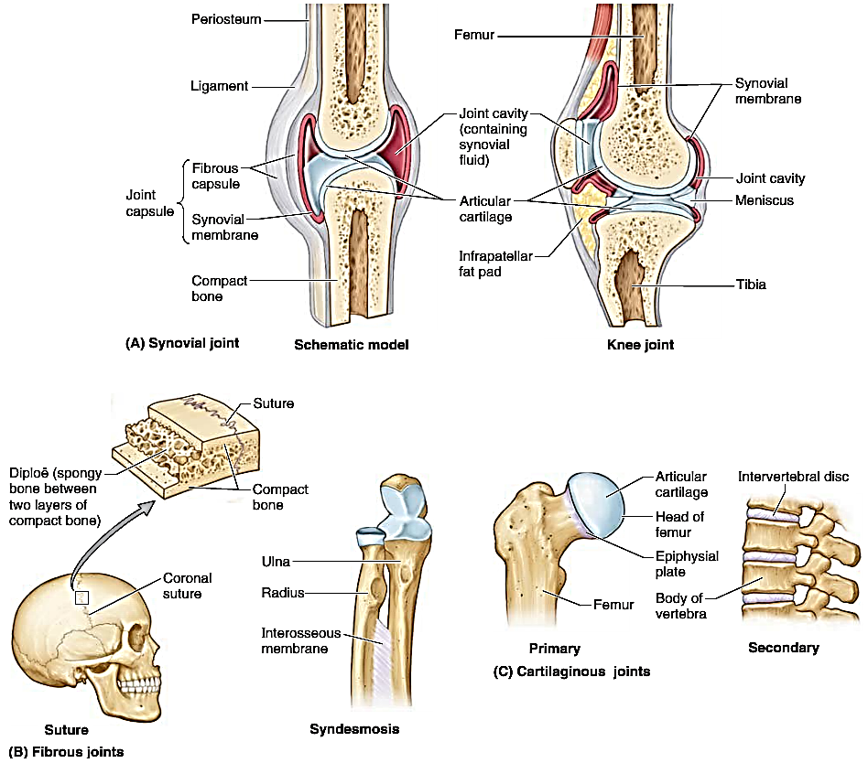
SKELETAL SYSTEM
Joints (articulations)

Slide 16
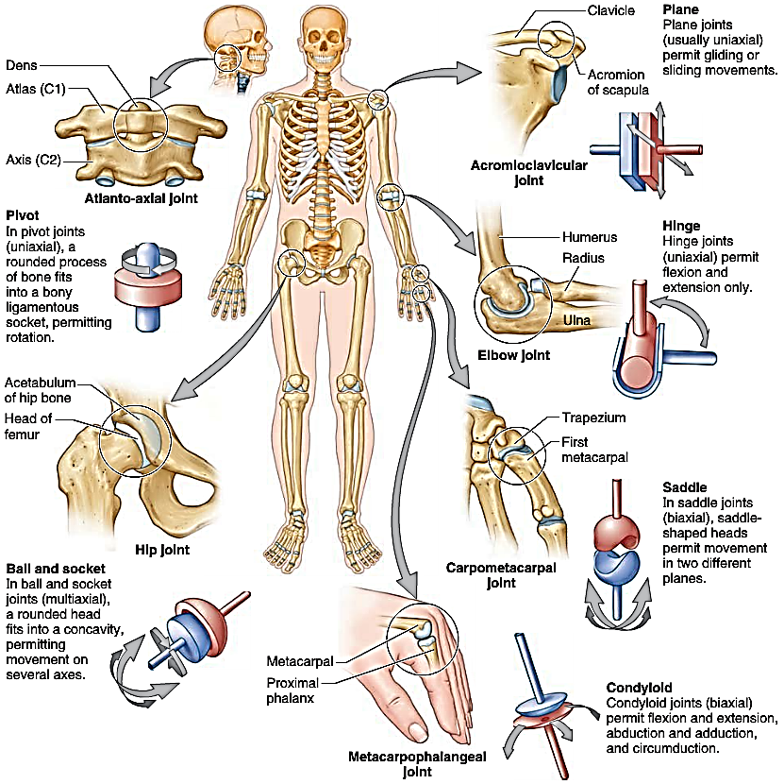
Synovia
l
j oints

Slide 17
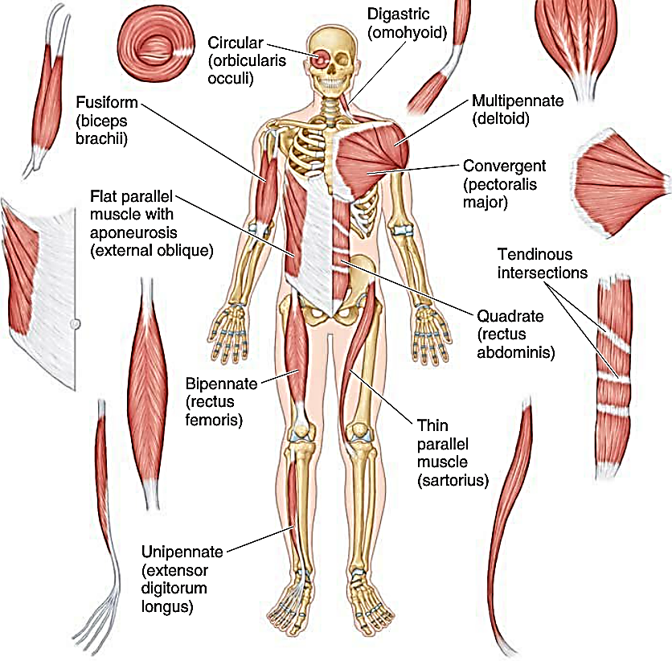
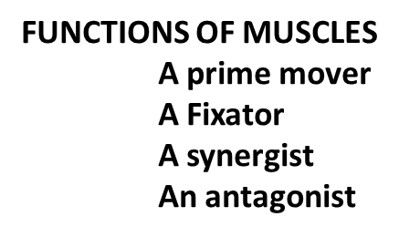
MUSCULAR SYSTEM
Types of Muscle
Skeletal striated
Cardiac striated
Smooth muscle
FORM
FEATURES
NAMING OF MUSCLES

Slide 18
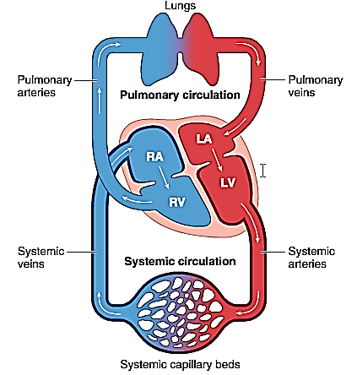
CARDIOVASCULAR
SYSTEM

Slide 19
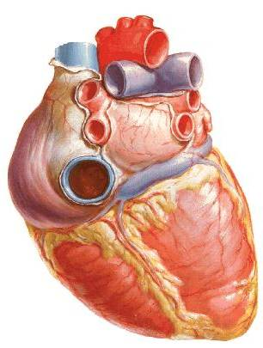
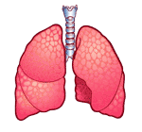
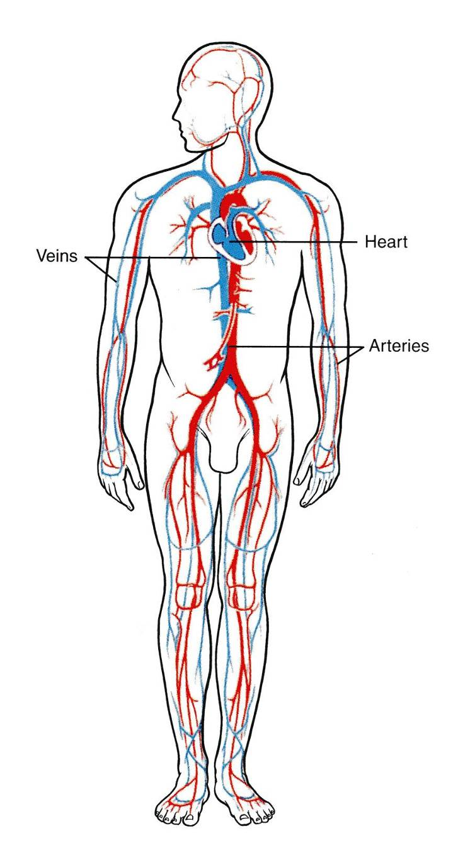
Right
Atrium
SVC
Pulmonary
Veins (4)
Left
Atrium
IVC
Left AV valve
Bicuspid
Right AV valve
Tricuspid
Aorta
Left
Ventricle
Right
Ventricle
Pulmonary trunk

Slide 20
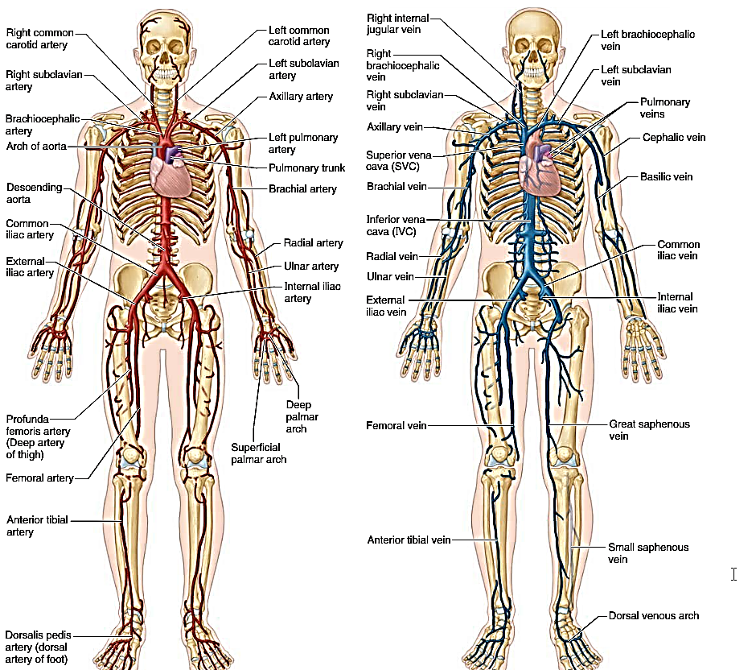
CARDIOVASCULAR
SYSTEM

Slide 21
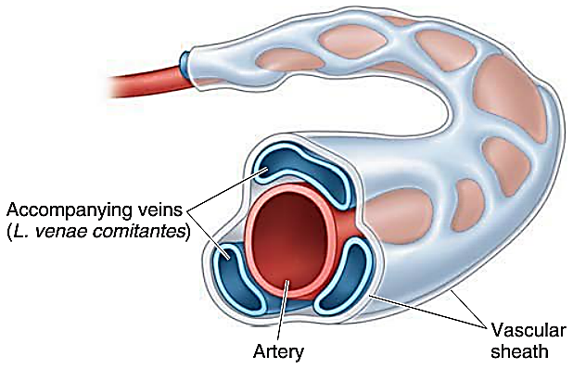
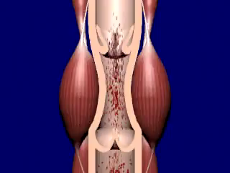
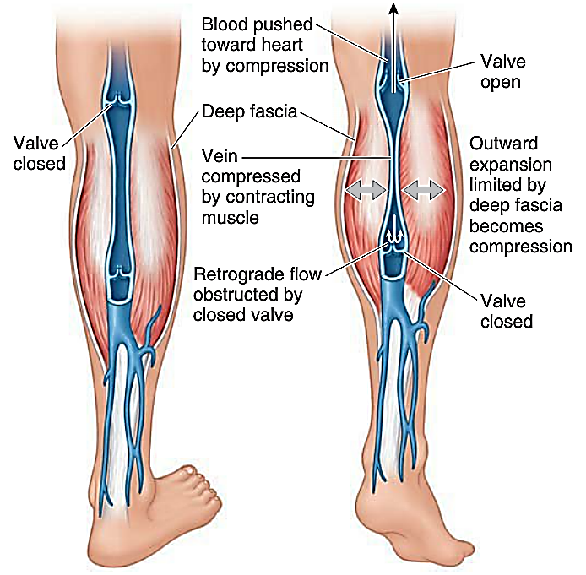
CARDIOVASCULAR
SYSTEM
When venous valves malfunction or the calf muscle-pump is not providing effective pumping blood pools-down in the legs causing increased pressure & distention of the vessels

Slide 22
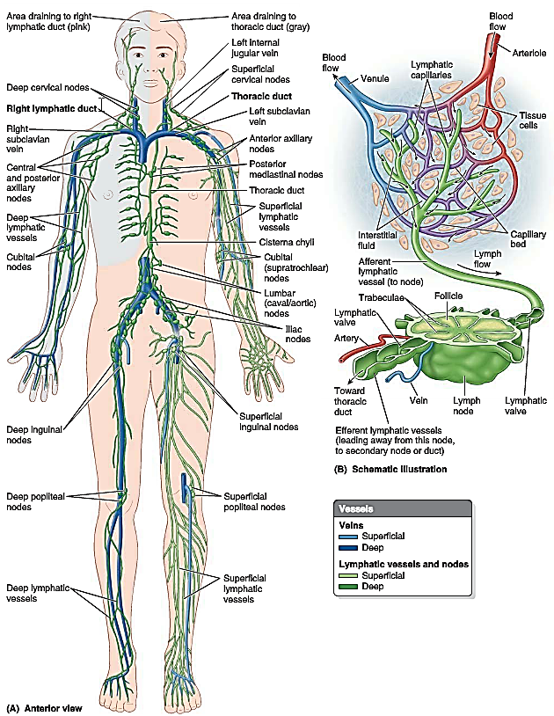
LYMPHOID
SYSTEM
The lymphoid system provides for the drainage of surplus tissue fluid and leaked plasma proteins to the bloodstream, as well as for the removal of debris from cellular decomposition and infection.

Slide 23
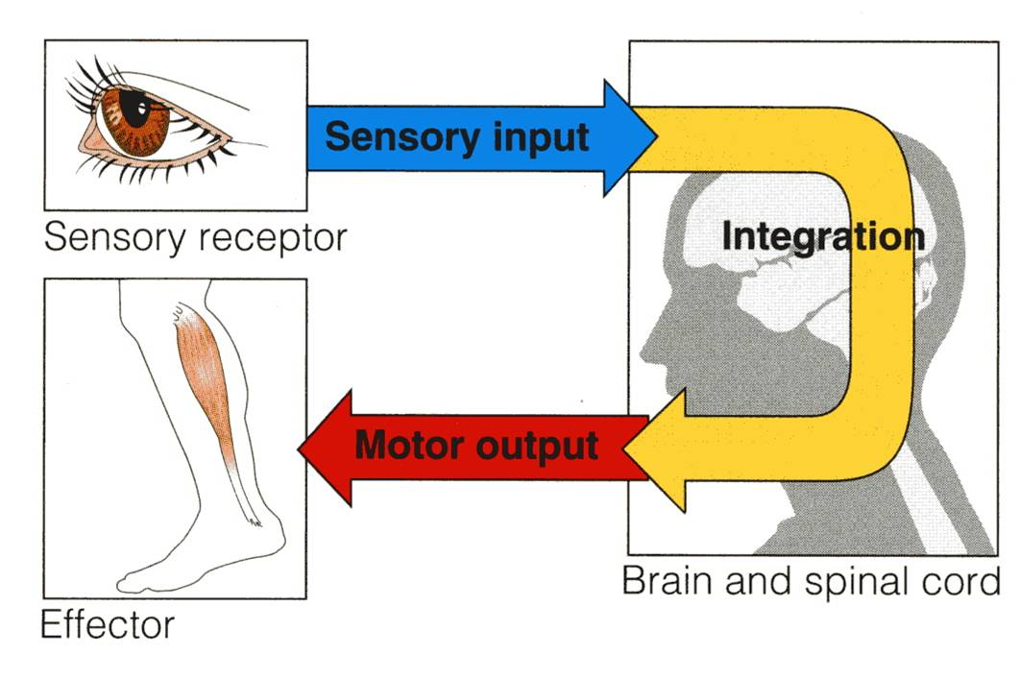
FUNCTIONS
NERVOUS
SYSTEM
collection of sensory input
integration
motor output

Slide 24
NERVOUS
SYSTEM
Classification
Nervous System (NS)
Functional Division
Structural Division
Central NS
Peripheral NS
Autonomic NS
Somatic NS
Brain
Spinal Cord
Sympathetic NS
Parasympathetic NS
12 pairs of Cranial nerves
&
31 pairs of spinal nerves

Slide 25

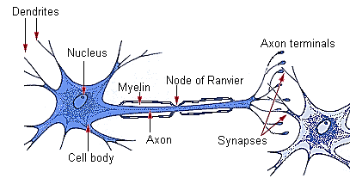
NERVOUS
SYSTEM
Nervous system consists of two main cell type
a. Neurons
b. Neuroglia/Non neuronal cells/Supporting cells
Neuron
Neuron is a functional structural unit of nervous system

Slide 26
What is a NERVE
  Its is a bundle of axons
What is a NUCLEUS
It is the collection of nerve cell bodies in the CNS
What is a GANGLION
It is a Collection of nerve cell bodies in the PNS

Slide 27
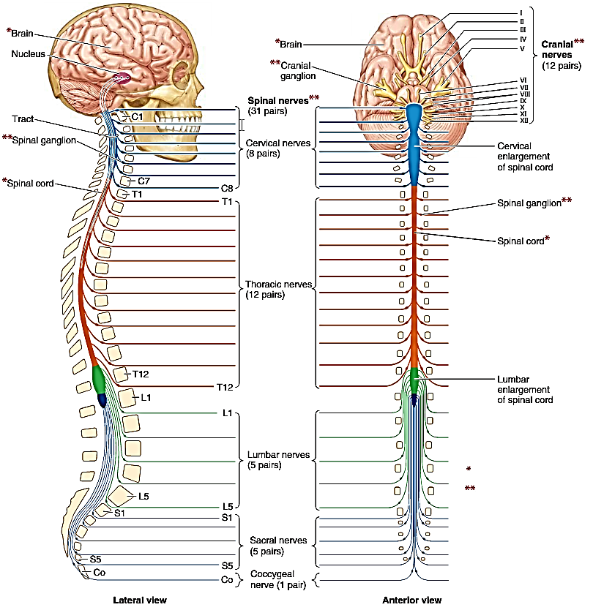
NERVOUS
SYSTEM

Slide 28
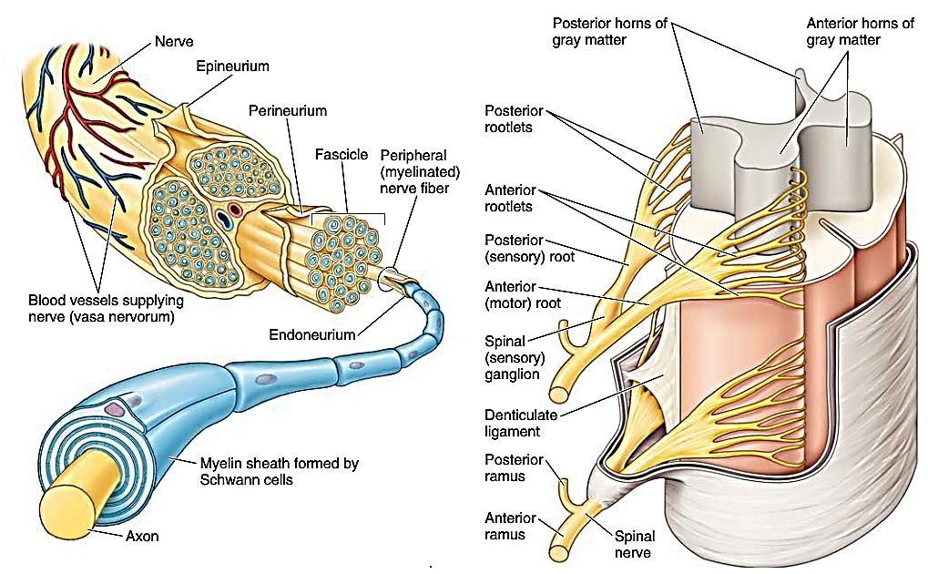
NERVOUS
SYSTEM

Slide 29
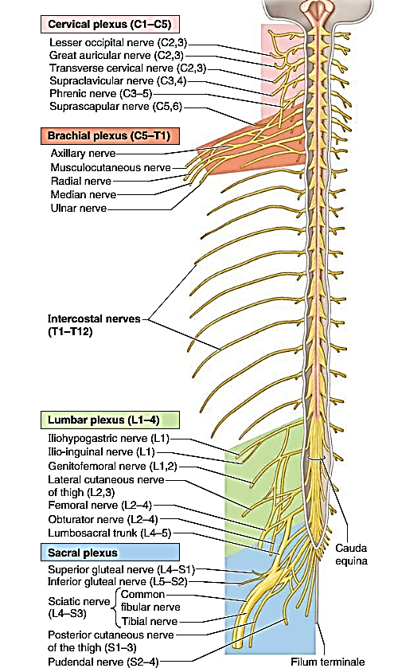
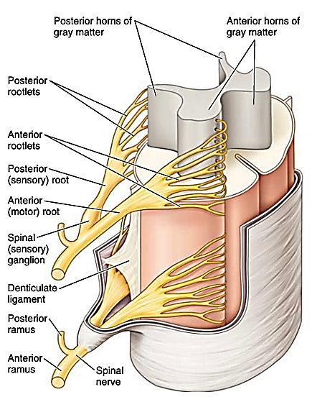
NERVOUS
SYSTEM

Slide 30
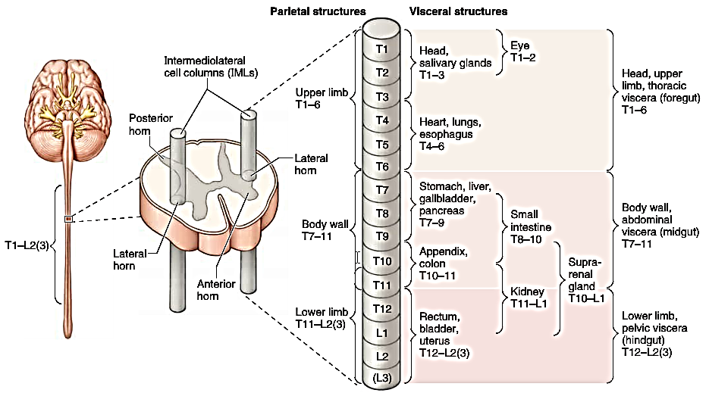
NERVOUS
SYSTEM
Autonomic Nervous System (ANS)
SYMPATHETIC (THORACOLUMBAR) DIVISION OF ANS

Slide 31
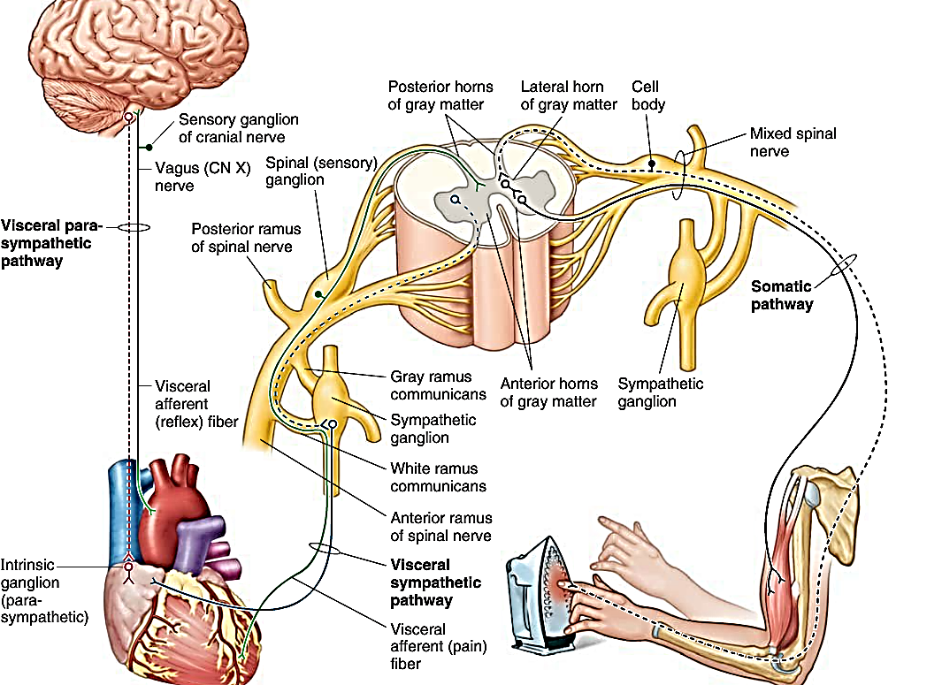

Slide 32
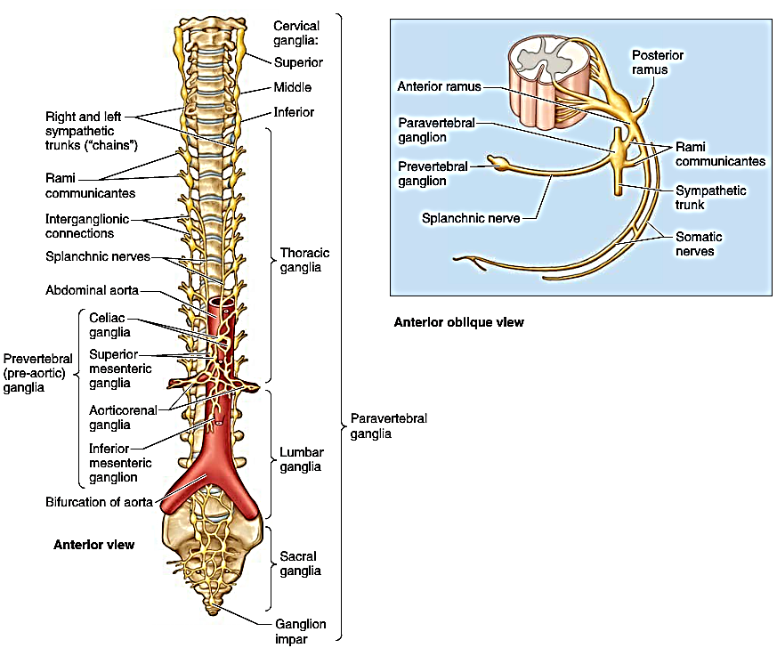
NERVOUS
SYSTEM
Autonomic Nervous System (ANS)
SYMPATHETIC (THORACOLUMBAR) DIVISION OF ANS

Slide 33
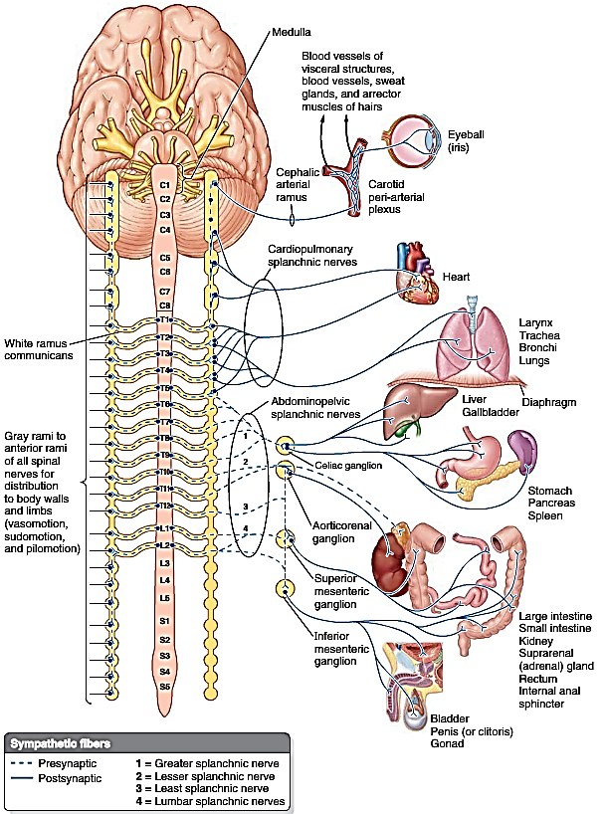
NERVOUS
SYSTEM
Autonomic Nervous System (ANS)
SYMPATHETIC (THORACOLUMBAR) DIVISION OF ANS

Slide 34
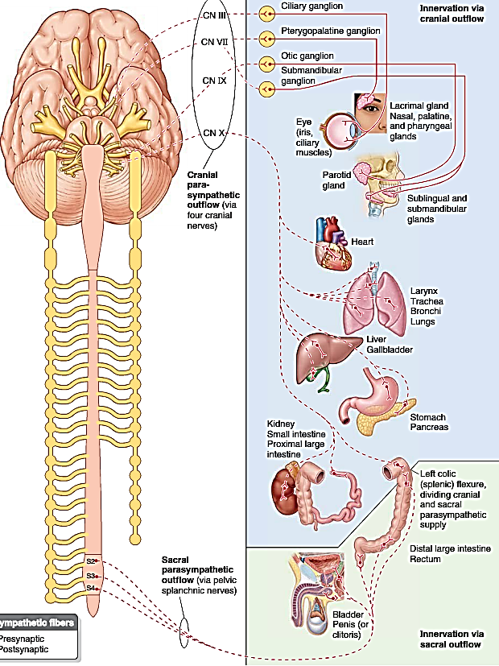
NERVOUS
SYSTEM
Autonomic Nervous System (ANS)
PARASYMPATHETIC (CRANIOSACRAL) DIVISION OF ANS

Slide 35
Thank you
&
Happy Holidays

