Slide 1
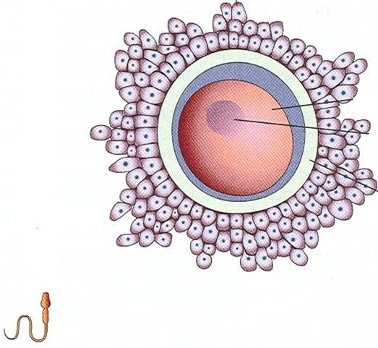
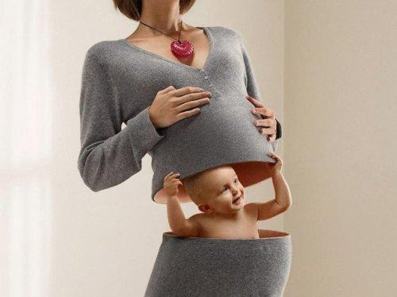
GENERAL EMBRYOLOGY
FROM
TO
PROF. AHMED FATHALLA

Slide 2
SPERMATOGENESIS VS OOGENESIS

Slide 3
OVARIAN CYCLE
UTERINE CYCLE

Slide 4
FERTILIZATION – DAY 0

Slide 5
SEGMENTATION (CLEAVAGE)
Embryoblast Embryo
Trophoblast Fetal membranes

Slide 6
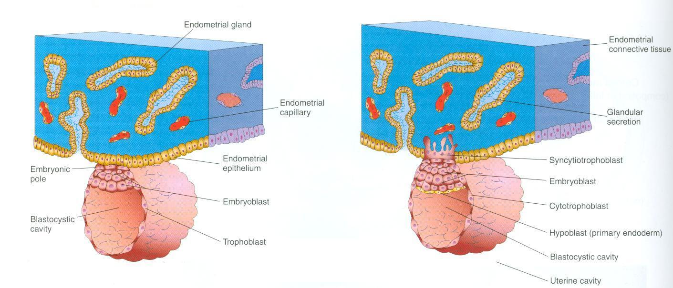
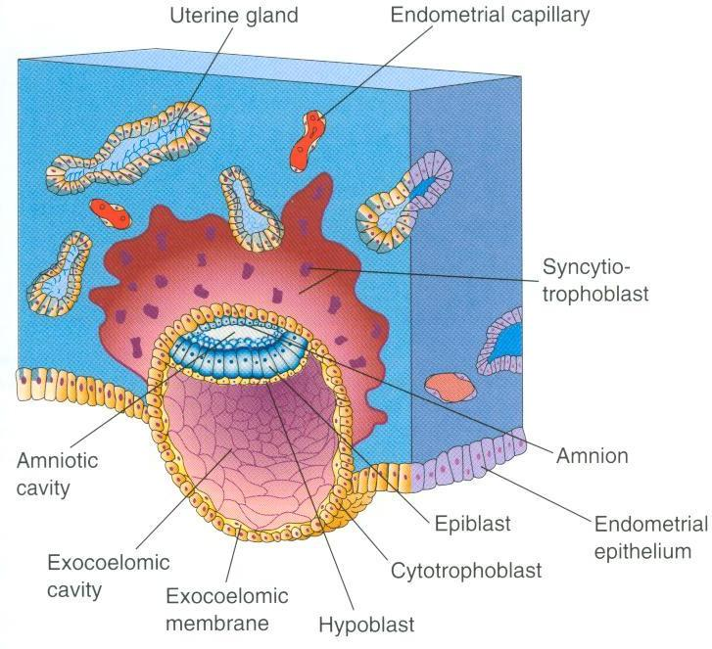
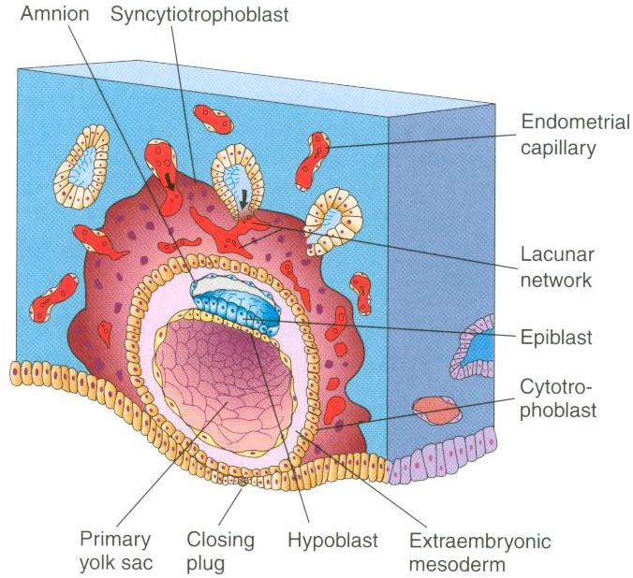
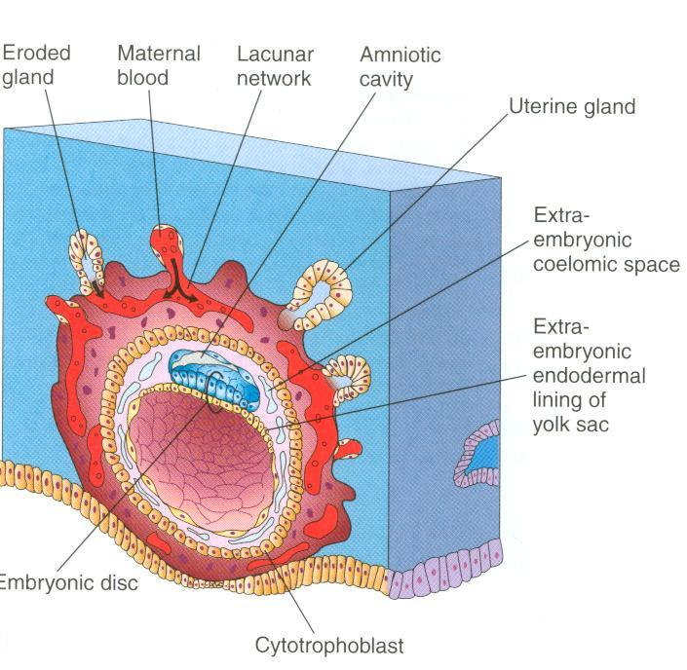
IMPLANTATION
DAY 6 – DAY 10
1
3
4
2

Slide 7
NORMAL & ABNORMAL IMPLANTATION

Slide 8
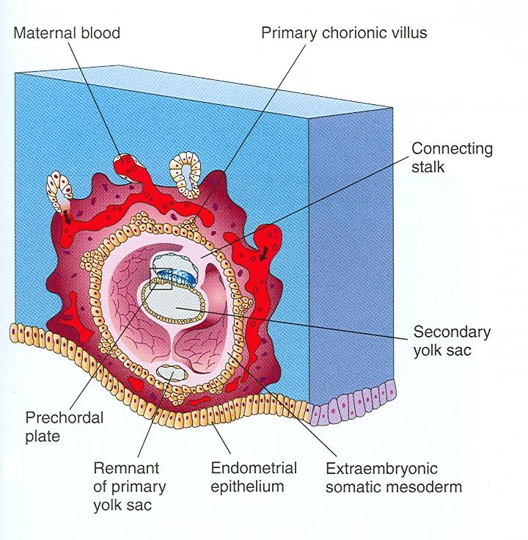
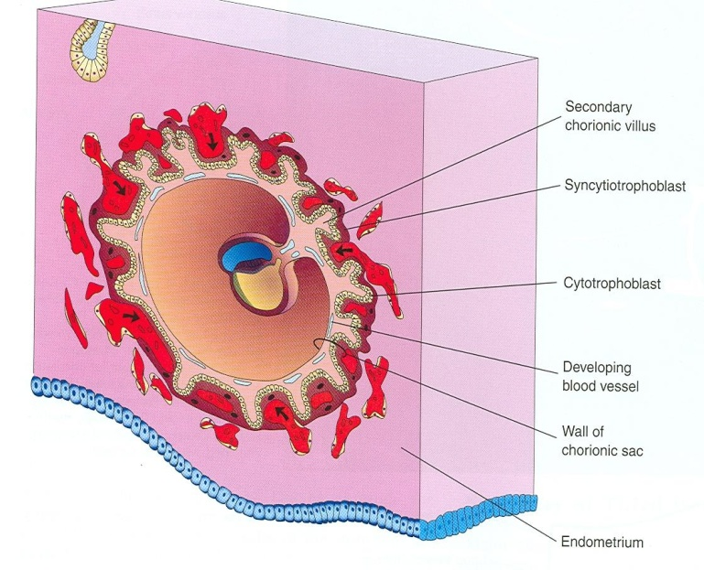
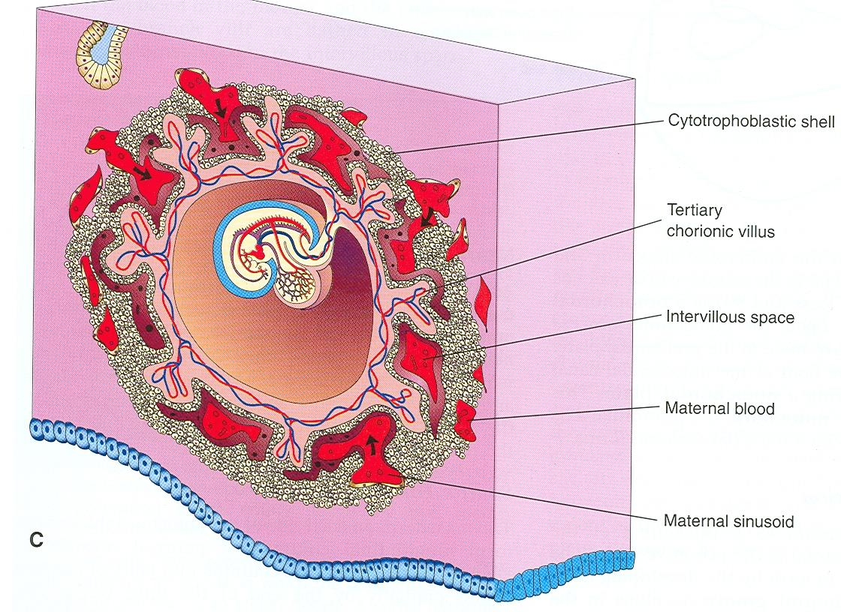
Primary chorionic villi: only trophoblast
Secondary chorionic villi: trophoblast + mesoderm
Tertiary chorionic villi:
trophoblast + mesoderm
+ fetal blood vessels

Slide 9
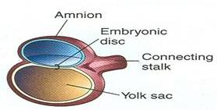
Bilaminar disc
Ectoderm & Endoderm
(End of 2nd Week)
Trilaminar disc
Ectoderm, Mesoderm & Endoderm
(End of 3rd Week)
Amniotic cavity
Yolk sac

Slide 10
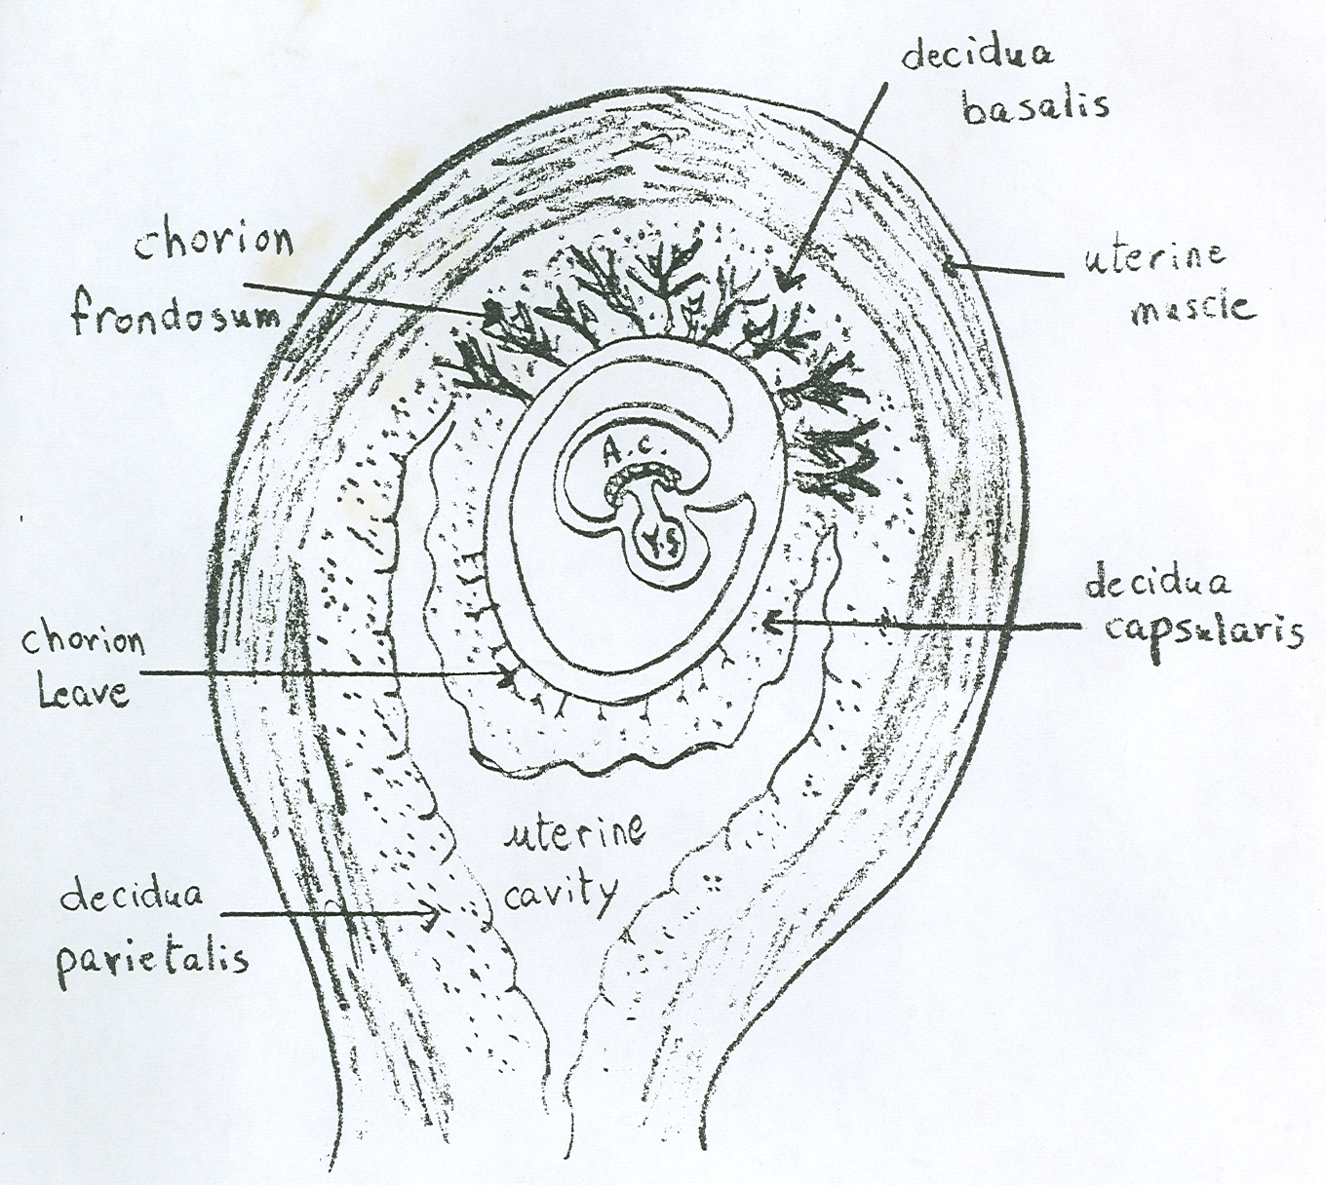
Decidua = functional layer of endometrium (uterine mucosa) in a pregnant women
PLACENTA

Slide 11
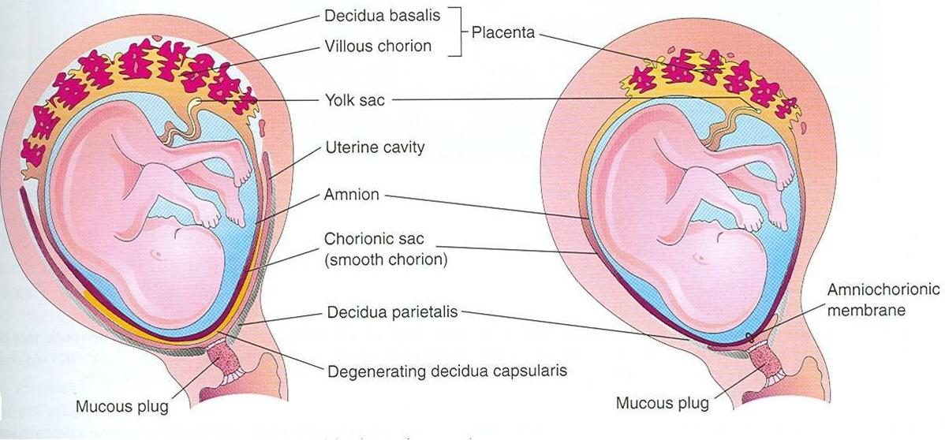
PLACENTA = DECIDUA BASALIS + VILLOUS CHORION (CHORION FRONDOSUM)

Slide 12
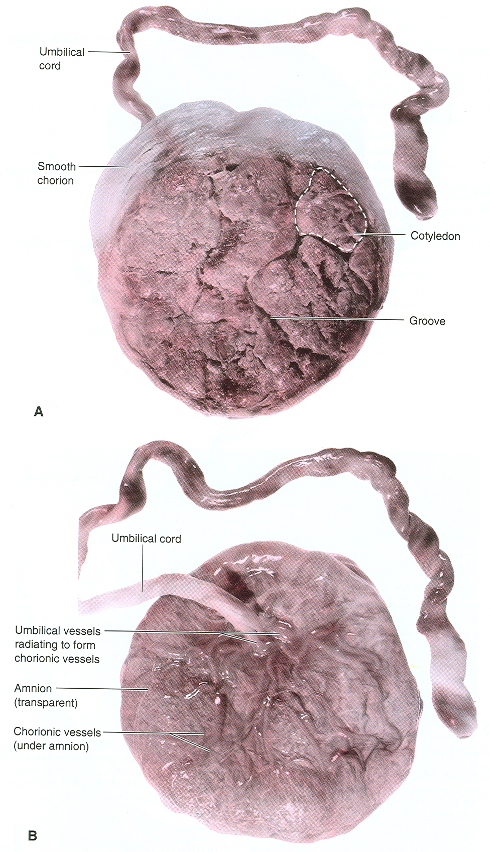
A- MATERNAL SURFACE OF PLACENTA
B- FETAL SURFACE OF PLACENTA

Slide 13
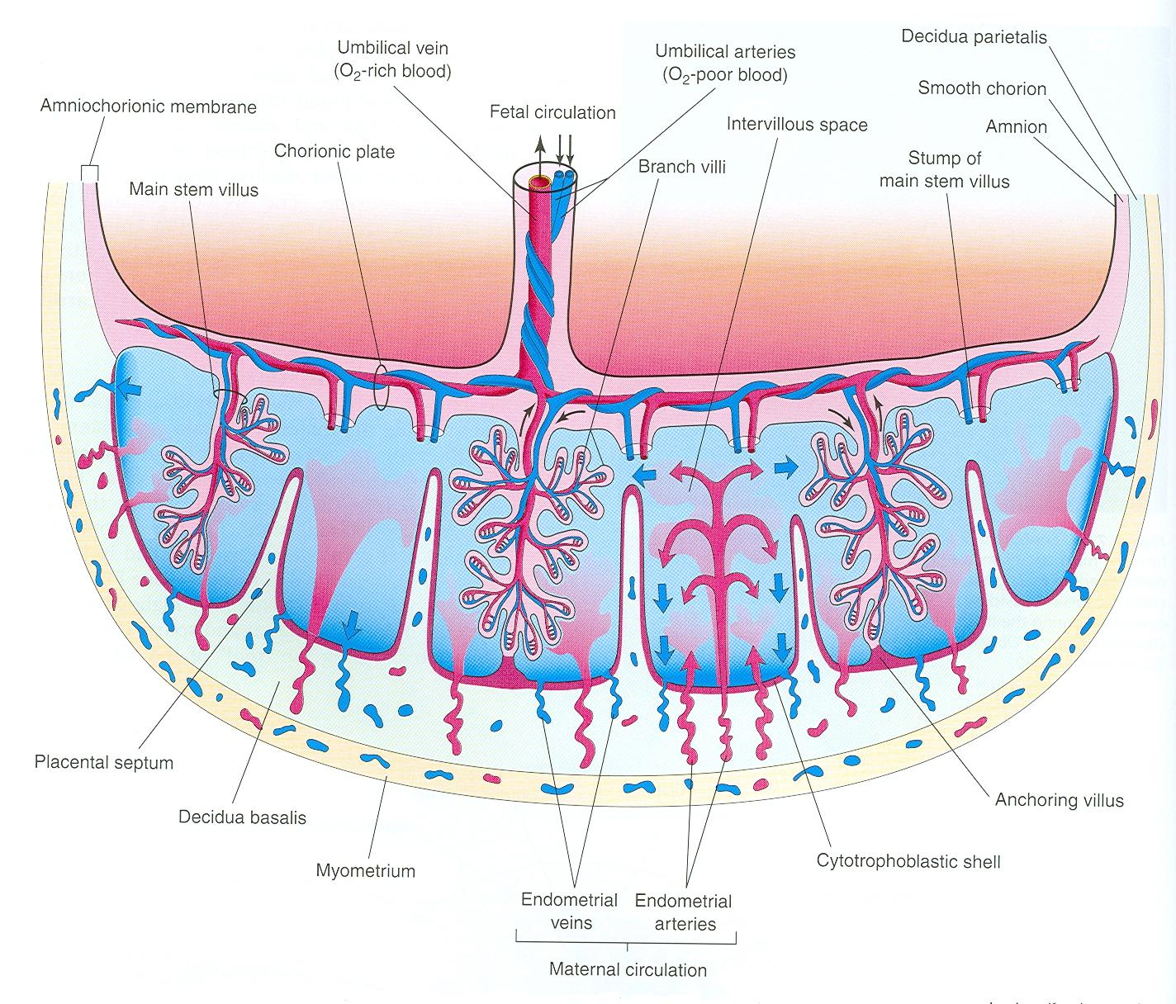
PLACENTAL CIRCULATION
Blood of mother

Slide 14
FUNCTION OF PLACENTA
TRANSFER:
Gases: oxygen, carbon dioxide
Nutritional substances: glucose, aminoacids, vitamins
Electrolytes: Na+, K+, Cl-
Maternal antibodies: antibodies against diphteria, smallpox, measles

Slide 15
FUNCTION OF PLACENTA
SECRETION OF HORMONES:
Protein hormones:
Human chorionic gonadotropin (early pregnancy tests)
Human placental lactogen
Human chorionic thyrotropin
Human chorionic corticotropin
Relaxin
Steroid hormones:
Progesterone
Estrogen

Slide 16
FOLDING (FROM 3RD TO 4TH WEEK)
*The sequence of events after which
the flat trilaminar embryonic disc
is transformed into a cylindrical embryo
*It occurs in 2 planes:
A- Median plane
B- Horizontal plane
*Its general results are:
Ectoderm covers embryo from outside
Amniotic cavity surrounds embryo
Yolk sac becomes divided into:
A- Gut: part enclosed inside embryo
(forms GIT)
B- Definitive yolk sac: part outside
embryo

Slide 17
PERIODS OF DEVELOPMENT
GERMINAL PERIOD (FIRST 3 WEEKS): Formation of the 3 germ layers.
EMBRYONIC PERIOD (4TH TO 8TH WEEK): Organogenetic period, the main organ systems begin to develop.
FETAL PERIOD (9TH WEEK TO BIRTH): concerned with rapid body growth & differentiation of tissues, organs & systems.

Slide 18
IMPORTANT DERIVATIVES OF GERM LAYERS
ECTODERM: Nervous tissue, Skin & its appendages.
MESODERM: Connective tissue (including blood, cartilage, & bone), Muscles, Urogenital organs.
ENDODERM: Mucous membrane of GIT & Respiratory tracts, mucous membrane of Urinary bladder.

Slide 19
LABOR

Slide 20
FIRST STAGE OF LABOR DILATATION OF CERVIX

Slide 21
SECOND STAGE OF LABOR EXPULSION STAGE

Slide 22
THIRD STAGE OF LABOR PLACENTAL STAGE

Slide 23
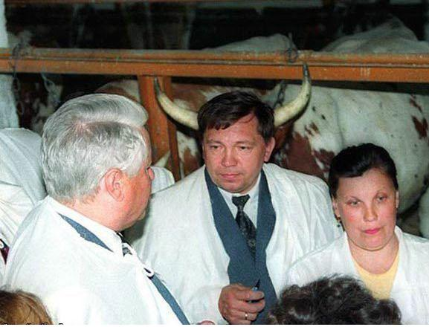
CONGENITAL ANOMALIES

Slide 24
TERATOLOGY
It is the branch of science that studies the causes, mechanisms & patterns of abnormal development.

Slide 25
GENETIC FACTORS
CHROMOSOMAL ABBERRATIONS
Nondisjunction: failure of a chromosomal pair to disjoin (detach): trisomy & monosomy.
Deletion: a part of a chromosome is lost.
Duplication: a part of a chromosome is duplicated.
Translocation: a transfer of a part of one chromosome to a nonhomologous chromosome.
MUTANT GENES
A loss or change in the function of a gene due to a permanent, heritable change in the sequence of genomic DNA.

Slide 26
ENVIRONMENTAL FACTORS
DRUGS:
Alcohol
Anticonvulsants (phenytoin or hydantoin)
Tranquilizers (thalidomide)
Antibiotics (tetracycline).
INFECTIONS:
Rubella virus (german measles)
Cytomegalovirus
Toxoplamsa Gondii (a parasite causing toxoplasmosis)

Slide 27
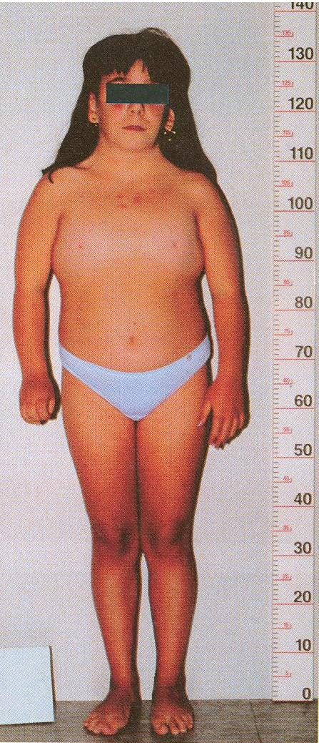
MONOSOMY X FEMALE - TURNER SYNDORME (45X)
Webbed neck
Short stature
Broad chest with space nipples
Absence of sexual maturation

Slide 28
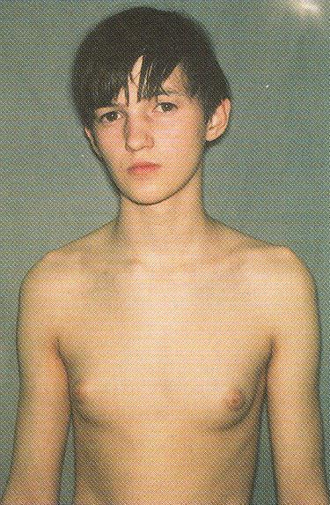
TRISOMY XXY – KLINEFELTER SYNDROME (47XXY)
Gynecomastia
(enlarged breast)
Small testes

Slide 29
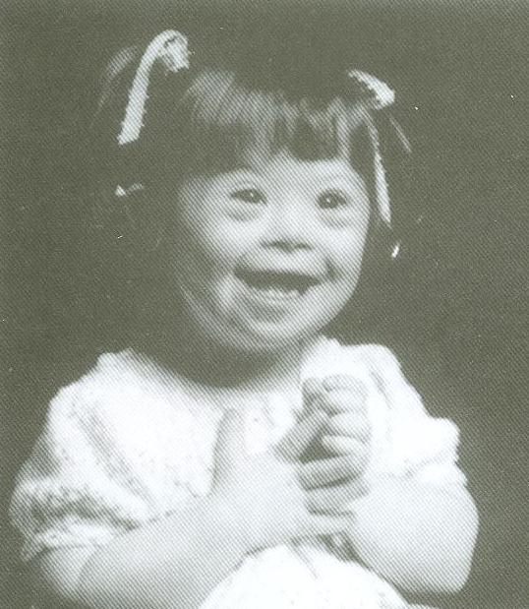
TRISOMY 21 – DOWN SYNDROME
Mental deficiency
Flat nasal bridge
Protruding tongue
Congenital heart defect

Slide 30
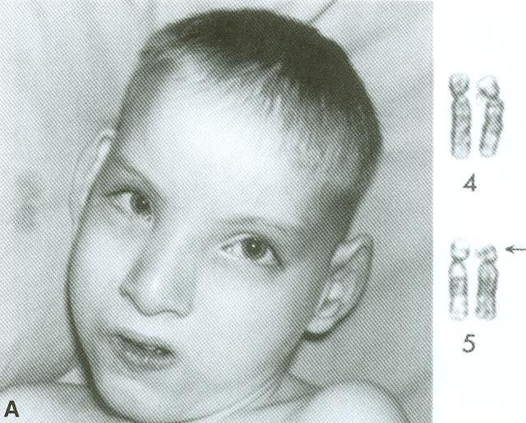
DELETION FROM CHROMOSOME 5 – CRIT DU CHAT
Microcephaly
(small head)
Mental retardation
Weak cat-like cry
Congenital heart disease

Slide 31
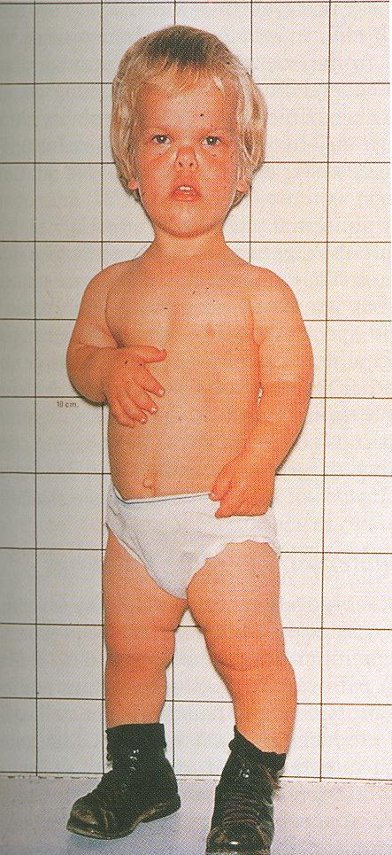
GENE MUTATION - ACHONDROPLASIA
Large head
Prominent forehead
Short stature
Depressed nasal bridge
Short limbs
Normal length of trunk
Bowed leg

Slide 32
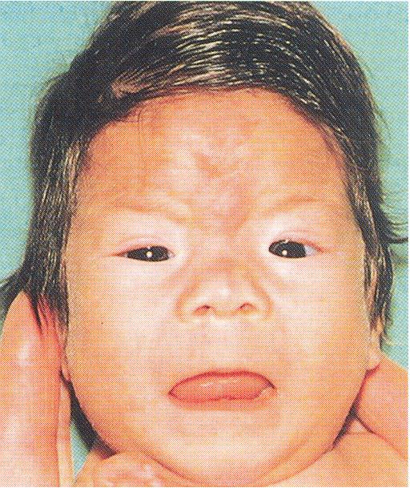
FETAL ALCOHOL SYNDROME
Flat nasal bridge
& short nose
Thin upper lip
Congenital heart disease

Slide 33
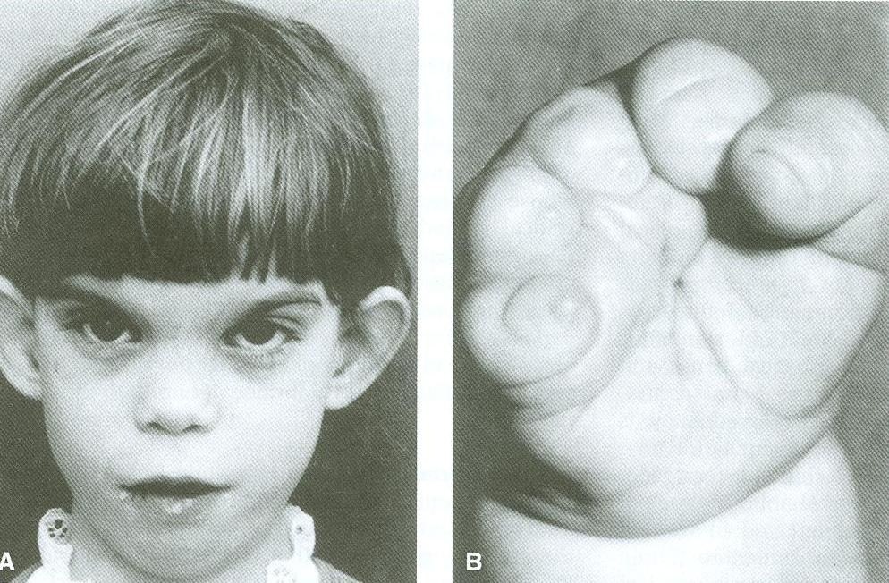
FETAL HYDANTOIN SYNDROME
Mental deficiency
Unusual ears
Short fingers
Wide-spaced eyes

Slide 34
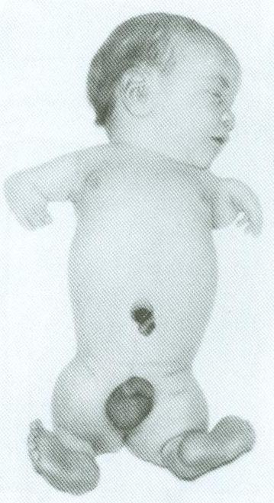
MEROMELIA (LIMB REDUCTION)
CAUSED BY THALIDOMIDE

Slide 35
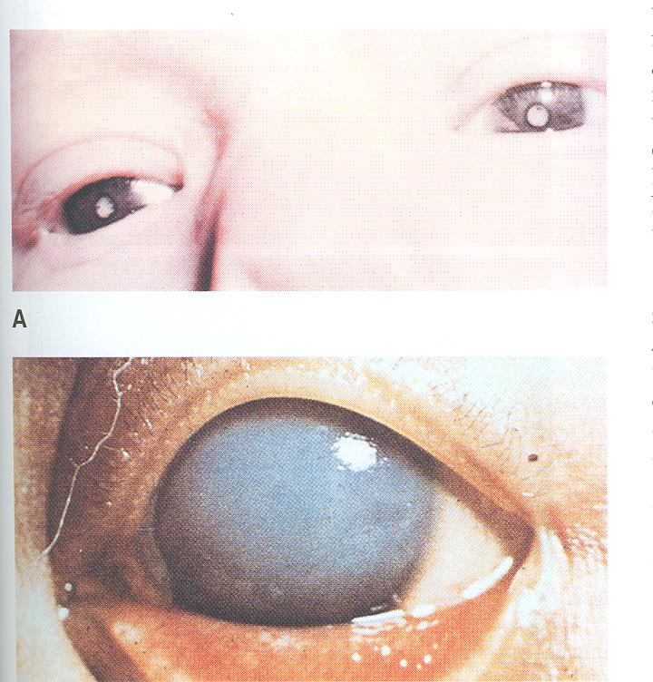
BILATERAL CONGENITAL CATARACT (CORNEAL OPACITY)
CAUSED BY RUBELLA VIRUS

Slide 36
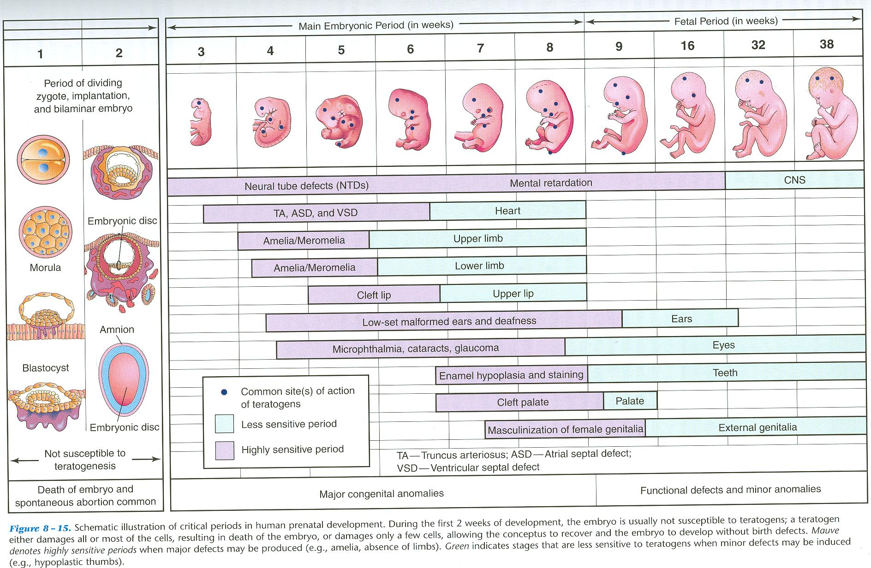

Slide 37
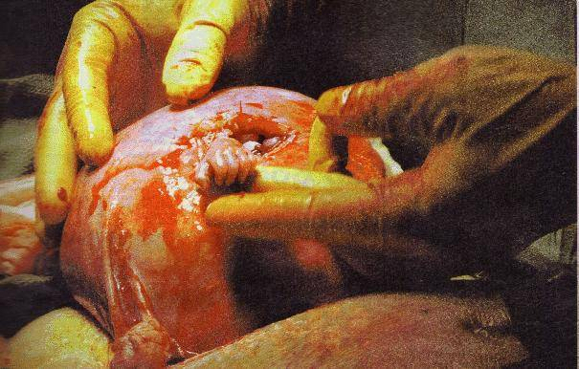
”و في أنفسكم أفلا تبصرون“
صدق الله العظيم

