Slide 1
Vascular problems of the upper and lower limbs
Essam Eldin Abd Elhady Salama

Slide 2
Objectives
We try to remember some anatomic points regarding the vascular tree of the upper and lower limbs.
Knowledge of some important problems and clinical applications related to the vascular tree of the upper and lower limbs.

Slide 3
Arterial supply of the upper limbs

Slide 4
Subclavian artery
Left side arises from arch of aorta,
Right side is a branch of brachiocephalic artery.
From origin to the outer margin of the 1st rib,
then it continues as axillary artery .
R
L

Slide 5
Axillary Artery
Begins at lateral margin of 1st rib.
To the lower border of Teres major.
Major Branches
Superior Thoracic Artery.
Thoracoacromial Artery.
Lateral Thoracic Artery.
Subscapular Artery.
Anterior Circumflex Humeral and
Posterior Circumflex Humeral.

Slide 6
Brachial Artery
Begins at the lower margin of Teres major, as a continuation of the axillary artery
Major Branches
Profunda Brachial,
Superior and Inferior Ulnar collateral arteries.
Muscular.
Nutrient to the humerus.
Terminates opposite the neck of radius by dividing unto the Radial and Ulnar Arteries,

Slide 7
Radial artery
Begins from the brachial artery at the level of the neck of the radius in the cubital fossa
Descends downward and laterally, rests on deep muscles of front of the forearm.
At the wrist it passes in the anatomical snuff box.
Ends in the hand by anastomosis with the deep branch of the ulnar artery, to be continued as the deep palmar arch

Slide 8
Radial artery
Branches :
o Radial recurrent artery (anastomoses with the radial collateral branch of the profunda brachii)
Muscular branches
Superficial palmar branch to complete the superficial palmar arch with ulnar artery
In the dorsum of the hand it gives radialis indicis and princeps pollicis.
Then continuous as deep palmer arch

Slide 9
Ulnar artery
Begins from termination of the brachial artery at the level of the neck of the radius in the cubital fossa.
It descends through the anterior compartment of the forearm.
Enters the palm superficial to the flexor retinaculum.
Ends in the hand by forming the superficial palmar arch anastomosing with the superficial palmar branch of the radial artery.

Slide 10
Ulnar artery
Branches :
o Anterior ulnar recurrent artery
o Posterior ulnar recurrent artery
o Common interosseous artery, which divides into anterior interosseous artery and posterior interosseous artery (which gives rise to the posterior interosseous recurrent artery) .
o Muscular branches.
o Cutaneous branches
Branches sharing in arterial anastomosis around the wrist joint.
Ends by be continuous as superficial palmar arch.

Slide 11
Superficial Palmar Arch
Direct continuation of Ulnar artery.
On the lateral side it is completed by superficial palmar branch of the radial artery.
It is superficially placed in palm in front of the long flexor tendons.
It gives four digital arteries

Slide 12
Deep Palmar Arch
Direct continuation of Radial artery.
On the medial side it is completed by deep branch of the ulnar artery.
It is deeply placed in palm in front of the metacarpal bones & Interosseous muscles.
Branches: Palmar, Metacarpal, Perforating & Recurrent
superiorly sharing in anastomosis around the wrist joint
inferiorly joining digital branches of the superficial palmar arch

Slide 13
Anastomosis around shoulder joint
Anastomosis occurs between branches of Subclavian and Axillary arteries:
Branches from Subclavian Artery:
Suprascapular artery
Superficial cervical artery
Branches from Axillary Artery:
Subscapular artery
Anterior circumflex humeral artery
Posterior circumflex humeral artery

Slide 14
Anastomosis around elbow joint
Anastomosis occurs between
Brachial, Radial and Ulnar arteries:
Branches from Brachial Artery:
Profunda Brachii artery
Superior ulnar collateral artery
Inferior ulnar collateral artery
Branches from Ulnar and Radial Arteries:
Radial & ulnar recurrent arteries
Interosseous recurrent artery

Slide 15
Veins of the Upper Limb
Superficial veins
Deep veins

Slide 16
Superficial Veins of the Upper Limb
Dorsal venous arch
Veins of the Palm
Cephalic vein
Basilic vein
Median vein of the forearm

Slide 17
Dorsal venous arch
Lies in the subcutaneous tissue proximal to Metacarpophalangeal joints.
Drains on the lateral side into the Cephalic vein, and on the medial side into the Basilic vein.
Communicates with the deep veins of the palm freely.

Slide 18
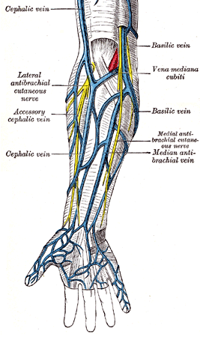
Cephalic Vein
Arises from the lateral side of the dorsal venous arch on the back of hand.
Winds round the lateral border of forearm
Ascends in the superficial fascia into the cubital fossa and up the front of the arm on the lateral side of Biceps.
On reaching the interval between deltoid & Pectoralis major muscles, it pierces deep fascia & joins the Axillary vein.
Drains the lateral and posterior surfaces of the limb.
Median Cubital Vein, a branch of cephalic vein, joins the Basilic vein in the cubital fossa.

Slide 19
Basilic Vein
Arises from the medial side of the dorsal venous arch on the back of hand.
Winds round the medial border of forearm.
Ascends in the superficial fascia on the posterior surface of the forearm.
Below elbow it inclines to reach the cubital fossa.
Ascends on the medial side of Biceps
It pierces deep fascia at the middle of the arm
It joins the vena comitantes of the brachial artery to form the Axillary vein.
Drains the medial and posterior surfaces of the limb.
Receives Median Cubital Vein at cubital fossa.

Slide 20
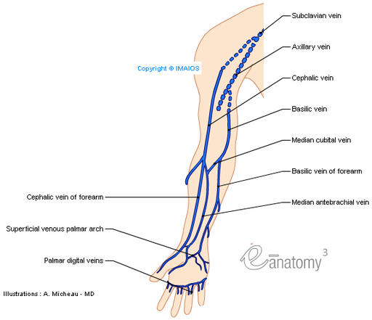
Median Vein of the Forearm
Arises in the palm
Ascends on the front of forearm
Drains into Basilic vein or Median cubital vein or divides into two branches:
Median Basilic vein: (drains into basilic vein)
Median cephalic vein: (drains into cephalic vein)

Slide 21
Deep Veins of the Upper Limb
Venae Comitantes
Axillary vein

Slide 22
Vena Comitantes
Deep veins accompany the respective arteries radial and ulnar.
Two vena comitantes of brachial artery join the basilic vein
at the lower border of teres major to form Axillary vein

Slide 23
Axillary Vein
Formed by the union of the vena comitantes of brachial artery with basilic vein
It becomes Subclavian Vein at the outer border of 1st rib
Tributaries correspond to the branches of the axillary artery and also receive Cephalic Vein

Slide 24
Arterial supply of the lower limbs

Slide 25
Arterial supply of the lower limbs
Right and left Common iliac arteries arise as terminal branches of the abdominal aorta at the level of L4
Each artery ends anterior to the Sacroiliac joint by dividing into
Internal Iliac artery.
External Iliac artery.

Slide 26
Internal Illiac Artery
The following branches are our concern
Obturator artery “ leaves the pelvis through the obturator canal”
Inferior Gluteal artery” leaves through the greater sciatic foramen inferior to pyriformis”
Superior Gluteal artery” leaves through the greater sciatic foramen superior to pyriformis”

Slide 27
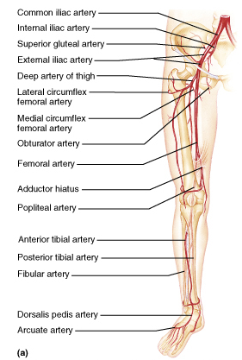
External Iliac artery
Femoral artery; continuation of the external iliac artery, at mid point of the inguinal ligament , It gives;
Profunda femoris; adductors, hamstrings, and quadriceps
Popliteal artery (continuation of femoral)
Anterior Tibial artery; anterior compartment of the leg, further branches to feet.
Posterior Tibial artery; posterior compartment of the leg flexor muscles, plantar arch, branches to toes

Slide 28
Femoral Artery
Is the continuation of the external iliac artery at mid point of the inguinal ligament.
Begins deep to the inguinal ligament.
Enclosed within the femoral sheath.
Becomes the popliteal artery at the adductor hiatus.
Proximal branches;
Superficial epigastric artery.
Superficial circumflex iliac artery.
Superficial external pudendal artery.

Slide 29
Femoral Artery “deep branches”
Deep external pudendal.
Descending genicular.” runs with saphenous nerve
Profunda femoris (deep femoral):Arises from deep of femoral artery within femoral triangle, Largest branch of femoral artery, Passes posterior to adductor longus muscle.
Branches:” of profunda femoris”
Medial femoral circumflex.
Lateral femoral circumflex.
Perforating arteries (3).
Descending genicular.

Slide 30
Femoral artery Cont.
The femoral artery enters the subsartorial canal “ adductor canal” then through the adductor hiatus to pass to the posterior compartment of the knee “popliteal fossa” and changes it’s name to popliteal artery
It is accompanied by popliteal vein which runs in the lateral side of the artery

Slide 31
Popliteal artery
Continuation of femoral artery as it passes through opening in adductor magnus muscle.
From its origin it runs downwards & slightly laterally in popliteal fossa.
Reaches lower border of popliteus
Terminates by dividing into anterior & posterior tibial arteries

Slide 32
Popliteal artery
Branches
Muscular: supplies surrounding muscles
Articular (genicular) :
lateral & medial superior genicular
middle genicular
lateral & medial inferior genicular

Slide 33
Blood Supply of the anterior Compartment of the Leg
Anterior Tibial Artery
Is the smaller of the terminal branches of the popliteal artery.
It arises at the level of the lower border of the popliteus muscle and
Passes forward into the anterior compartment of the leg through an opening in the upper part of the interosseous membrane.
Descends on the anterior surface of the interosseous membrane, accompanied by the deep peroneal nerve.
In front of the ankle joint, the artery becomes the dorsalis pedis artery.

Slide 34
Anterior Tibial Artery
Branches
Muscular branches to neighboring muscles.
Anastomotic branches around the knee and ankle joints.

Slide 35
Artery of the Posterior Fascial Compartment of the Leg
Posterior Tibial Artery
Is one of the terminal branches of the popliteal artery.
Begins at the level of the lower border of the popliteus muscle.
It lies on the posterior surface of the tibia below.
The artery passes behind the medial malleolus deep to the flexor retinaculum and terminates by dividing into
medial and lateral plantar arteries.

Slide 36
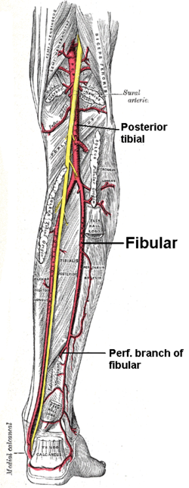
Artery of the Posterior Fascial Compartment of the Leg
Branches
Peroneal artery: gives off muscular branches and a nutrient artery to the fibula and ends by taking part in the anastomosis around the ankle joint.
Lateral Plantar Artery; the larger of the terminal branches of the posterior tibial artery.
On reaching the base of the fifth metatarsal bone, the artery curves medially to form the plantar arch and at the proximal end of the first intermetatarsal space joins the dorsalis pedis artery.
During its course, it gives off muscular, cutaneous, and articular branches. The plantar arch gives off plantar digital arteries to the toes.

Slide 37
Artery of the Posterior Fascial Compartment of the Leg
Branches
Medial Plantar Artery; the smaller of the terminal branches of the posterior tibial artery.
Reaching the base of the first metatarsal bone,

Slide 38
Anastomosis in the Lower Limb
Anastomosis between different arterial branches
To ensure blood circulation in the case of occlusion in any artery
Cruciate anastomosis
Geniculate anastomosis
Plantar anastomosis

Slide 39
Anastomosis in the Lower Limb
Cruciate anastomosis
Branches of inferior gluteal artery.
Medial femoral circumflex arteries
Lateral femoral circumflex arteries.
The first perforating artery.
Trochanterica nastomosis
Superior Gluteal arteries
Inferior Gluteal arteries.
Medial femoral circumflex arteries.
Lateral femoral circumflex arteries.

Slide 40
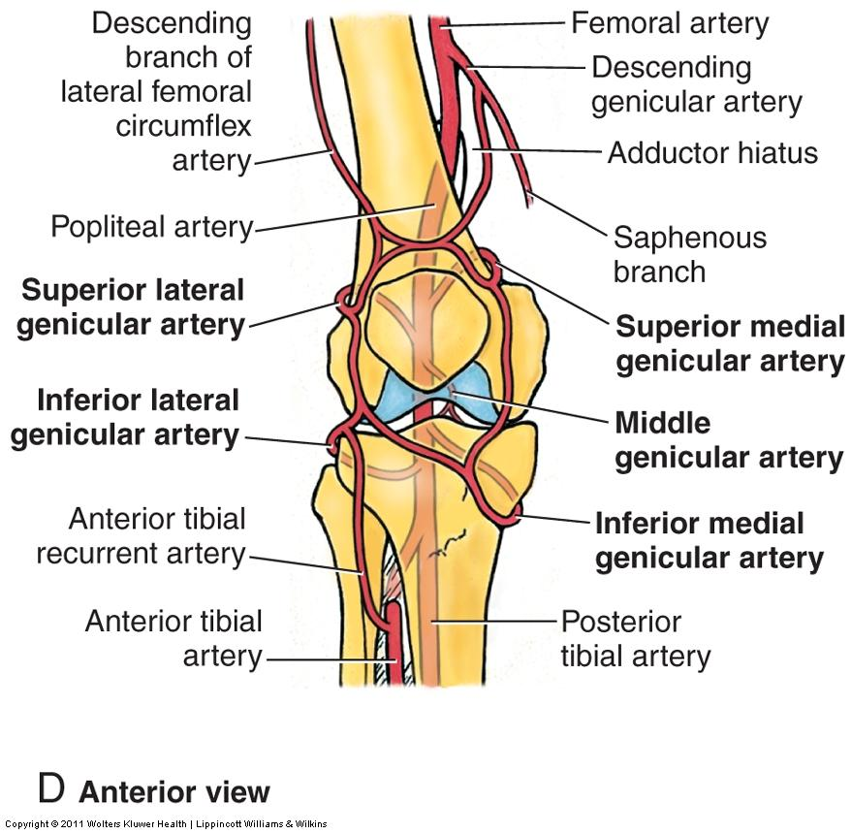
Anastomosis around the Knee Joint
Is made by the following branches:
Descending branch of lateral circumflex femoral.
Descending genicular of femoral
Anterior tibial recurrent.
Five branches of popliteal artery.

Slide 41
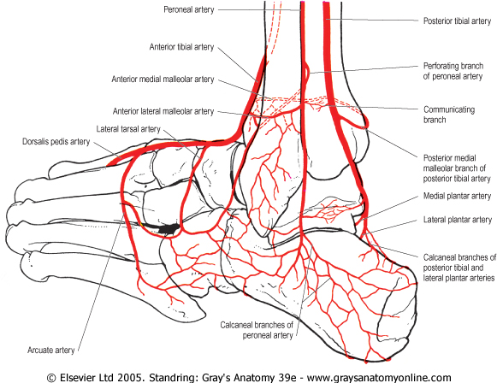
Anastomosis around the Ankle Joint
Is formed by the following branches:
Calcanean branches of posterior tibial and peroneal arteries.
Malleolar branches of posterior tibial and peroneal arteries.
Medial and lateral malleolar branches of anterior tibial artery.

Slide 42
Venous drainage of the lower limb
They are subdivided into superficial and deep veins.
The superficial veins are between the two layers of superficial fascia while
The deep veins accompany the arteries.
Both sets of veins are provided with valves more numerous in the deep than in the superficial set.

Slide 43
The great saphenous vein (long saphenous vein)
Is the longest vein in the body.
Begins in the medial marginal vein of the dorsum of the foot.
It passes in front of the medial malleolus and along the medial side of the leg.
along the medial side of the thigh to end in the femoral vein about 3 cm below the inguinal ligament.
Main Tributaries:
superficial circumflex iliac
superficial external pudendal

Slide 44
Small saphenous vein ( short saphenousvein)
Begins behind the lateral malleolus as a continuation of the lateral marginal vein,
Ascends to reach the middle of the back of the leg.
It perforates the deep fascia at the popliteal fossa and
ends in the popliteal vein
Tributaries
Branch from great saphenous vein
Lateral marginal vein
Numerous tributaries from the back of the leg.

Slide 45
Deep veins
They accompany the arteries and their branches.
They possess numerous valves.
The deep plantar venous arch lies alongside the plantar arterial arch drains into the medial and lateral plantar veins.
The posterior tibial vein accompanies the posterior tibial artery and joined by the peroneal vein to form the popletial vein.
The anterior tibial vein is the upward continuation of the venæ comitantes of the dorsalis pedis artery.
They leave the front of the leg by passing between the tibia and fibula, over the interosseous membrane, and unite with the posterior tibial vein

Slide 46
The Popliteal Vein ascends through the popliteal fossa to the opening in the Adductor magnus, where it becomes the femoral vein.
It receives tributaries corresponding to the branches of the popliteal artery, and the small saphenous vein.
The femoral vein accompanies the femoral artery through the upper two-thirds of the thigh.
It receives many muscular tributaries, and about 4 cm below the inguinal ligament is joined by the deep femoral vein and is joined by the great saphenous vein before it terminates.
The deep femoral vein receives tributaries corresponding to the perforating branches of the profunda artery, and through these establishes communications with the popliteal vein below and the inferior gluteal vein above.
.

Slide 47
CLINICAL APPLICATION
AND
PROBLEMS

Slide 48
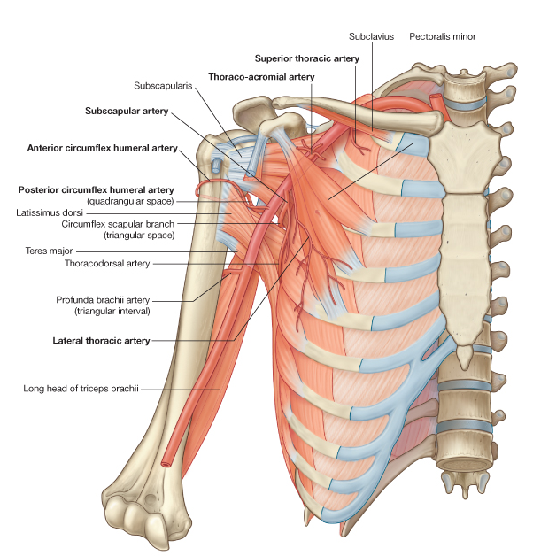
Thoracic outlet syndrome
The brachial plexus of nerves and the subclavian artery and vein are closely related to the upper surface of the first rib and the inferior surface of the clavicle.
It is caused by pressure on the lower trunk of the plexus and circulatory impairment of the upper limb.

Slide 49
The axillary sheath and brachial plexus nerve block
As the axillary sheath encloses the axillary vessels and the brachial plexus, through the cervicoaxillary canal
The brachial plexus nerve block is obtained by injection of the anesthetic solution into the sheath.
Position of the sheath is verified; and confirmed by feeling the pulsation of the 3rd part of the axillary artery.

Slide 50
Venipuncture and blood transfusion
The superficial veins are important for venipuncture, transfusion, and cardiac catheterization.
When a patient is in a state of shock the superficial veins are not always visible.
In extreme hypovolemic shock excessive venous tone may inhibit venous blood flow and so delay introduction of intravenous blood into the vascular system

Slide 51
Venipuncture and blood transfusion
The cephalic vein lies fairly constantly immediately posterior to the styloid process of the radius.
In the cubital fossa the median cubital vein is separated from the brachial artery by the bicipital aponeurosis, which protects the artery from mistaken introduction of irritating drugs.

Slide 52
Anatomy of Basilic and Cephalic vein catheterization
The basilic vein is the vein of choice for central venous catheterization
From the cubital fossa until reaching the axillary vein it increases in diameter and lies in direct line with the axillary vein
Abduction of the arm will overcome the troublesome caused by the valves in the axillary vein, and permits the catheter to move past the obstruction.

Slide 53
Anatomy of Basilic and Cephalic vein catheterization
The cephalic vein dose not increase in size as it ascends in the arm, and frequently divides into small branches
At it's termination it joins the axillary vein at right angle ,so it is difficult to maneuver the catheter around this angle.

Slide 54
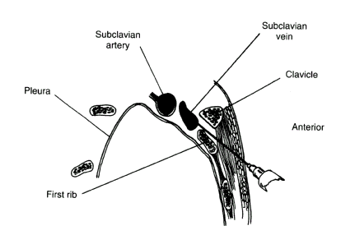
Catheterization
Subclavian vein
It lies immediately posterior to the medial third of the clavicle.
It is more medially placed on the left than the right side
The needle is inserted just below the lower border of the clavicle
at junction of medial third and outer two thirds.
It is pointed upward and posteriorly towards the middle of the suprasternal notch.

Slide 55
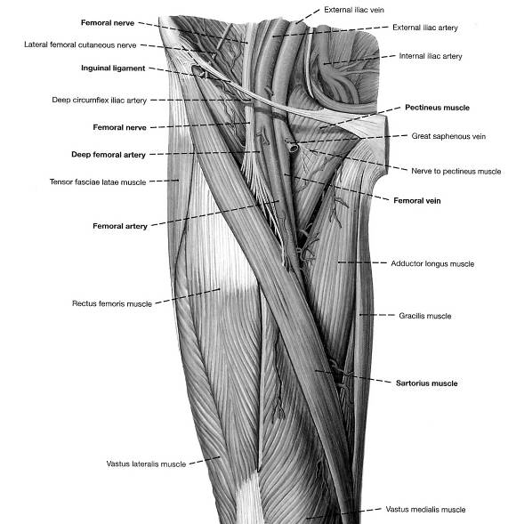
Femoral Vein Catheterization
Position; Supine
Femoral vein determination ;
• Femoral arterial pulse just below inguinal ligament
Needle placement
Medial to femoral artery
Needle held at 45 degree angle
2 cm below inguinal ligament
toward umbilicus.

Slide 56
Compartment syndrome of the forearm
The forearm is enclosed in a sheath of deep fascia that is attached to the periosteum of the posterior border of ulna
This sheath with the intermuscular septum and interosseous membrane divide the forearm into several compartments each has its own muscle , nerve and blood supply
there is very little room within each compartment, any edema can cause secondary vascular compression of the blood vessels; the veins first affected and later the arteries

Slide 57
Compartment syndrome of the forearm
Early signs include
Absence of capillary refill in the nail bed
Altered skin sensation.
Pain disproportionate to the injury , pain on passive stretch of muscles ( muscle ischemia)
Tenderness (late sign) is caused by edema.
Deep fascia must incised surgically to decompress the affected compartment.
A delay up to 4 h can cause irreversible damage to the muscles

Slide 58
Volkmann’s ischemic contracture
A contracture of muscles of the forearm follows fracture distal end humerus or both bones ; radius and ulna.
A localized segment of the brachial artery goes into spasm.
Reduction of the blood flow to flexor and extensor muscles that undergo ischemic necrosis.
The muscles are replaced by fibrous tissue, which contracts producing the deformity

Slide 59
Volkmann’s ischemic contracture
Both extensor and flexor, are affected
the wrist joint is flexed and metacarpophalangeal joints are extended and the interphalangeal joints are flexed

Slide 60
Arterial injury
Arteries of the upper limbs damaged by penetrating wounds may require ligation.
Adequate collateral circulation around shoulder, elbow and wrist prevent subsequent tissue necrosis or gangrene providing that the patient's general circulation is satisfactory.
It may tack days or weeks to open sufficiently to provide the distal part of the limb with the same volume of blood.

Slide 61
Palpation and compression of arteries
Arteries of the upper limb can be palpated or compressed in an emergency.
Subclavian artery ;can be traced in the root of posterior triangle of the neck as it crosses the 1st rib to become the axillary artery .
Axillary artery (3rd part); can be felt in the axilla as it lies anterior to teres major muscle .

Slide 62
Palpation and compression of arteries
Brachial artery; can be palpated in the arm as it lies on brachalis and is overlapped from the lateral side by the biceps brachii.
Radial artery; it lies superficial anterior to distal end of radius between tendons of brachioradialis and flexor carbi radialis (radial pulse) or as it crosses the anatomical snuffbox.
Ulnar artery; can be palpated as it crosses anterior to the flexor retinaculum lateral to pisiform bone.

Slide 63
Allen test
It is used to determine the patency of radial and ulnar arteries
The hands are resting on a lap
To examine the ulner artery
Ask the patient to tightly clench the fists
Compress the radial arteries
Ask the patient to open the hands;
the skin of the palm is at first white then the palms are promptly turn pink.
This establishes that the ulner arteries are patent.
Do the same with ulner arteries

Slide 64
ARTERIAL INNERVATION AND RAYNAUD’S DISEASE
Sympathetic innervation of the upper limb arteries is carried on by; preganglionic fibers from cell bodies from 2nd to 8th thoracic segments.
They ascend in the sympathetic trunk to synapse in middle and inferior cervical and 1st thoracic.
Postganglionic fibers are distributed along branches of the brachial plexus.

Slide 65
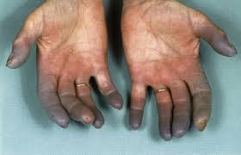
ARTERIAL INNERVATION AND RAYNAUD’S DISEASE
Raynaud’s disease is a vasospastic diseases involves digital arteries.
It may require cervicodorsal perganglionic sympathectomy to prevent necrosis of the fingers

Slide 66
Blood supply of the femoral head and avascular necrosis
Anastmosis between a small branch from obturator artery (run through the ligament of the head) and medial femoral circumflex artery (pierce the capsule and ascend the neck deep to the synovial membrane)

Slide 67
Blood supply of the femoral head and avascular necrosis
A vascular necrosis of the femoral head can occur after fracture of the neck of the femur
in adult fracture neck of the femur results in interfering with and interrupting the blood supply from the root of the femoral neck to the head
Blood supply along the ligament of the head my be insufficient to sustain viability of the head and necrosis gradually takes place.

Slide 68
Venous pump of the Lower Limb
The venae comitantes are subjected to intermittent pressure at rest and during exercise, and pulsation of the adjacent arteries;
helps the movement of blood up the limbs.
The superficial vein do not subjected to this presser
Valves in the perforating veins prevent escape of blood from the high presser deep system to the low presser superficial system.
With relaxation of the muscles within the compartment the venous blood is sucked from the superficial to the deep veins.

Slide 69
Varicose veins
Has a large diameter than normal , elongated and tortuous.
It is responsible for discomfort and pain.
Many causes include hereditary weakness of the veins wall and incompetent valves, elevated intra abdominal pressure, multiple pregnancies, and tumors

Slide 70
Varicose veins
Thrompophlepits of the deep veins so the superficial veins become the main venous pathway for the lower limbs
High presser venous blood escape from deep veins into the superficial veins due to incompetent perforators producing the varicosity.

Slide 71
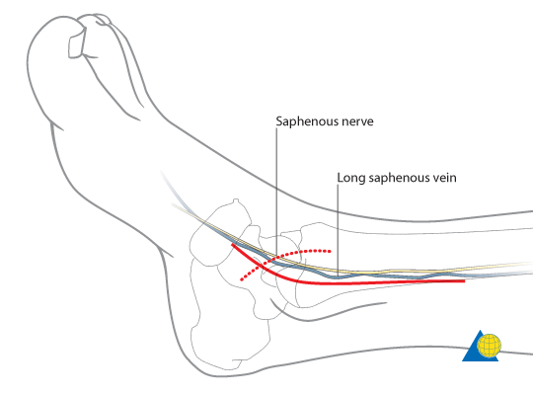
Great saphenous vein cut down
Exposure of the great saphenous vein for cut down at the ankle;
Skin in front of the medial malleolus is blocked by local anesthesia
Transverse incision across the long axis of the vein just anterior and superior to the medial malleolus.
Although it my be not visible it is constant

Slide 72
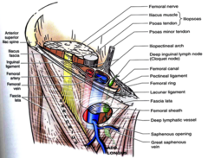
Great saphenous vein cut down
At the groin; The area of thigh skin below and lateral to scrotum or labia majus is blocked by local anesthetic.
Transverse incision 1.5 in 4 cm below (2 finger breadth) and lateral to the pubic tubercle
just medial to the femoral pulse if it is felt

Slide 73
Great saphenous vein
The coronary disease(grafting)
Bypass is done by inserting a graft of a portion of the Great saphenous vein

Slide 74
Anterior compartment syndrome
Produced by intracompartmintal tissue injury follow bone fracture
Early diagnosis is critical
Leg pain is exaggerated by dorsiflexion of the foot
Stretching of the muscles by passive planter flexion
Dorsalis peddis arterial pulse disappears

Slide 75
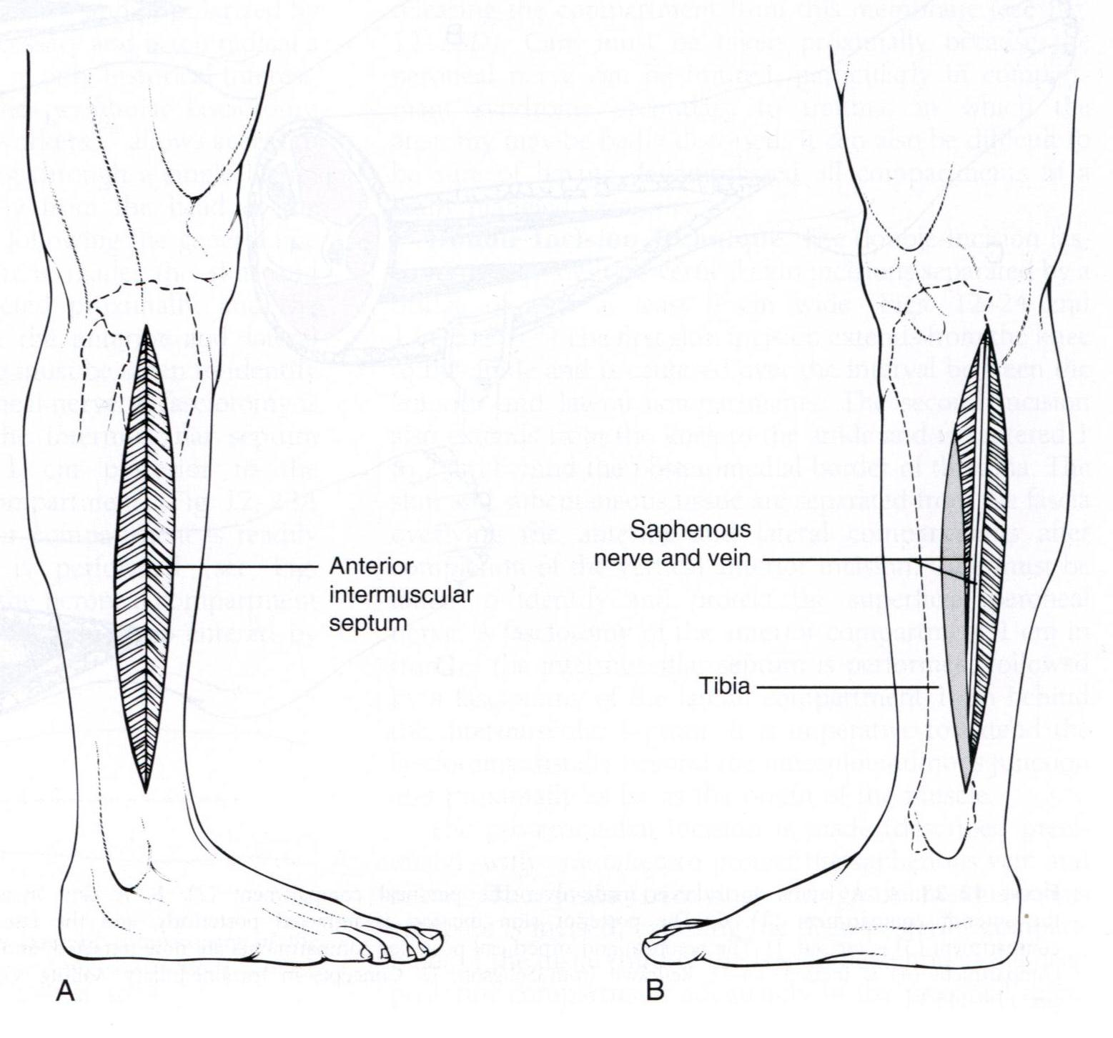
Anterior compartment syndrome
Anterior compartment muscle are paralyzed
Loss of sensation of the area supplied by the deep peroneal nerve.
Treatment;
Fasciotomy through longitudinal incision to decompress the area and prevent necrosis of muscles

Slide 76
Long distance air travel
Sit immobile for hours on long distance travel are prone to deep venous thrombosis.
My be a symptomatic or manifested by mild pain or tightness or tenderness in the calf muscles.
It is prevented by stretching of the legs every hour to improve the venous circulation

Slide 77
Arterial palpation of the lower limbs
Should know the precise position of the main arteries of the lower limbs.
To arrest a severe hemorrhage.
Palpate different parts of the arterial tree in arterial occlusive disease.

Slide 78
Arterial palpation of the lower limbs
Femoral artery; enters the thigh behind the inguinal ligament at a point mid way between the anterior superior iliac spine and the symphysis pubis, it is easily palpated or compressed against the pectineus muscle and the superior pubic ramus.
Popliteal artery; can be felt in depth of the popliteal fossa with relaxed deep fascia during passive flexion of the knee.

Slide 79
Arterial palpation of the lower limbs
Dorsalis pedis artery; midway between medial and lateral mallioli in front of the ankle joint firs interossias space between tendons of extensor hallucis longus and extensor digitorum longus.
Posterior tibial artery; behind medial malliolus, beneath flexor retinaculum between tendons of flexor digitorum longus flexor hallucis longus, midway between medial malliolus and the heel

Slide 80
Collateral circulation
Prevent necrosis or gangrene that may follow the arterial obstruction (Sudden occlusion).
Gradual occlusion as in atherosclerosis is less likely to be followed by necrosis
For the femoral artery cruciate and trochantric anastomosis
In the addauctor canal the perforating branches of prufunda femoris , articular and muscular branches of femoral and popliteal arteries

Slide 81
Arterial occlusive disease of the leg
More common in men; manifested by:
Ischemia of muscles produces cramp like pain with exercise, the supply to the calf muscles is inadequate , the patient is forced to stop walking after a limited distance
With rest the oxygen depletion is corrected and pain disappears this condition is known as intermittent claudication

Slide 82
Sympathetic innervation of the arteries
It develops from the lower thoracic and upper two or three lumber segments of the spinal cord
The preganglionic fibers pass to the lower thoracic and upper lumber ganglia via the white remi communicants.
Fibers synapse in the lumber and sacral ganglia
Postganglionic fibers reach blood vessel via lumber and sacral plexus.
Femoral artery receives its sympathetic supply from femoral and obturator nerves
The more distal arteries receives it sympathetic supply from common peronial and tibial nerves

Slide 83
Lumber sympathectomy and occlusive arterial disease
It is a form of treatment for occlusive arterial diseases of the lower limbs to improve the blood flow through the collateral circulation
Preganglionc sympathectomy is performed by removing the upper three lumber ganglia and the intervening parts of the sympathetic trunk

Slide 84
Thank you

