Slide 2
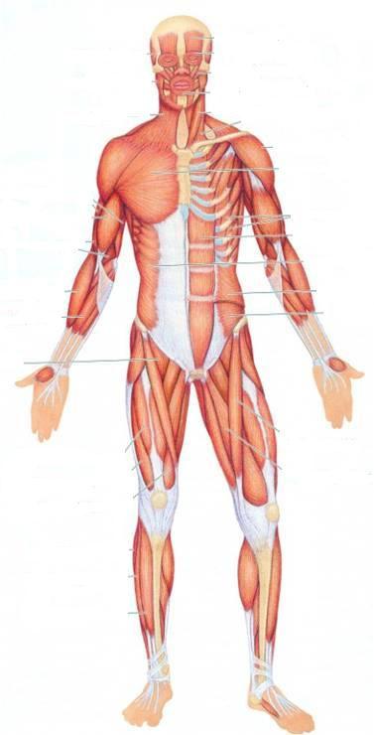
SKELETAL MUSCLES
Dr. Jamila EL Medany

Slide 3
OBJECTIVES
At the end of the lecture, students should be able to:
Describe the main criteria of skeletal muscles.
Describe the attachments of skeletal muscles.
Describe the different directions of skeletal muscle fibers.
Describe the mode of action of skeletal muscles.
Describe briefly the naming of skeletal muscles.
Describe briefly the nerve supply of skeletal muscles.

Slide 4
MUSCULAR SYSTEM
Composed of two main types :
1. Involuntary muscles:
(a) Smooth:
Found in the walls of viscera.
(b) Cardiac:
Found only in the Heart.
2. Voluntary (skeletal) muscles
SMOOTH
SKELETAL
CARDIAC

Slide 5
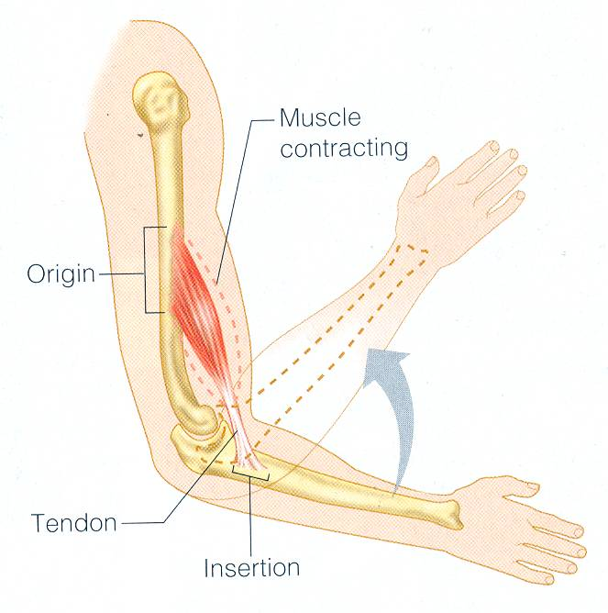
I
MAIN CRITERIA OF SKELTAL MUSCLES
Striated.
Attached to skeleton.
Produce movement of skeleton.
Voluntary
Supplied by Somatic Nerves.

Slide 6
The Direction of Muscle Fibers
The range of motion and the power of a muscle depends on the arrangement of its fascicles. It can be:
Circular
Convergent
Fusiform

Slide 7
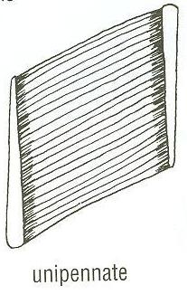
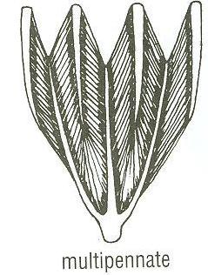
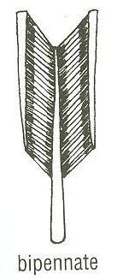
DIRECTION OF MUSCLE FIBERS
Parallel to line of pull: More range of movement, (less powerful).
Pennate (oblique to line of pull):
More powerful, (less range of movement.)
Unipennate.
Bipennate.
Multipennate.
parallel

Slide 8
Types of ATTACHMENT OF SKLETAL MUSCLES
Muscles are attached to bones, cartilage or ligaments through:
(1) Tendons :
cords of fibrous tissue.
(2) Aponeurosis :
A thin and strong sheet of fibrous tissue.
(3) Raphe :
An interdigitation of the tendinous ends of the flat muscles.

Slide 9
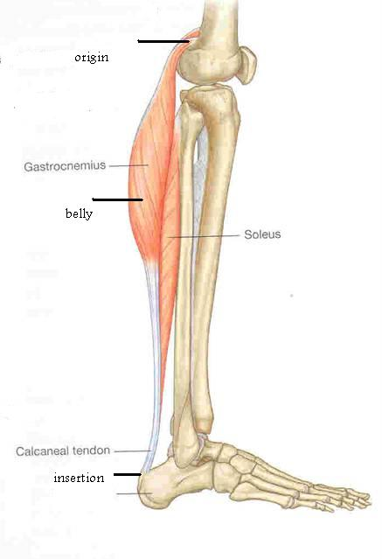
Differences between ATTACHMENTS
Number: (MOSTLY TWO)
ORIGIN | INSERTION
The Proximal end Mostly Fleshy, Least Movable, | The Distal end Mostly Fibrous, Most Movable,

Slide 10
MODE OF ACTION
(1) Prime mover (Agonist) :
It is the chief muscle responsible for a particular movement
Example:
Quadriceps Femoris is the prime mover for extension of the knee joint.

Slide 11
(2) Antagonist :
It opposes the action of the prime mover.
Before contraction of prime mover, the antagonist must be relaxed.
Example: Biceps Femoris (Flexor of knee)
It opposes the action of quadriceps when the knee joint is extended.

Slide 12
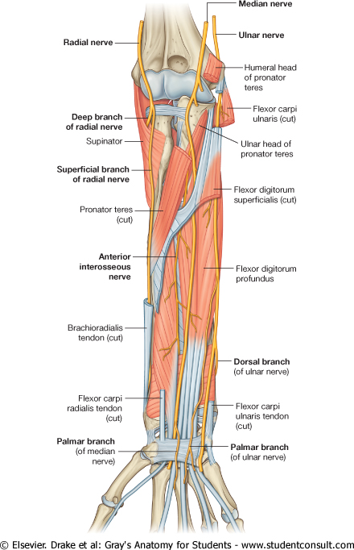
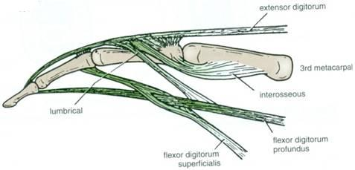
(3) Synergist :
Prevents unwanted movement in an intermediate joint crossed by the Prime Mover.
Example:
Flexors and Extensors of wrist joint
They contract to fix wrist joint in order that flexors and extensors of fingers work efficiently.

Slide 13
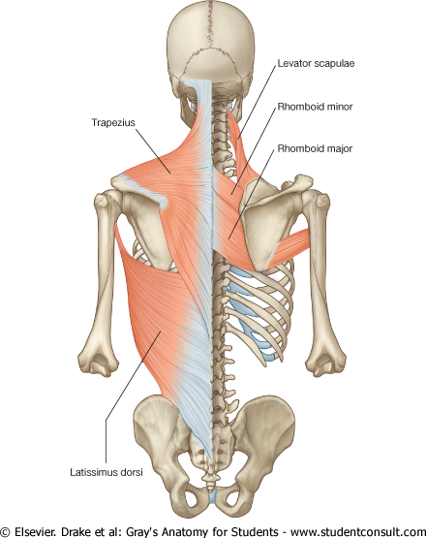
(4) Fixator :
Its contraction does not produce movement by itself but it stabilizes the origin of the prime mover so that it can act efficiently.
Example:
Muscles attaching the shoulder girdle to the trunk contract to fix shoulder girdle, allowing deltoid muscle (taking origin from shoulder girdle) to move shoulder joint (humerus).

Slide 14
NAMING OF MUSCLES
It is according to:
1. Size:
Major or maximus (large).
Minor or minimus (small).
Latissimus (broad).
Longus (long).
Brevis (short).
2. Position:
Pectoralis (pectoral region)
3. Depth:
Superficialis (superficial).
Profundus (deep).
Externus (external).

Slide 15
4. Shape:
Deltoid (triangular).
Teres (rounded)
Rectus (straight).
5. Number of Heads:
Biceps (2 heads).
Triceps (3 heads).
Quadriceps (4 heads).
6. Attachments:
Coracobrachialis (from coracoid process to arm).
7. Action:
Flexor digitorum: flexion of digits.

Slide 16
NERVE SUPPLY of Skeletal Muscles
The nerves supplying the skeletal muscles are Mixed:
60% are Motor.
40% are Sensory.
It has some Autonomic fibers (Sympathetic) for its blood vessels.
The nerve enters the muscle at about the middle point of its deep surface.

Slide 17
SUMMARY
Skeletal muscles are striated, voluntary muscles attached to & move the skeleton.
They have 2 attachments: origin & insertion.
Their fibers may be parallel or oblique (pennate) to the line of pull.
According to mode of action, they are classified as: prime mover, antagonist, synergist or fixator.
They may be named according to: size, shape, number of heads, position, attachments, depth or action.
They are supplied by a mixed somaticnerve.

Slide 18
THANK YOU

