Slide 1
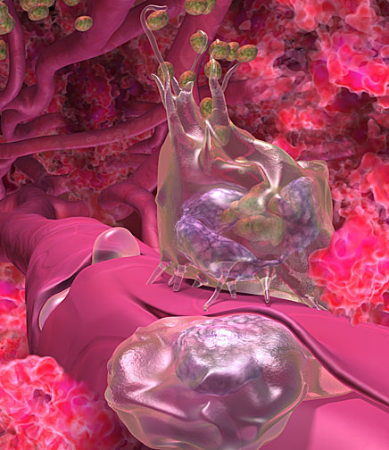
Introduction to Immunology & Lymphoid System
Immunology Unit
Department of Pathology
College of Medicine
KSU

Slide 2
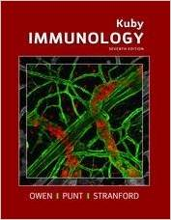
Reference
Kuby Immunology 7th Edition 2013
Chapter 1 Pages 1-22 & Chapter 2 Pages 27-57

Slide 3
Objectives
To know the historical perspective of immunology
To be familiar with the basic terminology and definitions of immunology
To recognize immune response cells
To understand types of immune responses
To know about the lymphoid system
To understand T and B cell functions

Slide 4
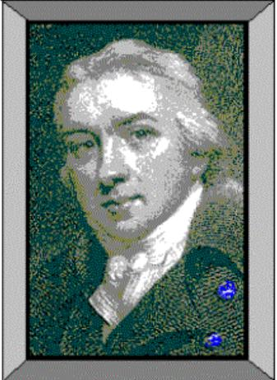
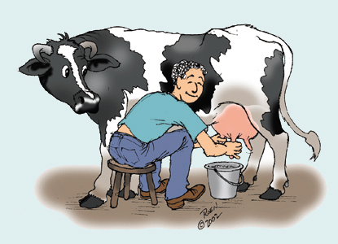
1798 Edward Jenner
Observation:
Milkmaids who contracted
cowpox (a mild disease)
were subsequently immune
to small pox

Slide 5
SCARRING BUMPS, BLINDNESS, LIMB DEFORMITIES

Slide 6
1798 Edward Jenner
Profound results:
Jenner’s technique of inoculating with
cowpox to protect against small pox
spread quickly throughout Europe.
(2) Began the science of Immunology,
the study of the body’s response
to foreign substances.

Slide 7
Louis Pasteur’s Contributions
Determined through studies of cholera in chickens that the virulence of a pathogen weakens with age (chickens inoculated with old strains not only survive but become resistant)
Attenuated – weakened, non-virulent strain whose exposure can confer resistance to disease
Classical experiment
Heat attenuated anthrax bacillus and subsequent challenge with virulent Bacillus anthracis in sheep

Slide 8
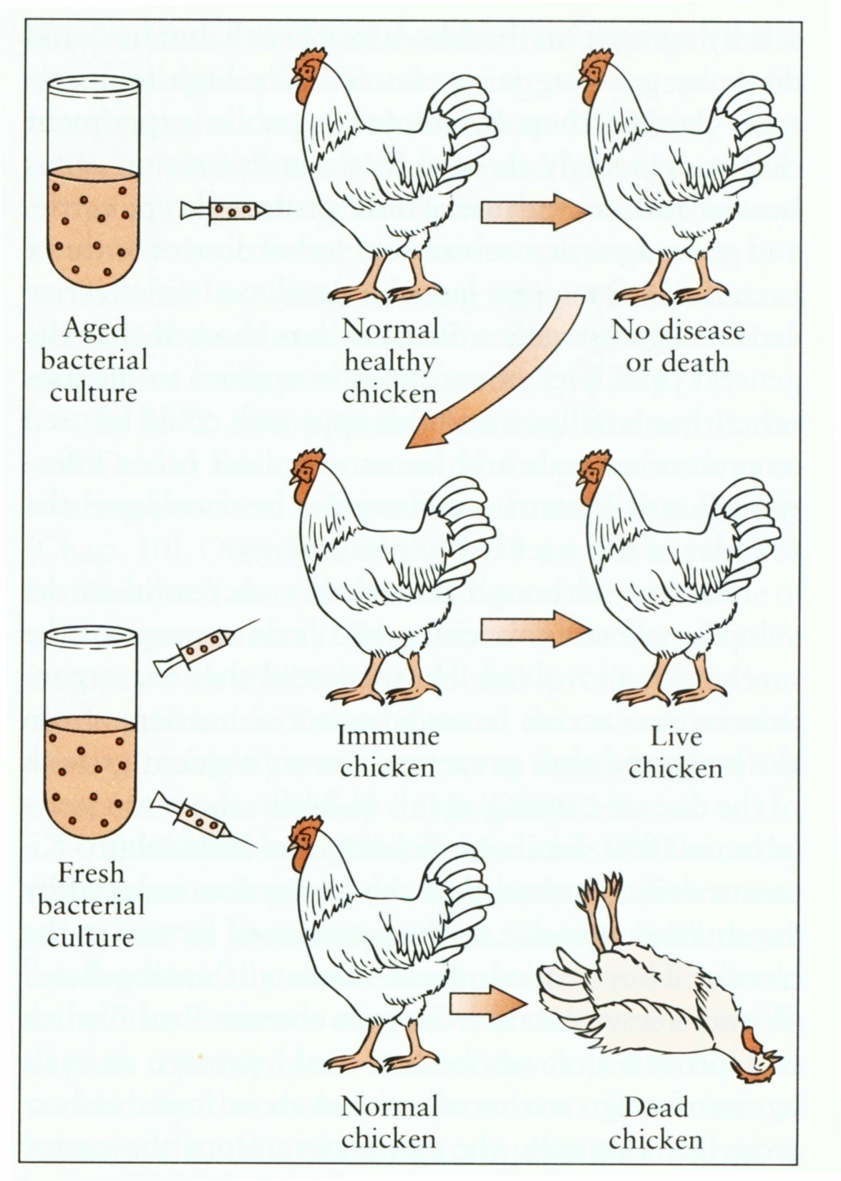
Louis Pasteur
Observation:
Cholera

Slide 9
What is immunology?
Immune (Latin- “immunus”)
To be free, exempt
People survived ravages of epidemic diseases when faced with the same disease again
Immunity: The state of protection from infectious disease
The study of mechanisms that humans and other animals use to defend their bodies from invading organisms such as bacteria, viruses, fungi, parasites and toxins

Slide 10
Definitions
(CD) Cluster of Differentiation: molecule with a CD designation is a characteristic cell surface protein often associated with the cell’s function.

Slide 11
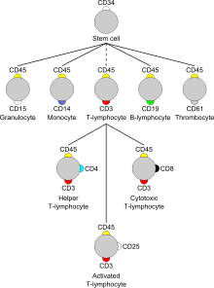
Cellular Markers (CD)

Slide 12
Definitions
Antigen (Ag): any substance (usually foreign) that binds specifically to a component of the adaptive immunity.
Allergen: noninfectious antigens that induce hypersensitivity reactions, most commonly IgE-mediated type I reactions.

Slide 13
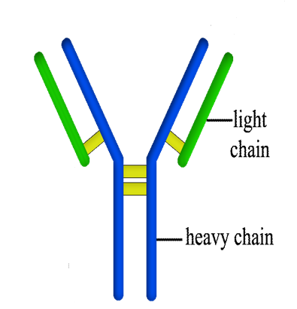
Definitions
Immunoglobulin (Ig) or Antibodies:
- Secreted from plasma cell (B cell)
- Consists of a heavy and light polypeptide chains linked to each other via disulfide bonds.

Slide 14
Definitions
Adaptive Immunity: Specific host defenses that are mediated by T & B cells following exposure to Ag.
Innate immunity: Nonspecific host defenses that exist prior to exposure to Ag.
Pathogen: a disease causing organism
Vaccination: deliberate induction of protective immunity to a pathogen

Slide 15
Where & what are antigens?
- Microorganisms & their related products
(proteins, polysaccharides, lipids)
- Environmental substances
- Drugs
- Organs, tissues, cells

Slide 17
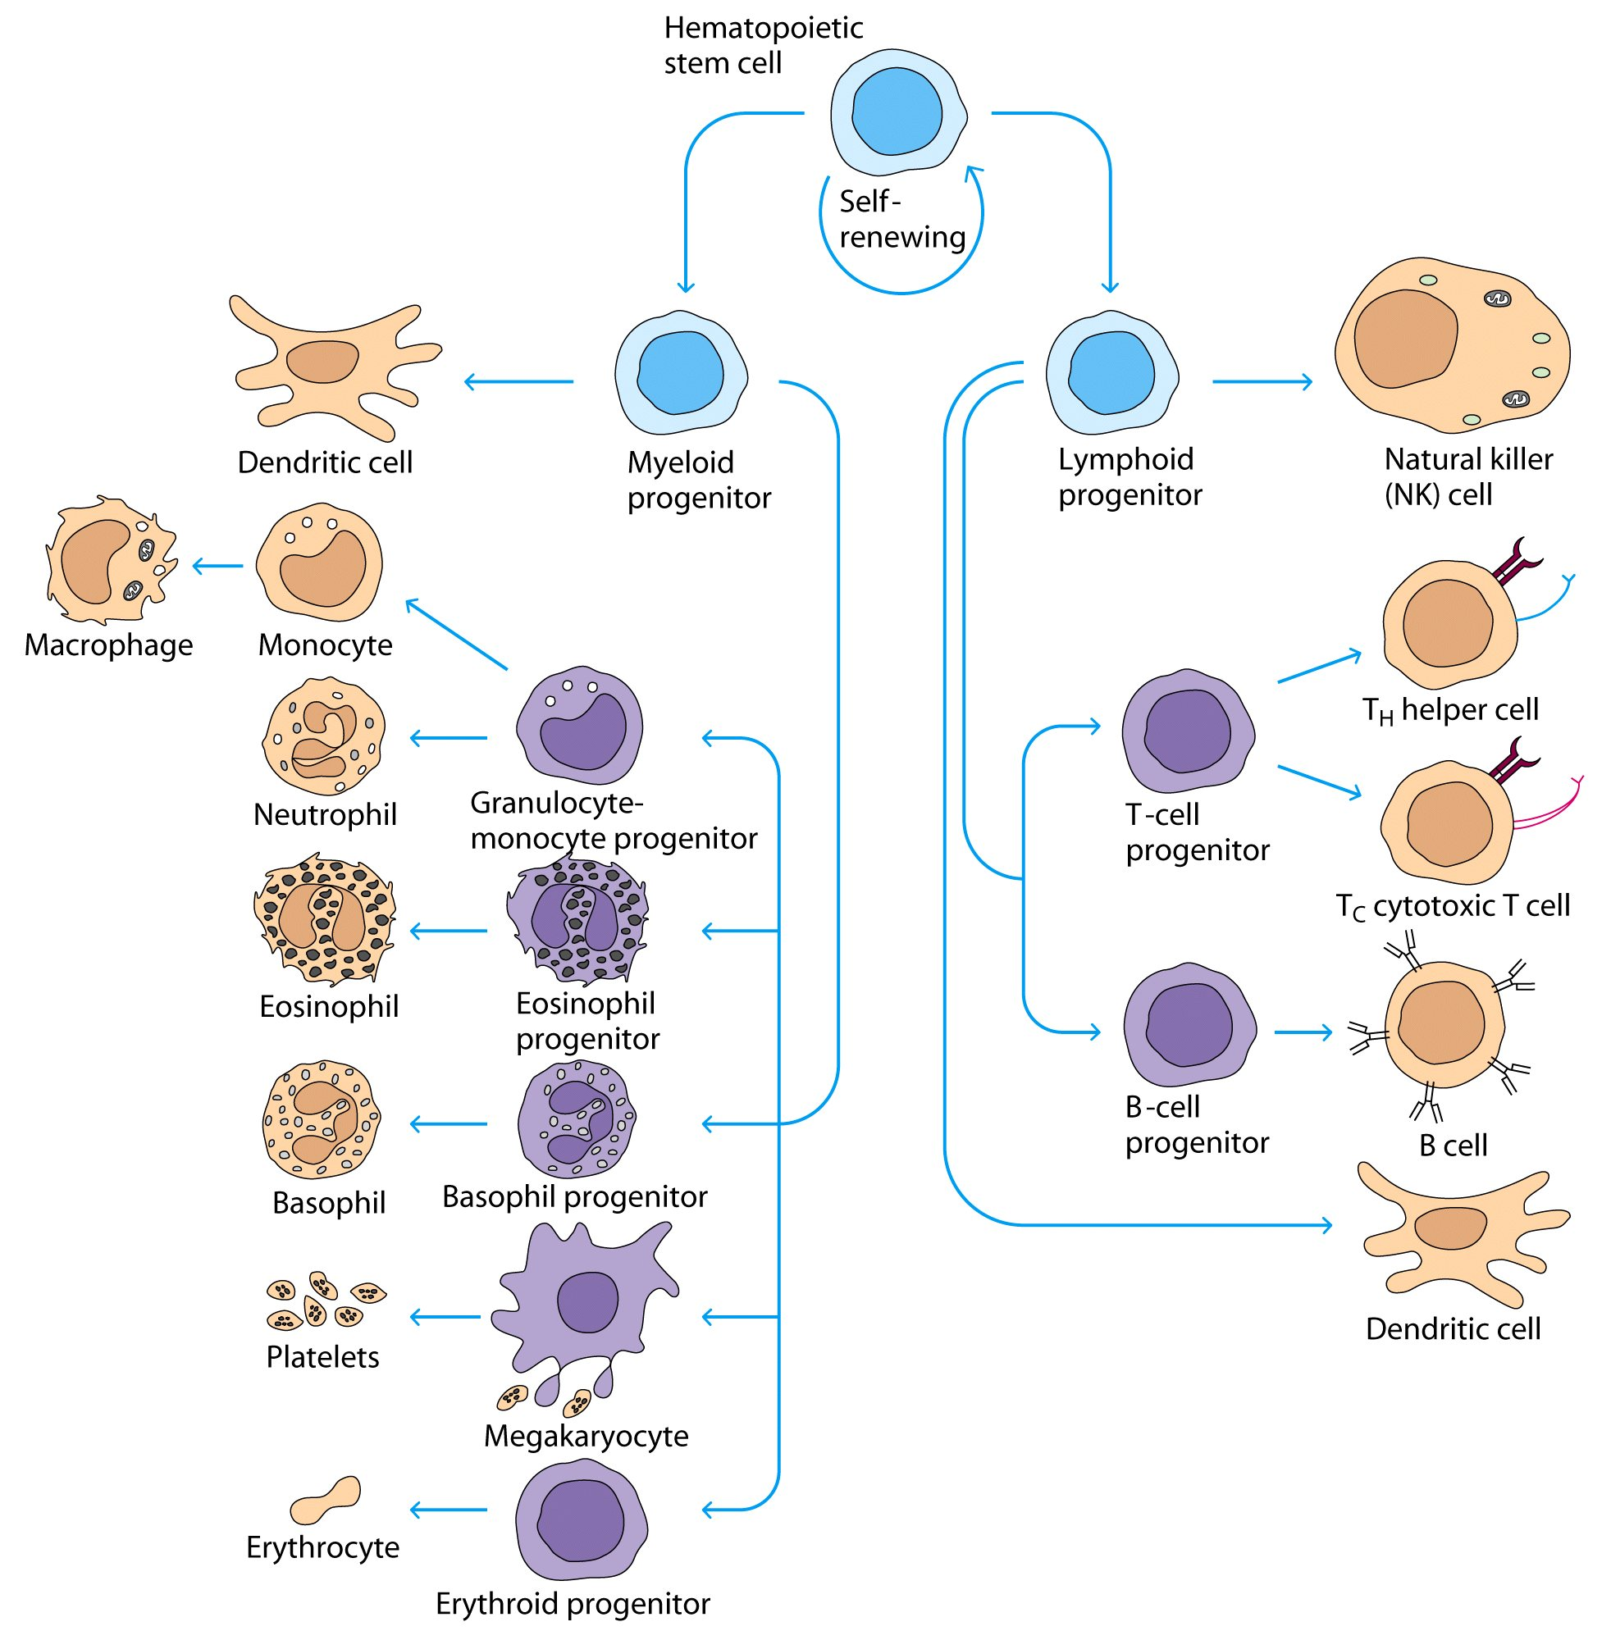

Slide 18
Antigen Presenting Cells
Responding Cells
CD3 Positive T Lymphocyte
T helper lymphocyte (CD4)
T cytotoxic lymphocyte (CD8)
Natural Killer Cell
B lymphocyte
Th1 (CD4)
Th2 (CD4)

Slide 19
Types of Immunity
Innate (nonspecific) Immunity
Shorter duration
No memory
Adaptive (specific) Immunity
Response of a specific B and T lymphocytes to an antigen
Exhibit immunological memory, specificity and self/nonself recognition

Slide 20
Adaptive Immunity
Humoral immunity
Immunity that is mediated by antibodies (B cells)
Cell Mediated Immunity
Immune response in which antigen specific T cells dominate

Slide 21
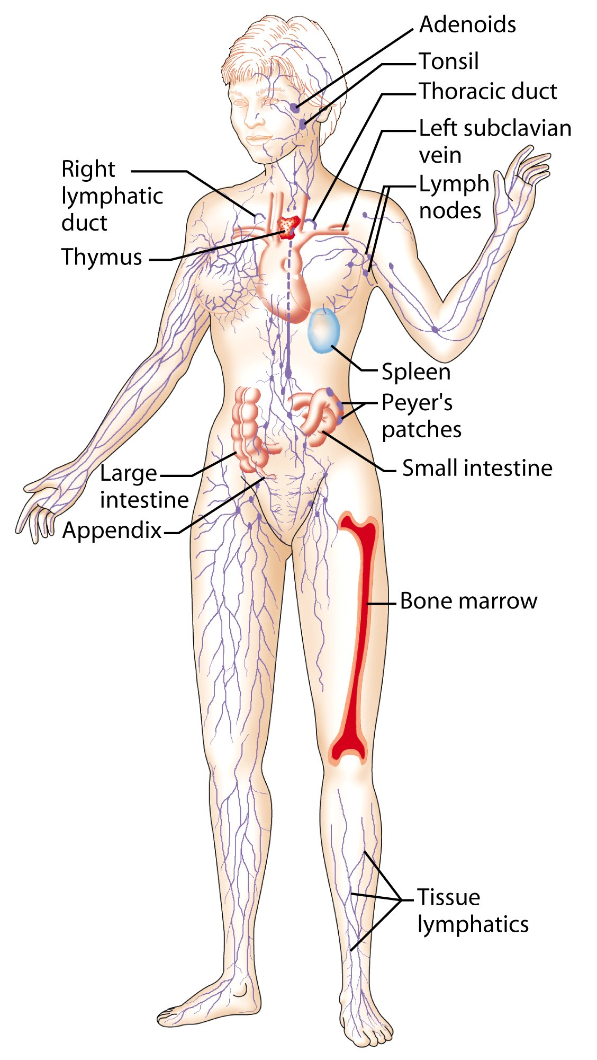
Lymphoid System
Lymphatic vessels and lymphoid organs

Slide 22
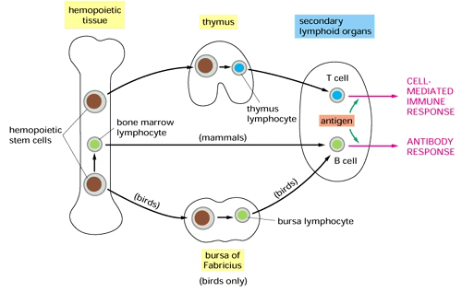
Primary Lymphoid Organs
(Development & Differentiation of immune cells)

Slide 23
Secondary Lymphoid Organs
(where the immune response occurs)
Spleen
Lymph nodes
Tonsils
MALT (Mucosa Associated Lymphoid Tissue)
Peyer’s patches
Appendix

Slide 24
Lymphoid series comprise of two main lymphocyte populations
T cells and B cells

Slide 25
T-Lymphocyte Differentiation
T cells originate in Bone Marrow then migrate to Thymus for development.
T cell precursors differentiate into mature T cells in thymus
Stem cells lack antigen receptors and CD3, CD4, CD8 surface markers
During their passage through thymus they differentiate into T cells expressing either markers (CD4 or CD8)

Slide 26
T-Lymphocytes
All T cells have CD3 proteins on their cell surface
Mature T cells have either CD4 or CD8 proteins but not both

Slide 27
Functions of T Helper Lymphocytes
CD4 Lymphocytes (T helper 1 and 2: Th1 and Th2)
Functions
Help B cells to develop into antibody producing plasma cells (Th2)
Help CD8 cells to become activated cytotoxic T cells (Th1)
Help macrophages in cell mediated immunity (Th1) during inflammatory response.

Slide 28
CD8 positive cells
Cytotoxic T Cells
About 35% of peripheral blood T cells
Perform cytotoxic functions
They kill virus-infected cells, tumors and allograft cells (transplant)

Slide 29
B cells
Origin
During embryogenesis – fetal liver
Migrate to bone marrow – final destination
They do not require thymus for maturation

Slide 30
B cells
B cell progenitors like Pro B cells, Pre B cells and immature B cells are found in bone marrow and mature B cells are found circulating in body fluids (blood, lymphatic fluid….etc.)
Mature B cells display surface IgM and IgD which serves as antigen receptor

Slide 31
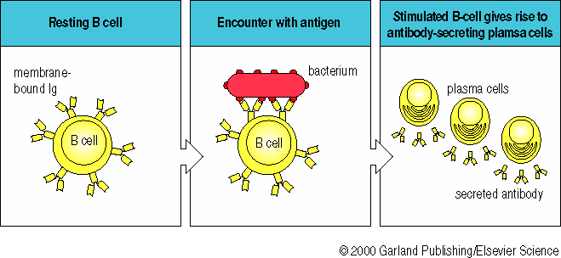
The Antibodies

Slide 32
Antibodies are also called Immunoglobulins
Immunoglobulins (Ig) are grouped into 5 classes:
IgG
IgM
IgA
IgD
IgE
Ig are glycoproteins
They differ in size, amount of CHO and biologic functions after binding to specific antigens

Slide 33
Take home message
Normal healthy state is maintained by intact immune response either innate (natural immunity) and/or adaptive (acquired immunity after exposure to antigens)
Cell mediated immunity and humoral immunity is mediated by T and B lymphocytes respectively
Lymphoid system provides suitable environment for development, maturation and proper functioning of cells of immune system

