Slide 1
Hypersensitivity Reactions
Immunology Unit
Department of Pathology
College of Medicine
King Saud University

Slide 2
Reference
Kuby Immunology 7th Edition 2013
Chapter 15 Pages 485-510

Slide 3
Objectives
To know that hypersensitivity reactions are over and excessive immune responses that can be harmful to body in four different ways
To be familiar with inflammatory processes in Type I hypersensitivity reaction that mediates allergic inflammation
To recognize that Type II hypersensitivity deals with immune responses against antigens that are integral part of cell membrane and are usually associated with autoimmune disorders
To know that Type III hypersensitivity reactions are mediated by immune complexes and cause vasculitis
To describe Type IV hypersensitivity is a purely cell mediated immune response associated with chronic inflammation

Slide 4
What is hypersensitivity?
Protective immunity: desirable reaction
Hypersensitivity: undesirable reaction
Undesirable responses can be mediated by
Antibody binding to antigens (Types I-III)
Cell mediated reaction to chemicals or proteins
(Type IV)

Slide 5
Gel and Coombs Classification
Type I: IgE Ab
Type IV: Cell Mediated Immunity
Type II: IgG Ab to tissue antigens
Type III: IgG Immune Complexes

Slide 6
Type I: Immediate Hypersensitivity
Most people will not react to these allergens but some individuals “atopic” respond by producing large amounts of IgE in response to those otherwise harmless substances
Non-allergic individuals respond to these allergens by producing IgG antibodies

Slide 7
Type I Hypersensitivity
Also termed as:
Immediate Hypersensitivity
Allergic reactions
Anaphylactic reactions are severe and rapidly progressing systemic forms which can be quickly life threatening
(Occurs within minutes to hours)

Slide 8
Features
Antibody type: IgE
- Cellular components:
Mast cells, basophiles & eosinophils
- Antigens:
Also known as allergens
(antigens with low molecular weight & highly soluble)

Slide 9
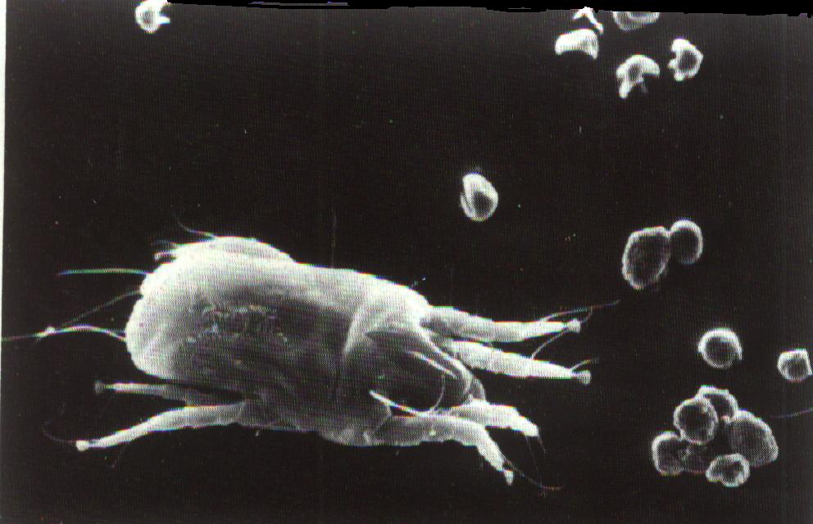
Allergens
Some of the allergens involved in type I hypersensitivity are: pollens, dust mite allergens, animal dander, nuts, shellfish, various drugs etc

Slide 10
Type I Reaction occur in 2 phases:
Type I reactions occur in two phases
- Sensitization phase
First contact with allergens
- Challenge phase
Subsequent contact with allergens
Phase I :
- Sensitization phase .
Allergen enter tissues , induce an
immune response . B – cells transform
to plasma cells & produce IgE.
- IgE bind to receptors on Mast cells and
basophiles ( F c ЄRI - high affinity receptors).
individuals become :
“ Sensitized . “
Phase I :
- Sensitization phase .
Allergen enter tissues , induce an
immune response . B – cells transform
to plasma cells & produce IgE.
- IgE bind to receptors on Mast cells and
basophiles ( F c ЄRI - high affinity receptors).
individuals become :
“ Sensitized . “

Slide 11
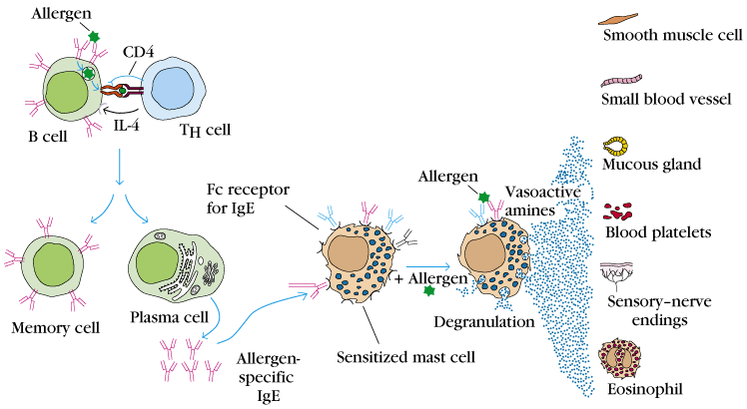
Type I Hypersensitivity (Immediate)
Sensitization
Challenge

Slide 12
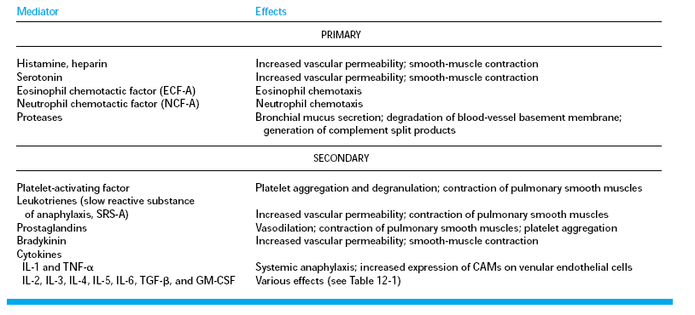
Primary and Secondary Mediators

Slide 13
Allergy is a systemic disorder
Nose
Pharynx
Allergic rhinitis
Asthma
Lungs
Esophagus
Food allergy
Stomach
Skin
Eczema
Urticaria
Allergic dermatitis

Slide 14
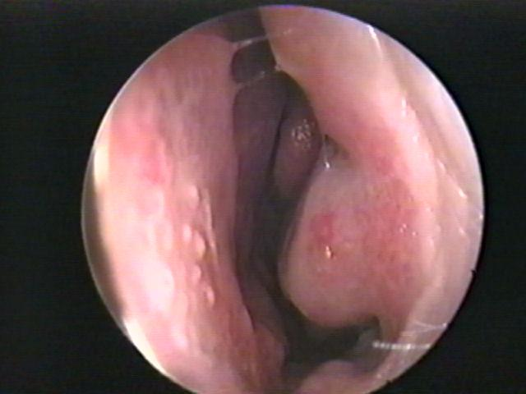
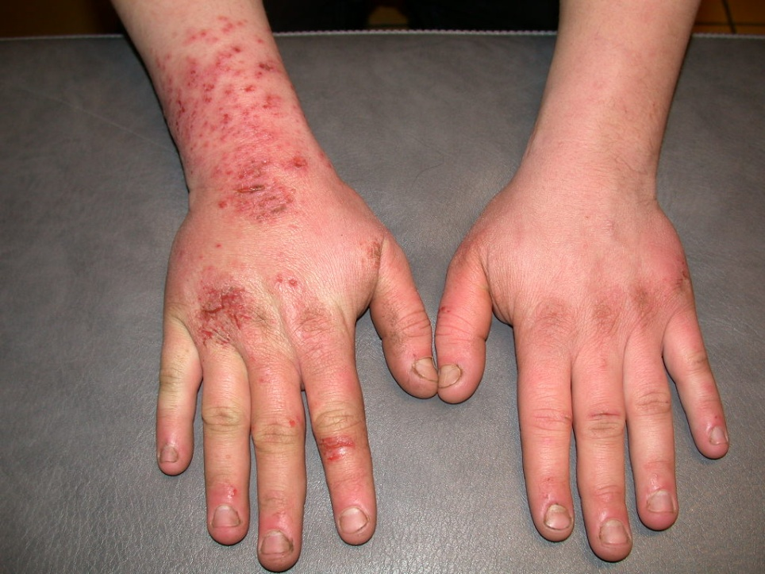
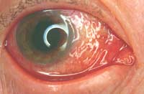
Allergy: Rhinitis, Eczema & Conjunctivitis
Normal nose

Slide 15
* Injected allergens:
Hymenoptera (bees, wasps, ants) sting venom enters the blood stream
→ Systemic inflammation
→ Anaphylactic shock
(life - threatening)
Anaphylactoid reactions:-
Are non - IgE mediated
may result from contrast media or
local anesthetics

Slide 16
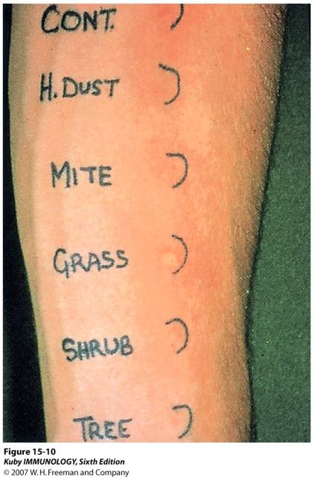
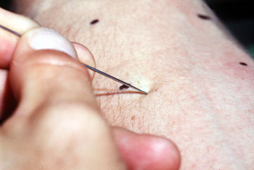
Diagnosis of Allergy
Skin Prick test
1. Skin prick test (SPT)
2. Specific IgE measurement (RAST)
3. Elimination / Provocation test (Food allergy)

Slide 17
Type II Hypersensitivity Reactions
Features:-
- IgG (or IgM)
- Antigens: bound to cell membranes
(Self antigens) - Exogenous antigens
(microbial)
- Complement activation (Invariable)

Slide 18
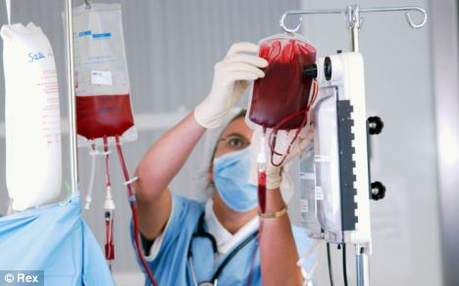
Clinical examples:
Glomerulonephritis (anti-glomerular basement membrane)
Mis-matched blood transfusion

Slide 19
Diagnosis
- Detection of antibodies and antigens by Immunofluoresence in tissue biopsy specimens e.g. kidney, skin etc.

Slide 20
Type III: Immune complex hypersensitivity
When an antigen reacts with an antibody the product they form is called an immune complex which is capable of inducing an inflammatory response
Immune complexes are deposited in tissues like kidneys (nephritis), joints (arthritis) or blood vessels (vasculitis)

Slide 21
Type III Hypersensitivity (immune–complex mediated)
Features
Antibody (IgG/ or IgM) + Antigen (soluble)
- Immune – Complex formation
- Complement activation
- Attraction of inflammatory cells

Slide 22
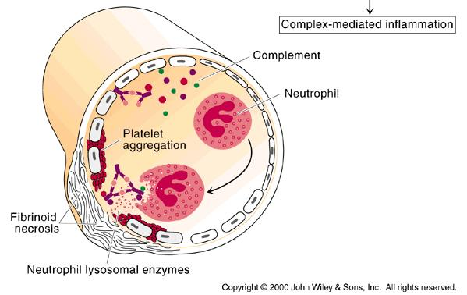
Type III Reactions

Slide 23
Type III Hypers. Reactions Clinical examples:
Glomerulonephritis: Rheumatoid arthritis, SLE

Slide 24
Diagnosis of Type III Hypers. Reactions
Demonstration of specific immune complexes in the blood or tissues by:
Immunofluoresence

Slide 25
Type IV hypersensitivity reactions (Delayed Hypersensitivity)
Features
Cell mediated immune response
Antigen dependent T cell (CD4 generally and CD8 occasionally) activation via MHC Class I or II
Activated macrophages
Delayed onset (2-4 days)
Abnormal cellular response
(Granuloma formation)

Slide 26
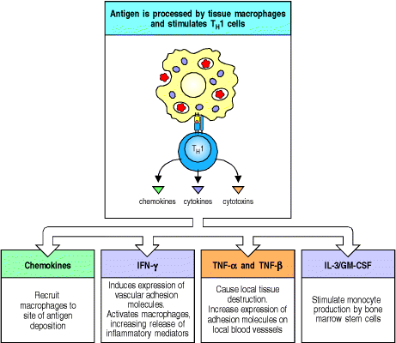
Mediators released by T_{DTH} cells

Slide 27
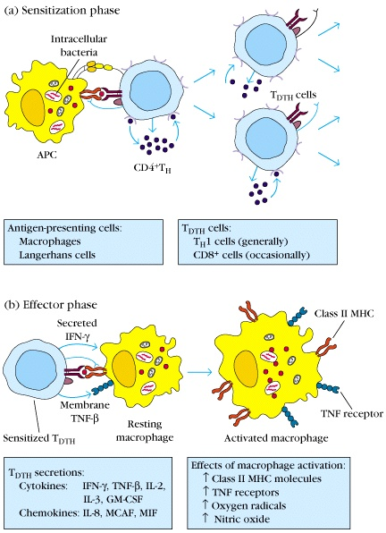
Development of DTH Response
Sensitization phase:
1-2 week period
Effector phase:
24-72 hours
Effector cells
(activated macs)
act non-specifically

Slide 28
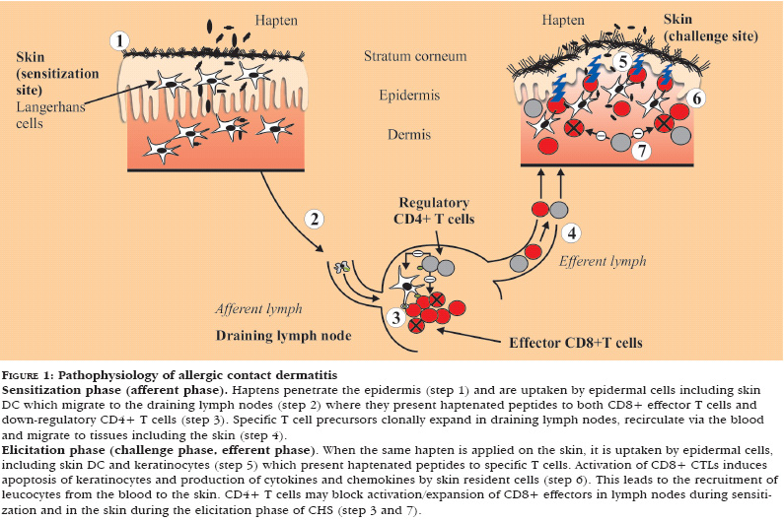
Pathophysiology of Contact dermatitis.

Slide 29
Type IV clinical examples:
Contact dermatitis
TB granuloma
(persistent antigen)

Slide 30
Diagnosis (Type IV)
1. Delayed skin test (Mantoux test)
2. Patch test (Contact dermatitis)
3. Lymphocyte transformation test

Slide 31
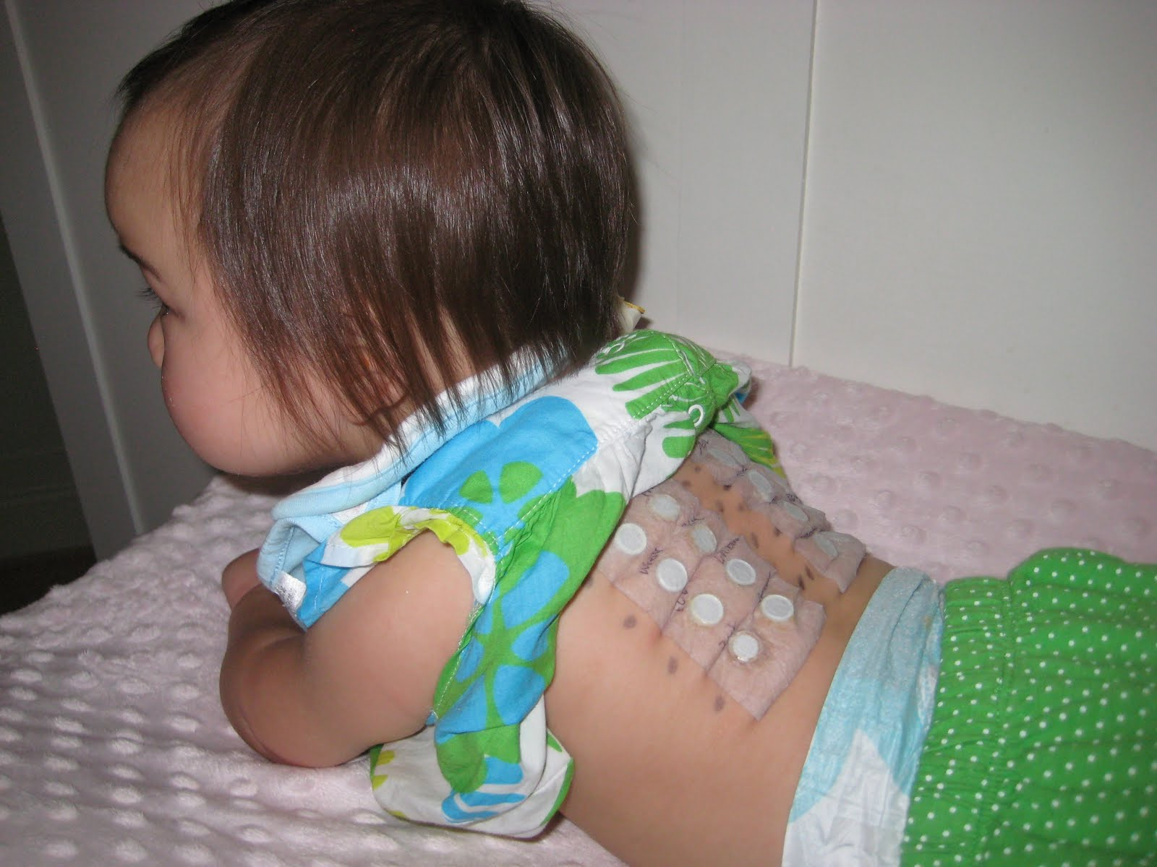
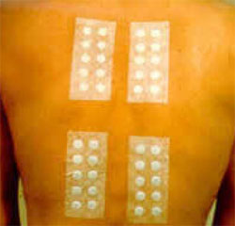
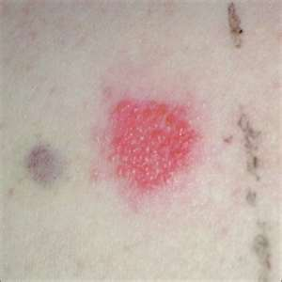
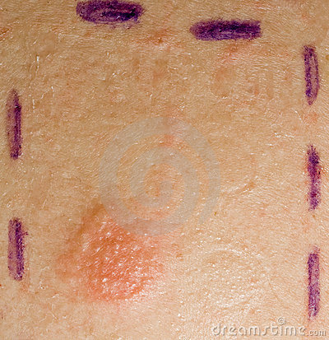
Skin Patch Test

Slide 32
Take Home Message
1. Type I (IgE), II (IgG) and III (IgG) hypersensitivity reactions are mediated by antibodies whereas Type IV hypersensitivity reaction is a cell mediated immune response.
2. Hypersensitivity reactions are undesirable, excessive, and aberrant immune responses associated with disorders such as allergy, autoimmunity and chronic inflammation.

