Slide 1
Basic Principles & Concepts in Learning (Learning how to learn)
Centre for Assessment & Evaluation
Dept. of Medical Education,
College of Medicine, KSU

Slide 2
Overview
What is Learning?
How is undergraduate learning different?
How to learn deeply and actively?
What is your learning style?
How to promote reflective learning?

Slide 3
Learning:
The process of acquisition of new knowledge, skills, attitudes, values, behaviours, preferences, understanding
It is not only knowledge
It is, however, not mere acquisition, but construction of meaning
Learner should be able to demonstrate such new learning

Slide 4
TEACHING & LEARNING
Teacher:
A teacher is anyone who affects the environment so that others learn.
(By this definition we don't even have to have a teacher!)
Learning: A process that leads to change, which occurs as a results of experience and increases potential for future performance.

Slide 5
Definitions: Learning is:
“a persisting change in human performance or performance potential . . . (brought) about as a result of the learner’s interaction with the environment”
(Driscoll, 1994).

Slide 6
Definitions: Learning is:
2.“the relatively permanent change in a person’s knowledge or behavior due to experience” (Mayer, 1982, p. 1040).
3. “an enduring change in behavior, or in the capacity to behave in a given fashion, which results from practice or other forms of experience” (Shuell, 1986, p. 412).

Slide 7
Study: a definition
“ Reading with a purpose i.E to obtain specific answers to specific questions”
Ailan Moran

Slide 8
When Learning take place?
Learning occurs as a result of the activity in which the learner not the teacher, engages.

Slide 9
Adults Learning Principles
Effective & Safe learning climate
Learners to be Involved in:
diagnosing their learning needs
Planning the learning
Identify learning resources
Evaluate their learning

Slide 10
How is
learning & studying as
an undergraduate (Adults)
different to
learning & studying as
a secondary school student (Adolescent) ?

Slide 11
How different is adult learning?
 | Adolescent learning | Adult learning
Sources
Orientation
Goals
Type of learning
Methods
Assessment
Mainly from teachers
Not only from teachers. Books, internet, peers are also very important
More knowledge oriented
Not only knowledge. In a professional course there are skills, attitudes, behaviours
To pass an exam
Not only to pass an exam, but mainly to train for a profession
Passive & superficial mostly
Active and deep learning. Learning needs to be with you for a lifetime
Mainly books and teacher’s notes
Lectures, small group discussions, computer assisted learning, library, internet, clinical skills sessions, laboratory
Written exams
Written exams, practicals, vivas (oral exams), clinical exams (e.g. OSCE), Workplace exams

Slide 12
Why are these differences in learning?
We consider you as adult learners
The need to know — adult learners need to know why they need to learn something before undertaking to learn it
Learner self-concept — need to be responsible for their own decisions
Role of learners' experience — have a variety of experiences of life - the richest resource for learning
Readiness to learn — are ready to learn those things they need to know in order to cope effectively with life situations
Orientation to learning — are motivated to learn to the extent that they perceive that it will help them perform tasks they confront in their life situations.

Slide 13
If adult learning is to be achieved…...
Learning has to be deep and active learning as opposed to superficial and passive learning
Why is deep/active learning important?
Superficial learning is easily and very quickly forgotten
With superficial learning you will not be able to apply or use it in practical situations
Deep learning accommodates varying learning styles

Slide 14
How can deep /active learning be achieved?
Do not be a passive receiver of information. Try to interact with information and try to apply it and try to do different things with that information.

Slide 15
Active versus passive learning
What is passive learning (teacher-centred)?
Memorizing without understanding.
Do not promote passive reception of information.
What is active learning (student-centred)?
Learning in a way that promotes understanding.
Try to promote interaction with information; i.e. by encouraging applying it, and doing different things with that information.

Slide 16
What do we remember?
20% of what we read
30% of what we hear
40% of what we see
50% of what we say
60% of what we do
90% of what we read, hear, see, say and do

Slide 17
Learn actively and deeply
Don’t just read and close the book
Try to do different things with what you have read immediately after writing
draw flow charts
draw diagrams using colour
write a summary
attempt answering pass papers
In short, interact with what you have learned

Slide 18
How to shift information from short term to long term memory?
1. Learn actively & deeply
2. Revisit, repeat & revise
Important points about revisiting & revision
There is no special place of time to revise.
Try to revisit and repeat at every given opportunity.
Do not wait until you finish studying to revise.

Slide 19
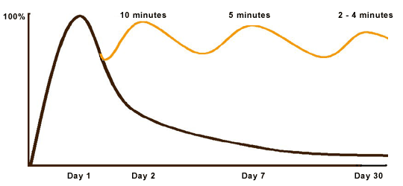
Forgetting curve

Slide 20
Why there is different in Learning from one person to Other??

Slide 21
Learning styles I
Visual learner
Auditory learner
Reading/writing
Kinaesthetic learner

Slide 22
Learning styles II
Thinkers
Reflector
Theorist
Activist
Pragmatist
Action-oriented

Slide 23
Your learning style =
How you perceive information
+
How you process information

Slide 24
WHAT IS LEARING STYLES?
The way in which each individual learner begins to concentrate on, process, absorb, and retain new and difficult information.
Learning styles are the most important tool for us when we construct knowledge.
The right way of studying does not exist.
Everybody learns in his individual way, but without knowing this way, you can’t learn efficiently – sometimes you can’t learn at all. SO
Learning styles are strategies or regular mental behaviors that are habitually applied by an individual to learning.

Slide 25
Classical classification of Learning styles:
Visual (prefer to learn by seeing)
Auditory (prefer to learn by sound)
Kinesthetic (prefer to learn by doing)
Verbal (linguistic) learning style
Logical (mathematical) learning style
Social (interpersonal) learning style

Slide 26
Visual style:
* Characteristics
– prefer to see the information
- like reading text
– memorizes by writing repeatedly
– when inactive, doodles, looks around
*Enhancing
– Visualization-imagine
– Visual prompts
– Concept maps
- visual representation of information-posters etc

Slide 27
Auditory style:
* Characteristics
– like to listen to teacher
– talks fluently and logically
– memorizes by repeating words aloud
– inactivity leads to talking to self or others
* Enhancing
– active listening
– rhyme and rhythm-mnemonics
– imagine you can hear …

Slide 28
Kinesthetic
* Characteristics
– hands on
– talks about actions, speaks more slowly
– inactivity leads to fidgeting
– distracted by physical disturbance
* Enhancing
– use objects that can be manipulated
– acting out
– body language and physical movements

Slide 29
The verbal (linguistic)style:
- Involves both the written and spoken word.
- Express both in writing and verbally.
- love reading and writing.
- Know the meaning of many words
- The temporal and frontal lobes drive this style.

Slide 30
The logical (mathematical) style:
using brain for logical and mathematical reasoning. classify and group information to learn or understand
Work well with numbers and perform complex calculations.
Work through problems and issues in a systematic way
- The parietal lobes, especially the left side, drive our logical thinking.

Slide 31
The social (interpersonal) style:
Communication well with people, both verbally and non-verbally.
listen well and understand other’s views.
Prefer learning in groups
prefer to stay around and talk with others.
- The frontal and temporal lobes handle much of our social activities

Slide 32
Perceptual Elements of style
Auditory
Learners
Visual Picture
Learners
Visual Text
Learners
Tactile and/or Kinesthetic
Learners
Verbal
Learners
Remember best when they LISTEN to a lecture, a presentation, or an audiotape.
Remember best when they SEE (create) mental images of what they hear or read.
Remember best when they READ the written word (textbooks, memos, and e-mail messages).
Remember best by DOING rather than sitting and listening, reading, or thinking about the information.
Remember best when they DISCUSS with others the new and complex information they are learning.

Slide 33
How can you learn from learning experiences (both academic & non-academic)?
By active reflection
What is reflection?
Reflection is purposeful and systematic revisiting of a learning experience with a view to learning
What is a learning experience?
Any incident that you either participate in or see/hear

Slide 34
Reflection - cyclical process
- many ways
Kolb’s cycle
Concrete experience
Reflective observation
Future planning
Abstract conceptualisation

Slide 35
Reflective cycle: a simplified version
1. What is the learning event?
2. What did I learn?
3. What more do I have to learn?
4. How can I learn it?
5. Evidence for further learning / change of practice?

Slide 36
Reflection
Evidence for learning / change of practice
Concrete experience
What is the event?
Reflective observation
Future planning
How can I learn?
What did I learn?
What more do I have to learn?
Abstract conceptualisation

Slide 37
Why should you participate in other non-academic activities?
They provide a rich source of learning experiences for you to develop a lot of abilities
Communication/interpersonal skills
Team work and leadership
Decision making
Organisational and management abilities
Attitudes
Personal development
Key to holistic education

Slide 38
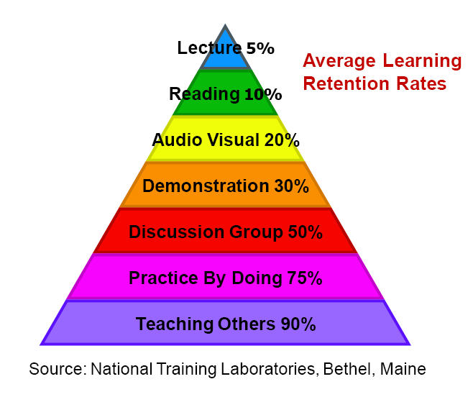

Slide 39
Summary
Learning in university is fundamentally different from learning in secondary school
Active and deep learning is the key to success in the university (and in later life)
Identify the learning style that suits you best to achieve deep learning and use it to the maximum
Try to learning from all experiences (both academic and non-academic) in the university

Slide 40
FINALY:
Take home messages from your outstanding colleagues (published evidence from our KSU study):
13 key factors for academic success:

Slide 42
What factors determine academic achievement in high achieving undergraduate medical students? A qualitative study.
Abdulghani et al. Medical Teacher 2014, 36: S43–S48
Thirteen factors influencing high academic achievement include:
Attendance to lectures,
Early revision,
Prioritization of learning needs,
Deep learning,
Learning in small groups,
Mind mapping,
Learning in skills lab,
Learning with patients,
Learning from mistakes,
time management,
family support.
Internal motivation and
Expected examination results

Slide 43
I wish you a very successful and enjoyable time in your course
All the best

