Slide 1
Foundation Block
Introduction to Parasitology
Dr: MONA BADR
Foundation Block, 2016
1

Slide 2
•
•
•
•
The natural ecology of malaria involves malaria parasites infecting successively two types
of hosts: humans and female Anopheles mosquitoes. In humans, the parasites grow and
multiply first in the liver cells and then in the red cells of the blood. In the blood, successive
broods of parasites grow inside the red cells and destroy them, releasing daughter
parasites ("merozoites") that continue the cycle by invading other red cells.
The blood stage parasites are those that cause the symptoms of malaria. When certain
forms of blood stage parasites ("gametocytes") are picked up by a female Anopheles
mosquito during a blood meal, they start another, different cycle of growth and
multiplication in the mosquito.
After 10-18 days, the parasites are found (as "sporozoites") in the mosquito's salivary
glands. When the Anopheles mosquito takes a blood meal on another human, the
sporozoites are inJected with the mosquito's saliva and start another human infection
when they parasitize the liver cells.
Thus the mosquito carries the disease from one human to another (acting as a "vector").
Differently from the human host, the mosquito vector does not suffer from the presence of
the parasites
Foundation Block, 2009
2

Slide 3
DEFINITIONS
•Infection:
– The entry , development and
multiplication of an infectious agent
in the body of humans or animals. The
result may be:
•inapparent ( asymptomatic)
infection, or
•manifest (symptomatic) infection..
Foundation Block, 2016
3

Slide 4
DEFINITIONS
•Host:
– A human or animal which harbors an infectious
agent under natural conditions .
• Definitive host (primary host):
- A host in which the parasite passes its
sexual stage.
• Intermediate host (secondary host):
– A host in which the parasite passes its larval or
asexual stages.
Foundation Block, 2016
4

Slide 5
DEFINITIONS
– A person or animal that harbors a specific
infectious agent in the absence of
symptoms and signs of a disease and
serves as a potential source of infection
•pathogenesis:
– Production and development of disease.
•pathogenicity:
– Capability of an infectious agent to cause
disease in a susceptiBle host.
Foundation Block, 2016
• carrier: .
5

Slide 6
DEFINITIONS
•Parasitism:
– A relationship in which an organism (the
infectious agent, the parasite) Benefits
the association with another organism
(the host) whereas the host is harmed
in some way.
from
•commensalism:
– Kind of relationship in which one organism ,
the commensal , isBenefited whereas t ,
the host , is not harmed but or even helped by
6
Foundation Block, 2016

Slide 7
DEFINITIONS
•Ectoparasite: parasite that lives on
the outer surface of its host.
•Endoparasite: Parasite that lives
inside its host.
•zoonosis: Disease of animals that is
transmissible to humans .
Foundation Block, 2016
7

Slide 8
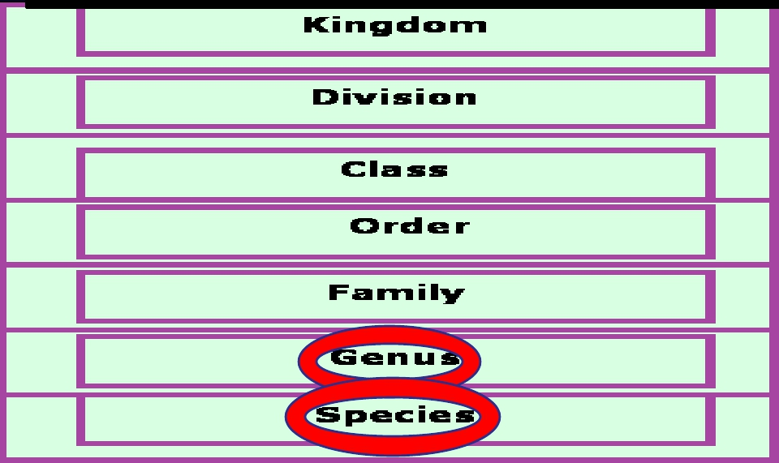
Scientific names of parasites follow Zoological
Classification
Foundation Block, 2016
8

Slide 9
CLASSIFICATION OF PARASITES
PROTOZOA | HELMINTHS
Unicellular Singlecellforallfunctions | Multicellular Specializedcells
1:Amoebae:moveby pseudopodia. 2:Flagellates:movebyflagella. 3:Ciliates:movebycilia 4:Apicomplexa(Sporozoa) tissueparasites | Roundworms(Nematodes): -elongated,cylindrical, unsegmented. Flatworms: -Trematodes:leaf-like, unsegmented. -Cestodes:tape-like, segmented.
Foundation Block ,2016
9

Slide 10
Foundation Block, 2016
10

Slide 11
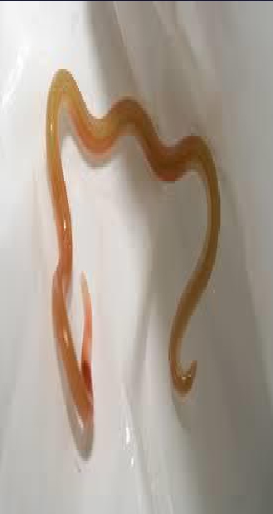
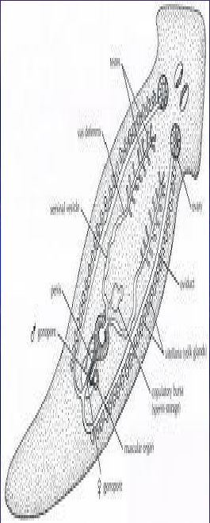
Foundation Block, 2009
11

Slide 12
Parasitic
Protozoa
Blood
and
tissues
Intestinal
Foundation Block, 2016
12

Slide 13
Examples of Diseases caused by
Intestinal Protozoa
Parasite
Giardia lamblia
Disease
giardiasis
Entamoebahistolytica
amoebiasis
Foundation Block, 2016
13

Slide 14
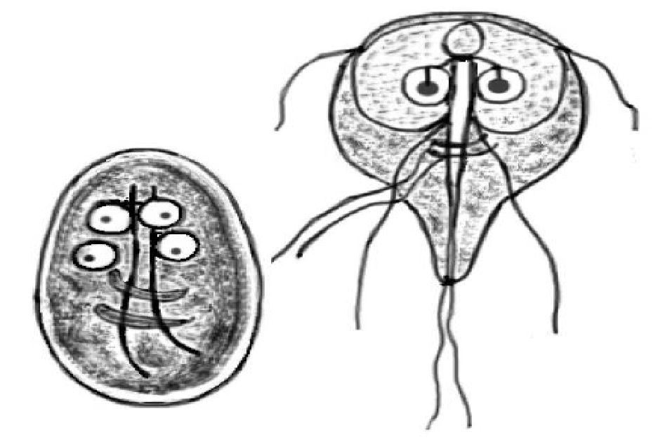
Foundation Block, 2016
14

Slide 15
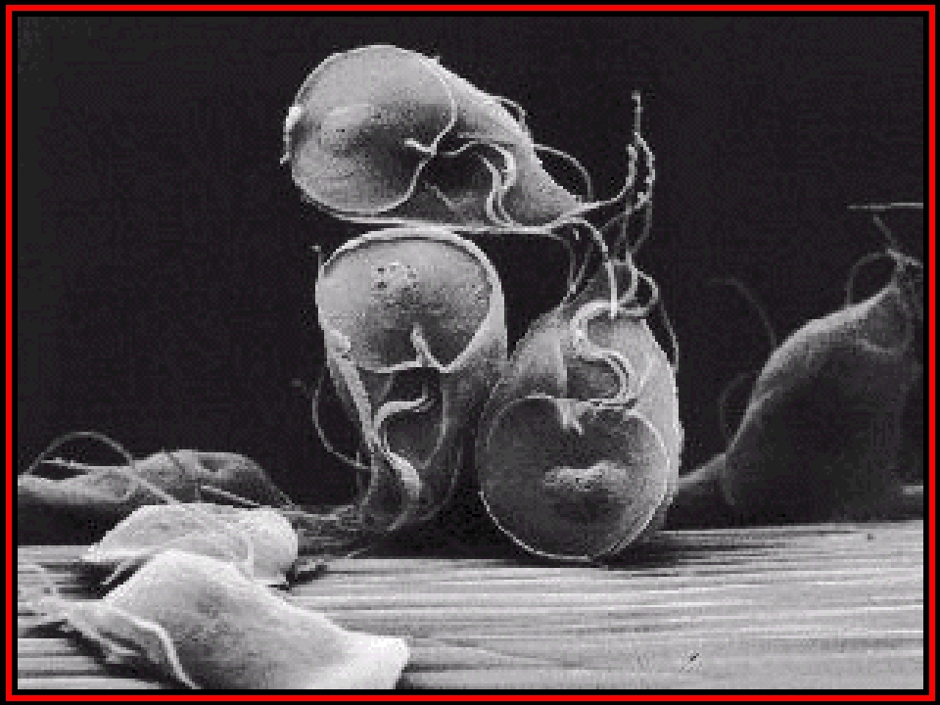
Giadria lamblia an example of Intestinal Protozoa
Foundation Block, 2016
15

Slide 16
Life
In the life cycle of Plasmodium, a female Anopheles mosquito (the definitive host) transmits a motile infective
form (called the sporozoite) to a vertebrate host such as a human (the secondary host), thus acting as a
transmission vector. A sporozoite travels through the blood vessels to liver cells (hepatocytes), where it
reproduces asexually (tissue schizogony), producing thousands of merozoites. These infect new red blood
cells and initiate a series of asexual multiplication cycles (blood schizogony) that produce 8 to 24 new infective
merozoites, at which point the cells burst and the infective cycle begins anew.
Other merozoites develop into immature gametocytes, which are the precursors of male and female gametes.
When a fertilised mosquito bites an infected person, gametocytes are taken up with the blood and mature in
the mosquito gut. The male and female gametocytes fuse and form a fertilized, motile zygote which develop
into new sporozoites that migrate to the insect's salivary glands, ready to infect a new vertebrate host. The
sporozoites are injected into the skin, in the saliva, when the mosquito takes a subsequent blood meal.
Only female mosquitoes feed on blood; male mosquitoes do not transmit the disease. The females of the
Anopheles mosquito prefer to feed at night.
Foundation Block, 2016
16

Slide 17
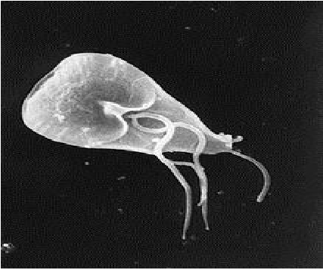
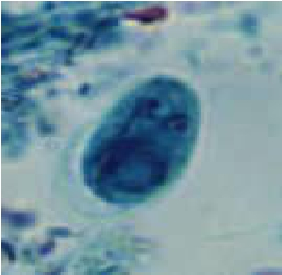
Giardia cyst
( infective stage)
Giardia trophozoite
Foundation Block, 2016
17

Slide 18
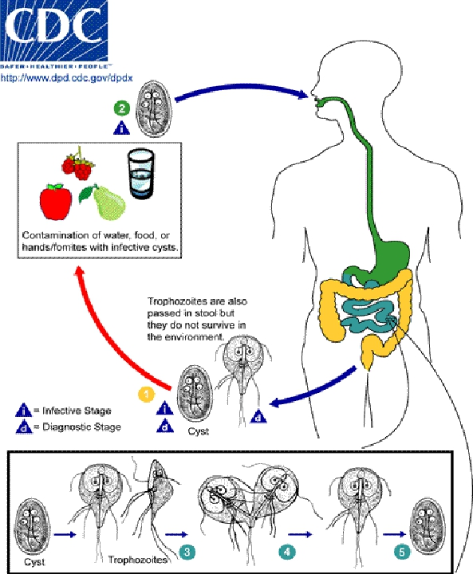
Giardia lamblia
Can cause diarrhea
with poor absorption of
the nutrient,loss of
appetite,stomach
cramp,vomiting.
Giardia infect the
cells of the
duodenum and
jejunum.
Foundation Block, 2016 18

Slide 19
1-. Giardia cysts are the infective stage of G. intestinalis. As few as 10 cysts
can cause infection , These cysts are ingested by consuming contaminated food
or water, or fecal-orally. They can survive outside the body for several months,
and are also relatively resistant to chlorination, UV exposure and freezing.
2_. When cysts are ingested, the low pH of the stomach ,the acidity
produces excystation , Excystation means the releases of
trophozoites .
3. Within the small intestine(duodenum,jejunum), the trophozoites reproduce
asexually (binary fission) and either float free or are attached to the mucosa of
the lumen.
4. Some trophozoites then encyst in the small intestine (become
cyst), Both cysts and trophozoites are then passed in the feces, but only the
cyst is infectious ,
Person-to-person transmission is possible, Animals can also be infected with
Giardia .
Foundation Block, 2009
19

Slide 20
Examples of Diseases caused by Blood
and Tissue Protozoa
Parasite
Plasmodium spp
Disease
malaria
Foundation Block, 2016
20

Slide 21
Malaria Species
Four main species of malaria :
Plasmodium falciparum
Plasmodium vivax
Plasmodium ovale
Plasmodium malariae
Foundation Block, 2016
21

Slide 22
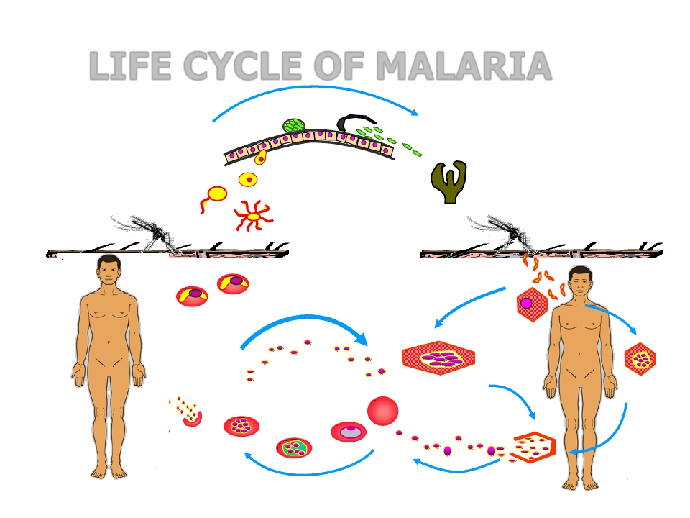
LIFE CYCLE OF MALARIA
Oocyst
Sporozoites
Zygote
Stomach Wall
Salivary Gland
sporozoites
Gametocytes
Erythrocytic
Cycle
Foundation Block, 2016
Pre-erythrocytic
(hepatic) cycle
Exo-erythrocytic
(hepatic) cycle
Hypnozoites
22

Slide 23
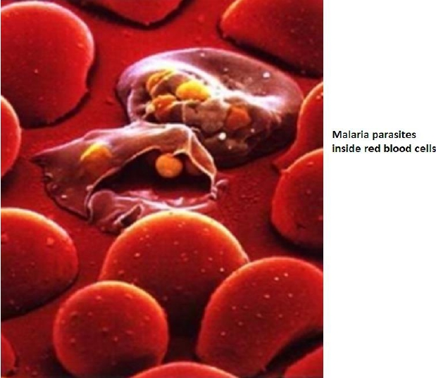
Main pathology of malaria is due to invasion of the RBCs
Foundation Block, 2016
23

Slide 24
Examples of Diseases caused by Blood
and Tissue Protozoa
Parasite
Leishmania major
Disease
Cutaneous leishmaniasis
Foundation Block, 2016
24

Slide 25
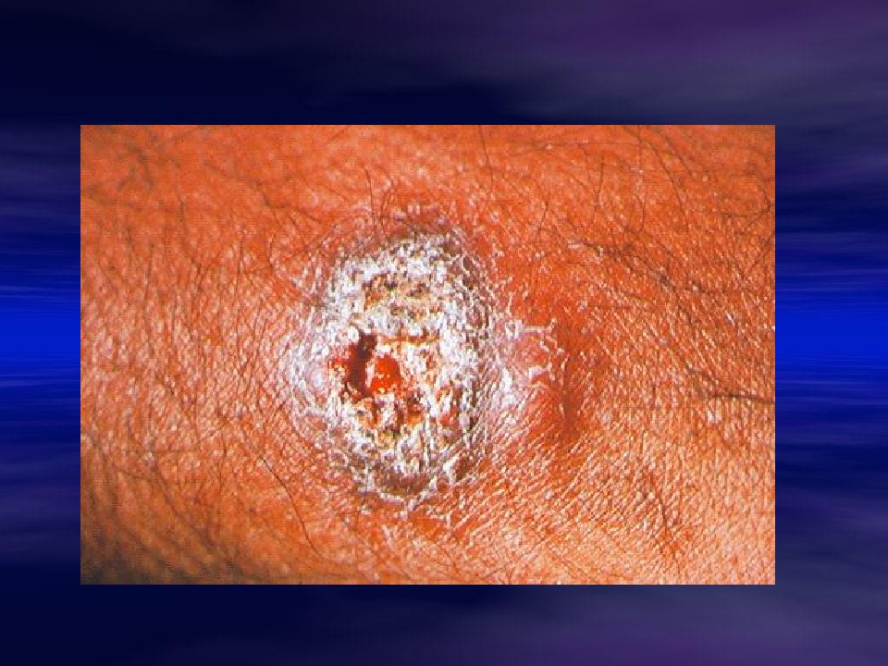
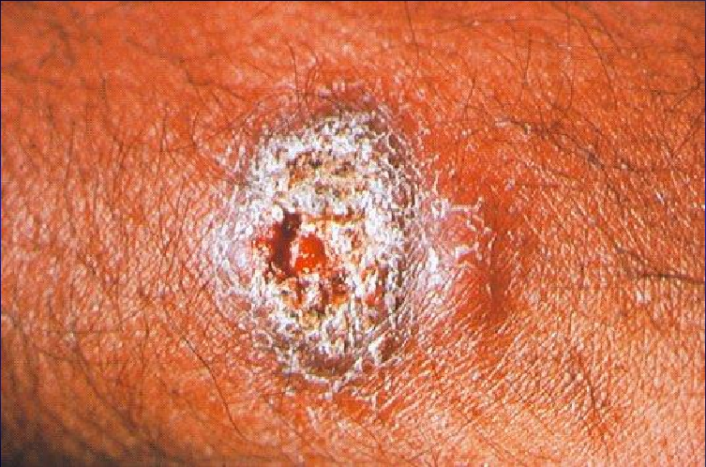
Cutaneous leishmaniasis caused by Leishmania major
Foundation Block, 2016
25

Slide 26
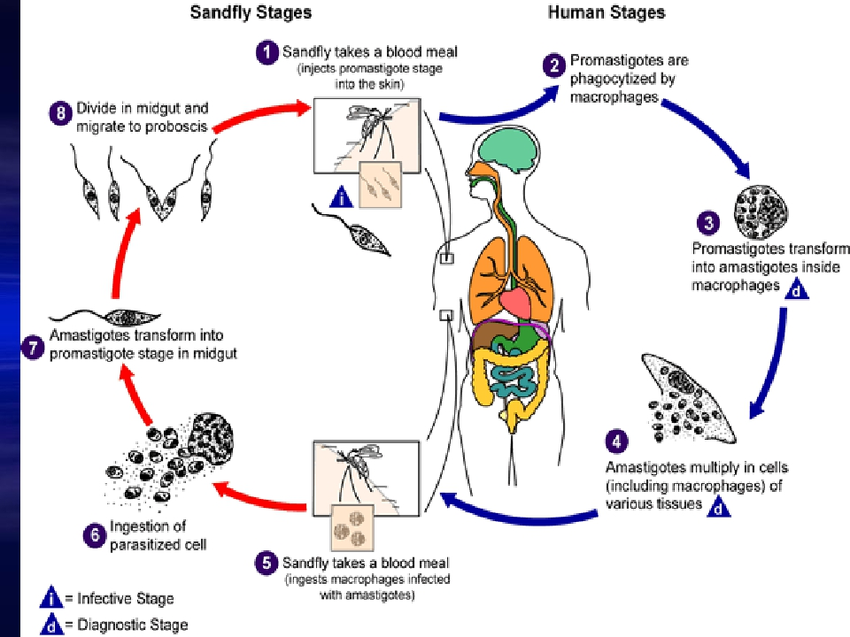
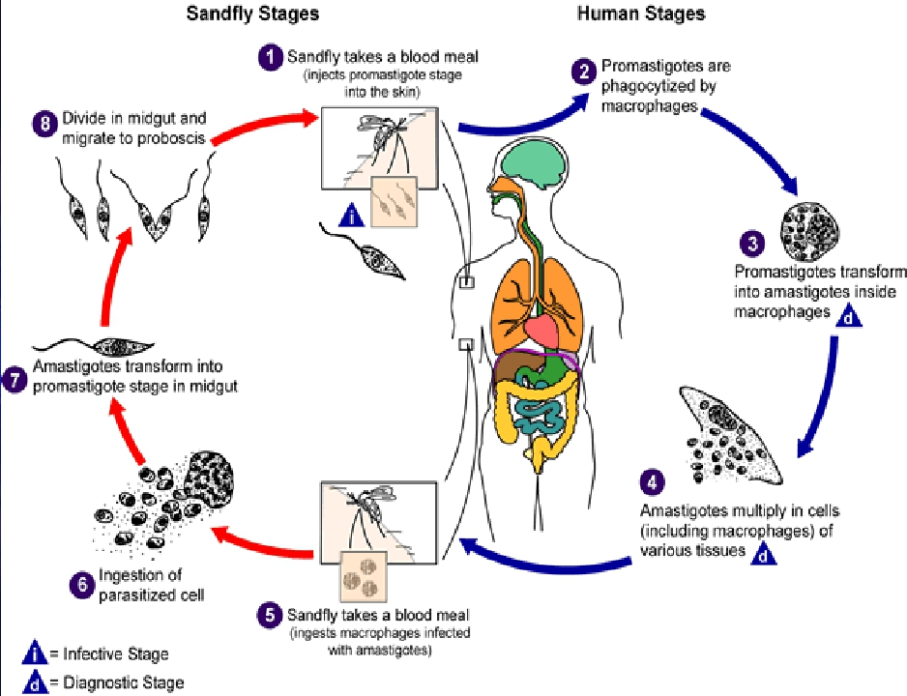
Foundation Block, 2012
26

Slide 27
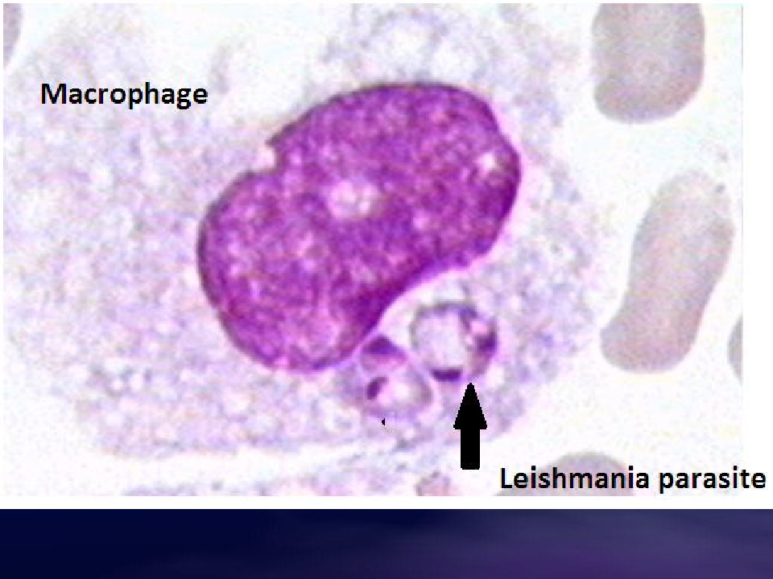
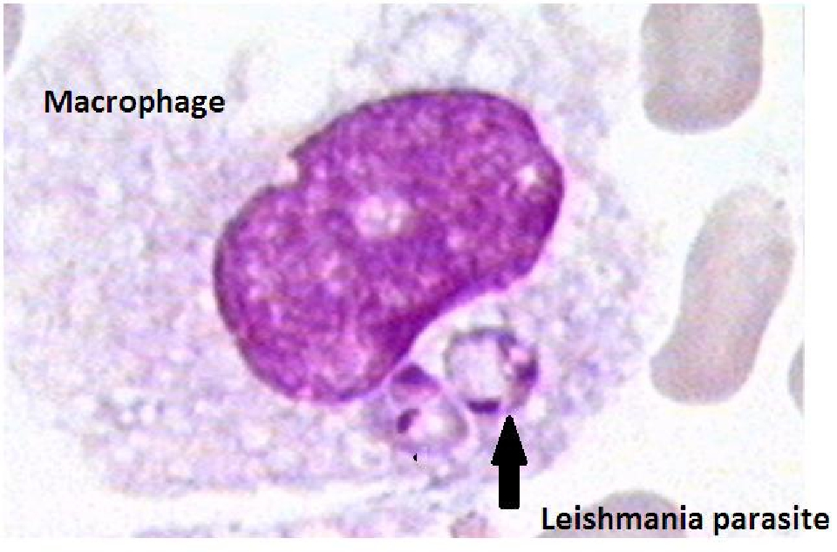
Foundation Block, 2016
27

Slide 28
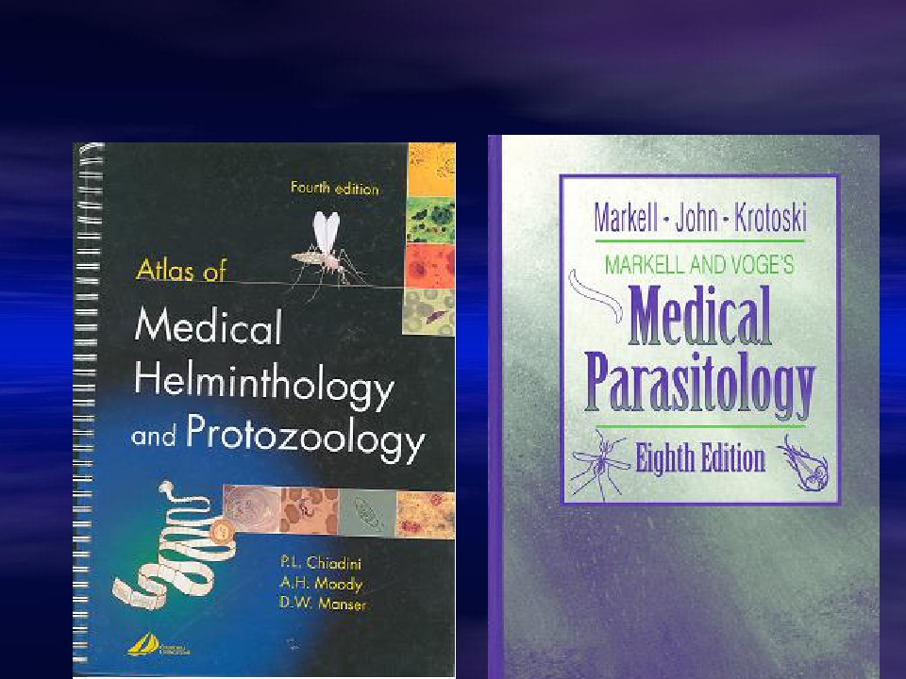
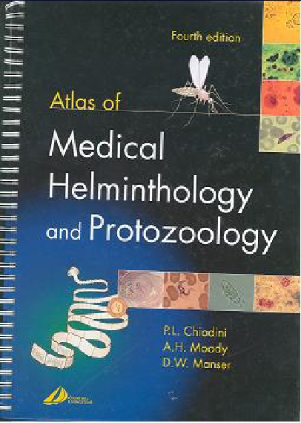
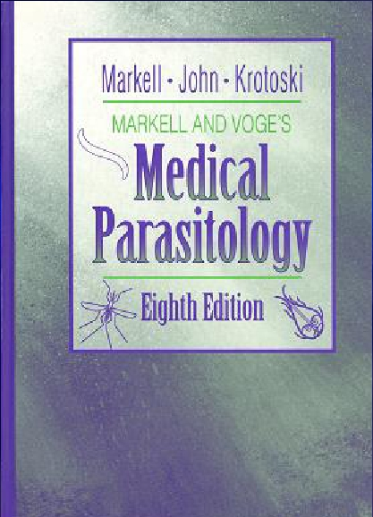
Resources on Parasitology
28

Slide 29
Resources on Parasitology
Centre for Disease Control and Prevention (CDC) :
http://www.dpd.cdc.gov/DPDx/HTML/Para_Health.htm
Foundation Block, 2016
29

Slide 30
OBJECTIVES
By the end of this lecture the student should be able to:
1. Define common terms describing host-parasite
relationship.
2. Outline the broad classification of parasites.
3. Name examples of protozoan parasites.
4. Describe the life-cycle of Giadia lamblia as an example
of intestinal protozoa.
5. Describe the main stages of the life-cycle of
Plasmodium as an example of blood and tissue
protozoa.
Foundation Block, 2016
30

