Slide 1
CLASSIFICATION OF TUMORS
Dr. Maria A. Arafah
Assistant Professor – Department of Pathology
http://fac.ksu.edu.sa/mariaarafah/courses

Slide 2
06/11/2016
Path 211
2
Objectives
• Definitions: neoplasm, tumor, oncology.
• Classification of tumors into benign and malignant.
• Nomenclature of tumors.
• Characteristics of benign and malignant tumors.
• Definitions: teratoma, hamartoma, choristoma.

Slide 3
06/11/2016
3
Definitions
• Neoplasia: literally means “new growth.”
• A neoplasm often is referred to as a tumor, and the study
of tumors is called oncology (from oncos, “tumor,” and
logos, “study of”).

Slide 4
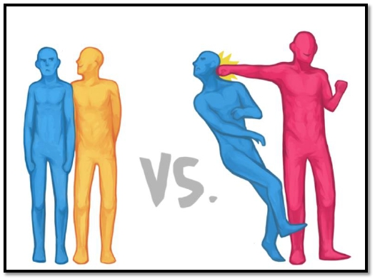
06/11/2016
4
Classification ofTumors
• The division of neoplasms into benign and malignant
categories is based on their potential clinical behavior.

Slide 5
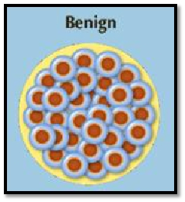
06/11/2016
5
Classification ofTumors
• Benign: the microscopic and gross characteristics of the
lesion are considered to be relatively innocent.
• Tumors remain localized.
• Tumors are amenable to local surgical removal.
• Patients generally survive.

Slide 6
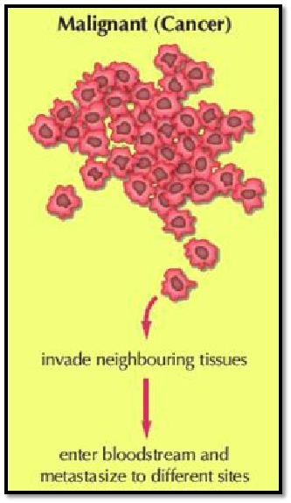
06/11/2016
Classification ofTumors
• Malignant: lesions can
invade and destroy adjacent
structures and spread to
distant sites (metastasize) to
cause death.
6

Slide 7
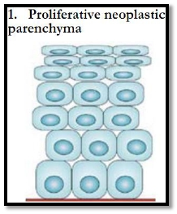
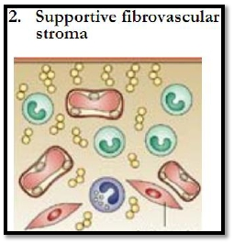
06/11/2016
Classification ofTumors
• All tumors, benign and malignant, have two basic
components:
7
1.
2.
The parenchyma, made up of transformed or neoplastic cells.
The supporting, host-derived, non-neoplastic stroma, made up of
connective tissue, blood vessels, and host-derived inflammatory
cells.

Slide 8
06/11/2016
8
Classification ofTumors
• The nomenclature of tumors and their biologic behavior
are based primarily on the parenchymal component.
• However, the growth and evolution of tumors is critically
dependent on their stroma as an adequate stromal blood
supply is a requisite for the tumor cells to live and divide.

Slide 9
06/11/2016
9
Nomenclature of Tumors - Benign
• Benign tumors are designated by attaching the suffix -
oma to the cell type from which the tumor arises.
• The nomenclature of mesenchymal tumors usually apply
this rule e.g.
• Fibroma: a benign tumor arising in fibrous tissue.
• Chondroma: a benign tumor arising in cartilaginous tissue.
• Osteoma: a benign tumor arising in bone tissue.

Slide 10
06/11/2016
10
Nomenclature of Tumors - Benign
• The nomenclature of benign epithelial tumors is more
complex: cell of origin, microscopic pattern or
macroscopic appearance.
• Adenoma is generally applied to benign epithelial
neoplasms producing gland patterns and to neoplasms
derived from glands but not necessarily exhibiting
glandular patterns.

Slide 11
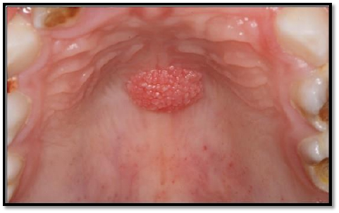
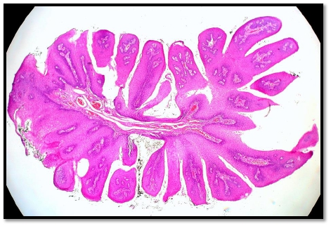
06/11/2016
11
Nomenclature of Tumors - Benign
• Benign epithelial neoplasms producing microscopically or
macroscopically visible finger-like or warty projections
from epithelial surfaces are referred to as papillomas.

Slide 12
06/11/2016
12
Nomenclature of Tumors - Benign
• Benign epithelial neoplasms forming large cystic masses,
as in the ovary, are referred to as cystadenomas.
• Some of the latter produce papillary patterns that protrude
into cystic spaces and are called papillary cystadenomas.

Slide 13
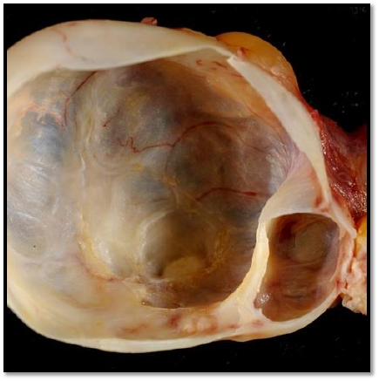
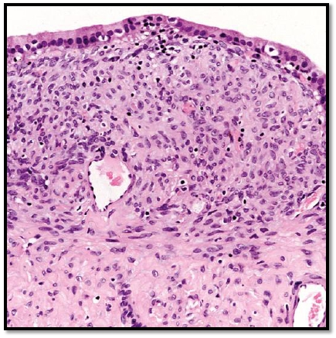
06/11/2016
13
Nomenclature of Tumors - Benign
Cystadenoma – Macroscopically
Cystadenoma – Microscopically

Slide 14
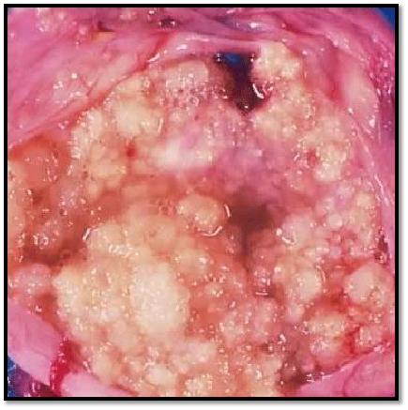
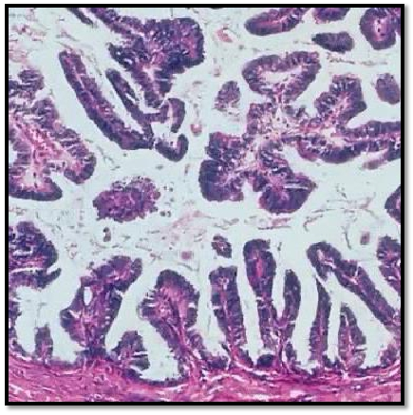
06/11/2016
14
Nomenclature of Tumors - Benign
Papillary cystadenoma –
Macroscopically
Papillary cystadenoma –
Microscopically

Slide 15
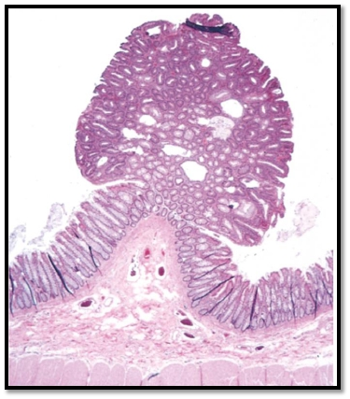
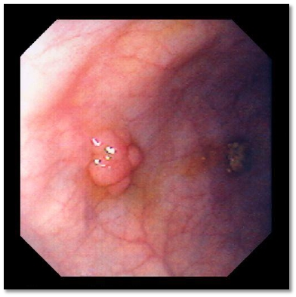
06/11/2016
15
Nomenclature of Tumors - Benign
• A polyp is a mass that projects above a mucosal surface,
as in the gut, to form a macroscopically visible structure.

Slide 16
06/11/2016
16
Nomenclature of Tumors - Malignant
• Malignant neoplasms arising in mesenchymal tissues are
called sarcomas.
• Fibrosarcoma: a malignant tumor arising in fibrous tissue.
• Chondrosarcoma: a malignant tumor arising in cartilaginous tissue.
• Osteosarcoma: a malignant tumor arising in bone tissue.

Slide 17
06/11/2016
17
Nomenclature of Tumors - Malignant
• Malignant neoplasms arising from epithelial cells are
called carcinomas.
• Carcinomas include:
• Carcinomas that arise from glandular epithelial cells (with or
without forming glands): adenocarcinomas
• Carcinomas that arise from squamous cells (some producing
keratin): squamous cell carcinomas.
• Carcinomas that show little or no differentiation: poorly
differentiated or undifferentiated carcinoma.

Slide 18
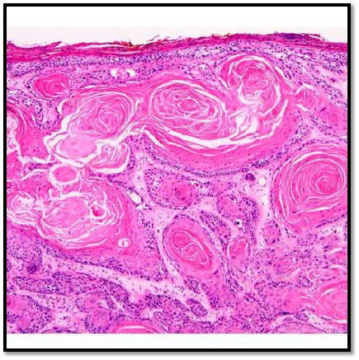
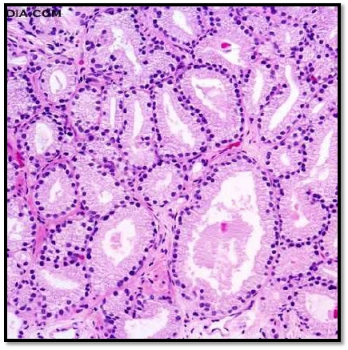
06/11/2016
18
Nomenclature of Tumors - Malignant
Squamous cell carcinoma
Adenocarcinoma

Slide 19
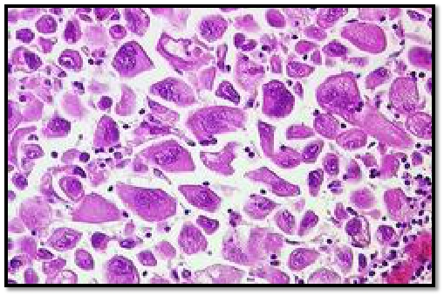
06/11/2016
19
Nomenclature of Tumors
• Not infrequently, however, a cancer is composed of
undifferentiated cells of unknown tissue origin, and must
be designated merely as an undifferentiated malignant
tumor.

Slide 20
06/11/2016
20
Nomenclature of Tumors
• The transformed cells in a neoplasm, whether benign or
malignant, often resemble each other, as though all had
been derived from a single progenitor, consistent with the
monoclonal origin of tumors.
• In some unusual instances, however, divergent
differentiation of a single neoplastic clone along two
lineages occurs, creating the so-called mixed tumors.

Slide 21
06/11/2016
21
Nomenclature of Tumors
• The best example is the mixed tumor of the salivary
gland. These tumors have obvious epithelial components
dispersed throughout a fibromyxoid stroma, sometimes
harboring islands of cartilage or bone.
• All of these diverse elements are thought to derive from a
single clone capable of giving rise to epithelial cells or
myoepithelial cells, or both, and the preferred designation
for these neoplasms is pleomorphic adenoma.

Slide 22
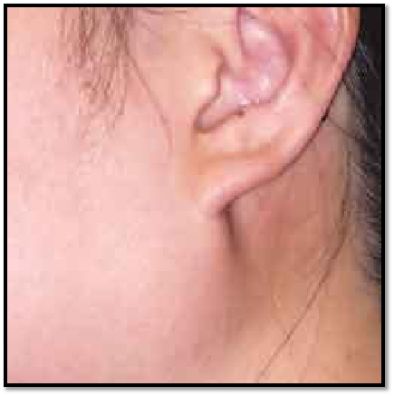
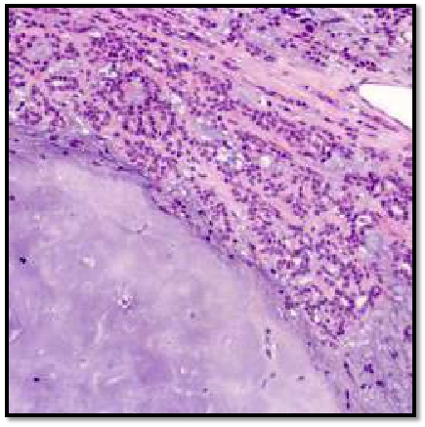
06/11/2016
PleomorphicAdenoma
22
Macroscopically
Microscopically

Slide 23
06/11/2016
23
Nomenclature of Tumors
• Some glaring inconsistencies may be noted. For example,
the terms lymphoma, mesothelioma, melanoma, and
seminoma are used for malignant neoplasms.

Slide 24
06/11/2016
24
Teratoma
• Teratoma is a special type of mixed tumor that contains
recognizable mature or immature cells or tissues
representative of more than one germ cell layer and
sometimes all three.
• Teratoma originates from totipotential cells such as those
normally present in the ovary and testis and sometimes
abnormally present in sequestered midline embryonic
rests. Such cells have the capacity to differentiate into any
cell type found in the adult body.

Slide 25
06/11/2016
25
Teratoma
• When all the components within the teratoma are well
differentiated, it is a benign (mature) teratoma.
• However, when they are less differentiated, it is an
immature, potentially or overtly, malignant teratoma.

Slide 26
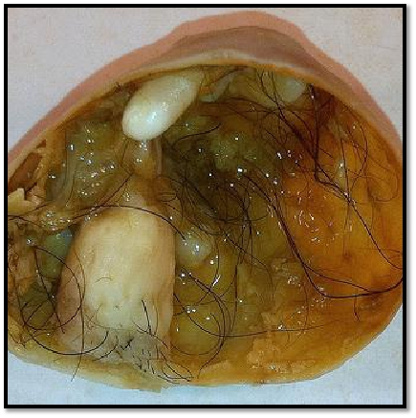
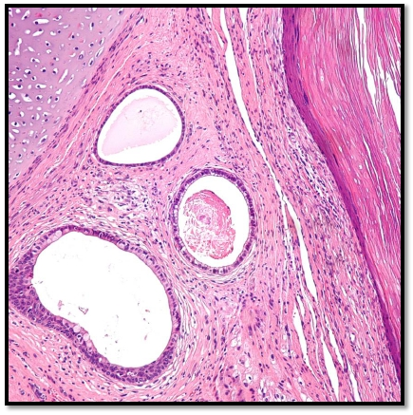
06/11/2016
Teratoma
26
Macroscopically
Microscopically

Slide 27
06/11/2016
27
Hamartoma
• Hamartoma is a mass of disorganized benign-looking
tissue indigenous to the particular site.
• For example, pulmonary chondroid hamartoma, which
contains islands of disorganized, but histologically normal
cartilage, bronchi, and vessels.
• Hamartomas have traditionally been considered
developmental malformations, but some genetic studies
have shown the presence of acquired translocations,
suggesting a neoplastic origin.

Slide 28
06/11/2016
28
Choristoma
• Choristoma is a congenital anomaly consisting of a
heterotopic rest of cells.
• For example, a small nodule of well-developed and
normally organized pancreatic tissue may be found in the
submucosa of the stomach, duodenum, or small intestine.
• Choristoma has usual trivial significance.

Slide 29
06/11/2016
29
Summary
• Although the terminology of neoplasms is regrettably not
simple, a firm grasp of the nomenclature is important
because it is the language by which the nature and
significance of tumors are categorized.

Slide 30
06/11/2016
Summary
30

Slide 31
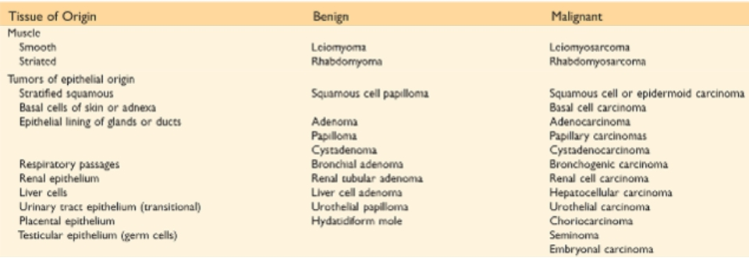
06/11/2016
Summary
31

Slide 32
06/11/2016
Summary
32

Slide 33
06/11/2016
33
Reference
• Kumar V, Abbas AK, Aster JC. Robbins Basic Pathology.
9th ed. Elsevier; 2013. Philadelphia, PA.

Slide 34
06/11/2016
34
END OF LECTURE
Thank You

