Slide 1
CLASSIFICATION OF TUMORS
Dr. Maria A. Arafah
Assistant Professor – Department of Pathology
http://fac.ksu.edu.sa/mariaarafah/courses

Slide 2
06/11/2016
Path 211
2
Objectives
• Compare between benign & malignant tumors in terms of
differentiation, rate of growth, local invasion &
metastases.
•
•
•
•
Identify the morphological features that differentiate
between benign & malignant tumors.
Define the terms: differentiation & anaplasia.
List the pathways by which malignant tumors spread.
Define the terms: dysplasia & carcinoma in situ.

Slide 3
06/11/2016
3
Introduction
• Features to distinguish between benign & malignant
tumors:
• Differentiation & anaplasia
• Rate of growth
• Local invasion
• Metastasis

Slide 4
06/11/2016
4
Differentiation &Anaplasia
• Differentiation & anaplasia are characteristics seen only in
the parenchymal cells that constitute the transformed
elements of neoplasms.
• Differentiation: the extent to which the parenchymal cells
of the tumor resemble their normal counterparts
morphologically and functionally

Slide 5
06/11/2016
5
Differentiation &Anaplasia
• Differentiation:
• Well differentiated = closely resemble their normal counterparts
• Moderately differentiated
• Poorly differentiated
• Undifferentiated (Anaplasia)

Slide 6
06/11/2016
6
Differentiation &Anaplasia
• Benign neoplasms are composed of well-differentiated
cells that closely resemble their normal counterparts.
• Lipoma: mature fat cells laden with cytoplasmic lipid vacuoles.
• Chondroma: mature cartilage cells that synthesize their usual
cartilaginous matrix (evidence of morphologic and functional
differentiation)
• In well-differentiated benign tumors, mitoses are usually
rare and are of normal configuration.

Slide 7
06/11/2016
7
Differentiation &Anaplasia
• The more differentiated the tumor cell, the more
completely it retains the functional capabilities of its
normal counterparts.
• e.g. benign neoplasms and even well-differentiated cancers of
endocrine glands frequently elaborate the hormones characteristic
of their origin.

Slide 8
06/11/2016
8
Differentiation &Anaplasia
• The stroma carrying the blood supply is crucial to the
growth of tumors but does not aid in the separation of
benign from malignant ones.
• However the amount of stromal connective tissue
determines the consistency of a neoplasm.
• e.g. certain cancers induce a dense, abundant fibrous stroma
(desmoplasia), making them hard, so-called scirrhous tumors.

Slide 9
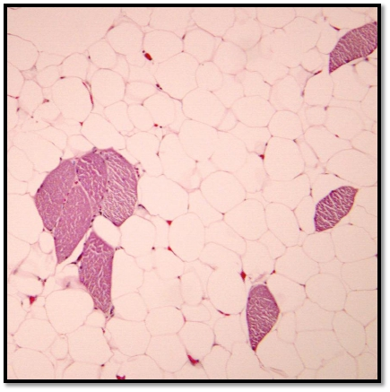
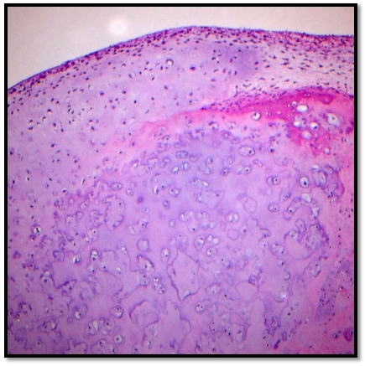
06/11/2016
Differentiation &Anaplasia
9
Lipoma
Chondroma

Slide 10
06/11/2016
10
Differentiation &Anaplasia
• Malignant neoplasms are characterized by a wide range
of parenchymal cell differentiation: from well differentiated
to completely undifferentiated.
• Between the two extremes lie tumors loosely referred to
as moderately differentiated.

Slide 11
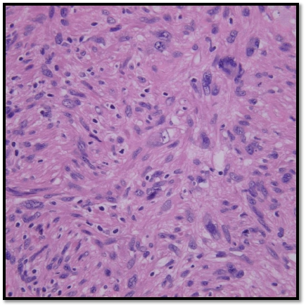
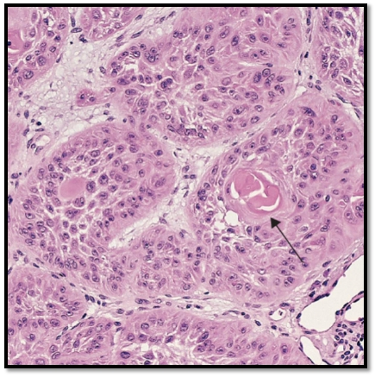
06/11/2016
Differentiation &Anaplasia
11
Leiomyosarcoma
Squamous cell carcinoma

Slide 12
06/11/2016
Differentiation &Anaplasia
• Malignant neoplasms that are composed of
undifferentiated cells are said to be anaplastic.
• Anaplasia: loss of the structural and functional
differentiation. It is a hallmark of malignancy.
12

Slide 13
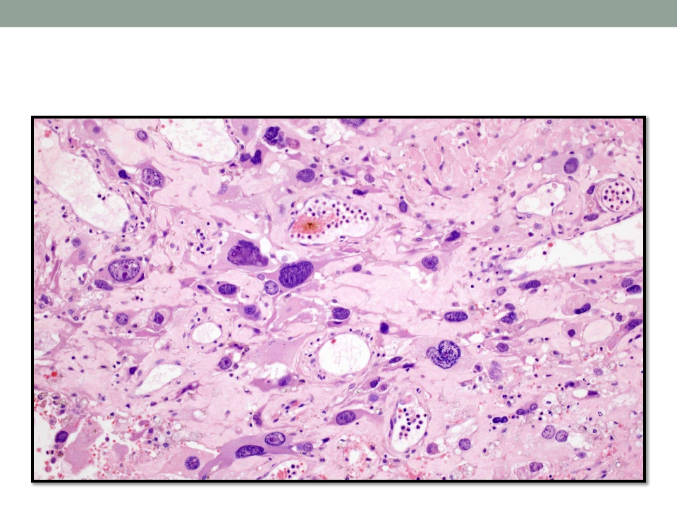
06/11/2016
Differentiation &Anaplasia
13

Slide 14
06/11/2016
14
Differentiation &Anaplasia
• It is important to recognize the following histopathological
features in any neoplasm:
• Pleomorphism: variation in size and shape
• Enlarged nuclei resulting in an increase of nuclear to cytoplasm
ratio (that may approach 1:1 instead of the normal 1:4 or 1:6)
•
•
•
•
Hyperchromasia (dark nuclei) due to coarse & clumped chromatin
Prominent nucleoli
Mitoses (typical or atypical forms)
Giant cells: larger than their neighbors & possess either one
enormous nucleus or several nuclei.

Slide 15
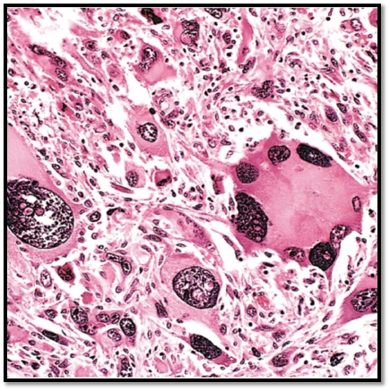
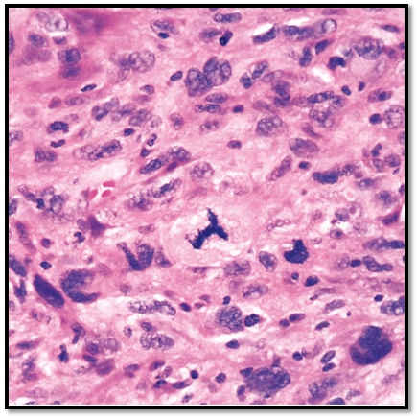
06/11/2016
Differentiation &Anaplasia
15
Tumor Giant Cells
Atypical Mitosis

Slide 16
06/11/2016
16
Dysplasia
• Definition: a loss in the uniformity of the individual cells
and a loss in their architectural orientation.
• It is a non-neoplastic process but a premalignant
condition.
• It occurs mainly in the epithelia.
• Dysplastic cells show a degree of: pleomorphism, ⬆N:C
ratio, hyperchrmasia, irregular nuclei, increased
mitoses, loss of polarity & a disordered maturation or
total failure of maturation.

Slide 17
17
06/11/2016
Dysplasia
• Dysplasia does not mean cancer.
• Dysplasia does not necessarily progress to cancer.
• Dysplasia may be reversible.
• The risk of invasive cancer varies with:
• grade of dysplasia (mild, moderate, severe)
• duration of dysplasia
• site of dysplasia

Slide 18
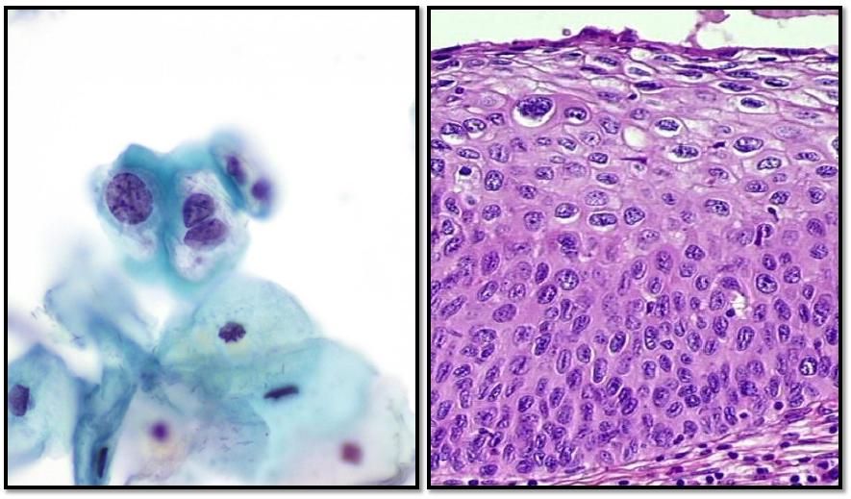
06/11/2016
Dysplasia
18

Slide 19
06/11/2016
Dysplasia
• Differences between dysplasia & cancer:
• Lack of invasiveness.
• Reversibility
19

Slide 20
06/11/2016
20
Carcinoma in Situ
• If dysplastic changes involve the entire thickness of the
epithelium it is called: carcinoma in-situ.
• Definition: an intraepithelial malignancy in which
malignant cells involve the entire thickness of the
epithelium without penetration of the basement
membrane.

Slide 21
06/11/2016
21
Carcinoma in Situ
• It is applicable only to epithelial neoplasms.
• It is a true neoplasm with all of the features of malignant
neoplasm except invasiveness.
• It displays the cytological features of malignancy without
invading the basement membrane.

Slide 22
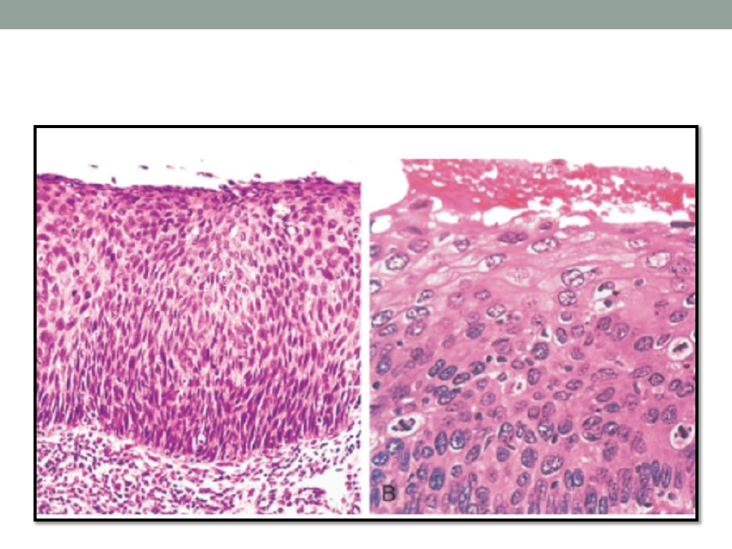
06/11/2016
Carcinoma in Situ
22

Slide 23
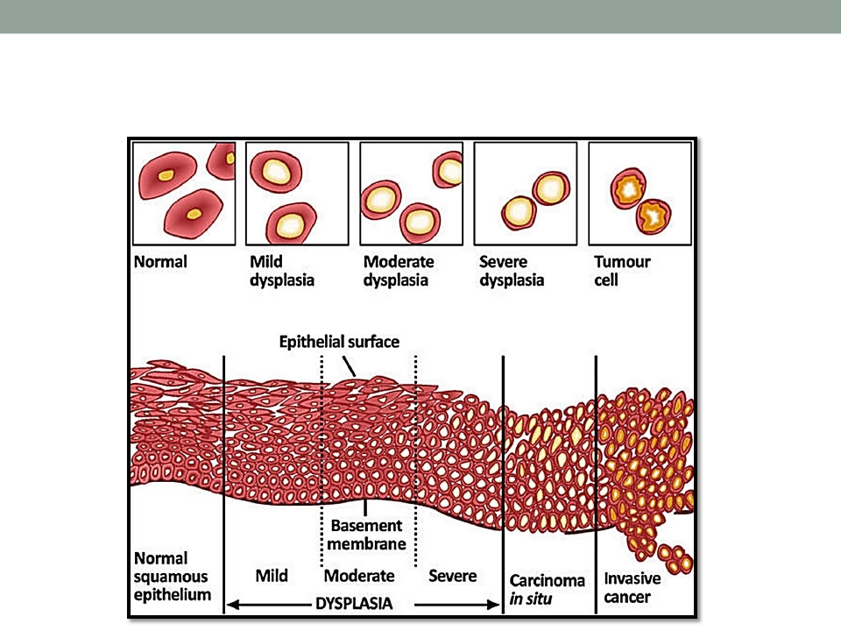
06/11/2016
Dysplasia & Carcinoma in Situ
23

Slide 24
06/11/2016
24
Reminder…
• Features to distinguish between benign & malignant
tumors:
• Differentiation & anaplasia
• Rate of growth
• Local invasion
• Metastasis

Slide 25
06/11/2016
25
Rate of Growth
• Benign tumors:
• They usually grow slowly.
• Their growth is affected by: adequate blood supply, location or
hormones e.g. leiomyoma of the uterus.

Slide 26
06/11/2016
26
Rate of Growth
• Malignant tumors:
• They usually grow fast.
• The rate of growth of malignant tumors usually correlates inversely
with their level of differentiation.

Slide 27
27
06/11/2016
Local Invasion
• Benign tumors:
• They remain localized.
• They cannot invade.
• They are usually encapsulated.

Slide 28
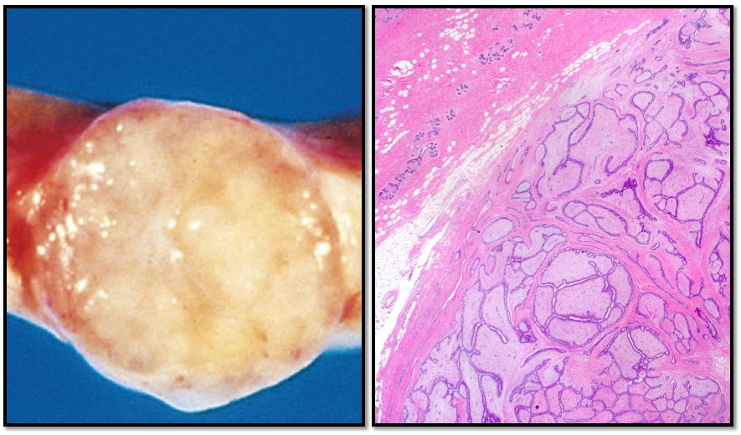
06/11/2016
Local Invasion
28

Slide 29
06/11/2016
29
Local Invasion
• Malignant tumors:
• They invade the underlying basement membrane or stroma.
• They are destructive.
• They are usually not encapsulated.

Slide 30
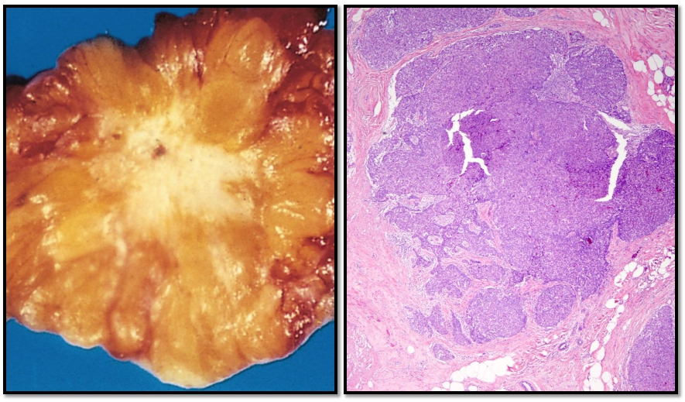
06/11/2016
Local Invasion*
30

Slide 31
06/11/2016
31
Metastasis
• Definition: it is the development of secondary implants of
a tumor that are discontinuous with the primary tumor &
located in remote tissues.
• More than any other attribute, the property of metastasis
identifies a neoplasm as malignant.

Slide 32
06/11/2016
32
Metastasis
• Cancer have different ability to metastasize.
• Approximately 30% patients present with clinically evident
metastases.
• Generally, the more anaplastic and the larger the primary
tumor, the more likely it metastasizes.

Slide 33
33
06/11/2016
Metastasis
• Malignant neoplasms disseminate by one of three
pathways:
• (1) seeding within body cavities
• (2) lymphatic spread
• (3) hematogenous spread

Slide 34
06/11/2016
34
Metastasis
• Spread by seeding occurs when neoplasms invade a
natural body cavity.
• This mode of dissemination is particularly characteristic of
cancers of the ovary, which often cover the peritoneal
surfaces widely.

Slide 35
06/11/2016
Metastasis
• Lymphatic spread is more typical of carcinomas.
• Breast carcinoma → axillary lymph node
• Lung carcinomas → bronchial lymph nodes
35

Slide 36
06/11/2016
36
Metastasis
• Hematogenous spread is favored by sarcomas but can
also occur in carcinomas.
• Veins are more commonly invaded.

Slide 37
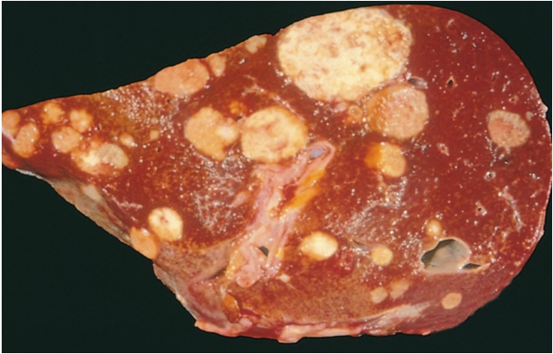
06/11/2016
Metastasis
• The liver and lungs are the most frequently involved
secondary sites.
37

Slide 38
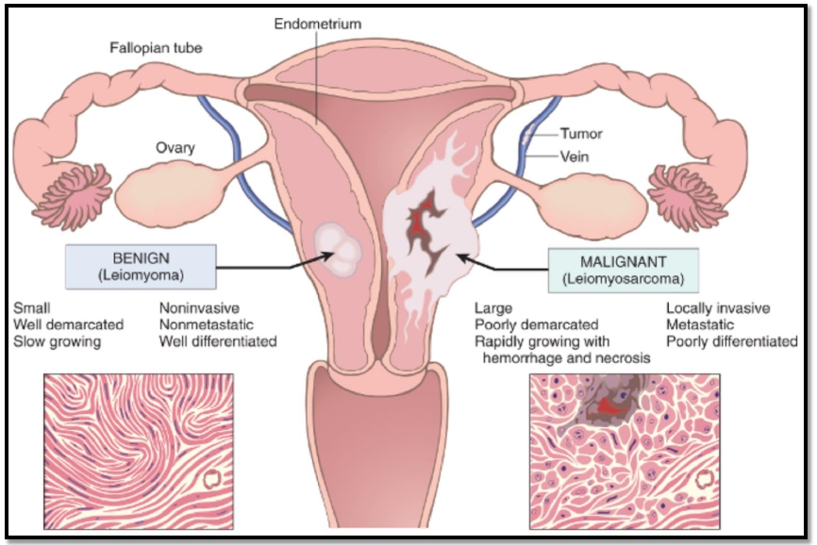
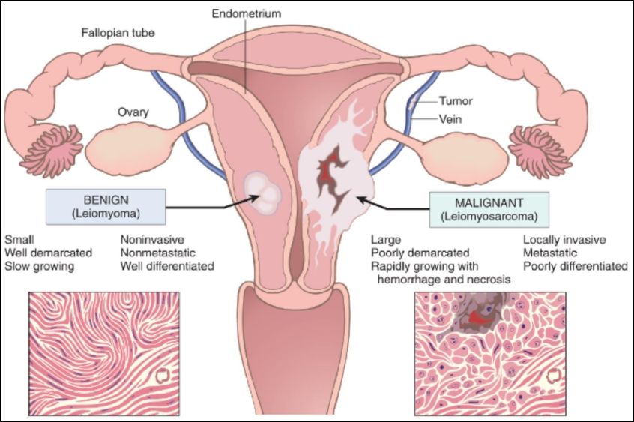
06/11/2016
Summary
38

Slide 39
06/11/2016
Summary
39

Slide 40
06/11/2016
40
Reference
• Kumar V, Abbas AK, Aster JC. Robbins Basic Pathology.
9th ed. Elsevier; 2013. Philadelphia, PA.

Slide 41
06/11/2016
41
END OF LECTURE
Thank You

