Slide 1
EPIDEMIOLOGYAND ETIOLOGY OF TUMORS
Dr. Maria A. Arafah
Assistant Professor – Department of Pathology
http://fac.ksu.edu.sa/mariaarafah/courses

Slide 2
06/11/2016
Path 211
2
Objectives
• To understand that the incidence of cancer varies with
age, race, geographic and genetic factors.
• To explain the genetic predisposition to cancer.
• To identify the precancerous conditions.
• To list the various causes of tumors.

Slide 3
3
06/11/2016
Epidemiology
• Studying the epidemiology of tumors will aid in the
following:
• Discover etiologic factors
• Plan preventive measures
• Know what types of tumors are common and what are rare
• Develop screening methods for early diagnosis

Slide 4
06/11/2016
Cancer Incidence
4

Slide 5
06/11/2016
Cancer Incidence
• Factors affecting the incidence of cancer:
• Geographic and environmental factors
• Age
• Hereditary factors
• Acquired preneoplastic conditions
5

Slide 6
06/11/2016
6
Geographic & Environmental Factors
• The rate of gastric carcinoma in Japan is 7 times its rate
in North America & Europe.
• The rate of breast carcinoma in North America is 5 times
its rate in Japan.
• Liver cell carcinoma is more common in African
populations.

Slide 7
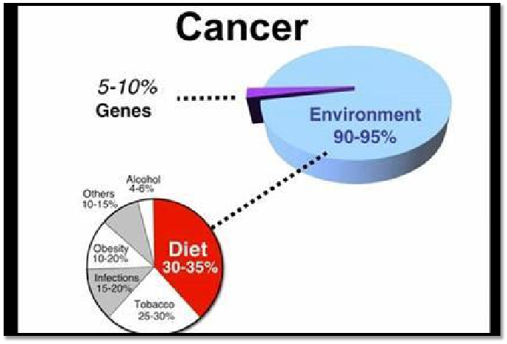
06/11/2016
7
Geographic & Environmental Factors

Slide 8
06/11/2016
8
Geographic & Environmental Factors
• Exposure to asbestos → mesothelioma
• Smoking → lung carcinoma
• Multiple sexual partners → cervical carcinoma
• Fat-rich diet → colon carcinoma

Slide 9
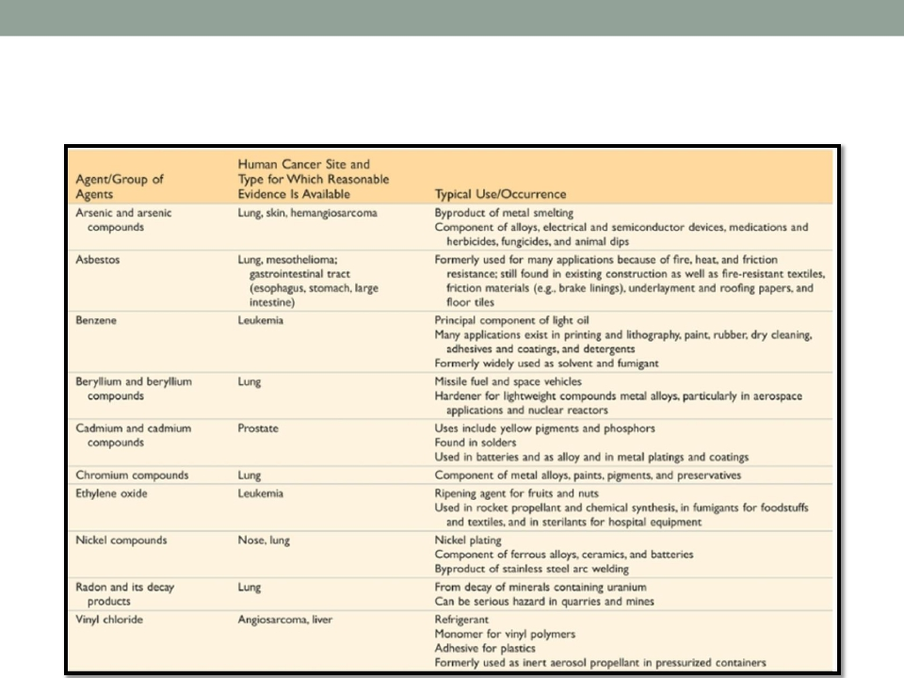
06/11/2016
9
Geographic & Environmental Factors

Slide 10
06/11/2016
10
Age
• Generally, the frequency of cancer increases with age.
• Most cancer mortality occurs between 55 and 75 years of
age and it also increases during childhood.
• The most common malignant tumors in children are:
• Leukemia
• CNS tumors
• Lymphomas
• Soft tissue & bone sarcomas.

Slide 11
11
06/11/2016
Hereditary Factors
• Hereditary factors include:
• Autosomal dominant cancer syndromes
• Autosomal recessive syndromes of defective DNA repair
• Familial cancers of uncertain inheritance

Slide 12
06/11/2016
12
Hereditary Factors
• Autosomal dominant cancer syndromes
• Several well-defined cancers in which inheritance of a single
mutant gene greatly increases the risk of developing a tumor.
• e.g. retinoblastoma in children:
• 40% of retinoblastomas are familial in nature.
• Carriers of this mutation have 10000 fold increase in the risk of
developing retinoblastoma
• e.g. multiple endocrine neoplasia (MEN syndrome)

Slide 13
06/11/2016
13
Hereditary Factors
• Autosomal recessive syndromes of defective DNA repair
• A group of rare autosomal recessive disorders is collectively
characterized by chromosomal or DNA instability and high rates of
certain cancers.
• e.g. xeroderma pigmentosum

Slide 14
06/11/2016
14
Hereditary Factors
• Familial cancers of uncertain inheritance
• All the common types of cancers that occur sporadically have been
reported to occur in familial forms where the pattern of inheritance
is unclear.
• e.g. breast, colon, ovary, brain
• Familial cancers usually have unique features:
• They start at early age
• They are multiple or bilateral
• They occur in two or more relatives

Slide 15
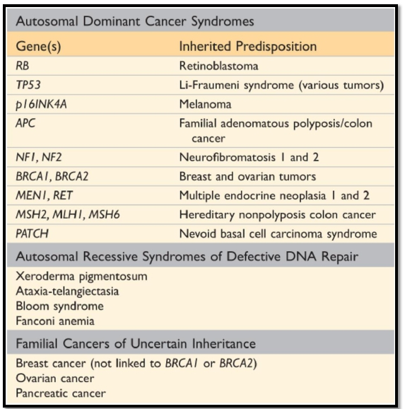
06/11/2016
Hereditary Factors
15

Slide 16
06/11/2016
16
Acquired Pre-neoplastic Conditions
• Acquired preneoplastic conditions are conditions that
predispose to cancer.
• Dysplastic bronchial mucosa in smokers→ lung carcinoma
• Liver cirrhosis → liver cell carcinoma
• Margins of chronic skin fistulae → squamous cell carcinoma
• Endometrial hyperplasia → endometrial carcinoma
• Leukoplakia of the oral cavity, vulva or penis → squamous cell
carcinoma
• Villous adenoma of the colon or rectum → colorectal adenocarcinoma

Slide 17
17
06/11/2016
Etiology of Tumors
• Classes of carcinogenic agents:
• Chemicals
• Radiant energy
• Microbial agents

Slide 18
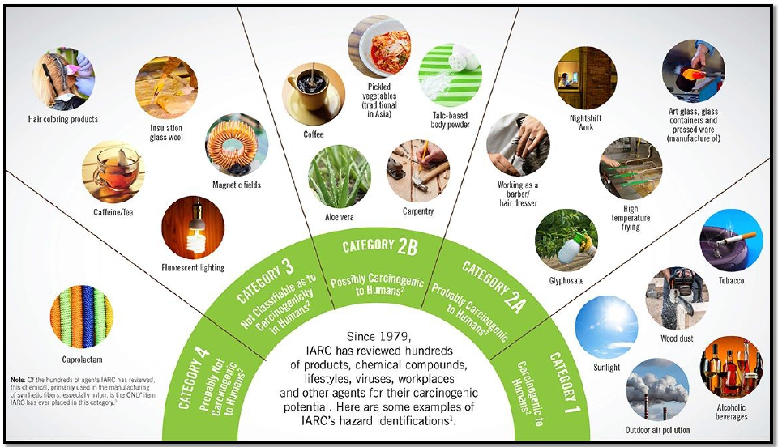
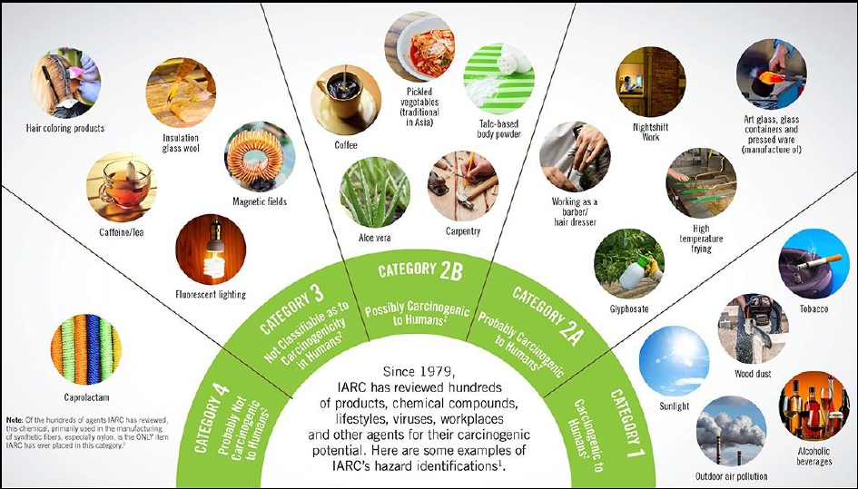
06/11/2016
Etiology of Tumors
18

Slide 19
19
06/11/2016
Chemical Carcinogens
• Chemical carcinogens can be natural or synthetic.
• They can cause cellular damage via:
• Direct
• Indirect

Slide 20
06/11/2016
20
Chemical Carcinogens
• Direct-acting agents
• They require no metabolic conversion to become carcinogenic.
• They are in general weak carcinogens but are important because
some of them are cancer chemotherapy drugs (e.g. alkylating
agents).

Slide 21
06/11/2016
21
Chemical Carcinogens
• Indirect-acting agents
• They require metabolic conversion of the chemical compound
(procarcinogen) to active & carcinogenic products (ultimate
carcinogen).
• e.g. benzo[a]pyrene, aromatic amines, azo dyes & Aflatoxin B1

Slide 22
06/11/2016
22
Chemical Carcinogens
• Mechanisms of action:
• Most chemical carcinogens are mutagenic i.e. cause genetic
mutations.
• the commonly mutated oncogenes & tumor suppressors are RAS and
TP53.
• All direct chemical carcinogens & ultimate chemical carcinogens
are highly reactive as they have electron-deficient atoms.
• They react with the electron rich atoms in the RNA, DNA & other
cellular proteins.

Slide 23
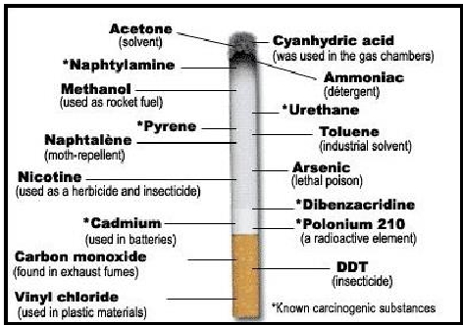
23
06/11/2016
Chemical Carcinogens
• Alkylating agents
• Polycyclic hydrocarbons
• Cigarette smoking
• Animal fats during broiling meats
• Smoked meats & fish

Slide 24
06/11/2016
24
Chemical Carcinogens
• Aromatic amines & azo dyes:
• B-naphthylamine cause bladder cancer in rubber industries &
aniline dye.
• Some azo dyes, used to color food, cause bladder cancer.

Slide 25
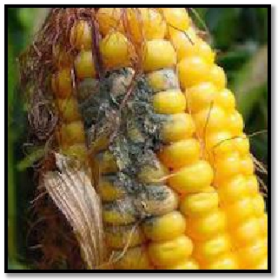
06/11/2016
25
Chemical Carcinogens
• Nitrosamines & nitrosamides are used are preservatives
& cause gastric carcinoma.
• Alfatoxin B1, produced by Aspergillus which grow on
improperly stored grains, it causes hepatocellular
carcinoma.

Slide 26
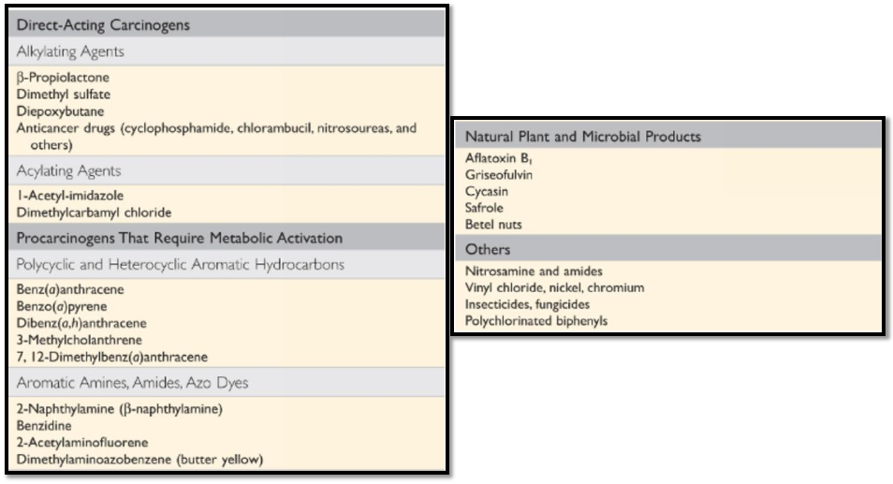
06/11/2016
Chemical Carcinogens
26

Slide 27
06/11/2016
27
Radiation
• Radiation, whatever its source (UV rays of sunlight, x-
rays, nuclear fission, radionuclides) is an established
carcinogen.
• Radiation has mutagenic effects: chromosomes breakage,
translocations & point mutations.

Slide 28
06/11/2016
28
Radiation
• UV rays of sunlight
• It causes skin cancers: melanoma, squamous cell carcinoma &
basal cell carcinoma.
• It is capable of DNA damage & mutations of p53 tumor suppressor
gene.
• When extensive exposure to UV rays occurs, the repair system is
overwhelmed → skin cancer.

Slide 29
29
06/11/2016
Viral & Microbial Oncogenes
• Viral & microbial oncogenes include:
• RNA viruses
• DNA viruses
• Other micro-organisms e.g. H. Pylori bacteria

Slide 30
06/11/2016
30
Viral & Microbial Oncogenes
• Host cells have endogenous gene to maintain a normal
cell cycle.
• Oncogene viruses induce cellular proliferation, mimic or
block cellular signals necessary for the cell cycle
regulation.

Slide 31
06/11/2016
31
Viral & Microbial Oncogenes
• RNA oncogenic viruses:
• Human T cell lymphotropic virus-1 (HTLV-1), a retrovirus, infects &
transforms T-lymphocytes.
• It causes T-Cell leukemia/Lymphoma after a prolonged latent
period (20-30 years).
• It is endemic in Japan & the Caribbean.

Slide 32
06/11/2016
32
Viral & Microbial Oncogenes
• RNA oncogenic viruses:
• It is transmitted like HIV but only 1% of infected patients develop T-
cell leukemia/Lymphoma.
• No cure or vaccine to HTLV-1.
• Treatment: chemotherapy with common relapses.

Slide 33
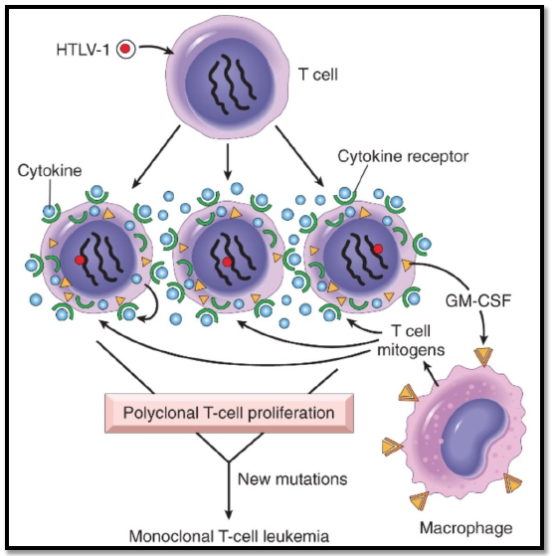
06/11/2016
HTLV-1 Infection
33

Slide 34
06/11/2016
34
Viral & Microbial Oncogenes
• DNA oncogenic viruses:
• DNA viruses form stable associations with hosts DNA, thus the
transcribed viral DNA transforms the host cells.
• e.g.
•
•
•
•
Human papilloma virus (HPV)
Epstein Barr virus (EBV)
Hepatitis B virus (HBV)
Kaposi sarcoma herpesvirus (KSHV, also called human herpesvirus-8
[HHV-8])

Slide 35
06/11/2016
35
Viral & Microbial Oncogenes
• HPV infection:
• HPV has more than 70 serotypes.
• It is a sexually transmitted.
• It causes benign warts, squamous cell carcinoma of the cervix,
anogenital region, mouth & larynx.

Slide 36
06/11/2016
Viral & Microbial Oncogenes
• HPV infection:
• HPV types 6 and 11:
• Genital warts
36
• HPV types 16, 18, 31:
• 85% of cervical carcinomas are caused by HPV 16 or 18
• High risk HPV types integrates with the host’s DNA

Slide 37
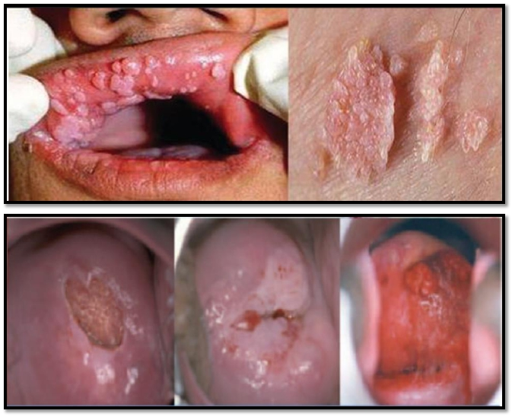
06/11/2016
HPV Infection
37

Slide 38
06/11/2016
38
Viral & Microbial Oncogenes
• HPV infection:
• The oncogenic potential of HPV 16 and 18 can be related to
products of two early viral genes, E6 and E7.
• E6 protein binds to Rb tumor suppressor and releases the E2F
transcription factors that normally are sequestered by Rb,
promoting progression through the cell cycle.
• E7 protein binds to p53 & facilitates its degradation.

Slide 39
06/11/2016
39
Viral & Microbial Oncogenes
• HPV infection:
• HPV infection alone is not sufficient to cause carcinoma and other
factors also contribute to the development of cervical carcinoma
e.g.
• cigarette smoking
• coexisting infections
• hormonal changes

Slide 40
06/11/2016
40
Viral & Microbial Oncogenes
• EBV infection:
• It is a common virus worldwide.
• It infects B lymphocytes & epithelial cells of the nasopharynx.
• It causes infectious mononucleosis.
• It causes several malignant tumors e.g.
• Burkitt’s Lymphoma
• B-cell lymphoma in immunosuppressed
• Nasopharyngeal carcinoma

Slide 41
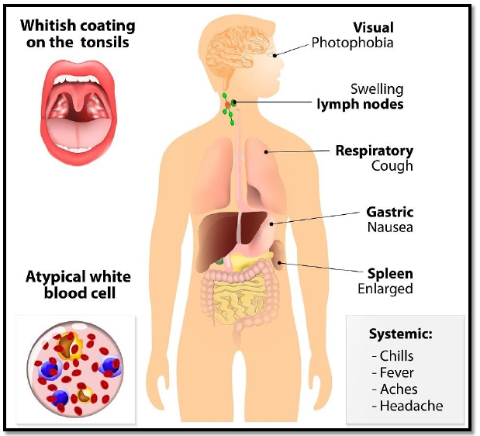
06/11/2016
41
EBV Infection – Infectious Mononucleoses

Slide 42
06/11/2016
42
Viral & Microbial Oncogenes
• EBV infection:
• Nasopharyngeal carcinoma is a malignant neoplasm arising from
the nasopharygeal epithelium.
• It is endemic in South China and parts of Africa.
• 100% of cases contain EBV genome in these endemic areas.

Slide 43
06/11/2016
43
Viral & Microbial Oncogenes
• EBV infection:
• EBV also causes Burkitt’s lymphoma, a highly malignant B-cell
tumor.
• However, rare sporadic cases occur worldwide.
• EBV-related Burkitt’s lymphoma is the most common childhood
tumor in Africa.
• All cases have t(8:14) genetic mutation.

Slide 44
06/11/2016
44
Viral & Microbial Oncogenes
• EBV infection:
• EBV causes B lymphocyte cellular proliferation.
• It causes loss of growth regulation.
• It predisposes the cells to genetic mutations, especially t(8:14).

Slide 45
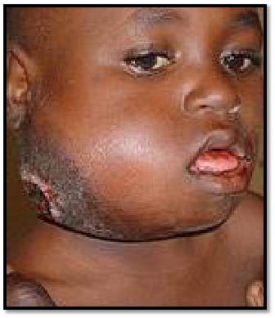
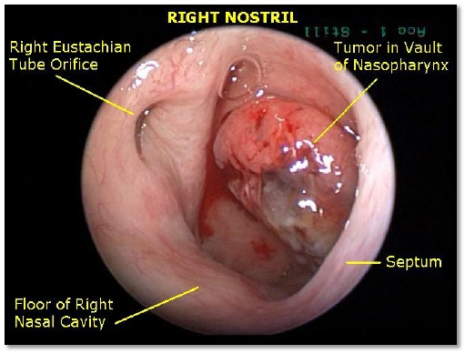
06/11/2016
EBV Infection
45

Slide 46
06/11/2016
46
Viral & Microbial Oncogenes
• HBV infection:
• HBV infection has a strong association with liver cell
carcinoma (HCC).
• It is present world-wide, but most commonly in the far East &
Africa.
• HBV infection incurs up to 200-fold risk of HCC.

Slide 47
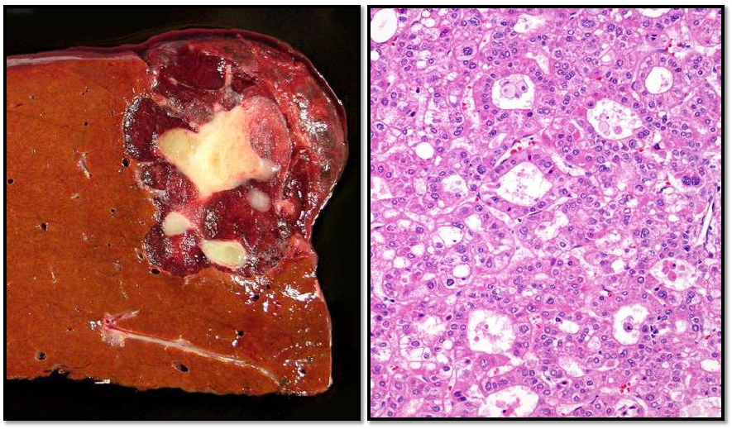
06/11/2016
HBV Infection
47

Slide 48
06/11/2016
48
Viral & Microbial Oncogenes
• Helicobacter Pylori bacteria:
• It is bacteria that infects the stomach
• It causes:
• Peptic ulcers
• Gastric lymphoma (Mucosal Associated Lymphoid Tumor (MALT)
• Gastric carcinoma

Slide 49
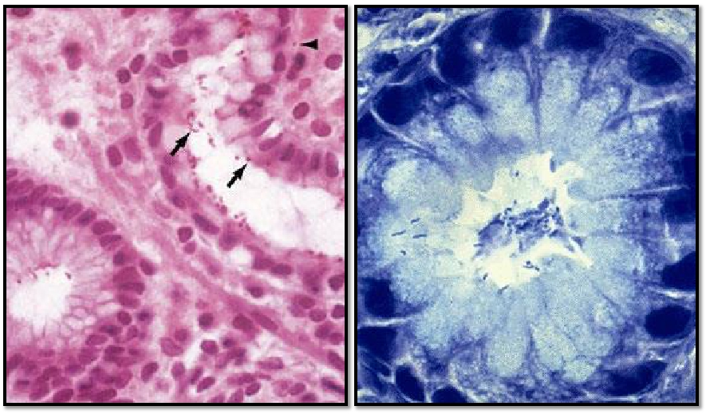
06/11/2016
H. Pylori Infection
49

Slide 50
06/11/2016
50
Reference
• Kumar V, Abbas AK, Aster JC. Robbins Basic Pathology.
9th ed. Elsevier; 2013. Philadelphia, PA.

Slide 51
06/11/2016
51
END OF LECTURE
Thank You

