Slide 1
Foundation block: pathology
INFLAMMATION AND REPAIR
Lecture 3
Dr. Maha Arafah
Associate Professor
Department of Pathology
King Saud University
Email: marafah@hotmail.com
Oct, 2016

Slide 2
1. Outcomes of acute inflammation 2. Different patterns of inflammation 3.Chemical mediators

Slide 3
Objectives
List and describe the outcome of acute inflammation.
Recognize the different patterns of inflammation.
Chemical mediators of inflammation:
Definition
Know the general principles for chemical mediators.
Know the cellular sources and major effects of the mediators.
List the most likely mediators of each of the steps of inflammation.

Slide 4
Outcomes of Acute Inflammation
List and describe the outcome of acute inflammation.
Acute inflammation may have one of the four outcomes:
Complete resolution
Healing by connective tissue replacement (fibrosis)
Progression of the tissue response to chronic inflammation
Abscess formation

Slide 5
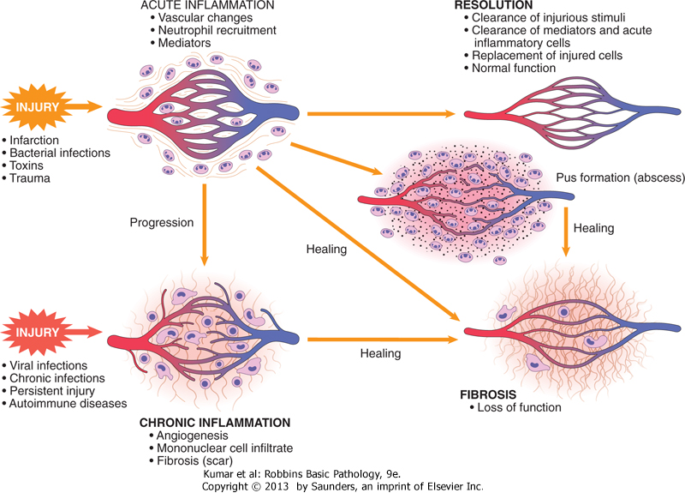
List and describe the outcome of acute inflammation.

Slide 6
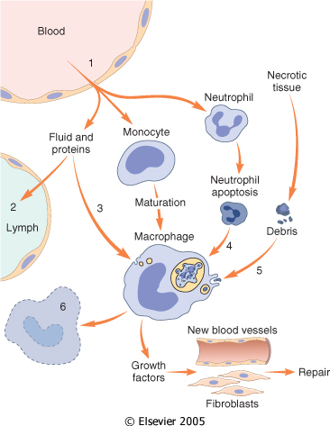
List and describe the outcome of acute inflammation.
Events in the resolution of inflammation
This involves neutralization, decay, or enzymatic degradation of the various chemical mediators; normalization of vascular permeability; and cessation of leukocyte emigration and apoptosis
The necrotic debris, edema fluid, and inflammatory cells are cleared by phagocytes and lymphatic drainage

Slide 7
Objectives
Upon completion of this lecture, the student should:
List and describe the outcome of acute inflammation.
Recognize the different pattern of inflammation.
Define the chemical mediators of inflammation.
Definition
Know the general principles for chemical mediators.
Know the cellular sources and major effects of the mediators.
List the most likely mediators of each of the steps of inflammation.

Slide 8
Morphologic Patterns of Acute Inflammation
2. Recognize the different patterns of inflammation.
Several types of inflammation vary in their morphology and clinical correlates. Why?
The severity of the reaction
specific cause
the particular tissue
site involved

Slide 9
Morphologic Patterns of Acute Inflammation
2. Recognize the different patterns of inflammation.
SEROUS INFLAMMATION
FIBRINOUS INFLAMMATION
SUPPURATIVE OR PURULENT INFLAMMATION
ULCERS

Slide 10
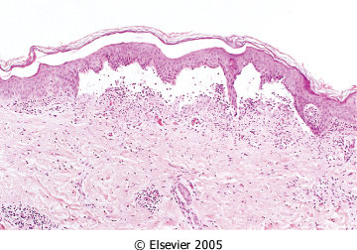
2. Recognize the different patterns of inflammation.
SEROUS INFLAMMATION: marked by the outpouring of a thin fluid

Slide 11
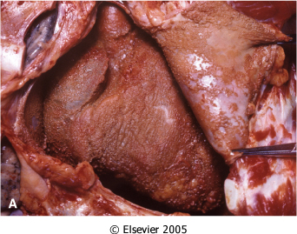
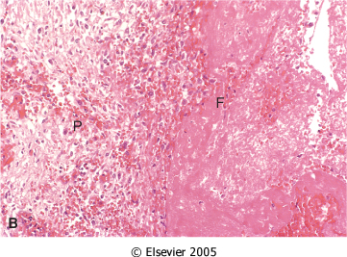
FIBRINOUS INFLAMMATION
2. Recognize the different patterns of inflammation.
A fibrinous exudate is characteristic of inflammation in the lining of body cavities, such as the meninges, pericardium and pleura (larger molecules such as fibrinogen pass the vascular barrier)
Fibrinous exudates may be removed by fibrinolysis, if not: it may stimulate the ingrowth of granulation tissue (organization)

Slide 12
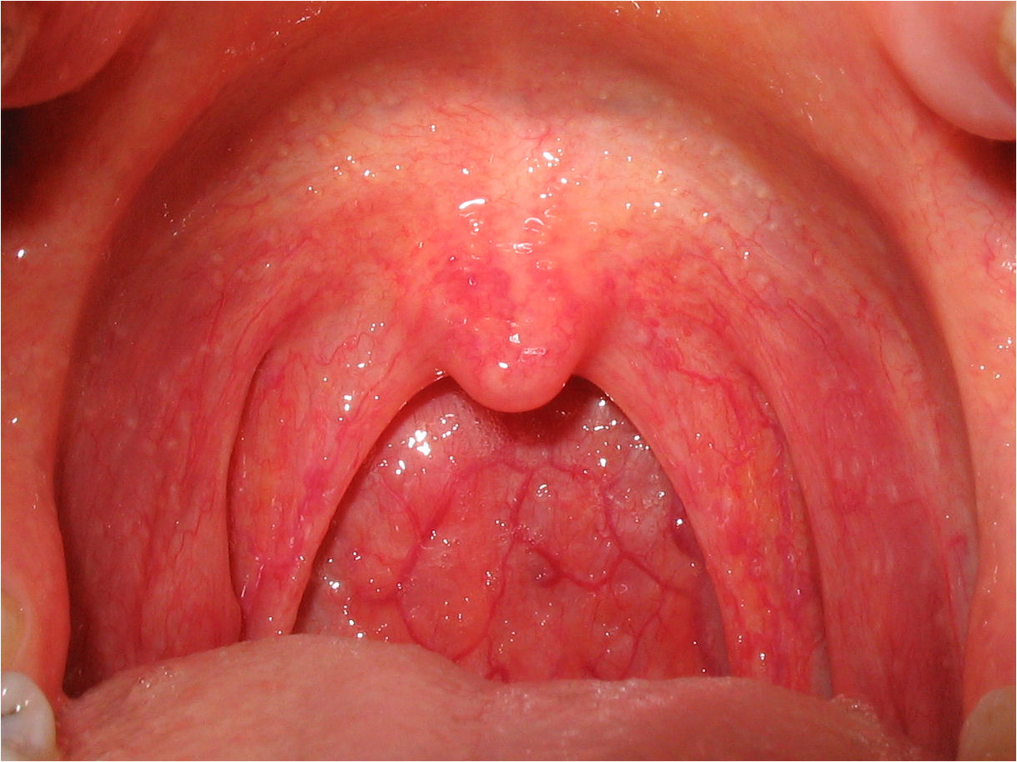
Catarrhal inflammation
2. Recognize the different patterns of inflammation.
Inflammation affects mucosa-lined surfaces with the outpouring of watery mucus

Slide 13
SUPPURATIVE OR PURULENT INFLAMMATION
2. Recognize the different patterns of inflammation.
characterized by the production of large amounts of pus or purulent exudate consisting of neutrophils, necrotic cells, and edema fluid caused by pyogenic (pus-producing) bacteria

Slide 14
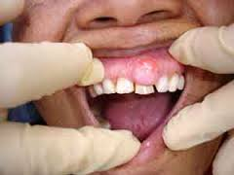
Suppurative abscess.
2. Recognize the different patterns of inflammation.
An enclosed collection of pus consisits of a mixture of neutrophils and necrotic debris.

Slide 15
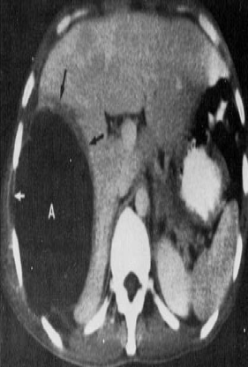
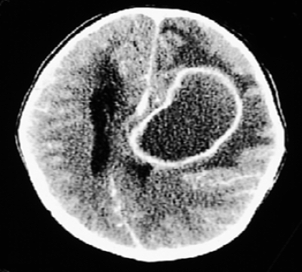
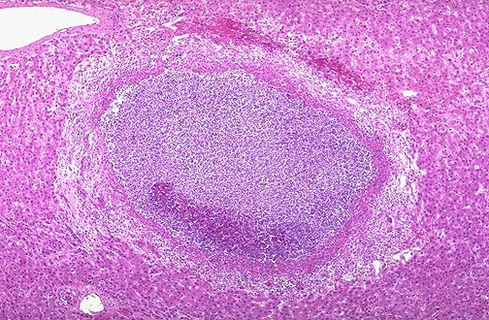
Morphologic Patterns of Acute Inflammation SUPPURATIVE OR PURULENT INFLAMMATION
2. Recognize the different patterns of inflammation.
Abscesses : localized collections of purulent inflammatory tissue caused by suppuration buried in a tissue, an organ, or a confined space

Slide 16
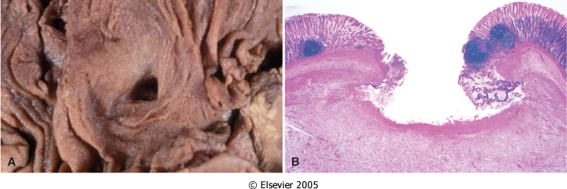
2. Recognize the different patterns of inflammation.
ULCERS
An ulcer is a local defect of the surface of an organ or tissue that is produced by the sloughing (shedding) of inflammatory necrotic tissue
Epithelial Defect
Necrotic base
Fibrinopurulent exudates
Granulation tissue
Fibrosis

Slide 17
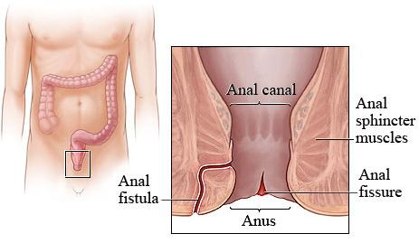
Fistula
2. Recognize the different patterns of inflammation.
A tract between two surfaces.

Slide 18
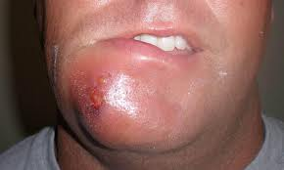
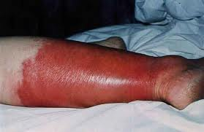
Cellulitis
2. Recognize the different patterns of inflammation.
denotes a spreading acute inflammation through interstitial tissues.

Slide 19
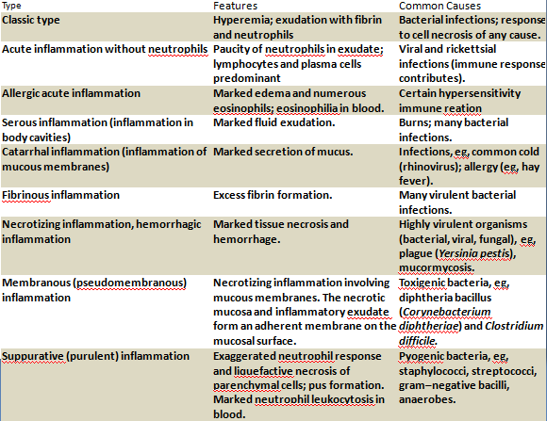

Slide 20
Objectives
Upon completion of this lecture, the student should:
List and describe the outcome of acute inflammation.
Recognize the different pattern of inflammation.
Chemical mediators of inflammation:
Definition
Know the general principles for chemical mediators.
Know the cellular sources and major effects of the mediators.
List the most likely mediators of each of the steps of inflammation.

Slide 21
3. Chemical mediators of inflammation
What are mediators?
Chemical mediators of inflammation are substances produced during inflammation inducing a specific events in acute inflammation.

Slide 22
General principles for chemical mediators
3. Chemical mediators of inflammation
The production of active mediators is triggered by:
microbial products
host proteins, such as the proteins of the complement, kinin and coagulation systems
( these are themselves activated by microbes and damaged tissues)

Slide 23
General principles for chemical mediators
Most mediators have the potential to cause harmful effects.
Therefore, there should be a mechanism to checks and balances their action.
Mediator function is tightly regulated by:
decay (e.g. AA metabolites)
inactivated by enzymes (kininase inactivates bradykinin)
eliminated ( antioxidants scavenge toxic oxygen metabolites)

Slide 24
Source of Chemical mediators
3. Chemical mediators of inflammation
Plasma-derived:
Complement
kinins
coagulation factors
Many in “pro-form” requiring activation (enzymatic cleavage)
Cell-derived:
Synthesized as needed (prostaglandin)
Preformed, sequestered and released (mast cell histamine)

Slide 25
3. Chemical mediators of inflammation
Notes:
.

Slide 26
3. Chemical mediators of inflammation

Slide 27
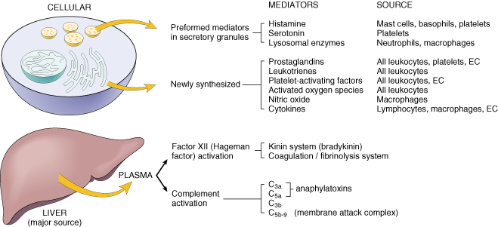
Cell-Derived Mediators
3. Chemical mediators of inflammation
Producing cells:
Tissue macrophages
Mast cells
Endothelial cells
Leukocytes
Notes:
Endothelial cells at the site of inflammation
Leukocytes recruited to the site form the blood

Slide 28
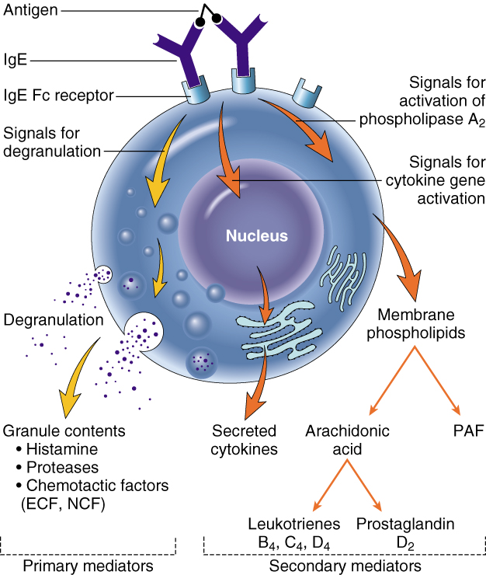
Vasoactive Amines Histamine & Serotonin
3. Chemical mediators of inflammation
Among first mediators in acute inflammatory reactions
Preformed mediators in secretory granules

Slide 29
Histamine
3. Chemical mediators of inflammation
Source:
many cell types, esp. mast cells, circulating basophils, and platelets
Stimuli of Release:
Physical injury
Immune reactions
C3a and C5a fragments
Leukocyte-derived histamine-
releasing proteins
Neuropeptides
Cytokines (e.g. IL-1 and IL-8)
Actions:
ARTERIOLAR DILATION
INCREASED VASCULAR PERMEABILITY (venular gaps)
ENDOTHELIAL ACTIVATION
Inactivated by:
Histaminase
Notes:
Histamine is the principal mediator of the immediate phase of increased vascular permeability, inducing venular endothelial contraction and interendothelial gaps.

Slide 30
Serotonin (5-HT)
3. Chemical mediators of inflammation
Source:
Platelets
Action:
Similar to histamine
Stimulus:
Platelet aggregation

Slide 31
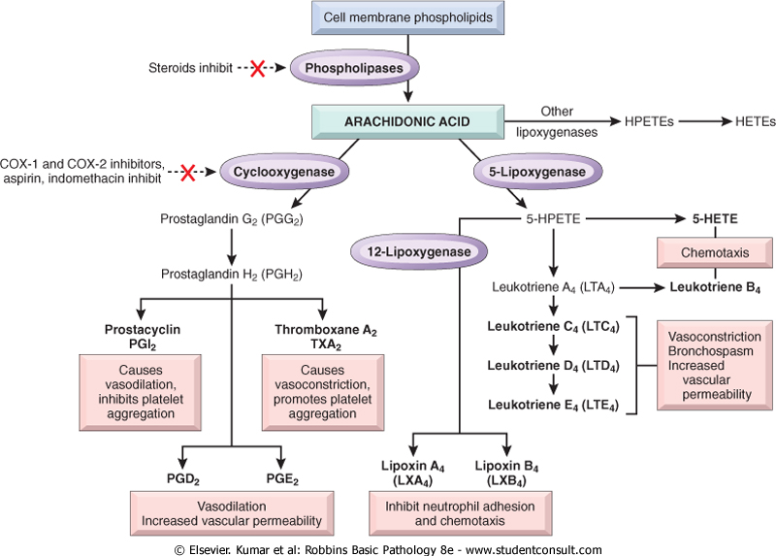
3. Chemical mediators of inflammation
Source:
Leukocytes
Mast cells
Endothelial cells
Platelets
Notes:
.

Slide 32
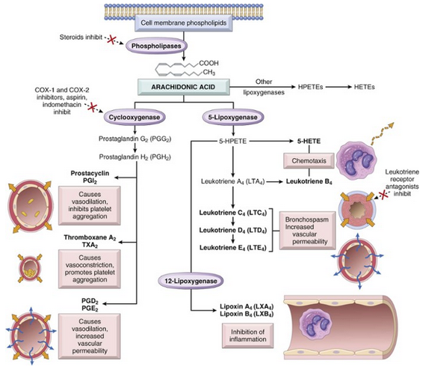
3. Chemical mediators of inflammation
Ss
Ss
Cyclo oxigenase pathway
5 lipoxigenase pathway
12 lipoxigenase pathway

Slide 33
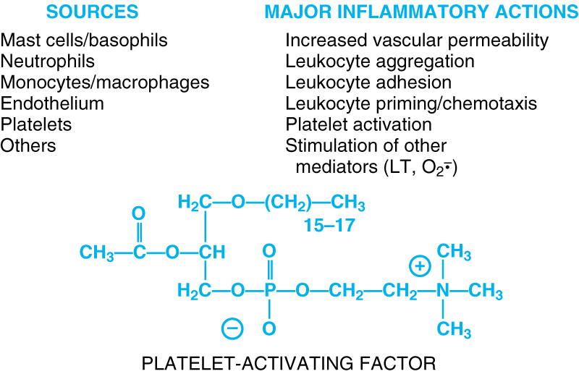
3. Chemical mediators of inflammation
Notes:
.

Slide 34
3. Chemical mediators of inflammation
Cytokines
Polypeptides
Actions:
Involved in early immune and inflammatory reactions
Some stimulate bone marrow precursors to produce more leukocytes
Notes:
.

Slide 35
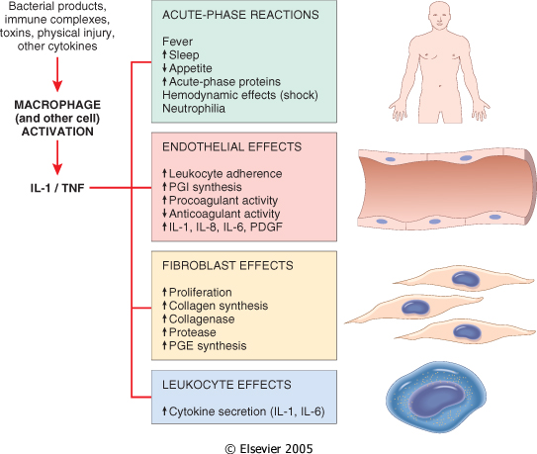
3. Chemical mediators of inflammation
Cytokine of
Acute inflammation:
Interleukin (IL-1) & TNF

Slide 36
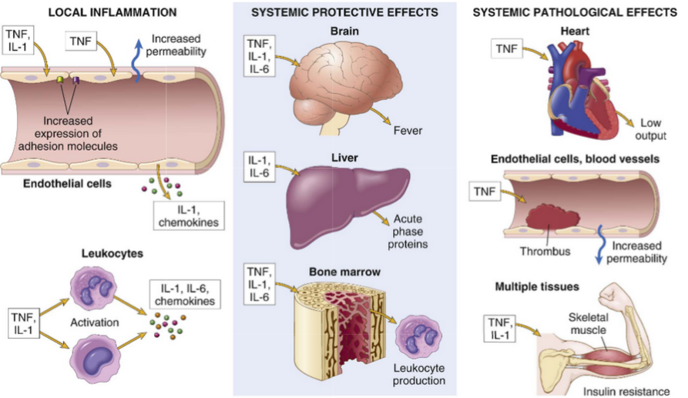
3. Chemical mediators of inflammation
Major roles of cytokines in acute inflammation

Slide 37
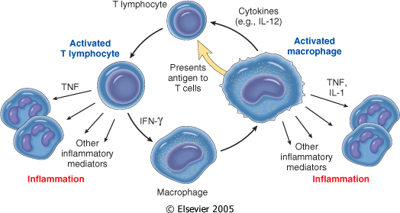
3. Chemical mediators of inflammation
Chronic Inflammation: Cytokines of
Interferon-γ (INF- γ) & Interleukin ( IL-12)
Activated lymphocytes and macrophages influence each other and also release inflammatory mediators that affect other cells.

Slide 38
3. Chemical mediators of inflammation
Chemokines
Small proteins
They are chemoattractants for leukocytes
Main functions:
Leukocyte recruitment & activation in inflammation
Normal anatomic organization of cells in lymphoid and other tissues
Notes:
.

Slide 39
3. Chemical mediators of inflammation
Reactive Oxygen Species
Synthesized via
NADPH oxidase pathway
Source:
Neutrophils and Macrophages
Stimuli of release:
Microbes
Immune complexes
Cytokines
Action:
Microbicidial (cytotoxic) agent
Notes:
.

Slide 40
3. Chemical mediators of inflammation
Nitric Oxide ( NO)
Short-lived
Soluble free-radical gas
Functions:
Vasodilation
Antagonism of platelet activation (adhesion, aggregation, & degranulation)
Reduction of leukocyte recruitment
Microbicidial (cytotoxic) agent (with or without ROS) in activated macrophages
Notes:
.

Slide 41
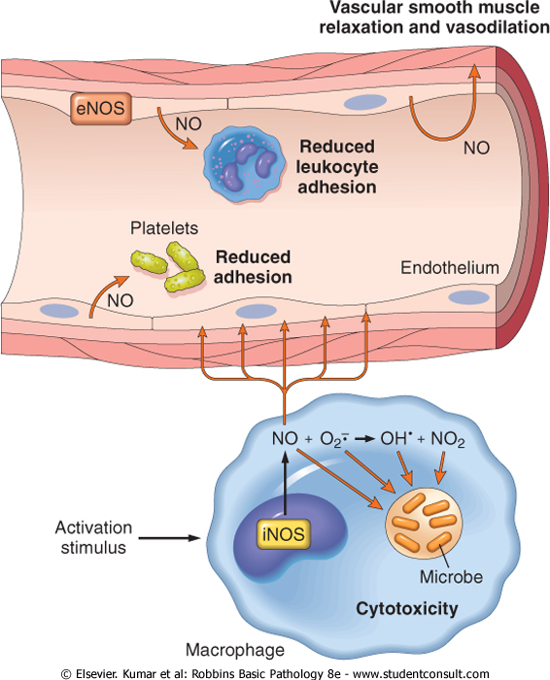
3. Chemical mediators of inflammation

Slide 42
3. Chemical mediators of inflammation
Lysosomal Enzymes of Leukocytes
Neutrophils & Monocytes
Enzymes:
Acid proteases
Neutral proteases (e.g. elastase, collagenase, & cathepsin)
Their action is checked by:
Serum antiproteases (e.g. α1-antitrypsin)
Notes:
.

Slide 43
3. Chemical mediators of inflammation
Neuropeptides
Small proteins
Secreted by nerve fibers mainly in lung & GIT
Initiate inflammatory response
e.g. Substance P :
Transmits pain signals
Regulates vessel tone
Modulates vascular permeability
Notes:
.

Slide 44
3. Chemical mediators of inflammation

Slide 45
PLASMA PROTEASES
3. Chemical mediators of inflammation
A variety of phenomena in the inflammatory response are mediated by plasma proteins that belong to three interrelated systems
1. Kinin
2. the complement
3. clotting systems

Slide 46
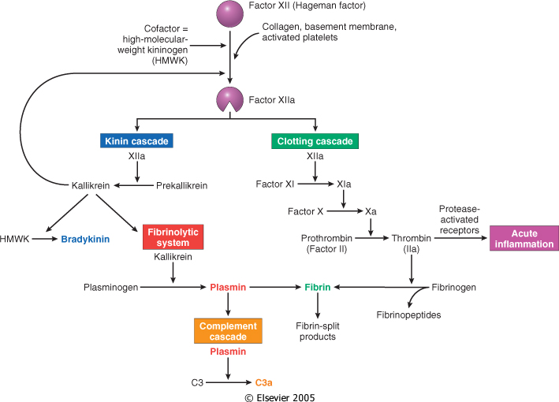
3. Chemical mediators of inflammation
Kinin & clotting systems
enhanced leukocyte adhesion & activation
increases vascular permeability, pain
increases vascular permeability, Chemotaxis

Slide 47
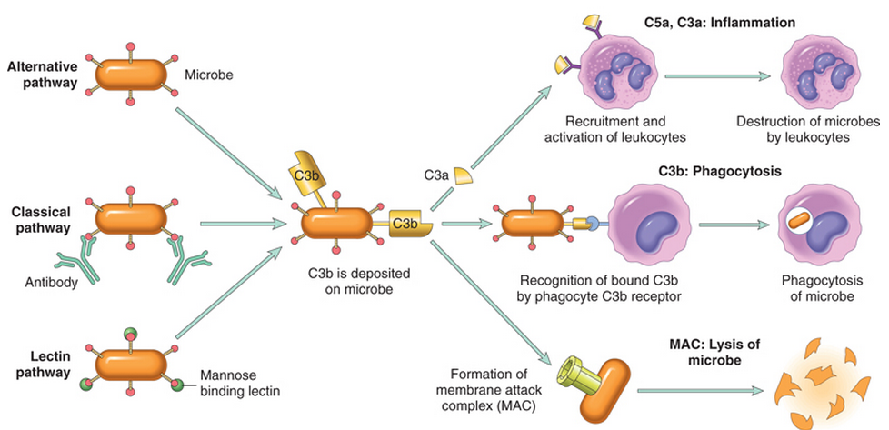
3. Chemical mediators of inflammation
Complement System

Slide 48
Complement protein
3. Chemical mediators of inflammation
C3a & C5a ➔ Increase vascular permeability
( anaphylatoxins)
C5a ➔ Chemotaxis
C3b ➔ Opsonization
C5-9 ➔ membrane attack complex

Slide 49
3. Chemical mediators of inflammation
Vasodilation | Prostaglandins Histamine Nitric oxide
Increased vascular permeability | Vasoactive amines Bradykinin Leukotrienes C4, D4, E4 PAF Substance P
Chemotaxis, leukocyte recruitment and activation | C5a Leukotriene B4 Chemokines IL-1, TNF Bacterial products
Fever | IL-1, TNF Prostaglandins
Pain | Prostaglandins Bradykinin
Tissue damage | Neutrophil and macrophage lysosomal enzymes Oxygen metabolites Nitric oxide
Role of Mediators in Different Reactions of Inflammation

Slide 50
The Actions of the Principal Mediators
Principal Actions | Source | Mediators
 |  | :Cell-Derived
Vasodilation, increased vascular permeability, endothelial activation | Mast cells, basophils, platelets | Histamine
Vasodilatation, increased vascular permeability. | Platelets | Serotonin
Vasodilatation, pain, fever. | Mast cells, leukocytes | Prostaglandins
Increased vascular permeability, chemotaxis, leukocyte adhesion and activation. | Mast cells, leukocytes | Leukotrienes
Vasodilatation, increased vascular permeability, leukocyte adhesion, chemotaxis, degranulation, oxidative burst | Leukocytes, endothelial cells | Platelet-activating factor
Killing of microbes, tissue damage | Leukocytes | Reactive oxygen species
Vascular smooth muscle relaxation; killing of microbes | Endothelium, macrophages | Nitric oxide
Local endothelial activation (expres-sion of adhesion molecules), systemic acute-phase response in severe infections, septic shock | Macrophages, lymphocytes Endothelial cells, mast cells | Cytokines (e.g. TNF, IL-)

