Slide 1
Foundation Block, Pathology
INFLAMMATION AND REPAIR
Lecture 4
Chronic inflammation
Systemic effect of inflammation
Dr. Maha Arafah
Associate Professor
Department of Pathology
King Khalid University Hospital and King Saud University
Email: marafah@ksu.edu.sa
marafah @hotmail.com
Oct 2016

Slide 2
Objectives
Define chronic inflammation with emphasis on causes, nature of the inflammatory response, and tissue changes.
Compare and contrast the clinical settings in which different types of inflammatory cells (eosinophils, macrophages, and lymphocytes) accumulate in tissues.
Describe the systemic manifestations of inflammation and their general physiology, including fever, leukocyte left shift, and acute phase reactants.

Slide 3
CHRONIC INFLAMMATION
1. Define chronic inflammation, its causes, effects and patterns
Inflammation of prolonged duration (weeks to years) in which continuing inflammation, tissue injury, and healing, often by fibrosis, proceed simultaneously

Slide 4
CHRONIC INFLAMMATION
1. Define chronic inflammation, its causes, effects and patterns
It is slow evolving (weeks to months) resulting into fibrosis
The essential changes are:
1. Absence of polymorphs (natural life span of 1–3 days); the appearance of macrophages, lymphocytes and often plasma cells
2. Proliferation of vascular endothelium by ‘budding’ – formation of new capillaries (angiogenesis).
3. Proliferation of fibroblasts with collagen production leading to Fibrosis.

Slide 5
Chronic inflammation may arise in the following settings:
1. Define chronic inflammation, its causes, effects and patterns
Persistent infections by microbes that are difficult to eradicate.
These include :
Mycobacterium tuberculosis
Treponema pallidum (the causative organism of syphilis)
certain viruses and fungi
All of which tend to establish persistent infections and elicit a T lymphocyte-mediated immune response called delayed-type hypersensitivity.

Slide 6
Chronic inflammation may arise in the following settings:
1. Define chronic inflammation, its causes, effects and patterns
2. Immune-mediated inflammatory diseases (hypersensitivity diseases): Diseases that are caused by excessive and inappropriate activation of the immune system leading to autoimmune diseases.
e.g.
Rheumatoid arthritis
inflammatory bowel disease
psoriasis
or
Immune responses against common environmental substances that cause allergic diseases, such as bronchial asthma.

Slide 7
Chronic inflammation may arise in the following settings:
1. Define chronic inflammation, its causes, effects and patterns
3. Prolonged exposure to potentially toxic agents.
Examples are nondegradable exogenous materials such as inhaled particulate silica, which can induce a chronic inflammatory response in the lungs (silicosis)
Endogenous agents such as cholesterol crystals, which may contribute to atherosclerosis

Slide 8
Chronic inflammation may arise in the following settings:
1. Define chronic inflammation, its causes, effects and patterns
4. Mild forms of chronic inflammation may be important in the pathogenesis of many diseases
Such diseases include:
neurodegenerative disorders such as Alzheimer disease
atherosclerosis
metabolic syndrome and the associated type 2 diabetes,
and some forms of cancer in which inflammatory reactions promote tumor development

Slide 9
CHRONIC INFLAMMATION
1. Define chronic inflammation, its causes, effects and patterns
Characterized by a 3 different set of reactions:
Infiltration with mononuclear cells, including:
Macrophages
Lymphocytes
Plasma cells
Tissue destruction, largely induced by the products of the inflammatory cells
Repair, involving new vessel proliferation (angiogenesis) and fibrosis
Acute inflammation is distinguished by vascular changes, edema, and a predominantly neutrophilic infiltrate

Slide 10
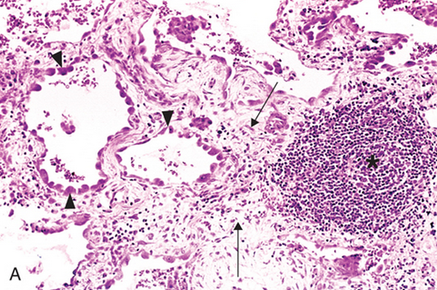
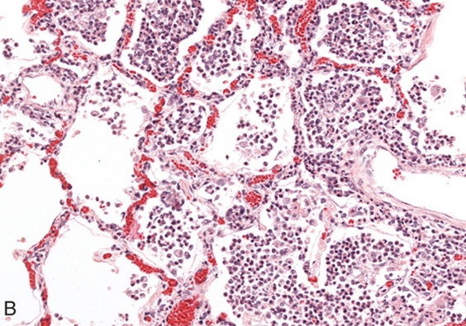
1. Define chronic inflammation, its causes, effects and patterns
Lung chronic inflammation
Lung acute inflammation

Slide 11
Chronic inflammation patterns
1. Define chronic inflammation, its causes, effects and patterns
Chronic non specific inflammation
Chronic granulomatous inflammation
Features of chronic inflammation
Examples:
Foreign material, e.g. silicates, including asbestos.
Auto-immune diseases, e.g. auto-immune thyroiditis
Chronic inflammation in which modified macrophages (epithelioid cells) accumulate in small clusters surrounded by lymphocytes. The small clusters are called: (GRANULOMAS)
Example:
TUBERCULOSIS

Slide 12
Cells in Chronic inflammation
1. Define chronic inflammation, its causes, effects and patterns
2. Different types of inflammatory cells accumulate in tissues
Complex interactions between several cell populations and their secreted mediators.
Mediated by the interaction of monocyte macrophages with T and B lymphocyte, plasma cells and others

Slide 13
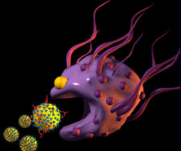
Macrophages
1. Define chronic inflammation, its causes, effects and patterns
2. Different types of inflammatory cells accumulate in tissues
In tissue:
the liver (Kupffer cells)
spleen and lymph nodes (sinus histiocytes)
central nervous system (microglial cells)
and lungs (alveolar macrophages)
In blood: monocytes
Under the influence of adhesion molecules and chemokines, they migrate to a site of injury within 24 to 48 hours after the onset of acute inflammation
(macrophages)

Slide 14
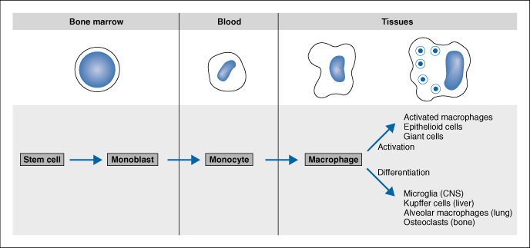
2. Different types of inflammatory cells accumulate in tissues
mononuclear phagocyte system
monocytes begin to emigrate into extravascular tissues quite early in acute inflammation and within 48 hours they may constitute the predominant cell type

Slide 15
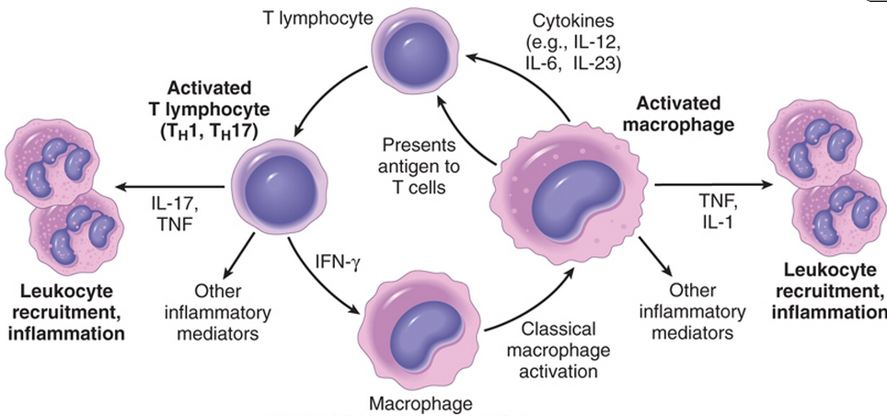
MONONUCLEAR CELL INFILTRATION Macrophages
1. Define chronic inflammation, its causes, effects and patterns
2. Different types of inflammatory cells accumulate in tissues
Macrophages may be activated by a variety of stimuli, including
cytokines (e.g., IFN-γ) secreted by sensitized T lymphocytes and by NK cells
bacterial endotoxins

Slide 16
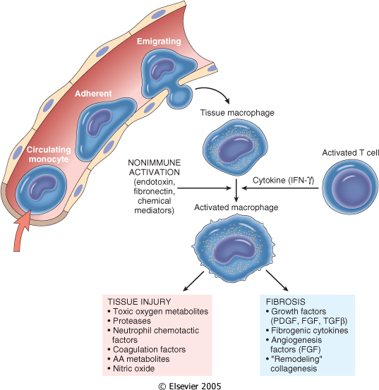
1. Define chronic inflammation, its causes, effects and patterns
2. Different types of inflammatory cells accumulate in tissues
The roles of activated macrophages in chronic inflammation
to eliminate injurious agents such as microbes
to initiate the process of repair
secrete mediators of inflammation, such as cytokines (TNF, IL-1, chemokines, and eicosanoids).
display antigens to T lymphocytes and respond to signals from T cells, thus setting up a feedback loop
It is responsible for much of the tissue injury in chronic inflammation

Slide 17
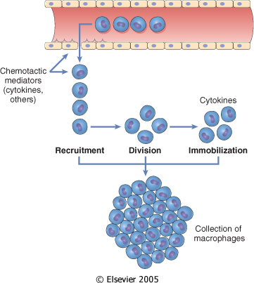
Macrophages
1. Define chronic inflammation, its causes, effects and patterns
2. Different types of inflammatory cells accumulate in tissues
In chronic inflammation, macrophage accumulation persists, this is mediated by different mechanisms:
Recruitment of monocytes from the circulation
Local proliferation of macrophages
Immobilization of macrophages
Collection of activated macrophages :
GRANULOMA

Slide 18
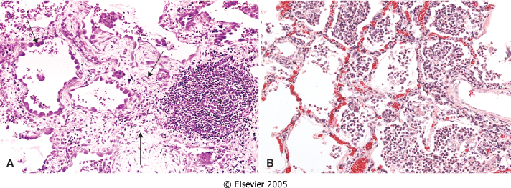
CELLS IN CHRONIC INFLAMMATION
1. Define chronic inflammation, its causes, effects and patterns
2. Different types of inflammatory cells accumulate in tissues
Lymphocytes
Both T & B Lymphocytes migrates into inflammation site

Slide 19
Lymphocytes
2. Different types of inflammatory cells accumulate in tissues
1. Define chronic inflammation, its causes, effects and patterns
B lymphocytes may develop into plasma cells, which secrete antibodies
T lymphocytes are activated to secrete cytokines:
CD4+ T lymphocytes promote inflammation and influence the nature of the inflammatory reaction

Slide 20
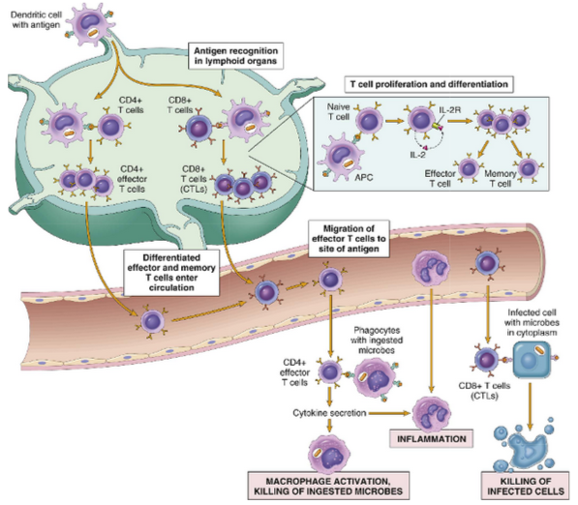
1. Define chronic inflammation, its causes, effects and patterns
2. Different types of inflammatory cells accumulate in tissues
Cell-mediated immunity

Slide 21
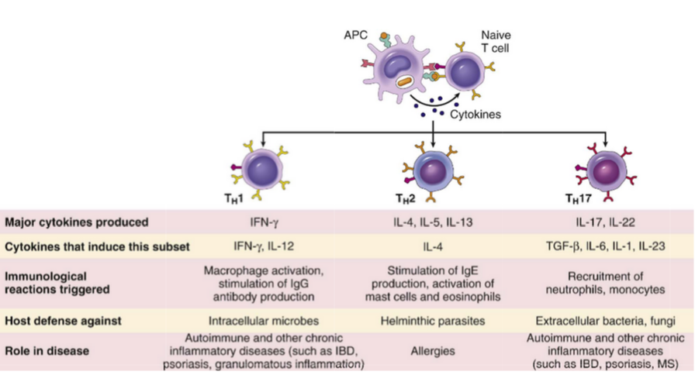
2. Different types of inflammatory cells accumulate in tissues
Subsets of helper T (TH) cells
In response to stimuli (mainly cytokines) present at the time of antigen recognition, naive CD4+ T cells may differentiate into populations of effector cells that produce distinct sets of cytokines and perform different functions.
IBD, inflammatory bowel disease
MS, multiple sclerosis

Slide 22
CD4+ helper T cells
2. Different types of inflammatory cells accumulate in tissues
There are three subsets of CD4+ helper T cells :
T_{H}1 cells produce the cytokine IFN-γ,
Function: activates macrophages in the classical pathway.
T_{H}2 cells secrete IL-4, IL-5, and IL-13
Function: recruit and activate eosinophils and are responsible for macrophage activation.
T_{H}17 cells secrete IL-17 and other cytokines
Function: induce the secretion of chemokines responsible for recruiting neutrophils and monocytes into the reaction.

Slide 23
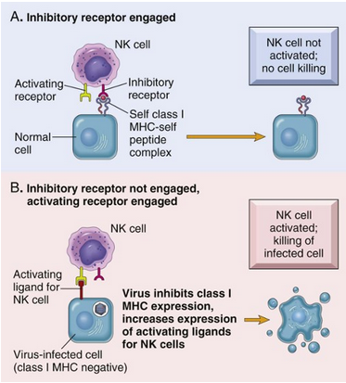
1. Define chronic inflammation, its causes, effects and patterns
2. Different types of inflammatory cells accumulate in tissues
Activating and inhibitory receptors of natural killer (NK) cells
Healthy cells express self class I MHC molecules, which are recognized by inhibitory receptors, thus ensuring that NK cells do not attack normal cells.
In infected and stressed cells, class I MHC expression is reduced so that the inhibitory receptors are not engaged, and ligands for activating receptors are expressed.
The result is that NK cells are activated and the infected cells are killed.

Slide 24
1. Define chronic inflammation, its causes, effects and patterns
2. Different types of inflammatory cells accumulate in tissues
Humoral immunity
Naive B lymphocytes recognize antigens, and under the influence of TH cells and other stimuli, the B cells are activated to proliferate and to differentiate into antibody-secreting plasma cells.
Some of the activated B cells undergo heavy-chain class switching and affinity maturation, and some become long-lived memory cells.
Antibodies of different heavy-chain classes (isotypes) perform different effector functions.
Note that the antibodies shown are IgG; these and IgM activate complement; and the specialized functions of IgA (mucosal immunity) and IgE (mast cell and eosinophil activation) are not shown.

Slide 25
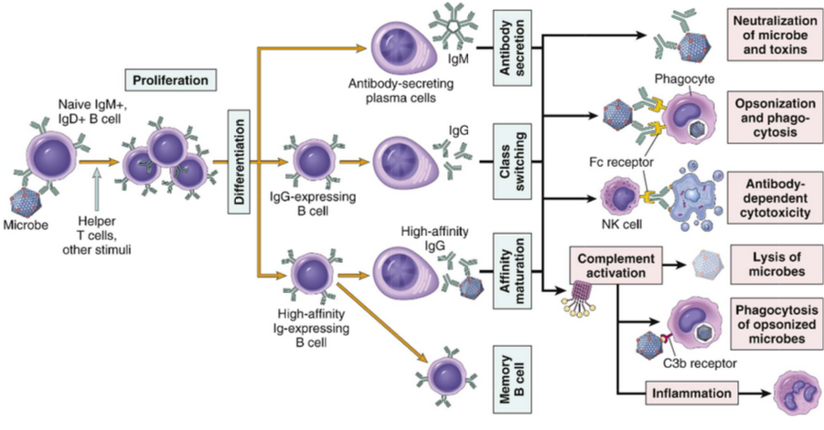
2. Different types of inflammatory cells accumulate in tissues
Humoral immunity

Slide 26
OTHER CELLS IN CHRONIC INFLAMMATION
2. Different types of inflammatory cells accumulate in tissues
Plasma cells
Lymphoid cell (Mature B cells)
Common cell in chronic inflammation
Primary source of antibodies
Antibodies are important in inflammation e.g. neutralize antigen and clearance of foreign Ag

Slide 27
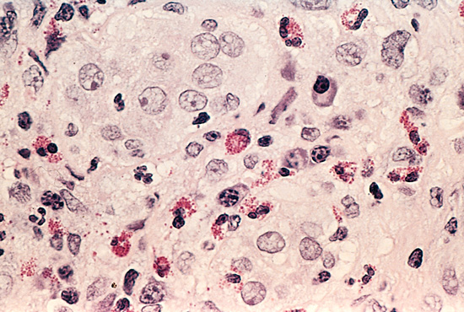
2. Different types of inflammatory cells accumulate in tissues
Eosinophils
are abundant in immune reactions mediated by IgE and in parasitic infections
respond to chemotactic agents derived largely from mast cells
Granules contain major basic protein: toxic to parasites and lead to lysis of mammalian epithelial cells

Slide 28
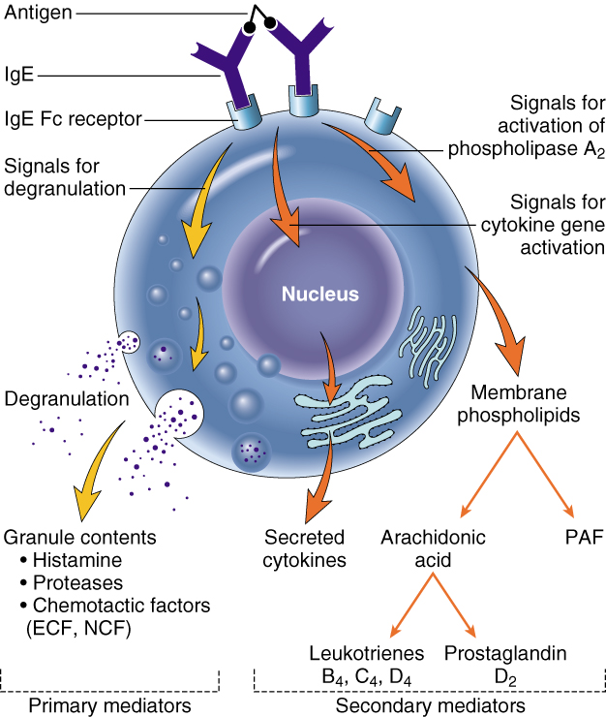
2. Different types of inflammatory cells accumulate in tissues
Mast cells
are widely distributed in connective tissues
express on their surface the receptor that binds the Fc portion of IgE antibody
the cells degranulate and release mediators, such as histamine and products of AA oxidation

Slide 30
Systemic effects of Inflammation
3. systemic manifestations of inflammation
Acute phase reaction/response
- IL-1 and TNF
Fever
Malaise
Anorexia
Bone marrow
- IL-1 + TNF
Leukocytosis
Lymphoid organs
Liver
- IL-6, IL-1, TNF
Acute phase proteins
C-reactive protein
Lipopolysaccharide binding protein
Serum amyloid A
a-2 macroglobulin
Haptoglobin
Ceruloplasmin
fibrinogen

Slide 31
Fever Produced in response to Pyrogens
3. systemic manifestations of inflammation
Types of Pyrogens:
Exogenous pyrogens: Bacterial products
Endogenous pyrogens:
IL-1 and TNF
Bacterial products stimulate leukocytes to release cytokines such as IL-1 and TNF that increase the enzymes (cyclooxygenases) that convert AA into prostaglandins.

Slide 32
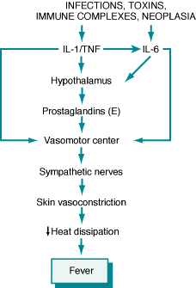
3. systemic manifestations of inflammation
Fever
In the hypothalamus, the prostaglandins, especially PGE₂, stimulate the production of neurotransmitters such as cyclic AMP, which function to reset the temperature set-point at a higher level.
NSAIDs, including aspirin , reduce fever by inhibiting cyclooxygenase and thus blocking prostaglandin synthesis.

Slide 33
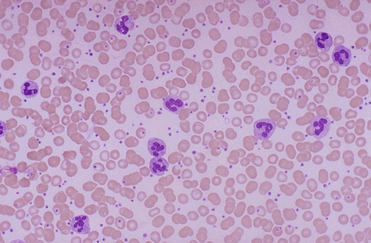
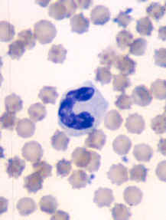
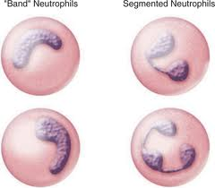
3. systemic manifestations of inflammation
Leukocytosis
Shift to left
Notes:
Acute inflammation is marked by an increase in inflammatory cells. Perhaps the simplest indicator of acute inflammation is an increase in the white blood cell count in the peripheal blood, here marked by an increase in segmented neutrophils (PMN's).

Slide 34
3. systemic manifestations of inflammation
Inflammation Systemic Manifestations
Leukocytosis:
WBC count climbs to 15,000 or 20,000 cells/μl
most bacterial infection (Neutrophil)
Lymphocytosis:
Infectious mononucleosis, mumps,
German measles
Eosinophilia: bronchial asthma,
hay fever, parasitic infestations
Leukopenia: typhoid fever,
infection with rickettsiae/protozoa

Slide 35
Elevation of C reactive protein
3. systemic manifestations of inflammation

Slide 36
3. systemic manifestations of inflammation
Increased erythrocyte sedimentation rate (ESR)
The rise in fibrinogen causes erythrocytes to form stacks (rouleaux) that sediment more rapidly at unit gravity than do individual erythrocytes.

Slide 37
3. systemic manifestations of inflammation

Slide 38
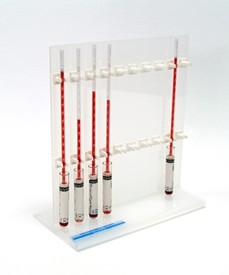
Erythrocyte sedimentation rate (ESR)
3. systemic manifestations of inflammation

Slide 39
Summary
Chronic inflammation is different from acute inflammation with respect to causes, nature of the inflammatory response, and tissue changes.
Different clinical settings associated with different types of inflammatory cells (eg, eosinophils, monocyte-macrophages, and lymphocytes) accumulate in the tissues.
The systemic manifestations of inflammation include fever, leukocyte left shift, and acute phase reactants.

Slide 41
Cell-mediated immunity
Dendritic cells (DCs) capture microbial antigens from epithelia and tissues and transport the antigens to lymph nodes. During this process, the DCs mature, and express high levels of MHC molecules and costimulators. Naive T cells recognize MHC-associated peptide antigens displayed on DCs.
The T cells are activated to proliferate and to differentiate into effector and memory cells, which migrate to sites of infection and serve various functions in cell-mediated
immunity.
CD4+ effector T cells of the TH1 subset recognize the antigens of microbes ingested by phagocytes, and activate the phagocytes to kill the microbes; other subsets of effector cells enhance leukocyte recruitment and stimulate different types of immune responses.
CD8+ cytotoxic T lymphocytes (CTLs) kill infected cells harboring microbes in the cytoplasm.
Some activated T cells remain in the lymphoid organs and help B cells to produce antibodies, and some T cells differentiate into long-lived memory cells.

