Slide 1
INFLAMMATION AND REPAIR
Lecture 5
Tissue Repair and Regeneration
Foundation Block, pathology
2016
Dr. Maha Arafah
Associate Professor
Department of Pathology
King Khalid University Hospital and King Saud University
Email: marafah@ksu.edu.sa
marafah @hotmail.com

Slide 2
Objectives
Upon completion of this lecture, the student should:
Describe the differences between repair processes: regeneration, healing and fibrosis. List examples of each cell type.
Know the differences between the various cell in regenerative abilities types.
Know the mechanism of repair and formation of granulation tissue.
List the three main phases of cutaneous wound healing.
Compare and contrast the difference between healing by primary intention and healing by secondary intention.
List factors which are associated with delayed wound healing.
List complication of wound healing.

Slide 3
Goal of the repair process
To restore the tissue to its original state after inflammatory reaction
Some tissues can be completely reconstituted after injury, such as the repair of bone after a fracture or the regeneration of the surface epithelium in a cutaneous wound.
For tissues that are incapable of regeneration, repair is accomplished by
connective tissue deposition, producing a scar.
Notes:
The goal of the repair process is to restore the tissue to its original state. The inflammatory reaction set in motion by the injury contains the damage, eliminates the damaging stimulus, removes injured tissue, and initiates the deposition of ECM components in the area of injury.
Some tissues can be completely reconstituted after injury, such as the repair of bone after a fracture or the regeneration of the surface epithelium in a cutaneous wound. For tissues that are incapable of regeneration, repair is accomplished by connective tissue deposition, producing a scar. This term is most often used in connection to wound healing in the skin, but it is also used to describe the replacement of parenchymal cells by connective tissue, as in the heart after myocardial infarction.
If damage persists, inflammation becomes chronic, and tissue damage and repair may occur concurrently. Connective tissue deposition in these conditions is usually referred to as fibrosis. In the broader sense, the term fibrosis applies to any abnormal deposition of connective tissue, regardless of cause.

Slide 4
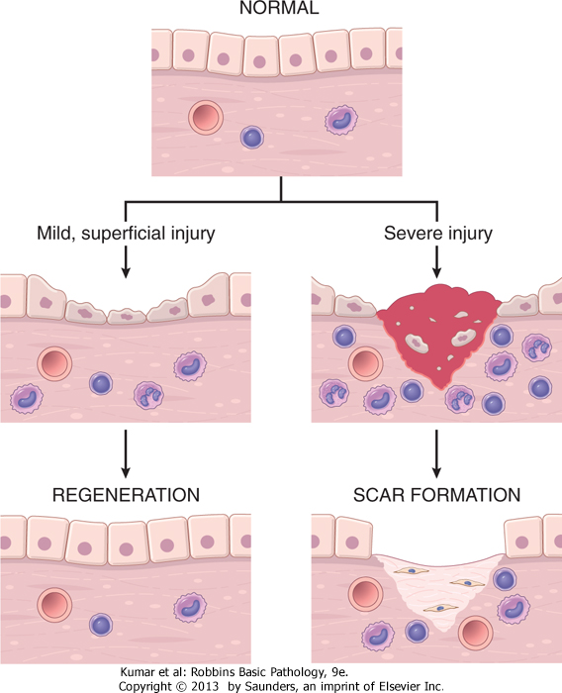
1. Describe the differences between regeneration, healing and fibrosis.

Slide 5
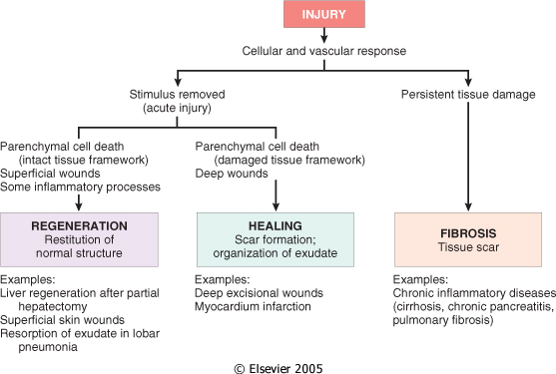
1. Describe the differences between regeneration healing and fibrosis.
If damage persists, inflammation becomes chronic, and tissue damage and repair may occur concurrently. Connective tissue deposition in these conditions is usually referred to as fibrosis.

Slide 6
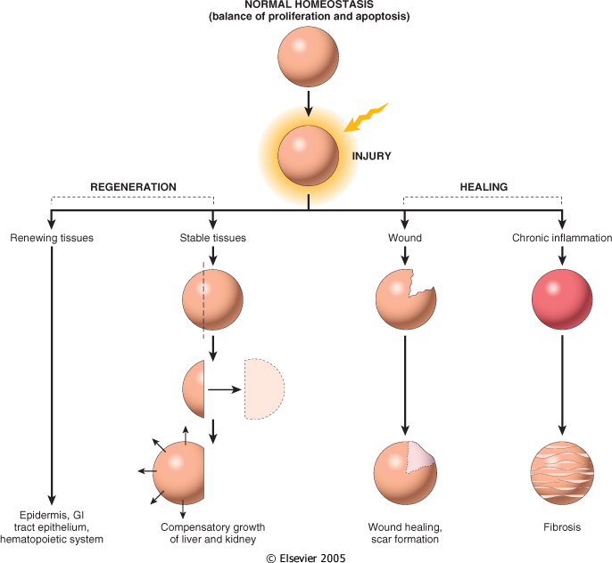
1. Describe the differences between regeneration healing and fibrosis.

Slide 7
Repair by tissue regeneration or healing depend on cell type.
2. The differences between the various cell in regenerative abilities types
Labile cells: continue to proliferate throughout life : squamous, columnar, transitional epithelia; hematopoitic and lymphoid tissues
Stable cells: retain the capacity of proliferation but they don’t replicate normally: parenchymal cells of all glandular organs & mesenchymal cells
Permanent cells: cannot reproduce themselves after birth: neurons, cardiac muscle cells

Slide 8
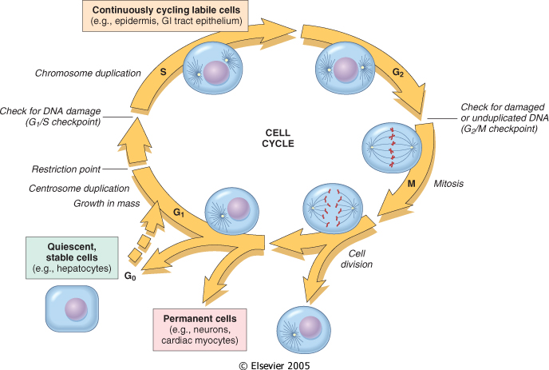
2. The differences between the various cell in regenerative abilities types

Slide 9
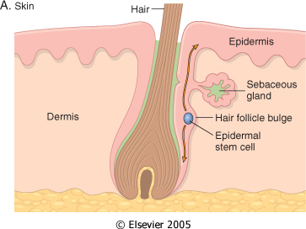
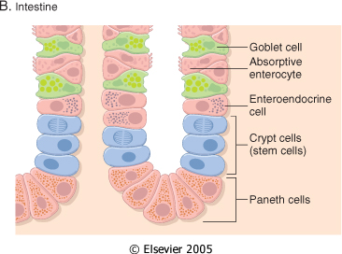
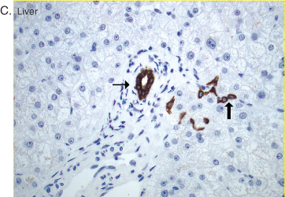
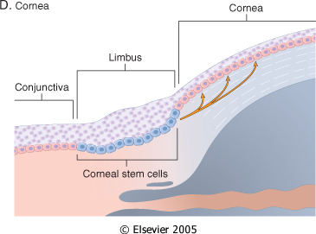
2. The differences between the various cell in regenerative abilities types

Slide 10
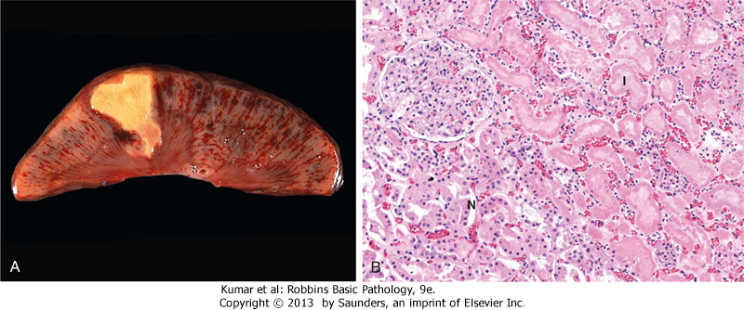
Healing
3- Know the mechanism of repair and formation of granulation tissue.
Healing is usually a tissue response
  (1) to a wound (commonly in the skin)
  (2) to inflammatory processes in internal organs
  (3) to cell necrosis in organs incapable of regeneration

Slide 11
3. Know the mechanism of repair and formation of granulation tissue.

Slide 12
Mechanism of repair
3. Know the mechanism of repair and formation of granulation tissue.
Repair begins early in inflammation.
At site of inflammation, fibroblasts and vascular endothelial cells begin proliferating to form a specialized type of tissue (hallmark of healing) called:
granulation tissue
The process is called organization
Notes:
Repair begins early in inflammation. Sometimes as early as 24 hours after injury, if resolution has not occurred, fibroblasts and vascular endothelial cells begin proliferating to form a specialized type of tissue that is the hallmark of healing, called granulation tissue. The term derives from its pink, soft, granular appearance on the surface of wounds, but it is the histologic features that are characteristic: the formation of new small blood vessels (angiogenesis) and the proliferation of fibroblasts (Fig. 3-17). These new vessels are leaky, allowing the passage of proteins and red cells into the extravascular space. Thus, new granulation tissue is often edematous. We next discuss mechanisms of angiogenesis and scar formation, the main components of the healing process.

Slide 13
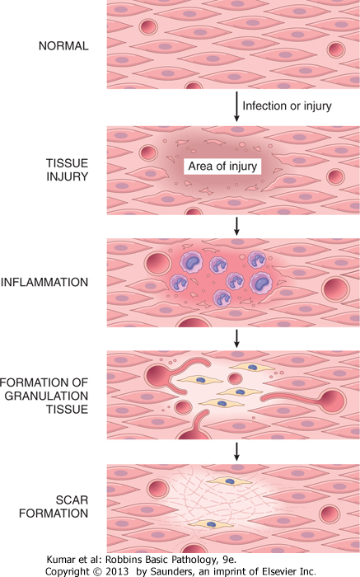
3. Know the mechanism of repair and formation of granulation tissue.
© 2005 Elsevier

Slide 14
3. Know the mechanism of repair and formation of granulation tissue.

Slide 15
Repair by connective tissue (granulation tissue)
3. Know the mechanism of repair and formation of granulation tissue.
It consists of:
  fibroblasts surrounded by abundant extracellular matrix
  newly formed blood vessels
  scattered macrophages and some other inflammatory cells.

Slide 16
What is the role of macrophages in wound healing?
3. Know the mechanism of repair and formation of granulation tissue.
Cleanup of debris, fibrin, and other foreign material at the site of repair.
Macrophages recruit other cells: fibroblasts and angioblasts
Stimulation of matrix production , interleukins that stimulate fibroblasts and angioblasts to produce the extracellular matrix.
Remodeling of the scar. They secrete collagenases

Slide 17
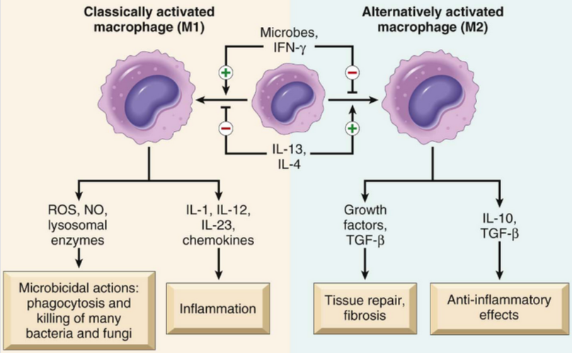
Role of macrophages in wound healing
3. Know the mechanism of repair and formation of granulation tissue.

Slide 18
Fibroblast Migration and Proliferation
3. Know the mechanism of repair and formation of granulation tissue.
Migration of fibroblasts to the site of injury and their subsequent proliferation are triggered by multiple growth factors, including mainly TGF-β and others e.g. PDGF, EGF, FGF, and the cytokines IL-1 and TNF
This lead to:
  increased synthesis of collagen and fibronectin
  decreased degradation of extracellular matrix (ECM) by metalloproteinases
Notes:
SCAR FORMATION Body_ID: HC003028 Growth factors and cytokines released at the site of injury induce fibroblast proliferation and migration into the granulation tissue framework of new blood vessels and loose ECM that initially forms at the repair site. We discuss three processes that participate in the formation of a scar: (1) emigration and proliferation of fibroblasts in the site of injury, (2) deposition of ECM, and (3) tissue remodeling. Body_ID: P003089 Fibroblast Migration and Proliferation Body_ID: HC003029 Granulation tissue contains numerous newly formed blood vessels. As discussed previously, VEGF promotes angiogenesis but is also responsible for a marked increase in vascular permeability (VEGF was first named vascular permeability factor).¹⁰⁷ The latter activity leads to exudation and deposition of plasma proteins, such as fibrinogen and plasma fibronectin, in the ECM and provides a provisional stroma for fibroblast and endothelial cell ingrowth. Migration of fibroblasts to the site of injury and their subsequent proliferation are triggered by multiple growth factors, including TGF-β, PDGF, EGF, FGF, and the cytokines IL-1 and TNF (see Table 3-5). The sources of these growth factors and cytokines include platelets, a variety of inflammatory cells (notably macrophages), and activated endothelium. Macrophages are important cellular constituents of granulation tissue, clearing extracellular debris, fibrin, and other foreign material at the site of repair. These cells also elaborate TGF-β, PDGF, and FGF and therefore promote fibroblast migration and proliferation.¹⁰⁸ If the appropriate chemotactic stimuli are present, mast cells, eosinophils, and lymphocytes may also accumulate. Each of these cells can contribute directly or indirectly to fibroblast migration and proliferation. Of the growth factors involved in inflammatory fibrosis, TGF-β appears to be the most important because of the multitude of effects that favor fibrous tissue deposition. TGF-β is produced by most of the cells in granulation tissue and causes fibroblast migration and proliferation, increased synthesis of collagen and fibronectin, and decreased degradation of ECM by metalloproteinases (discussed later). TGF-β is also chemotactic for monocytes and causes angiogenesis in vivo, possibly by inducing macrophage influx. TGF-β expression is increased in tissues in a number of chronic fibrotic diseases in humans and experimental animals. Body_ID: P003090 ECM Deposition and Scar Formation Body_ID: HC003030 As repair continues, the number of proliferating endothelial cells and fibroblasts decreases. Fibroblasts progressively deposit increased amounts of ECM. Fibrillar collagens form a major portion of the connective tissue in repair sites and are important for the development of strength in healing wounds. As described later in the discussion of cutaneous wound healing, collagen synthesis by fibroblasts begins within 3 to 5 days after injury and continues for several weeks, depending on the size of wound. Many of the same growth factors that regulate fibroblast proliferation also stimulate ECM synthesis (see Table 3-4). For example, collagen synthesis is enhanced by several factors, including growth factors (PDGF, FGF, TGF-β) and cytokines (IL-1, IL-13), which are secreted by leukocytes and fibroblasts in healing wounds. Net collagen accumulation, however, depends not only on increased collagen synthesis but also on decreased degradation. Ultimately, the granulation tissue scaffolding is converted into a scar composed of spindle-shaped fibroblasts, dense collagen, fragments of elastic tissue, and other ECM components. As the scar matures, vascular regression continues, eventually transforming the richly vascularized granulation tissue into a pale, avascular scar. Body_ID: P003091 Tissue Remodeling Body_ID: HC003031 The replacement of granulation tissue with a scar involves transitions in the composition of the ECM. Some of the growth factors that stimulate synthesis of collagen and other connective tissue molecules also modulate the synthesis and activation of metalloproteinases, enzymes that degrade these ECM components. The balance between ECM synthesis and degradation results in remodeling of the connective tissue framework-an important feature of both chronic inflammation and wound repair.

Slide 19
ECM Deposition and Scar Formation
3. Know the mechanism of repair and formation of granulation tissue.
As repair continues, the number of proliferating endothelial cells and fibroblasts decreases.
Net collagen accumulation, however, depends not only on increased collagen synthesis but also on decreased degradation.
Notes:
SCAR FORMATION Body_ID: HC003028 Growth factors and cytokines released at the site of injury induce fibroblast proliferation and migration into the granulation tissue framework of new blood vessels and loose ECM that initially forms at the repair site. We discuss three processes that participate in the formation of a scar: (1) emigration and proliferation of fibroblasts in the site of injury, (2) deposition of ECM, and (3) tissue remodeling. Body_ID: P003089 Fibroblast Migration and Proliferation Body_ID: HC003029 Granulation tissue contains numerous newly formed blood vessels. As discussed previously, VEGF promotes angiogenesis but is also responsible for a marked increase in vascular permeability (VEGF was first named vascular permeability factor).¹⁰⁷ The latter activity leads to exudation and deposition of plasma proteins, such as fibrinogen and plasma fibronectin, in the ECM and provides a provisional stroma for fibroblast and endothelial cell ingrowth. Migration of fibroblasts to the site of injury and their subsequent proliferation are triggered by multiple growth factors, including TGF-β, PDGF, EGF, FGF, and the cytokines IL-1 and TNF (see Table 3-5). The sources of these growth factors and cytokines include platelets, a variety of inflammatory cells (notably macrophages), and activated endothelium. Macrophages are important cellular constituents of granulation tissue, clearing extracellular debris, fibrin, and other foreign material at the site of repair. These cells also elaborate TGF-β, PDGF, and FGF and therefore promote fibroblast migration and proliferation.¹⁰⁸ If the appropriate chemotactic stimuli are present, mast cells, eosinophils, and lymphocytes may also accumulate. Each of these cells can contribute directly or indirectly to fibroblast migration and proliferation. Of the growth factors involved in inflammatory fibrosis, TGF-β appears to be the most important because of the multitude of effects that favor fibrous tissue deposition. TGF-β is produced by most of the cells in granulation tissue and causes fibroblast migration and proliferation, increased synthesis of collagen and fibronectin, and decreased degradation of ECM by metalloproteinases (discussed later). TGF-β is also chemotactic for monocytes and causes angiogenesis in vivo, possibly by inducing macrophage influx. TGF-β expression is increased in tissues in a number of chronic fibrotic diseases in humans and experimental animals. Body_ID: P003090 ECM Deposition and Scar Formation Body_ID: HC003030 As repair continues, the number of proliferating endothelial cells and fibroblasts decreases. Fibroblasts progressively deposit increased amounts of ECM. Fibrillar collagens form a major portion of the connective tissue in repair sites and are important for the development of strength in healing wounds. As described later in the discussion of cutaneous wound healing, collagen synthesis by fibroblasts begins within 3 to 5 days after injury and continues for several weeks, depending on the size of wound. Many of the same growth factors that regulate fibroblast proliferation also stimulate ECM synthesis (see Table 3-4). For example, collagen synthesis is enhanced by several factors, including growth factors (PDGF, FGF, TGF-β) and cytokines (IL-1, IL-13), which are secreted by leukocytes and fibroblasts in healing wounds. Net collagen accumulation, however, depends not only on increased collagen synthesis but also on decreased degradation. Ultimately, the granulation tissue scaffolding is converted into a scar composed of spindle-shaped fibroblasts, dense collagen, fragments of elastic tissue, and other ECM components. As the scar matures, vascular regression continues, eventually transforming the richly vascularized granulation tissue into a pale, avascular scar. Body_ID: P003091 Tissue Remodeling Body_ID: HC003031 The replacement of granulation tissue with a scar involves transitions in the composition of the ECM. Some of the growth factors that stimulate synthesis of collagen and other connective tissue molecules also modulate the synthesis and activation of metalloproteinases, enzymes that degrade these ECM components. The balance between ECM synthesis and degradation results in remodeling of the connective tissue framework-an important feature of both chronic inflammation and wound repair.

Slide 20
Granulation tissue morphology
3. Know the mechanism of repair and formation of granulation tissue.
As early as 24 hr. after injury, fibroblasts and vascular endothelial cells begin proliferating to form (by 3-5 days) granulation tissue - pink soft granular appearance on the surface of the wound.
New granulation tissue is often edematous.
histologically : granulation tissue is composed of :
  proliferation of new small blood vessels and
  proliferation of fibroblasts
  macrophags

Slide 21
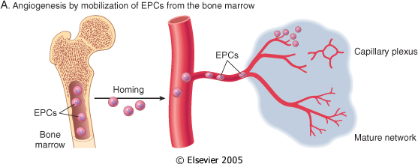
3. Know the mechanism of repair and formation of granulation tissue.
Angiogenesis
Angiogenesis from Endothelial Precursor Cells

Slide 22
SCAR FORMATION
4. List the three main phases of cutaneous wound healing.
Further healing: increased collagen, decreased active fibroblasts and new vessels(thrombosis and degeneration)
At the end: scar (inactive fibroblasts, dense collagen, fragments of elastic tissue, extracellular matrix, few vessels).

Slide 23
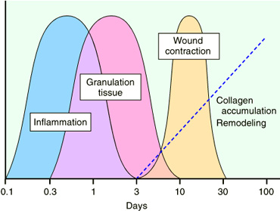
4. List the three main phases of cutaneous wound healing.
Slide 4.19

Slide 24
Functions of the Extracellular Matrix
4. List the three main phases of cutaneous wound healing.
The ECM is much more than a space filler around cells. Its various functions:
  Mechanical support
  Control of cell proliferation
  Scaffolding for tissue renewal
  Establishment of tissue microenvironments.

Slide 25
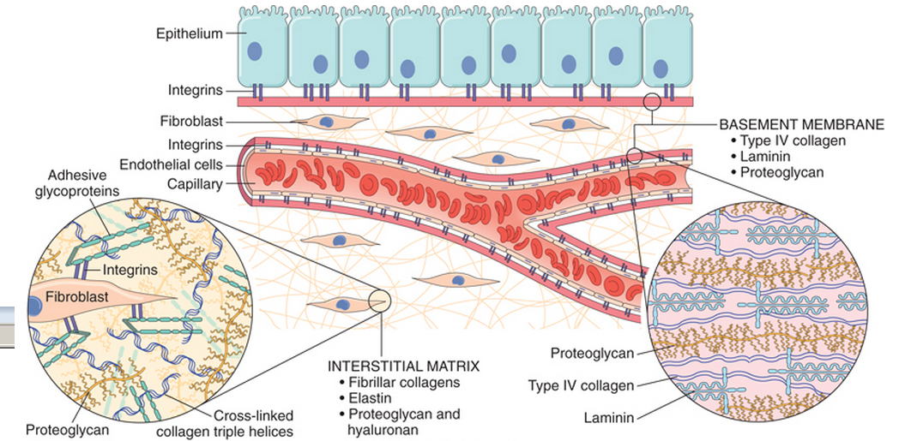
4. List the three main phases of cutaneous wound healing.

Slide 26
Cutaneous Wound healing
5. healing by primary intention and healing by secondary intention
2. Secondary union
(healing by 2nd intention)
more extensive loss of cells and tissue:
-infarction
-inflammatory ulceration
-abscess formation
surface wound with large defect
large tissue defect that must be filled
Primary union
(healing by 1st intention)
clean surgical incision
no significant bacterial contamination
minimal loss of tissue
clot, scab formation

Slide 27
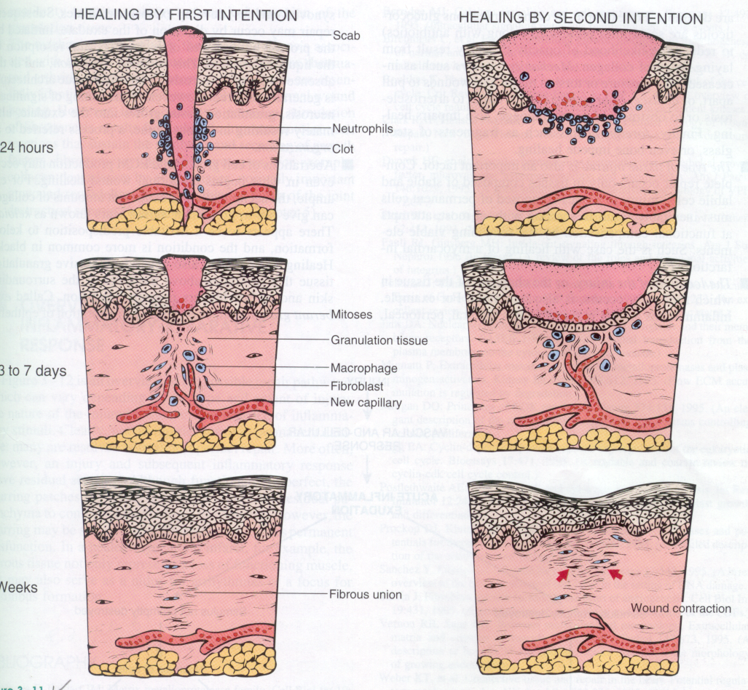
Primary union (healing by first intention)
5. healing by primary intention and healing by secondary intention
24 hr.: hematoma & neutrophils, mitotic activity of basal layer, thin
epithelial layer
Hageman factor (factor 12) will activate both the coagulation sequence and the kinin system as an initial response to this injury
day 3: macrophages, granulation tissue
day 5: collagen bridges the incision, epidermis thickens
2nd week:: continued collagen and fibroblasts, blanching
End of 1st month: scar (cellular connective tissue, intact epidermis, lost appendages).

Slide 28
Primary union
(healing by first intention)
5. healing by primary intention and healing by secondary intention
Later, collagen type III is slowly replaced by collagen type I and the wound acquires tensile strength.
By the end of third month, the tissue has approximately 80% of its original strength.

Slide 29
Cutaneous Wound healing
5. healing by primary intention and healing by secondary intention
Secondary union (healing by 2nd intention)
It occur in large, gaping wounds, as well those that are infected or contain foreign material

Slide 30
Difference between primary intention and secondary intention
5. healing by primary intention and healing by secondary intention
The basic process of healing is the same in all wounds. In contrast to healing by primary intention, wounds healing by secondary intention
  Require more time to close because the edges are far apart
  Show a more prominent inflammatory reaction in and around the wound
  Contain more copious granulation tissue inside the tissue defect
  wound contraction (5 to 10%), ?myofibroblasts

Slide 31
Mechanisms of fibrosis
Persistent tissue injury leads to chronic inflammation and loss of tissue architecture.
Cytokines produced by macrophages and other leukocytes stimulate the migration and proliferation of fibroblasts and myofibroblasts and the deposition of collagen and other extracellular matrix proteins.
The net result is replacement of normal tissue by fibrosis.

Slide 32
Delayed wound healing

Slide 33
What is the most common cause of delayed wound healing?
6. factors which are associated with delayed wound healing
Infection
Foreign bodies in the wound
Mechanical factors
Nutritional deficiencies
Poor perfusion
Excess corticosteroid
the most important cause of delay in healing; it prolongs inflammation and potentially increases the local tissue injury.
Suture help healing of wound
protein deficiency and vitamin C deficiency inhibit collagen synthesis and retard healing. Zinc and copper deficiency
due either to arteriosclerosis and diabetes or to obstructed venous drainage

Slide 34
Excess corticosteroid
5. healing by primary intention and healing by secondary intention
have well-documented anti-inflammatory effects, and their administration may result in weakness of the scar
however, the anti-inflammatory effects of glucocorticoids are sometime desirable. For example, in corneal infections

Slide 35
COMPLICATIONS IN CUTANEOUS WOUND HEALING
6. Complications of wound healing
Complications in wound healing can arise from abnormalities in any of the basic components of the repair process. These aberrations can be grouped into three general categories:
  (1) deficient scar formation
  (2) excessive formation of the repair components
  (3) formation of contractures.

Slide 36
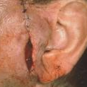
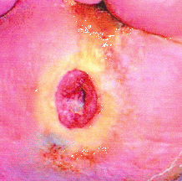
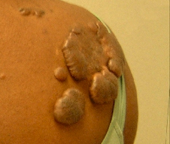
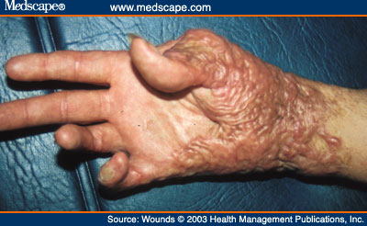
6. Complications of wound healing
Wound dehiscence
Wound ulceration
Keloid
Contracture

Slide 37
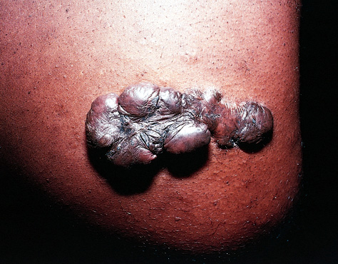
What is a keloid?
6. Complications of wound healing
Keloids are excessive scars composed of irregularly deposite hyalinized collagen bands. They may appear as bulging masses.

Slide 38
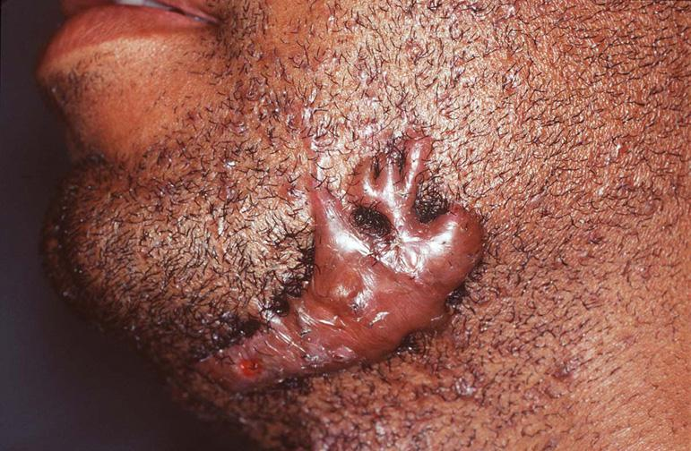
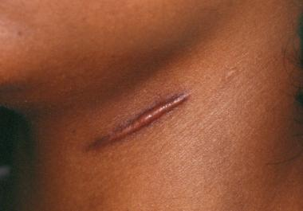
What is the difference between keloid and hypertrophic scar?
6. Complications of wound healing
Keloids are the result of an overgrowth of dense fibrous tissue that usually develops after healing of a skin injury. The tissue extends beyond the borders of the original wound, does not usually regress spontaneously, and tends to recur after excision.
hypertrophic scars are characterized by erythematous, pruritic, raised fibrous lesions that typically do not expand beyond the boundaries of the initial injury and may undergo partial spontaneous resolution. Hypertrophic scars are common after thermal injuries.

Slide 39
TAKE HOME MESSAGES:
The various cell types (ie, labile, stable, and permanent cells) affect the outcome of healing.
Three main phases of cutaneous wound healing:
  (1) inflammation, (2) formation of granulation tissue, and (3) ECM deposition and remodeling
Healing by primary intention occur in surgical clean wound and healing by secondary intention occur when excessive tissue damage is present.
Several factors are associated with delayed wound healing.
Complication of wound healing include failure of healing, contracture and excessive scar formation.

