Slide 1
Granulomatous Diseases Dr Shaesta Naseem Zaidi
PRACTICAL 4
Pathology Dept, KSU
Foundation Block

Slide 2
1- Tuberculosis of the lung
Pathology Dept, KSU
Foundation Block

Slide 3
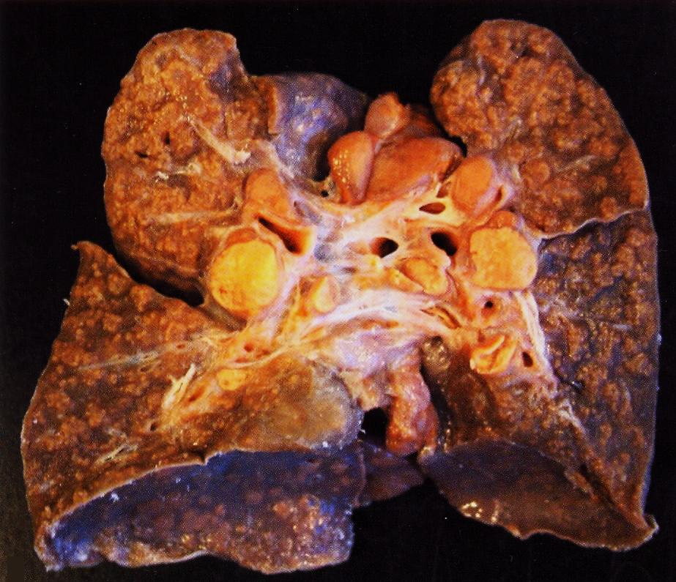
Pulmonary TB – Caseous Necrosis – Gross
The granulomas have areas of caseous necrosis. This pattern of multiple caseating granulomas primarily in the upper lobes is most characteristic of secondary T.B.
Pathology Dept, KSU
Foundation Block

Slide 4
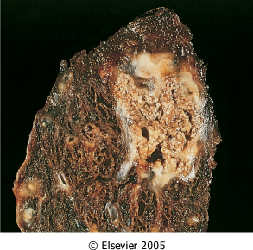
Pulmonary TB – Caseous Necrosis – Gross
Initial (primary) infection with T.B. producing a sub-pleural lesion called
a Ghon’s focus. The early Ghon’s focus together with the lymph node lesion constitute the Ghon’s complex..
Pathology Dept, KSU
Foundation Block

Slide 5
Pulmonary TB - Ghon’s Complex – Gross
The Ghon’s complex is seen here at closer range. Primary tuberculosis is the pattern seen with initial infection with tuberculosis in children. Reactivation, or secondary tuberculosis, is more typically seen in adults.
Pathology Dept, KSU
Foundation Block

Slide 6
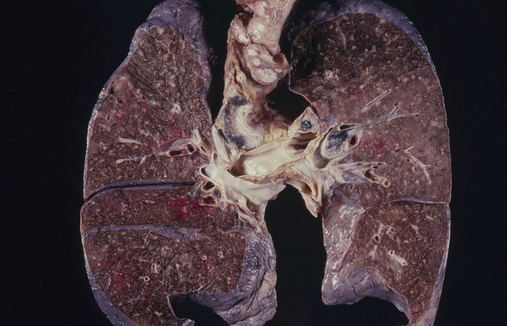
Miliary TB of the Lungs
Miliary TB can occur when TB lung lesions erode pulmonary veins or when extrapulmonary TB lesions erode systemic veins.
This results in hematogenous dissemination of tubercle bacilli producing myriads of 1-2 mm. lesions throughout the body in susceptible hosts.
Miliary spread limited to the lungs can occur following erosion of pulmonary arteries by TB lung lesions.
Pathology Dept, KSU
Foundation Block

Slide 7
Tuberculous Granulomas
Well-defined granulomas are seen here. They have rounded outlines. The one toward the center of the photograph contains several Langhan’s giant cells. Granulomas are composed of transformed macrophages called epithelioid cells along with lymphocytes, occasional PMN's, plasma cells, and fibroblasts
Pathology Dept, KSU
Foundation Block

Slide 8
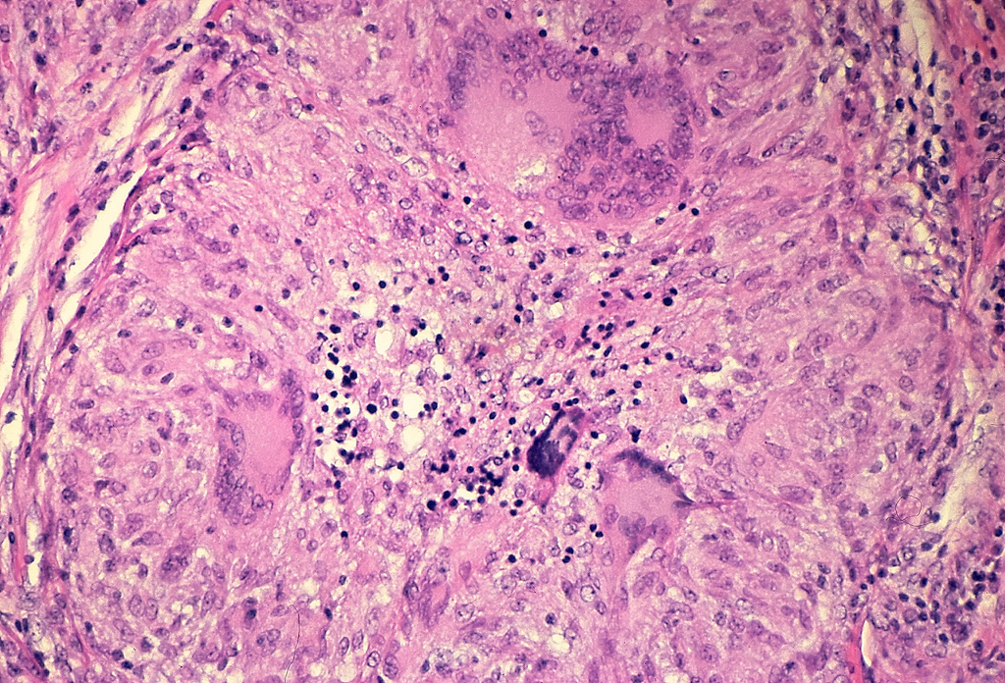
Pulmonary TB - Granuloma with central
early necrosis
The pyknotic nuclei of epithelioid cells in the center of the granuloma (apoptotic bodies) are a precursor of necrosis.
Pathology Dept, KSU
Foundation Block

Slide 9
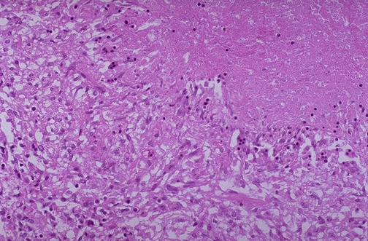
Tuberculous Granulomas
1
2
The edge of a granuloma is shown here at high magnification. At the upper is amorphous pink caseous material [1] composed of the necrotic elements of the granuloma as well as the infectious organisms. This area is ringed by the inflammatory component [2] with epithelioid cells, lymphocytes, and fibroblasts.
Pathology Dept, KSU
Foundation Block

Slide 10
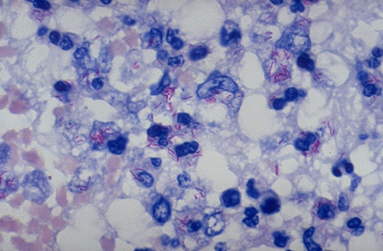
Acid Fast bacilli of Mycobacterium TB in the Lung
A stain for Acid Fast Bacilli is done (AFB stain) to find the mycobacteria . The mycobacteria stain as red rods, as seen here at high magnification.
Pathology Dept, KSU
Foundation Block

Slide 11
2- Tuberculous Lymphadenitis
Pathology Dept, KSU
Foundation Block

Slide 12
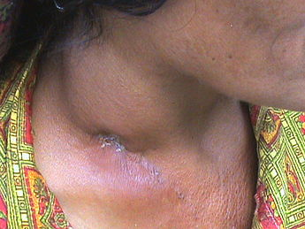
Tuberculous Lymphadenitis - Gross
Enlarged right cervical lymph nodes
Discharging sinus
Chronic granulomatous lymphadenitis secondary to tuberculosis
Pathology Dept, KSU
Foundation Block

Slide 13
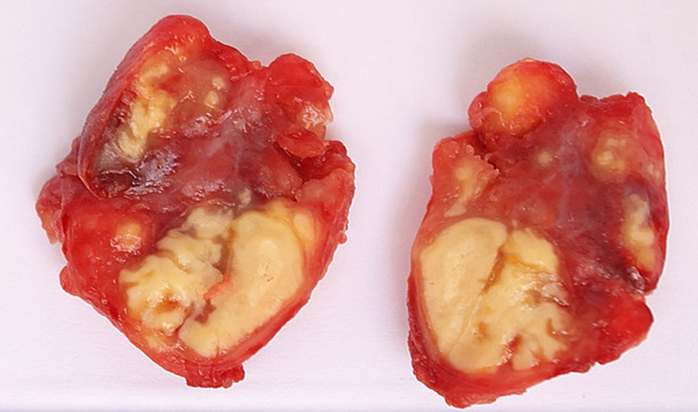
Tuberculous Lymphadenitis – Cut Section
Section of a lymph node with connective tissue capsule and lymphoid tissue
Pathology Dept, KSU
Foundation Block

Slide 14
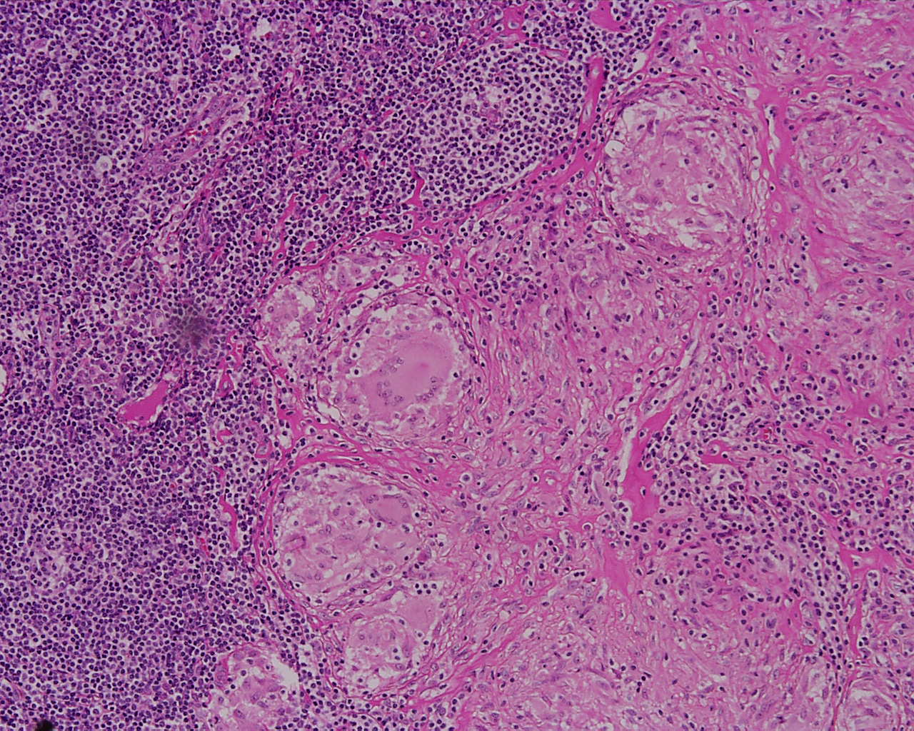
Tuberculous Lymphadenitis
Many round and oval tubercles/ granulomas with or without central caseation that appears structureless, homogenous and pink in colour.
Pathology Dept, KSU
Foundation Block

Slide 15
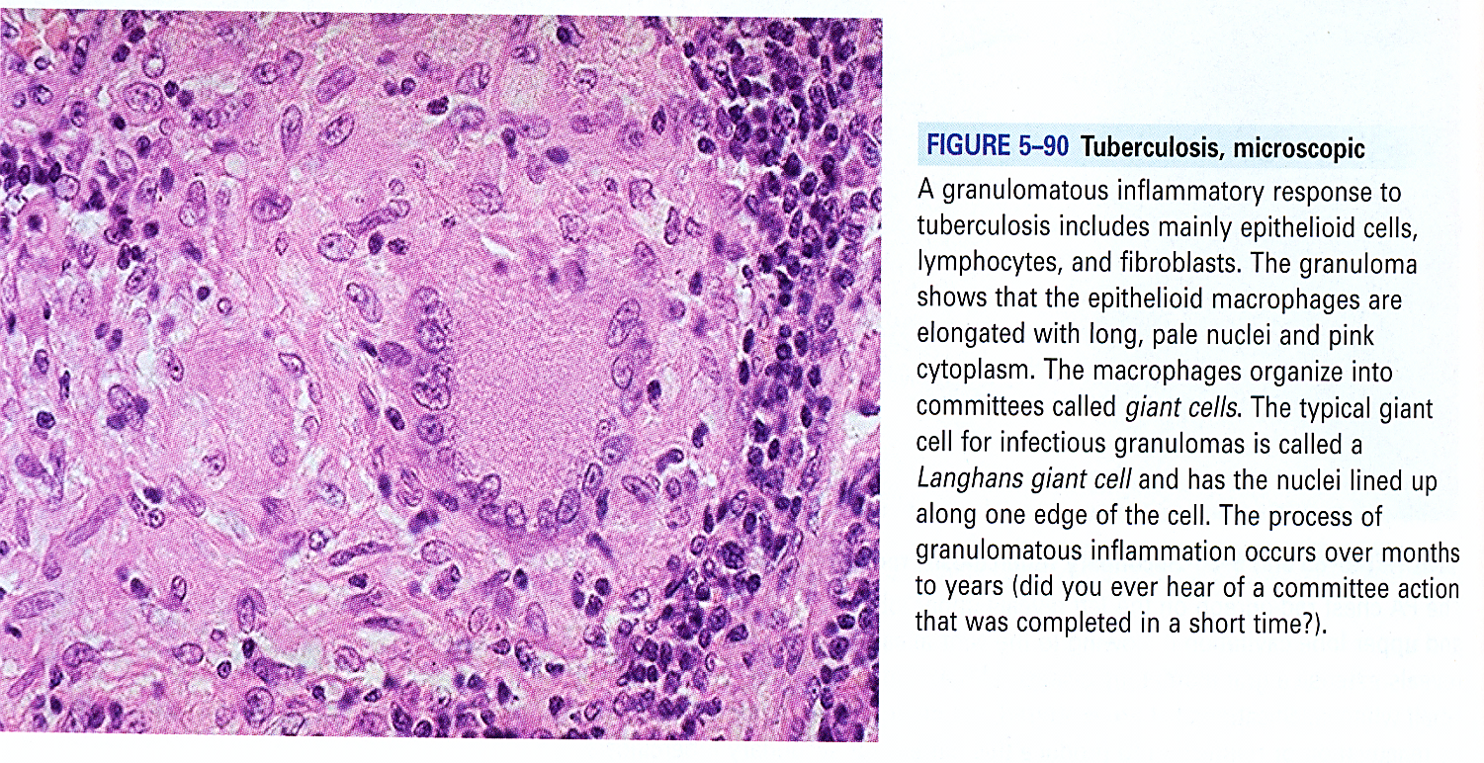
Tuberculous Lymphadenitis
lymphocytes
giant cell
epithelioid -histiocytes
The granulomas consists of epithelioid cells, few langhan’s giant cells (large cell with multiple peripheral nuclei) and peripheral rim of lymphocytes
Notes:
Principal lesion seen in this picture is Non-caseating giant cell granuloma.

Slide 16
Granulomatous/Tuberculous Lymphadenitis
A granulomatous inflammatory response to tuberculosis includes mainly epithelioid cells, lymphocytes and fibroblasts.
The granuloma shows that the epithelioid -histiocytes are elongated with long, pale nuclei and pink cytoplasm.
The macrophages join together and form multinucleated cells called giant cells.
The typical giant cell for infectious granulomas is called a Langhans giant cell and has the nuclei lined up along one edge of the cell in a horse-shoe pattern

Slide 17
Tuberculous lymphadenitis : Section of a lymph node with connective tissue capsule and lymphoid tissue shows:
Many round and oval tubercles/ granulomas with or without central caseation that appears structureless, homogenous and pink in colour.
The granulomas consists of epithelioid cells, few langhan’s giant cells (large cell with multiple peripheral nuclei) and peripheral rim of lymphocytes.

Slide 18
3- Bilharzial Granulomas
Pathology Dept, KSU
Foundation Block

Slide 19
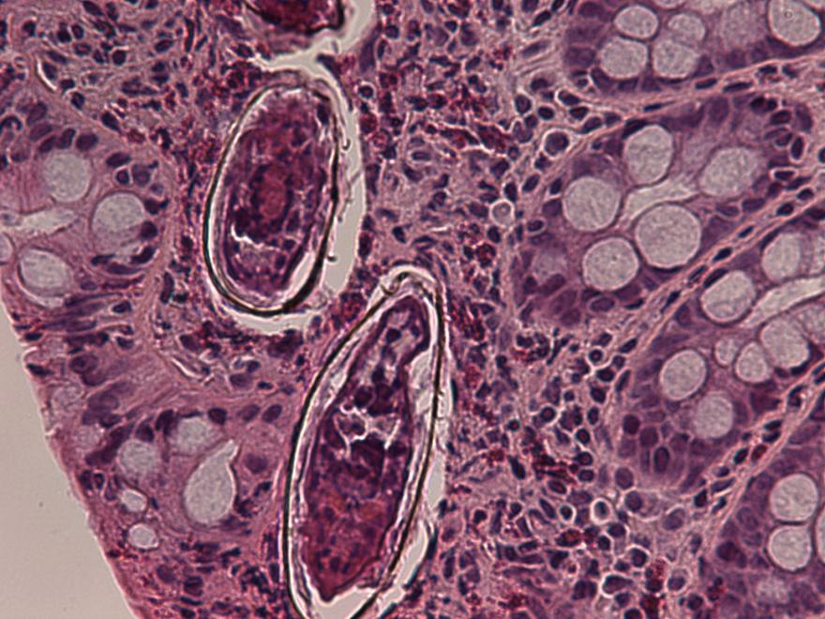
Colonic Bilharziasis - HPF
Colon biopsy of bilharziasis. Fibrosing foreign body granuloma against the miracidium-containing ovum of S. mansoni is observed in the submucosal layer (H&E).
Pathology Dept, KSU
Foundation Block

Slide 20
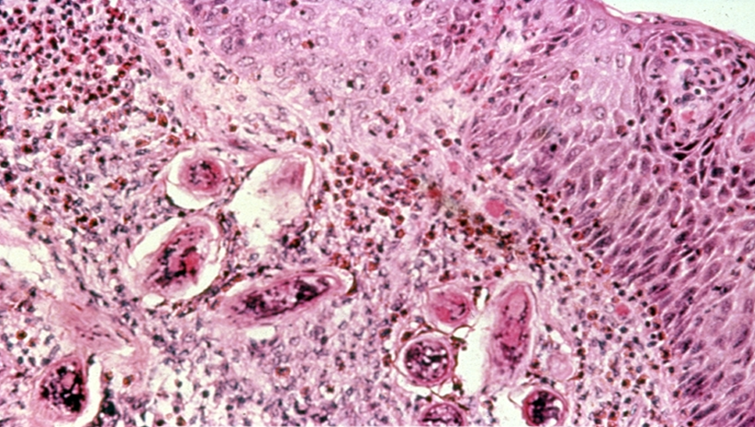
Bilharziasis of the Urinary Bladder
Schistosoma haematobium. Urinary Bladder biopsy showing bilharziasis eggs
Pathology Dept, KSU
Foundation Block

Slide 21
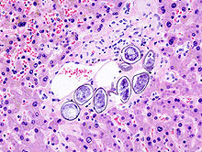
S. japonicum in the Hepatic portal tract
S. japonicum eggs in hepatic portal tract
Pathology Dept, KSU
Foundation Block

Slide 22
Bilharziasis of the rectum\urinary bladder: Section of fragments of rectal\urinary bladder mucosa shows:
Many Bilharzial ova with yellow brown shells in mucosa and submucosa surrounded by fibrosis and chronic inflammatory cells consisting of lymphocytes, plasma cells and many eosinophils.
Few granulomas are seen around the ova.

Slide 23
4- Cutaneous Leishmaniasis
Pathology Dept, KSU
Foundation Block

Slide 24
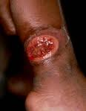
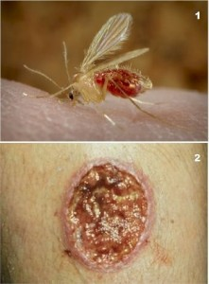
Cutaneous Leishmaniasis
Leishmaniasis is caused by parasitic infection, mainly by parasites of the Leishmania genus which are carried by a blood-sucking insect known as the sandfly.
Pathology Dept, KSU
Foundation Block

Slide 25
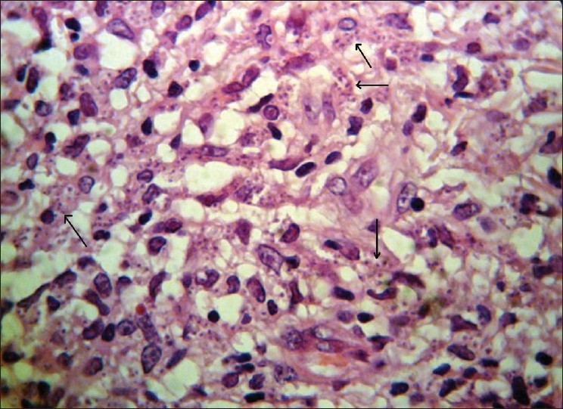
Cutaneous Leishmaniasis
Histological view shows marked cellular infiltration and parasites
(Leishman bodies) within macrophages
Pathology Dept, KSU
Foundation Block

Slide 26
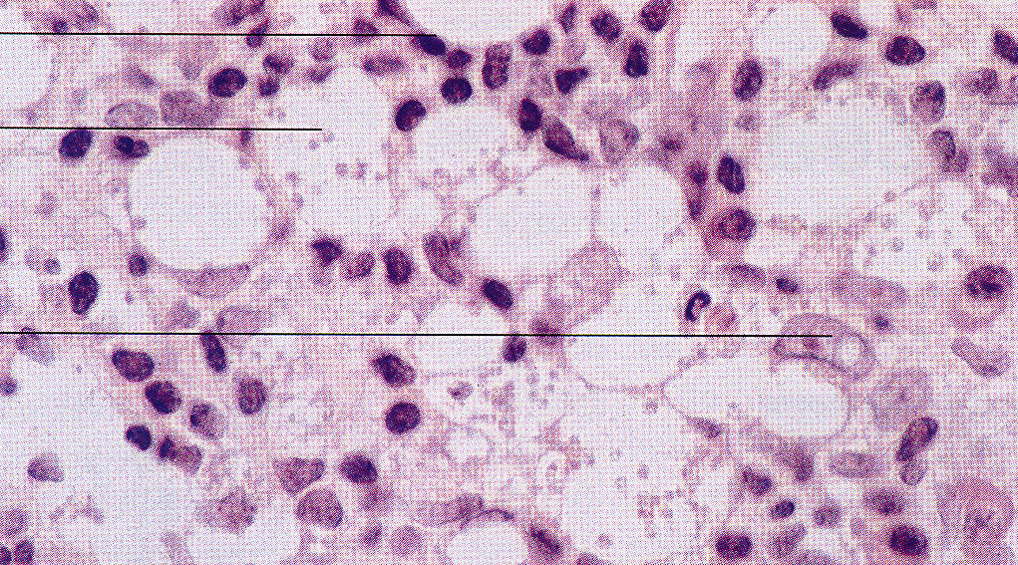
Cutaneous Leishmaniasis
Lymphocyte
Leishman Donovan bodies
Macrophage
Figure C. Histopathological features of Cutaneous Leishmaniasis (high mag.).
Note the presence of numerous Leishman-Donovan bodies within the foamy macrophages.

Slide 27
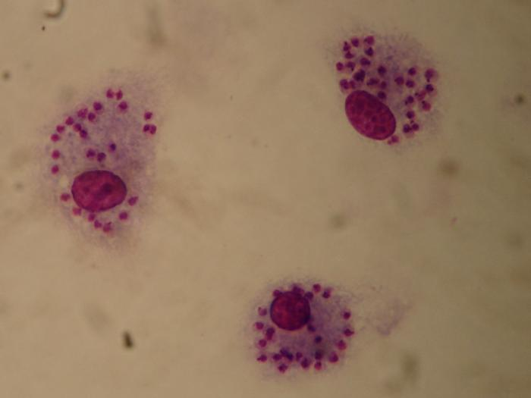
Cutaneous Leishmaniasis
The blood film shows macrophages containing Leishmania amastigotes, each with a prominent kinetoplast (seen as a darkened spot next to the larger nucleus) and no flagella (in contrast with the promastigote form).
Pathology Dept, KSU
Foundation Block

Slide 28
GOOD LUCK

