Slide 1
NEOPLASIA ------- (Malignant Tumors)
PRACTICAL 6
Pathology Dept, KSU
Foundation Block

Slide 2
1- Squamous cell carcinoma of the skin
Pathology Dept, KSU
Foundation Block

Slide 3
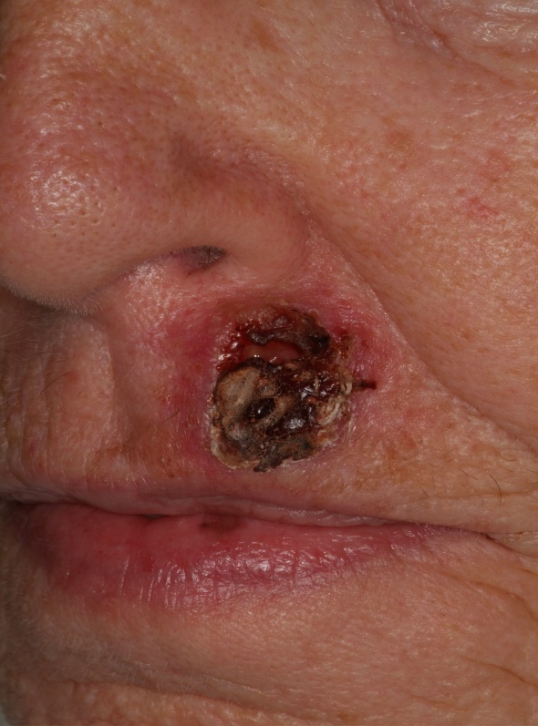
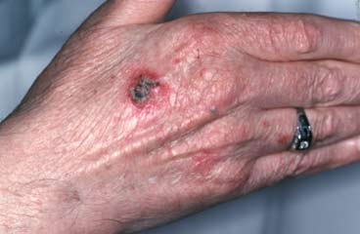
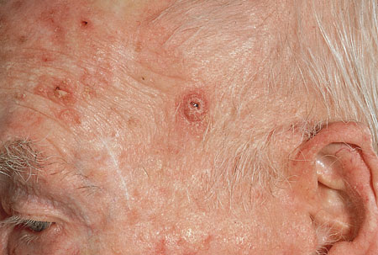
Squamous Cell Carcinoma - Gross
Haemorrhagic and ulcerated lesion on the upper lip/back of hand and forehead
A sore that does not heal or any change in an existing mole, wart, or skin lesion can point to SCC.
There may be an ulcer or reddish skin plaque that grows very slowly, may bleed occasionally (especially if located on the lip), may have an ulcerated center with raised, hard edges, may have a pearly quality with tiny blood vessels, is commonly present on sun-exposed areas.
Squamous cell carcinoma most likely and initially metastasise to the lymph nodes.
Pathology Dept, KSU
Foundation Block

Slide 4
Squamous Cell Carcinoma - Histopathology
Sq Cell Carcinoma
The normal squamous epithelium at the right merges into the squamous
cell carcinoma at the left, which is infiltrating downward. The neoplastic squamous cells are still similar to the normal squamous cells, but are less orderly
Pathology Dept, KSU
Foundation Block

Slide 5
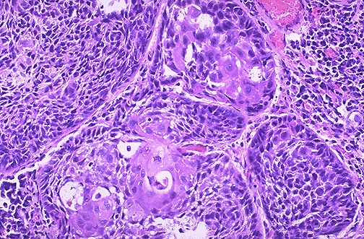
Squamous Cell Carcinoma - Histopathology
Here is a moderately differentiated squamous cell carcinoma in which some, but not all, of the neoplastic cells in nests have pink cytoplasmic keratin
Pathology Dept, KSU
Foundation Block

Slide 6
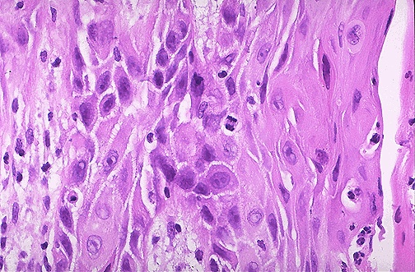
Squamous Cell Carcinoma - HPF
At high magnification, this squamous cell carcinoma demonstrates enough differentiation to tell that the cells are of squamous origin.
The cells are pink and polygonal in shape with intercellular bridges.
The neoplastic cells show pleomorphism, with hyperchromatic nuclei.
A mitotic figure is present near the center
Foundation Block

Slide 7
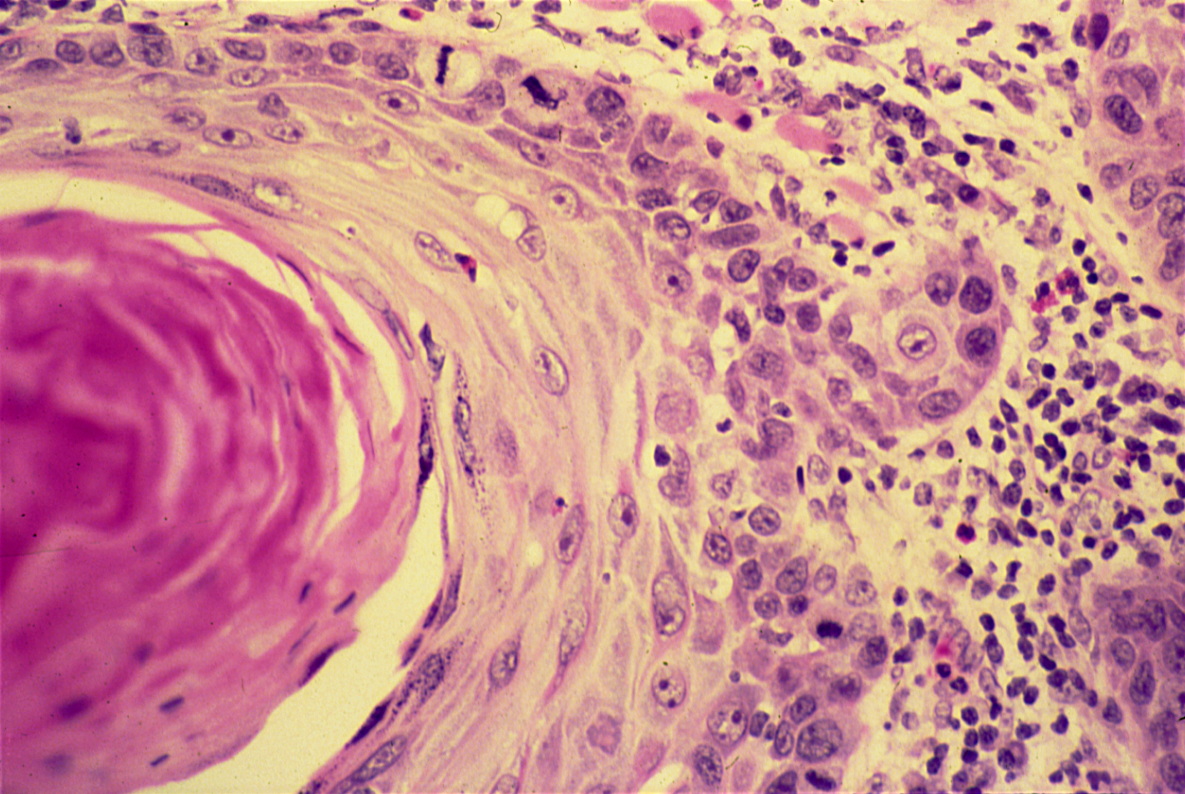
Squamous Cell Carcinoma - HPF
The dermis is infiltrated by masses of well differentiated neoplastic squamous cells separated by fibrous tissue stroma with chronic inflammatory cells.
Tumour cells show pleomorphism, hyperchromatism and many mitotic figures .
Pinkish laminated keratin pearls (epithelial cell nests) are present in the center.
Pathology Dept, KSU
Foundation Block

Slide 8
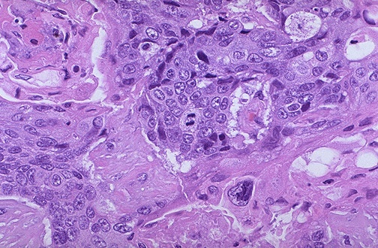
Squamous Cell Carcinoma - HPF
Malignant squamous cells
Keratin production
Mitotic figures
Nuclear pleomorphism
A mitotic figure is seen here in the center, surrounded by cells of a poorly differentiated squamous cell carcinoma, with pleomorphic cells that have minimal pink keratinization in their cytoplasm.
In general, mitoses are more likely to be seen in malignant neoplasms
Pathology Dept, KSU
Foundation Block

Slide 9
2- Adenocarcinoma of the large intestine
Pathology Dept, KSU
Foundation Block

Slide 10
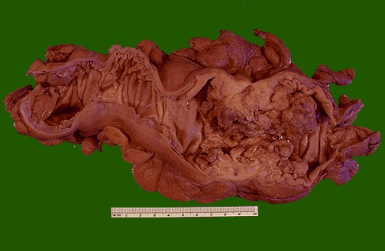
Adenocarcinoma of the Colon
This cancer is more exophytic in its growth pattern. Thus, one of the complications of a carcinoma is obstruction (usually partial).
Pathology Dept, KSU
Foundation Block

Slide 11
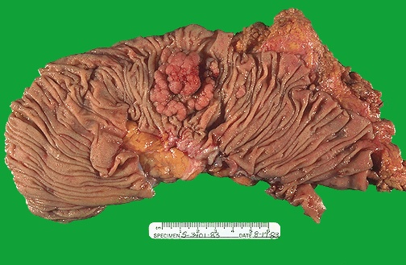
Adenocarcinoma of the Colon
This is an adenocarcinoma arising in a villous adenoma. The surface of the neoplasm is polypoid and reddish pink. Hemorrhage from the surface of the tumor creates a guaiac positive stool. This neoplasm was located in the sigmoid colon
Pathology Dept, KSU
Foundation Block

Slide 12
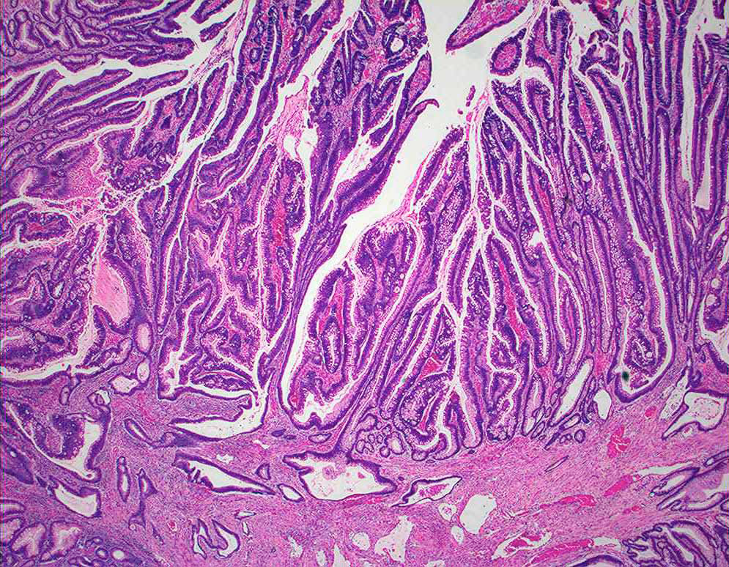
Adenocarcinoma of the Colon
A moderately differentiated colonic adenocarcinoma .
Tumour consists of crowded irregular malignant acini separated by
thin fibrovascular stroma.
Pathology Dept, KSU
Foundation Block

Slide 13
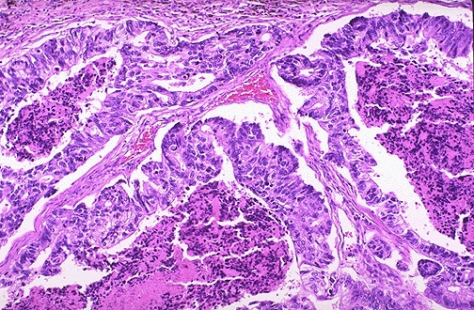
Adenocarcinoma of the Colon - LPF
Here is an adenocarcinoma in which the glands are much larger
and filled with necrotic debris.
Pathology Dept, KSU
Foundation Block

Slide 14
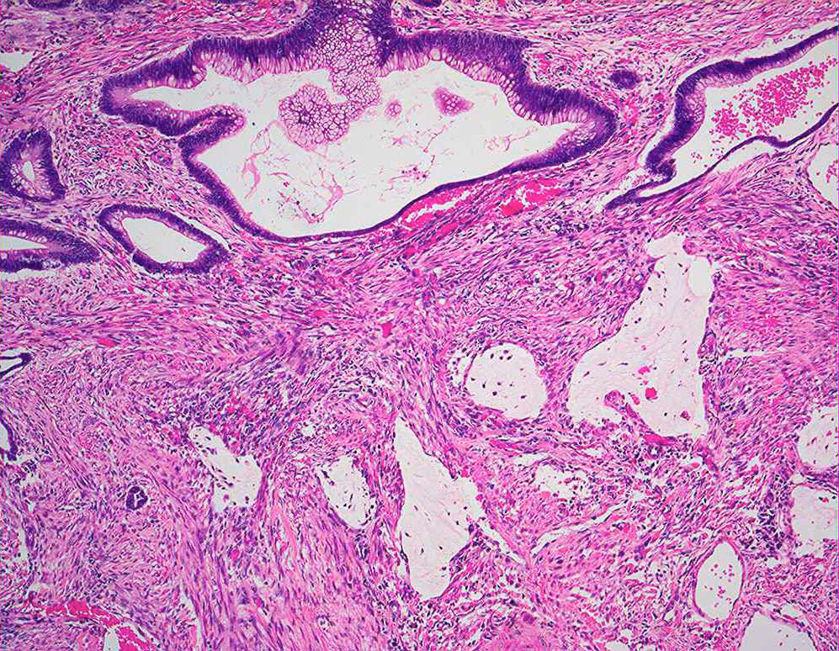
Adenocarcinoma of the Colon - LPF
The acini are lined by one or several layers of neoplastic cells with papillary projection showing pleomorphism, hyperchromatism and few mitoses.
Pathology Dept, KSU
Foundation Block

Slide 15
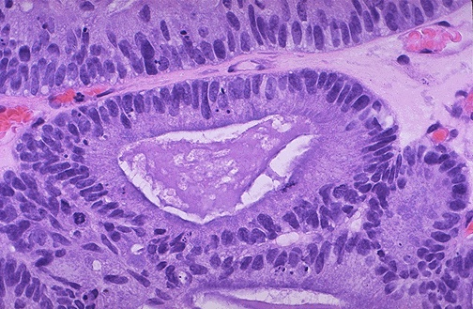
Adenocarcinoma of the Colon - HPF
At high magnification, the neoplastic glands of adenocarcinoma have crowded nuclei with hyperchromatism and pleomorphism. No normal goblet cells are seen
Pathology Dept, KSU
Foundation Block

Slide 16
3- Leiomyosarcoma
Pathology Dept, KSU
Foundation Block

Slide 17
Leiomyosarcoma
Cut surface of this leiomyosarcoma showing poorly defined, pale and soft, large fleshy mass with hemorrhage and necrosis.
Sarcomas metastasize through blood vessels (Hematogenous route)
Foundation Block

Slide 18
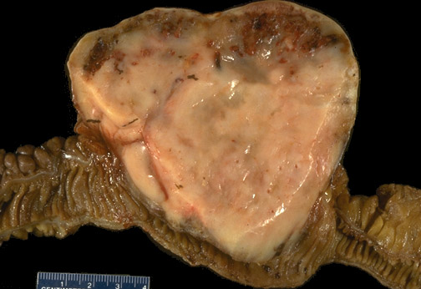
Leiomyosarcoma of Small Intestine
This is a leiomyosarcoma of the small bowel. As with sarcomas in general, this one is big and bad.
Sarcomas are uncommon at this site, but must be distinguished from other types of neoplasms.
Pathology Dept, KSU
Foundation Block

Slide 19
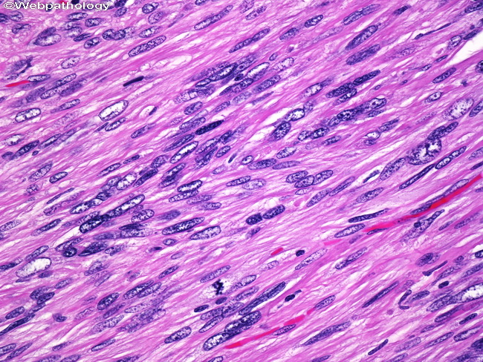
Leiomyosarcoma – HPF Microscopy
Spindle shaped, large and pleomorphic malignant cells with cigar shaped nuclei arranged in fascicles.
Increased mitotic figures.
Pathology Dept, KSU
Foundation Block

Slide 20
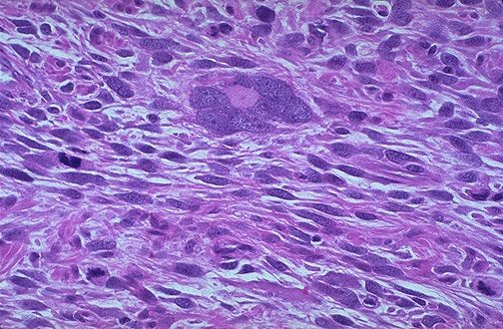
Leiomyosarcoma of the Uterus - HPF
They often have very large bizarre giant cells along with the malignant spindle cells.
Mitotic figures are frequent.
Pathology Dept, KSU
Foundation Block

Slide 21
THE END

