Slide 1

ميحرلا نمحرلا الله مسب

Slide 2
Hemostasis
Dr. Abeer Al-Ghumlas

Slide 3
At the end of this lecture student
should be able to:
Recognize different stages of hemostasis
Describe formation and development of
platelet
Describe the role of platelets in
hemostasis.
Recognize different clotting factors
Describe the cascade of clotting .

Slide 4
Describe the cascade of intrinsic
pathway.
Describe the cascade of extrinsic and common pathways.
Recognize the role of thrombin in
coagulation
Recognize process of fibrinolysis and function of plasmin

Slide 5
Hemostasis:
the spontaneous arrest of bleeding from ruptured blood vessels
Mechanisms:
Vessel wall
Platelet
Blood coagulation
Fibrinolytic system

Slide 6
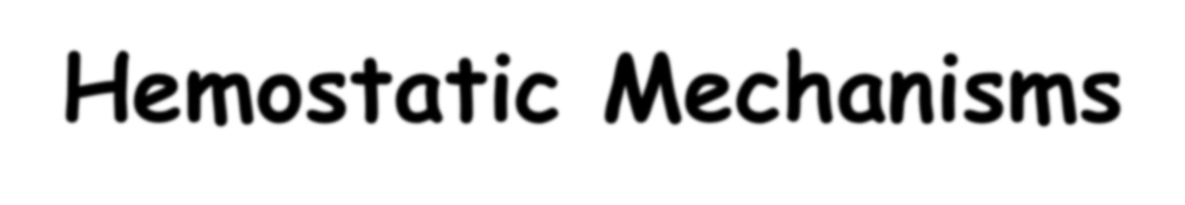
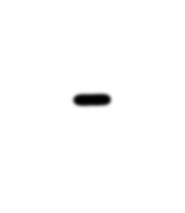

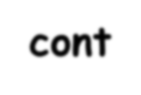

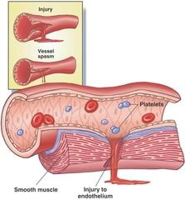
Hemostatic Mechanisms-
cont
1.Vessel wall
Immediately After injury a localized
Vasoconstriction
– Mechanism:
Systemic release of adrenaline
Nervous factors
local release of thromboxane A2 & 5HT by platelets

Slide 7
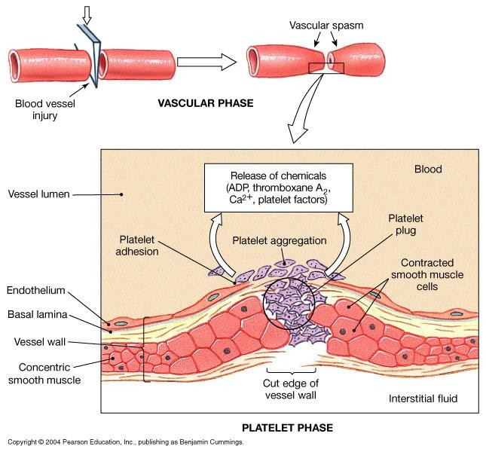

Slide 8
Hemostatic Mechanisms:
Mechanisms:
  Vessel wall
  Platelet
  Blood coagulation
  Fibrinolytic system

Slide 9
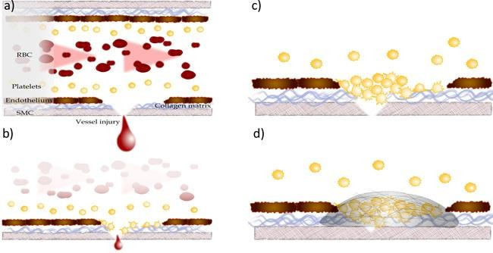
Platelet haemostatic plug
formation

Slide 10
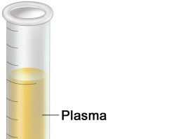
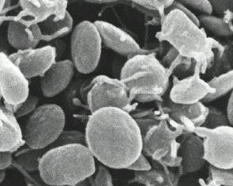
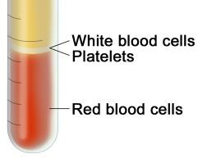
Platelets (PLT)
Thrombocytes

Slide 11
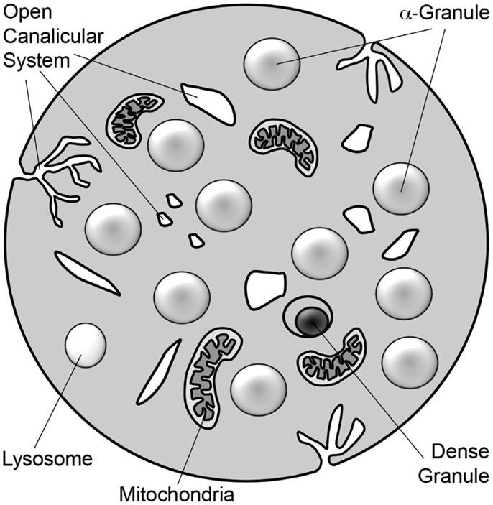
Platelets
- cont
small disc shaped cells
Platelet count = 150x10³-300x10^{3/}ml,
life span 8-12 days
Fibrinogen vWF
Other proteins
– Contain high calcium content & rich in ADP
– Active cells contain
contractile protein,
ADP
Serotonin Calcium

Slide 12
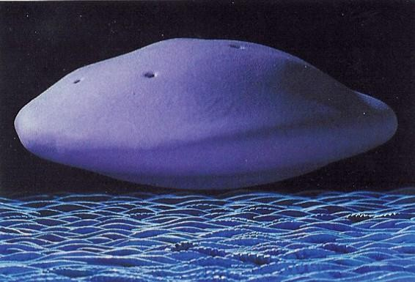
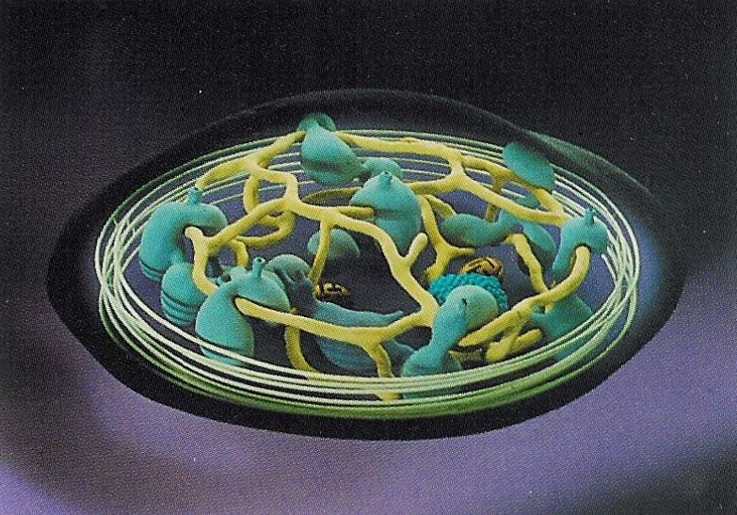

Slide 13
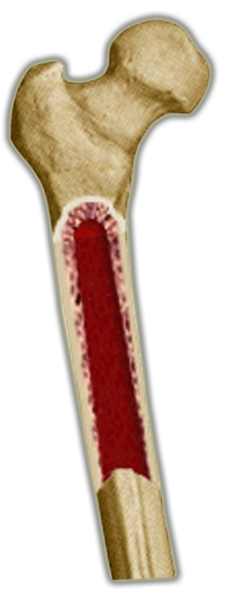




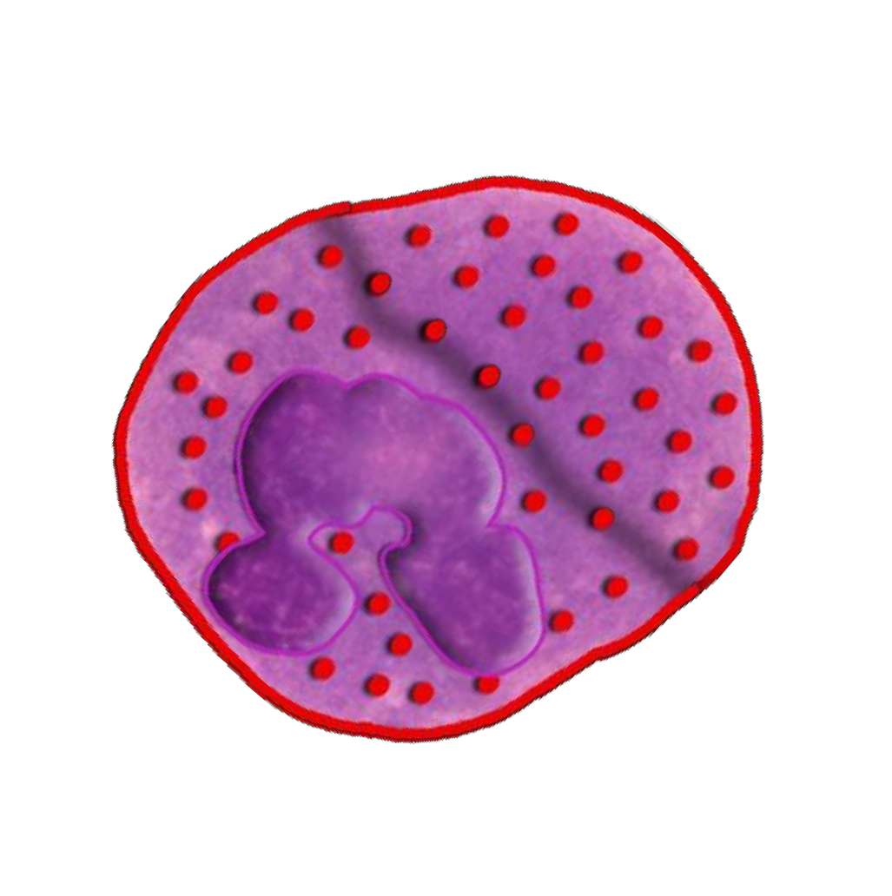

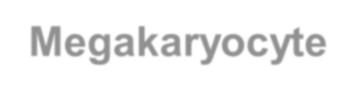
platelets
Thrombocytes
are
Fragments of megakaryocytes in the bone marrow
Bone marrow
Regulation of thrombopoiesis By:
Thrombombopoietin
Megakaryocyte

Slide 14
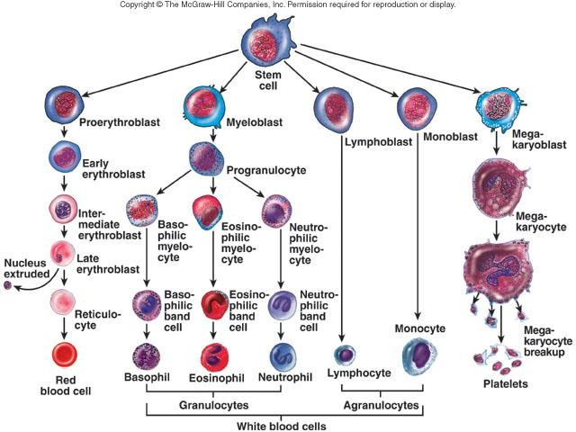

Slide 15
Platelets –
cont.
Site of formation:
Bone marrow
Steps:
Stem cell
Megakaryoblast
Megakaryocyte
Platelets

Slide 16
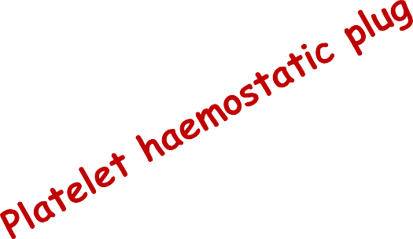
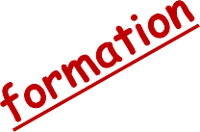
Platelet haemostatic plug
formation

Slide 17
Platelet Functions
Begins with Platelet activation

Slide 18
Platelet Activation
Adhesion
Shape change
Aggregation
Release
Clot Retraction

Slide 19

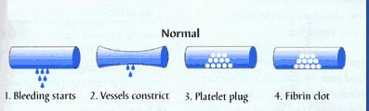
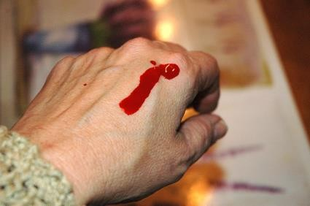

Slide 20
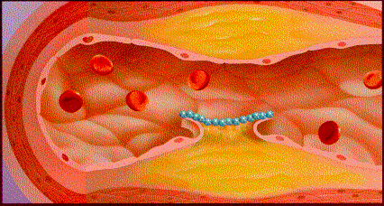
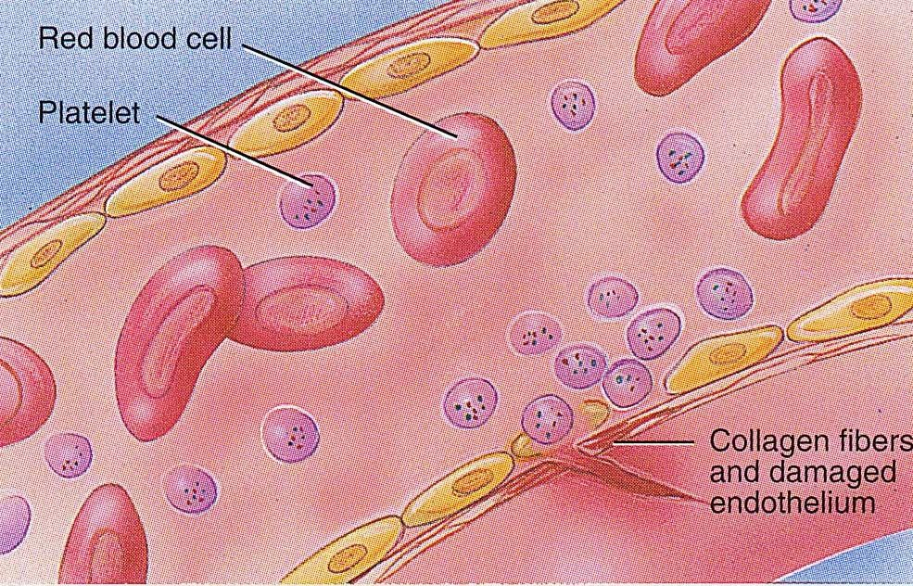
Platelet Adhesion
Exposed collagen
attracts platelets
Platelets stick to exposed collagen underlying damaged endothelial cells in vessel wall

Slide 21
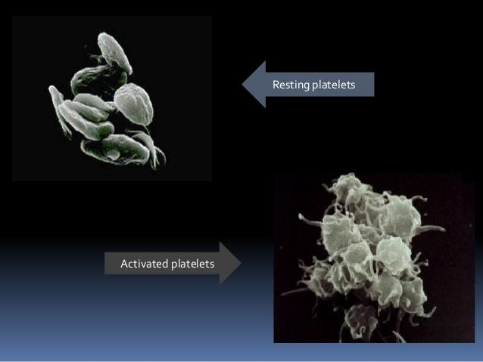
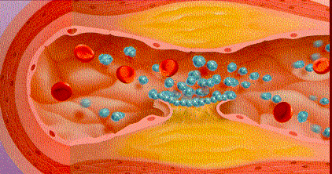
Platelets activated by adhesion
Extend projections to make contact with
each other

Slide 22
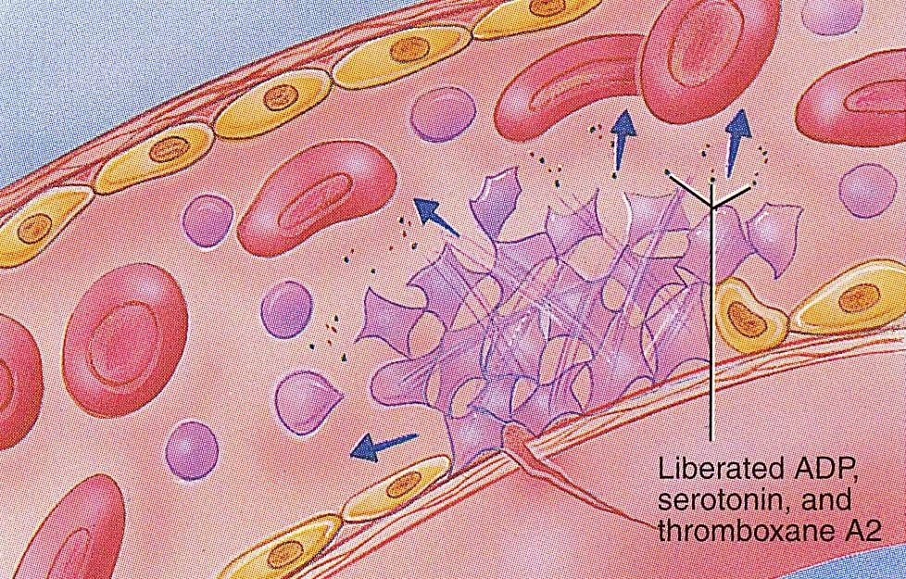
Platelet Release Reaction
Activated platelets release Serotonin, ADP & Thromboxane A2
Serotonin & thromboxane A2 are vasoconstrictors decreasing blood flow through the injured vessel.
ADP & Thromboxane A2 (TXA2) → ↑ the stickiness of platelets → ↑ Platelets aggregation → plugging of the cut vessel

Slide 23
Activated Platelets
Secrete:
5HT → vasoconstriction
ADP
Platelet phospholipid (PF3) → clot
formation
Thromboxane A2 (TXA2) is a prostaglandin formed from arachidonic acid
Function:
  vasoconstriction
  Platelet aggregation
(TXA2 inhibited by aspirin)

Slide 24
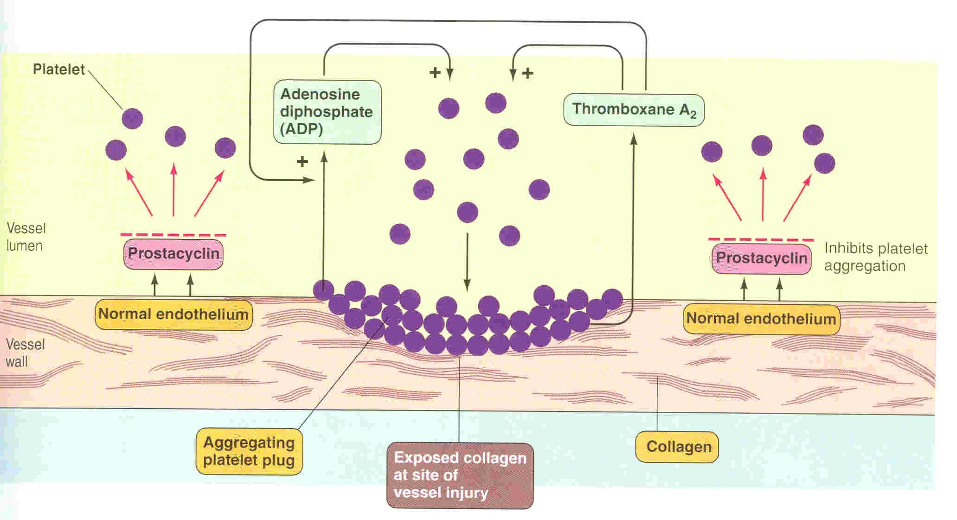
Platelets aggregation
24

Slide 25
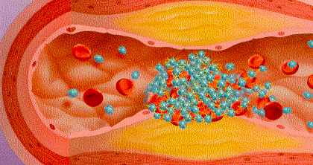
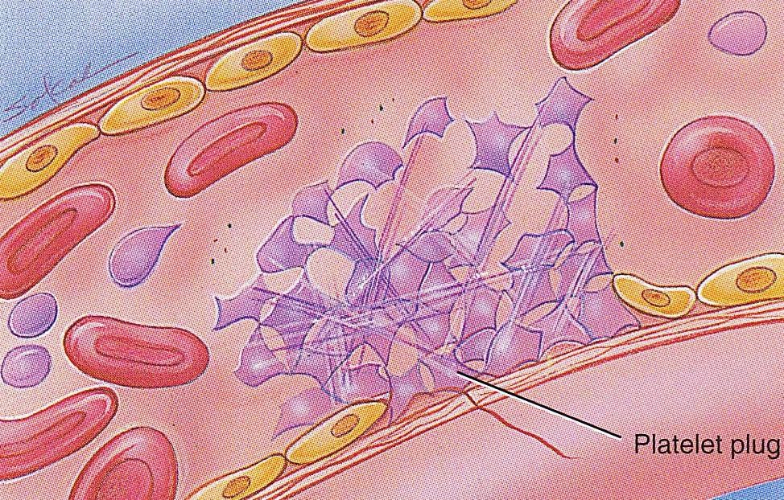
Platelet Aggregation
Activated
platelets
stick
activate
together
and
new platelets
to form a mass called a platelet plug
Plug reinforced by fibrin threads formed during clotting process

Slide 26
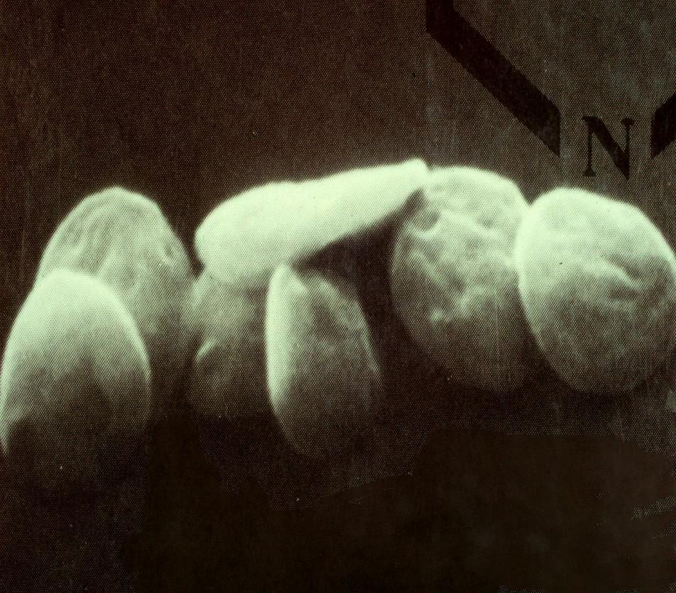
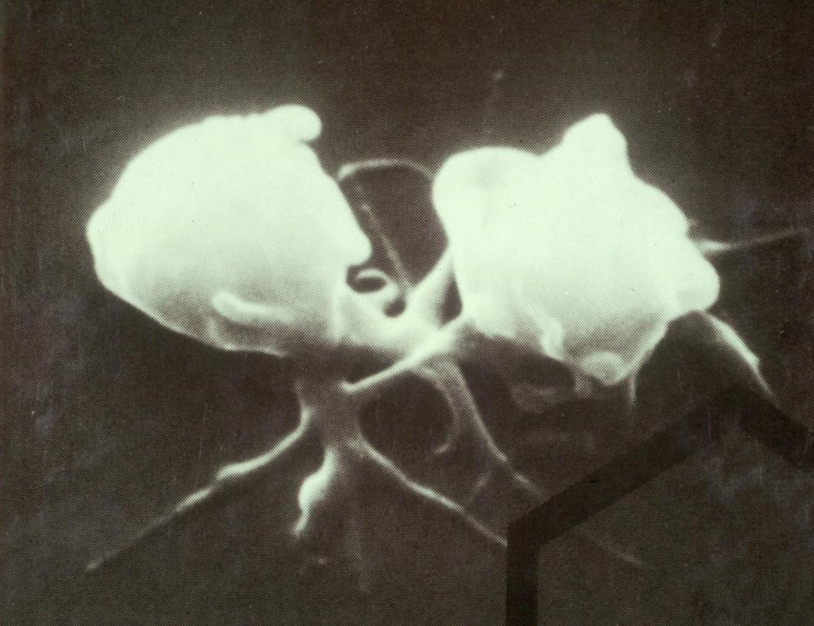
Platelet shape change and Aggregation

Slide 27
Platelet Activation
Clot Retraction:
Myosin and actin filaments in platelets are stimulated to contract during aggregation further reinforcing the plug and help release of granule contents

Slide 28
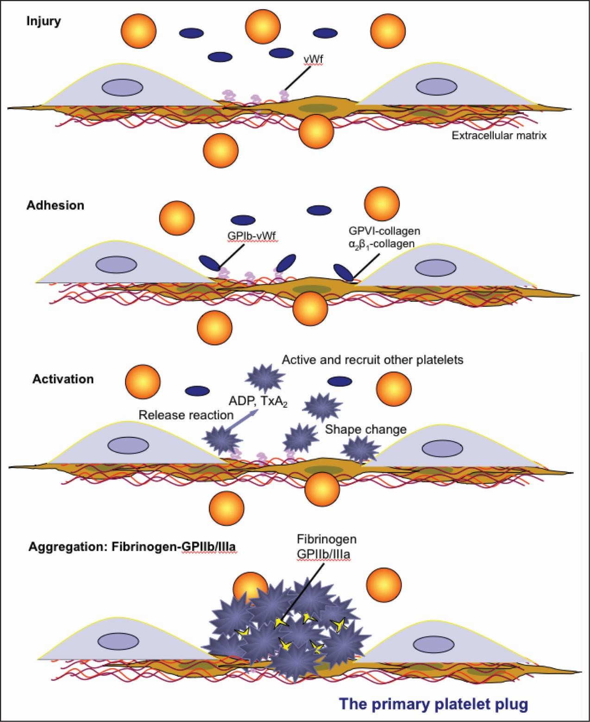

Slide 29
Platelet function
Adhesion
Activation Aggregation
Secretion

Slide 30
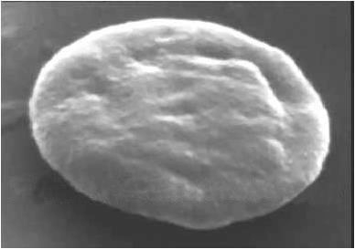
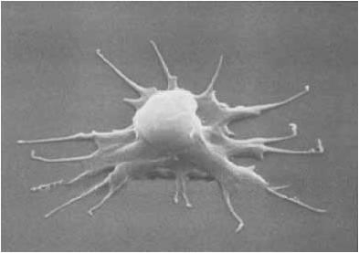
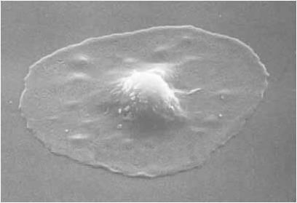

Slide 31
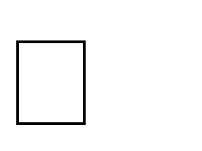
Intact endothelium secret prostacyclin and NO which inhibit aggregation
31

Slide 32
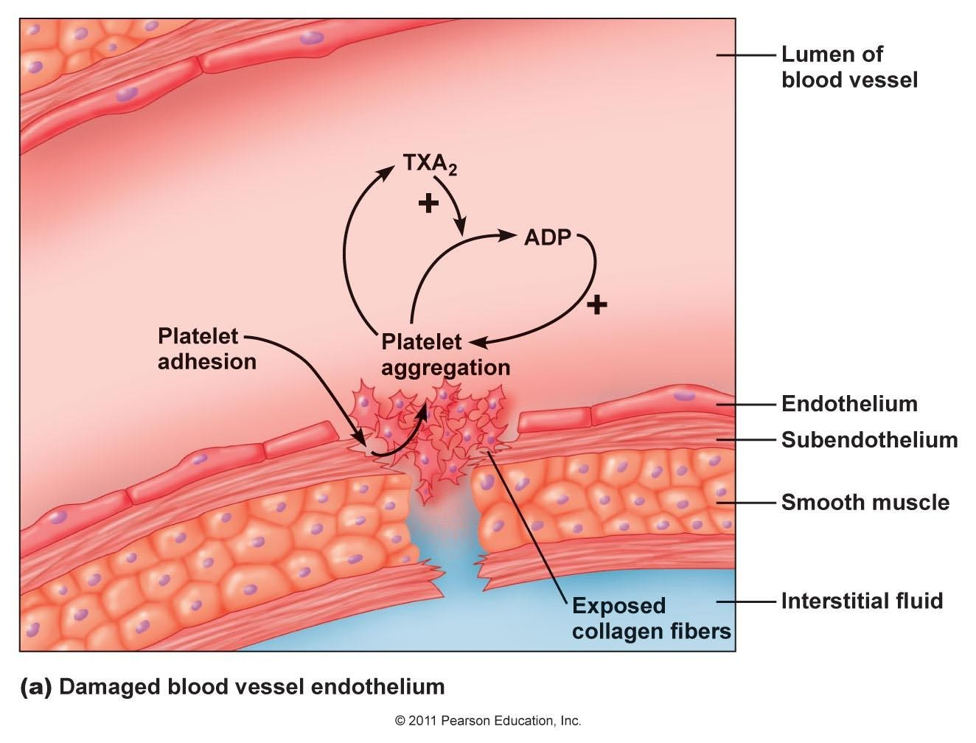
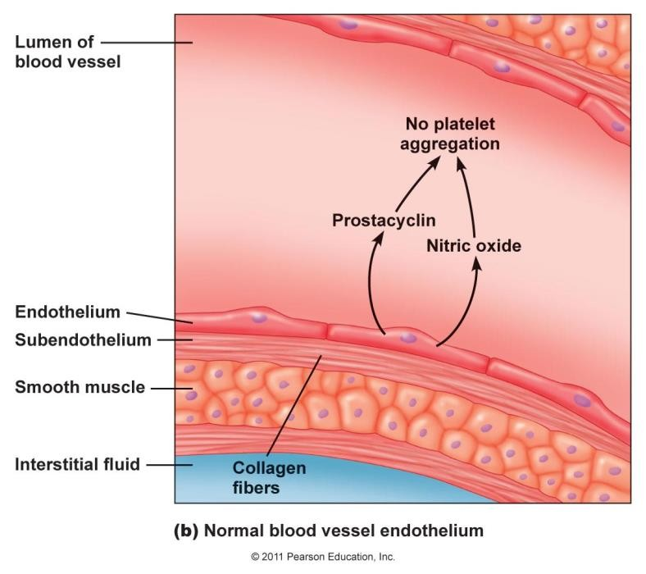

Slide 33
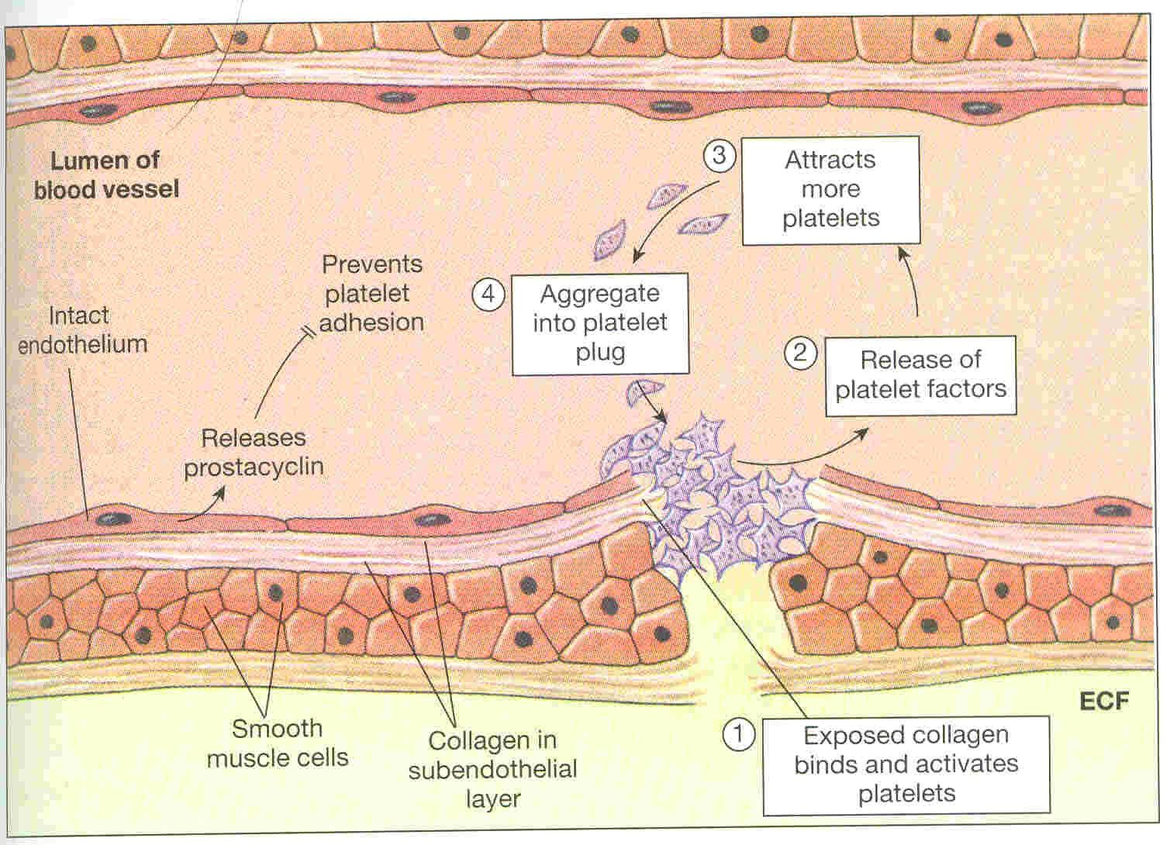
Platelet plug formation

Slide 34


Slide 35
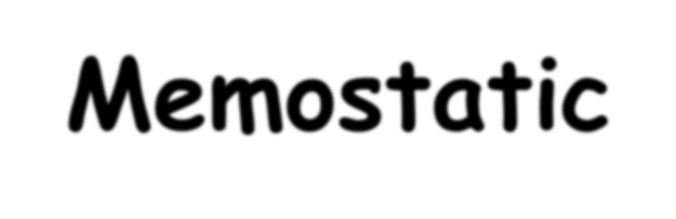

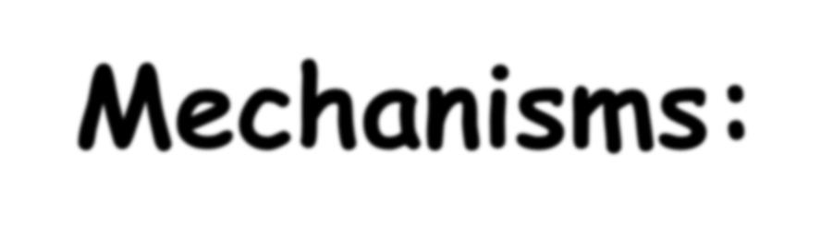

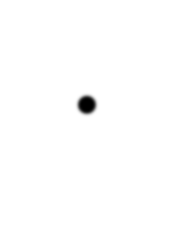
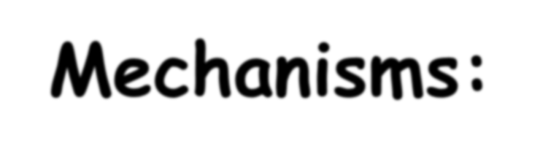
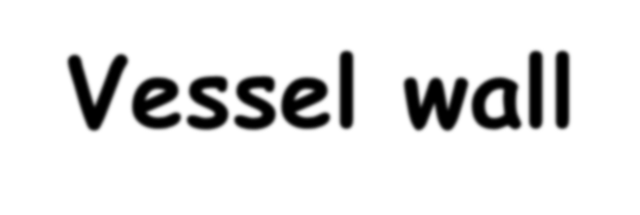
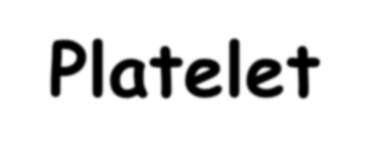
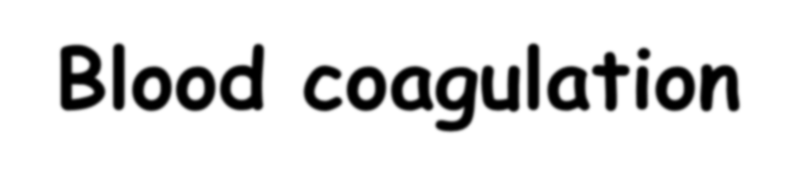
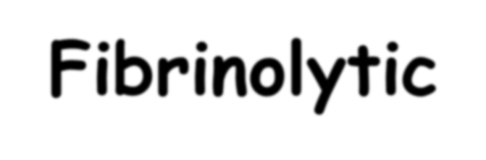
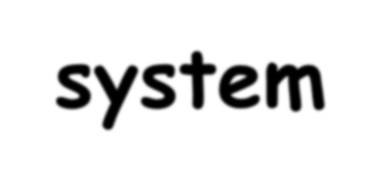
Memostatic Mechanisms:
Mechanisms:
  Vessel wall
  Platelet
  Blood coagulation
  Fibrinolytic system

Slide 36
Clotting Factors
Circulate in plasma in inactive sate
Factors | Names
I II III IV V VII VIII IX X XI XII XIII | Fibrinogen Prothrombin Thromboplastin Calcium Labile factor Stable factor Antihemophilic factor A Antihemophilic factor B Stuart-Power factor Plasma thromboplastin antecedent (PTA) Hagman factor Fibrin stablizing factors

Slide 37
Blood coagulation
(clot formation)
A series of biochemical reactions leading to
the formation of a blood clot
This reaction leads to the activation of thrombin enzyme from inactive form prothrombin
Thrombin will change fibrinogen (plasma protein) to fibrin (insoluble protein)
Prothrombin (inactive thrombin) is activated
by a long intrinsic or short extrinsic
pathways
37

Slide 38



The Intrinsic Pathway
Blood trauma or contact with collagen
The Extrinsic Pathway
Tissue trauma
F XII
F XIIa
HMW Kininogen
Prekallikrein
Tissue factor (TF)
FXI
FXIa
Ca++
FVIIa
FVII
F IX
F IXa
Ca++
FVIII PLTs Ca++
F X
F Xa
Blood
clot
FV
PLTs, Ca++
Prothrombin
Thrombin
Fibrinogen
Fibrin

Slide 39
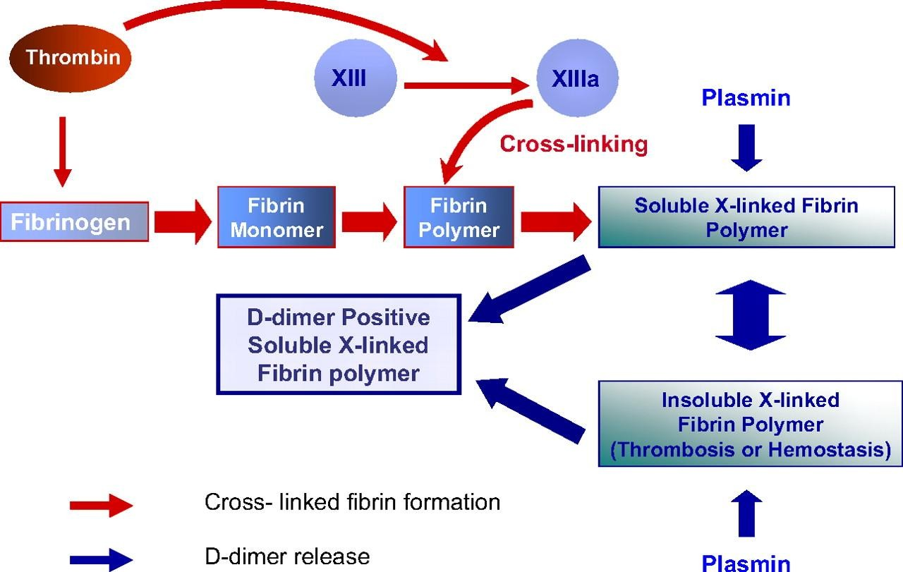

Slide 40
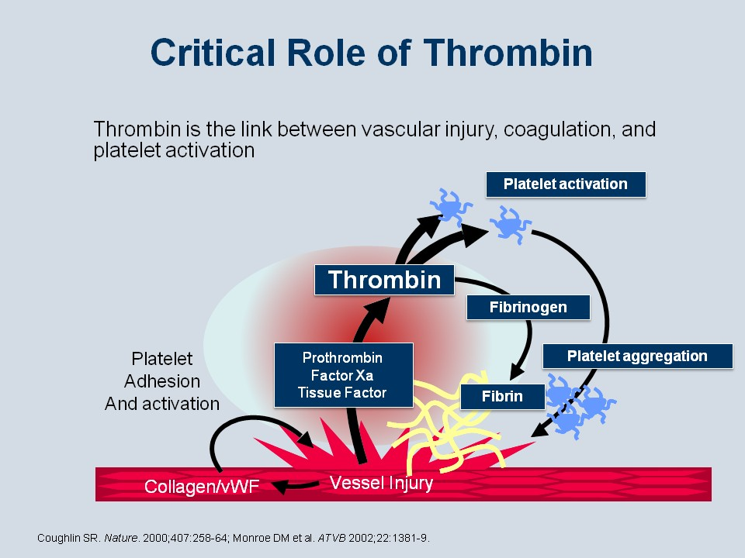
Thrombin
Thrombin changes fibrinogen
to fibrin
Activates factor V
Thrombin is essential in platelet morphological changes to form primary plug
Thrombin stimulates platelets to release ADP & thromboxane A2; both stimulate further platelets aggregation
40

Slide 41
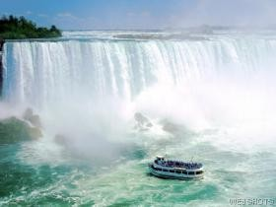


Slide 42
Intrinsic Pathway | Pathway Extrnsic
Contact activation ↓ XII →XIIa ↓ XI →XIa ↓ IX → IXa ↓VIII, Ca,P X → Xa | Tissue Factors ↓ ↓ ↓ ↓ VII,Ca ↓ ↓ ↓ Xa ← X
Xa ↓ ↓ V, Ca, P Prothrombin (II) → Thrombin (IIa) ↓ Fibrinogen (I) → Fibrin (soluble) ↓ XIII, Ca Insoluble fibrin

Slide 43
Intrinsic pathway
The trigger is the activation of factor XII by contact with foreign surface, injured blood vessel, and glass.
Activate factor (XIIa) will activate XI
Xla will activate IX
IXa + VIII + platelet phospholipid + Ca
activate X
Following this step the pathway is common for both
43

Slide 44
Extrinsic pathway
Triggered by material released from damaged
tissues (tissue thromboplastin)
tissue thromboplastin + VII + Ca → activate X
Common pathway
Xa + V +PF3 + Ca ( prothrombin activator) it is a proteolytic enzyme activate prothrombin → thrombin
Thrombin act on fibrinogen → insoluble thread like
fibrin
Factor XIII + Ca → strong fibrin (strong clot)
44

Slide 45
Activation Blood Coagulation
Intrinsic Pathway: all clotting factors present in the blood
Extrinsic Pathway: triggered by tissue factor
Common Pathway

Slide 46
Intrinsic Pathway | Extrinsic pathway
Contact activation ↓ XII →XIIa ↓ XI →XIa ↓ IX → IXa ↓VIII, Ca,P* X → Xa | Tissue factor ↓ ↓ VII,Ca ↓ Xa ← X
Xa ↓ ↓ V, Ca, P* Prothrombin (II) → Thrombin (IIa) ↓ Fibrinogen (I) → Fibrin (soluble) ↓ XIII, Ca insoluble fibrin
P* = phospholipid from platelets

Slide 47




Platelet haemostatic plug
formation

Slide 48




















Hemostasis:
the spontaneous arrest of bleeding
from ruptured blood vessels
Mechanisms:
Vessel wall
Platelet
Blood coagulation
Fibrinolytic system (Fibrinolysis)

Slide 49
Fibrinolysis
Formed blood clot can either become
fibrous or dissolve
Fibrinolysis (dissolving) = Break down of fibrin by naturally occurring enzyme plasmin therefore prevent intravascular blocking
There is balance between clotting and
fibrinolysis
  Excess clotting → blocking of Blood
Vessels
  Excess fibrinolysis → tendency for
bleeding
49

Slide 50

clotting
fibrinolysis
Thrombosis
Haemorrhage

Slide 51

Fibrinolysis
Plasminogen
activators
Plasminogen
Plasmin
Anti-activators
Coagulation
Fibrin
FDP*
The fibrinolytic System
FDP*: Fibrin Degradation Products

Slide 52

Plasmin is present in the blood in inactive form
plasminogen
Plasmin is activated by tissue plasminogen
activators (t-PA) in blood.
Plasmin digest intra & extra vascular deposit of
Fibrin → fibrin degradation products (FDP)
Unwanted effect of plasmin is the digestion of
clotting factors
52

Slide 53
Plasmin is controlled by:
Plasminogen Activator Inhibitor (PAI)
Antiplasmin from the liver
Uses:
– Tissue Plasminogen Activator (t-PA) used to
activate plasminogen to dissolve coronary clots
53

Slide 54



Plasmin
Fibrin
Fibrin degradation product

Slide 55




Haemostatic Mechanisms

Slide 56



Bleeding disorders
Excessive bleeding can
result from:
  Platelet defects: deficiency in number (thrombocytopenia) or defect in function.
  Coagulation factors
defect:
Deficiency in coagulation factors (e.g. hemophilia).
  Vitamin K deficiency.

Slide 57


Hemophilia:
Cont. bleeding disorders
↑ bleeding tendency.
X-linked disease.
Affects males.
85% due to FVIII deficiency (hemophilia A), and 15% due to
FIX deficiency (hemophilia B).
Vitamin K deficiency & liver disease:
  Almost all coagulation factors are synthesized in the liver.
  Prothrombin, FVII, FIX, & FX require vitamin K for their
synthesis.

Slide 58



