Slide 1
Transport of Substances Through the Cell Membrane
Dr. Maha Saja

Slide 2
Objectives
At the end of this session, the students should be able
to:
Describe the fluid mosaic model of membrane structure and function.
Define permeability and list factors influencing permeability.
Identify and describe carried-mediated transport processes: Primary active transport, secondary active transport, facilitates diffusion.

Slide 3
Previously..
Fluid body compartments are divided into:
  Intracellular
  Extracellular
The amount of solutes in the two
compartments differ.
How is this achieved and maintained?
  “Selective permeability”

Slide 4
What is meant by Selective
Permeability
The membrane allows some substances to
cross it but not others.
This controls the type & amount of substances entering and leaving the cell.
It arises from the membrane structure.

Slide 5
Structure of the Cell
Membrane

Slide 6
Structure of the Cell
Membrane
Cell membrane = plasma membrane.
Thickness = 7.5-10 nm.
Composed of:
  Lipids (42%)
  Proteins (55%)
  Carbohydrates (3%)
Phospholipids (25%)
Cholesterol (13%)
Other lipids (4%)
(Guyton and Hall Textbook of Physiology. 13th ed. Chapter-2)

Slide 7
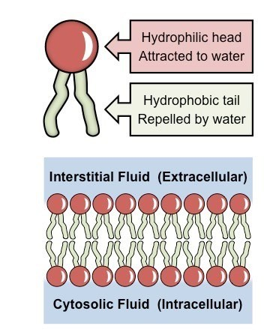
Structure of the Cell Membrane
The cell membrane = a
lipid bilayer.
The most abundant lipid =
phospholipids.
A phospholipid molecule
have two ends:
  Hydrophilic (phosphate end)
  Hydrophobic (fatty acid end)
(Guyton and Hall Textbook of Physiology. 13th ed. Chapter-2)

Slide 8

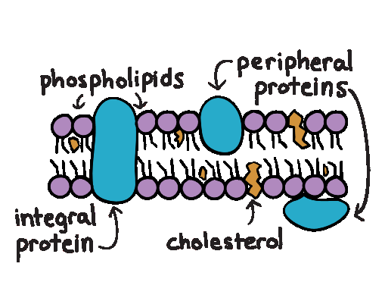



Structure of the Cell Membrane
Membrane
proteins
Integral
Peripheral
Span the thickness of the cell membrane.
Function as:
Channels (or
pores).
Carrier proteins.
Receptors.
Are attached to one surface of the membrane.
Function as:
Enzymes
(Guyton and Hall Textbook of Physiology. 13th ed. Chapter-2)

Slide 9
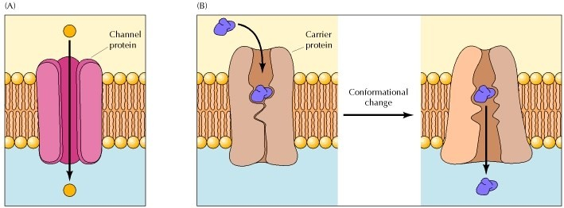
Channel vs. Carrier Proteins
Channel proteins form open pores through which molecules of the appropriate size (e.g., ions) can cross the membrane.
Carrier proteins selectively bind the small molecule to be transported and then undergo a conformational change to release the molecule on the other side of the membrane.

Slide 10
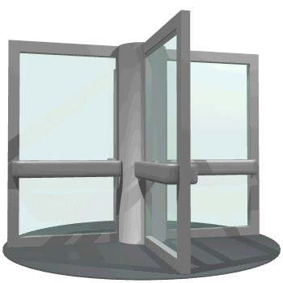

Carrier
Channel

Slide 11
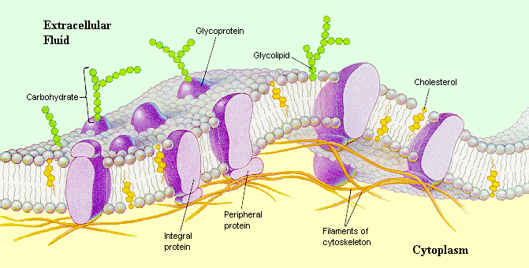
Structure of the Cell Membrane
Function of
CHOs:
Receptors.
Attach cells to each other.
Immune reactions.
Carbohydrates in the cell membrane are invariably attached to:
  Proteins → Glycoproteins
  Lipids → Glycolipids
Carbohydrate molecules protrude to the outside of the
cell forming a loose carbohydrate coat = “glycocalyx”

Slide 12
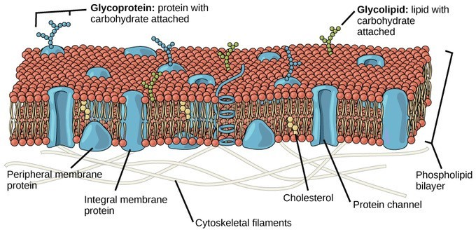
The Fluid Mosaic Model of
Plasma Membrane

Slide 13
Movement (Transport) of Substances Across the Cell Membrane

Slide 14
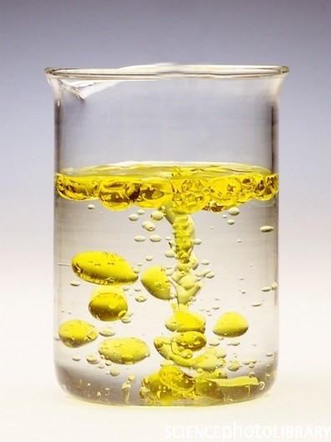

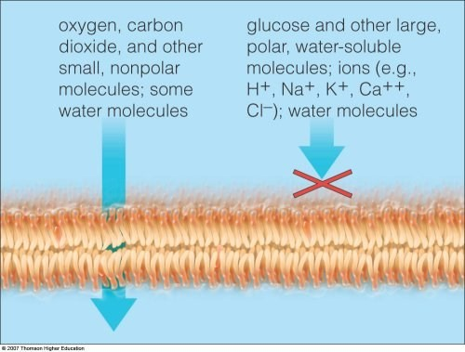
Substances that can Across the Cell Membrane
Lipid soluble
substances
Water soluble substances
rane
Alternative route
Oil and water do not mix
Cross freely by diffusion
Through memb
proteins

Slide 15
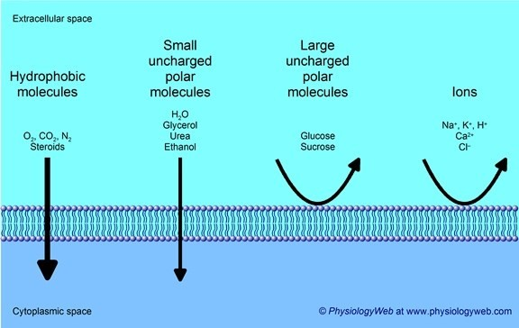
Substances that can Across the Cell Membrane

Slide 16
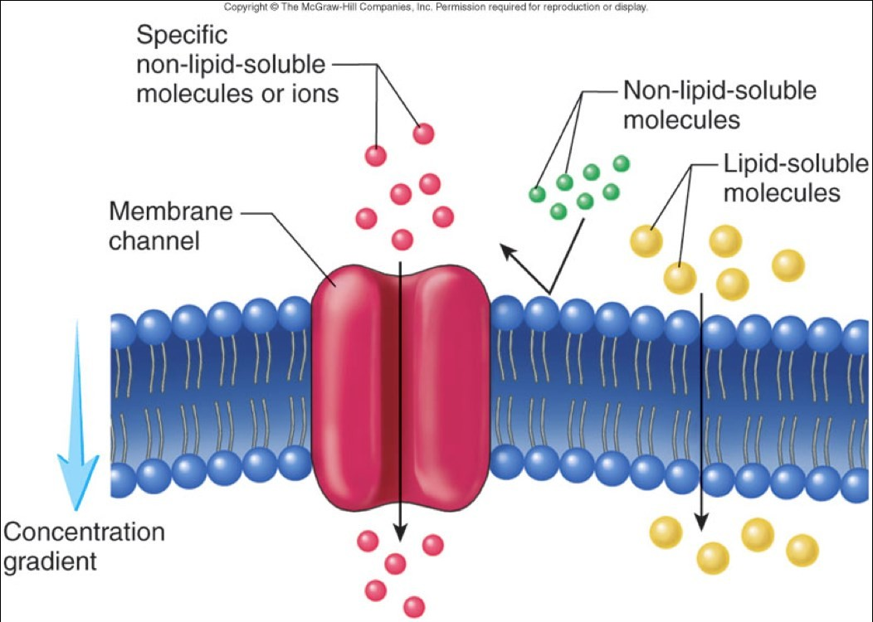
Substances that can Across the Cell Membrane
Achieved through a trans- membrane protein carrier/transporter/channel

Slide 17
Transport Mechanisms
The transport of material between body or
cellular compartments can be divided into:
  Passive Transport = does not require energy.
  Active Transport = requires energy.

Slide 18




Transport Mechanisms
Passive Transport
Active Transport
Molecules move along their energy gradient.
Does not require energy.
Types:
  Simple Diffusion.
  Facilitated Diffusion.
  Osmosis.
Molecules move against their energy gradient.
Requires energy.
Types:
  Primary Active Transport.
  Secondary Active Transport.

Slide 19
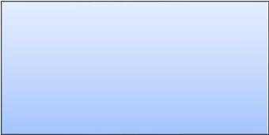
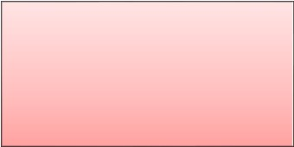
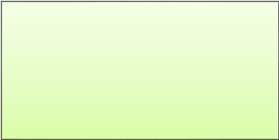
Passive Transport Mechanisms
Passive Transport
Diffusion
Osmosis
Movement of water from an area of low solute concentration to an area of high solute concentration.
Simple
Facilitated

Slide 20
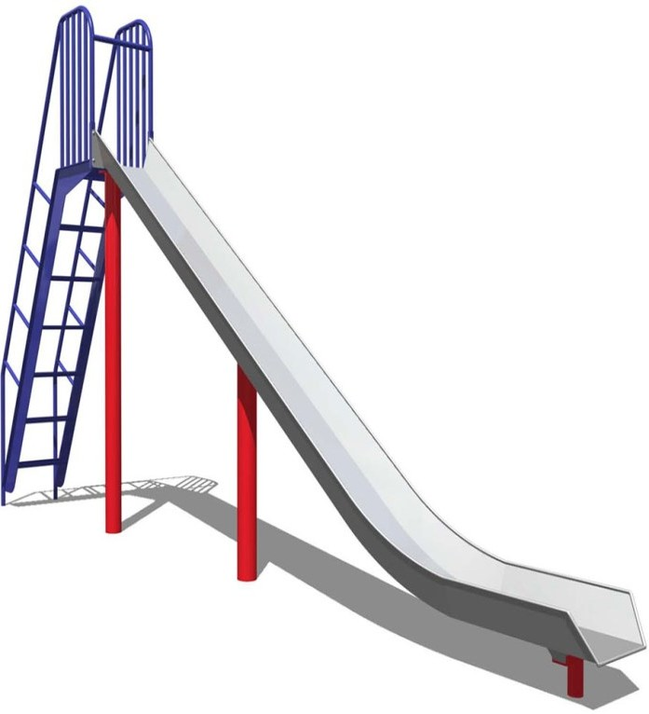

Diffusion
Diffusion = the random movement of substances down an energy gradient.
This gradient can be:
  Concentration gr.
  Electrochemical gr.
  Pressure gr.
High conc.
substances will move “down” their concentration gradient
Low conc.

Slide 21
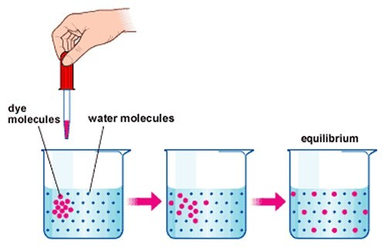
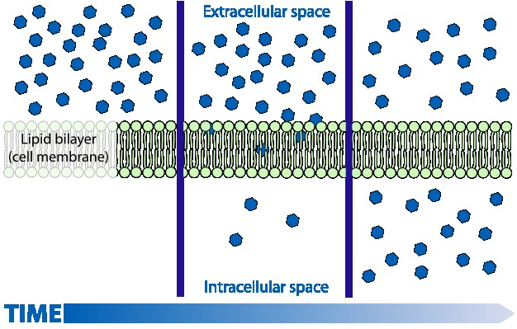
Diffusion

Slide 22




Types of Diffusion
Diffusion
Facilitated Diffusion
Simple Diffusion
The movement of molecules through the intermolecular spaces or membrane openings (channels) without the necessity of binding to a carrier protein on the membrane.
The transported molecule binds to a carrier protein which then undergoes a conformational change allowing the molecule to pass through to the other side of the cell membrane.
The carrier facilitates passage of the molecule through the CM

Slide 23
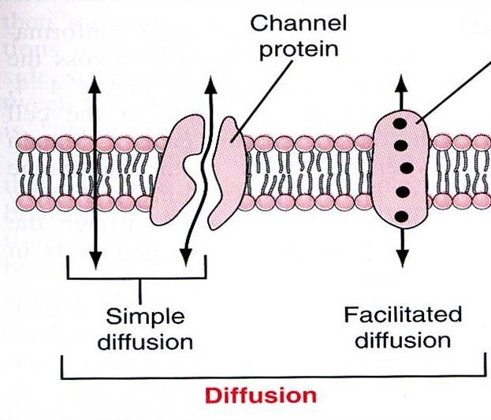
Types of Diffusion
Carrier protein
Also called “Carrier-mediated diffusion”.
Lipid-soluble substances (e.g. O2, CO2, and alcohol)→ Pass through the interstices of the lipid bilayer.
Water-soluble substances (water, ions) → pass through channels that penetrate all the way through the CM.
Diffusion of a substance is “facilitated” by the use of a specific carrier protein.
Examples (glucose, amino acids).

Slide 24
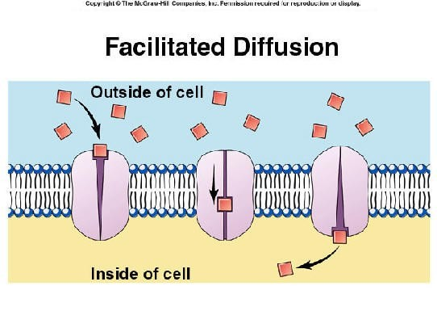

Slide 25




What is the difference between
simple and facilitated diffusion?
Simple diffusion
Facilitated diffusion
The rate of diffusion increases proportionately with the concentration of the diffusing substance.
The rate of diffusion increases proportionately with the concentration of the diffusing substance until it reaches a maximum Vmax.
At Vmax, an increase in the concentration of the diffusing substance does not increase the rate of diffusion.

Slide 26

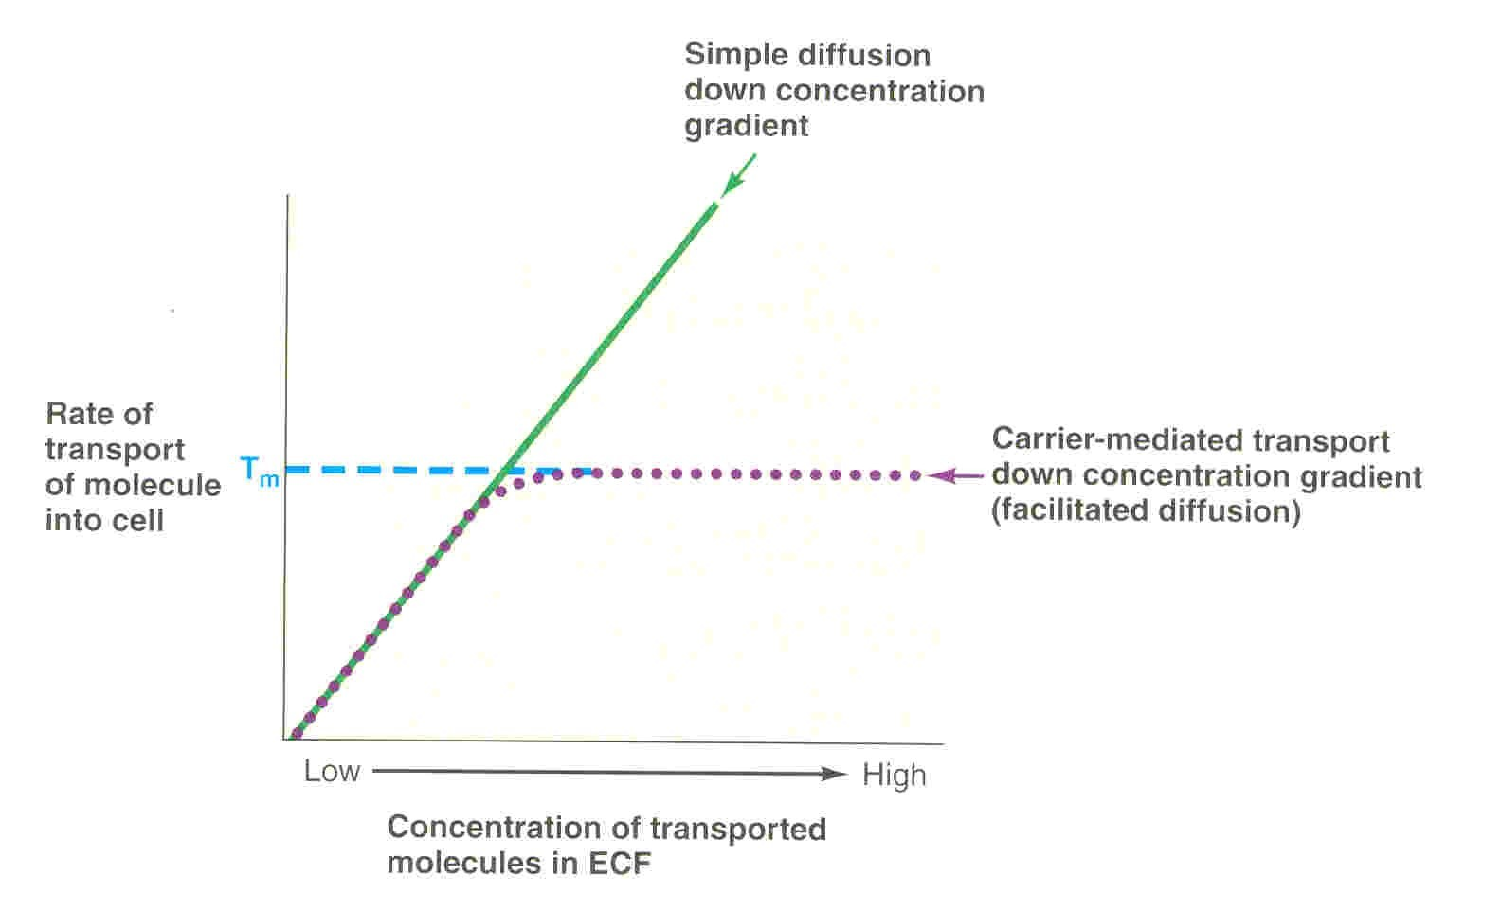
The rate at which molecules can be transported by facilitated diffusion depends on the rate at which the carrier protein molecule can undergo conformational change back and forth between its bound and unbound state.

Slide 27
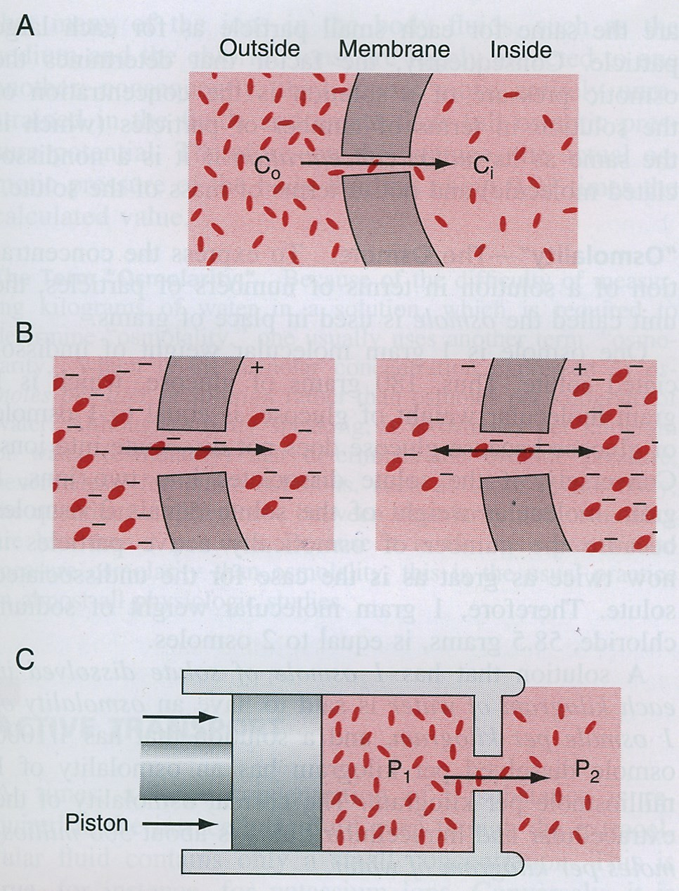
Factors Affecting Net Rate of
Diffusion
Size.
Temperature.
Steepness of the
gradient:
  Concentration difference
  Membrane electrical
difference.
  Pressure difference.
Charge.
Pressure.

Slide 28
Active Transport
Occurs when a cell membrane moves molecules or ions “up-hill” against a concentration gradient (or “up-hill” against an electrical or pressure gradient).
Examples include:
  Ions like: sodium, potassium, calcium, iron, iodine,
hydrogen ions.
  Amino acids, glucose and other sugars.
Requires energy and a carrier protein.

Slide 29







Active Transport
According to the source of energy used to facilitate
transport, it can be divided into;
Active Transport
Indirect source of energy
Primary Active Transport
Secondary Active Transport
Direct source of energy
Co-transport
Counter-transport

Slide 30


Types of Active Transport
Primary Active
Secondary Active
The energy is derived directly from breakdown of adenosine triphosphate (ATP) or some other high-energy phosphate compound.
Examples include:
  Sodium-potassium ATPase pump.
  Calcium ATPase pump
  Hydrogen ATPase pump.
The energy is derived indirectly by using the concentration or electrochemical gradient generated by a primary active transporter.

Slide 31
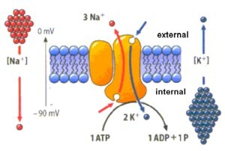
Primary Active Transport
This pump functions by moving 3 molecules of sodium OUT and 2 molecules of potassium INTO the cell both against their concentration gradients.
The importance of this pump:
Maintaining Na and K concentration differences across the cell membrane.
Establishes a negative electrical voltage inside the cell.
Is the basis for nerve signal transmission.

Slide 32
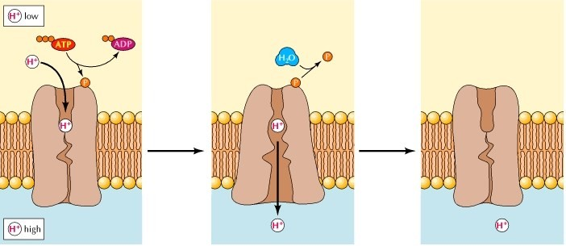
Primary Active Transport
H+ ATPase Pump
Present in:
Parietal cells of stomach → secretion of HCl in the stomach.
Intercalated cells of distal renal tubules → excretion of acids from the
body.
Pumps H+ out of the cell and into the lumen.

Slide 33
Primary Active Transport
Ca+2 ATPase Pump
Present in:
  Sarcoplasmic reticulum in muscle cells
  Mitochondria
  Some cell membranes.
Maintains low Ca+2 concentration inside the cell.

Slide 34
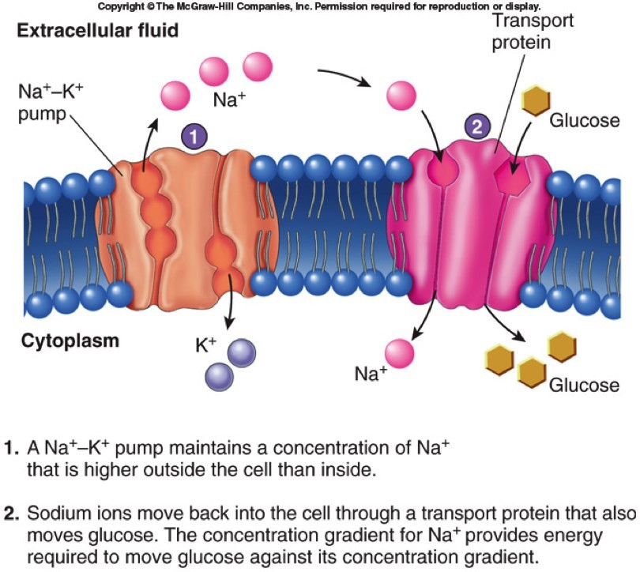
Secondary Active Transport
(Co-transport)
Derives energy indirectly… How?

Slide 35
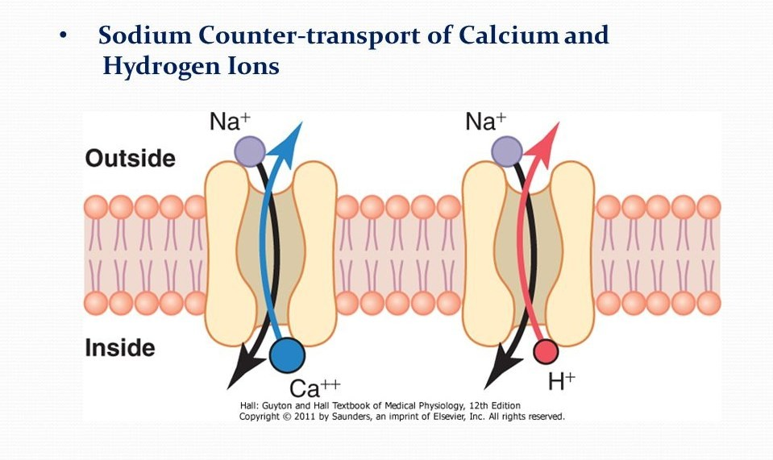
Secondary Active Transport
(Counter-transport)

Slide 36




Types of Secondary Active
Transport
Co-Transport
Counter-Transport
When both substances are transported together in the same direction.
Examples;
  Na+-Glucose co- transport (PCT)
  Na+-amino acid co- transport (PCT)
When one substance is transported in the opposite direction to the other substance.
Examples;
  Na+-H+ counter-transport (PCT)
  Na+-Ca+2 counter- transport (PCT)

Slide 37
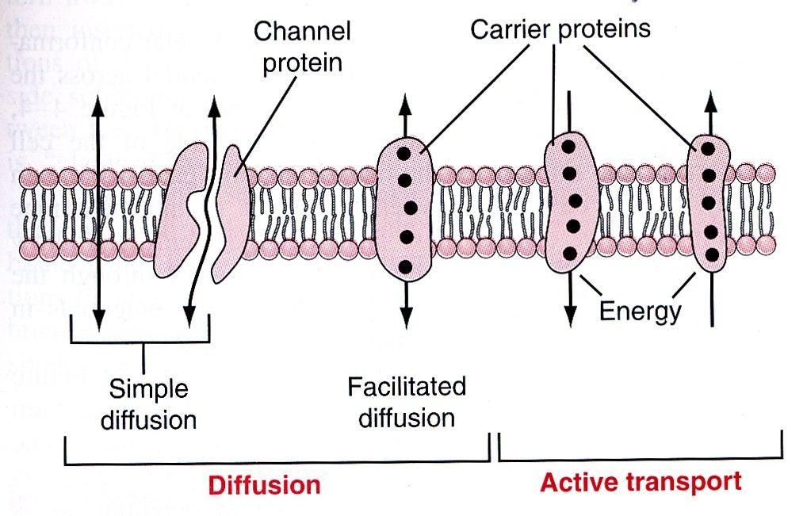
Revision!

Slide 38
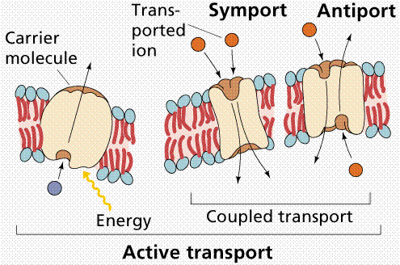
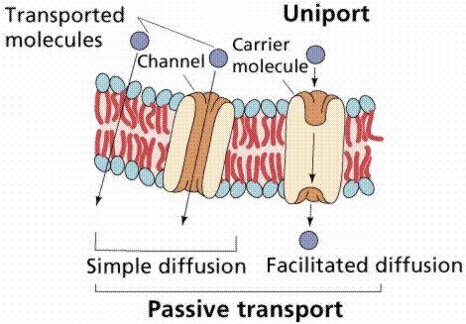
Revision!

Slide 39


