Slide 1
Homeostasis
Dr. Maha Saja Physiology department, Level 2,
Office 89,
Extension # 56210 Email: msaja@ksu.edu.sa

Slide 2
Objectives
Define and discuss the concept of homeostasis and its
importance to the living organism.
Discuss the physiologic control mechanisms that enable
maintenance of the normal steady state of the body.
Define a feedback mechanism and describe its components.
Differentiate between positive and negative feedback
mechanisms and give examples for each in the body.
Apply the knowledge gained in feedback mechanisms to disturbances in the disturbances in ECF volume and osmolarity.

Slide 3
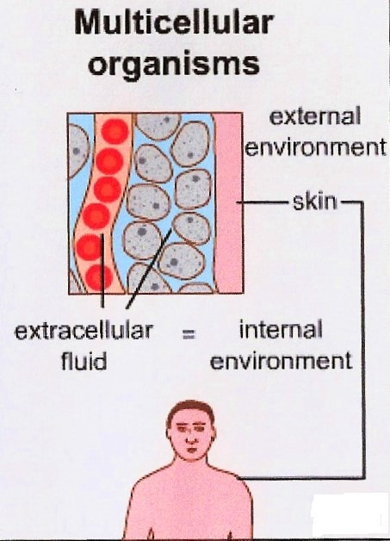


The Internal environment
All body cells live in the same environment →ECF.
The skin separates this environment from the outside world (external environment).
3

Slide 4
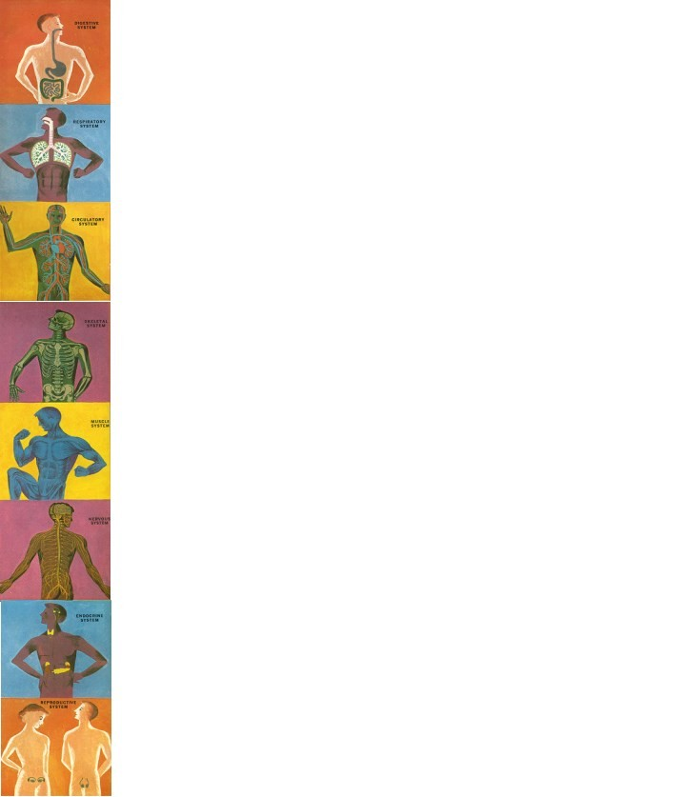
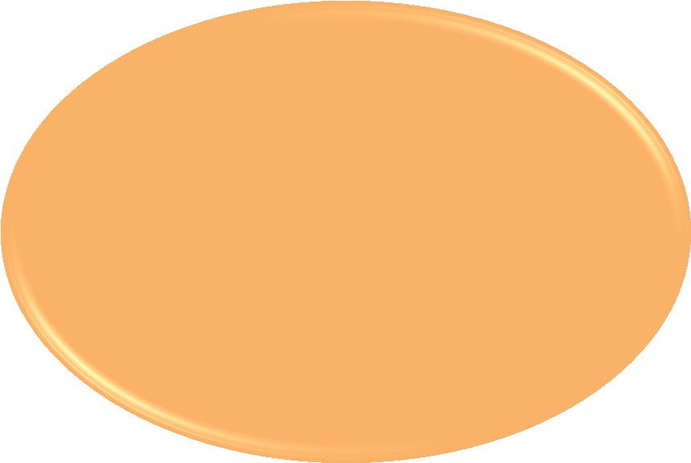

In order for the cell to function properly,
The internal environment need to have the right amount/level of these substances/variables.
(not too much and not too little)
waste
CO2
Urea
Energy (ATP)
Work
Chemical reactions
enzymes
Fatty acids Amino acids
pH Temperature
Ions
Glucose
Oxygen
ECF
(Mr. Ford’s class-Introduction to anatomy and physiology-youtube)

Slide 5
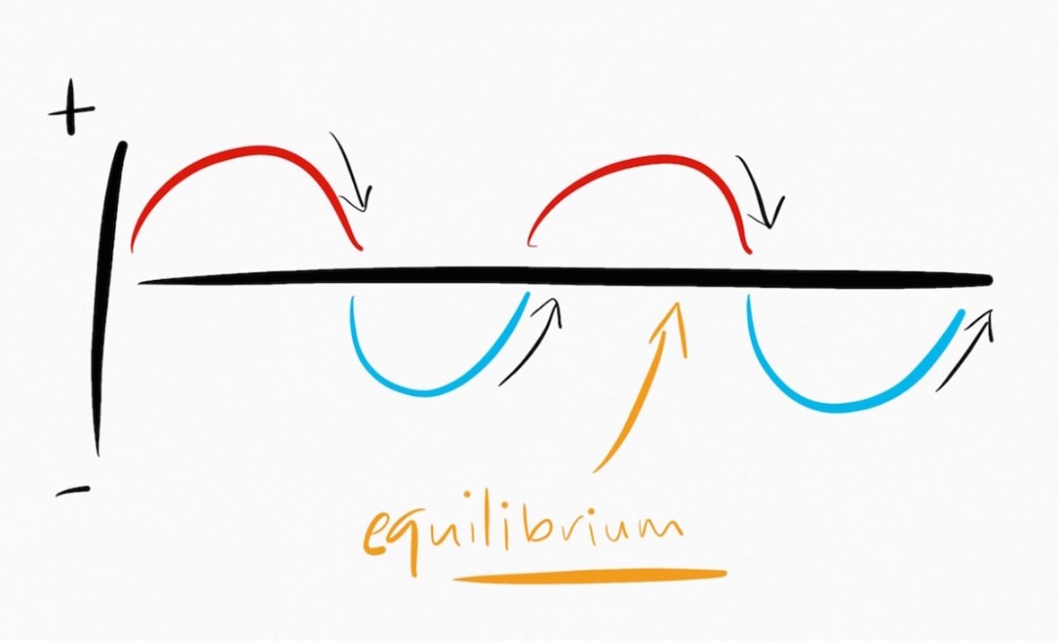
The Internal environment
The internal environment must be kept
constant in the face of an ever changing
external environment.
The internal environment of the body (ECF)is
in a dynamic state of equilibrium
5

Slide 6
“Homeostasis”
The process by which the body keeps the internal environment constant despite changes in the external environment is known as “Homeostasis”.
Homeostasis means:
  Homeo- : sameness, similarity
  -stasis: standing
Essentially all the functions of the body organs and tissues aim at keeping the internal environment at a nearly constant state.
(Guyton and Hall Textbook of Medical Physiology. 13th ed. Ch-1)

Slide 7
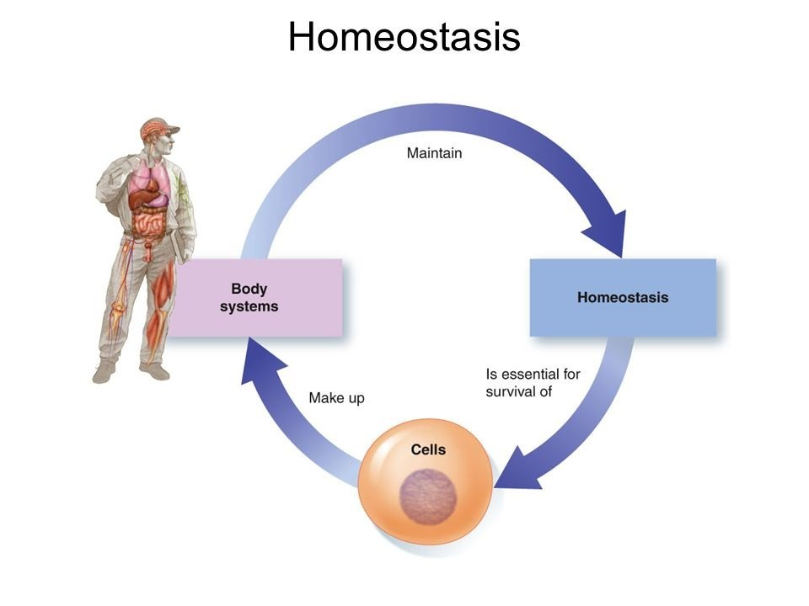

Slide 8

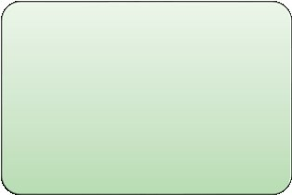

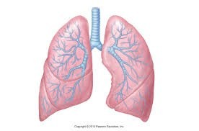
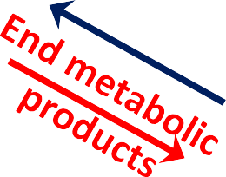
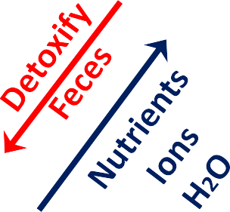
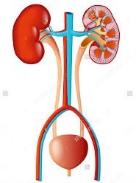
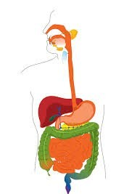
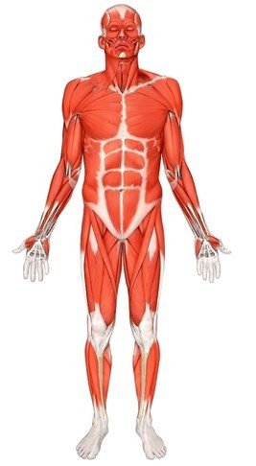
Control systems
Protection
Skin Immune system
Nervous system
Endocrine systems
O2
Internal environment
CO2

Slide 9
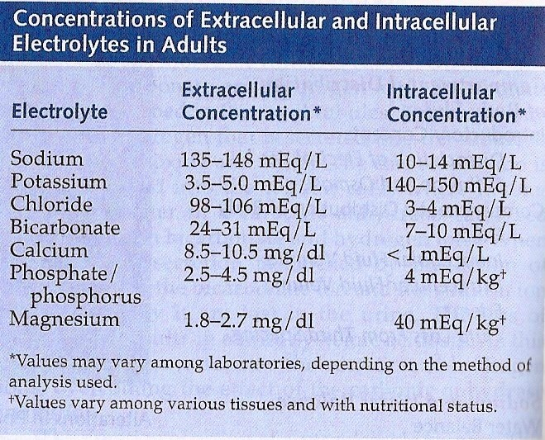
Body constituents are normally regulated within a range rather than a
fixed value;

Slide 10


Control Mechanisms
The body has thousands of control systems.
They function to restore balance when it is lost.
Control systems operate;
  Within the organ itself
  Throughout the body → to control interrelations between organs.
10

Slide 11
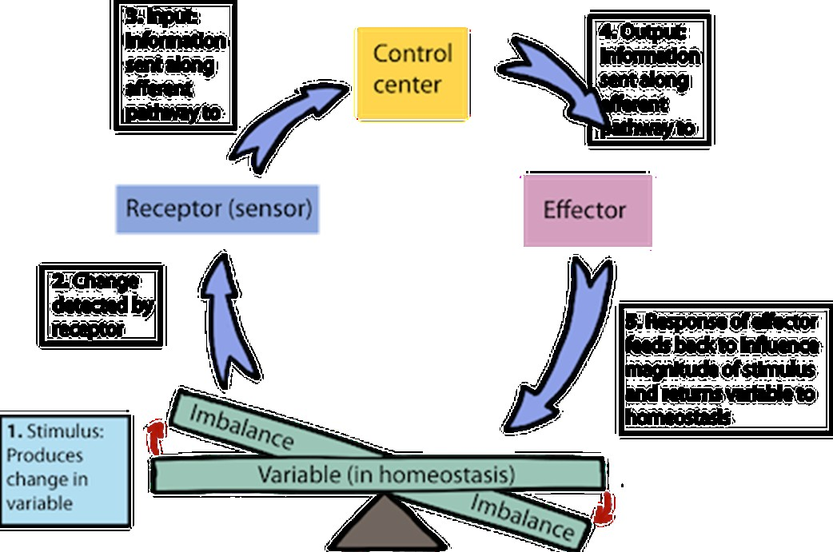
Feedback Mechanisms
What is meant by
feedback?
A loop system in which the system responds to perturbation either in the same direction (positive feedback) or in the opposite direction (negative feedback).

Slide 12
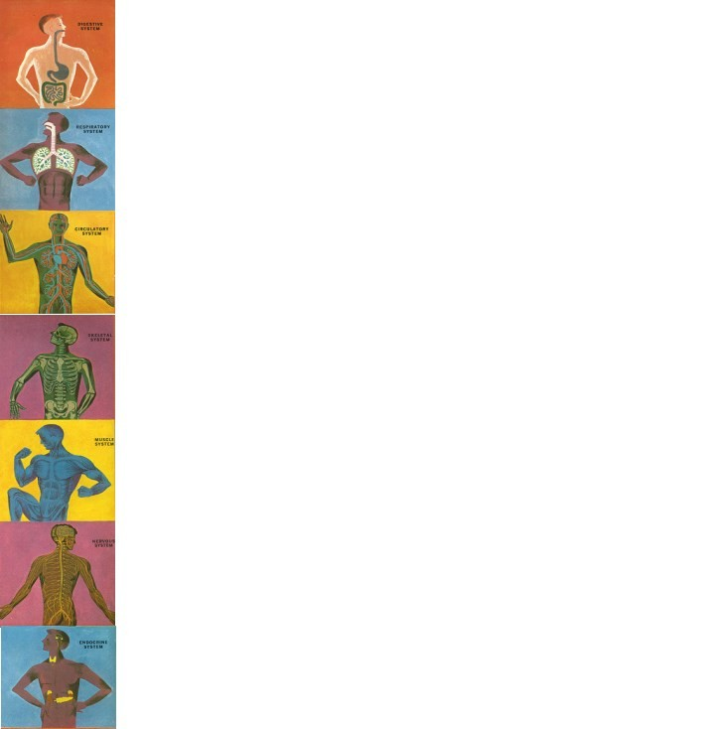
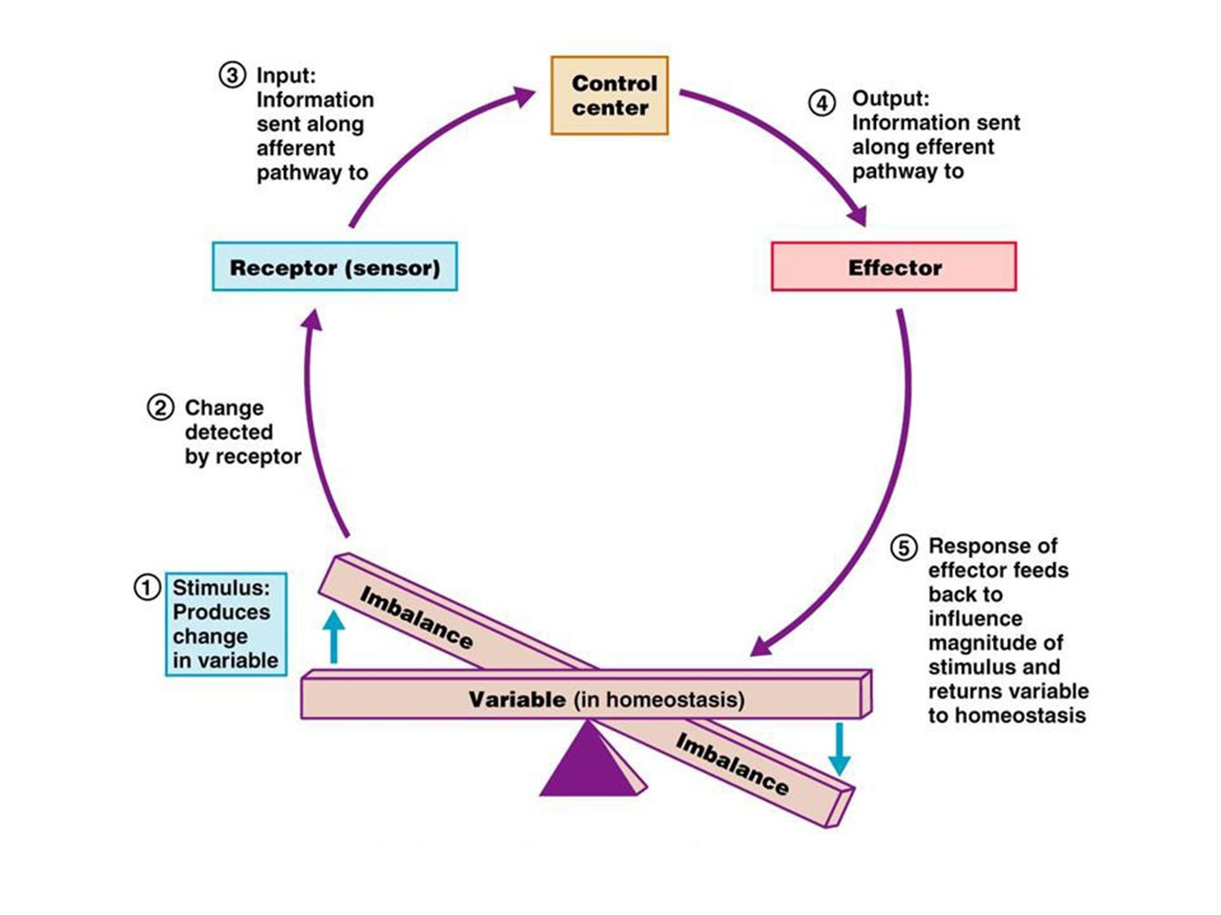
What are the components of a
feedback mechanism?

Slide 13
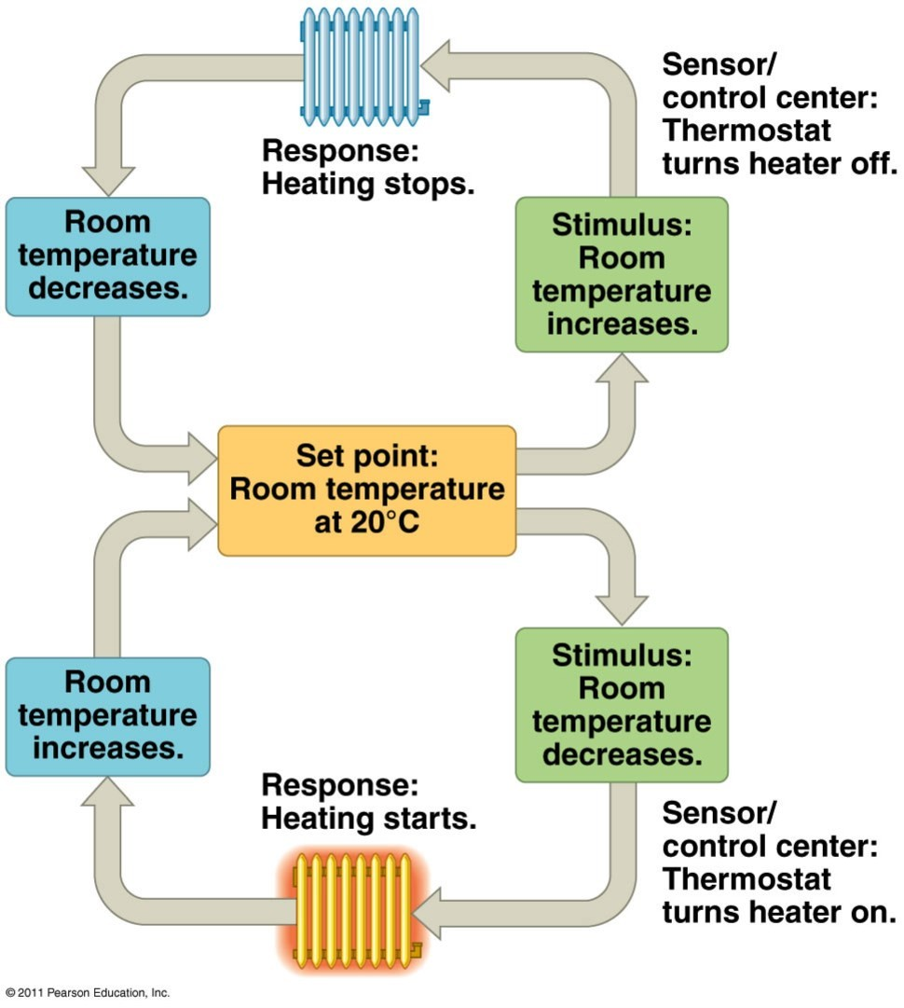
The Thermostat Analogy

Slide 14




Types of Feedback Mechanisms
Negative feedback
Positive feedback
The effector response of the system is in the opposite direction to the stimulus that initiated the response.
E.g;
A high level of in CO2 in the ECF will increase pulmonary ventilation, increasing the amount of CO2 expired which will bring the level of CO2 in ECF down.
Most of the control systems of the body act by negative feedback.
The effector response is in the same direction of the stimulus that initiated the response.
E.g;
In nerve signaling, entry of a small amount of Na+ into the cell will open more Na+ channels causing more Na+ to enter the cell.
Only few systems display positive feedback mechanisms.. WHY?
(Guyton and Hall Textbook of Medical Physiology. 13th ed. Ch-1)

Slide 15
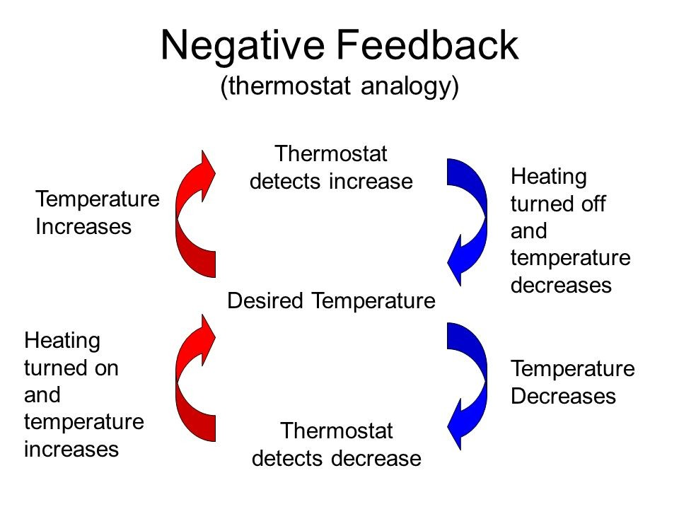

Slide 16


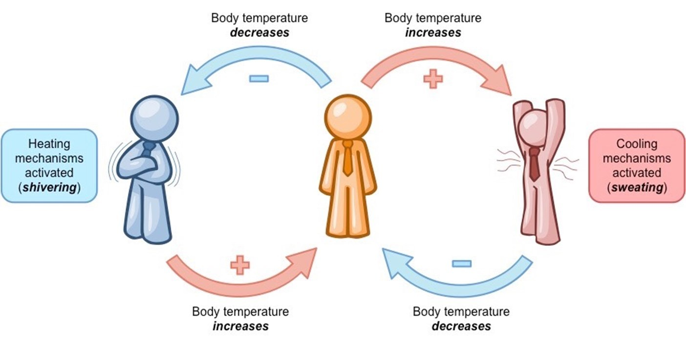
Examples of Negative Feedback Mechanisms
Body temperature control

Slide 17


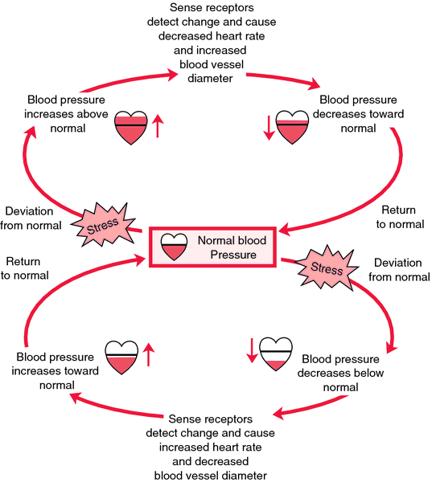
Blood pressure control

Slide 18


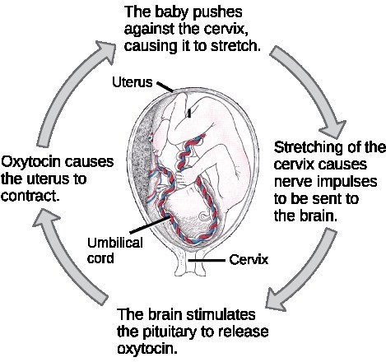
Examples of Positive Feedback Mechanisms
Childbirth
Can you find other examples for a positive feedback mechanism in the body?

Slide 19
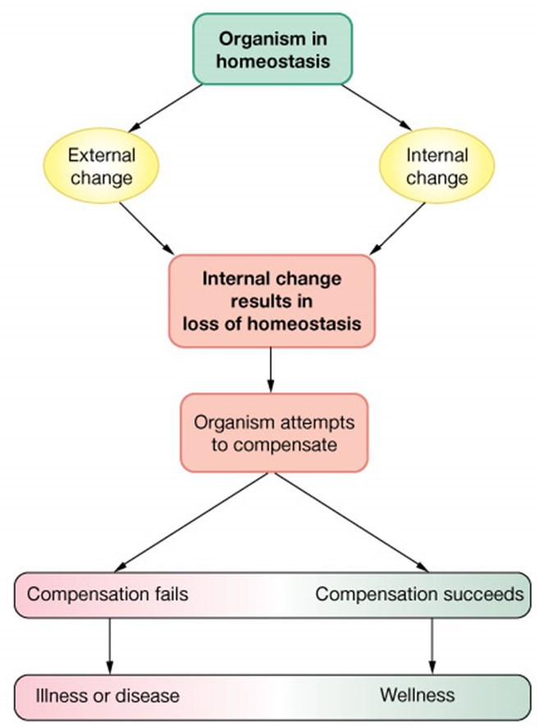
Disease is a state od disturbed
homeostasis

Slide 20




Body Fluid Imbalance
Body Fluid Imbalance
Volume
change
Osmolarity
change
Commonly both
occur together
Volume expansion
Volume contraction
Hyper- osmolarity
Hypo- osmolarity
Decrease output (kidney failure, SIADH)
Increase input (Infusion of excessive IV fluids)
Increase output (diarrhea, vomiting, diuretics)
Decrease input (low intake)
Excessive salt intake
Loss of water more than solutes
Loss of salts (diuretics)
Gain of water more than solutes (SIADH)

Slide 21
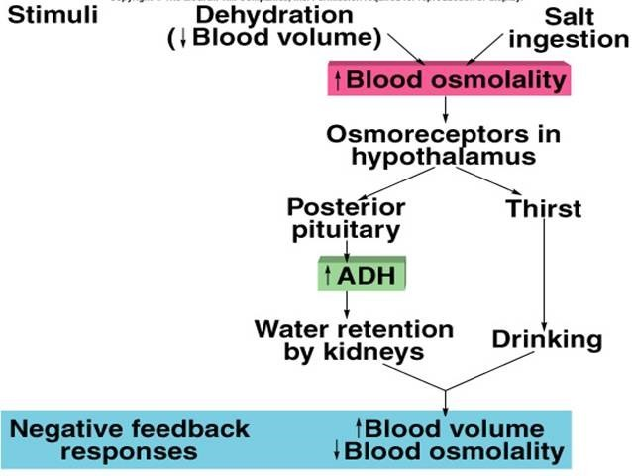
What are the feedback mechanisms operating in Fluid balance control?

Slide 22
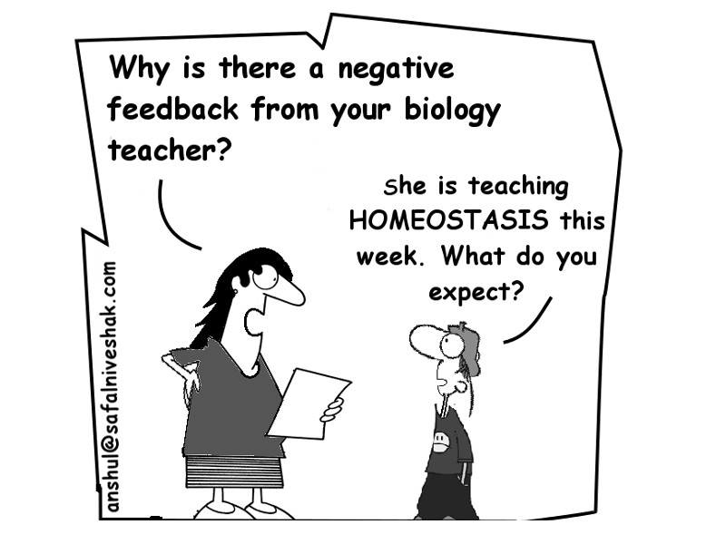

Slide 23


