Slide 1
BLOOD PHYSIOLOGY
White Blood Cells
(WBC)
Dr. Nervana Mostafa

Slide 2
Lecture content
Formation of WBC
Types of WBC
Genesis, sites of formation and life span of WBC
Neutrophils formation, maturation and function
Phagocytosis

Slide 3
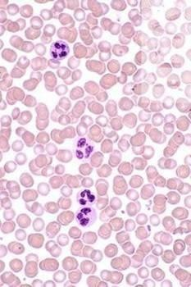
red blood cells (5-6-million /ml)
white blood cells
(5000/ml)
3

Slide 4
White Blood Cells
Leucocytes Formed in bone marrow & lymph tissue
Protection against infection by:
Phagocytosis
Secretion of antibodies
WBC = 4000—11000/ml

Slide 5
Types of WBC
Granular (polymorphnuclear PMN):
Neutrophil 62%.
–
10-16um, lobulated nucleus 2-5, purple
cytoplasmic granules
Eosinophil 2.3%.
– 12-18um, 2 lobe nucleus, coarse red
granules
Basophil 0.4%.
•
–
10-14um, rarely segmented nucleus, nucleus hidden by large round bluish granules

Slide 6
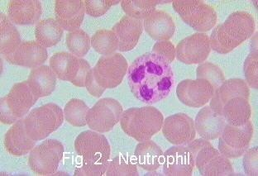
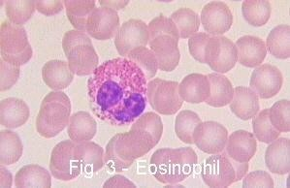
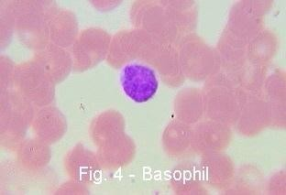
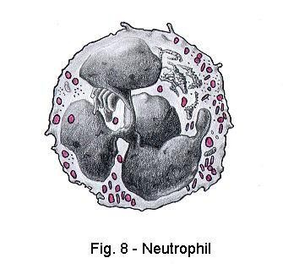
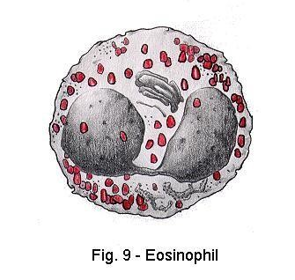
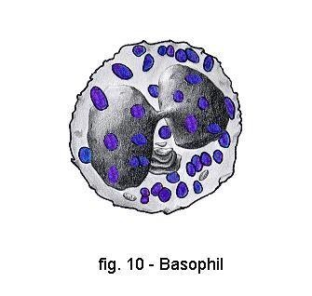

Slide 7
Types of WBC cont.
15-20um, kidney shape nucleus
Lymphocyte 30%
round nucleus
small (5-8um)
large (9-15um)
2. A granular
– Monocytes
5.3%

Slide 8
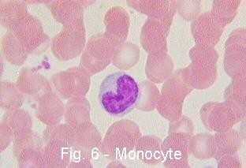
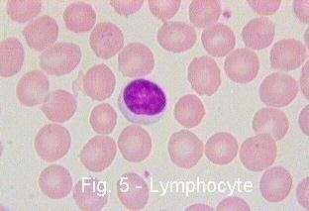
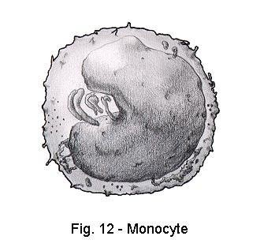
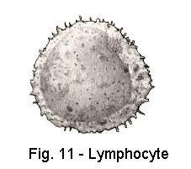

Slide 9
Genesis of WBC
Two major lineage of WBC are
formed:
Myelocytic: granular,monocytes
Lymphocytic: lymphocytes

Slide 10
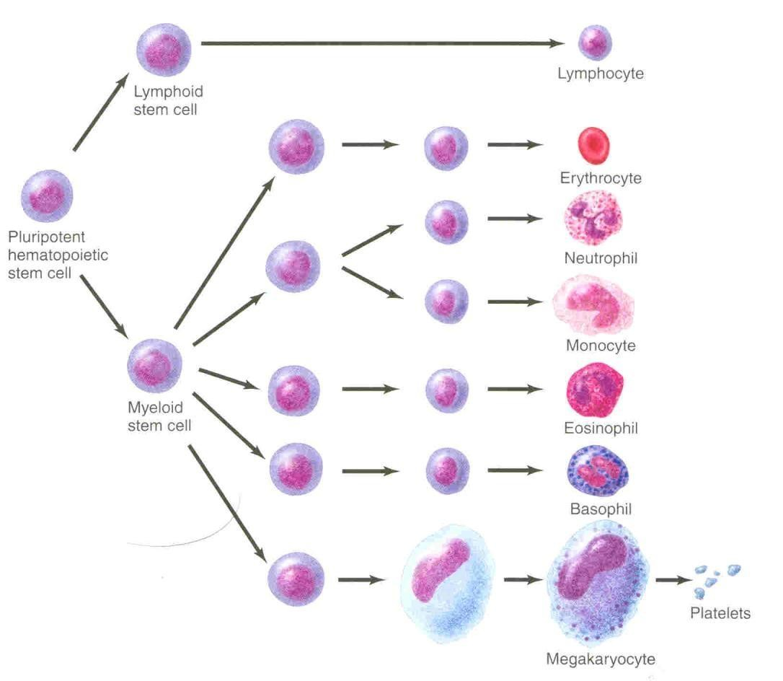
Genesis of WBC

Slide 11
Sites of WBC Formation
sites of WBC formation
Granulocytes (neutrophil, basophil, eosinophil) in bone marrow
Monocytes- bone marrow
lymphocytes- bone marrow,
thymus, lymphoid tissues
•
•

Slide 12
Life span of WBCs
Granulocytes= 4-5 days in tissues, During infection life span only few hours because they die after ingesting bacteria.
Monocytes = 10-20- hours then they leave blood to tissues transform into macrophage, its life span goes up to months.
Lymphocytes = weeks to months
according to its type

Slide 13
White Blood Cells
NEUTROPHILLS

Slide 14
Formation and Maturation of Neutrohils
Formed in Bone Marrow
Stem cells →
Myeloblast →
Promyelocytes →
Neutrophil myelocytes →
Young neutrophil metamyelocytes →
Band neutrophil →
Polymorphnuclear neutrophil (Mature
Neutrphils released to blood)

Slide 15
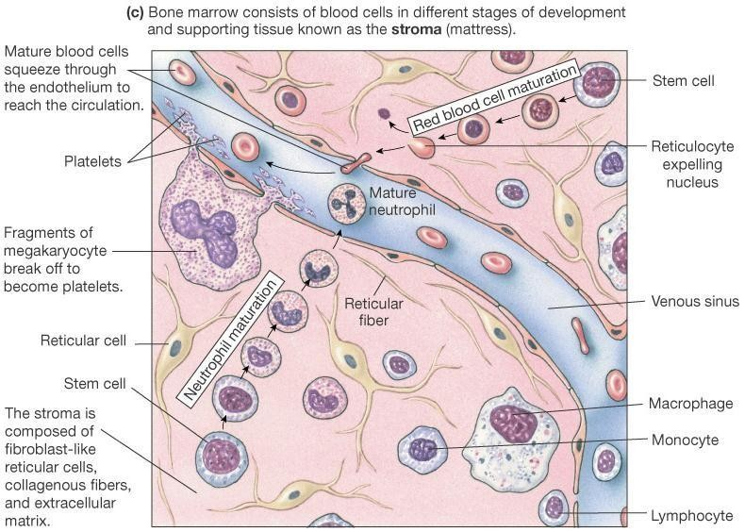

Slide 16
Neutrophil Function
Defense against infection: Neutrophil has the ability of engulfing bacteria or organism by a process of phyagocytosis
Steps of Phygocytosis
Chemotaxis
Margination
Diapedesis
Ameoboid movement
Engulfing and killing of a microbe

Slide 17
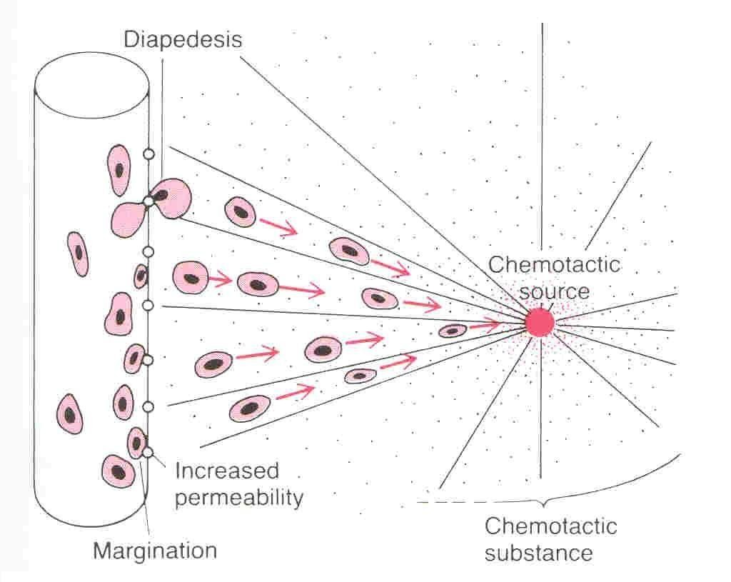
Chemotaxis, margination & diapedesis
Dr Sitelbanat 2011

Slide 18
Chemotaxis
The attraction of the neutrophils to inflamed area following chemotactic substances release from infected site:
Chemotactic substances:
Bacterial toxin
Degenerative products of inflamed tissue
Complement system
Reaction product of plasma clotting

Slide 19
Margination & Diapedesis
WBC marginate along the wall of
blood capillaries
WBC squeezes itself through
endothelial holes leaving blood
capillaries (diapedesis)
WBC move by amoeboid motion
towards inflammation area following chemotactic substance released from site of infection
Upon reaching the site of infection neutrophils start to engulf infecting organism

Slide 20
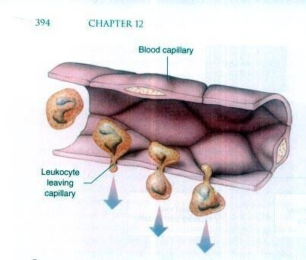

Slide 21
Phagocytosis
Selective process: foreign substance recognize
by:
Rough surface
No protective protein coat, which prevents phagocytosis
Marked by certain substance e.g Complement 3 or antibodies making them ready for killing a process known as
3.
opsonization
Neutrophils encircled the bacteria with pseudopodia and engulf it inside into a vacuole
(phagosome), takes 3-20 bacteria

Slide 22
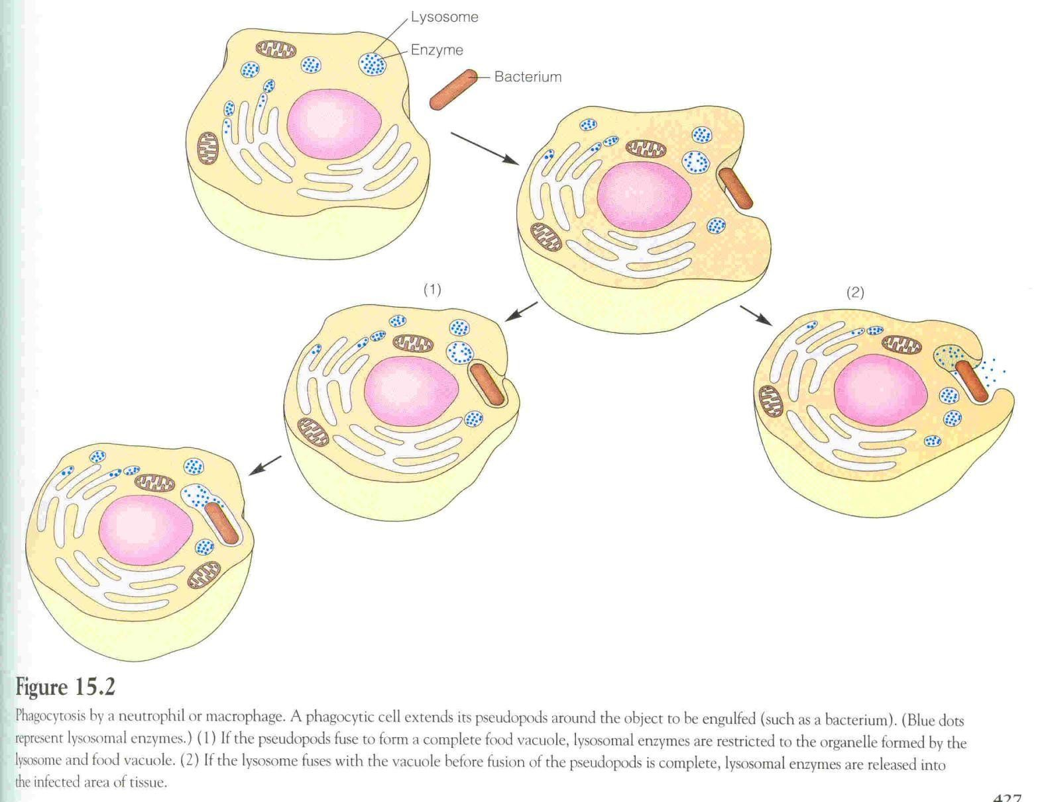
Dr Sitelbanat 2011

Slide 23
Microbial killing
Digestion of organism inside the phagosom
•Fusion of intracellular lysosomes with phagosome vacuole
•Lysosomes discharge its proteolytic enzymes such as myeloperoxidase, catalase into the vacuole, killing and digesting the engulfed bacteria.
And or
•Release of bactericidal such as superoxide, hydrogen peroxide to kill the bacteria

Slide 24
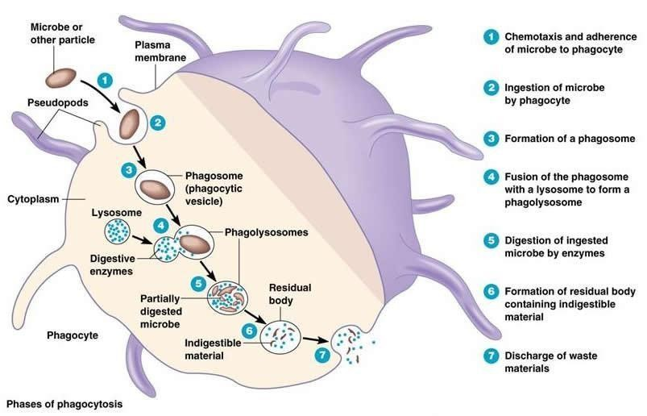
Microbial killing
Dr Sitelbanat 2011

Slide 25
Objectives
At the end of this lecture student
should be able to:
Describe different Types of WBC
Recognize the general functions of
WBC
Describe genesis and site of formation of WBC.
25

Slide 26
Objectives
At the end of this lecture student should be
able to:
Describe stages of neutrophil formation
Describe the role of neutrophils in defending
the body against infection
Describe the process of phagocytosis.
25

