Slide 1
Introduction to anatomy skeletal system: bone
Prof. Ahmed Fathalla Ibrahim

Slide 2
OBJECTIVES
At the end of the lecture, students should be able to:
Define the word “Anatomy”
Enumerate the different anatomical fields
Describe the anatomical position
Describe different anatomical terms of position & movements as well different anatomical planes
Classify bones according to shape, structure & development
Enumerate different bones of both axial & appendicular skeleton

Slide 3
ANATOMY
The science which deals with the study of:
the structure and shape of the body
body parts & their relationships to one another

Slide 4
ANATOMICAL SCIENCES
Gross Anatomy: Study of human body with naked eye
Microscopic Anatomy (Histology): Study of fine structure (cells & tissues) of the human body with the help of microscope
Developmental Anatomy ( Embryology)
Radiological Anatomy
Cross-sectional Anatomy
Applied Anatomy
Surgical Anatomy

Slide 5
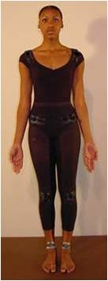
ANATOMICAL POSITION
It is the standard position in which the body assume to describe its parts.
Body is erect
Arms hanging by the side
Palm facing forward
Feet parallel

Slide 6
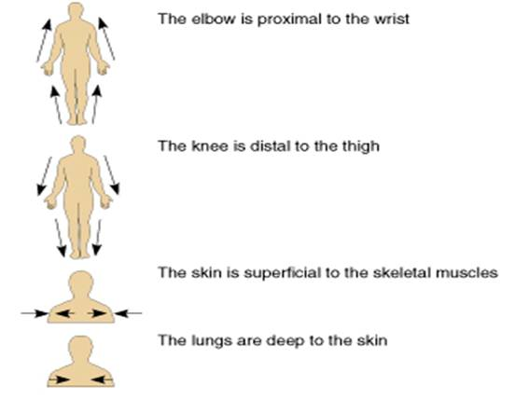
ANATOMICAL TERMINOLOGY
TERMS OF POSITION
Superior (cranial): near to head
Inferior (caudal): away from head
Anterior (ventral): near to front
Posterior (dorsal): near to back
Medial: near to median plane
Lateral: away from median plane
Proximal: near to trunk
Distal: away from trunk
Superficial: near to skin (surface)
Deep: away from skin

Slide 7
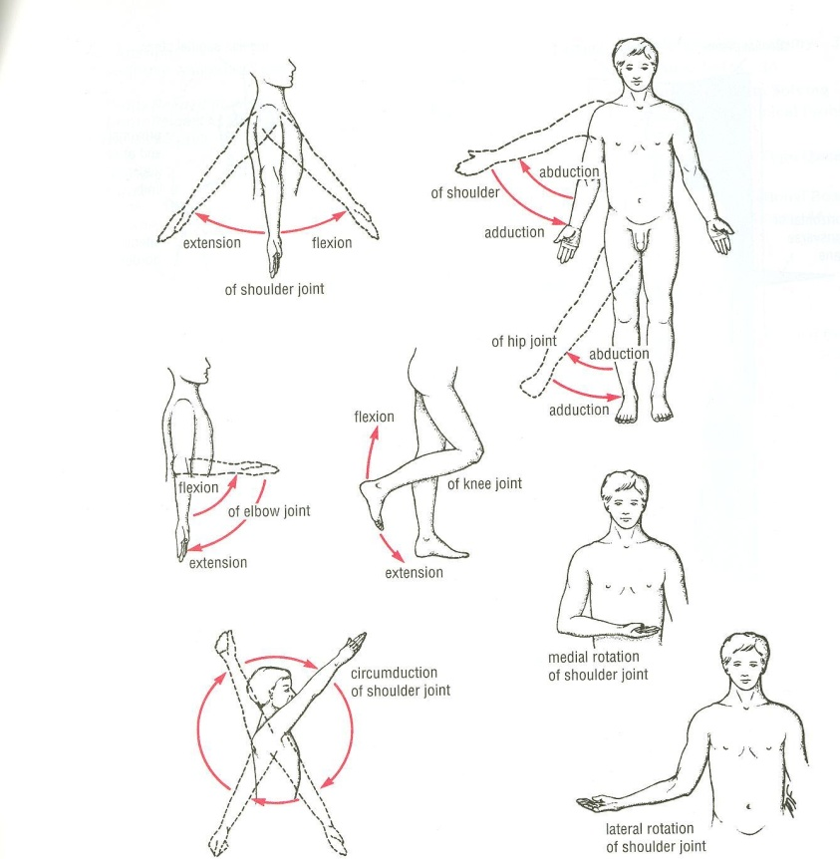
ANATOMICAL TERMINOLOGY
TERMS OF MOVEMENT
Flexion: approximation of 2 parts (decreasing the angle between 2 parts)
Extension: straightening (increasing the angle between 2 parts)
Abduction: away from median plane
Adduction: toward median plane
Lateral rotation: rotation away from median plane
Medial rotation: rotation toward median plane
Circumduction: combined movements of flexion, extension, abduction & adduction

Slide 8
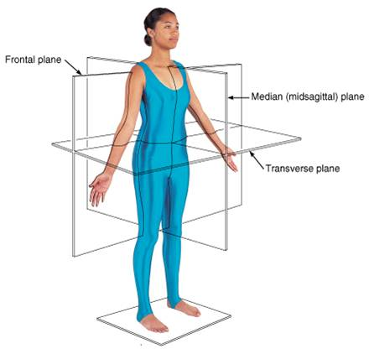
ANATOMICAL PLANES & SECTIONS
Sagittal (median): divides the body into 2 equal halves (right & left)
Parasagittal (paramedian): divides the body into 2 unequal parts (right & left)
Frontal (coronal): divides the body into anterior & posterior parts
Transverse (cross): divides the body into superior & inferior parts

Slide 9
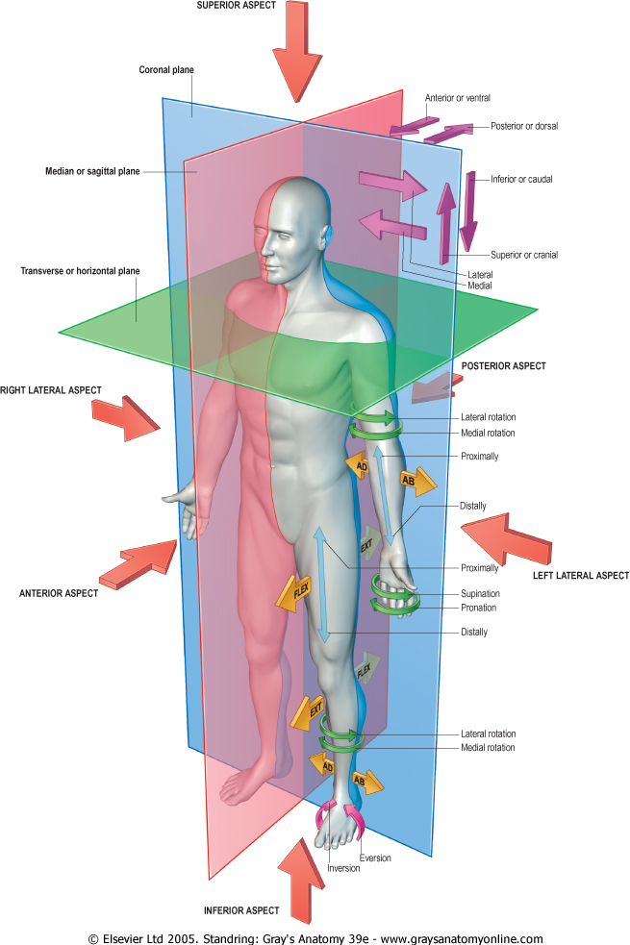
PLANES, TERMS OF POSITION & TERMS OF MOVEMENT

Slide 10
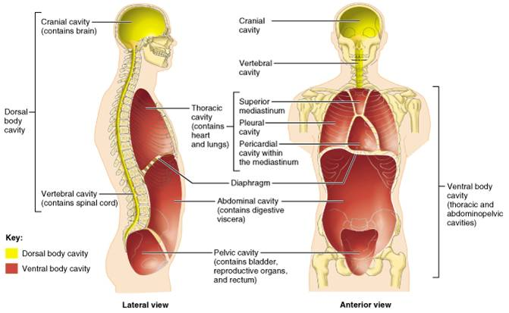
BODY CAVITIES
Ventral body cavity: divided by diaphragm into:
Thoracic cavity: superior to diaphragm, contains heart & lungs
Abdominal cavity: inferior to diaphragm, contains stomach, intestine, liver, urinary bladder, etc…
Dorsal body cavity: divided into 2 parts continuous with each other:
Cranial cavity: space inside skull, contains brain
Spinal cavity: space inside vertebral column, contains spinal cord

Slide 11
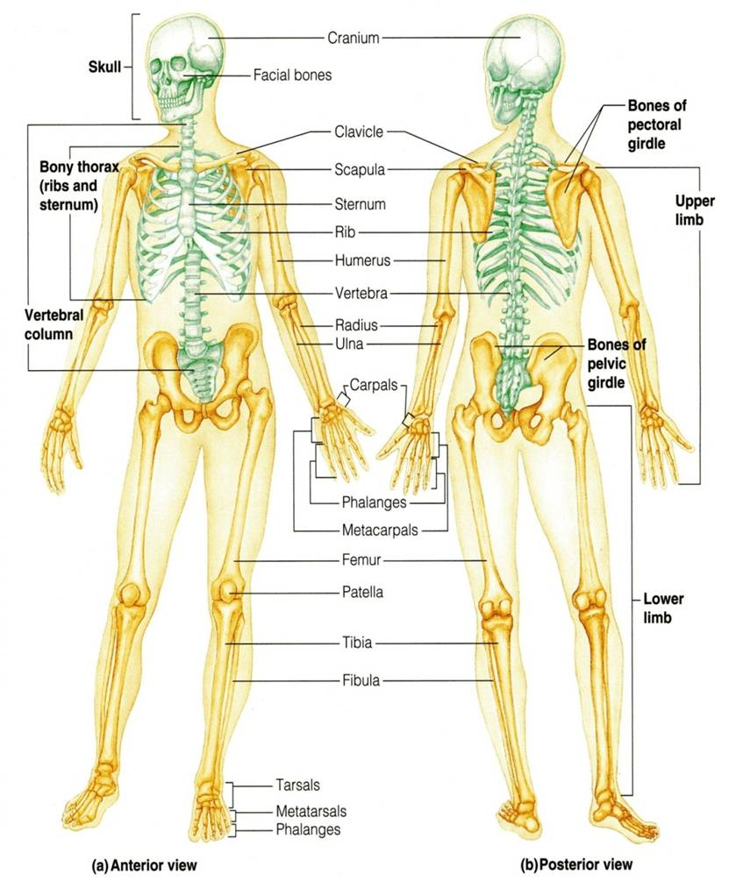
SKELETAL SYSTEM
Includes:
Bones
Joints: articulations between bones

Slide 12
FUNCTIONS OF BONE
Support: of the body organs
Protection: of soft body organs
Attachment :of muscles
Movement: of the body as a whole, or of the body parts
Storage: of fat and minerals e.g. calcium and phosphorus
Blood cell formation

Slide 13
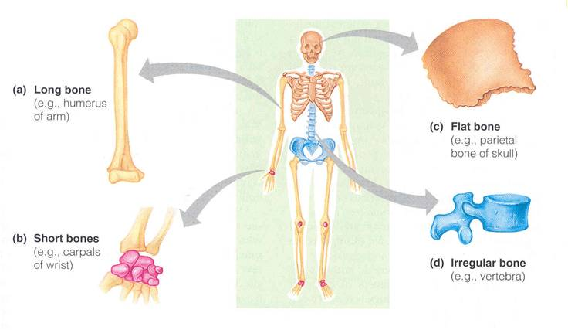
CLASSIFICATION OF BONE
Bones are classified on the bases of their:
Shape: long, short, flat, irregular
Structure: compact, spongy
Development: membrane, cartilage

Slide 14
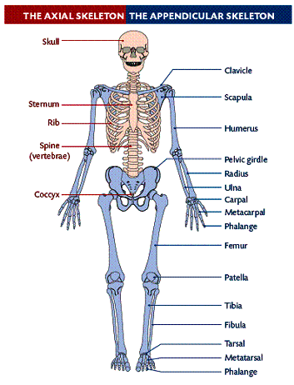
THE SKELETON
Formed of 206 bones
Divided into:
Axial skeleton: bones forming the trunk (longitudinal axis) of body
Appendicular skeleton: bones forming the girdles & limbs

Slide 15
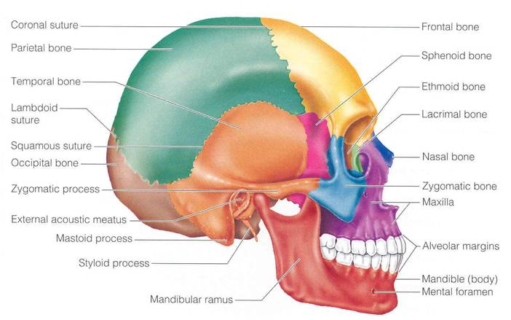
BONES OF AXIAL SKELETON
SKULL
Consists of:
Cranium: bones enclosing brain: frontal, occipital, parietal, temporal
Facial bones: bones of face: maxilla, nasal, zygomatic, mandible

Slide 16
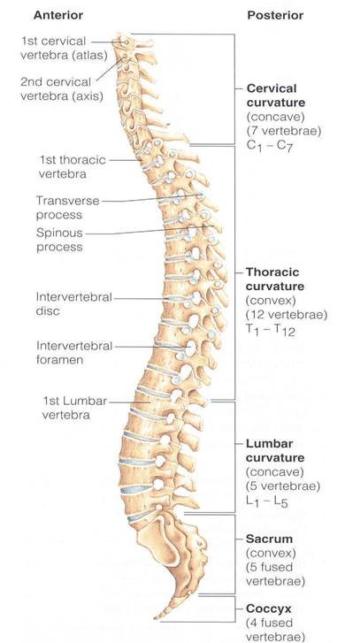
BONES OF AXIAL SKELETON
VERTEBRAL COLUMN
Number: 33 vertebrae
Functions: protects spinal cord and supports the body
Formed of:
7 cervical vertebrae
12 thoracic vertebrae
5 lumbar vertebrae
5 sacral vertebrae fused to form sacrum
4 coccygeal vertebrae fused to form coccyx

Slide 17
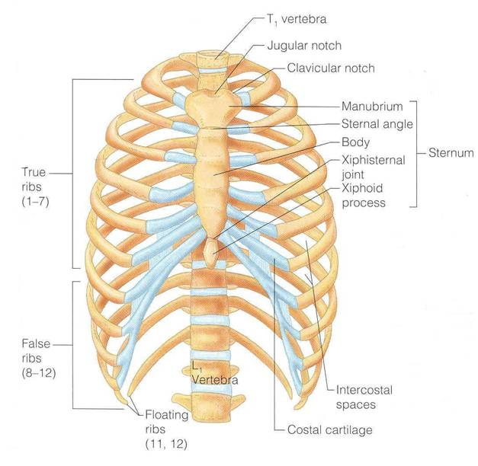
BONES OF AXIAL SKELETON
STERNUM
Has 3 parts: manubrium, body & xiphoid process
RIBS
Number: 12 pairs
All ribs articulate with vertebrae
Only upper 7 pairs articulate with sternum

Slide 18
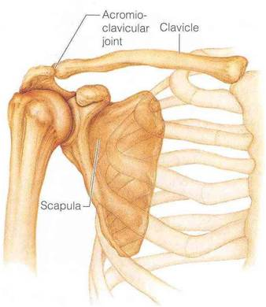
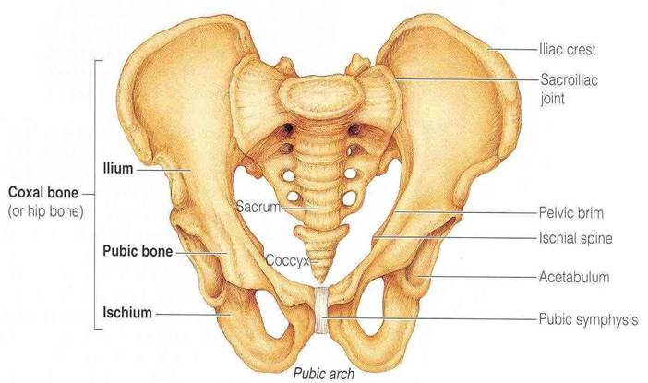
BONES OF APPENDICULAR SKELETON
PECTORAL GIRDLE
Connects upper limb with axial skeleton
Formed of: clavicle & scapula (2 bones on each side)
PELVIC GIRDLE
Connects lower limb with axial skeleton
Formed of: hip bone (one bone on each side)

Slide 19
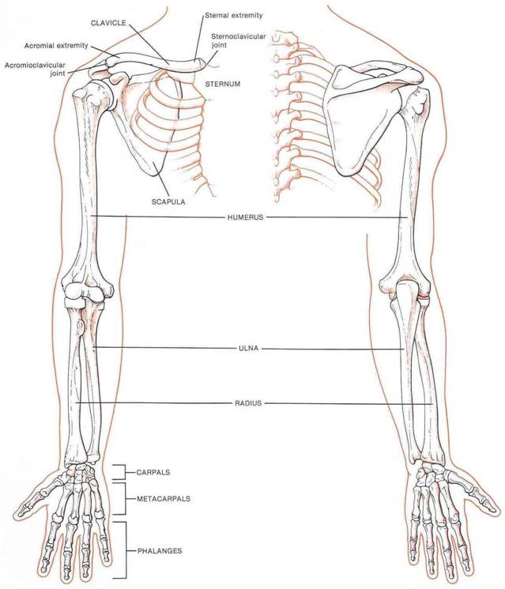
BONES OF APPENDICULAR SKELETON
UPPER LIMB
Bone of arm: humerus
Bones of forearm: radius (lateral) & ulna (medial)
Bones of hand:
8 carpal bones
5 metacarpal bones
14 phalanges: 2 for thumb & 3 for each of medial 4 fingers

Slide 20
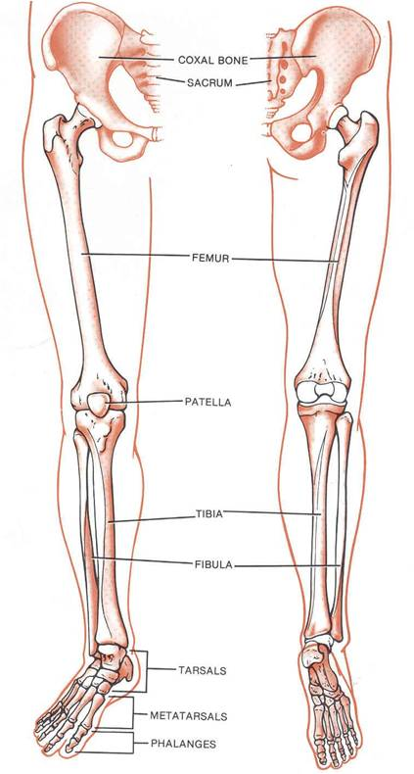
BONES OF APPENDICULAR SKELETON
LOWER LIMB
Bone of thigh: femur
Bones of leg: fibula (lateral) & tibia (medial)
Patella
Bones of foot:
7 tarsal bones
5 metatarsal bones
14 phalanges: 2 for big toe & 3 for each of lateral 4 toes

Slide 21
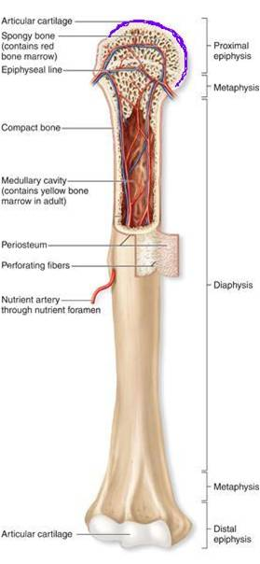
LONG BONES
Formed of:
A shaft (diaphysis): composed of compact bone
Two ends (epiphysis): composed of spongy bone
The region of contact between epiphysis & diaphysis is called: metaphysis: contains epiphyseal plate of cartilage responsible for linear bone growth

Slide 22
QUESTION 1
Which one of the following bones is a bone of the axial skeleton?
Femur
Humerus
Scapula
Sternum

Slide 23
QUESTION 2
Which one of the following bones is an example of an irregular bone?
Femur
Vertebra
Scapula
Sternum

Slide 24
QUESTION 3
Which one of the following planes divides the body into superior & inferior parts?
Frontal (coronal) plane
Sagittal (median) plane
Parasagittal (Paramedian) plane
Transverse plane

Slide 25
THANK YOU

