Slide 1


Slide 2
DOCTOR – PATIENT COMMUNICATION
GENERAL PRINCIPLES
LEARNING SKILL COURSE
DEPARTMENT OF MEDICAL EDUCATION
COLLEGE OF MEDICINE

Slide 3
قال جابر رضى الله عنه :
ما رأيت الرسول صلى الله عليه وسلم مرة إلا تبسم في وجهي

Slide 4
Contents:
Part-1:
General communication skills
    Verbal v/s Nonverbal
    Active v/s Passive
    Listening v/s Hearing
    Body language
Part-2:
Communication Skills with Pts
How to learn communication skills
Summary

Slide 5
Objectives:
What are our objectives for this session today??????
Let us get agree on some

Slide 6
Most common ways to communicate
Visual Images
Speaking
Writing
Body Language

Slide 7
Part 1
General Communication
Skills

Slide 8
Communication Skills Overview
Effective communication skills are a critical element in our career and personal lives.
We all must use a variety of communication techniques to both understand and be understood

Slide 9
Communication Goals
To change behavior
To get and give
Information
To get action
To persuade
To ensure understanding
Source: CGAP Direct

Slide 10
Critical success factor for life
The majority of our perceived ability comes from how we communicate
30% What we know
70% How we
communicate it
Source: CGAP Direct

Slide 11
Communication Process

Slide 12

THINK
ARTICULATE
COMMUNICATE
INFLUENCE

Slide 13
FEEDBACK

Slide 14
DESIRED
ACTION

Slide 15

Sender
Receiver
Message

Slide 16
C o m p o n e n t s o f C o m m u n i c a t i o n
COMPONENTS OF COMMUNICATION
CONTEXT
Stimuli
Sender –Encoder
Thought, or an idea to be sent to the receiver in true meanings
Message
Medium
Verbal, Non-verbal
Receiver - Decoder
Thought or the idea of sender received in right perception
NOISE
FEEDBACK
Verbal, Non-verbal

Slide 17
What Is the Interpersonal Communication Process?
Communication
Sequential Steps
  Encoded
  Transmitted
  Decoding
  Noise
  Feedback

Slide 18
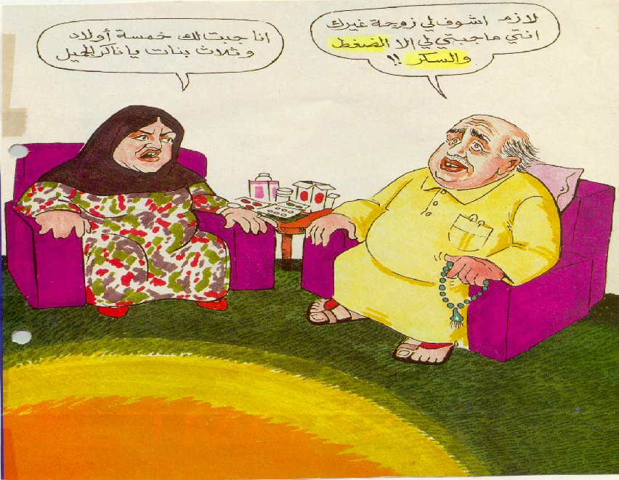

Slide 19
IMPORTANCE OF LISTENING

Slide 20
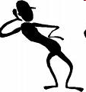



IMPORTANCE OF LISTENING
80 % TOP EXECUTIVES BELIVES IT AS MOST IMPORTANT SKILL
STRENGTHENS ORGANIZATIONAL RELATIONSHIPS
CREATES OPPORTUNITIES OF INNOVATION

Slide 21

TYPES OF LISTENING
CONTENT LISTENING
  UNDERSTAND & RETAIN SPEAKERS MESSAGE
  EMPHASIS IS ON INFORMATION & UNDERSTANDING

Slide 22

TYPES OF LISTENING
CRITICAL LISTENING
  UNDERSTAND & EVALUATE THE MEANING
  LOGIC OF ARGUMENT
  STREANTH OF EVIDENCE
  INTENTIONS & MOTIVES
  VALIDITY OF CONCLUSION

Slide 23


TYPES OF LISTENING
EMPATHIC LISTENING
  UNDERSTAND FEELINGS,NEEDS, WANTS
  AVOID JUMPING WITH ADVICE UNTILL NOT ASKED FOR.
  APPREACIATE HIS/HER FEELINGS & UNDERSTAND THE SITUATION

Slide 24
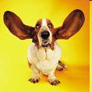
TYPES OF LISTENING
ACTIVE LISTENING
  AVOID OR TURN OFF ANY BIASES OR FILTERS TO TRUALY HEAR & UNDERSTAND THE SPEAKERS MESSAGE
  ENCOURAGE SPEAKERS WITH POSITIVE BODY LAUNGUAGE
  Passive Listening??

Slide 25
ACTIVE LISTENING
LISTENING/RECEIVING / RESPONDING
  PHYSICALLY HEARING THE MESSAGE & ACKNOWLEDGING IT

Slide 26
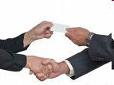
LISTENING PROCESS
RESPONDING
  CAN BE VERBAL OR NON VERBAL
  GENERALLY INITIAL RESPONSE TAKES IN FORM OF VERBAL FEEDBACK

Slide 27
BARRIERS IN EFFECTIVE COMMUNICATION
SELECTIVE LISTENING
DEFENSIVE LISTENING
LACK OF COMMON BACKGROUND

Slide 28
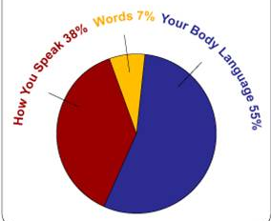
NON VERBAL COMMUNICATION
55%
Face and body: non-verbal communication or face and body language.
38%
voice dynamics:
tone + inflection + volume + accent + non-word sounds; and...

Slide 29
Non- Verbal Communication
Visual: expression, eye contact, eye movement
Listening: carefully, actively, memory
Kinesthetic: Posture, distance, mobility, muscle tone, hand movement, etc

Slide 30
RECOGNIZING NON VERBAL COMMUNICATION
FACIAL EXPRESSION
GESTURES & POSTURES
VOCAL CHARACTRISTICS

Slide 31



RECOGNIZING NON VERBAL COMMUNICATION
PERSONAL APPREARENCE
TOUCH
TIME & SPACE

Slide 32
Example of body language
Sitting with legs crossed, foot kicking slightly:
    Boredom
Biting nails:
    Anxiety
Shoulder hunched, hands in pockets
    Depression/Dejection

Slide 33
Example of body language
Folded arms and leg crossed away from you:
    Rejection
Tapping fingers:
    Impatience
Avoiding eye contact:
    Untrustworthy

Slide 34

How Do We Receive and
Understand Messages Accurately?
Listening
  Active Listening
    Sensing
    Attending
    Reflecting

Slide 35
ACTIVE LISTENING
Few tips towards Active Listening:
Understand our own communication style.
Be an active listener.
Use normal communication.
Give Feedback

Slide 36
ACTIVE LISTENING…(cntd…)
1. Understand your own communication style:
High level of self-awareness to creating good & long lasting impression on others.
Understand how others perceive you.
Make others comfortable by selecting appropriate behavior that suits your personality while listening. (Ideally nodding your head).

Slide 37
ACTIVE LISTENING…(cntd…)
2. Be An Active Listener:
People speak @ 100 to 175 WPM but can listen intelligently @ 300 WPM.
One part of human mind pays attention, so it is easy to go into mind drift.
Listen with a purpose.
Purpose can be to gain information, obtain directions, understand others, solve problems, share interest, see how another person feels, show support, etc.
If it is difficult to concentrate then repeat the speakers words in your mind.

Slide 38
ACTIVE LISTENING…(cntd…)
3. Use Non-verbal Communication:
Smile,
Gestures,
Eye contact,
Your posture.

Slide 39
ACTIVE LISTENING…(cntd…)
4. Give Feedback
Remember that what someone says and what we hear can be amazingly different.
Repeat back or summarize to ensure that you understand.
Restate what you think you heard and ask, "Have I understood you correctly?"

Slide 40


Both girls want the orange
Notes:
Writing, Speaking, Presentation – can’t talk on this topic much. Just know that it is important. You can have the best ideas in the world, but if you can’t get them across, they are not much good.
In my experience, the main cause for projects to fail, for friendships to fail, for wasted time & effort

Slide 41
But without good listening, neither gets what they want…
Notes:
Writing, Speaking, Presentation – can’t talk on this topic much. Just know that it is important. You can have the best ideas in the world, but if you can’t get them across, they are not much good.
In my experience, the main cause for projects to fail, for friendships to fail, for wasted time & effort

Slide 42
What do you think about?
I have something really important to tell you
Maybe I should get a haircut

Slide 43
Techniques to improve listening skills
SUMMARIZE
Pull together the main points of a speaker
PARAPHRASE
Restate what was said in your own words
QUESTION
Challenge speaker to think further, clarifying both your and their understanding

Slide 44
Practice Paraphrasing
Paraphrasing is simply restating what another person has said in your own words.
Use phrases such as:
  In other words…
  I gather that…
  If I understand what you are saying…
  What I hear you saying is…
  Pardon my interruption, but let me see if I understand you correctly…

Slide 45
Part 2
Communication
Skills with Patients

Slide 46
Communication
Skills??
With Patients

Slide 47
Benefits
Good communication skills :
    identify patients' problems more accurately:
      Diagnostic Accuracy
    Improve Pts understanding & Information retention
    Increase adherence to treatment
    Their patients adjust better psychologically and
    Pts more satisfied with their care

Slide 48
Benefits (Cont…)
Doctors with good communication skills have greater job satisfaction and less work stress

Slide 49
Effect on Health Outcome
Effective communication important in the delivery of high-quality health care.
(Roter 1987, Betakis 1991, Stewart 1995).

Slide 50
The health outcome is positively affected by:
Probing the thoughts, feelings, and expectations of patients.
Encouraging them to ask questions,
allowing patients to share in the decision making.
Stewart 1995, in a review of several studies

Slide 51
Effect on Health Outcomes
The reduction of anxiety.
The reduction of psychological distress.
Pain relief.
Symptom resolution.
Mood improvement.
Reduction of high blood pressure.
(Stewart 1995).

Slide 52
The Toronto consensus statement
“stressed that the main complaint of patients is related to “communication problems and not to clinical competency.”
(Simpson 1991)

Slide 53
“The main remarks made by patients in the PHC centers in Riyadh was that:
“physicians were not listening enough to their complaints.”
( Saeed 2001)

Slide 54
Interpersonal skills
1. Respect: treating others as one would want to be treated
2. Paying attention
3. Being positive & mindful of importance of the relationship,
4. Having a caring intent & interested in the pt's ideas, values, and concerns.
5. Flexibility or ability to monitor the relationship in real time & adjust interpersonal skills as necessary.)

Slide 55
Consultation Skills
Communication
Skills:
Verbal e.g
&
Non-verbal e.g
Clinical skills:
Examination
Procedures

Slide 56
Verbal & Non-verbal Communication
Information is in the words:
    1%
Information is in the tone of voice:
    39%
Information is in the gestures & expression:
    60%

Slide 57
Patient-Centered Care
Patients as partners
Involve them in decision making
Enlist their sense of responsibility for their care
Respect their individual values and concerns

Slide 58
Effective
Communication
Skills
(Models)

Slide 59
Effective
Communication Skills
The planning
*what subjects to address.
*time is limited :prioritize.
*what to discuss another time.
*Prepare by going over all the necessary information ….

Slide 60
Effective
Communication Skills
Greet the person by their names (أبو فلان).
Make eye contact ,introduce yourself warmly
Smile (ease the tension on either side)
Shake hands. Ask the person to sit down by indicating a chair.
establish a rapport by asking a simple
open- ended question ,
explain that you may need to take notes,

Slide 61
Effective
Communication Skills
Use a good mix of open-ended & closed-ended questions.
Listen actively
  and pay attention to what he or she says,
  don’t interrupt.
pick up on cues from their speech and respond appropriately.

Slide 62
Two basic types of questions
Closed questions:
  Get a one-word response and inhibit thought.
  Questions begin with who, when and which
Open-ended questions:
  Invite unique thought, reflection or an explanation.
  Questions begin with how, what and how come (not why!).

Slide 63
Effective
Communication Skills
Maintain appropriate eye contact, giving verbal and non-verbal feedback to ease the flow of the exchange.
Silences allow thinking and reflection, so don’t feel you always have to fill them.

Slide 64
Effective
Communication Skills
Aim to encourage emotional expression as this will often prove to be the most therapeutic aspect of the interaction.
If you think you are not getting through to the other person, resist the temptation to raise your voice.
Being positive

Slide 65
Effective
Communication Skills
At the end:
Summarize
Give a chance to ask
Agree a time for a follow-up.
Thank and escort him to the door

Slide 66
in
Communication with Pts
PITFALLS

Slide 67
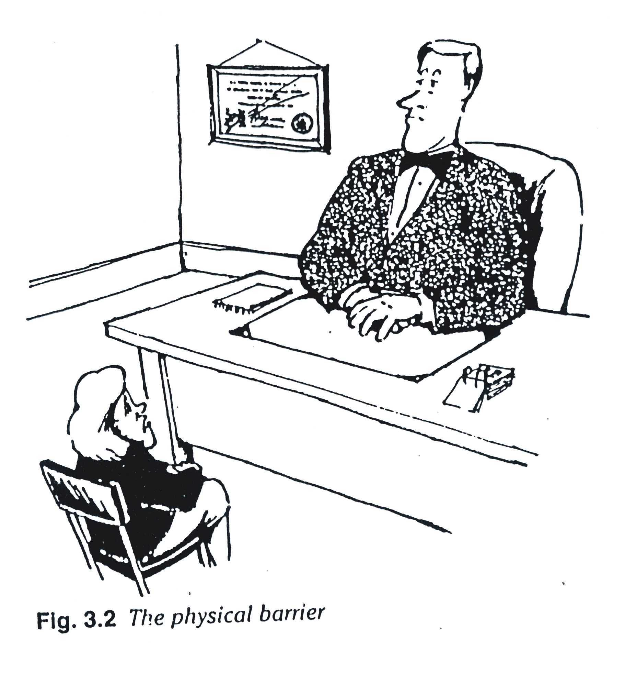

Slide 68
Blocking behavior
Interrupting
Offering advice and reassurance before the main problems have been identifiedl
Lack of concern
Attending to physical aspects only
Switching the topic

Slide 69
LEARNING Communication SKILLS
Practice
Rehersal
Recording
Refelection
Feedback

Slide 70
Gender Differences

Slide 71
Communication
Message
Sender
Receiver

Slide 72
Take Home Message
To Be a Good Doctor/Teacher we Have to Be a
GOOD COMUNICATOR

Slide 73
شكــــــراً
THANKS
Dept. of Medical Education

