Slide 1
Body fluids Tutorial
Fluids Compartments:
What are the different fluid compartments of the body?
What is the size of each compartment of the total body fluids?
What is the percentage of each compartment of the total body weight?
How are body fluid compartments in a 75 kg man distributed?

Slide 2
Fluid Compartments ≈ 60% of body weight
Extracellular fluid
(≈ 1/3)
33% of TBW
20% of body wt
Intracellular fluid
(≈ 2/3)
67% of TBW
40% of body wt
Plasma
25% of ECF
5% of body wt
Interstitial fluid
75% of ECF
15% of body wt
Transcellular fluid
CSF
Intraocular
Pleural
Peritoneal
Pericardial
Synovial
Digestive secretions

Slide 3
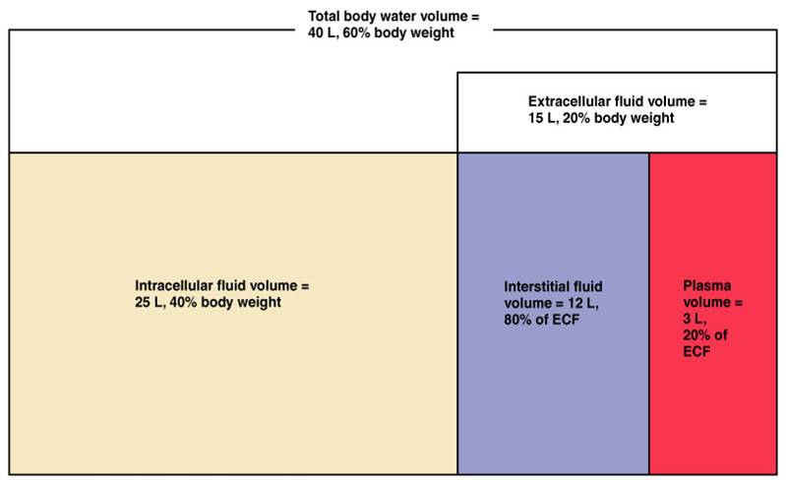

Slide 4
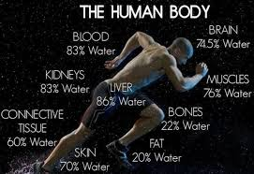

Slide 5
Water intake and output:
What are the sources of water for the body?
How does the body lose water?
Does the water intake match the water output in a normal person?

Slide 6
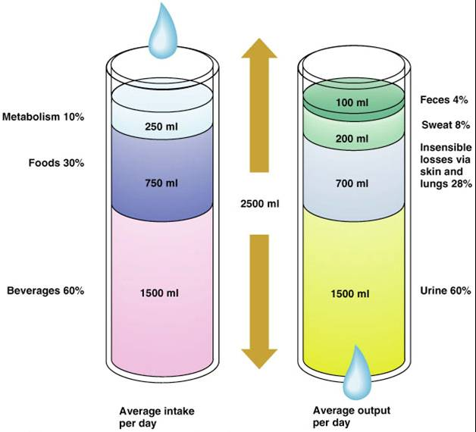

Slide 7
Composition of body fluids:
What is the major cation in ECF?
What is the major cation in ICF?
What are the major anions in ECF?
What are the major anions in ICF?
Why is there a difference in the composition of ECF and ICF?
What is the difference between plasma and ECF?
Why is there a difference between plasma and ECF?

Slide 9
What will happen to ECF, ICF and the human cell size if:
We infuse distilled water into his veins?
We infuse 0.9% saline into his veins?
We infuse 1.8% saline into his veins?
We infuse isotonic 5% dextrose (a type of sugar that can penetrate the cell membrane) into his veins?

Slide 10
What factors of body fluids are regulated to maintain balance among body fluids compartments?
Why is regulation of ECF volume important?
Why is regulation of ECF osmolarity important?

Slide 11
Factors affecting body fluids
Water intake & output
Age:
- infant: 73%
- elderly: 45%
Gender:
- adult male: 60%
- adult female: 40-50%
Obesity
Climate
Habits
Level of physical activity

Slide 12
Dehydration
What are the common causes of dehydration?
What are the common clinical features of dehydration?
How is dehydration classified?

Slide 13
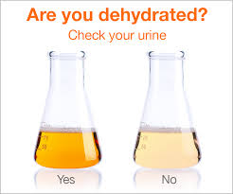

Slide 15
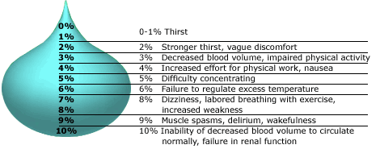

Slide 16
Management of dehydration:
What are the different methods used for rehydration?
What are the substances used for rehydration?

Slide 17
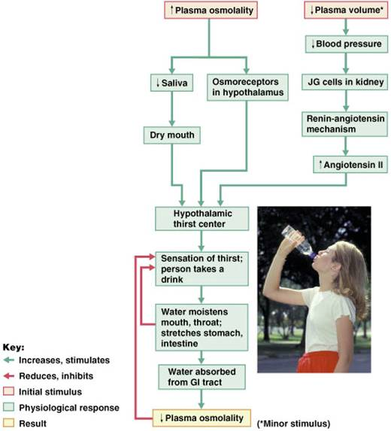

Slide 19
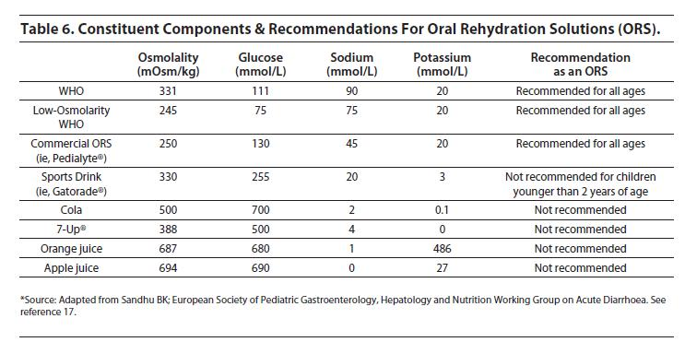

Slide 20
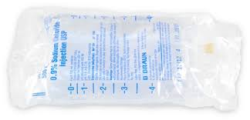
IV Rehydration

Slide 21
Thank you!!

