Slide 1
Anatomy OSPE 436 الأمّة بحاجة إلى الشباب والعالِم الموسوعة لتنهض وتتحرر..
Before you begin:
→ Make sure you understand the difference between the terms NAME & TYPE which have completely different answers.
→ Make sure your SPELLING is correct or relatively similar to ensure your grade on each question.

Slide 2
CASE 1
A
Identify: A,B,C&D
A. Scapula
B. Humerus
C. Ulna ( Medial )
D. Radius ( Lateral )
B
C
D

Slide 3
CASE 2
A
Identify:A,B,C&D
A. Hip Bone
B. Femur
C. Fibula ( smaller & lateral )
D. Tibia ( bigger & medial )
B
Identify the labeled bones:
1. Femur
2. Patella
3. Fibula (lateral)
4. Tibia (medial)
D
1
C
2
3
4

Slide 4
CASE 3
Identify the type of bone A
A.Flat bone
A

Slide 5
*Remember
Types of bones :
Flat (like this example)
Irregular (vertebra)
Long (humerus of arm)
Short (carpals of wrist)
Sesamoid (patella)
Pneumatic (العظام الهوائية مثل الموجود بقلب الجمجمة)

Slide 6
CASE 4
صورة أوضح لجذع الدماغ
Identify the labeled structures:
1. Cerebrum
2. Cerebellum
3. Spinal cord
4. Diencephalon
5. Midbrain
6. Pons
7. Medulla oblongata
5
6
7
Brain Stem

Slide 7
*Remember

Slide 8
*Remember

Slide 9
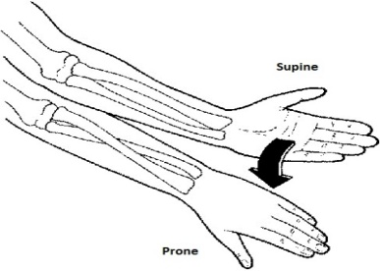
CASE 5
Fig(1)
1
Identify the numbered movements & the lateral bone in figure 1
1. Supination
2. Pronation
3. Flexion
4. Extension
5. Dorsiflexion(ترفع رجلك عن البنزين)
6. Plantarflexion ((فرامل
7. Inversion (Inversion ; inside)
8. Eversion (Outwards)
lateral bone in figure 1 : Radius
2
3
4
5
6
7
8
للتوضيح فقط

Slide 10
*Remember

Slide 11
CASE 6
Identify the bones : A,B&C
A. Ulna
B. Radius
C. 2nd Metacarpal bone

Slide 12
*Remember
- The radius lower end is bigger than the ulna lower end.
- To count the metacarpal bones; we start from the thumb.

Slide 13
CASE 7
Identify the type of this skeletal muscle:
Multipennate

Slide 14
*Remember
^مهم تحفظون مثال على كل نوع

Slide 15
*Remember

Slide 16
*Remember
*مهم فقط الريجنز

Slide 17
*Remember

Slide 18
THAT’S IT
Anatomy OSPE team :
غادة المزروع محمد غندور
روان القحطاني ندى الدخيل
THANKS for 435 anatomy team

