Slide 1
Histology Practical
(foundation block)

Slide 2
You should know before the exam that :
* The diagrams in these slides are going to be the same in the exam however, it may not be colored.
* You have to mention the full name always and don’t use shortcuts you could lose marks because of that
* The Arrows in the diagrams are very important so please study them well
* The exam is gonna be easy so don’t worry ☺.

Slide 3
Nucleus
Q1- Identify : Nucleus
Q2- Location of :
Heterochromatin
( drak and inactive )
Euchromatin
( pale and active )
Nuclear pore
( openings in the nuclear envelope )
Nuclear envelope
(lining the nucleus)
Nucleolus
( The biggest dark region in the nucleus)
Q3- What is the function of Nucleolus ?
formation of ribosomal RNA (rRNA), which is responsible for protein synthesis in the cytoplasm
Q4- what is the function of the nucleus?
•It is the site of formation of the three types of RNA.
•It is essential for the vitality and division of the cell.
•It is the site of storage of genetic information
Nuclear enclope

Slide 4
Cell membrane
(trilaminarappearance )
Q1- Identify :
Cell membrane
Q2 - FUNCTION of The CM:
Selective barrier

Slide 5
Mitochondria
Q1- Identify : Mitochondria
Rod-shaped. Its wall has 2 membranes
Q2- What is the function ?
1) Generation of ATP
“ they are called the power house “
2) They can form their own proteins and undergo self replication.
because the have their own DNA

Slide 6
Golgi Apparatus
Q1- Identify :
Golgi apparatus
Q2- What is the function ?
Sorting, modification & packaging
of proteins.
Secretory vesicles formation.

Slide 7
Smooth Endoplasmic
Reticulum
Q1- Identify :
Smooth Endoplasmic Reticulum
* Characteristics: Membranous tubules and vesicles, with no ribosomes on the surface
Q2- What is the function ?
Synthesis of lipids & cholestrol
Detoxification from drugs and toxins

Slide 8
Rough Endoplasmic
Reticulum
Q1- Identify :
Rough Endoplasmic Reticulum:
Membranous sheets of flattened tubules &Vesicles with ribosomes on the surface.
Q2- What is the function ?
Ribosomes
(small black dots)
Synthesis of Proteins By ribosomes on its outer
surface.

Slide 9
Centrioles
Q1- Identify :
Centrioles:
2 cylinders which are perpendicular to each other
Q2- What is the function ?
Essential for cell division
Formation of Cilia and Flagella
*Their wall is made of 9 triplets of microtubules
(9x3 = 27 microtubules)

Slide 10
Cilia
Q1- Identify :
Cilia
hair like striations on the free surface of some cells.
Q2- What is the function ?
movement of particles or fluids in one direction
*Shaft form of 9 doublets and 2 central singlets of microtubules (9x2 +2 = 20)
Microtubules
(9 doublets and 2 central)
*Their core is formed of microtubules

Slide 11
Microvilli
Q1- Identify ?
Microvilli :
Cylindrical cytoplasmic projections of apical surface to increase surface area
Q2- What is the function ?
Increase surface area
*They contain actin flaments (Microfilaments)

Slide 12
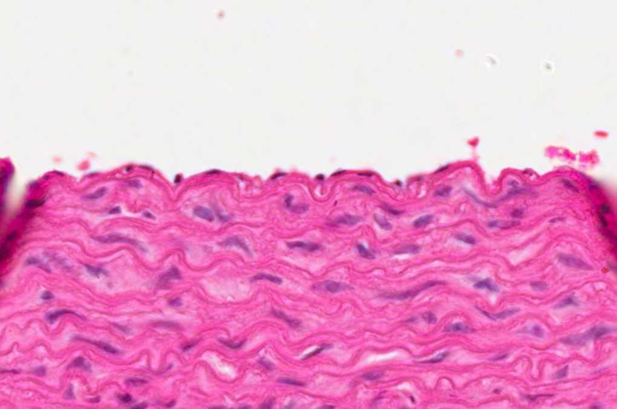
Simple Squamous Epithelium
* Characteristics
•One layer
•Flat cells
•Flat nuclei
Q1- Identify the type of epithelium ?
Simple Squamous Epithelium.
Q2- What is the type of Connective
tissue ?
Elastic connective tissue.
Q3- Mention the organ ? (Distribution , site)
Endothelium* of (Aorta)
Alveoli of lungs.

Slide 13
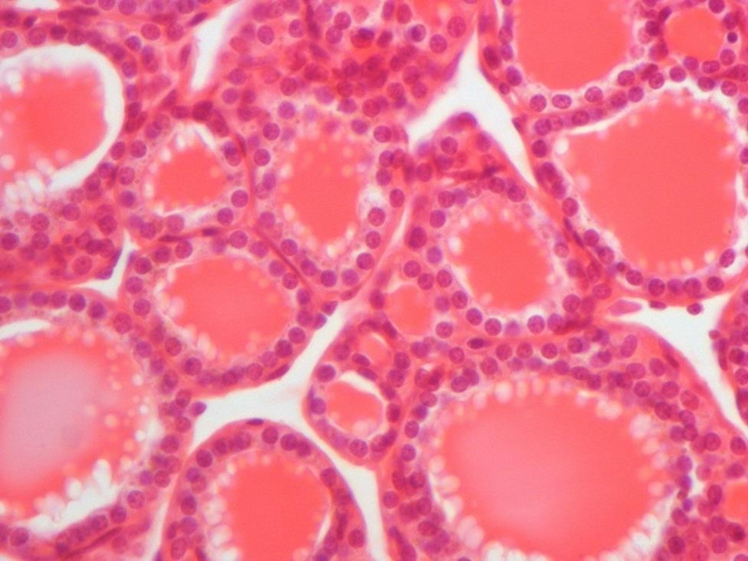
Simple Cuboidal Epithelium
Q1- Identify the type of Epithelium ?
Simple Cuboidal Epithelium.
Q2- Mention the organ ? (Distribution , site)
Thyroid gland. (follicles)
Characteristics :
One layer.
Cuboidal cells.
Round central nuclei.

Slide 14
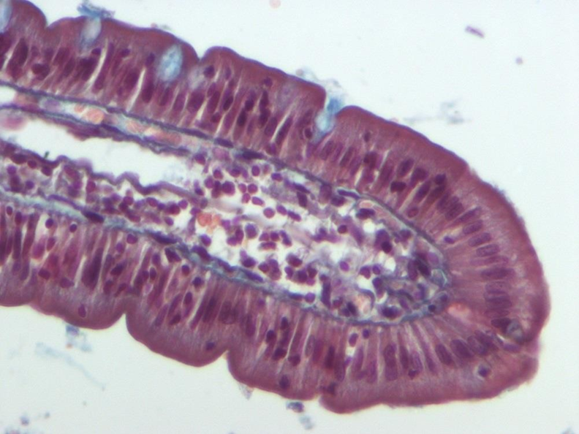
Simple Columnar Epithelium
Goblet cells
Q1-Identify the type of epithelium ?
Simple Columnar Epithelium.
Q2 –Mention the organ ? (Distribution , site)
GIT small intestines (WITH GOBLET CELLS )
Stomach and Gall bladder.(WITHOUT GOBLET CELLS)
Characteristics :
One layer
Columnar cells
Basal oval nuclei
Goblet cells (Functions in mucous secretion)

Slide 15
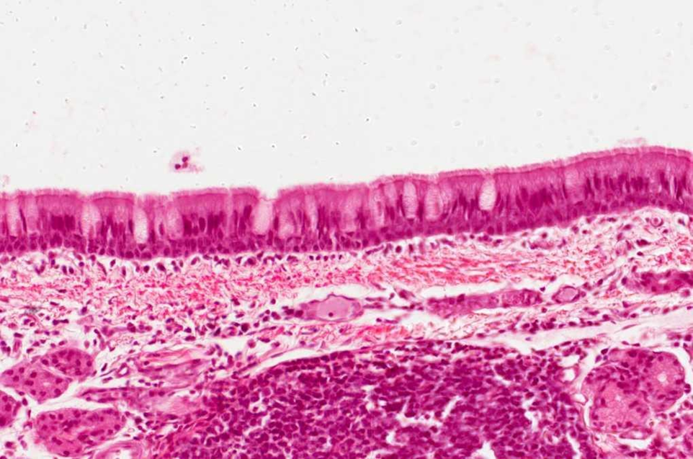
Pseudostratified Columnar Ciliated Epithelium with Goblet Cells
Q1-Identify the type of epithelium ?
Pseudostratified columnar ciliated epithelium with Goblet Cells.
Q2 –Mention the organ ? (Distribution , site)
Trachea and Bronchi.
Characteristics :
1-One layer of columnar cells.
2-Some are tall, others are short that can’t make to surface.
3-All cells rest on basement membrane.
4-Nuclei appear at different levels.

Slide 16
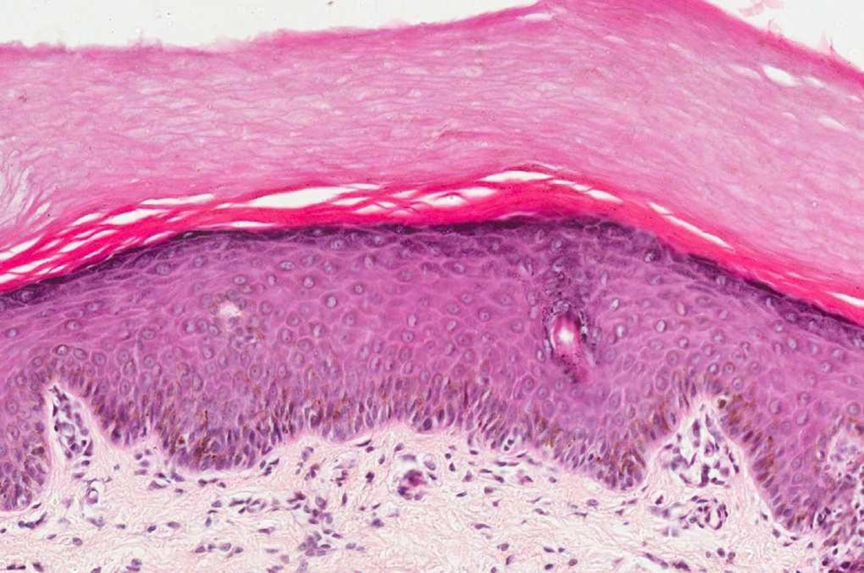
Stratified Squamous Keratinized Epithelium
Q1 –Mention the organ? (Distribution , site)
Epidermis of skin.
Characteristics :
1-Multiple layers of cells.
2-Basal cells are columnar with basal oval nuclei.
3-Intermediate cells are polygonal with central rounded nuclei.
4-Surface cells are flat with flattened nuclei.
5-with a layer of keratin on the surface.

Slide 17
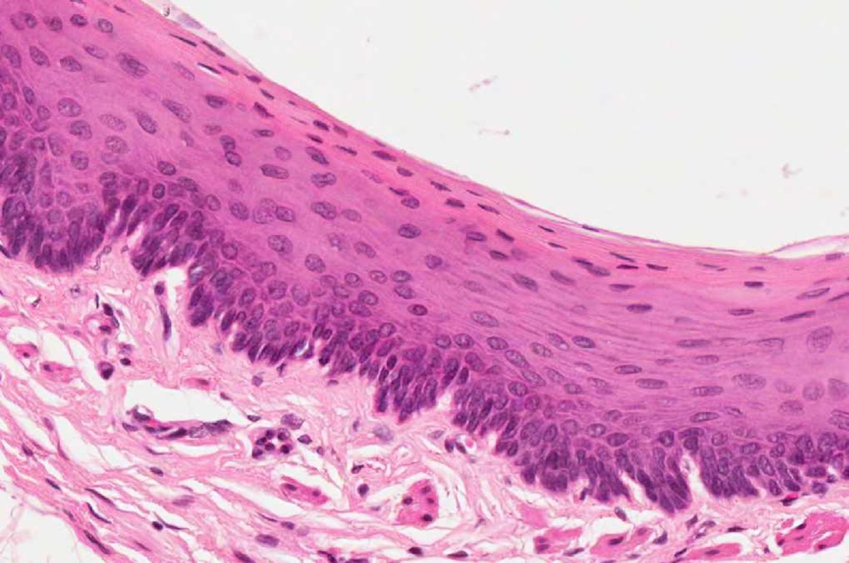
Stratified squamous non-keratinized Epithelium
Q1 –Mention the organ? (Distribution , site)
Esophagus.
Characteristics :
1-Multiple layers of cells.
2-Basal cells are columnar with basal oval nuclei.
3-Intermediate cells are polygonal with central rounded nuclei.
4-Surface cells are flat with flattened nuclei.
5-without a layer of keratin on the surface.

Slide 18
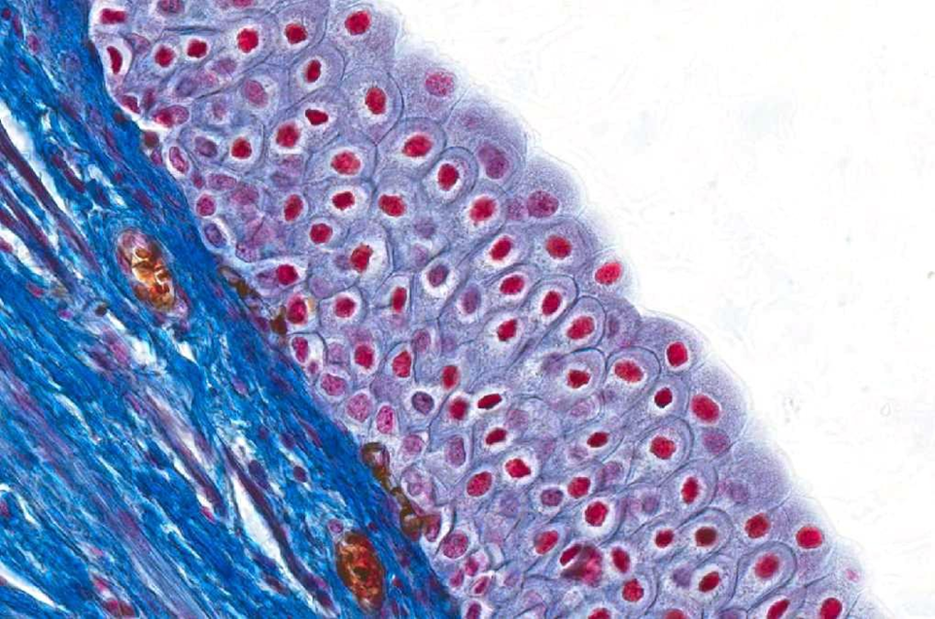
Transitional Epithelium
Q1-Identify the type of epithelium?
Transitional Epithelium
Q2-Mention the organ? (Distribution , site)
Urinary bladder
Characteristics :
1-Multiple layers of cells.
2-Basal cells are columnar.
3-Intermediate cells are polygonal.
4-Surface cells large cuboidal with
convex free surface and may be binucleated.

Slide 19
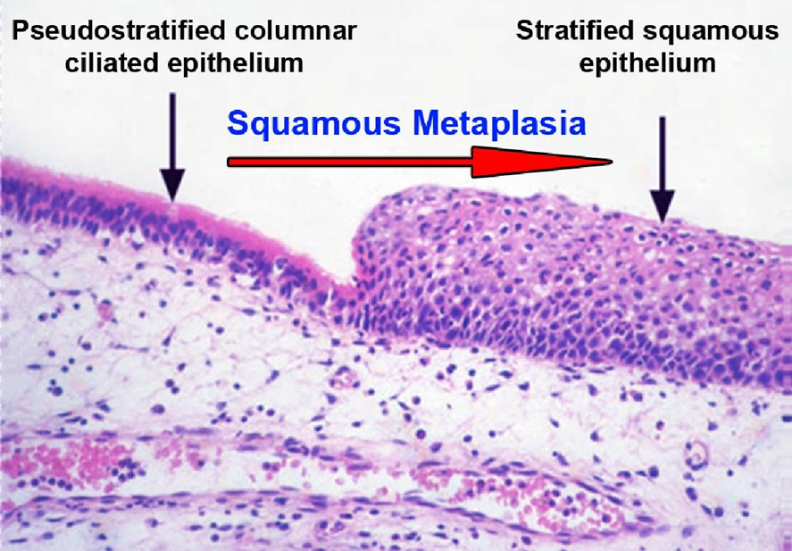
Squamous Metaplasia
Q1-Identify
Squamous Metaplasia*
From pseudostratified columnar ciliated epithelium to stratified squamous epithelium in trachea.
Metaplasia*: Change of epithelium from simple into
stratified epithelium
تغير طبيعة الخلايا من نوع إلى آخر

Slide 20
Dense collagenous regular connective tissue
Q1- What is the type of fibers ?
Collagen Fibers
Q2- What is the type of cells ?
Fibroblasts cells
Q3- Mention the organ or the distribution:
Tendons and ligaments

Slide 21
Elastic connective tissue
Q1- Identify:
Elastic connective tissue
Elastic connective tissue
Adipose connective tissue
Q2- Type of epithelium:
Simple squamous
Q3- Mention the organ :
Aorta

Slide 22
Adipose Connective Tissue
Q1- Identify the type of connective tissue:
Adipose connective tissue
Q2- What is the type of cells ?
Adipocyte

Slide 23
Reticular connective tissue
Q1- Identify the type of connective tissue:
Reticular connective tissue (Collagen Type III)
Q2- Mention the organ:
Lymph node and Spleen

Slide 24
Plasma cell
Q1- Identify the type of the cell :
Plasma cell (Clock-face)
Negative Golgi Appearance
Q2- What is the function ?
Secretion of Antibodies
Q3- What is the type of cytoplasm ?
Basophilic cytoplasm

Slide 25
Mast cell
Q1- Identify the type of the cell:
Mast cell
Q2- what is the function ?
Secretion of Histamine and Heparin

Slide 26
Lymph Node
Capsule
Q1- Identify :
Lymph Node
Q2- Location of :
Lymphatic nodule (Follicle)
Cortex
Paracortex
Medulla
Lymphatic nodule (Follicle)
Cortex
Septa
Paracortex
Medulla
Cortex

Slide 27
Thymus
Q1- Identify:
Thymus “ Incomplete septum”
Q2- Location of :
Cortex
Medulla (Hassall’s corpuscles)
Cortex (dark area)
Medulla (pale area)

Slide 28
Palatine Tonsil
Q1- Identify:
Palatine Tonsil ( incomplete capsule )
Crypt
Q2- What is the type of epithelium ?
Stratified squamous epithelium
Follicle
Follicle

Slide 29
THANK YOU !
Histology team members :
Team Leaders :
Rana Barasain
Reema AlBarrak
Shahad AL Anzan
Doaa Walid Abdulatif
Ghadah Al Muhanna
Amal Al Qarni
Wateen Al Hamoud
Weam Babaier
Ahmed Badahdah
Mutasem Alhasani
Nassir Abodjain
Nawaf Aldarweesh
Mohammed Khojah
Reema AlOtaibi
Faisal AlRabaii
Contact us on HistologyTeam436@gmail.com

