Slide 1
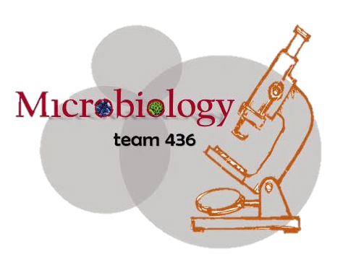

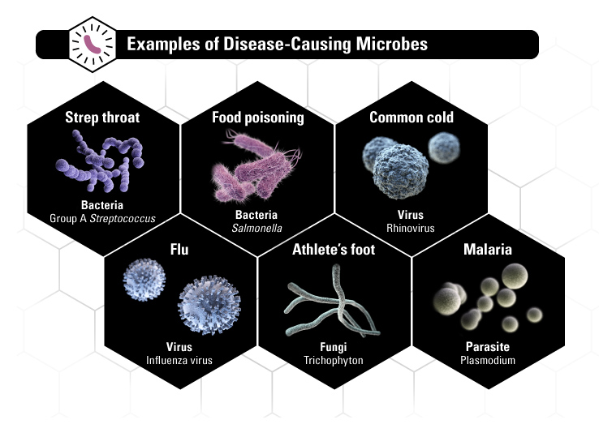
microbiology
PRACTICAL

Slide 2
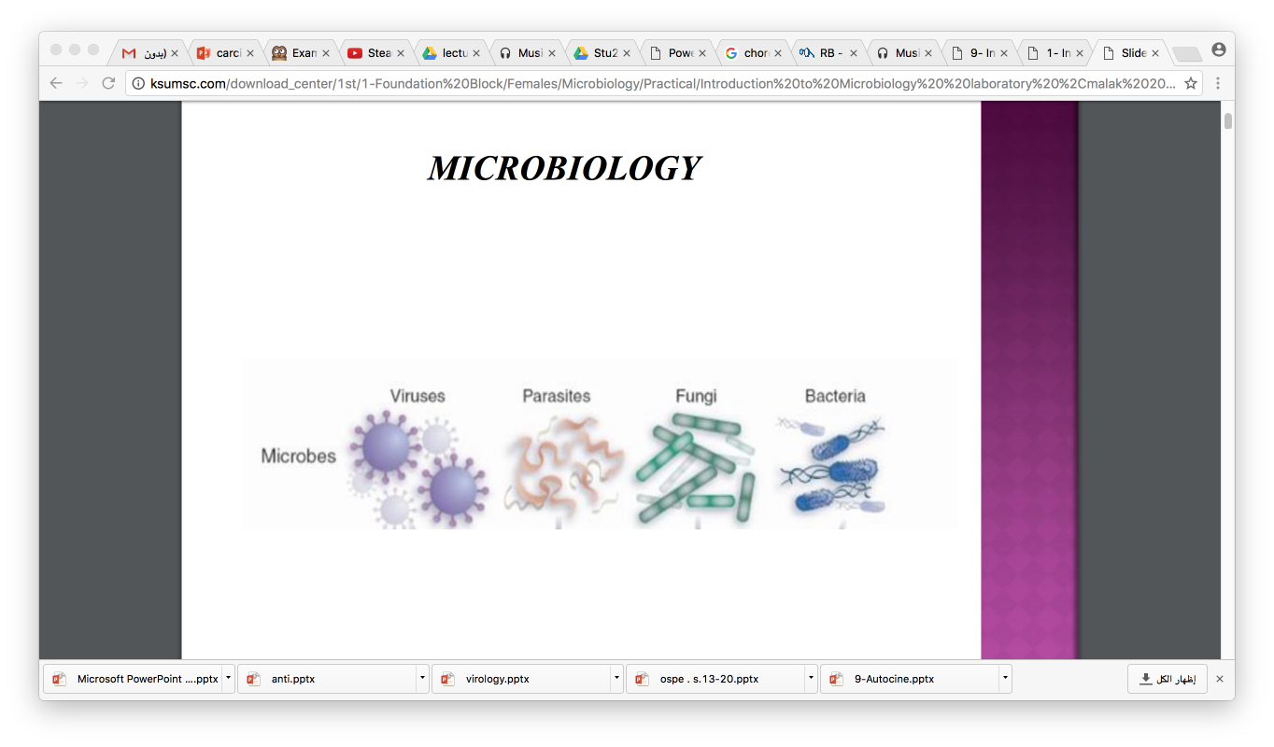
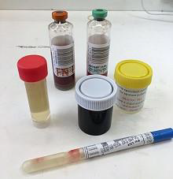
Laboratory diagnosis of infections . ID
Microscopic examination.
culture.
Serological tests (Ab).
Detection of Ag.
Molecular method .
Types of specimens

Slide 3
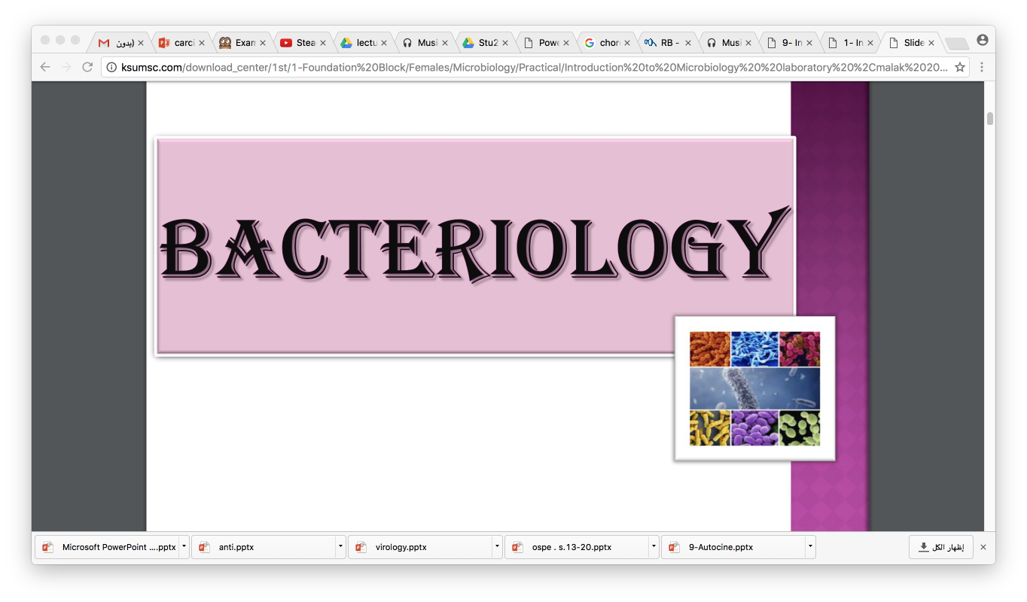
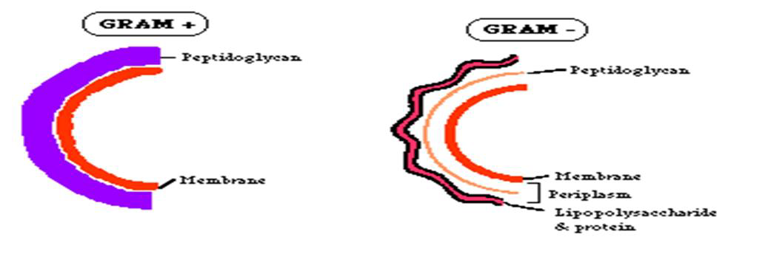
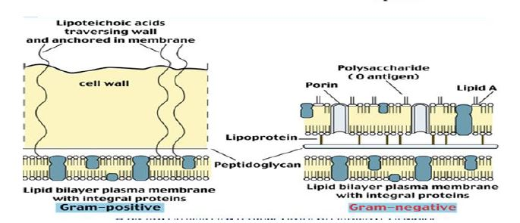
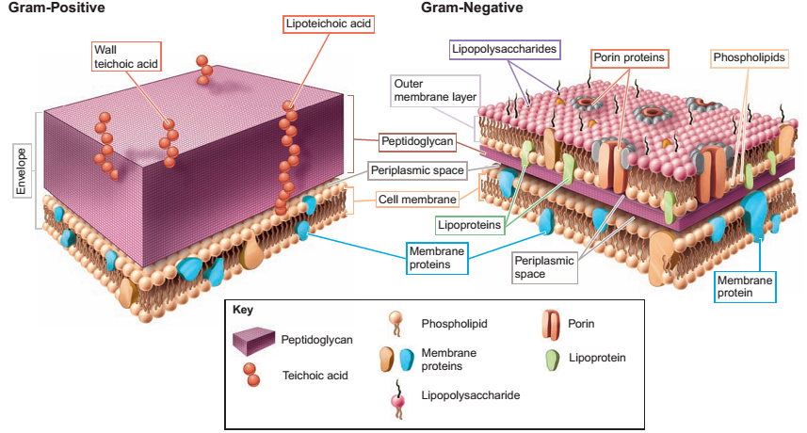
BACTERIOLOGY
Bacterial cell wall
Extra picture just to make it clear

Slide 4
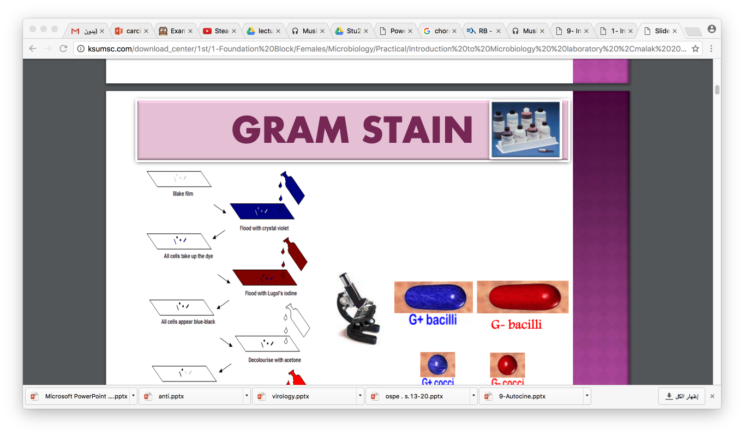
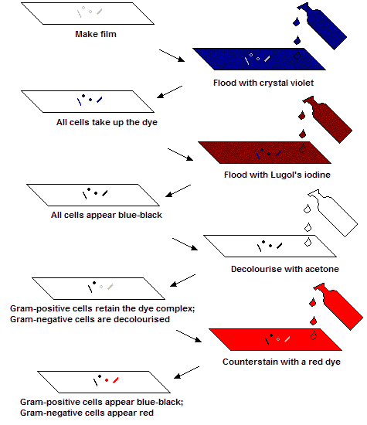
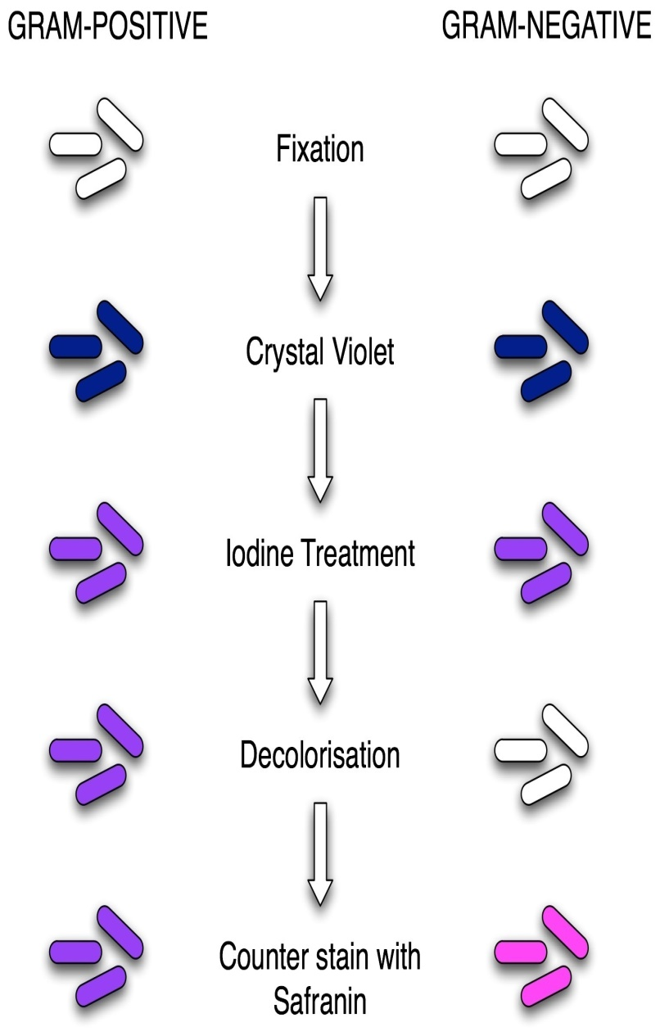








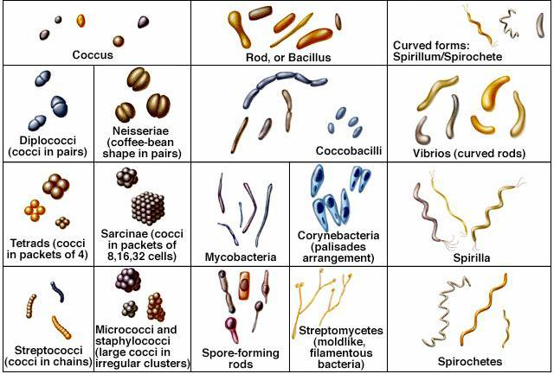
BACTERIOLOGY
Gram stain
1
2
1
3
2
4
3
4
G- bacilli
Bacterial shapes and arrangements

Slide 5
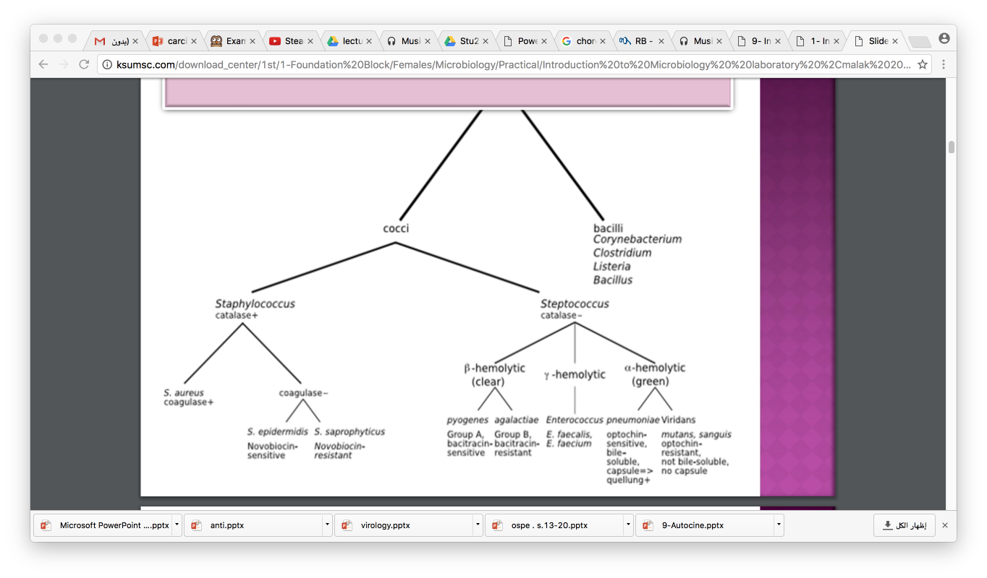
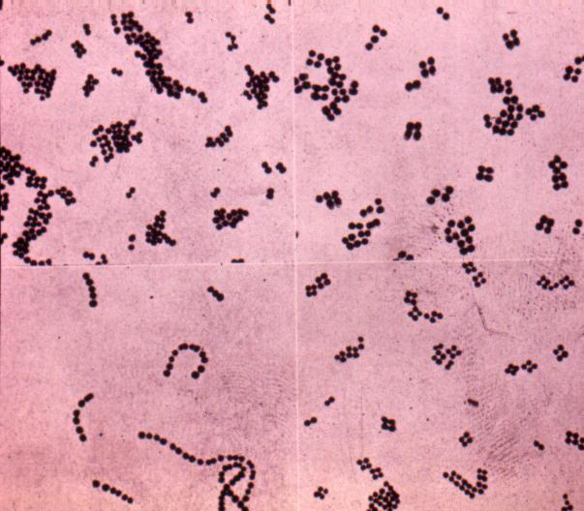
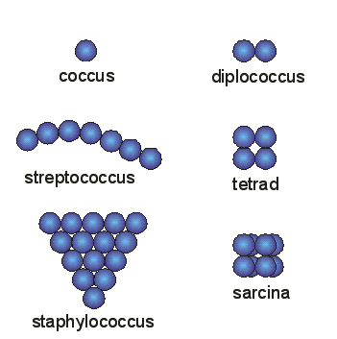
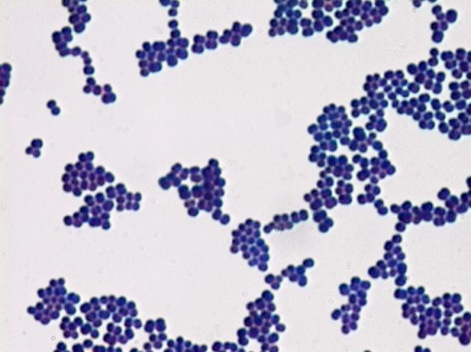
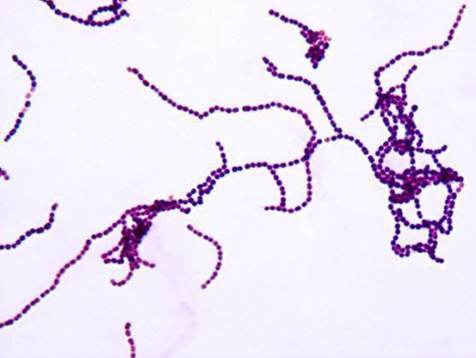
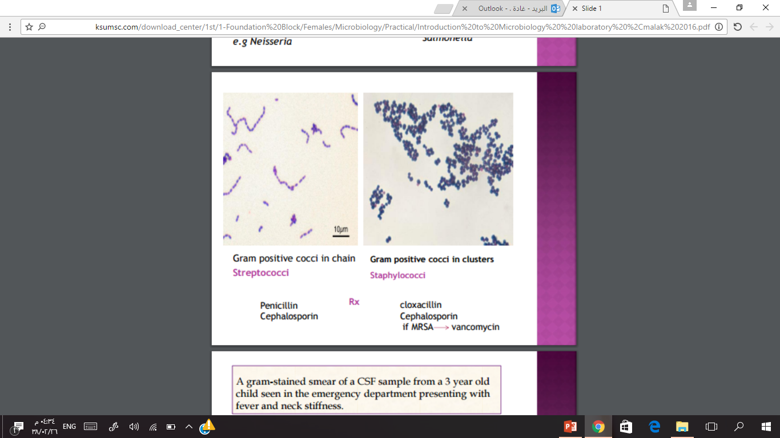
BACTERIOLOGY
Gram positive bacteria
Q. Describe this organism?
Gram positive cocci arrange in clusters
Staphylococcus
Gram positive cocci arrange in chain
Streptococcus
positive | positive | Gram stain
cocci | cocci | the shape
clusters | chain | The arrangement
Staphylococci | Streptococci | Ex:
cloxacillin Cephalosporin if MRSA → vancomycin | Penicillin Cephalosporin | RX (Prescription)

Slide 6
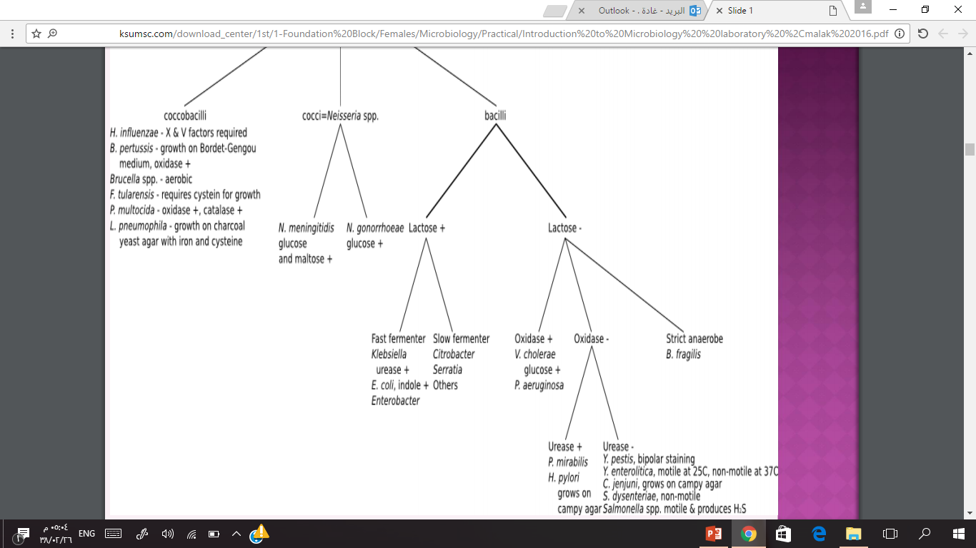
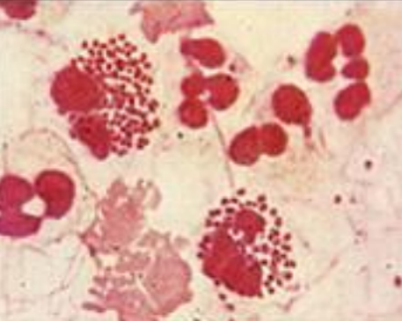
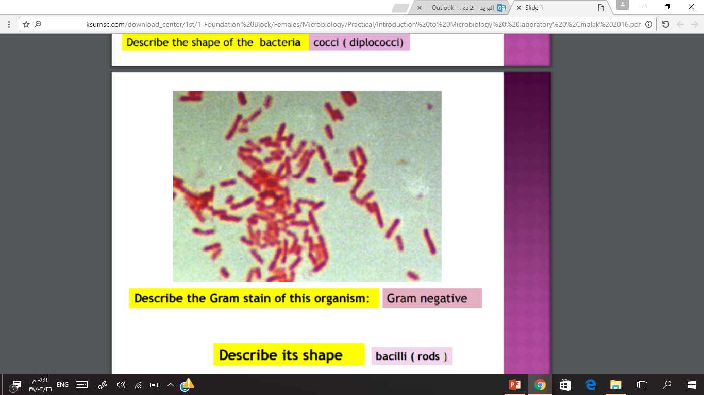






BACTERIOLOGY
Gram negative bacteria
Describe the Gram stain of this organism?
Describe its shape ?
Engulfed bacteria
neutrophils cells
nucleus
Gram negative bacilli (rods)
e.g E. coli Salmonella
Gram negative cocci (Diplococci )
e.g Neisseria

Slide 7
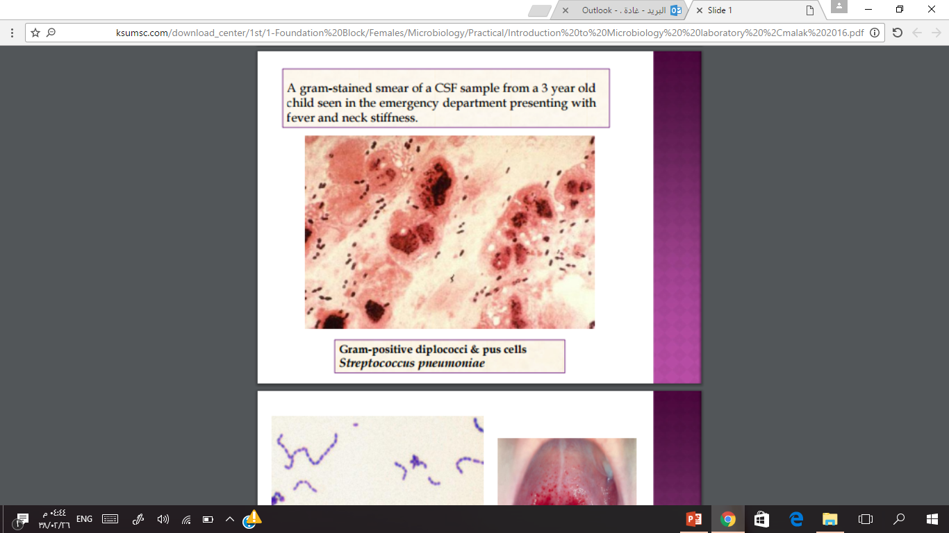
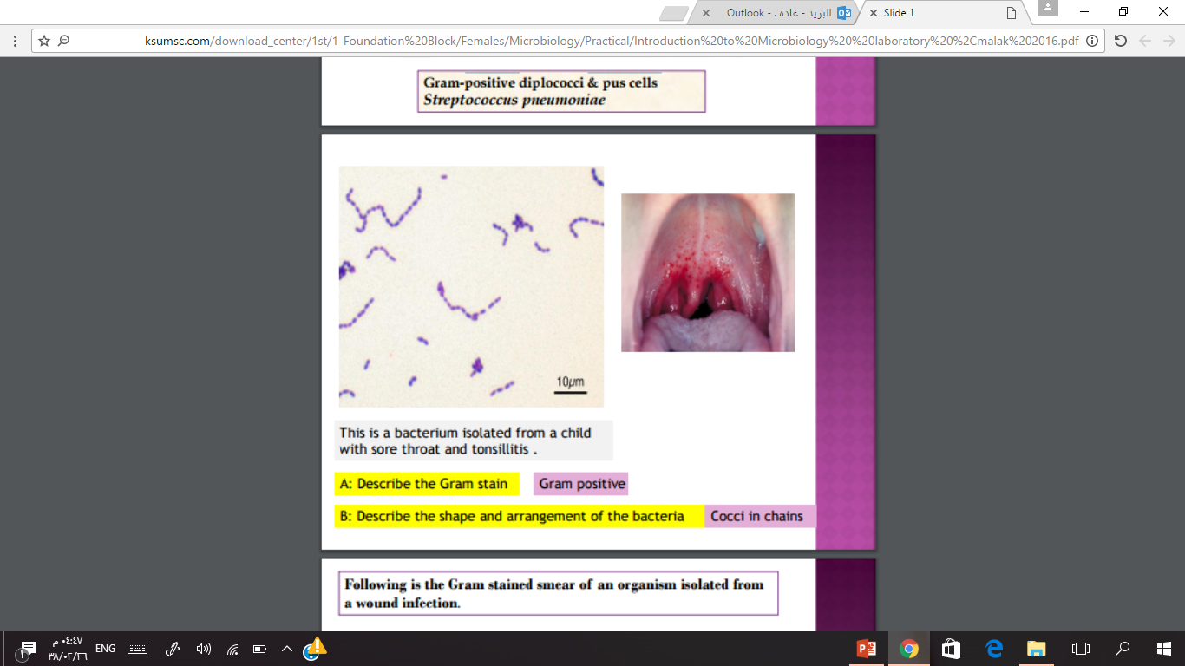
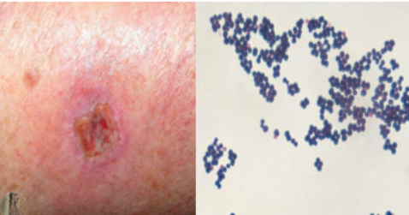
Case1:
BACTERIOLOGY
Following is the Gram-stained smear of from urethra of a 25 –year old male complaining of urethral discharge
Describe the Gram stain of the intracellular bacteria ?
Describe the shape of the bacteria ?
Case2:
-Gram negative
-cocci ( diplococci)
A gram-stained smear of a CSF sample from a 3 year old child seen in the emergency department presenting with fever and neck stiffness.
Describe what you see ?
Gram-positive diplococci & pus(neutrophils) cells
Streptococcus pneumoniae
Case3:
This is a bacterium isolated from a child with sore throat and tonsillitis .
A: Describe the Gram stain
B: Describe the shape and
arrangement of the bacteria?
Case4:
Gram positive Cocci in chains
Following is the Gram stained smear of an organism isolated from a wound infection.
Describe what you see in this slide ?
What is the likely organism ?
Gram-positive cocci in clusters
Staphylococcus aureus

Slide 8
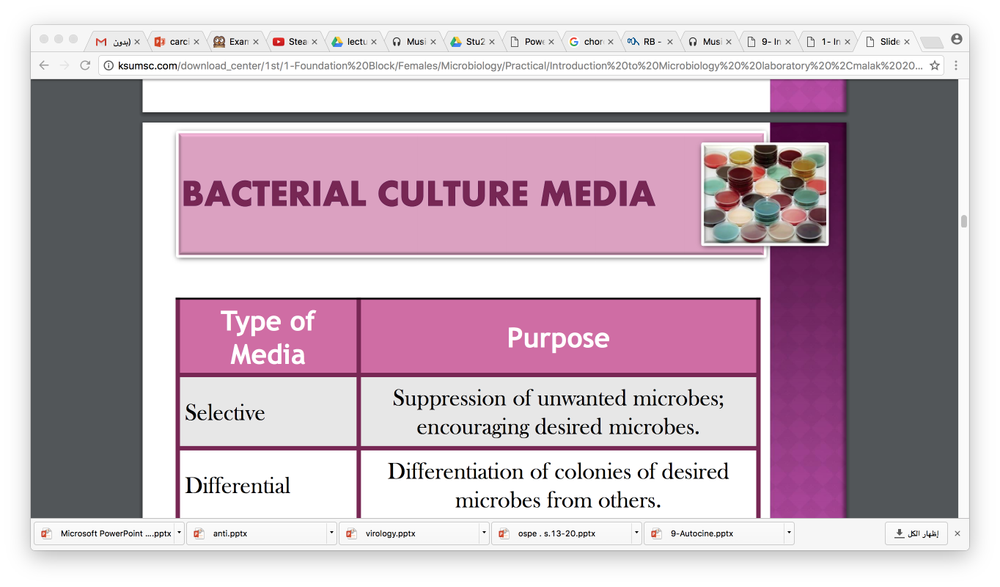
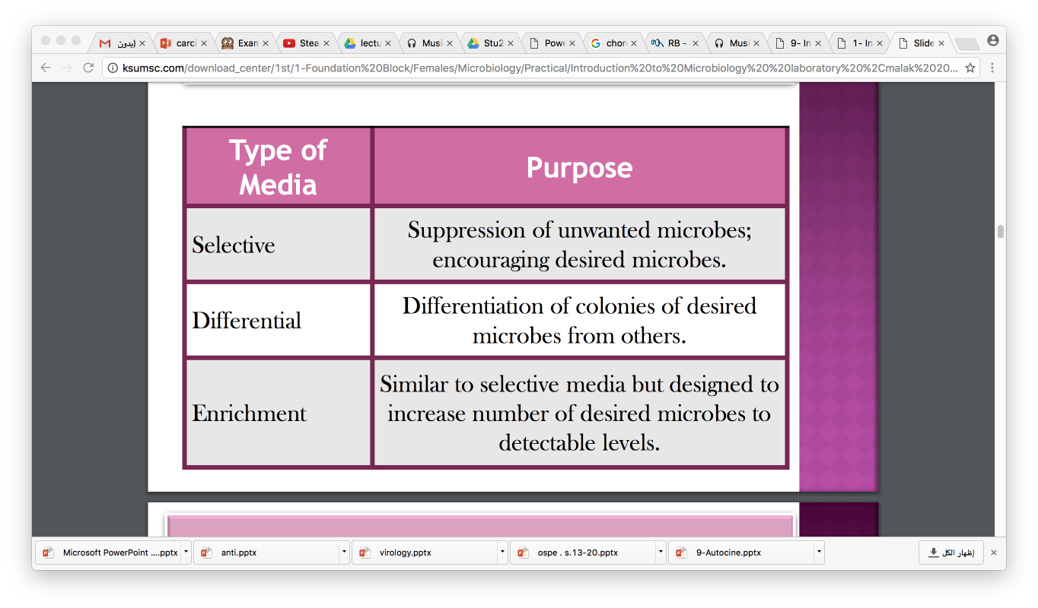
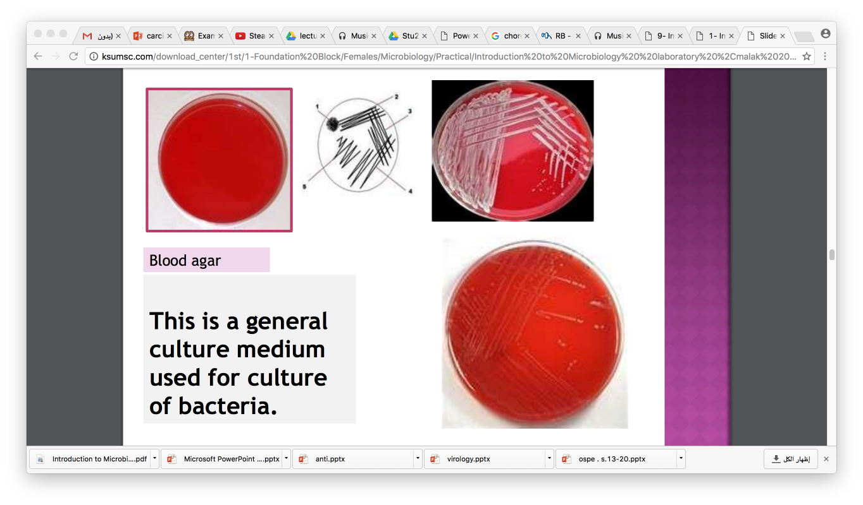
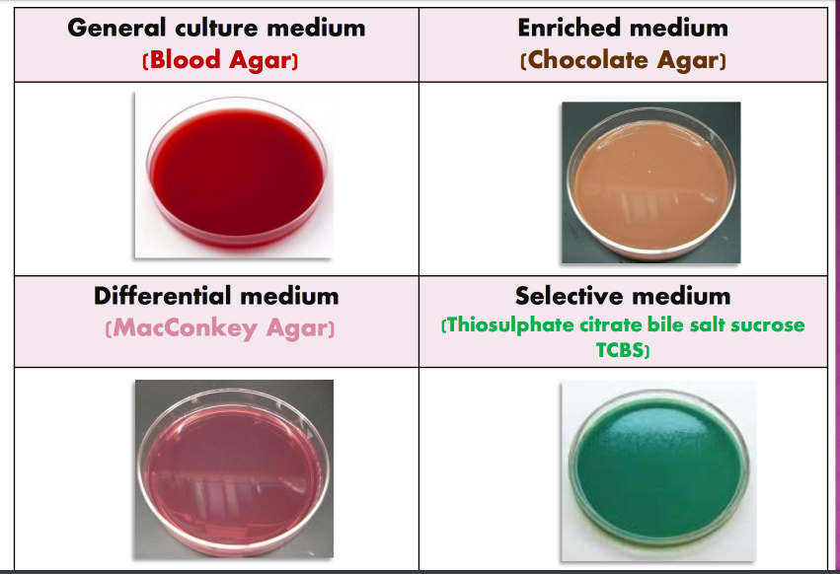
BACTERIOLOGY
Bacterial Culture Media

Slide 9
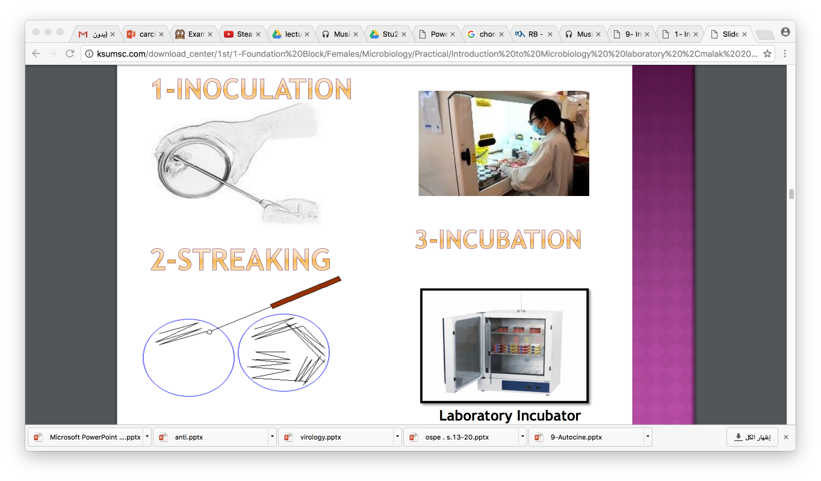
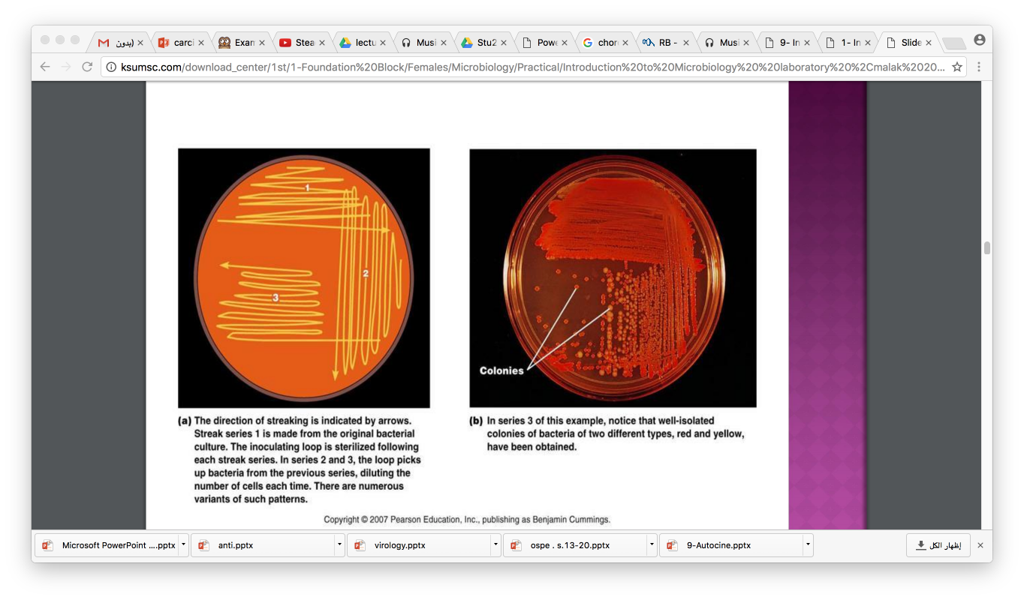
BACTERIOLOGY
Bacterial Culturing
Inoculation
Streaking
Incubation

Slide 10
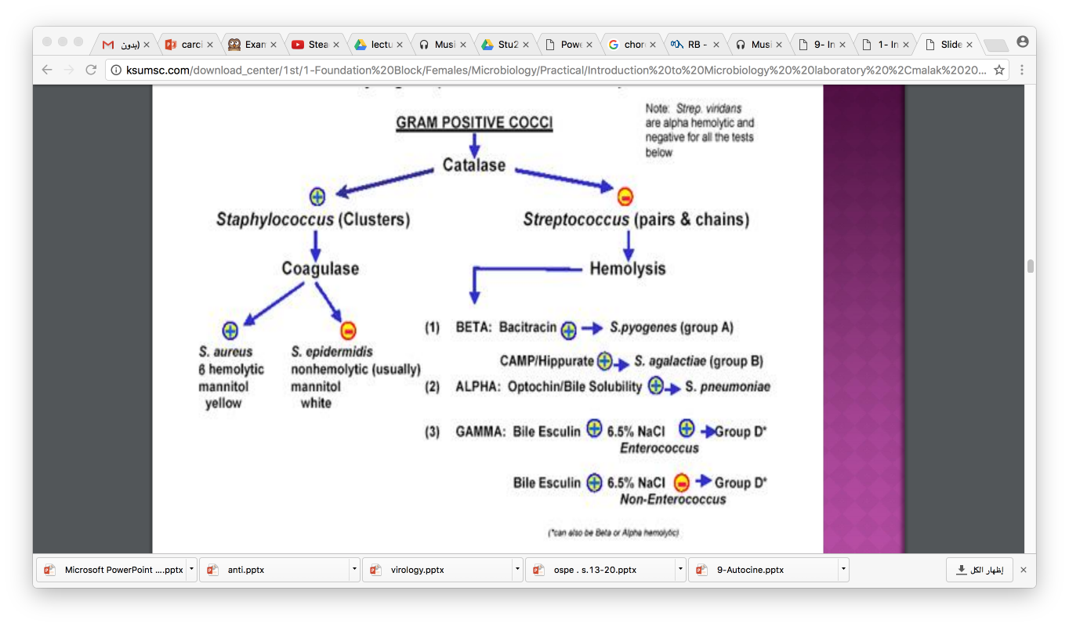
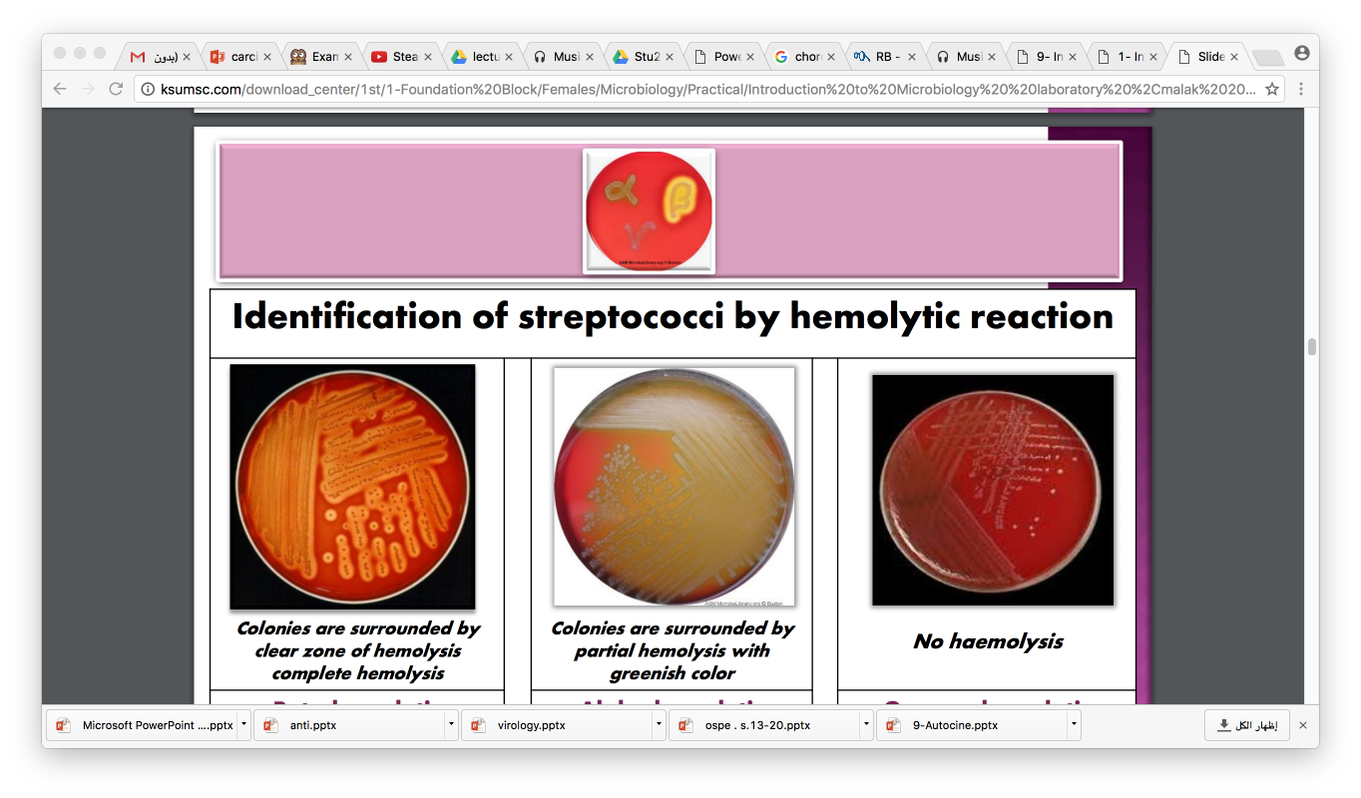
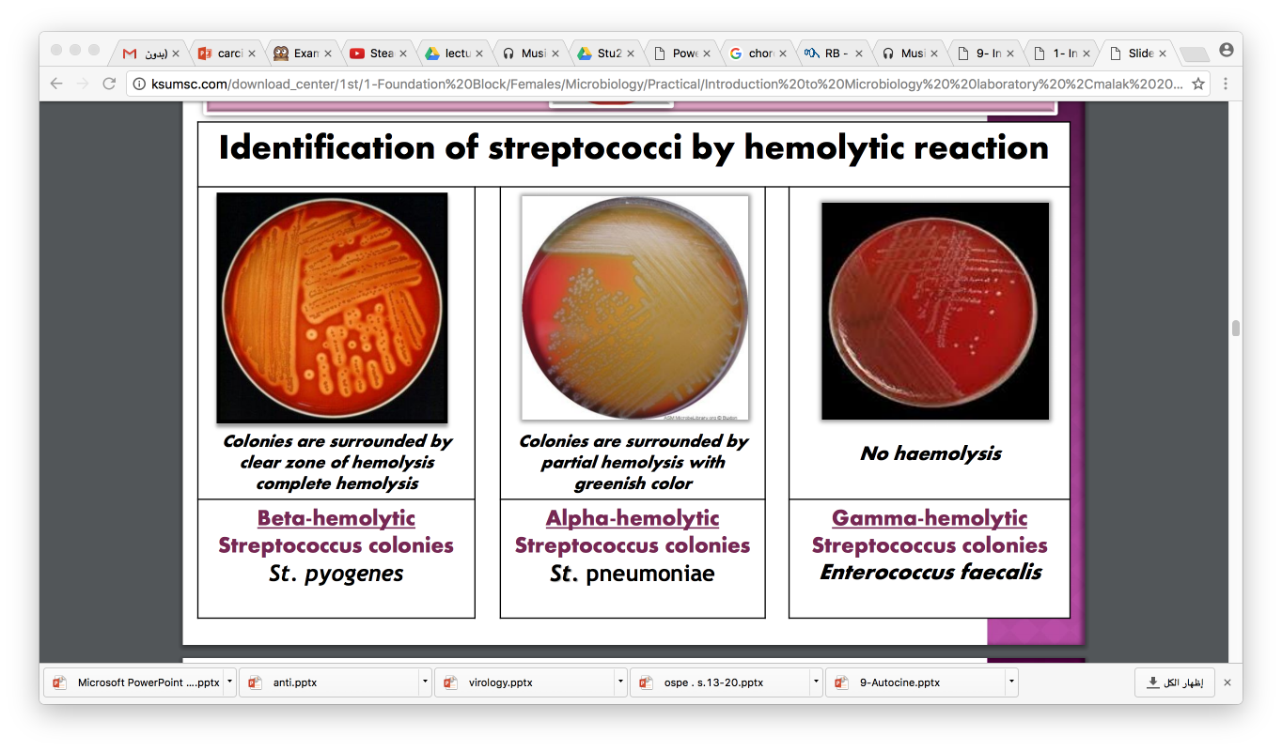
BACTERIOLOGY
Hemolytic reaction

Slide 11
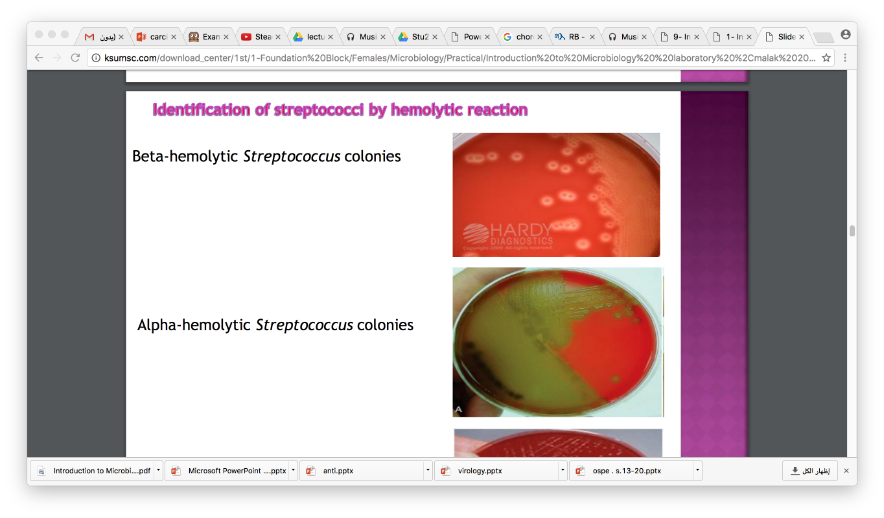
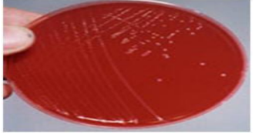
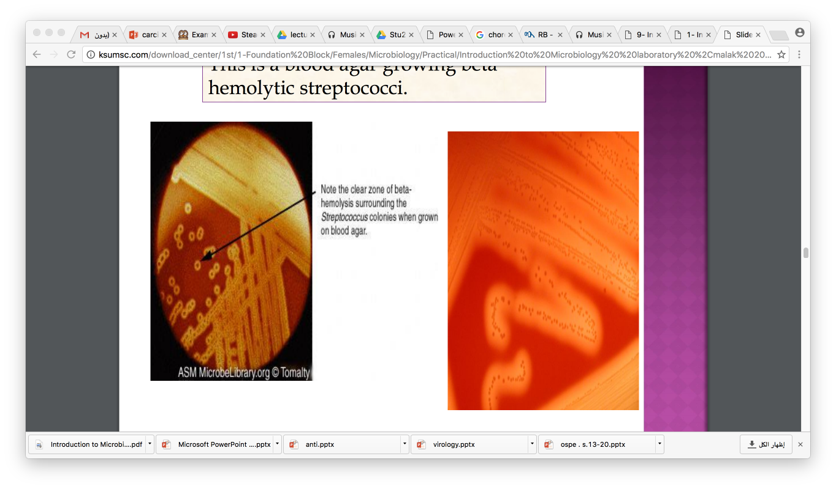
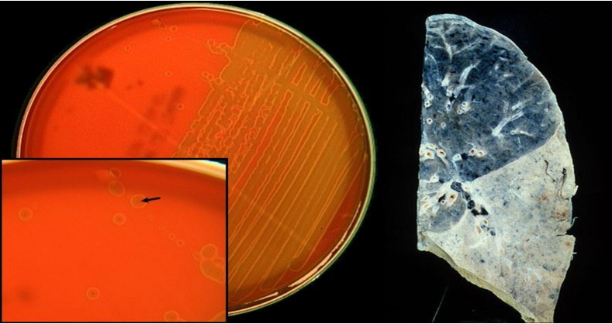
BACTERIOLOGY
Identification of streptococci by Hemolytic reaction
Beta-hemolytic Streptococcus colonies
Gamma-hemolytic Streptococcus colonies
Alpha-hemolytic Streptococcus colonies
This is a blood agar growing beta hemolytic streptococci.
Case:
This culture was grown from a sputum specimen of a 60 year old man complaining of cough, fever and chest pain
Alpha-hemolytic streptococci on blood agar

Slide 12
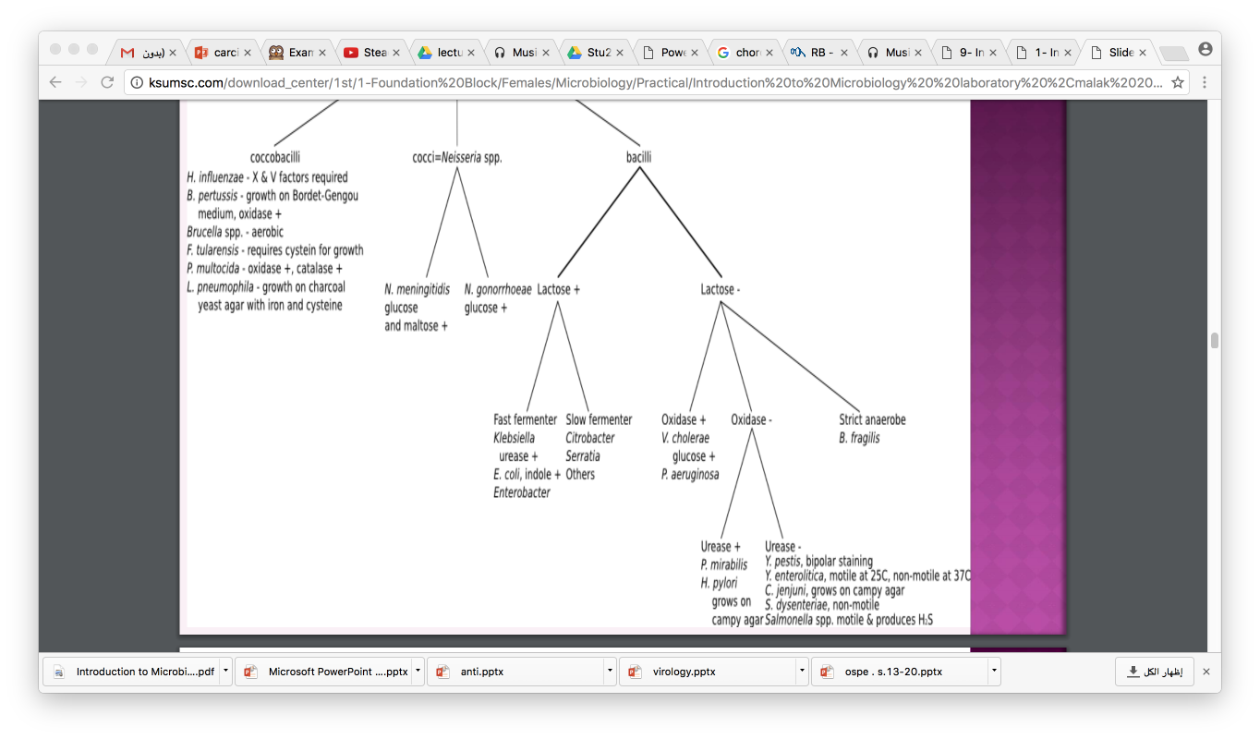
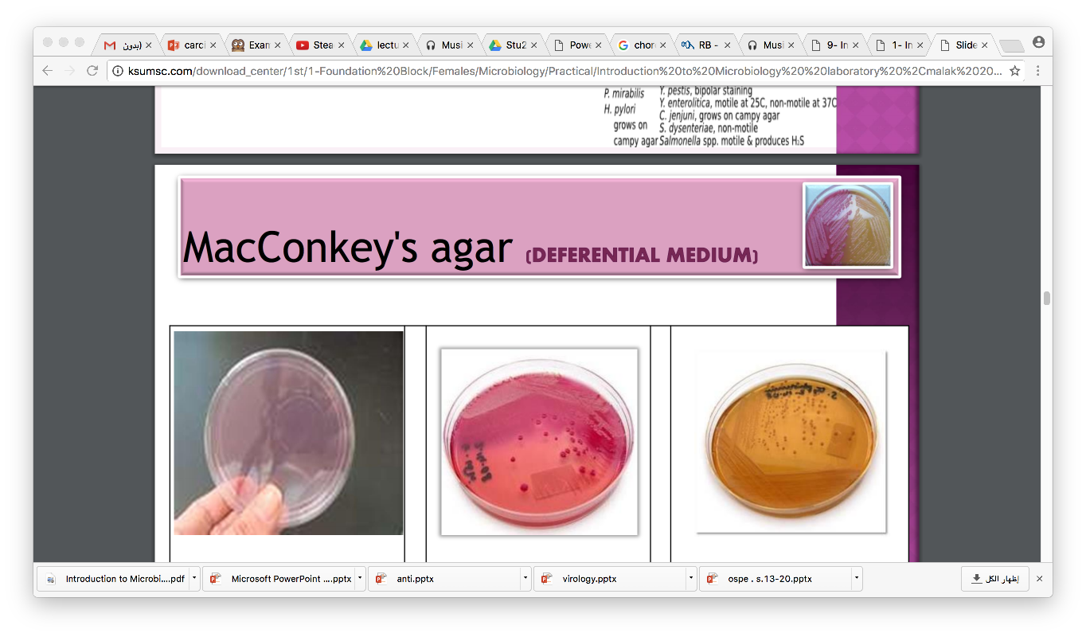
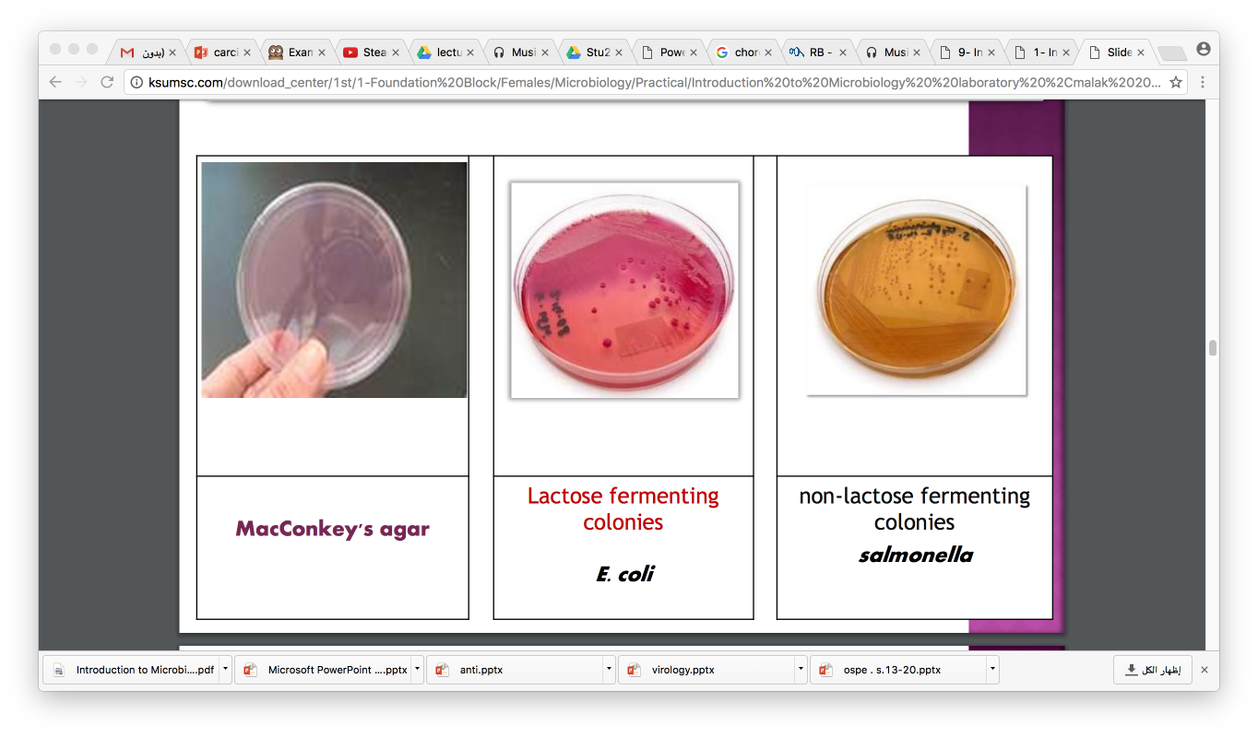
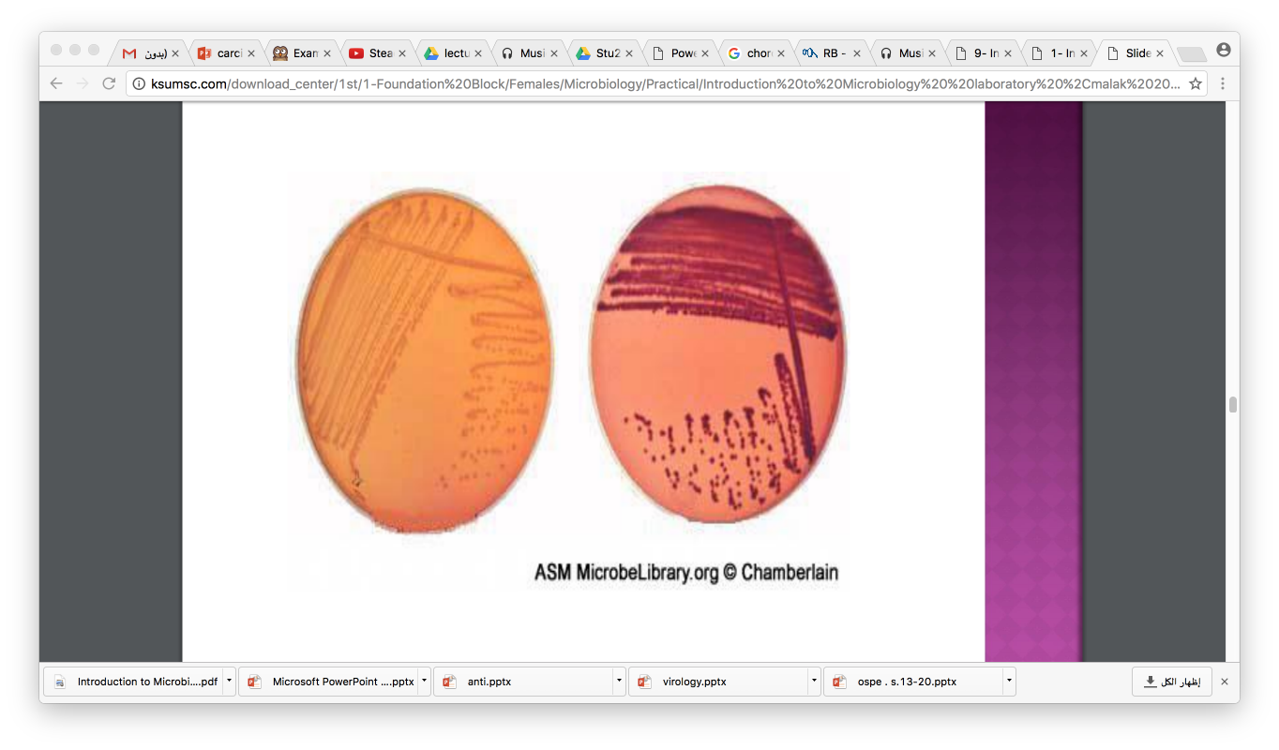
BACTERIOLOGY
Gram negative bacteria
MacConKey’s agar (Deferential Medium)

Slide 13
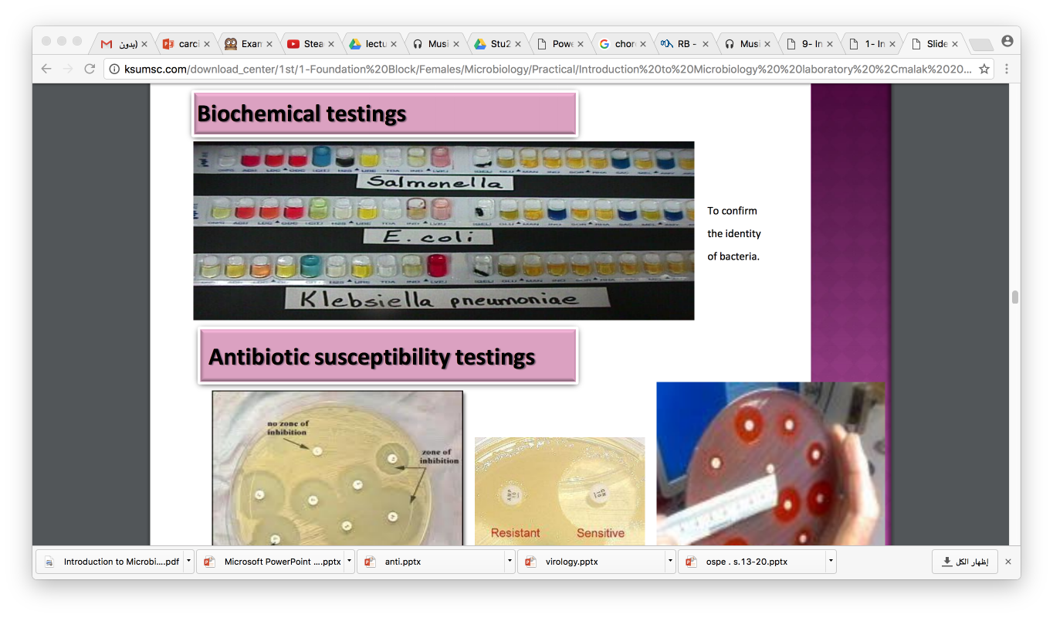
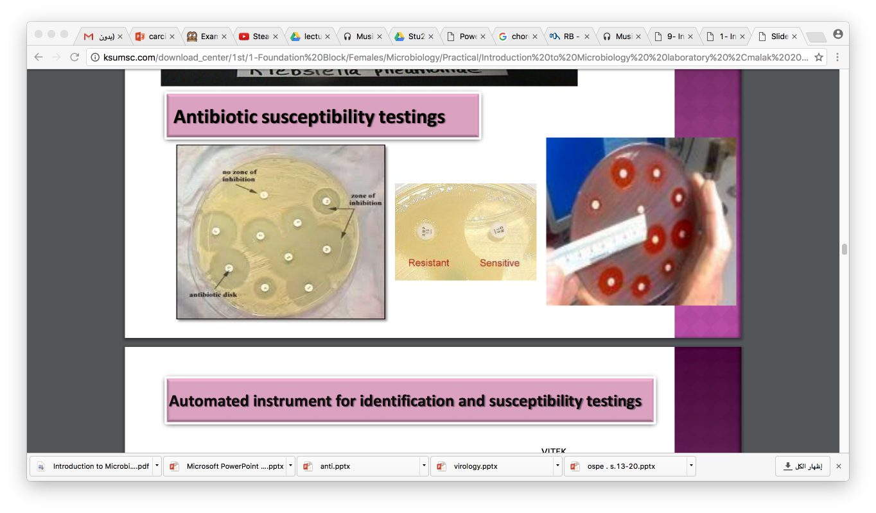
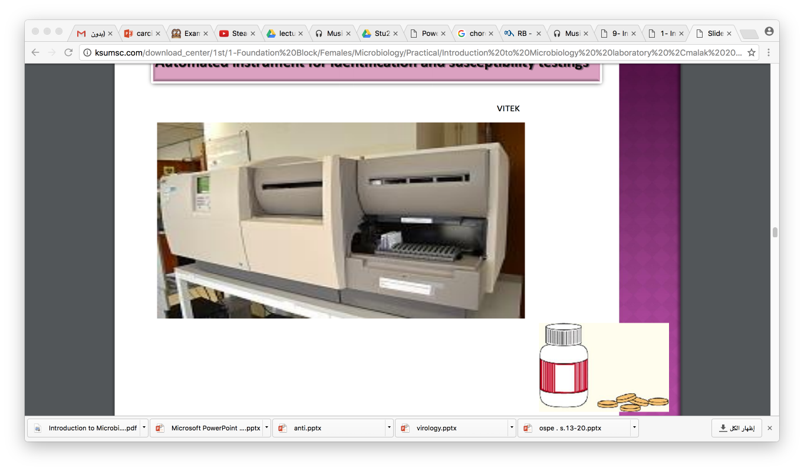
BACTERIOLOGY

Slide 14

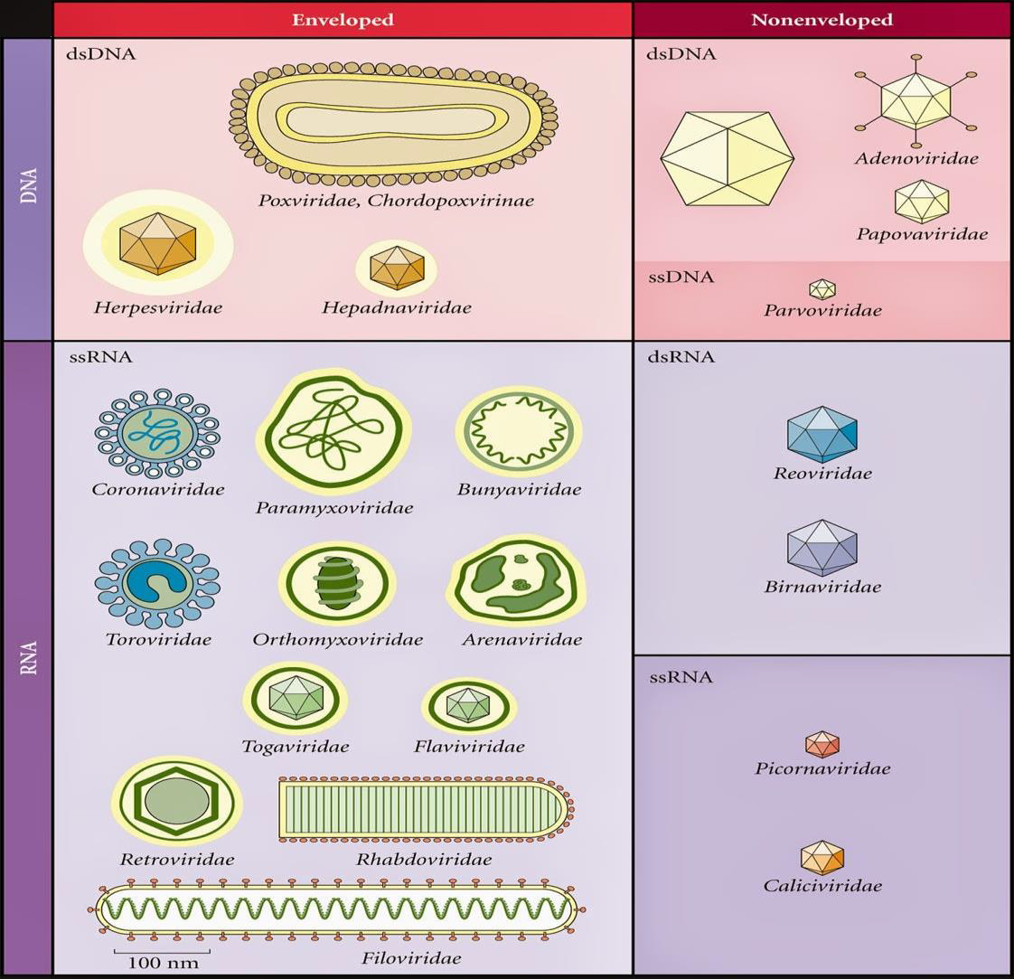
VIRAL STRUCTURE
VIROLOGY
Helical Virus
Icosahedral Virus
VIRAL CLASSIFICATION

Slide 15
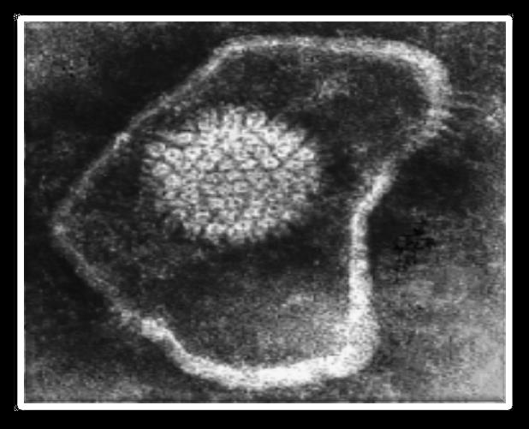
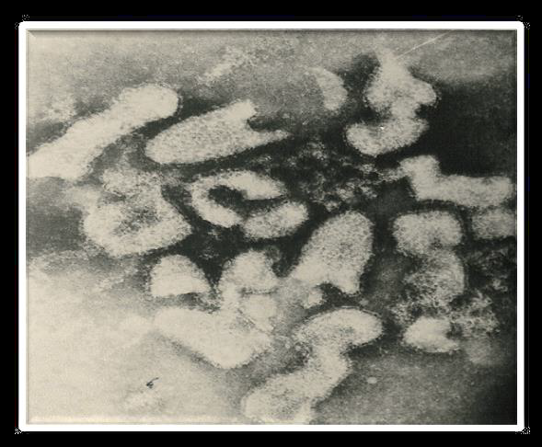
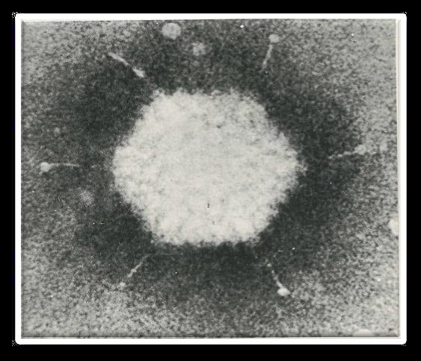
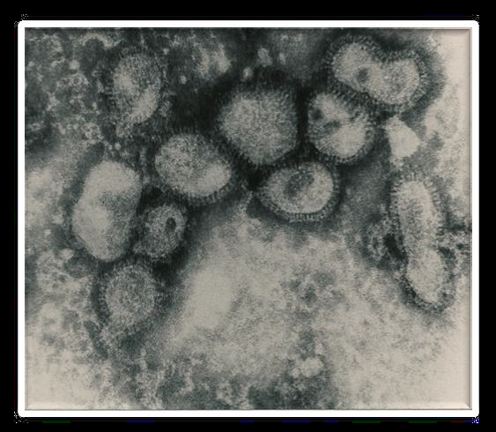
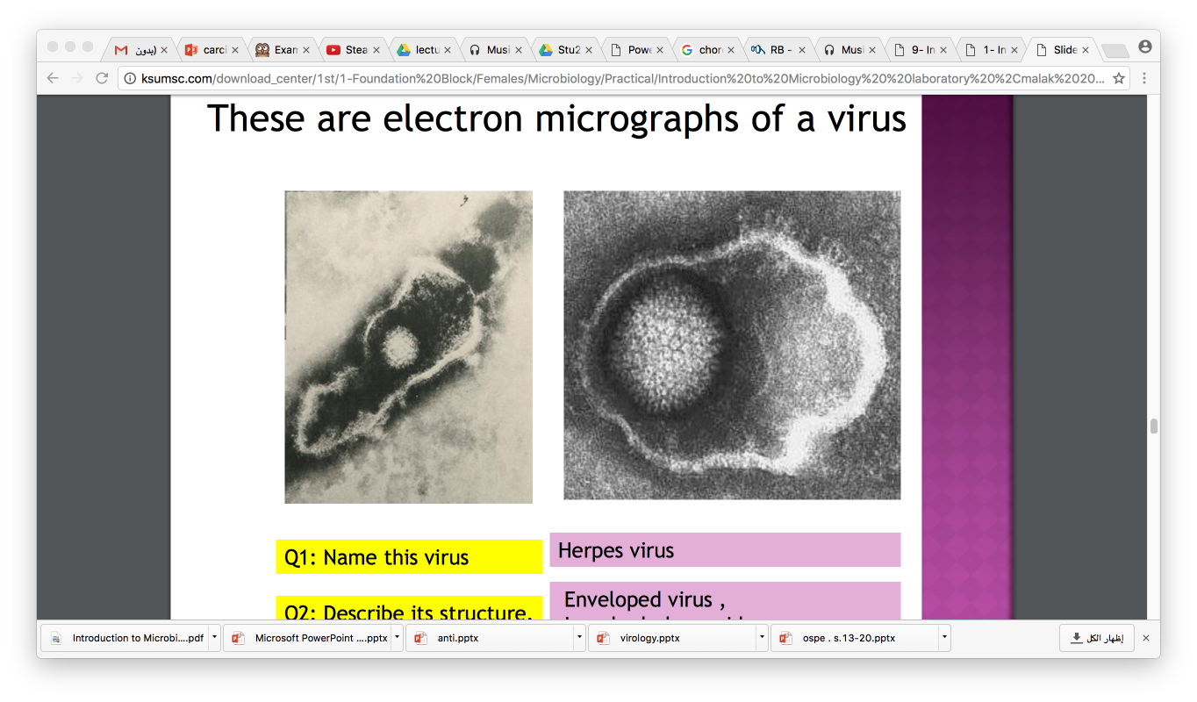




VIRAL ELECTRON MICROGRAPH
VIROLOGY
Loose envelope
Bullet shape
Herpes virus: Herpesviridae
Rabies virus: Rhabdoviridae
Enveloped virus
Icosahedral capsid
d.s DNA genome
Enveloped virus
Helical capsid
s.s RNA genome
Adenovirus : Adenoviridae
Influenza Viruses: Orthomyxoviridae
Nonenveloped virus
Icosahedral capsid
d.s DNA genome
Enveloped V & spikes
Helical capsid
Segmented s.s RNA
Only Virus with fiber
Pleomorphic shape
These are electron micrographs of a virus
Q1: Name this virus ?
Herpes virus
Q1: Name this virus ?
Adenovirus
Q1: Name this virus?
Influenza Viruses
Q1: Name this virus?
Rabies virus
Q2: Describe its structure?
Enveloped virus
Icosahedral capsid
d.s DNA genome
Q2: Describe its structure ?
Nonenveloped virus, with fiber
Icosahedral capsid
d.s DNA genome
Q2: Describe its structure ?
Enveloped Virus with spikes ,
Helical capsid
Segmented s.s RNA
Q2: Describe its structure ?
Enveloped virus
Helical capsid
s.s RNA genome

Slide 16














PARASITOLOGY
Classification of Parasites
1- Ascaris lumbricoides( round warm)
2- taetnia saginata (cestodes)
Ascaris adult
Round worm , un-segmented
Tape-like worm segmented.
3- fasciolahepatica(termatodes)
5- giardia lamblia cyst
Two nuclei,
each with central karyosome
Four pairs of flagella
flat worm , un-segmented ,leaf like

Slide 17








PARASITOLOGY
1-LICE ,Louse(singular) , Lice (pleural)
Pediculus humanus
2-Phlebotomus ( sand fly)
3-Mosquitoes
vector
vector
vector

Slide 18



MYCOLOGY
Fungi can be divided to two types based on morphology
Microscopic appearance of yeast and mould fungi

Slide 19
THE TEAM :
Shrooq Alsomali
Rawan Alqahtani
Hanin Bashaikh
Jawaher Alkhayyal
Reem Alshathri
Ohoud Abdullah
Ghadah Almazrou
Lama Al-musallm
THE TEAM :
Waleed Aljamal
Ibrahim Fetyani
Meshal Eiaidi
Khalid Alhusainan
Hussam Alkhathlan
Faisal Alqumaizi
Contact us :
436microbiologyteam@gmail.com
Twitter :
@microbio436

