Slide 1
BLOOD PRACTICAL
This slides contain both (Slides + Handout الملزمة)
Procedures in Female slide and handout are the same .Therefore ,we put it as one procedure
Don’t forget to bring your calculator
Red : important
Green: only found in males’ slides.
Purple: only found in females’ slides.
Gray: notes.
Physiology practical Team 436 – Foundation block
(CBC & ESR )
{يامالك الملك وكلناك أمرنا واستودعناك همومنا فبشرنا بما يفتح مداخل السعادة إلى قلوبنا }

Slide 2
Aims of the Practical
Counting Red blood cells.
Counting White blood cells.
Determination of hemoglobin concentration.
Determination of packed cell volume (PCV) hematocrit.
Calculation of red blood cell indices.
Determination of ESR.

Slide 3
Objectives(CBC & ESR)
1- Recognize the method used to measure the different hematological values, and compare it with the normal values. 2- Do the calculation of indices, their normal values and their importance in diagnosis of different types of anemia. 3- To know how to measure the erythrocyte sedimentation rate . 4-To recognize what is the clinical value of these measurements

Slide 4
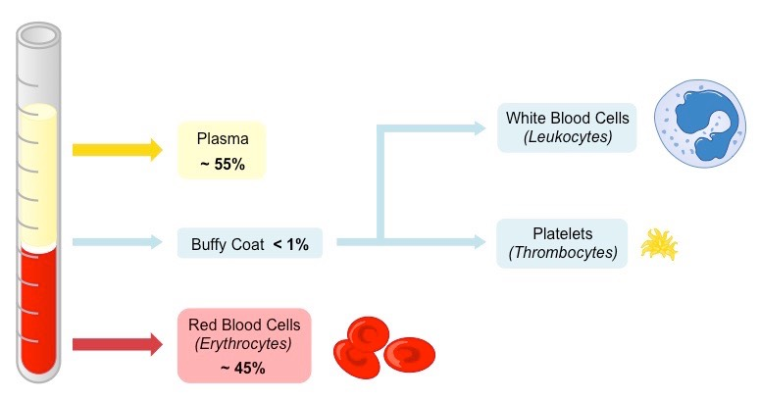
Blood Composition
The average blood volume of adults is about 7% of body weight (5 - 5.5 L).
Cellular component 45%
RBCs
WBCs
Plasma 55%
Water 98%
Plasma Protein
Platelets
Ions
Ions like : ( Na , K , HCO3 , PO4 … etc. )
Plasma Protein like : ( Albumin , Globulin , Fibrinogen )
Plasma has same ionic composition as Interstitial fluid
In male slides and female doctor said take it as a revision

Slide 5
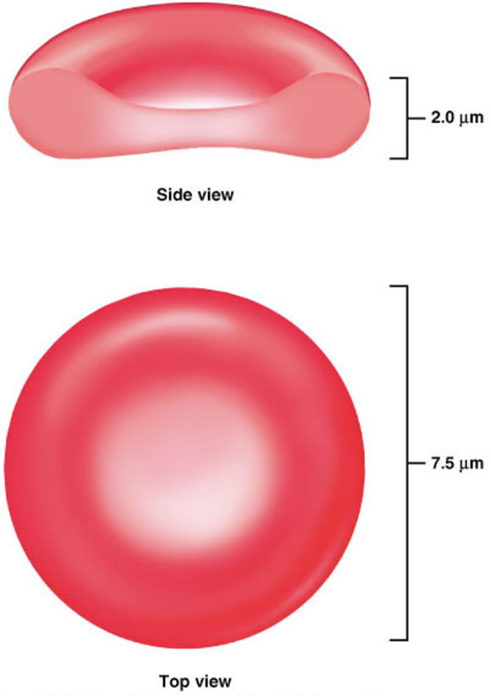
Red blood cell ( Erythrocytes )
STRUCTURE :
Flat biconcave disc
Non-nucleated
Dimensions:
Diameter: 7.5 μm
Thickness 2 μm
Contain a red pigment
(hemoglobin)
RBC membrane is elastic
so it is flexible
(can easily pass through the capillaries).
In male slides and female doctor said take it as a revision

Slide 6
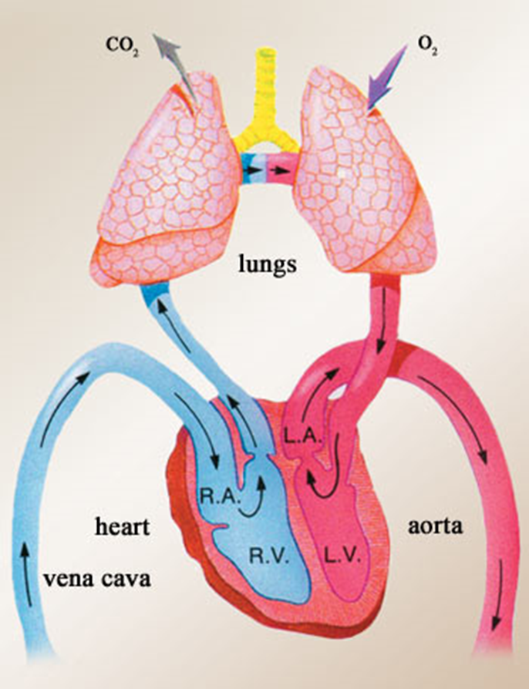
Red blood cell ( Erythrocytes )male slides
RBCs Count
Functions
Carry Hemoglobin
Buffer (decrease pH; regulation)
Transport oxygen from lungs to tissues and
carbon dioxide from tissues to lungs ;
(because they contain hemoglobin) .
RBCs are metabolically active cells; uses glucose for energy
Male
4.8-6.5 million cells/mm3
Female
3.8-5.8 million cells/mm3
Life span is 120 Day
In Different textbooks there are different values but they are nearly similar

Slide 7
Erythropoiesis
The process of Production of Erythrocytes :
Hemocytoblasts: give rise to all formed elements .
Features of the maturation process of RBC
1. Reduction in size
2. Disappearance of the nucleus
3. Acquisition of hemoglobin
In male slides but female doctor said take it as a revision

Slide 8
Control of Erythropoiesis
Erythropoiesis is stimulated by erythropoietin hormone
Stimulated by:
Hypoxia (low oxygen)
Anemia
Hemorrhage
High altitude
Lung disease
Heart failure
Nutritional requirements of RBC production :
1. Amino Acids
3.Vitamins
( B12 , Folic Acid , c )
2.Iron
4.Trace Element
( Copper , Cobalt , Zinc )
In male slides and female doctor said take it as a revision

Slide 9
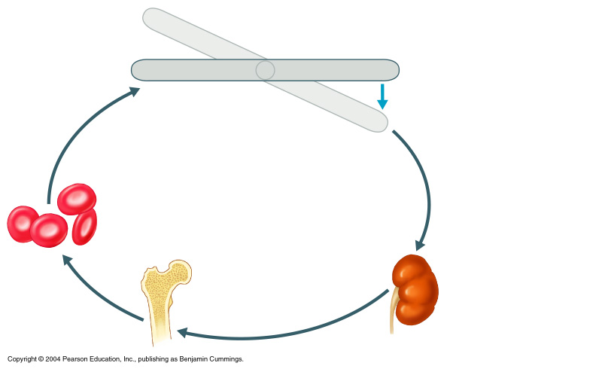
Erythropoiesis
Erythropoietin
Erythropoietin Mechanism
Start
Imbalance
Stimulus:
1.Hypoxia :
High altitude
Heart or lung diseases
Anemia
2.Blood loss
Normal blood oxygen levels
Imbalance
Increases O₂-carrying ability of blood
Reduces O₂ levels in blood
Kidney (and liver to a smaller extent) releases
Erythropoietin
Structure: 24% CHO
67% protein
Half life: 6.7 hours.
Enhanced erythropoiesis increases RBC count
Erythropoietin stimulates red bone marrow
In male slides and female doctor said take it as a revision
Figure 17.6

Slide 10
Hemoglobin
Hemoglobin is the protein molecule in red blood cells. carries oxygen from the lungs to body’s tissues and returns carbon dioxide from the tissues to the lungs .
It is red pigment present in RBCs and gives red blood cells their color.
280 million molecules / cell .
Male
13-18 g/dl
Female
11.5 -16.5 g/dl
Anemia :
Decrease number of RBC and Hb .
Symptoms : Tired , Fatigue , shortness of breath .
Signs : pallor , tachycardia .
Tachycardia: rapid heart rate.
In male slides and female doctor said take it as a revision

Slide 11
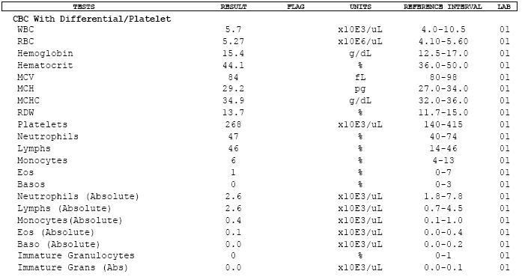
Complete Blood Count (CBC)
It is a test panel requested by a doctor or other medical professional that gives information about the cells in a patient's blood.

Slide 12
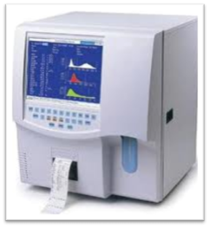
Materials and methods
Coulter analyzer
Diluent reagents
Lytic reagent
Calibrator kit
EDTA anticoagulant blood
- Is an isotonic electrolyte solution that:
Dilute the whole blood sample .
Stabilize cell membrane for accurate counting and size
( الخلايا تكون متراصة فنفرق بين الخلايا عشان يصير العد صحيح )
Conduct aperture current
Rinse instrument components between analysis
Prevent duplicate cell counts
Detail Next slide
To prevent blood from clotting
Is an alternative to the whole blood reference method for calibration
(to know if the machine work efficiently)
(مثال : يكون عندي عينة مكتوب عليها كميات المكونات اللي فيها ( كمية الهيموجلوبين , كمية الكريات الدم الحمراء/البيضاء) فندخل العينة بالجهاز ونشوف هل المكونات اللي طالعة من الجهاز هي نفسها المكتوب على العينة
Lysis RBCs for hemoglobin measurements and WBCs count

Slide 13
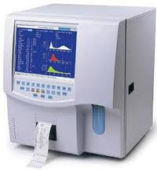
Coulter Counter Principle = Coulter analyzer
It count and measure the size of the cells by detecting and measuring electrical resistance when a liquid pass through aperture.
While passing the aperture, the cells impedes the current and causes a measurable pulse.
Number of pulses --> number of particles.
Height of pulses --> volume of particles.
Example : Short pules → small cell

Slide 14
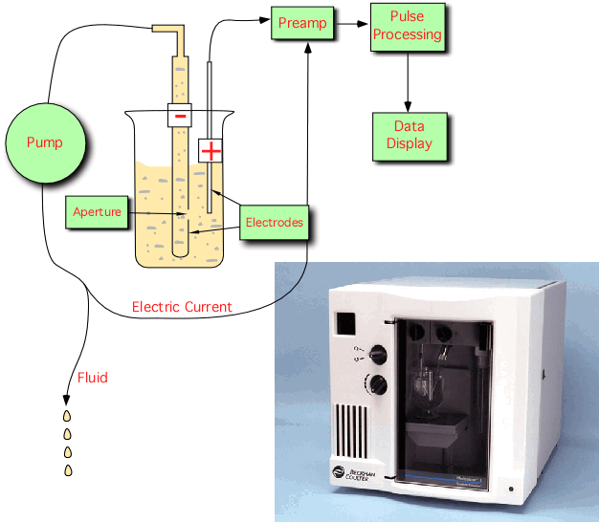
Coulter Counter Principle
In male slides and female doctor said take it as a revision

Slide 15
Coulter Counter Principle
In male slides and female doctor said take it as a revision

Slide 16
PROCEDURE 1: MEASUREMENT OF BLOOD CELL COUNTS BY USING COULTER ANALYZER
Aim : draw blood from a superficial vein in order to analyse the blood for various haematological values using Coulter Analyser .
Tourniquet
4. Activate the Coulter analyzer machine and a probe will move across and down into aspirate position. The aspiration syringe draws 12 µl of whole blood into the probe.
3. Use a disposable syringe to draw 5ml of blood from the vein(Usually from median cubital vein in front of the elbow joint ) then Immediately transfer it to EDTA anti-coagulated tube to prevent blood from clotting.
1. Clean the area of the skin to be pricked .
2. Apply the tourniquet above the elbow joint to impede the flow of venous blood towards the heart for a while.
The probe for the aspiration in step 4

Slide 17
Complete Procedure1
7. Finally all the hematological values are reported and printed
5. The Coulter Analyzer makes the necessary dilutions with the reagents
6 . It accurately counts and measures the sizes of cells by detecting and measuring changes in electrical resistance when a particle (such as cell) in the conductive liquid passes through a small aperture.
As each cell goes through the aperture, it impedes the current and causes a measurable pulse .
height of each pulse →the volume of that cell
Number of pulses signals →Number of particles.
* reagent I : Diluted and used to count RBC.
* reagent II : Lysing RBC and used for counting WBC and Hemoglobin.
For videos click the YouTube icon or https://www.youtube.com/watch?v=1iY4Ufqh1XY

Slide 18
Red Blood Indices (team work 435)
In males slides:
MCV is from 78-98 fl
MCHC is from 32-36
 | Definition | The calculation of Red Blood Indices | Higher than average | Average (normal value) | Lower than average
Mean cell volume (MCV) | The average volume of red blood cell measured in femtoliters (fl) | MCV = $\frac{PCV ×10}{RBC count }$ PCV = packed cell volume | RBC are large in size and they are called Macrocytes. | 77-98 μm3 (fl) | RBC are small in size and they are called Microcytes
Mean cell hemoglobin (MCH) | The average weight of Hb in red blood cells cell measured in picograms (pg). | MCH = $\frac{Hb ×10}{RBC count }$ Hb = hemoglobin concentration | RBCs are Hyperchromic | 27-32 pg | RBCs Are Hypochromic
Mean cell Hb concentration (MCHC) | Concentration of Hb (hemoglobin) per 100 ml of RBC measured in grams/deciliters (g/dl). | MCHC = $\frac{Hb ×100}{PCV}$ PCV = packed cell volume Hb=hemoglobin concentration | - | 30-36 g/dl | Iron deficiency Anemia

Slide 19
Normal values
(35-54 )% | (35 – 47)% | (40 – 54)% | PCV % (percentage from the whole blood )

Slide 20
Type of Anemia
Hemorrhagic Anemia
Aplastic Anemia
Hemolytic Anemia
Nutritional Anemia
Macrocytic Anemia (megaloblastic)
Microcytic Anemia
In male slides and female doctor said take it as a revision

Slide 21
Types of Anemia (نحسب بالمعادلات بالسلايد السابق( رقم 18) ثم نقارن بالقيم الطبيعية سلايد رقم 19 ثم نقارن النتائج بهذا الجدول لمعرفة نوع الأنيميا )
 | Case A | Case B
RBC | Low | Low
HB | Low | Low
PCV | Low | Low
MCV | Low | high
MCH | Low | N/ high
MCHC | Low | N/low
Type of anemia | Microcytic Hypochromic | Macrocytic megaloblastic
Cause | Iron deficiency | Vit B12 or Folic deficiency

Slide 22
Important Terminology
POLYCYTHEMIA:
THROMBOCYTOSIS:
THROMBOCYTOPENIA:
ANAEMIA:
LEUCOCYTOSIS:
LEUCOPENIA:
Increased red blood cell count above normal.
Reduced ability of blood to carry Oxygen due to either decreased red blood cell count and/or haemoglobin concentration.
Increased white blood cell count above normal
Decreased white blood cell count below normal.
Increased platelets count above normal.
Decreased platelets count below normal.

Slide 23
Clinical applications:
Low numbers of RBCs may indicate:
Blood loss:
Anemia (various types).
Hemorrhage.
Bone marrow failure (for example: from radiation, toxin, fibrosis, tumor).
Erythropoietin deficiency (secondary to renal disease).
Hemolysis (RBC destruction).
High numbers of RBCs may indicate:
Low oxygen tension in the blood:(hypoxia)
Congenital heart disease
Cor pulmonale
Pulmonary fibrosis
Polycythemia vera.(increase number of RBC without any cause )
Dehydration (such as : from severe diarrhea).
Renal (kidney) disease with high erythropoietin production.

Slide 24
Low numbers of WBCs (leukopenia) may indicate:
Bone marrow failure (for example: due to infection, tumor or fibrosis).
Presence of cytotoxic substance.
Autoimmune/collagen-vascular diseases (such as : lupus erythematosus).
Disease of the liver or spleen.
Radiation exposure.
High numbers of WBCs (Leucocytosis) may indicate:
Infectious diseases.
Inflammatory disease (such as : rheumatoid arthritis or allergy).
Leukemia.
Severe emotional or physical stress.
Tissue damage (burns).

Slide 25
Low numbers of Platelet (Thrombocytopenia ) may indicate:
A plastic anemia.
Chemotherapy.
High numbers of Platelet (Thrombocytosis)
may indicate:
Chronic myeloid leukemia.

Slide 26
QUESTIONS AND PROBLEMS
1- What is the clinical importance of knowing the red blood cell indices?
2- Discuss briefly the etiological classification of Anemia?
They help to determine the type of anemia a patient is suffering from.
CAUSE | TYPE OF ANEMIA
loss of blood | Hemorrhagic Anaemia
Bone marrow suppression by drugs or radiations etc. | Aplastic Anaemia
Deficiency of Iron, folic acid, Vitamin B12 | Nutritional Anaemias
Increased destruction of RBCs such as sickle cell disease | Hemolytic Anaemia

Slide 27
3- An examination of the blood of 2 adult males (A and B) provided the following data:
SUBJECT “B” | SUBJECT “A”
2.5 X 10⁶ / mm³ | 3.6 X 10⁶ / mm³ | RBC COUNT
8 g/dl | 7.2 g/dl | Hb Concentration
25% | 25% | Packed Cell Volume
A) Calculate MCV, MCH and MCHC for each of these subjects.
SUBJECT “A” | SUBJECT “B”
MCV = 25 x 10 /3.6 = 69.4 fl MCH = 7.2 x 10 / 3.6 = 20 pg MCHC = 7.2 x 100 / 25 = 28.8 g/dl | MCV = 25 x 10 /2.5 = 100 fl MCH = 8 x 10 / 2.5 = 32 pg MCHC = 8 x 100 / 25 = 32 g/dl
B) What are the abnormalities encountered in these men. What are the possible causes of these abnormalities?.
Subject “A” ➔ Microcytic hypochromic anaemia (Iron deficiency anaemia)
Subject “B” ➔ Macrocytic normochromic anaemia (Megaloblastic anaemia or Pernicious anaemia)
Don’t forget to bring your calculator

Slide 28
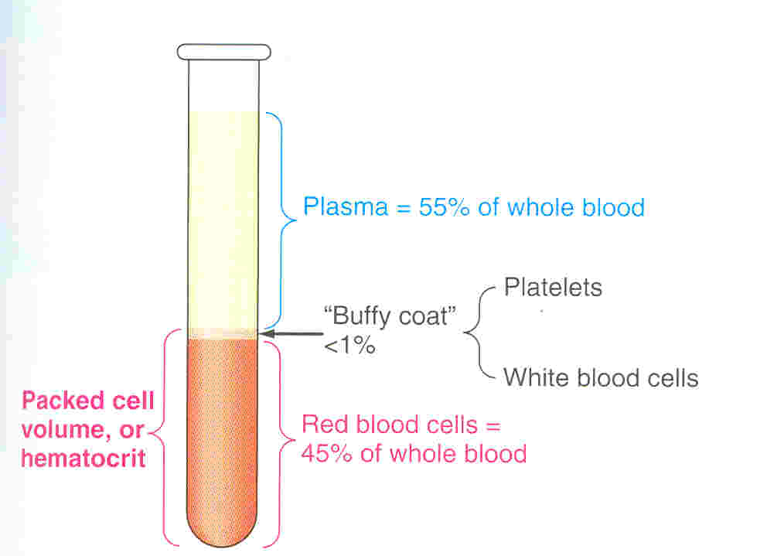
Packed Cell Volume (PCV) or Hematocrit
The ratio of packed blood cells volume to plasma
(packed cell volume : RBC’s)
*Plasma: has anticoagulants. *Serum: Without anticoagulants
Low hematocrit may indicate:
Anemia (various types).
Blood loss (hemorrhage).
Bone marrow failure (for example, due to radiation, toxin, fibrosis, tumor).
Hemolysis( RBC’s destruction )related to transfusion reaction.
Leukemia.
High hematocrit may indicate:
Dehydration
Burns
Diarrhea
Polycythemia Vera.
Low oxygen tension
smoking
congenital heart disease
living at high altitudes

Slide 29
PROCEDURE 2: MEASUREMENT OF HEMATOCRIT/PACKED CELL VOLUME (PCV):
Aim : draw blood from capillaries in order to measure Hematocrit (PCV) using micro-hematocrit reader.
3. Discard the first drop of blood, because it is mixed with tissue fluid
2. Prick the skin using the pen lancet.
1. Clean the area of the skin of a finger-tip or an ear lobe with a sterilized alcohol swab.
4. Allow the second drop of blood to be formed until it become large enough to fill 75% of the heparinized capillary tube (heparin inside the tube) by the capillary action when it is brought closer to the blood.
5. Apply only gentle pressure beneath the pricked skin to help the flow of blood, because if more pronounced pressure is exerted, blood is likely to be diluted with interstitial fluid.

Slide 30
Complete Procedure2
6. Put all the capillary blood samples in a centrifuge machine for 5 minutes at the speed of 3000-4000 RPM to separate plasma from cells.
5.Seal one end of the capillary tube with plasticine((صلصال. (you should have several capillaries )
8. The packed cell volume or Hematocrit can then be determined as a percentage of the total volume using Hematocrit reader.
7. Once centrifuged, take one of the capillary blood samples to see the cells have been packed at the bottom of the tube and the light-weight clear plasma visible above the cells.
plasma

Slide 31
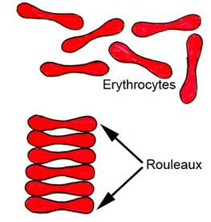
Erythrocyte Sedimentation Rate (ESR) (سرعة الترسيب )
Is the rate at which red blood cells sediment in a period of 1 hour.
non-specific measure of inflammation.
RBC Sedimentation :
Is controlled by the balance between plasma protein (fibrinogen), and the negative charge of the erythrocytes.
In inflammatory, the high fibrinogen level causes RBCs to stick to each other to form stacks (rouleaux), which settle faster.

Slide 32
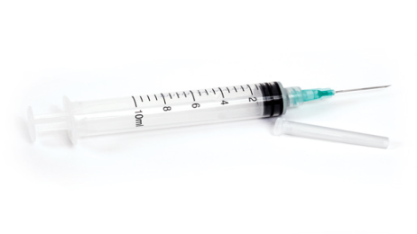
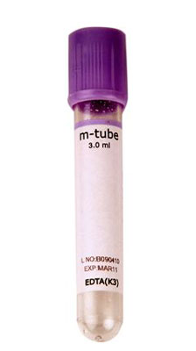
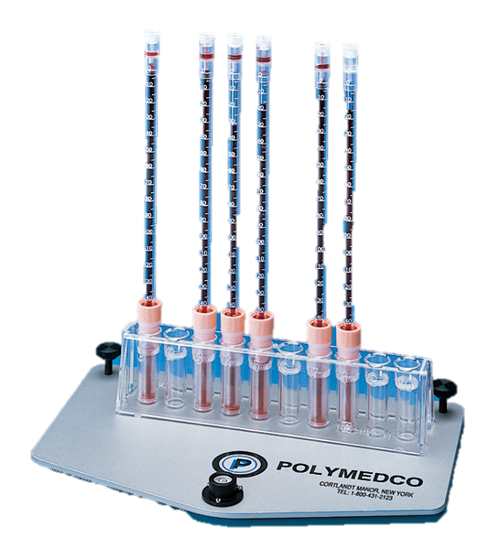
PROCEDURE 3: ERYTHROCYTE SEDIMENTATION RATE (E.S.R.) equipment
DISPOSABLE STERILE SYRINGES AND NEEDLES
1- Using a sterile syringe, draw 1.6 ml of blood from a suitable vein
WESTERGREN’S SEDIMENTATION APPARATUS
3- Fill the Westergren’s tube with blood up to the zero mark.
4- Place the tube upright in the stand and leave it undisturbed like this for one hour.
ANTICOAGULANT EDTA TUBE
2- Transfer the blood to a test tube containing EDTA to prevent clotting.
5- Note down the height of the column of clear plasma at the top of red blood cells in the tube after one hour then we take notes after the 2nd our . This will be E.S.R. reading
Normally the value of E.S.R. ranges from (0-7)mm and it is slightly higher in females than males due to : less number of red blood cells.
3 Materials

Slide 33
ESR Results
In males slides normal range is from 0-7 mm
Normal ESR range :
Male → 3-7mm\1st hour , 7-15 mm\2nd hour
Female → slightly higher than 7 mm due to less RBC
Moderately elevated ESR occurs :
Infections
Inflammation
Anemia
Malignancies
Pregnancy
old age.
A very high ESR associated with :
multiple myeloma
polymyalgia Rheumatic
temporal arteritis

Slide 34
Clinical application of ESR
Nonspecific test.
Prognostic not diagnostic.
Monitor disease activity and response to therapy.
ESR is : a nonspecific marker of inflammation and is affected by other factors .
ESR results must be used along with other clinical findings.

Slide 35
C-reactive protein & ESR
C-reactive protein is an acute phase protien produced by the liver during an inflammatory reaction.
Since C-reactive protein levels in the blood rise more quickly after the inflammatory or infective process begins, ESR is often replaced with C-reactive protein measurement.

Slide 36
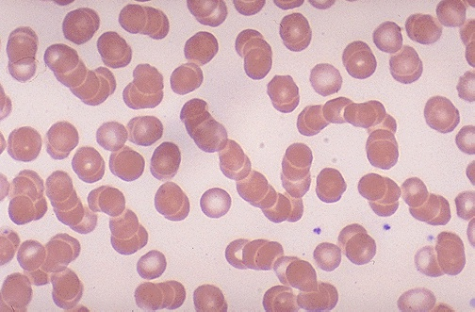
Question & problem
4- What is meant by rouleaux formation?
6- What is the clinical significance of E.S.R.?
7- What conditions are associated with an increased E.S.R.?
5- Why does rapid rouleaux formation increase the E.S.R.?
Rouleaux formation becomes rapid when plasma protein concentration is high and because of this E.S.R. also becomes increased.
When red blood cells are stacked together in long chains because of their biconcave disc like surfaces sticking to each other, it is called Rouleaux formation.
This is a non-specific indicator of presence of a disease.
This is a useful prognostic tool.
Infections
Connective tissue disorders
Inflammatory disorders
Malignancies
Anaemia
Pregnancy

Slide 37
Thank you!
The Physiology 436 Team:
Ruba Ali
Dorrah alhamdi
Nasser abu dujeen
Team Leaders:
Qaiss Almuhaideb
Lina Alwakeel
Don’t forget to bring your calculator
Contact us:
Physiology436@gmail.com
@Physiology436

