Slide 1
Blood Groups Clotting Time and Bleeding Time
This slides contain both (Slides + Handout)
Procedures in the slide and handout are the same .Therefore ,we put it as one procedure
Red: very important.
Green: only found in males’ slides.
Purple: only found in females’ slides.
Gray: notes.
Physiology practical Team 436 – Foundation block (lecture 3)
{يامالك الملك وكلناك أمرنا واستودعناك همومنا فبشرنا بما يفتح مداخل السعادة إلى قلوبنا }

Slide 2
Objectives
1.Understand and practice the method used in determining blood groups (ABO and Rhesus (Rh) systems).
2.Determine your own Bleeding and clotting time
3.Recognize the importance of bleeding time and clotting time in haemostasis.
Objectives

Slide 3
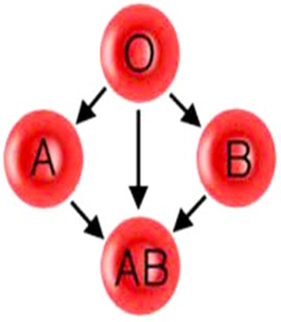
Blood Groups and Rhesus system
Objectives :
1-Under stand and practice the method used in determining blood groups (ABO and Rhesus (Rh) system )
Antigen is what makes these blood types different ; they’re the cells identification tag
ABO System | Antigen | Antibody | Percentages (male’s slide)
Group A | Antigen A on RBCs membrane | Anti B in Blood plasma | 40%
Group B | Antigen B on RBCs membrane | Anti A in blood plasma | 11%
Group AB | Antigen A & B on RBCs membrane | No antibody in blood plasma | 4%
Group O | No Antigen on RBCs membrane | Both Anti A and Anti B in blood plasma | 45%
Rhesus system (Rh) | Antigen | Notes
Rh positive (Rh+ve) | Antigen D on RBCs membrane | (96-98%) more dominant
Rh negative (Rh-ve) | No Antigen on RBCs membrane | (2-4%)
Important note: Percentages are approximated (not exact)

Slide 4
Rh “D” Antigen (males slides)
Of next importance is the Rh type.
Term “Rh” is a misnomer.
Rh is a blood group system with many antigens, one of which is “D”.
Rh refers to the presence or absence of the D antigen on the red blood cell.
The D antigen is immunogenic, i.e. individuals exposed to it will very likely make an antibody to it. For this reason all individuals are typed for D, if negative must receive Rh (D) negative blood. If they didn’t receive negative blood (were exposure to the antigen )the result will be : presence of the antibody to the “D” antigen
The most important patient population to consider is : females of child-bearing age.
Which we will describe later

Slide 5
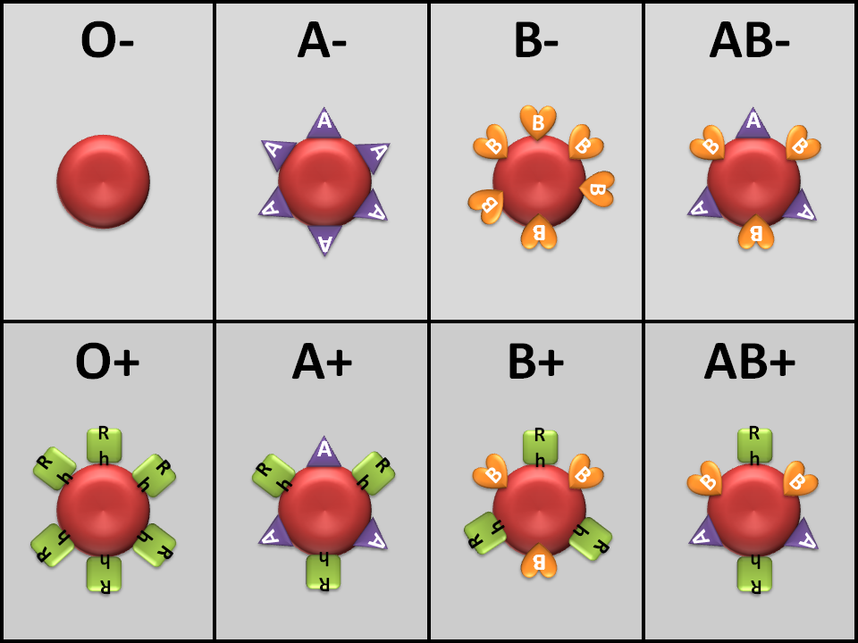
Blood Groups Antigens
Objectives :
1-Under stand and practice the method used in determining blood groups (ABO and Rhesus (Rh) system )
Picture.

Slide 6
Procedure 1 Material
Objectives : (من الملزمة)
1- Understand and practice the method used in determining blood groups
HIGH TITER: ANTI-A , ANTI-B AND ANTI-D SERA
A MICROSCOPE
TOOTH PICKS
MICROSCOPE SLIDES
ALCOHOL SWAB
1. LANCET or
2. GREASE PENCIL or
3. PRICKER
Titer : Anti-A : اللي لونه أزرق , Anti-B : اللي لونه أصفر, Anti-D : اللي لونه شفاف وعليه ورقة بيضاء

Slide 7
Procedure 1
Objectives : (من الملزمة)
1- Understand and practice the method used in determining blood groups
1- Take 3 microscope slides and label them clearly as “A”, “B” and “D”.
2- Prick the finger after sterilizing with alcohol swab using a lancet and place one drop of blood in each of the 3 microscope slides.
4- Stir the mixture on each slide with the help of different pieces of tooth picks for a minute or two.
5- Examine the mixtures carefully for the signs of red blood cell agglutination. When agglutination happened , (they have a speckled or peppered appearance. If there is a doubt, examine the slides using the low power of a microscope
3- Quickly add a drop of anti-A, anti-B and anti-D sera to slides labeled as “A”, “B” and “D” respectively
= B+
Agglutination : red blood cells clump together (كأنه مرشوش عليه فلفل ☺ (

Slide 8
Interpretation of Slide Typing Testing with Anti-A Anti-Serum and Anti-B Anti-Serum
If an RBC contains the “A” antigen the red blood cells will be agglutinated by anti-A, (a positive reaction).
If an RBC contains the “B” antigen the red blood cells will be agglutinated by anti-B, (a positive reaction).
If an RBC does not have the A antigen there will be no clumping, (a negative reaction).
If an RBC does not have the B antigen there will be no clumping by anti-B, (a negative reaction).

Slide 9
Result
Objectives : (من الملزمة)
1- Understand and practice the method used in determining blood groups
Picture from the slide
More explanation

Slide 10
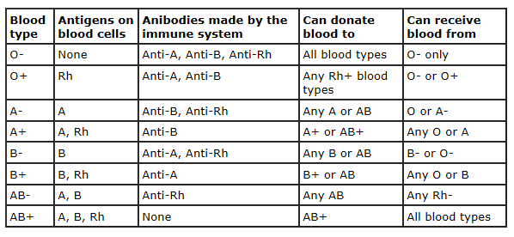
Blood Groups
Objectives :
1-Under stand and practice the method used in determining blood groups (ABO and Rhesus (Rh) system )
Objective :
Under stand and practice the method used in determining blood groups (ABO and Rhesus (Rh) system )
O- : universal donor
AB + : universal receiver

Slide 11
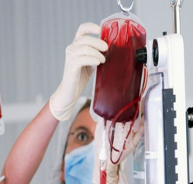
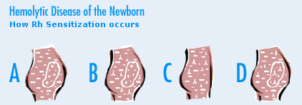
Clinical Applications
Objectives :
1-Under stand and practice the method used in determining blood groups (ABO and Rhesus (Rh) system )
Objective :
Under stand and practice the method used in determining blood groups (ABO and Rhesus (Rh) system )
Important in the following condition :
Hemolytic disease of the new born (HDN)
(Erythroblastosis Fetal)
Blood transfusion
Blood product
HDN
It is a blood disorder in a fetus or newborn infant.
HDN may develop when a mother and her unborn baby have different blood types (called "incompatibility").
Mother produces antibodies to Rh (D) antigen. after the labor because the mother’s blood will be mixed with baby’s blood ,
So the Antibody will attack the developing baby's red blood cells (2nd baby with Rh+ )
This is why Rh negative women are given (Rhogam) after birth of Rh positive baby (After 1st baby)
Mother is Rh- father is Rh+ (Rh+ is more dominant ): baby is RH+
1st baby
D antibody
2nd baby attacked by antibodies

Slide 12
Question & problem(من الملزمة)
1.What are the agglutinogens and agglutinins found in people with different blood groups in ABO system?
2.How the different blood groups can donate or receive blood among them during blood transfusion?
Blood Group | Can give blood to | Can receive blood from
AB ⁺ | AB⁺ | All blood groups
AB ⁻ | AB⁻, AB⁺ | AB⁻, A⁻, B⁻, 0⁻
A⁺ | A⁺, AB⁺ | A⁺, A⁻, 0⁺, 0⁻
A ⁻ | A⁻, A⁺, AB⁻, AB⁺ | A⁻, 0⁻
B⁺ | B⁺, AB⁺ | B⁺, B⁻, 0⁺, 0⁻
B⁻ | B⁻, B⁺, AB⁻, AB⁺ | B⁻, 0⁻
O⁺ | 0⁺, A⁺, B⁺, AB⁺ | 0⁺, 0⁻
O ⁻ | All blood groups | 0⁻
Agglutinns | Agglutinogens | Blood group
Anti – B antibodies | A | A
Anti – A antibodies | B | B
No antibody | A , B | AB
Both Anti-A & Anti-B antibody | No Antigen | O

Slide 13
Question & problem(من الملزمة )
3.What other blood group systems do exist other than classical ABO and Rh groups systems?
4. What is the distribution of the ABO and Rh blood groups in Saudi Arabia?
More than 30 blood group systems have been identified other than classical ABO and Rh groups such as MNS system, Kell System, Lewis System etc.
48% | O+
24% | A+
17% | B+
4% | AB+
4% | O-
2% | A-
1% | B-
0.23% | AB-
From this table, we can easily conclude that about 93 % of Saudi population is Rh +ve and only about 7% is Rh –ve. The most common blood group in ABO system is O, followed by A, then B and the least common is AB among Saudis.

Slide 14
Question & problem(من الملزمة )
5. How does this distribution differ from that found in rest of the world?
6.What is the most common incompatibility ?
7.Under what circumstances can Rh incompatibility develop and how?
Almost the same distribution is seen in Europe and America as in Saudi Arabia. The blood group “B” is more prevalent than blood group “A” in some Asian countries
The most common form of HDN is ABO incompatibility, which is usually not very severe. The least common form is Rh incompatibility, which can almost always be prevented. When this form does occur, it can cause very severe anemia in the baby.
Rh incompatibility is a condition that develops when a pregnant woman has Rh-negative blood and the baby in her womb has Rh-positive blood inherited from the Rh-positive father(because Rh+ is more dominant).
During pregnancy, red blood cells from the unborn baby can cross into the mother's bloodstream during labour . Because the mother is Rh-negative, her immune system treats Rh-positive fetal cells as if they were a foreign substance and makes antibodies against the fetal blood cells. These anti-Rh antibodies may cross back through the placenta into the developing baby and destroy the baby's circulating red blood cells. When red blood cells are broken down, they make bilirubin. This causes an infant to become jaundiced. Because it takes time for the mother to develop antibodies, firstborn infants are often not affected unless the mother had past miscarriages or abortions that sensitized her immune system. However, all children she has afterwards who are also Rh-positive may be affected.
الخلاصة للفقرة الثانية :
إذا كانت الأم + والطفل – فهذا يؤدي إلى تكوين أجسام مضادة (Antibody)أول طفل يكون سليم (لان التكوين ياخذ وقت) ولكن ثاني طفل بتكون حياته بخطر لأن الأجسام المضادة بتبدأ تهاجم خلايا دم االطفل الحمراء واللي ممكن يؤدي إلى أمراض زي jaundice

Slide 15
Question & problem(من الملزمة )
8.How it is treated ?
9.How it is prevented ?
Infants with mild Rh incompatibility may be treated with:
Drugs used to treat allergic reactions (antihistamines)
Drugs used to treat swelling and allergies (steroids)
Feeding and fluids (hydration)
Fluids given through a vein (intravenously)
Light therapy using bilirubin lights
Medicines to raise blood pressure if it drops too low
Infants with severe Rh incompatibility may be treated with exchange transfusion after birth or intrauterine transfusion before birth.(من داخل الرحم )
Special immune globulins, called RhoGAM (anti-D antibodies), are used to prevent RH incompatibility in mothers who are Rh-negative. If the father of the infant is Rh-positive or if his blood type cannot be confirmed, the mother is given an injection of RhoGAM during the second trimester. If the baby is Rh-positive, the mother will get a second injection within a few days after delivery.
These injections prevent the development of antibodies against Rh-positive blood.

Slide 16
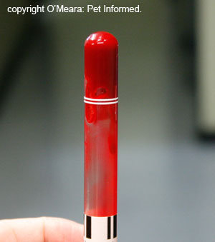
Clotting Time
Objectives :
2-Determine your own Bleeding and clotting time.
It is : The time required for blood to form a clot.
The normal coagulation time in glass tubes is : (5-15 )minutes.
The whole blood clotting time is a rough measure of all intrinsic clotting factors in the absence of tissue factors.
Used : in diagnosis of hemophilia.
Its chief application is : in monitoring anti-coagulant therapy.
(males slides)
Prolong clotting time seen in deficiencies in the intrinsic coagulation pathway.
Example:
hemophilia due to deficiency of Factor VIII (8).

Slide 17
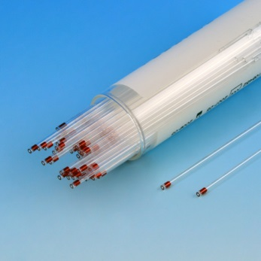
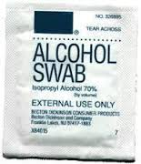
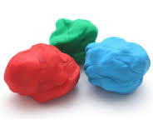
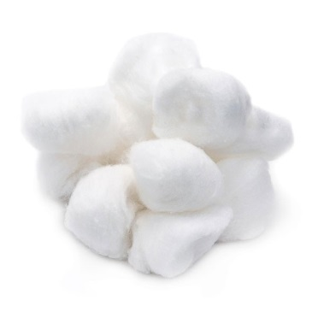
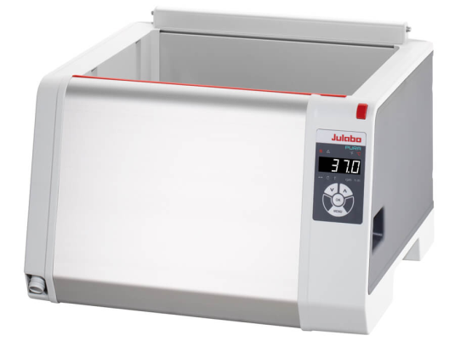
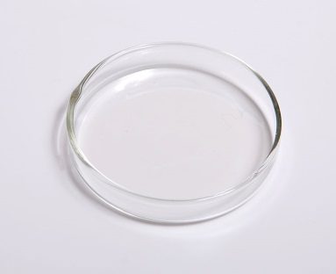
Procedure 2 material
Objectives :
2-Determine your own Bleeding and clotting time.
Capillary tubes of uniform size ( non heparinized) (مادة تمنع تجلط الدم )
Plasticine.(صلصال)
Cotton wool.
Alcohol swabs.
A petri-dish.
A water bath set at 37°C.

Slide 18
Procedure 2
Objectives : (من الملزمة )
2-Discuss the normal ranges of bleeding time and clotting time and determine their own values experimentally
1. Prick a finger of the subject observing the usual precautions and note the time at which the prick is made.
(لأنها تكون مختلطة بالأنسجة ) 2. Wipe away the first drop of blood.
5. Place this capillary tube in the water bath and repeat all the above steps with many capillary tubes.
6. Two minutes after making the prick, break a capillary tube and separate the two halves slowly and look for a continuous thread like clot between the two broken halves of the tube.
7. Repeat step 6 at 30 seconds interval with the remaining tubes until you see a thread-like clot between the broken halves of one of the capillary tubes.
8. Note the time. The time from pricking the finger to the appearance of the clot is the clotting time
3. Then while the blood is still freely flowing, place one end of the capillary tube on it and let the tube fill , holding the tube horizontally let it fill by capillary action.
4. Close both ends of this filled capillary tube with the plasticine.
To see the clotting time Procedure:
https://www.youtube.com/watch?v=71GNTwUuaNI ( from 1.14 – 1.50)
https://www.youtube.com/watch?v=G2RfE8rCYSw

Slide 19
Result:
Objectives : (من الملزمة )
2-Discuss the normal ranges of bleeding time and clotting time and determine their own values experimentally
Usually the clotting time measured by this method is in the range 2-7 minutes.
Prolong clotting time seen in deficiencies in the intrinsic coagulation pathway.
Example:
hemophilia due to deficiency of Factor VIII (8).

Slide 20
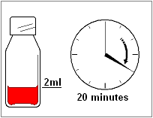
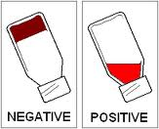
Clotting Time using Test Tube Method (THIS PRUCEDURE IS ONLY IN THE SLIDE) :
Objectives :
2-Determine your own Bleeding and clotting time.
Place 2 ml blood into non heparinized test tube incubated in water bath.
Every 30 second invert gentle to check for clot formation.
Time from pricking finger to clot formation is clotting time.
Normally 6-10 min by this method
Measurement of the clotting factors are better used
Clot formed
No Clotting
To see it in video : https://www.youtube.com/watch?v=719GNTwUuaNI (From 1:50 – 3:15)

Slide 21
Question & problem(من الملزمة )
1. What is the normal range of clotting time?
4.What is the clinical significance of the clotting time?
5.What is the source of heparin in the body?
2. What are the clinical conditions in which the clotting time is greater than normal?
3. Name the substances which are used as anti-coagulants
2-7minutes
Hemophilia
Heparin
Warfarin
Calcium Oxalate
Before surgery
Diagnosis of bleeding disorders
Mast cells
Basophils
Sodium Citrate
EDTA (Ethylene Diamine Tetra-butyric Acid)
Liver
Lungs

Slide 22
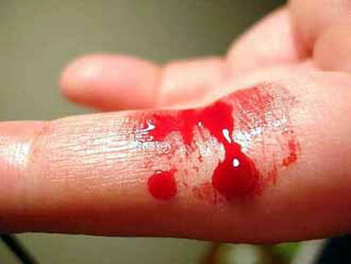
Bleeding Time
Objectives :
3-Recognize the importance of bleeding time and clotting time in hemostasis
The time taking for bleeding to stop (time for a platelet plug to form).
Bleeding time is a test of platelet function.
The template bleeding time is used when the test is performed by standard template method.

Slide 23
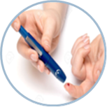
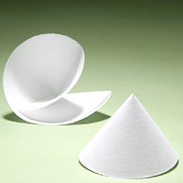
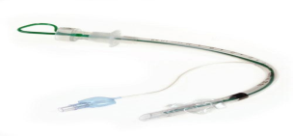
Procedure 3
Objectives (من الملزمة ):
3-Recognize the importance of bleeding time and clotting time in haemostasis
Material
Procedure
1. Prick a finger /lobe of ear of the subject observing after sterilizing it with alcohol swab .
2. the usual precautions and note the time at which the prick is made. (The pricked skin should not be touched until the experiment is over.)
3. Apply a piece of filter paper (blotting paper) to the emerging drop of blood from the pricked skin every 30 seconds until the bleeding stops
4. Note the time when the bleeding stops. The time from pricking the finger to the stop of bleeding is the bleeding time .
5. The bleeding time estimated by this method of a normal subject is within 2-5 minutes
Alcohol swab
Filter paper
Stop watch
التجربة في السلايد
التجربة في الملزمة
stylette : to prick an ear lobe
To see it in video:
https://www.youtube.com/watch?v=SvlpFUeFoXg
Lancet : to prick a finger
ملاحظة : التجربة في الملزمة والسلايد تحتوي نفس الخطوات ولكن في السلايد يتم إجرائها على الأذن وفي الملزمة يتم اجرائها على الإصبع

Slide 24
Question & problem(من الملزمة )
What is the normal range of bleeding time?
Which blood cells deficiency may prolong the bleeding time?
Name one condition in which bleeding time is prolonged (increased)?
2 – 7 minutes
Platelets
Thrombocytopenia

Slide 25
The Standardized Template Method
A sphygmomanometer cuff is applied to the subject’s arm and inflated to 40mmHg.
Normal bleeding times determined with this method are in the range 2.5-9.5 minutes.
- Stop the procedure. - Apply pressure to stop the bleeding. - Report as greater than 15 min.
The volar surface is cleaned with 70% alcohol.
A sterile metal template with a linear slit (11mm long) is pressed firmly against the skin.
A scalpel blade, with a guard, is carefully introduced so that it protrudes 1mm through the template slit. An incision, 1mm deep and 9mm long can then be made.
Blood is gently, but completely removed with filter paper at 15 second intervals until the bleeding stops.
Notes :
If the bleeding time exceeds 15 minutes :

Slide 26
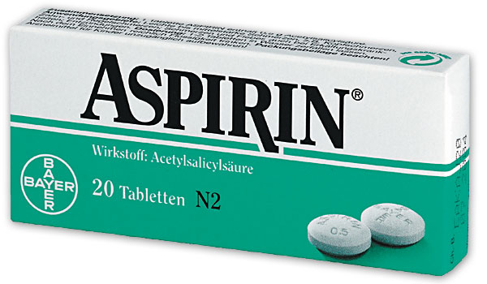
Clinical Application
Bleeding time is prolonged (hemophilia ) because of the following conditions:
Platelet dysfunction.
Blood vessel wall disorders.
Von Willebrand Disease.
Thrombocytopenia.
Vitamin K deficiency.
Medications such as : Aspirin.

Slide 27
Important notes
The presence of D-Antibody needs a previous exposure (no problem at the first blood transfusion)
The blood needs more time to clot in the tube in comparison to the blood inside the body circulation because the tissue factor is missing in the tube

Slide 28
Thank you!
The Physiology 436 Team:
Ruba Ali
Dorrah alhamdi
Ibrahim Al Deeri
Nasser Abu Dujeen
Hassan al Shammari
Team Leaders:
Qaiss Almuhaideb
Lina Alwakeel
Contact us:
Physiology436@gmail.com
@Physiology436

