Slide 1
PHYSIOLOGY PRACTICAL REVISION
The exam is more likely to be short answers questions, no experiments will be performed.
• you’re going to need them for simple calculations of red blood indices(MCV,MCH,MCHC), which are important to know different types of anemia. Remember their units.
Understanding blood groups is very important. • Remember the normal values and the related clinical conditions.
identify WBCs under the microscope, identify their function.
This revision is not sufficiently enough, you have to read the teamwork’s lectures or the handouts.
Don’t forget to bring your calculator
Red : important
Green: only found in males’ slides.
Purple: only found in females’ slides.
Gray: notes.
Qaiss Almuhaideb
Lina alwakeel
Ruba Ali
Dorrah alhamdi
Nasser Abu Dujeen
Hassan Al Shammari

Slide 2
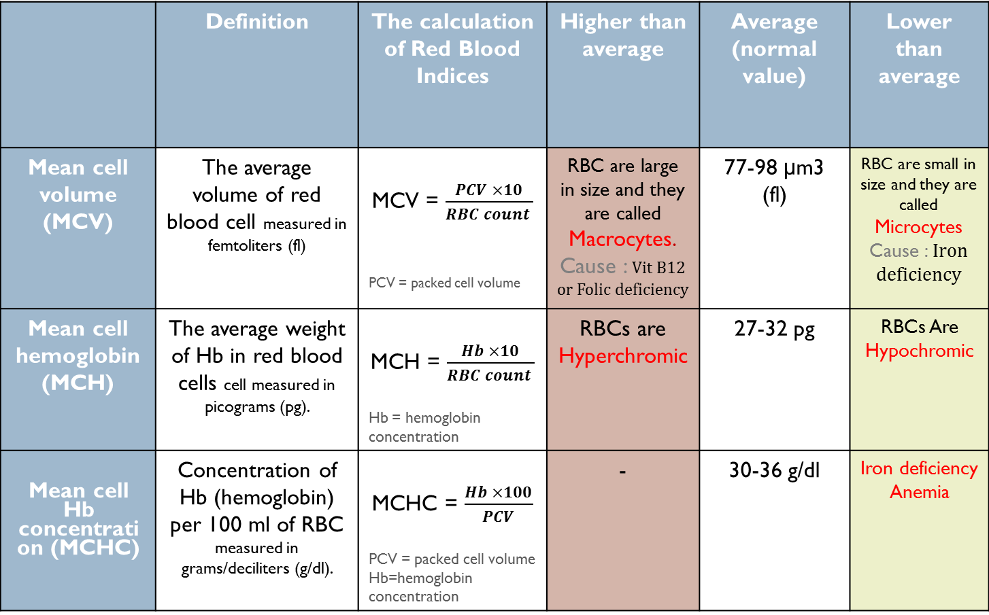
Red Blood Indices (team work 435)
من كلام الدكاترة ان شاء الله بتجي معادلة تحلوها وتقارنوها مع النتائج الطبيعية وتحددوا نوع الانيميا
In males slides:
MCV is from 78-98 fl
MCHC is from 32-36
 | Definition | The calculation of Red Blood Indices | Higher than average | Average (normal value) | Lower than average
Mean cell volume (MCV) | The average volume of red blood cell measured in femtoliters (fl) | MCV = $\frac{PCV ×10}{RBC count }$ PCV = packed cell volume | RBC are large in size and they are called Macrocytes. Cause : Vit B12 or Folic deficiency | 77-98 μm3 (fl) | RBC are small in size and they are called Microcytes Cause : Iron deficiency
Mean cell hemoglobin (MCH) | The average weight of Hb in red blood cells cell measured in picograms (pg). | MCH = $\frac{Hb ×10}{RBC count }$ Hb = hemoglobin concentration | RBCs are Hyperchromic | 27-32 pg | RBCs Are Hypochromic
Mean cell Hb concentration (MCHC) | Concentration of Hb (hemoglobin) per 100 ml of RBC measured in grams/deciliters (g/dl). | MCHC = $\frac{Hb ×100}{PCV}$ PCV = packed cell volume Hb=hemoglobin concentration | - | 30-36 g/dl | Iron deficiency Anemia

Slide 3
Example : An examination of the blood of 2 adult males (A and B) provided the following data:
SUBJECT “B” | SUBJECT “A”
2.5 X 10⁶ / mm³ | 3.6 X 10⁶ / mm³ | RBC COUNT
8 g/dl | 7.2 g/dl | Hb Concentration
25% | 25% | Packed Cell Volume
A) Calculate MCV, MCH and MCHC for each of these subjects.
SUBJECT “A” | SUBJECT “B”
MCV = 25 x 10 /3.6 = 69.4 fl MCH = 7.2 x 10 / 3.6 = 20 pg MCHC = 7.2 x 100 / 25 = 28.8 g/dl | MCV = 25 x 10 /2.5 = 100 fl MCH = 8 x 10 / 2.5 = 32 pg MCHC = 8 x 100 / 25 = 32 g/dl
B) What are the abnormalities encountered in these men. What are the possible causes of these abnormalities?.
Subject “A” ➔ Microcytic hypochromic anaemia (Iron deficiency anaemia)
Subject “B” ➔ Macrocytic normochromic anaemia (Megaloblastic anaemia or Pernicious anaemia)
Don’t forget to bring your calculator

Slide 4
Normal value + Clinical applications:
Low number | High number
Blood loss : due to : Anemia or Hemorrhage. Bone marrow failure (exp: from radiation, toxin, fibrosis, tumor). Erythropoietin deficiency (secondary to renal disease). Hemolysis (RBC destruction). ANAEMIA : Reduced ability of blood to carry Oxygen due to either decreased red blood cell count and/or haemoglobin concentration. | Low oxygen tension in the blood:(hypoxia) Congenital heart disease Cor pulmonale Pulmonary fibrosis Dehydration (as : severe diarrhea). Renal (kidney) disease with high erythropoietin production. POLYCYTHEMIA: increase in RBCs no | RBCs Normal value : 4.7-5.6x 10^6/μl
called : Leukopenia may indicate Bone marrow failure (exp: due to infection, tumor or fibrosis). Presence of cytotoxic substance. Autoimmune/collagen-vascular diseases (as : lupus erythematosus). Disease of the liver or spleen. Radiation exposure. | Called : Leukocytosis may indicate : Infectious diseases. Inflammatory disease (as : rheumatoid arthritis or allergy). Leukemia. Severe emotional or physical stress. Tissue damage (burns). | LeukocyteNormal value : 4-11x 10^3/μl
Called : Thrombocytopenia may indicate : A plastic anemia. Chemotherapy. | Called : Thrombocytosis may indicate Chronic myeloid leukemia. | Platelets Normal value : 150-400x 10^3/μl
Anemia (various types). Blood loss (hemorrhage). Bone marrow failure due to radiation, toxin, fibrosis, tumor). Hemolysis( RBC’s destruction)related to transfusion reaction. Leukemia. | Dehydration : due to : Burns , Diarrhea Polycythemia Vera. Low oxygen tension due to : smoking , congenital heart disease, living at high altitudes | Packed Cell Volume (PCV) or Hematocrit (35-54)%
HB normal value : 13-18g/dl
PCV : The ratio of packed blood cells volume to plasma (ratio of RBC’s to plasma )
*Plasma: has anticoagulants. *Serum: Without anticoagulants

Slide 5
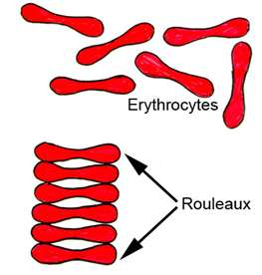
Erythrocyte Sedimentation Rate (ESR) (سرعة الترسيب )
ESR: Is the rate at which red blood cells sediment in a period of 1 hour.
It is controlled by the balance between plasma protein (fibrinogen), and the negative charge of the erythrocytes.
Normal ESR range : Male → 3-5mm\1st hour , 7-15 mm\2nd hour
Female → slightly higher than 7 mm due to less RBC
Moderately elevated ESR occurs :
Infections, Inflammation , Anemia , Malignancies , Pregnancy , old age.
A very high ESR associated with :
multiple myeloma , polymyalgia Rheumatic , temporal arteritis
Clinical application of ESR :
C-reactive protein & ESR
Nonspecific test : a nonspecific marker of inflammation and is affected by other factors
Prognostic not diagnostic.
Monitor disease activity and response to therapy.
ESR results must be used along with other clinical findings.
C-reactive protein is an acute phase protien produced by the liver during an inflammatory reaction.
Since C-reactive protein levels in the blood rise more quickly after the inflammatory or infective process begins, ESR is often replaced with C-reactive protein measurement.

Slide 6
QUESTIONS AND PROBLEMS
1- What is the clinical importance of knowing the red blood cell indices?
2- Discuss briefly the etiological classification of Anemia?
They help to determine the type of anemia a patient is suffering from.
CAUSE | TYPES OF ANEMIA
Loss of blood | Hemorrhagic Anemia
Bone marrow suppression by drugs or radiations etc. | Aplastic Anemia
Increased destruction of RBCs such as sickle cell disease | Hemolytic Anemia
Megaloblastic anemia : Deficiency of folic acid, Vitamin B12 | Macrocytic normochromic anemia
Pernicious anemia : Malabsorption of Vit 12 due to lacking of intrinsic factor in the stomach
Deficiency of Iron | Microcytic Hypochromic anemia
Thalassemia | Microcytic Hypochromic non-nutritional anemia
Nutritional Anemia
3- What is meant by rouleaux formation?
4- Why does rapid rouleaux formation increase the E.S.R.?
Rouleaux formation becomes rapid when plasma protein concentration is high and because of this E.S.R. also becomes increased.
When red blood cells are stacked together in long chains because of their biconcave disc like surfaces sticking to each other, it is called Rouleaux formation.

Slide 7
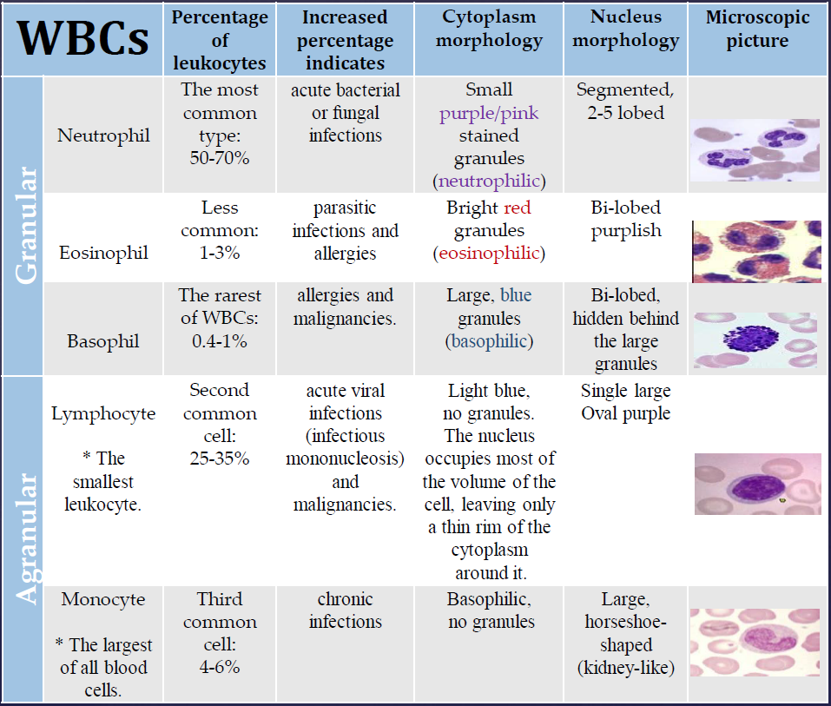
WBC
Never Let Monkey Eat Banana
Neutrophil , Lymphocyte , Monocyte , Eosinophil , Basophil
Most common → less common
Differential Leukocyte Count (DLC) ?
a routine test in hospitals which determine the percentage of each type of white blood cells in the total leucocyte population.
granules contain Heparin (an anticoagulant).
and Histamine, which increases the permeability of capillary walls.
Stains are used:
Leishman’s stain
Wright’s stain
The diagram above from 435

Slide 8
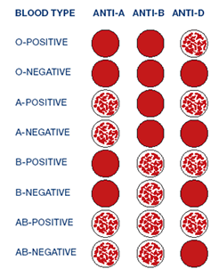
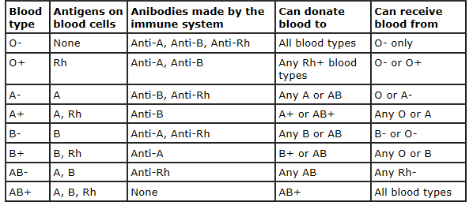
Blood Groups and Rhesus system
Antigen is what makes these blood types different ; they’re the cells identification tag
Rh is misnomer and it refers to the presence or absence of the D antigen on the red blood cell there is D (+) , No D (-)
O- : universal donor
AB + : universal receiver
Agglutination : Ag A + Anti A = positive reaction
Agglutination : Ag B + Anti B = positive reaction
No clumping : no ag A /B = negative reaction
The most common form is ABO incompatibility, which is usually not very severe.
The least common form is Rh incompatibility
O+ is the most common in Saudi Arabia AB- least common in Saudi Arabia

Slide 9
Clinical Applications
Hemolytic disease of the new born (HDN)
(Erythroblastosis Fetal)
Blood transfusion
Blood product
Important in the following condition :
Bleeding Time | Clotting Time
It is The time taking for bleeding to stop (time for a platelet plug to form). | It is rough measure of all intrinsic clotting factors (monitoring anti-coagulant therapy)
2-5min (some says 2-7) | Time : 2-7 in glass tube : 5-15
HDN
It is a blood disorder in a fetus or newborn infant when a mother and her unborn baby have different blood types (called "incompatibility").
Mother produces antibodies to Rh (D) antigen. after the labor because the mother’s blood will be mixed with baby’s blood ,
So the Antibody will attack the developing baby's red blood cells (2nd baby with Rh+ )
Prevention : mother is given (Rhogam) anti-D antibodies after birth of Rh positive baby (After 1st baby)
Treatment of baby with incompatibility :
Mild : Drugs used to treat allergic reactions (antihistamines)
Drugs used to treat swelling and allergies (steroids)
Feeding and fluids (hydration)
Fluids given through a vein (intravenously)
Light therapy using bilirubin lights
Medicines to raise blood pressure if it drops too low
Sever : exchange transfusion after birth or intrauterine transfusion before birth
Clotting time is used in :
Used : in diagnosis of hemophilia.
Clinical significance of the clotting time: Before surgery , Diagnosis of bleeding disorders
prolong the bleeding time: due to
Platelet dysfunction.
Blood vessel wall disorders.
Von Willebrand Disease.
Thrombocytopenia.
Vitamin K deficiency.
Medications such as : Aspirin.
Mother is Rh- father is Rh+ (Rh+ is more dominant ): baby is RH+

