Slide 1
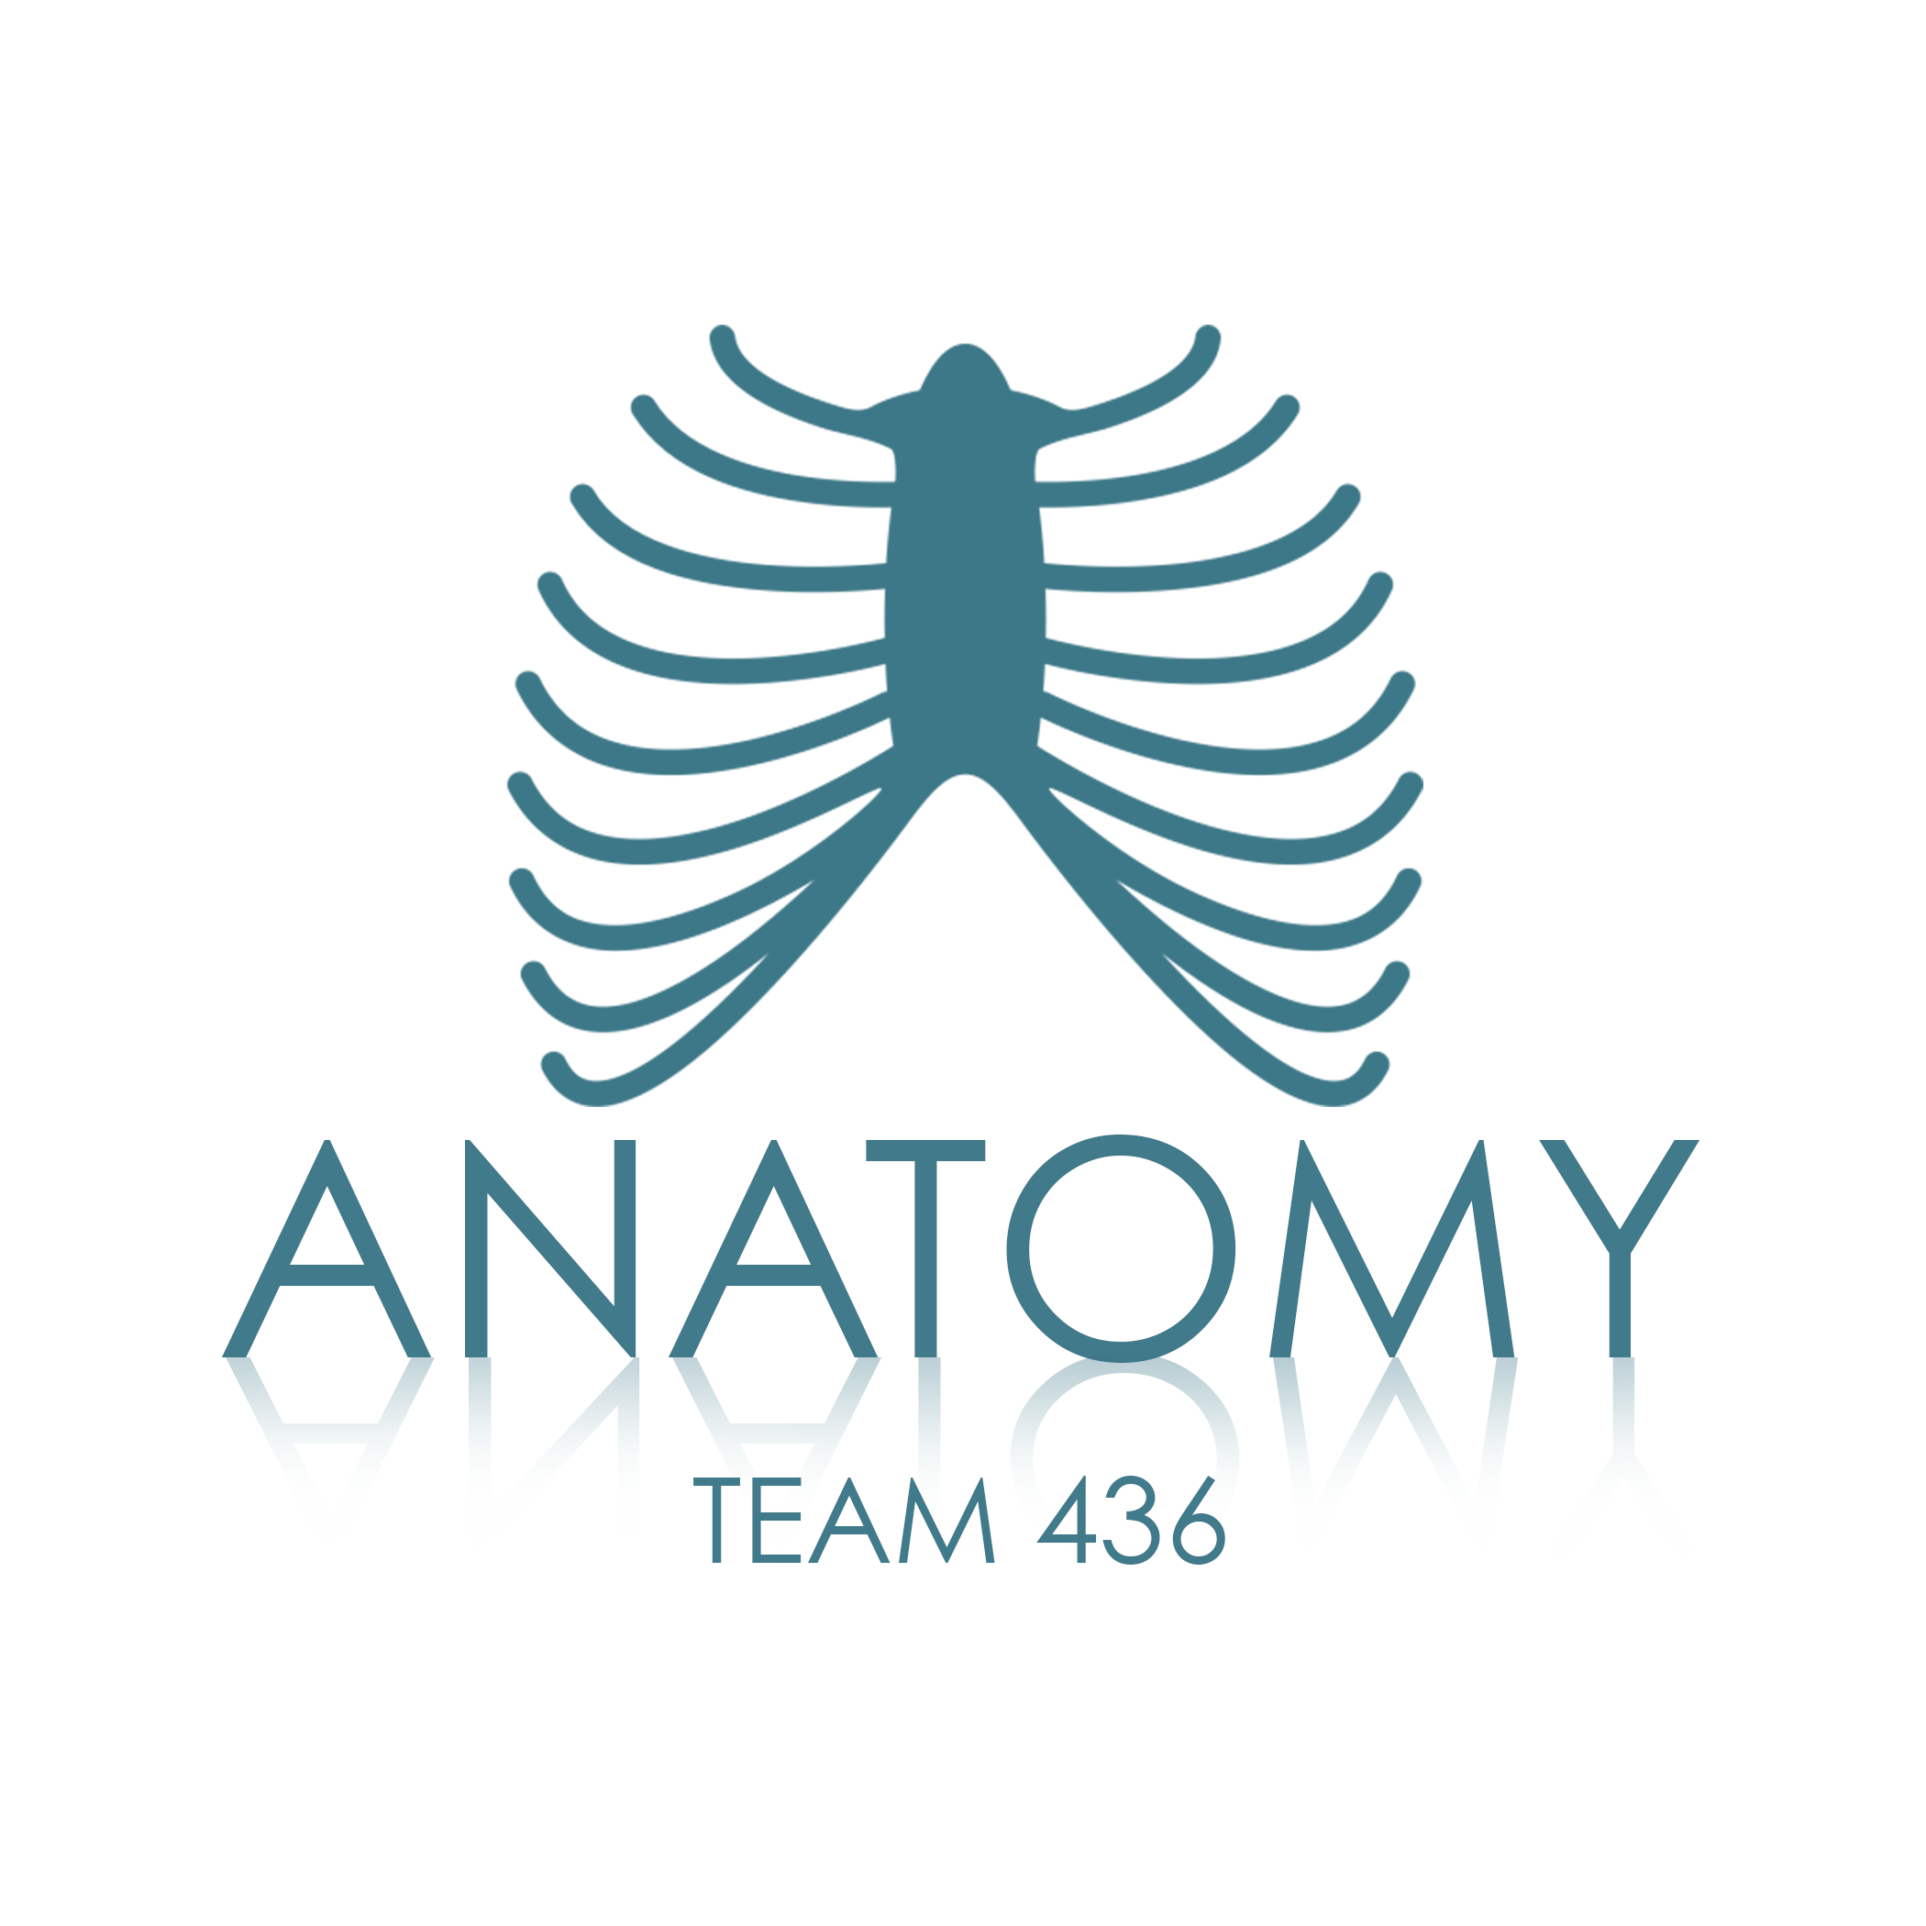
Skeletal Muscles SECOND LECTURE
هذا العمل لا يغني عن المصدر الأساسي للمذاكرة

Slide 2
Objectives:
Describe the main criteria of skeletal muscles.
Describe the attachments of skeletal muscles.
Describe the different directions of skeletal muscle fibers.
Describe the mode of action of skeletal muscles.
Describe briefly the naming of skeletal muscles.
Describe briefly the nerve supply of skeletal muscles.

Slide 3
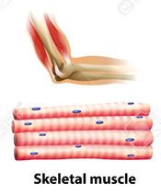
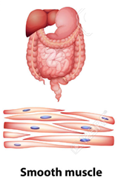
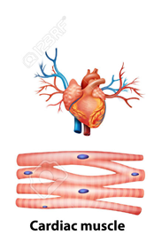
Muscular System
Objective 1: Describe the main criteria of skeletal muscle.
Voluntary
Involuntary
Skeletal
Smooth:
Found in the walls of viscera.
Appear smooth
Cardiac :
Found only in the heart.
Appear striated
Appear striated
Criteria of skeletal muscles :
Striated .
Attached to skeleton.
Voluntary.
Produce movement of skeleton.
Supplied by somatic nerves.

Slide 4
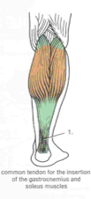
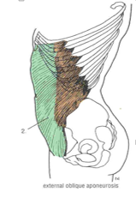
Types of attachment of skeletal muscles
Objective 2: Describe the attachments of skeletal muscles
Muscles are attached to bones, cartilage or ligaments through:
Tendons
Tough cord of fibrous connective tissue that connects muscles to the bone, and is capable of withstanding tension.
ex. the gastrocnemius and soleus muscles (calf muscles) unite into one band tissue, which becomes Achilles tendon that will connects to the heal bone).
Aponeurosis
Thin, broad and strong sheet of fibrous tissue. It connects a muscle with the parts it moves
ex. External oblique aponeurosis.
Raphe
Interdigitation of tendinous ends of the flat muscles.
ex. Raphe of mylohyoid muscle.

Slide 5
Differences between attachment (number (mostly two))
Origin | Insertion
- The proximal end - Mostly fleshy - Least movable | - The distal end - Mostly fibrous - Most movable
Objective 2: Describe the attachments of skeletal muscles

Slide 6
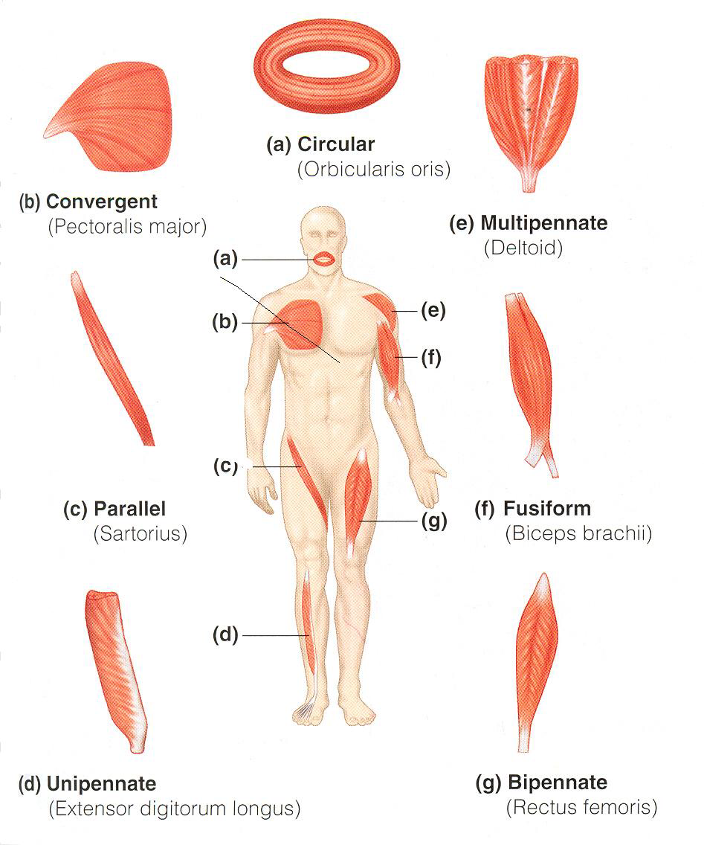
Direction of muscle fibers
Objective 3: Describe the different directions of skeletal muscle fibers.
Direction of movement | Characteristics | Example
Circular | - a ring like band of muscle that surrounds a bodily opening and constricts it when contracted. | Orbicularis oris (mouth)
Convergent (triangular) | - widespread muscle fibers that converge on a common attachment site (tendon). | Pectoralis major
Fusiform | -a spindle-shaped muscle, thick in the middle and tapered at ends | Biceps brachii
Parallel (Parallel to line of pull) | More range of movement Less powerful | Sartorius
Pennate (oblique to line of pull) | Less range of movement. More powerful Three types : - Unipennate - Bipennate (line of pull is in the center) - Multipennate | Unipennate (Extensor digitorum longus) Bipennate (Rectus femoris) Multipennate (Deltoid)

Slide 7
Mode of Action
Objective 4: Describe the mode of action of skeletal muscles.
Their relationship with the prime mover : | Ex: |  | Type
 | Muscle causes it | Movement
It is the prime mover. | Quadriceps Femoris | Extension of the knee joint. | (1) Prime mover (Agonist) It is the chief muscle responsible for a particular movement
It opposes the action of the prime mover. Before contraction of prime mover, the antagonist must be relaxed. | Biceps Femoris | Flexion of the knee joint. | (2) Antagonist
Prevents unwanted movement in an intermediate joint crossed by the Prime Mover. | Flexors and Extensors of wrist joint | No movement. They contract to fix wrist joint in order that flexors and extensors of fingers work efficiently. | (3) Synergist Muscles that assist the prime mover by stabilizing muscle movements.
Its contraction stabilizes the origin of the prime mover so that it can act efficiently. | Levator scapulae & Rhomboid minor & Rhomboid major | No movement. Muscles attaching the shoulder girdle to the trunk contract to fix shoulder girdle, allowing deltoid muscle to move shoulder joint (humerus). | (4) Fixator
^لأنهم يشتغلون سوا فيلغون بعض

Slide 8
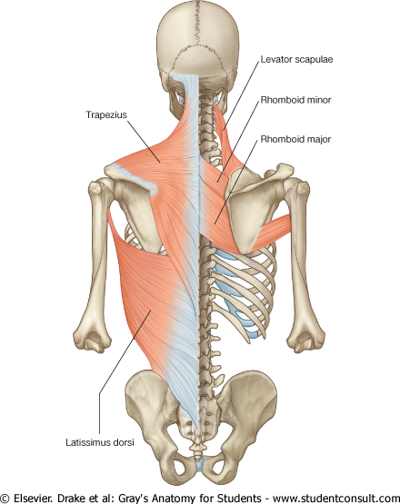
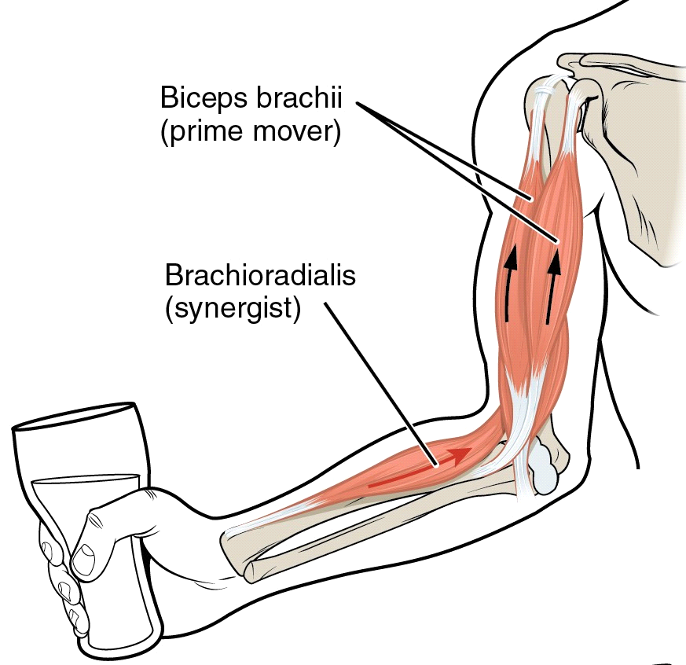
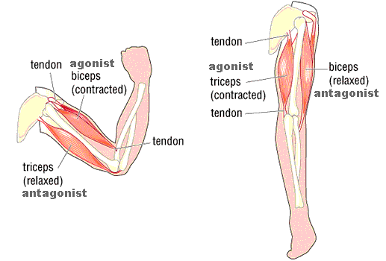
Mode of Action (Examples)
Objective 4: Describe the mode of action of skeletal muscles.
Prime Mover (Agonist) & Antagonist
Synergist
Fixator

Slide 9
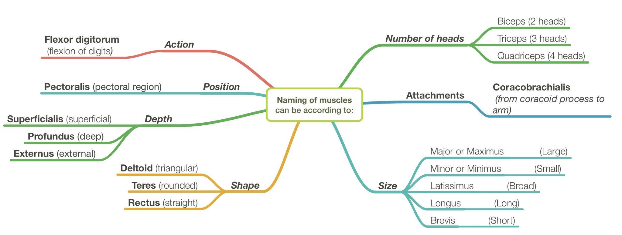
Objective 5: Describe briefly the naming of skeletal muscles.
.
Naming of Muscles
Notes:
1- muscle naming is in Latin not English and that's why we can't say that a certain muscle is called "large" but we can call it "major or Maximus".
2- muscles' long names (such as coracobrachialis) are usually made of combinations of the names of the bones that the muscle is between (. أحيانا تكون أسماء العضلات طويلة وذلك لأن ذلك الاسم ناتج عن اشتقاق من اسمين لعظمتين مثلا تقع العضلة بينهما).

Slide 10
Nerve Supply of Skeletal Muscles
Objective 6: Describe briefly the nerve supply of skeletal muscles.
Notes:
• Sensory nerves: carries information from the nerves to the central nervous system.
• Motor nerves: carries information from the brain and the spinal cord to the muscles .
• The somatic nervous system is the part of the peripheral nervous system associated with skeletal muscle voluntary control of body movements.
• The nerves supplying the skeletal muscles are mixed:
• 60% are Motor (responsible of movement and actions)
• 40% are Sensory.
• It has some Autonomic fibers (Sympathetic) for its blood vessels.
• The nerve enters the muscle at about the middle point of its deep surface.

Slide 11
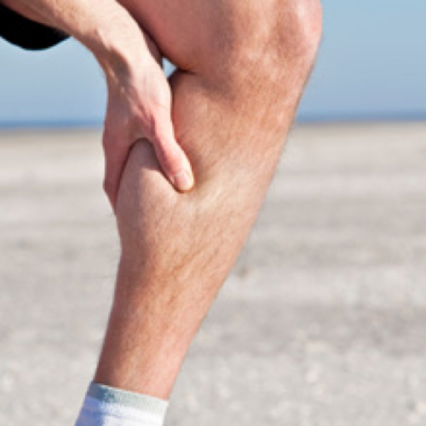
MUSCLE DISEASES & INJURIES
Muscle diseases and injuries are common, especially in sports activities. A severe muscle injury can keep you from participating in the activities that you love and enjoy for living.
Muscle diseases and injuries could be one of the major factors that threat someone’s professional career(s).
Muscular Dystrophy: A genetic disease that cause a damage of muscle fibers.
Muscle Cramps: can occur suddenly and involuntarily in one or more muscles.
Sprains and Strains: Twist or pull in the muscles or tendons which can either be sudden or over a period of time, with or without tearing of the muscle.
Contusions: often caused by a direct trauma or repeated blow to the muscle. In some cases, the condition can be caused by falling on a hard surface.
ONLY ON THE BOYS’ SLIDES

Slide 12
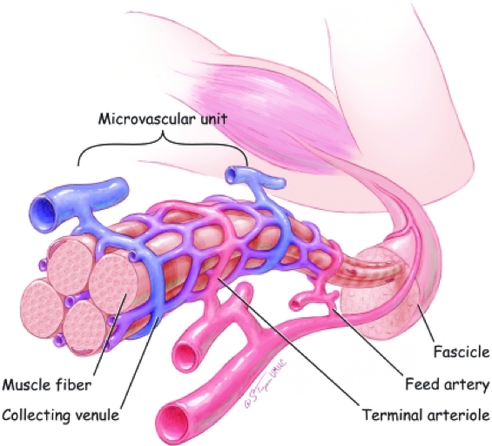
BLOOD SUPPLY
O During extreme physical exertion, more than 80% of cardiac output can be directed to contracting muscles.
O The vascular inflow to skeletal muscles is provided by primary arteries, which represent the last branches of the arterial supply that arise before entry into the tissue.
O The primary arteries are appropriately distributed along the long axis of the muscle and give rise to feed arteries that course toward the epimysium of the muscle at right or oblique angles to the primary arteries.
ONLY ON THE BOYS’ SLIDES

Slide 13
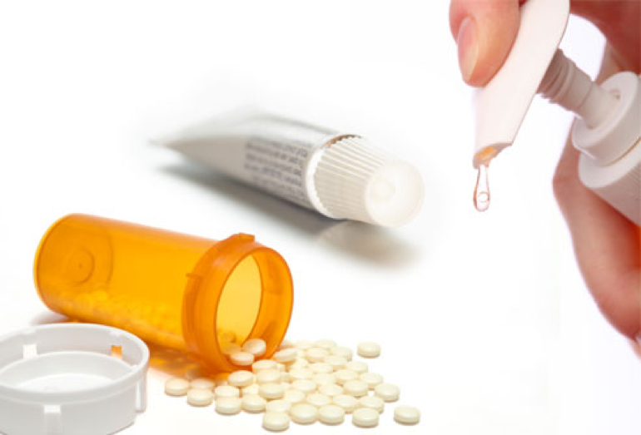
MUSCLE TREATMENTS
O Minor muscle injuries may be treated with simple home remedies, such as rest, applying ice, using compression bandage, and elevating your injured limb.
O Anti-inflammatory medication.
O Physiotherapy
O Severe muscle injuries need to be checked by a qualified health care provider.
O A torn muscle or tendon may need to be surgically repaired.
ONLY ON THE BOYS’ SLIDES

Slide 14
SUMMARY
Skeletal muscles are striated, voluntary muscles attached to & move the skeleton.
They have 2 attachments: origin & insertion.
Their fibers may be parallel or oblique (pennate) to the line of pull.
According to mode of action, they are classified as: prime mover, antagonist, synergist or fixator.
They may be named according to: size, shape, number of heads, position, attachments, depth or action.
They are supplied by a mixed somatic nerve.

Slide 15
Helpful Links
Videos
https://www.youtube.com/watch?v=I80Xx7pA9hQ
1- Mode of actions
2- Describing the attachments
https://www.youtube.com/watch?v=PGDXXUtPw4A
Modes of actions
https://www.youtube.com/watch?v=zETNcHZT3Qw
The direction of muscle fibres.
Quizzes
https://www.cliffsnotes.com/study-guides/anatomy-and-physiology/the-muscular-system/quiz-skeletal-muscle-actions

Slide 16
Team Members
Jawaher Abanumy (Leader) Dania Alkelabi Heba Alnasser Deena Alnowiser Jawaher Alkhayyal Rana Barasain Wejdan Alzaid Shouq Albogami Lara AlSaleem Ghadah Almazrou Ameera Niazi Lama Alfawzan
Nawaf AlKhudairy (Leader) Mohammed Ghandour Khalid Aleedan Abdullah Jammah Abdulmalik Alhadlaq Majed Al Zain Rakan Bahammam Mosaed Alnowaiser Mohammed Alyousef Mohammed Nasr Yazeed Suhaibani
anatomyteam436@gmail.com

