Slide 1
Nervous System THIRD LECTURE
KEY
Doctor’s slides
Notes/extra explanation
Important
Only on boys’/girls’ slides
هذا العمل لا يغني عن المصدر الأساسي للمذاكرة

Slide 2
Objectives
List the subdivisions of the nervous system.
Define the terms: grey matter, white matter, nucleus, ganglion, tract and nerve.
Define the terms neurons, neuroglia
List the parts of the brain.
Identify the external and internal features of spinal cord.
Enumerate the cranial nerves.
Describe the parts and distribution of the spinal nerve.
Define the term “dermatome”.
List the structures protecting the central nervous system.

Slide 3
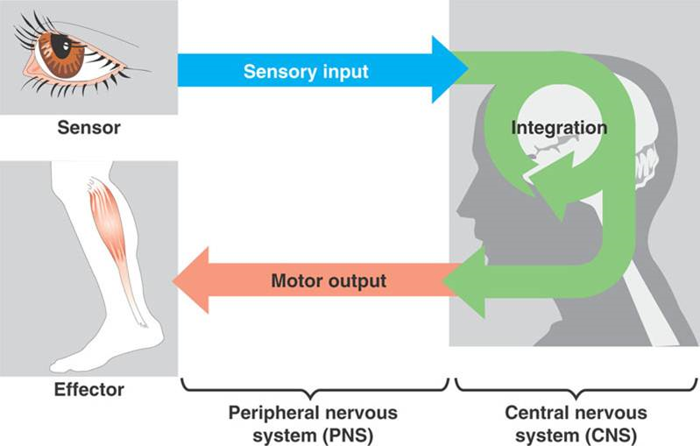
Functions of The Nervous System:
Objective 1: List the subdivision of the nervous system.
1- Collection of sensory input : (PNS) Identifies changes (Also called stimuli)
occurring inside and outside the body using
sensory receptors.
2- Integration: (CNS) Processes, analyses
and interprets changes, then makes decisions.
3- Effects a response: (PNS) by activating muscles
or glands (effectors) via motor output.

Slide 4
Objective 1: List the subdivision of the nervous system.
Structural organisation:
Functional Organisation:
Autonomic (Visceral) Sensory
(CNS)
(Brain , spinal cord)
Somatic Sensory
(PNS)
(Nerves , ganglia)
SAME للربط

Slide 5
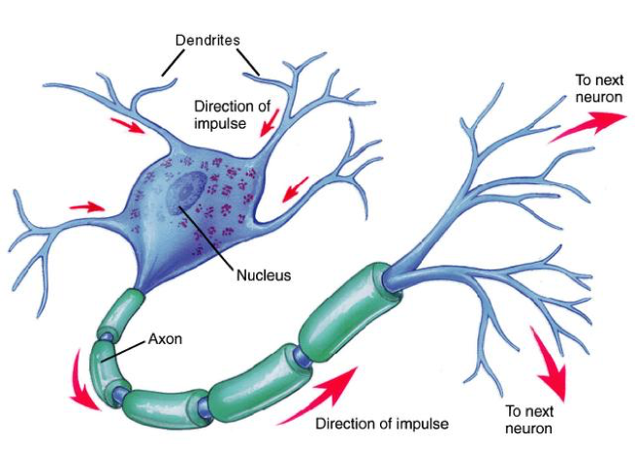
NEURONS
Objective 3: Define the terms neurons, neuroglia
They are the basic structural (anatomical), functional, and embryological units of the nervous system.
A human’s nervous system contains about 10^10 neurons.
Functions:
1- Receive information from sensory receptors or other neurons.
2- Transmit information to other neurons or effector organs.

Slide 6
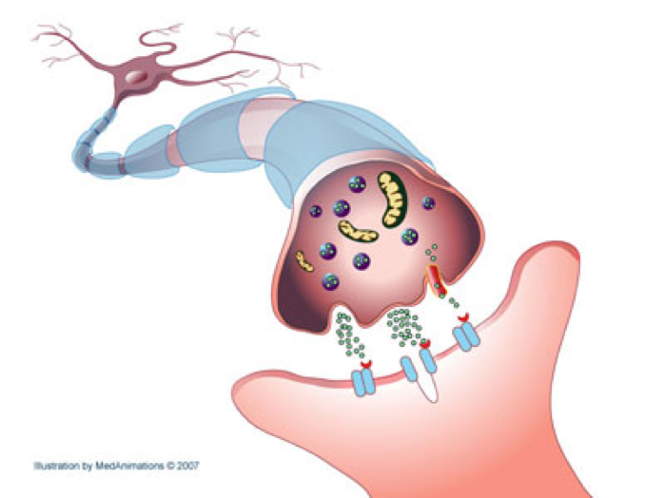
NEURONS
Objective 3: Define the terms neurons, neuroglia
Information is passed between neurons at specialized regions called synapses
Processes branch out of a single cell (neuron) body, they are receptors, also known as Dendrites.
The branched process that carries information away from the cell body is called an Axon.
At the end of the axon, specializations called terminal buttons occur, which transfer information to other Dendrites of other neurons.

Slide 7
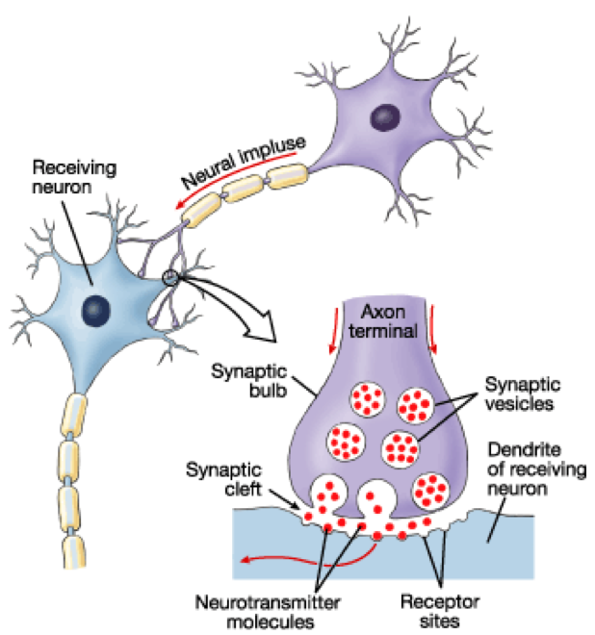
NEURONS
Objective 3: Define the terms neurons, neuroglia
Transmission of information between neurons almost always occurs by chemical rather than electrical means.
The action potential releases chemicals called neurotransmitters that are stored in synaptic vesicles in the presynaptic ending.
Function:
Neurotransmitters diffuse across the narrow gap between pre- and post-synaptic membranes to bind to the receptors on the postsynaptic cell.

Slide 8
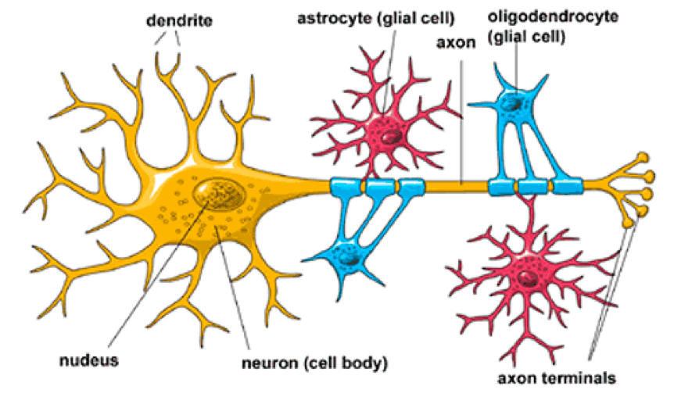
NEUROGLIA (Glia)
Objective 3: Define the terms neurons, neuroglia
It is the other major cellular component of the nervous system, in the form of connective tissue.
Unlike neurons, neuroglia do not have a direct role in information processing but they are essential for the normal functions of nerve cells.
They are three types:
Oligodendrocytes
They form the myelin sheath that surrounds many axons, which increases the rate of conduction (transmission).
Microglia
They have a phagocytic role in response to nervous system damage.
Astrocytes
They provide biochemical support for endothelial cells that form the blood–brain barrier.

Slide 9
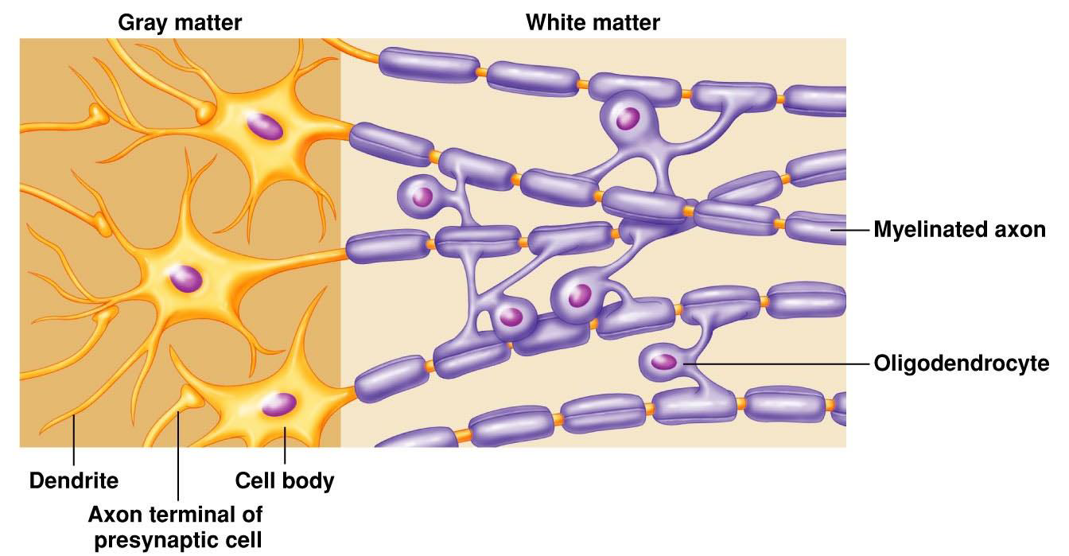
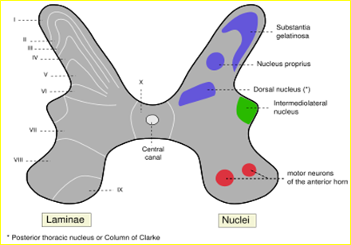
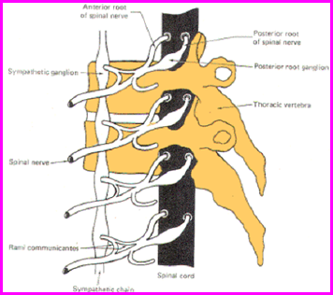
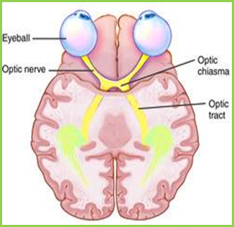
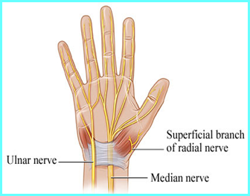
Nervous Tissue consists of Nerve cells (neurons) + Supporting cells (neuroglia). It is organised into white matter and grey matter.
Grey Matter | White Matter
Cell Bodies | No cell bodies
Short process of the neurons | Long process of the neurons
Neuroglia | Neuroglia
Blood Vessels | Blood vessels
Objective 2: Define the terms: grey matter, white matter, nucleus, ganglion, tract and nerve.
Note:
Process refers to the projections from the cell body (dendrite and axon).
Remember…
 | Inside CNS | Outside CNS
Group of neurons | Nuclei | Ganglia
Group of nerve fibers (axons) | Tract | Nerve

Slide 10
Objective 4: List the parts of the brain.
The Brain
Large mass of nervous tissue located in the cranial cavity. It has four major regions.
1- Cerebrum
The largest part of the brain & has two hemispheres.
The cerebral hemispheres are connected by a thick bundle of nerve fibers called corpus callosum.
The surface shows:
ridges of tissue, called gyri (elevation), separated by grooves called sulci.
Divided by deeper sulci, into 4 lobes:
Frontal
Parietal
Temporal
Occipital
2- Diencephalon:
It has four parts:
Thalamus.
Hypothalamus.
Subthalamus.
Epithalamus.
Located between the cerebrum and brainstem.
Function:
Regulates visceral activities and the autonomic nervous system.
3- Brainstem:
It has three parts:
Midbrain
Pons
Medulla oblongata
Function:
1-Produces rigidly programmed autonomic behaviors.
2-Provides pathway for tracts running between higher and lower neuronal centers.
4-Cerebellum
Has 2 hemispheres and a convoluted surface.
It has an outer cortex of gray matter and an inner region of white matter.
It provides precise coordination for body movements and helps to maintain equilibrium.

Slide 11
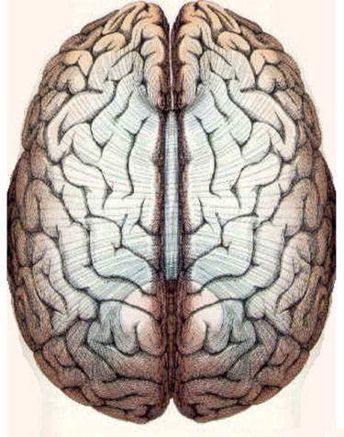
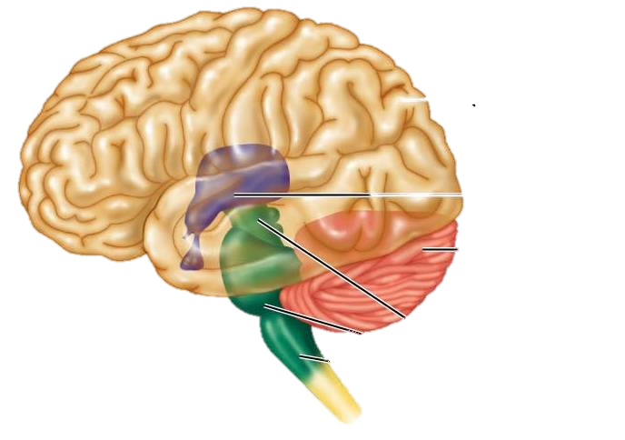
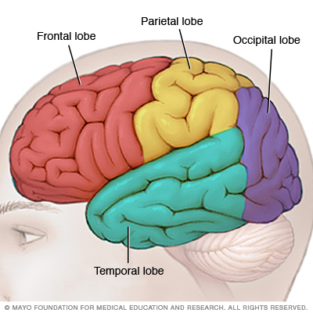
Corpus callosum
Objective 4: List the parts of the brain.
Diagrams
Gyrus
Sulci
Left hemisphere
Right
hemisphere
(1) Cerebrum
(2) Diencephalon
(4) Cerebellum
(3) Brain Stem
Midbrain
Pons
Medulla Oblongata

Slide 12
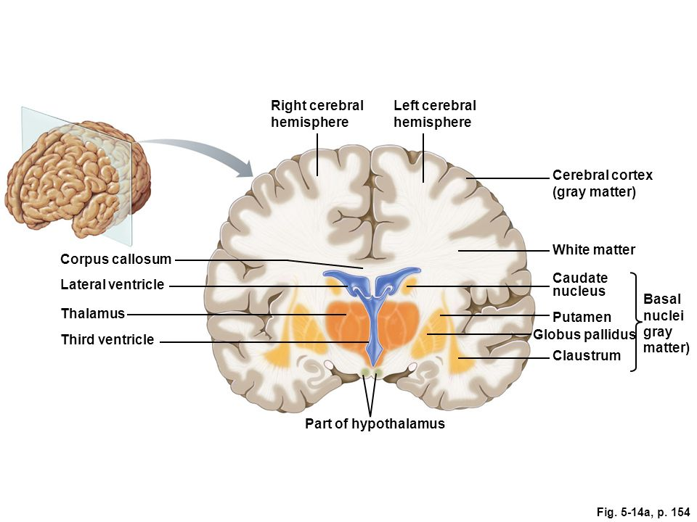
Cerebral Hemisphere
Objective 4: List the parts of the brain.
TISSUE OF THE CEREBRAL HEMISPHERES
The outermost (lateral) layer is called gray matter or cortex.
The deeper layer is called white matter (or medulla), composed of fiber tracts (bundles of nerve fibers), carrying impulses to and from the cortex.
Located deep within the white matter are masses of grey matter called the basal nuclei. They help the motor cortex in the regulation of voluntary motor activities.

Slide 13
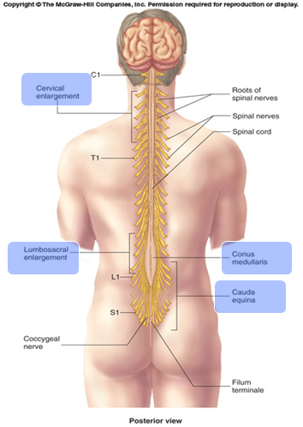
Spinal Cord
Objective 5: Identify the external and internal features of spinal nerve.
It is a two-way conduction pathway to the brain & a major reflex center.
42-45 cm long, cylindrical shape, lies within the vertebral canal.
Extends from foramen magnum to L2 vertebra.
The spinal cord is extended to L2 vertebra but in children it extends to L3 vertebra because their vertebral column is smaller/shorter.
Continuous above with medulla oblongata.
Caudal tapering end is called conus medullaris.
Has 2 enlargements: cervical and lumbosacral.
cervical enlargement and lumbosacral enlargement
وهم أكثر سماكة لأنه يتفرع منهم nerves تغذي الأطراف العلوية والسفلية.
Gives rise to 31 pairs of spinal nerves.
Group of spinal nerves at the end of the spinal cord is called cauda equina.
End of spinal cord: conus medullaris.
End of spinal nerves: cauda equina.

Slide 14
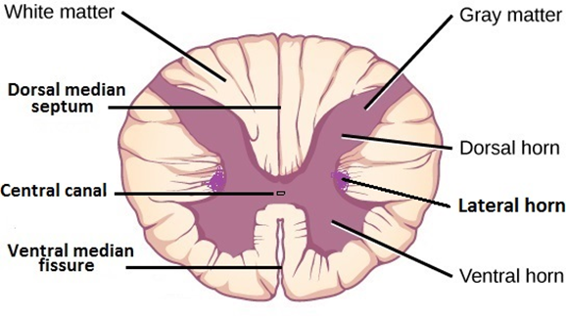
Cross Section of Spinal Cord
Objective 5: Identify the external and internal features of spinal nerve.
It is incompletely divided into two equal parts:
anteriorly by a short, shallow median fissure
posteriorly by a deep, narrow median septum.
It is composed of grey matter in the center surrounded by white matter.
The grey matter resembles the letter H, having two posterior, two anterior and two lateral horns/columns.
 | The brain |  | Spinal cord
 | Cerebrum | Cerebellum
Cortex “outer layer” | Gray matter |  | White matter
Medulla “inner layer” | White matter |  | Gray matter

Slide 16
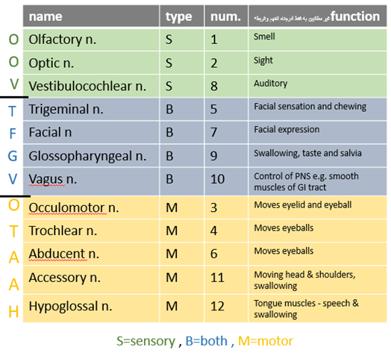
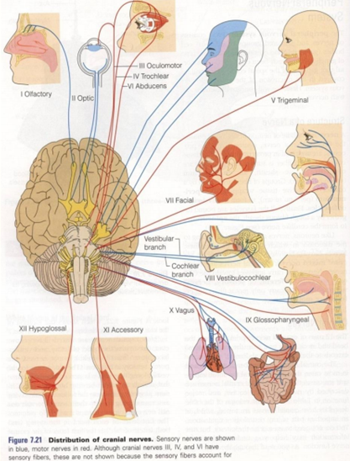
Cranial Nerves
• 12 pair: 3 pairs are sensory, 5 pairs are motor, and 4 pairs are both.
Objective 6: Enumerate the cranial nerves.

Slide 17
(EXTRA) More Mnemonics to memorize the name, number and type of cranial nerve:
Number | Name |  | Type
1 | On | Olfactory | Some | Sensory
2 | Old | Optic | Say | Sensory
3 | Olympus | Occulomotor | Marry | Motor
4 | Towering | Trochlear | Money | Motor
5 | Top | Trigeminal | But | Both
6 | A | Abducent | My | Motor
7 | Fin | Facial | Brother | Both
8 | And | Acoustic (Vestibulocochlear) | Says | Sensory
9 | German | Glossopharyngeal | Big | Both
10 | Viewed | Vagus | Brains | Both
11 | A | Accessory | Matter | Motor
12 | Hop | Hypoglossal | More | Motor
These two should be memorized together.
On Old Olympus Towering Top,
A Fin And German Viewed A Hop
Some Say Marry Money But My Brother Says Big Brains Matter More

Slide 18
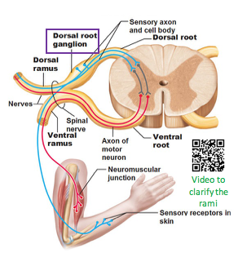
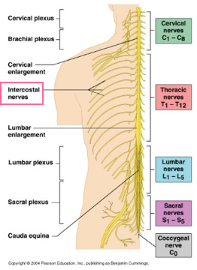
Spinal Nerves and Nerve Plexus:
31 pairs, Each spinal nerve is attached to two roots: dorsal (sensory) and ventral (motor)
Objective 7: Describe the parts and distribution of the spinal nerve.
Dorsal roots bear a sensory ganglion (DRG).
Each spinal nerve exits from the intervertebral foramen and divides into dorsal and ventral ramus.
The rami (one = ramus) contain both sensory and motor fibers,
Roots have pure nerves, but trunks have mixed nerves.
The dorsal rami are distributed individually supply the skin and muscles of the back.
The ventral rami form plexuses ضفائر (except in thoracic region where they form intercostal nerves), which supply the anterior part of the body.

Slide 19
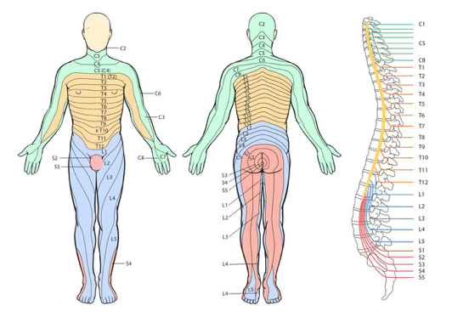
Dermatomes:
Objective 8: Define the term dermatome.
The segment of skin supplied by a segmental spinal nerve is called “Dermatome”
إذا أصيب جزء من الحبل الشوكي بضرر يحدث تضرر لمنطقة الجلد المرتبطة بذلك الجزء

Slide 20
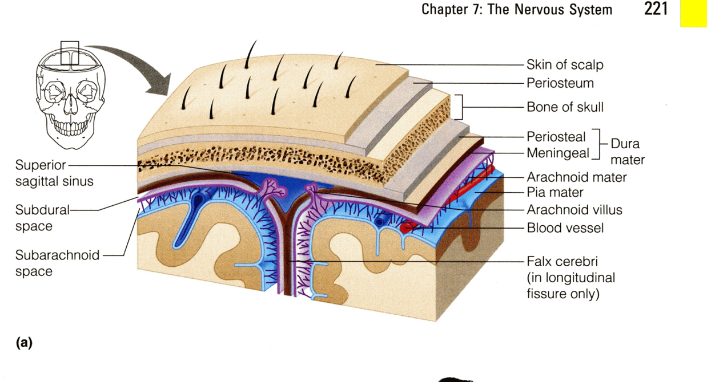
Protection of CNS:
Objective 9: List the structures protecting the central nervous system.
The CNS is protected by:
Bones:
Skull and vertebral column
Meninges (membrane):
3 layers
Cerebrospinal Fluid:
In the subarachnoid space
Dura mater
(outermost)
Arachnoid mater
(middle)
Pia mater
(innermost)

Slide 21
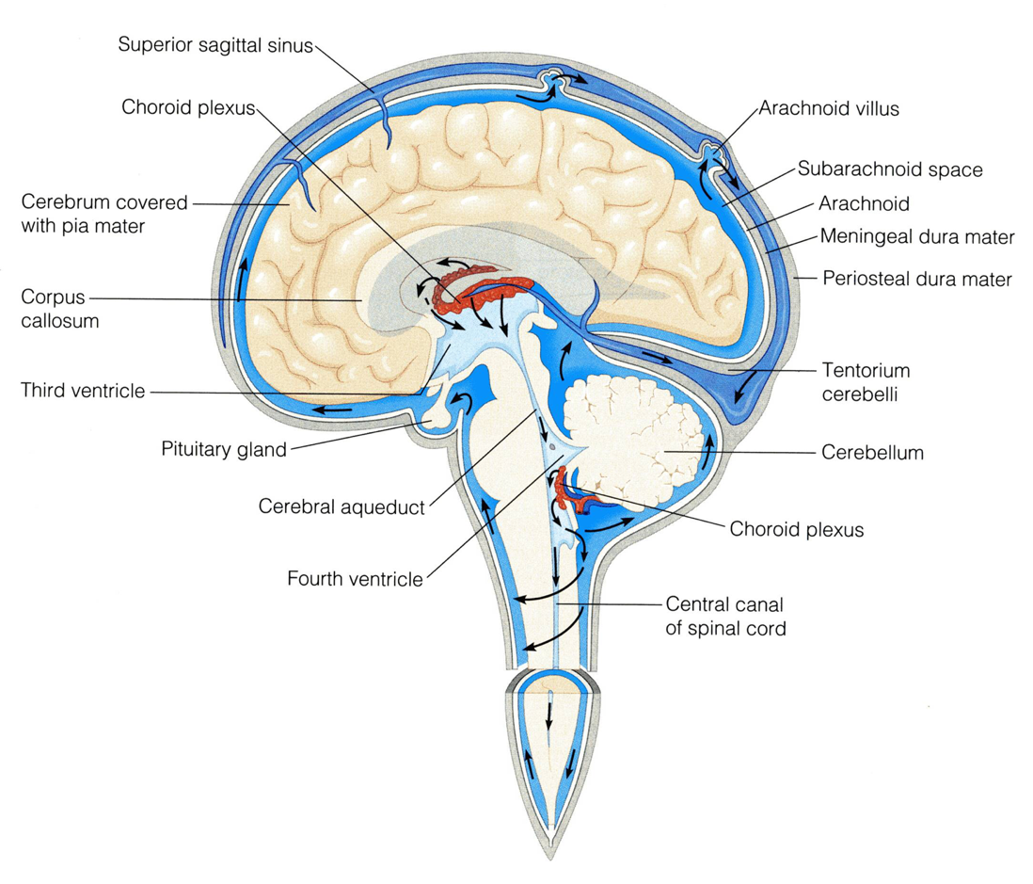
Cerebrospinal Fluid
Cerebrospinal Fluid (CSF) is constantly produced by the choroid plexuses inside the ventricles of brain.
Most of the CSF drains from the ventricles into the subarachoid space around the brain and spinal cord. A little amount flows down in the central canal of the spinal cord.
CSF is constantly drained into the dural sinuses through the arachnoid villi.
Objective 9: List the structures protecting the central nervous system.
Notes:
Cerebrospinal fluid يمتص الصدمات
Central canalالزائد من السائل ينزل الى ال

Slide 22
Test Yourself: (True or False)
1. Nucleus is a group of neurons within the PNS.
2. In the Brain, grey matter is located in the centre and surrounded by white matter.
3. Oligodendrocytes form the myelin sheath that surrounds many neuronal axons, which increase the rate of conduction.
4. Diencephalon provides the pathway for fibre tracts running between higher and lower neuronal centres.
5. Information is passed between neurons at specialized regions called synapses.
6. Cerebrum provides precise coordination for body movements and helps maintain equilibrium.
7. Each spinal nerve exits from the intervertebral foramen and divides into a dorsal and ventral ramus.
8. The dorsal rami form plexuses .
9. Dermatome is a segment of skin supplied by one spinal nerve.
10. CSF is produced by the choroid plexuses inside the ventricles of brain.
11. The rami contain only sensory fibres.
12. CSF is drained into the dural sinuses through the arachnoid villi.

Slide 23
Helpful Links
Online Tests
https://www.onlineexambuilder.com/anatomy-nervous-system/exam-36310
https://www.onlineexambuilder.com/nervous-system/exam-36516
Videos
https://www.youtube.com/watch?v=qPix_X-9t7E (General Review)
https://www.youtube.com/watch?v=KnD16gwpCz8 (Spinal Cord)
Websites
http://www.getbodysmart.com/index.htm
http://www.innerbody.com/

Slide 24
Team Members
Jawaher Abanumy (Leader) Dania Alkelabi Heba Alnasser Deena Alnowiser Jawaher Alkhayyal Rana Barasain Wejdan Alzaid Shouq Albogami Lara AlSaleem Ghadah Almazrou Ameera Niazi Lama Alfawzan
Nawaf AlKhudairy (Leader) Mohammed Ghandour Khalid Aleedan Abdullah Jammah Abdulmalik Alhadlaq Majed Al Zain Rakan Bahammam Mosaed Alnowaiser Mohammed Alyousef Mohammed Nasr Yazeed Suhaibani
: anatomyteam436@gmail.com

