Slide 1
Autonomic Nervous System FOURTH LECTURE
KEY
Doctor’s slides
Notes/extra explanation
Important
Only on boys’/girls’ slides
Revised By :
Trad Alwakeel & Shoag Alahmari
هذا العمل لا يغني عن المصدر الأساسي للمذاكرة

Slide 2
Objectives:
Define the autonomic nervous system.
Describe the structure of autonomic nervous system.
Trace the preganglionic & postganglionic neurons in both sympathetic & parasympathetic nervous system.
Enumerate in brief the main effects of sympathetic & parasympathetic nervous system.

Slide 3
Recall that..
Group of neurons inside CNS -> Nucleus
Group of neurons outside CNS -> Ganglion

Slide 4
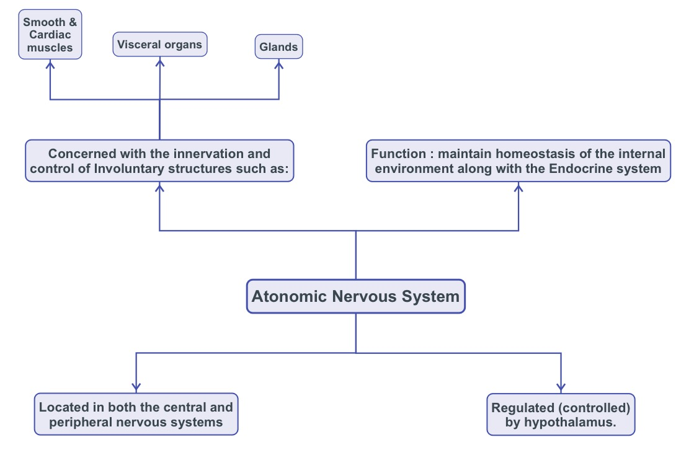
Objective 1: Define the autonomic nervous system.
Function: maintain homeostasis of the internal environment along with the Endocrine system.
Autonomic Nervous System

Slide 5
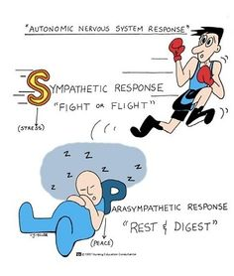
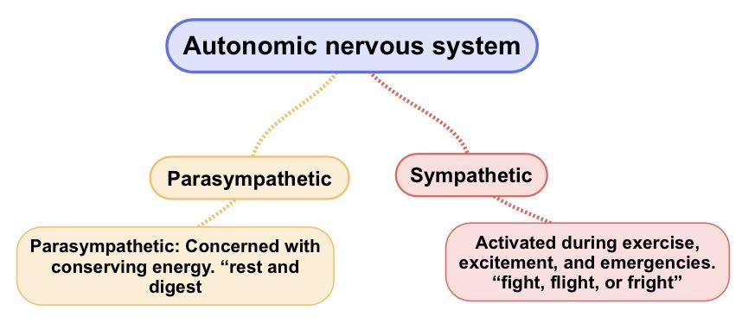
The autonomic nervous system is divided according to its anatomical, physiological, and pharmacological characteristics into two subdivisions:
Objective 2: Describe the structure of autonomic nervous system.
Both divisions operate in conjunction with one another (i.e. have antagonistic control over the viscera) to maintain a stable internal environment.
”

Slide 6
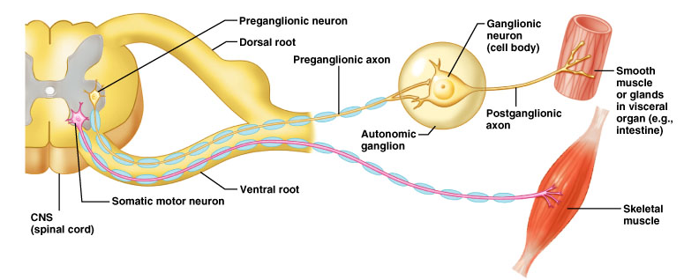
Objective 3: Trace the preganglionic & postganglionic neurons in both sympathetic & parasympathetic nervous system
The efferent pathway of te somatic nervous system consists of one neuron.
While, the efferent pathway of the autonomic nervous system is made up of two neurons: preganglionic and postganglionic neurons.
The cell bodies of the preganglionic neurons are located in the brain and spinal cord. Their axons synapse with the postganglionic neurons whose cell bodies are located in the autonomic ganglia.

Slide 7
Objective 2: Describe the structure of autonomic nervous system.
Para sympathetic
Sympathetic
Preganglionic cell body
In the sympathetic, the preganglionic is shorter than the postganglionic.
In the parasympathetic, the preganglionic is longer than the postganglionic
Short
Long
Preganglionic fiber
Autonomic
Ganglion
Postganglionic cell body
Long
Short
Postganglionic fiber
Target organ
Target organ

Slide 8
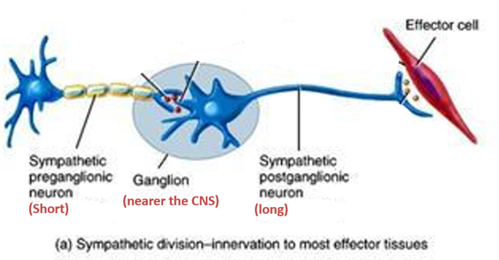
Sympathetic Division
Objective 3: Trace the preganglionic & postganglionic neurons in both sympathetic & parasympathetic nervous system
Neurons
Preganglionic neurons are located in the lateral gray horn of T ₁- L₂ (OR L₃) segments of spinal cord (Thoracolumbar outflow) (Outflow means the passage of impulses outwardly from the central nervous system.)
As their preganglionic neurons are short, their ganglia are located near the CNS (spinal cord).

Slide 9
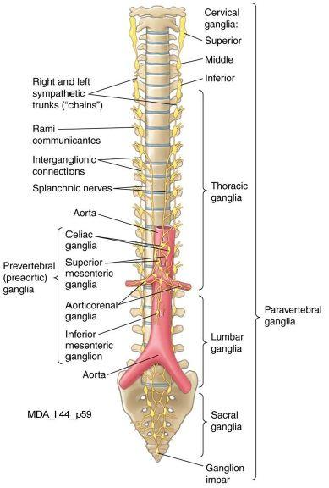
(ii) Ganglia
Depending on their location with respect to the vertebral column they are divided into:
Objective 3: Trace the preganglionic & postganglionic neurons in both sympathetic & parasympathetic nervous system
Prevertebral ganglia: | Paravertebral ganglia:
(pre means in front of) | (para means next to)
coeliac & mesenteric ganglia (In front of the vertebrae (on the abdominal aorta)) | sympathetic chain ganglia (Two interconnected chains, one on each side of vertebral column)
Postganglionic fibers supply: 1) abdominal 2) pelvic viscera | Postganglionic fibers supply: 1) structures in head & thorax 2) blood vessels 3) sweat glands
Number of Paravertebral ganglia:
3 in cervical
11-12 in thoracic
4 in lumbar
4 in sacral.
The chains end (fuse) into a common ‘ganglion impar’ in front of coccyx

Slide 10
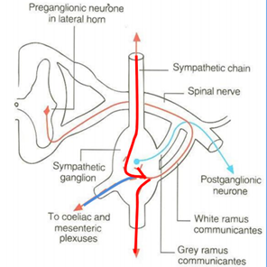
(iii) Fibers
Fibers in Sympathertic Chain Can Either:
Preganglionic fibers | Postganglionic fibers
Cell body In lateral horn | Cell body In ganglia
Leave spinal chord, run in the ventral roots & travel through the spinal nerve, & join the sympathetic chain ganglia. | Leave sympathetic chain ganglia & enter again into the spinal nerve.
Via the white rami communicantes. (WRC) | Via grey rami communicantes (GRC)
Axon tips in ganglia | Axon tips in target organ
1. Ascend, descend or remain at the same level to synapse with neurons (postganglionic) of paravertebral ganglia located in sympathetic chain.
2. Leave the sympathetic chain (without synapse) to reach coeliac & mesenteric ganglia (around branches of abdominal aorta) to synapse with their neurons (postganglionic).
Objective 3: Trace the preganglionic & postganglionic neurons in both sympathetic & parasympathetic nervous system

Slide 11
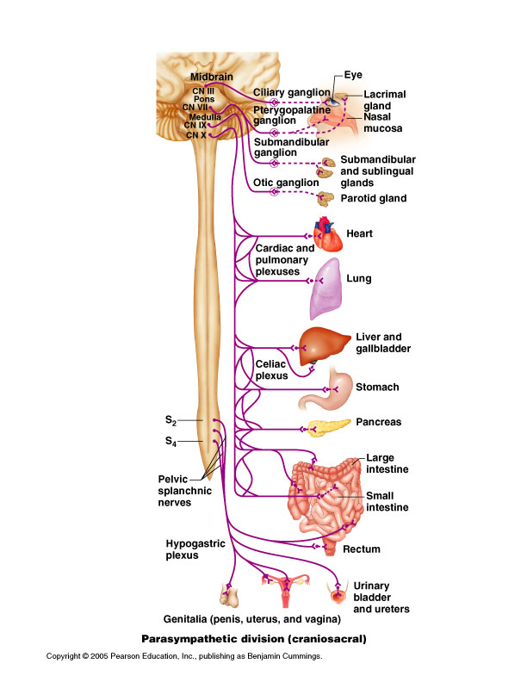
Parasympathetic Division
Objective 3: Trace the preganglionic & postganglionic neurons in both sympathetic & parasympathetic nervous system
1- Outflow | 2- Preganglionic fibers | 3- Postganglionic fibers
A- Cranial outflow: Nuclei of the cranial nerves in the Brain Stem: Oculomotor (3rd) Facial (7th) Glossopharyngeal (9th) Vagus (10th) | From: Cranial outflow Carried by: 3rd, 7th, 9th & 10th cranial nerves. Terminate in: •Ciliary •Pterygopalatine •Submandibular •Anything has (otic) as a suffix •Peripheral ganglia | Innervate (Supply) organs of: Head Neck Thorax Abdomen
B- Sacral outflow: Lateral gray horn of S2-S4 segments of the spinal cord. (Cells located in 2nd, 3rd & 4th sacral segments of Spinal Cord) | From: Sacral outflow Carried by: corresponding sacral nerves. (Pelvic splanchnic nerves) Terminate in: Peripheral ganglia in pelvis where they synapse. | Innervate organs of: Pelvis Lower abdomen
In the sympathetic division all the neurons were from the spinal chord, whereas in the parasympathetic some are from the brain (cranial) and some are from the spinal chord (sacral region).
The sympathetic ganglia were divided into 2 types (prevertebral and paravertebral) whereas the parasympathetic ganglia are few, found in specific places and have specific names.

Slide 12
Review
Cranial: cells in brain stem: nuclei of 3rd, 7th 9th & 10th
Sacral: cells in S2 – S4 segments of spinal cord
Cells of lateral horn of spinal cord (T1 – L2/L3)
Short axon
Long axon
Cells of sympathetic chain
Cells of plexuses surrounding abdominal aorta (Coeliac, superior & inferior mesenteric)
Cranial: cells of ciliary, pterygopalatine, submandibular, otic
& peripheral ganglia
Sacral: cells of peripheral ganglia
Long axon
Short axon
Sympathetic
Parasympathetic

Slide 13
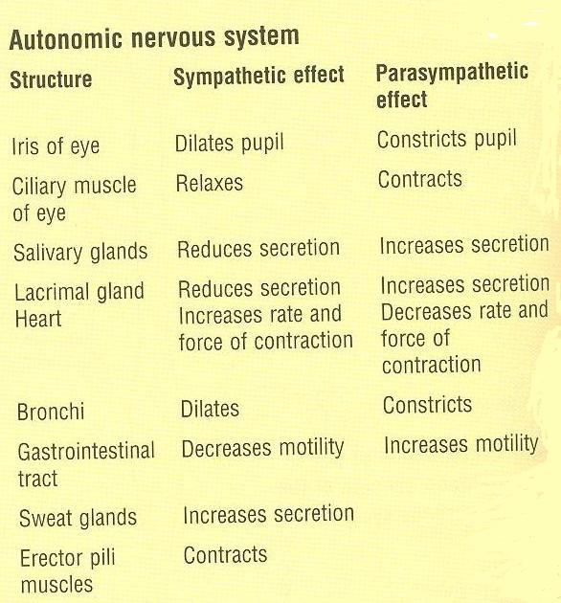
Objective 4: Enumerate in brief the main effects of sympathetic & parasympathetic nervous system.
Sweat glands and erector pili muscles (attached to hair follicles) only have a sympathetic effect.

Slide 14
Test Yourself
At which one of the following sites are preganglionic neurons of the sympathetic nervous system located?
Brain stem
Thoracic segments of spinal cord
Sacral segments of spinal cord
Sympathetic chain
Regarding the parasympathetic nervous system, which one of the following statements is correct?
Its preganglionic axons are short.
It supplies sweat glands.
Its preganglionic neurons are located in the sacral segments of spinal cord.
Its postganglionic neurons are located in the coeliac & mesenteric plexuses.
Answers: 1.b 2.c

Slide 15
(EXTRA Explanation)
Para- means beside and that's how the parasympathetic was named: its origin is above and under the origin of the sympathetic.
The sympathetic & parasympathetic division are made up of 2 parts: preganglia and postpanglia with the ganglion being the part that connects them.
In anatomy nothing is random. The location of the ganglia is related to its function.
In the sympathertic division the ganglia are close to the CNS so when someone, for exmple, is being chased by a lion they need a lot of things to work together at the same time and since the ganglion is close to the source it can send a single message far and wide.
However in the parasympathetic division the ganglia are farther away from the CNS and closer to (or even inside) their target organ and their signals are more specific since they are only sent when your body has the time and energy to send them.
And so the length of the pre/post ganglionic depends on the location of the ganglion. The closer the ganglion is the shorter the preganglion and the longer the postganglionic fibers are, and vice versa.

Slide 16
Helpful Links
Autonomic nervous system
https://www.youtube.com/watch?v=jA1NyCE4M2g
https://www.youtube.com/watch?v=71pCilo8k4M
https://www.youtube.com/watch?v=eeQ6c5nu-ck&feature=share
Sympathetic: https://www.youtube.com/watch?v=zDT4f0TKj3k&feature=share
Parasympathetic: https://www.youtube.com/watch?v=PiM_pLLrVto&feature=share
Quizzes
https://www.cliffsnotes.com/study-guides/anatomy-and-physiology/the-nervous-system/quiz-the-autonomic-nervous-system
http://www.proprofs.com/quiz-school/quizshow.php?title=biol-231-anatomy-physiology-ii&q=1 **
(**this quiz contains some questions outside our material)

Slide 17
Team Members
Jawaher Abanumy (Leader) Dania Alkelabi Heba Alnasser Deena Alnowiser Jawaher Alkhayyal Rana Barasain Wejdan Alzaid Shouq Albogami Lara AlSaleem Ghadah Almazrou Ameera Niazi Lama Alfawzan
Nawaf AlKhudairy (Leader) Mohammed Ghandour Khalid Aleedan Abdullah Jammah Abdulmalik Alhadlaq Majed Al Zain Rakan Bahammam Mosaed Alnowaiser Mohammed Alyousef Mohammed Nasr Yazeed Suhaibani
: anatomyteam436@gmail.com

