Slide 1
AMINO ACIDS
– Color Index:
Important.
Extra Information.
Doctors slides.
436 Biochemistry team

Slide 2
Objectives:
What are the amino acids?
General structure.
Classification of amino acids.
Optical properties.
Amino acid configuration.
Non-standard amino acids.
Derivatives of amino acids.

Slide 3
What are the amino acids ?
1- the chemical units that combine to form proteins.
There are 20 amino acids
A) Humans can produce about half of amino acids.
B) The others must be supplied in the food.
2- Type of organic acid that contain both a carboxyl group ( COOH ) and an amino group ( NH2 ).
Amino acids play central roles:
A. The building blocks of proteins.
B. They play intermediates role in metabolism.
When proteins are digested or broken down amino acids are left.

Slide 4
General structure of amino acids:
Alpha carbon that is attached to:
A) hydrogen atom ( H )
B) side chain ( R ) (which is distinctive for each amino acid and gives the amino acid a unique set of characteristics).
C) carboxylic acid group ( COOH )
D) Primary Amino acid group ( NH2 ) ( except for proline which has a secondary amino group).
ALPHA CARBON: is between the carboxyl and the amino group.

Slide 5
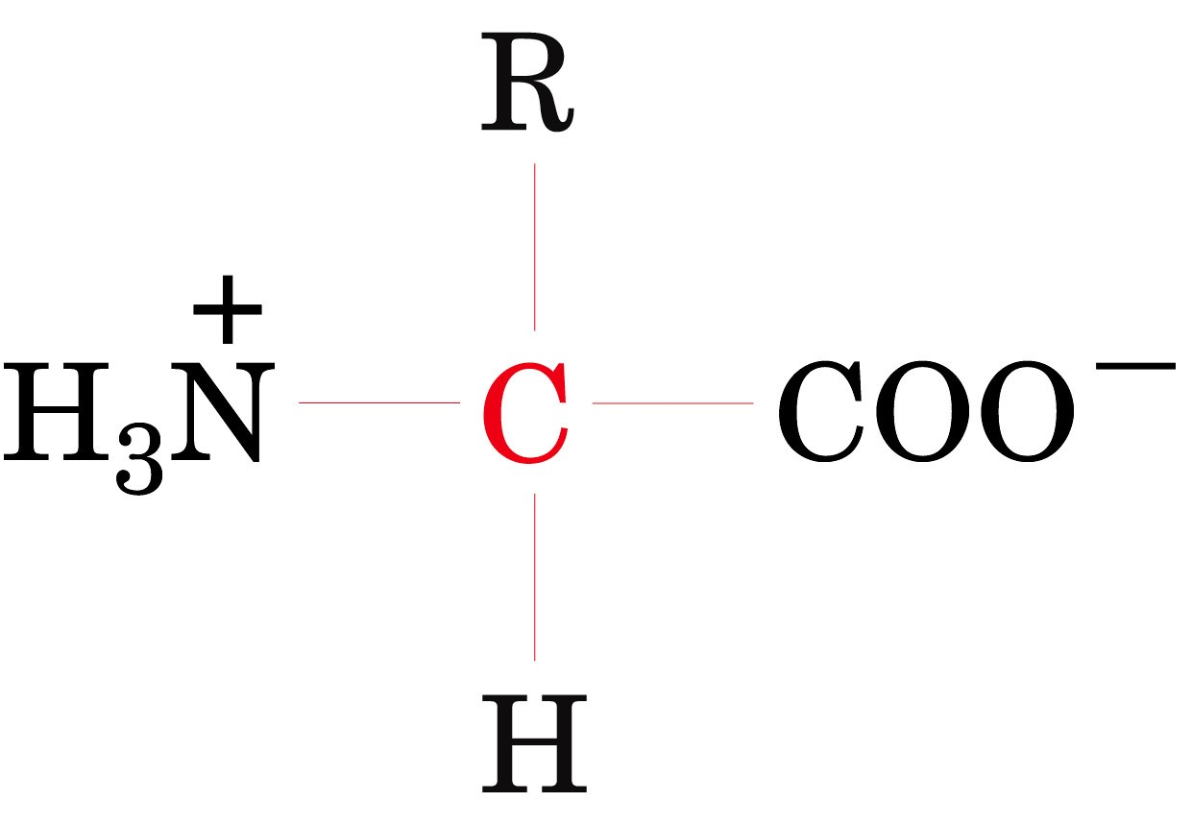
Isoelectric point (PI) and Zwitterion:
Zwitterions are neutral amino acid.
Zwitterions can have more than one charge. However, the sum of those charges MUST equal zero.
Unlike other compounds, zwitterions
Simultaneously have both cationic and
Anionic states.
The isoelectric point (PI): is the pH at which the molecule carries no net charge.

Slide 6
The molecule in its isoelectric point. If we put it in an acidic or a basic solution, what will happen? - In an acidic solution: Acidic solutions have low pH, The carboxylic acid will gain a proton (Hydrogen atom) and lose its negative charge. Due to that, the overall charge on the molecule is now positive. It becomes cationic. - In a basic solution: Basic solutions have high pH, The amino group will lose a proton and lose its positive Charge. Due to that, the overall charge on the molecule is now negative. It becomes anionic.
Zwitterion
Isoelectric point
cationic
anionic
* Zwitterion is used to describe the molecule. Isoelectric point is used to describe the pH level.
PI and Zwitterion video

Slide 7
PK Value
It is the ability of an acid to donate a proton (dissociate).
Also known as pKa or acid dissociation constant.
The pK values of α-carboxylic group is in the range of 2.2.
The pK values of α-amino group is in the range of 9.4.
كلما قلت قيمة pK زادت حامضية المجموعة وقدرتها على منح المزيد من أيونات الهيدروجين.
PK and acidity: Inverse relationship.
dr notes: carboxylic group is a stronger acids (with low pk value) than the amino group, so it will give off it's proton first (first pk value = 2.2 ) then the amino group ( higher pk value) will donate afterward (second pk group = 9.4) .

Slide 8
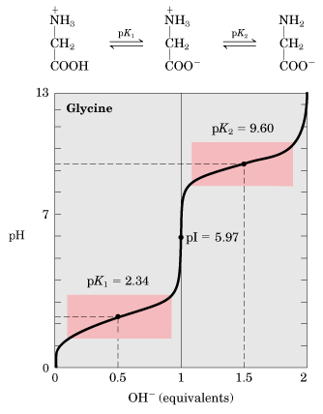
Titration curve of glycine
When pK1= pH (2.3) 50% of molecules are in cation form and 50% are in zwitterion form. (لما ترتفع قيمة البي كي أكثر من 2.3 تبدأ تقل كمية الكاتيون بالمحلول حتى تصل عند قيمة 5.9 ، هنا يصير كل المركب زويترأيون )
When pK2 = pH (9.6) 50% of molecules are in anion form and 50% are in zwitterion form. نفس الفكرة اللي فوق لما ترتفع قيمة البي كي أكثر من 9.6 تبدأ ترتفع نسبة الأنيون بالمحلول)
Buffering action is maximum around pK values and minimum at PI.
dr. notes:
- zwitterion the amino acid itself that has no net charge.
- If the side chain contains an ionized group, in this case the amino acid is not a zwitterion.
- Buffer is a solution resists change in pH when an acid or base is added into it.
- At physiological pH, the a-carboxyl and a- amino groups are dissociated.
- All free amino acids and charged amino acids in peptide chains, can serve as buffers.

Slide 9
Titration curve of glycine
We are adding alkaline to the solution which means we are adding ( OH-) to the solution. This will increase the ph value of the medium .
Since the COOH group in Glycine has lower pk value it will start donating its H proton to the medium first. at ph 2.3 , So it becomes COO and Zwitterion will formed.
At this stage (around pk value 1) the buffering will be at its max
When the ph value reaches a certain level (9.6) the ammonia group starts donating its H protons and becomes NH2.
At this point anionic formed.
The buffering hear is at its
Max.
The buffering here is at its minimum

Slide 12
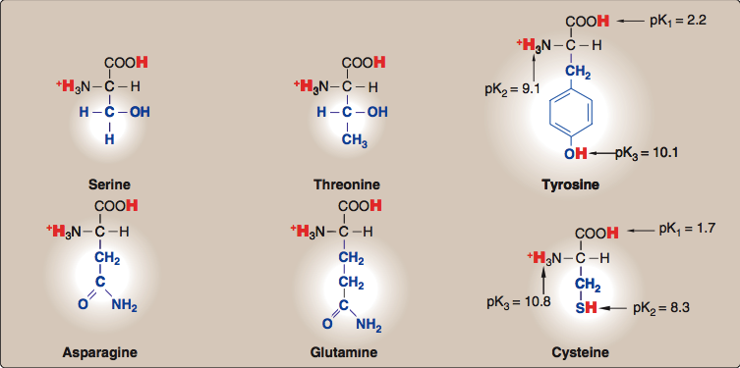

Slide 14
Mnemonics
Non-polar
ProGAV PIL TM proline, glycine, alanine, valine, phenylalanine, isoleucine, leucine
, tryptophan, methionine
Polar
"SomeTimes Cats Try A Growl" serine, threonine, cysteine, tryrosine , asparagine, glutamine
Charged
"A Good Lawyer Aims High" Aspartate, Glutamate, Lysine, Arginine, Histidine

Slide 15
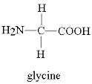
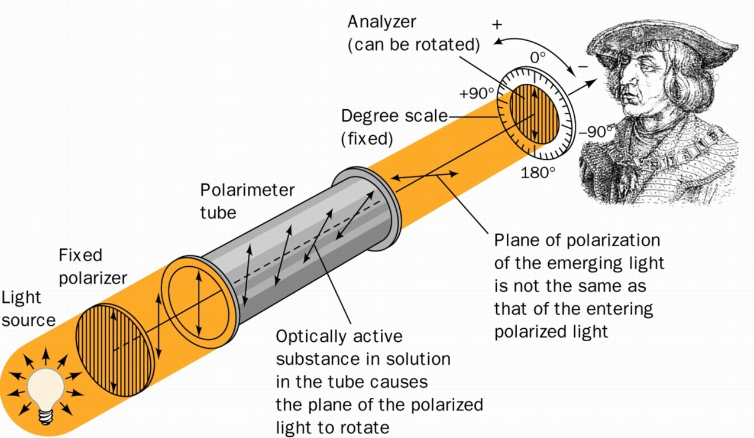
Optical properties
Asymmetric
The α-carbon of most of the amino acids is attached to four different chemical groups.
Asymmetric molecules are active
All mammalian amino acids are optically active ”except glycine”
They rotate the plane of polarized light in a polarimeter
Symmetric
Glycine is an example of symmetric amino acids “α-carbon is not attached to 4 different groups”
symmetric molecules are optically inactive.
You don't have to memorize it just for better understanding

Slide 16
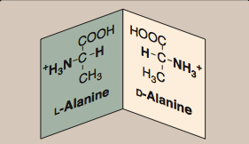
Amino acid configuration
right

Slide 17
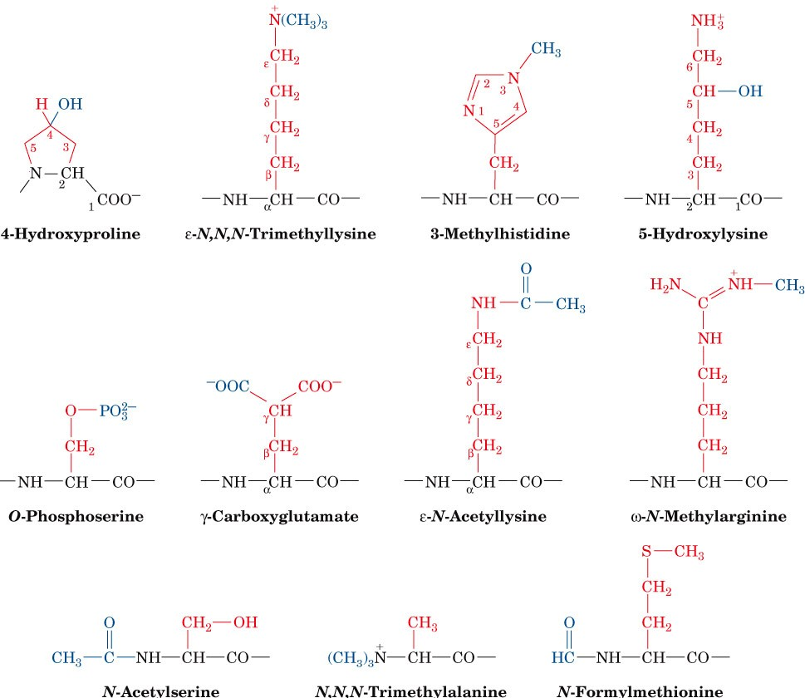
Non-standard amino acids
Aside from the twenty standard amino acids, there are a vast number of "non-standard" amino acids.
These nonstandard amino acids are usually formed through modifications to standard amino acids.
*you don't have to memorize the names.

Slide 18
Amino acids derivatives
Name | Derivative of | Role
Gamma amino butyric acid (GABA) | glutamic acid | neurotransmitters
Dopamine | tyrosine | neurotransmitters
Histamine | Histidine | the mediator of allergic reactions
Thyroxine | Tyrosine | An important thyroid hormone

Slide 19
Review
 |  | ESSENTIAL | NON ESSENTIAL | CONDITIONAL
NON POLAR SIDE CHAINS |  | Isoleucine, Leucine, methionine, phenylalanine, tryptophan and valine. | alanine | Glycine, proline
UNCHARGED POLAR SIDE CHAINS |  | threonine | asparagine | Cysteine, glutamine, tyrosine and serine
POLAR SIDE CHAINS | ACIDIC | ---------------- | Aspartic acid, glutamic acid | --------------
 | BASIC | Histidine, lysine | -------------- | arginine

Slide 20
MCQs + useful videos
Proline has a …………. amino group ?
A) Primary B) secondary C) tertiary D) quaternary
Histamine derivative of ?
A) Glutamic acid B) tyrosine C) tyrosine D) histidine
PK value
Classification of amino acids
Introduction to amino acids
Isoelectric point and zwitterion
*Proline is an imino acid

Slide 21
PI Calculation
 | Formula | Example
neutral side chains: | pI = 1/2 (pKa₁ + pKa₂)
acidic side chains | pI = 1/2 (pKa₁ + pKa₃)
basic side chains | pI = 1/2 (pKa₂ + pKa₃)
Lowest two pKa
Highest two pKa
More details about pI calculation:
http://www.mhhe.com/physsci/chemistry/carey5e/Ch27/ch27-1-4.html

Slide 22
Girls team members:
1- أسيل السليماني.
2- روان الوادعي.
3- ريم السرجاني.
4- ربا آل سالم.
5- سارة الشمراني.
6- سمية الغامدي.
7- شهد السويدان.
8- لجين الزيد.
9- منيرة الضفيّان.
Boys team members:
1- عبدالعزيز الشديد.
2- فهد العتيبي.
3- محمـد حبيب.
4- محمـد العسيري.
5- محمـد المهوس.
6- هشام القوسي.
7- حاتم النداح.
-Contact us:
Biochemistryteam436@gmail.com
twitter.com/436biochemteam
-Team leaders:
نوره السهلي.
عبدالله المانع.

