Slide 1
Cell signaling
– Color Index:
Important.
Extra Information.
Doctors slides.
436 Biochemistry team

Slide 2
Objectives:
Differentiate different steps in signaling pathways
Describe the second messenger systems
Recognize the function of signaling pathways for
Signal transmission
Amplification
Discuss the role of signaling pathways in regulation and integration of metabolism

Slide 3
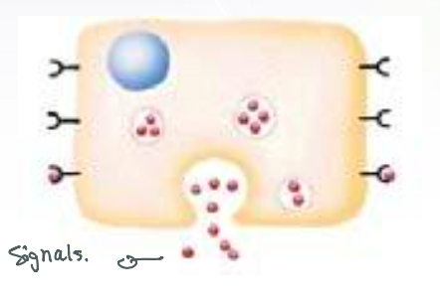
NO CELL LIVES IN ISOLATION*
Signalling Process
Cells communicate with each other.
Cells send & receive information (signals)**
Information is relayed (received) within cell to produce a response.
Recognition of signal*
By receptors
Transduction
Change of external signal into intracellular message with amplification & formation of second messenger**
Effect
Modification of cell metabolism & function***
General concept ☺
Cell signaling is part of a complex system of communication that governs basic activities of cells and coordinates cell actions. The ability of cells to understand correctly respond to their microenvironment is the basis of development, tissue repair, and immunity as well as normal tissue homeostasis.
#للربط
Transduction= transformation= change
Notes:
*Because cell survival depends on communication.
**Dr’s note:
If cells are adjacent to each other, they can communicate without signals
Dr’s notes :
*Signals which are lipid soluble can go directly to the cell without the recognition by a receptors. (No recognition step)
**The first messenger is called (Signals) while the second messenger is called (intracellular signals)
***The modification of cell metabolism & function is done by the second messenger (Intracellular signals)

Slide 4
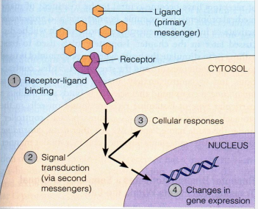
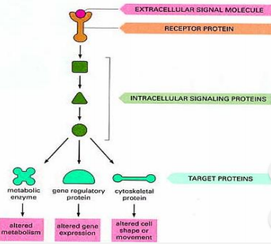
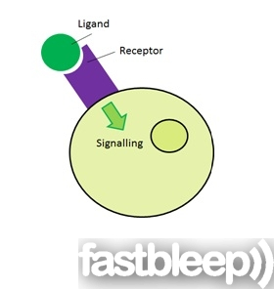
General signaling pathway (cascade)
1- The ligand ( signal or primary messenger ) will bind to the receptor
2- the receptor will recognize this signal.
3- This binding will stimulates the transduction by the second messenger, and this transduction includes:
Cellular responses
Changes in gene expression.
Biochemical cascade: a series of biochemical reactions, in which a product of the previous step is the substrate of the next.
1
2
3
Recognition
More in Next slide
Performed by receptors
Ligand (hormone or neurotransmitter) will produce response only in cells that have receptors for this particular ligand.
Each cell has a specific set of receptors
4

Slide 5
More in next slide

Slide 6
Different Responses to the Same Signaling Molecule: (B) Same Cell but, Different Pathways (continued)
Its secretion is stimulated by:
Hypoglycemia (deficiency of glucose in the bloodstream)
Glucagon (hormone) secretion¹
Hepatocyte (liver cells) : They have glucagon receptor ²
Second messenger: cAMP ( cyclic Adenosine Monophosphate )
Response: Enzyme phosphorylation (add P group)
P
P
Glycogen synthase³
(Inactive form)
Inhibition of glycogenesis
Both provide more glucose to blood
Glycogen phosphorylase⁴
(Active form)
Stimulation of glycogenolysis
Formation of glycogen
breakdown of glycogen to glucose
Glucagon is a peptide hormone, produced by alpha cells of the pancreas. The effect of glucagon is to make the liver release the glucose it has stored in its cells into the bloodstream, with the net effect of increasing blood glucose.
A receptor coupled with G-protein *more in next slide*
Is an enzyme involved in converting glucose to glycogen → therefore glucagon makes it INACTIVE.
Glycogen phosphorylase is one of the phosphorylase enzymes. It breaks up glycogen into glucose subunits.

Slide 7
(G-Proteins) GTP-Dependant Regulatory Proteins
G-Proteins : Trimeric ( 3 subunits α,β,γ ) membrane proteins.
Types according to its function :
G-stimulatory (G_{s}) and G-inhibitory (G_{i}) binds to GTP/GDP
come in between the receptor & 2nd messenger .
Regulate the formation of synthesis of 2nd messenger
Forms of G-Proteins
( β , γ separate from α)
Inactive form
Trimeric –bound GDP
(αβγ/GDP)
Active form
ONLY α-bound GTP
(α/GTP)
- The α-subunit has intrinsic GTPase activity ( act as an Enzyme ), resulting in hydrolysis of GTP into GDP and inactivation of G-proteins
Note: GTP: Guanosine triphosphate. GTP is essential to signal transduction, in particular with G-proteins, in second-messenger mechanisms where it is converted to guanosine diphosphate (GDP) through the action of GTPases.

Slide 8
Calcium phosphatidylinositol system.
Adenylyl cyclase system.
Remember ☺
Second messenger:
(intracellular signal
Formed during transduction)
intracellular signaling molecules released within the cell in response to a hormone to trigger physiological changes.
Two important second messenger systems:

Slide 9
First: Adenylyl cyclase system
Inhibition of protein kinase A (cAMP-dependent protein kinase)
Signal: Hormones or neurotransmitters are primary messengers
Hormones or neurotransmitters such as : Glucagon & Epinephrine
Or toxins such as : Cholera & pertussis toxins
Receptor: G-protein-coupled receptor
Adenylyle cyclase : a membrane bound enzyme
Function : It converts ATP to cAMP (cyclic AMP)
Second messenger : cAMP
Response: Activation/inhibition of protein kinase A
According to G-protein’s function: The resulting response will be:
Activation of protein kinase A (cAMP-dependent protein kinase)
Note: For example: The effect of adrenaline is via a G protein signaling cascade, which transmits chemical signals from outside the cell across the membrane to the inside of the cell (cytoplasm). The outside signal (in this case, adrenaline) binds to a receptor, which transmits a signal to the G protein, which transmits a signal to adenylyl cyclase, which transmits a signal by converting ATP to cAMP (2nd messenger)
Note: protein kinase A is a family of enzymes whose activity is dependent on cellular levels of cyclic AMP (cAMP).
It is activated by cAMP.

Slide 10
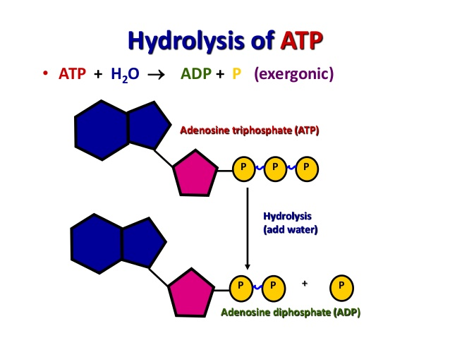
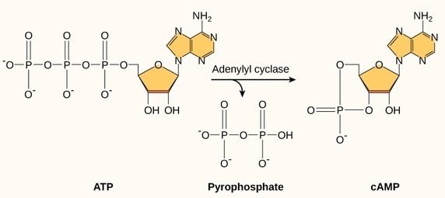
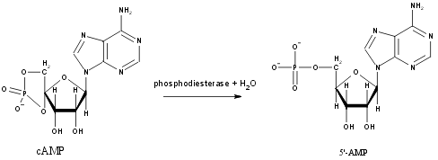
What is AMP & CAMP ?
Extra information that might help you:
We know that When the third phosphate is removed from ATP, we get ADP, which stands for Adenosine Di Phosphate.
BUT when two phosphates are removed from ATP, we get AMP.
cAMP is the cyclic structure of AMP, AMP is converted to cAMP by a specific Enzyme.

Slide 11
Signal Transduction: Adenylyl Cyclase System
Ligand/Receptor Binding Activation of Gs-protein
Activation of adenylyl cyclase
Resting state: No Signal
GDP is replaced by GTP which is bound to α- subunit, then α- subunit dissociates from β&γ subunits.
α- subunit binds to adenylyl cyclase and makes it active.
Binding of ligand (primary messenger) to the receptor activates G-protein.
Adenylyl cyclase converts ATP to cAMP .
cAMP is the second messenger.

Slide 12
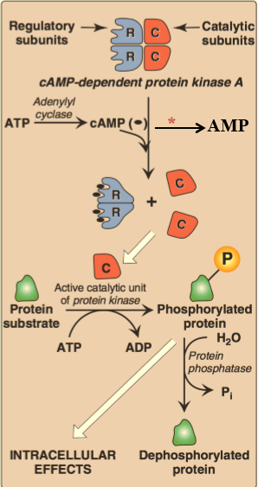
#NOTE: This information isn’t mentioned on the slides, but it’s already mentioned on the objective, so you should know it .
1-cAMP binds to cAMP-dependent protein kinase at its regulatory subunits.
2- then the catalytic subunits of cAMP-dependent protein kinase will be released.
3-Catalytic subunits catalyze the transferring of phosphate group from ATP to the specific amino acids of protein such as : serine & threonine.
4-When the phosphate group is bounded to the protein, it becomes phosphorylated
5-The resulting protein could be either active or inactive
Actions of cAMP
*phosphodiesterase
e.g. phosphorylated form of glycogen synthase is inactive while The Phosphorylated form of glycogen phosphorylase is active

Slide 13
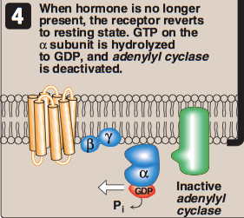
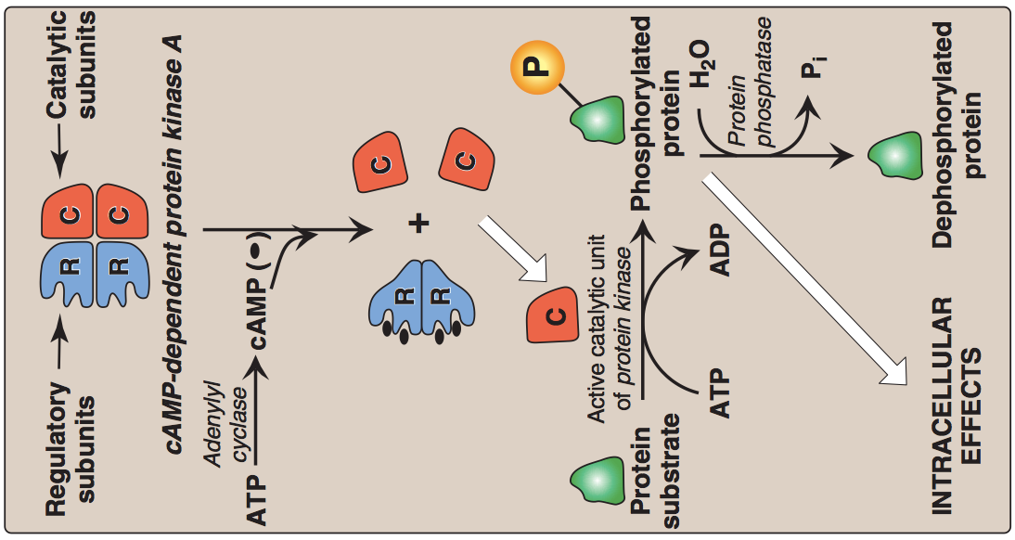
Termination of signal: *3 ways*
Degradation of Phosphorylated protein
Removing phosphate group (PO4) from protein by enzyme called protein phosphatase
Inhibition of protein kinase A
Decreasing the amount of cAMP by enzyme called phosphodiesterase which converts cAMP to AMP
Inhibition of adenylyl cyclase
By hydrolyzing GTP to GDP in G-protein which leads to inactive form of G protein then α-subunit will bind to β &γ subunits
Phosphodiesterase
AMP

Slide 14
G-PROTEIN COUPLED RECEPTOR
- This is called seven pass receptor because it crosses cell membrane seven times.
- It has an extracellular domain receives signals and intracellular domain which holds G-PROTEIN

Slide 15
Glycogen : polysaccharide form with glucose is stored in animal tissues like liver .
Glucagon :
protein hormone produced by pancreas .
Regulation of Glycogen Metabolism by Glucagon:
Effects on Glycogen Synthase and Phosphorylase
لما يقل مستوى السكر أو الجلكوز بالدم ، يبدأ البنكرياس يفرز هرمون الجلوكاجون اللي بدوره يزيد مستوى الجلوكوز ، كيف؟ يروح هالهرمون للهدف اللي هي خلايا الكبد ويسوي شيئين، ليش الكبد بالذات؟ عشان فيه يتخزن الجلايكوجين وش هو هالجلايكوجين؟ هذا بوليمر (بولي سكرايت) متكون أساسا من مونومر ( الجلكوز ) ، طيب وش الفايدة؟ عشان احنا نبغى نزيد كمية الجلكوز بالدم، من وين نجيب هالجلوكوز ؟ من تكسير الجلايكوجين اللي متخزن من قبل بالكبد إلى جلوكوز وننزله على الدم، بالمقابل نبغى نقتصد أو نقلل استهلاك الجلوكوز إلا للضرورة فنروح نثبط عملية تكوين الجلايكوجين، وهالشيئين طبعًا نحتاج فيها إنزيمات.
The Action (stimuli)
Hypoglycemia
The Hormone
Glucagon secretion
The Target
Hepatocyte: Glucagon/receptor binding
Second messenger
cAMP
Response
Enzyme phosphorylation
Insulin :
Decreased the level of glucose in the blood .
Glucagon :
Increased the level of glucose in the blood.
Glycogenesis :
The formation and storage of glycogen .
Glycogenolysis :
the breakdown of glycogen .
Glycogen phosphorylase (the enzyme )
(Active form)
Stimulation of glycogenolysis
Glycogen synthase(the enzyme )
(Inactive form)
Inhibition of glycogenesis

Slide 16
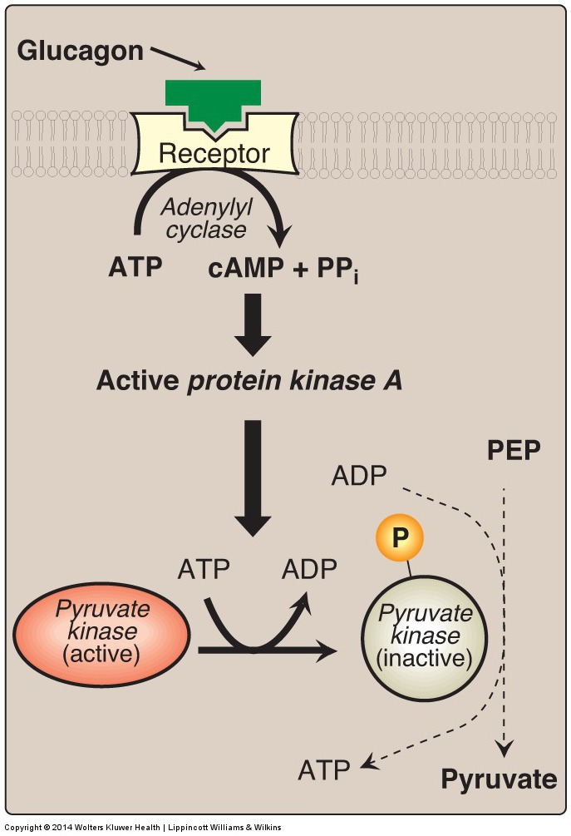
Pyruvate Kinase Regulation: Covalent Modification
It is the last step in Glycolysis.
Glucagon is released then binds with the receptor .
It activates the Adenylyl Cyclase which will convert ATP to cAMP .
cAMP activates the Protein Kinase A .
This protein Kinase A can phosphorylate (Add phosphate group) the pyruvate kinase .
After that it becomes Inactive
So the Glycolysis is stopped .
In Hypoglycemia :
Stop Glycolysis .
Stop Glycogenesis.
Start Glycogenolysis .
تكمله لأحداث السلايد اللي قبل ، هرمون الجلوكاجون ممكن يستهدف شيء ثاني غير خلايا الكبد مثلا خلايا الجسم العادية ،ايش يبغى منها ؟ طبعا إنها توفر أو تقلل من استهلاك الجلوكوز ، ليش ؟ لأنها بشكل طبيعي تستخدم الجلوكوز في عملية التنفس الخلوي عشان تنتج طاقة، فيروح للخلايا هذي ويثبط شوي عملية تكسير الجلوكوز إلا للضرورة .
Pyruvate kinase is regulated by covalent modification
Covalent modification are alterations of proteins by enzymes. It includes addition and removal of chemical groups (phosphate in this case).
This is an example of pathways with adenylyl Cyclase.
Remember:
Protein Kinase A has several functions in the cell, including regulation of glycogen, sugar & lipid metabolism

Slide 17
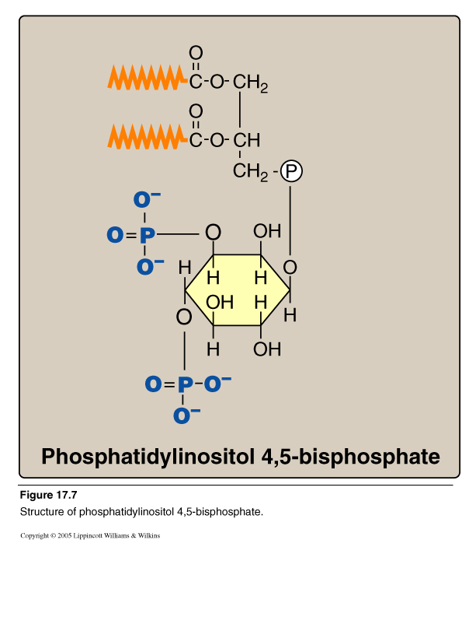
Second: Calcium/Phosphatidylinositol System
We can find it in the cell membrane , it plays an important role in cell signaling by Calcium/Phosphatidylinositol System .
Structure of Phosphatidylinositol :
Di-acyl-glycerol (DAG)
+
inositol 4-5 bisphosphate
Phospholipase C breaks the bond with red arrow.
After breakdown, inositol 4-5bisphosphate Takes the phosphate group (PO4) with red arrow becoming Inositol 1,4,5 triphosphate.
Phospholipase C

Slide 18
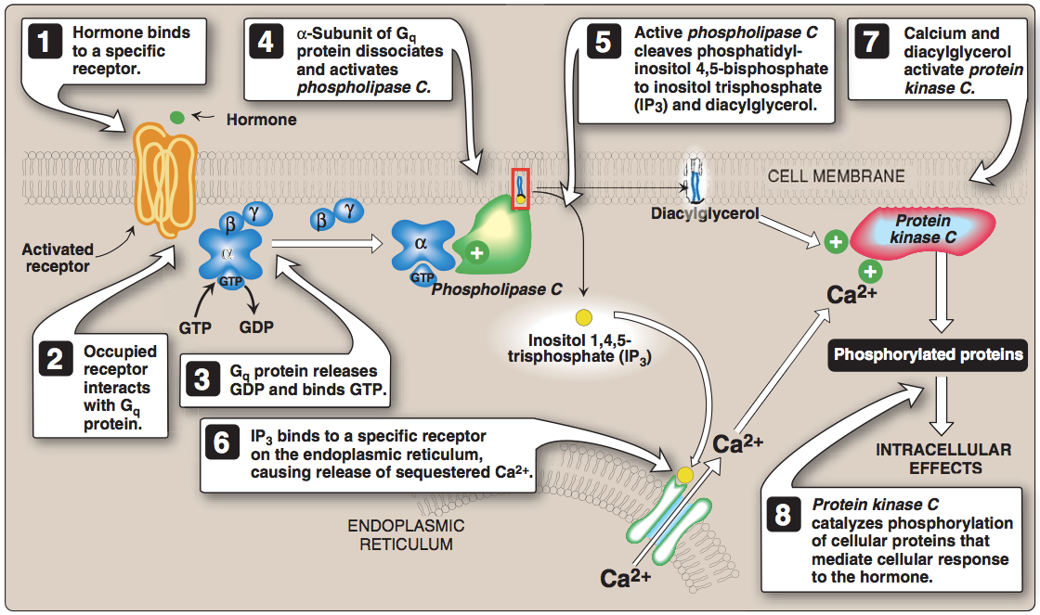
Intracellular Signaling by Inositol trisphosphate
e.g., Antidiuretic hormone (ADH), Acetylecholine

Slide 19
1. Binding
Hormone/neurotransmitter binds to G-protein coupled receptor.
2,3. Receptor Interaction
Receptor will Interact with G-protein Which will lead to replacing GDP with GTP.
4. Dissociation
α-subunit dissociates from β & γ subunits, and activates Phospholipase C.
5. Breaking Down
Phospholipase C break phosphatidylinositol 4-5bisphosphate into DAG + inositol 4-5 bisphosphate
6. Ca Releasing
ER stores Calcium Which released to the cytoplasm when IP3 binds. (IP3: Inositol 1,4,5 triphosphate)
7. Kinase C Activation
Calcium and DAG activate protein kinase C
8. Responding to Action
Protein kinase C catalyze protein phosphorylation. These proteins will give the response of the hormone or neurotransmitter.
e.g. “Antidiuretic hormone (ADH), Acetylecholine”

Slide 20
Calcium/Phosphatidylinositol | Adenylyle cyclase | The system
Phospholipase C | Adenylyle cyclase | Enzyme
Diacylglycerol (DAG) & Inositol 1,4,5 triphosphate (IP3) | cAMP | Secondary messenger
Protein kinase C (C stand for Ca++ ) | Protein kinase A (A stand for cAMP ) | Protein
Acetylcholine & Anti-diuretic Hormone | -hormones or neurotransmitters ( e.g. Glucagon & Epinephrine) Toxins ( e.g. cholera and pertussis toxins) | signal

Slide 21
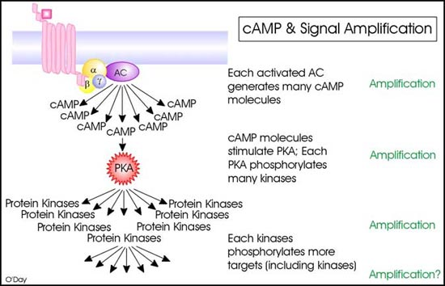
Signal Amplification
Signal amplification means that the process
doesn’t occur in 1:1 ratio for example:
1 adenylyl cyclase generates 10 or 100 cAMP
cAMP activates 1000 protein kinases
Protein Kinase phosphorylates a lot of targets.
كل شي أخذناه إلى الآن أكيد ما يصير بشكل بسيط أو حبة حبة ، كل خطوة فيها تتضاعف مرات ومرات وتعطي انتشار للإشارة ، بمعنى إذا وصل الهرمون للمستقبل بعد ما ينشط البروتين ، البروتين بدل ما ينتج cAMP واحد لا ينتج عشر ، و هالعشر كل واحد فيها يستهدف ميه وكل واحد من هالمية يستهدف ألف ، وبكذا يكون الإشارة تضاعفت عشر آضعافها أو حتى ألف ضعف .

Slide 22
TAKE HOME MESSAGE
Cell signaling allows:
Signal transmission and amplification.
Regulation of metabolism.
Intercellular communications & coordination of complex biologic functions.
#NOTES:
- Phosphorylation doesn’t mean activation, certain enzymes are activated by dephosphorylation. - Enzymes stimulated by insulin activated by dephosphorylation while enzymes stimulated by glucagon are activated by Phosphorylation.

Slide 23
videos
G-Protein Coupled Receptors| Khan Academy
Signal Transduction Pathways
Signal Amplification
Calcium/phosphatidylinositol system
cAMP+G-Protein (highly recommended)
Calcium/Phosphatidylinositol System (highly recommended)
MCQs

Slide 24
TEAM 436
Girls team members:
1- مها الغامدي.
2- لمى الفوزان.
3- ريم السرجاني.
4- بثينة الماجد.
5- سارة الشمراني.
6- روان سعد.
7- نوره الشبيب.
Boys team members:
1- محمد المهوس.
-Team leaders:
نوره السهلي.
عبدالله المانع.
-Contact us:
Biochemistryteam436@gmail.com
twitter.com/436biochemteam

