Slide 1
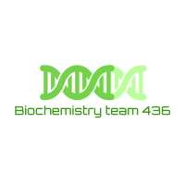

Major Metabolic Pathways of Glucose
& Glucose Transport
– Color Index:
Important.
Extra Information.
Doctors slides.
436 Biochemistry team

Slide 2
Objectives:
Define a metabolic pathway.
Describe the general metabolic pathways for
glucose (production and utilization).
Briefly describe the HMP.
Recognize the mechanisms of glucose transport

Slide 3
Pathway: Series of chemical reactions that have one goal.
Reaction: Substrate+Substrate Product.
Metabolic pathways
Definition
Pathway for glucose happens in almost every cell, starting by oxidation of glucose and ending with pyruvate (or lactate).
Regulatory mechanism(s)
Site
Reaction
1- Rapid short-term
-Covalent modification
-Allosteric
2- Slow long-term (hormone)
-Induction\repression
- Cellular tissue (tissue)
- Subcellular
Inside the cell (Mitochondrial)
Few are rate-limiting enzymes (They are found only in irreversible pathways).

Slide 4
Metabolic pathways of glucose
Catabolic Cycles | Anabolic Cycles
Glycolysis & Kreb (mainly) Glycogenolysis HMP | Gluconeogenesis Glycogenesis
Production
Glycogenolysis
Gluco-neo-genesis
Hexose interconversion
To understand ☺
*You DON’T have to know this*
Prefix:
Glyco-: glucose
Glycogeno-: glycogen
*except in synthesis of glycogen: we say glycogensis instead of saying glycogeno-genesis.
To differentiate: the synthesis of glucose is glucoNEOgenesis*
Catabolic
Anabolic
Utilization
HMP / PPP
Glyco-lysis
Hexose interconversion
Glycogenesis
Catabolic
Catabolic
Anabolic
Suffix:
-genesis: process of producing
-lysis: breaking down.
Krebs cycle
Catabolic

Slide 5
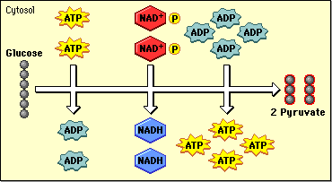
GLYCOLYSIS
*Aerobic: with oxygen
*Anaerobic: without oxygen
Oxidation (breaking down) of glucose to provide energy
Aerobic glyclolysis
 | Anaerobic glycolysis | Aerobic glycolysis
When | In absence of oxygen , cells that lack mitochondria | If there is enough(adequate supply) oxygen, Cells that has mitochondria
End product | Lactate + 2 ATP | Pyruvate(s) + 8 ATP

Slide 6
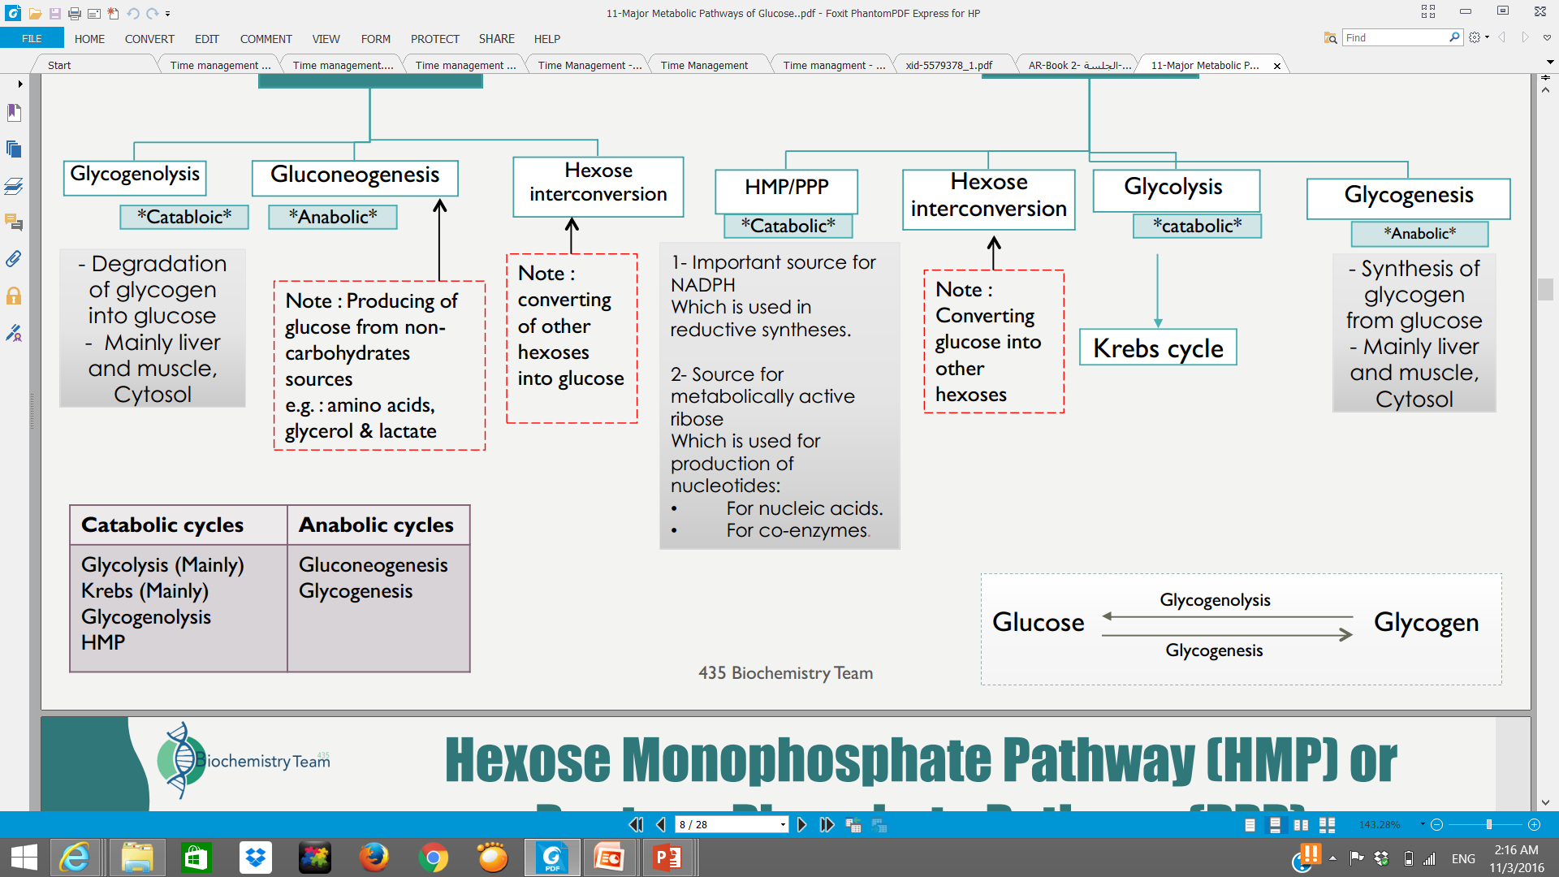
Glycogenesis and Glycogenolysis
Glycogenesis
Glycogenolysis
Occurs when glucose and ATP are present in relatively high amounts (This process is: storage)
Synthesis of glycogen from glucose
Occurs in response to hormonal and neural signals
Degradation (تكسير) of glycogen into glucose
(اذا زاد الجلوكوز في الجسم و كانت الطاقة موجودة يتم تخزين الجلوكوز على شكل جلايكوجين عشان يحرقه و يستخدمه بعدين)
(اذا احتاج الجسم يرسل اشارت كهربائية او هرمونات لتكسير الجلايكوجين و تحويله لجلوكوز)
Both the same location: Mainly in liver and muscle→ Cytosol

Slide 7
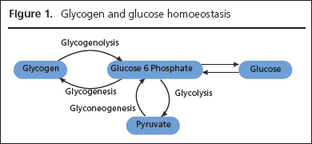
Gluconeogenesis
صناعة الجلوكوز من مواد غير الكربوهيدرات
Synthesis of glucose from non-carbohydrate precursors
Precursor: is a chemical that is transformed into another compound
The precursors could be lactate (anaerobic), pyruvate (aerobic), glycerol and alpha-keto acids
It requires mitochondria and cytosolic enzymes
Occurs in Liver and kidney
Glycerol: is a part of the triacylglycerol molecule which is the main constituent of body fat.
Keto acids: are organic compounds that contain a carboxylic acid group and a ketone group. The alpha-keto acids are especially important in biology as they are involved in the Krebs citric acid cycle and in glycolysis.
cytosolic enzymes: present in cytosol.

Slide 8

Hexose MonoPhosphate shunt (HMP)
Also known as Pentose Phosphate Pathway (PPP)
Note: Oxidation of glucose, also known as glycolysis, is the process which releases energy stored in glucose by combining it with oxygen.
HMP shunt is an alternative (another) pathway of glucose oxidation.
Has the same regulatory mechanism's as glucose (rapid short-term and slow long-term)
it is not involved in the generation of energy unlike glycolysis
Around 10% of glucose (that all the body makes) is entered in this pathway.
In liver and kidney→ this percentage is up to 30%
Occurs in many places such as the cytosol of the liver, adipose tissue (to produce fatty acids from glucose)
Has two main functions and two phases
فيديو يلخّص لك
1- Oxidative phase
2- Non-oxidative phase
1-Provides NADPH
2- Provides Pentoses

Slide 9
Biomedical Importance of (HMP) & (PPP)
A source of NADPH
NADPH is required for:
Synthesis of fattyacids, steroid and some amino acids.
Detoxification of drugs by (cytochrome P450 ) .
In scavenging (remove) the free radicals .
Provides Pentoses for: (Pentose and its derivatives are useful in the synthesis of: )
Nucleic acids (DNA and RNA )
Nucleotides ( ATP , NAD ,FAD and CoA )
Note: Cytochrome P450: enzymes also function to metabolize potentially toxic compounds, including drugs and products of endogenous metabolism such as bilirubin
436 Biochemistry team

Slide 10
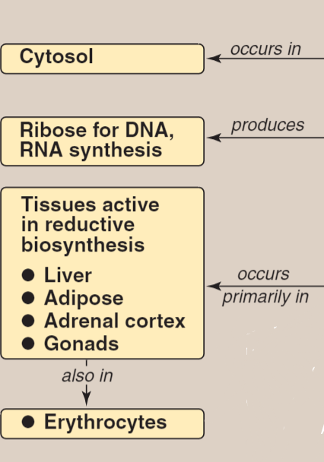

Tissue Distribution
From Lippincott
Location of HMP: in the Cytosol of the following locations:
Liver | Lactating mammary glands | Adrenal cortex | Gonads
Adipose Tissue | Erythrocytes(RBC) to reduce glutathione | Lens | Cornea
Glutathione: antioxidant capable of preventing damage caused by reactive oxygen species. (Free Radicals)
Cornea: the transparent layer forming the front of the eye.
The adrenal cortex: the outer part of the adrenal gland.
Gonads: an organ that produces gametes; a testis or ovary.
Notes ☺
Phases of HMP Shunt
Oxidative phase
-which provides NADPH-
Non-Oxidative phase
-which provides pentoses-
Oxidative phase
436 Biochemistry team
Non-Oxidative phase

Slide 11
Phase1: oxidative pathway
Colors are for your understanding ☺
The purpose of this phase is to :
1- provide 2 NADPH
2- convert Glucose6-phosphate to
Ribulose 5-phospate which is an important molecule to start the next phase.
Note ☺
We start with Glucose-6-Phosphate C₆H₁₃O₉P
We end with Ribulose 5-phosphate C₅H₁₁O₈P
Ribose: aldose sugar
Ribulose: Ketone sugar

Slide 12
Phase2: non oxidative
A) Interconversion of pentose
***girls doctor said skip it
الهدف منه سكر خماسي وسداسي
Ribulose 5 phosphate
يتحول الى :
Ribose 5 phosphate
Xylulose-5P: an intermediate in the pentose phosphate pathway. It is a ketose sugar formed from ribulose-5-phosphate.
These non-oxidative reversible reactions permit ribulose
5-phosphate to be converted either to ribose 5-phosphate (needed for nucleotide synthesis) or to intermediates of glycolysis—fructose 6-phosphate
and glyceraldehyde 3-phosphate.
***
#للرّبط: تنطق "زي اللوز"
Remember that 2 important enzymes are needed in non-oxidative reactions :
1- Transketolase, an enzyme always associated with TPP (Thiamine pyrophosphate)
TPP: a prosthetic group (is a Coenzyme associated permanently) for the Transketolase enzyme.
It is important to activate the enzyme.
2- Transaldolase.

Slide 13
التفاعل الاول
تحويل ribulose الى ribose
Colors are for your understanding ☺
(Conversion of pentose phosphate to hexose phosphate)
Non Oxidative
التفاعل الثاني
Ribose + xylulose ( this reaction is catalyzed by Transketolase with TPP). And will give us 2 new sugar molecules :
Sedoheptolose (7C) AND glyceraldehyde (3C)
مهم
التفاعل الثالث
Sedoheptolose +glyceraldehyde (this reaction is catalyzed by Transaldolase) And will give us 2 new sugar molecules : fructose (6C). And erythrose (4C).
تفاعلات Xylulose تكون مصحوبة بإنزيم transketolase .
وزي ماقلنا هالإنزيم دايما يكون معاه TPP
التفاعل الأخير
Xylulose5-P+Erythrose4-P ( this reaction is catalyzed by Transketolase with TPP. And will give us 2 sugar molecules :
Fructose 6-P AND
Glyceraldehyde 3-P .
Note: both Glyceraldehyde and fructose are intermediates of glycolysis

Slide 14
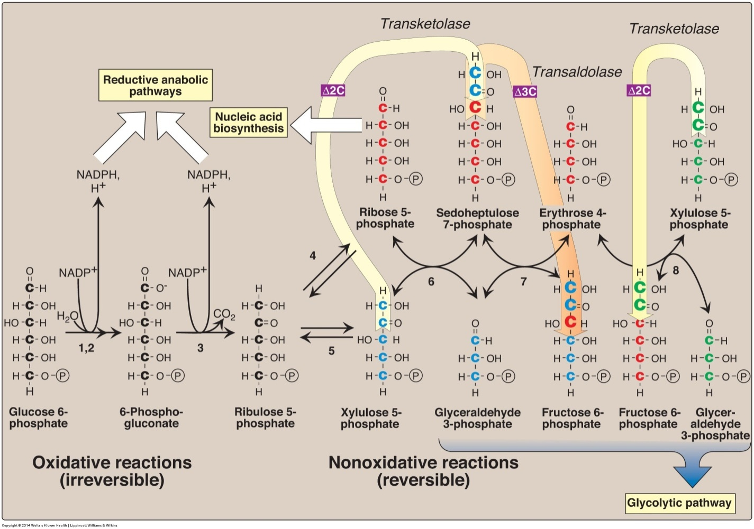
Colors are for your understanding ☺
Phase One
Phase One
Enzymes numbered above are: 1, 2) glucose 6-phosphate dehydrogenase and 6-phosphogluconolactone hydrolase
3) 6-phosphogluconate dehydrogenase, 4) ribose 5-phosphate isomerase, 5) phosphopentose epimerase
6 and 8) transketolase (coenzyme: thiamine pyrophosphate) and 7) transaldolase.

Slide 15
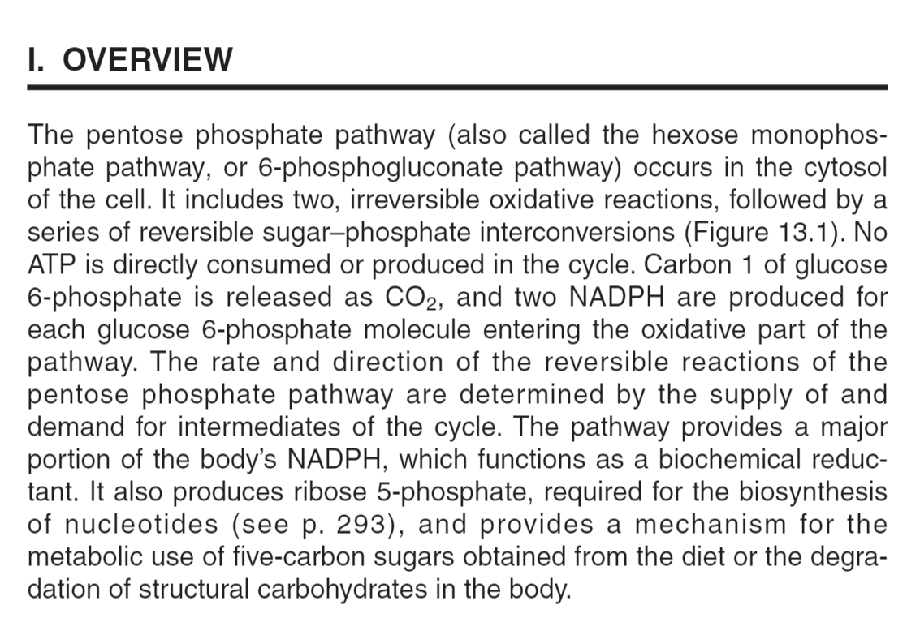
Extra explanation: From Lippincott

Slide 16
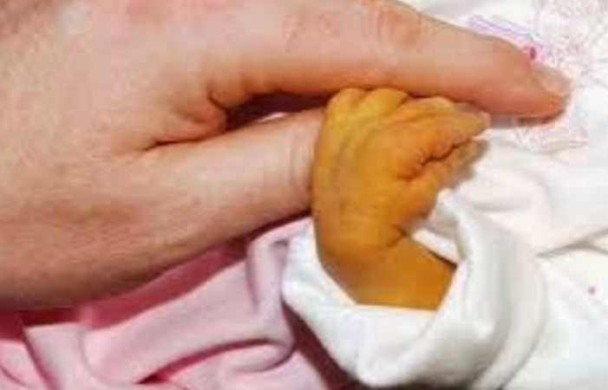
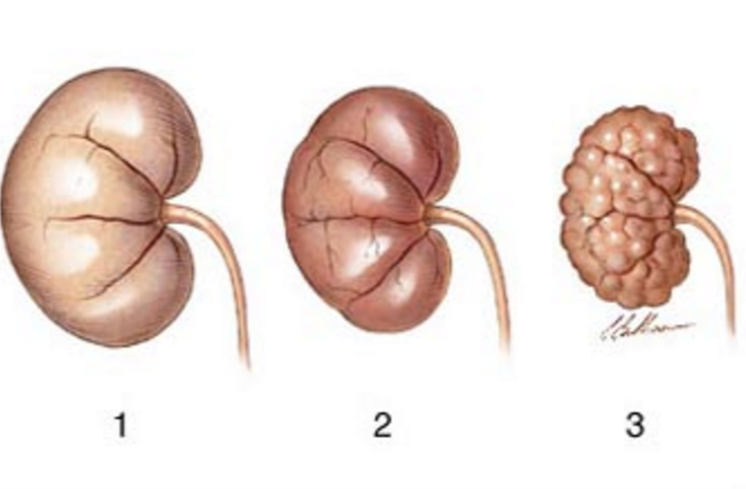
Clinical Correlations
G-6-PD deficiency results in :
Heamolytic Aneamia
Notes ☺
Glucose-6-phosphate dehydrogenase deficiency
The condition is characterized by abnormally low levels of glucose-6-phosphate dehydrogenase, an enzyme involved in the pentose phosphate pathway that is especially important in the red blood cell. G6PD deficiency is the most common human enzyme defect
Hemolytic anemia: relating to or involving the rupture or destruction of red blood cells.
Neonata: relating to newborn children
Neonatal Jaundice
Kidney failure

Slide 17
Glucose Transport
(GLUT 1-14)
• Tissue-specific expression pattern
Na+
Monosaccharide Co-transporter:
Na-Independent
Facilitated Diffusion
GLUT-1
GLUT-2
GLUT-3
GLUT-4
GLUT-5
GLUT-7
RBCs and brain (blood-brain barrier)
Adipose tissue & skeletal muscle
Small intestine & testes
Liver (ER-membrane
Liver, kidney & pancreas
Against concentration gradient
Energy dependent
Carrier-mediated
Coupled to Na+ transport
Down the concentration gradient
Energy-Independent
Glucose Transporters (GLUT 1-14)
Neurons
GLUT-1, 3 & 4: Uptake of glucose from the blood.
GLUT-2: Blood, cells it’s a bidirectional transporter, allowing glucose to flow in 2 directions.
GLUT-5: Fructose transport .
Boys doctor mentioned that now it 20 Glucose transporters
Note : GLUT-4 is insulin
sensitive, because it
needs insulin to work.

Slide 18
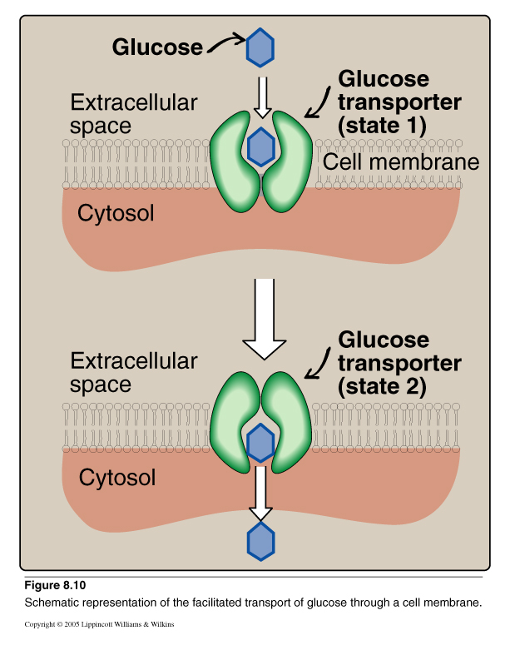
Glucose Transport: Facilitated Diffusion
435 Teamwork:
- الجلوكوز لا يستطيع أن ينتشر خلال الخلية , لأنه مركب هايدروفيلك \ محب للماء .
- لذلك فهو يحتاج إلى طريقة أخرى , فإما أن يدخل مع الصوديوم عن طريق الكو ترانسبورت الذي سبق أن تعرفنا عليه بالفسيولوجي.
- أو أنه يدخل عن طريق كارير بروتينز خاصة به بطريقة الفاسيليتد دفيوجن والتي أيضا سبق التعرف عليها بالفسيولوجي. (مثل الصورة)

Slide 19
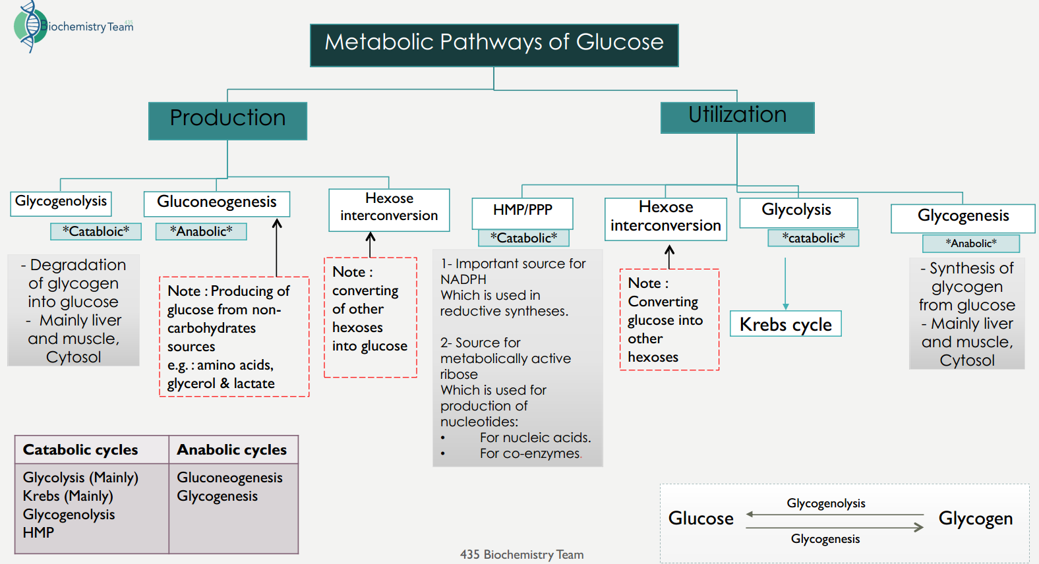
Revision

Slide 20
Take home messages
There are multiple pathways for glucose that can be grouped in to catabolic (utilizing glucose) or anabolic (producing glucose)
Glycolysis is the major metabolic pathway of glucose breakdown to provide energy
Alternative pathway for glucose oxidation but not meant for producing energy
Has two phases- oxidative and non-oxidative
During oxidative phase, glucose-6-P is oxidized with generation of 2 moles of NADPH, and one mole of pentose phosphate, with liberation of CO2
During non-oxidative phase, pentose phosphate is converted to intermediates of glycolysis
QUIZ

Slide 21
Boys team members:
1- حمد الحسون.
2- محمد حكمي.
3- خالد القحطاني.
4- حمد الحميدان.
5- محمد حبيب.
6- خالد الراجح.
7- فهد العتيبي.
8- طلال الطخيم.
Girls team members:
نورة الشبيب
-Team leaders:
عبدالله المانع.
نوره السهلي.
-Contact us:
Biochemistryteam436@gmail.com
twitter.com/436biochemteam

