Slide 1
Glycolysis
– Color Index:
Important.
Extra Information.
Doctors slides.
436 Biochemistry team

Slide 2
Objectives :
Recognize glycolysis as the major oxidative pathway of glucose
List the main reactions of glycolytic pathway
Discuss the rate-limiting enzymes/Regulation
Assess the ATP production (aerobic/anaerobic)
Define pyruvate kinase deficiency hemolytic anemia
Discuss the unique nature of glycolysis in RBCs.

Slide 3
Glycolysis
Glycolysis
1-Aerobic
(Available both : O2 &
mitochondria)
2- Anaerobic
(Absence of O2 or mitochondria or both of them)
It is the major pathway for glucose oxidation, in the cytosol of all cells .
It works aerobically or anaerobically, depending on the availability of oxygen and intact mitochondria .
It allows tissues to survive in presence or absence of oxygen, e.g. Skeletal muscle.
RBCs rely completely on glucose as their metabolic fuel "metabolized by anaerobic glycolysis.
The general concept:
Glycolysis breaks down glucose and forms pyruvate with the production of two molecules of ATP. The pyruvate is the end product of glycolysis.
We highly recommend you watch this video:

Slide 4
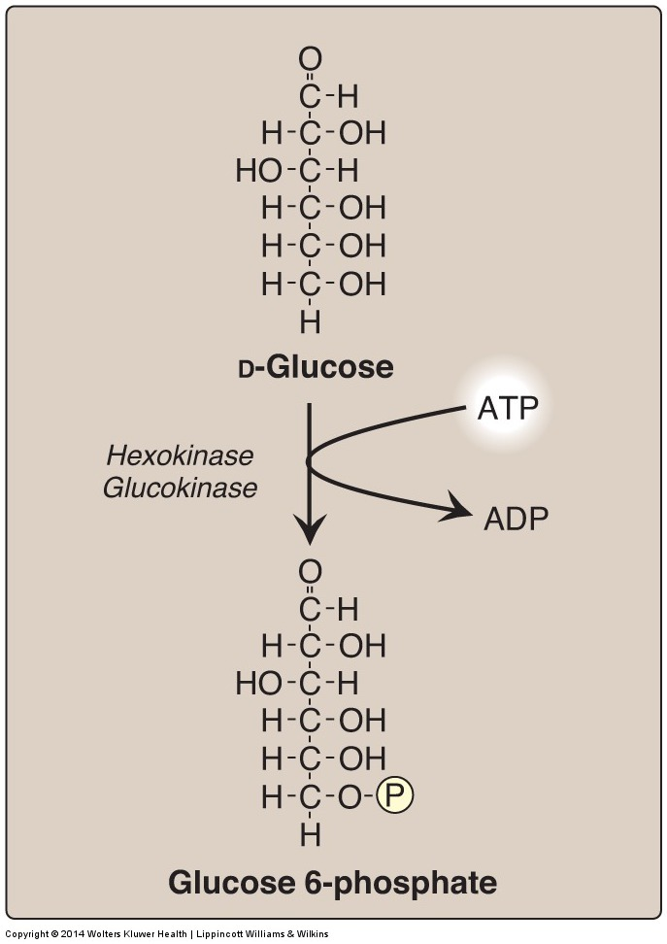
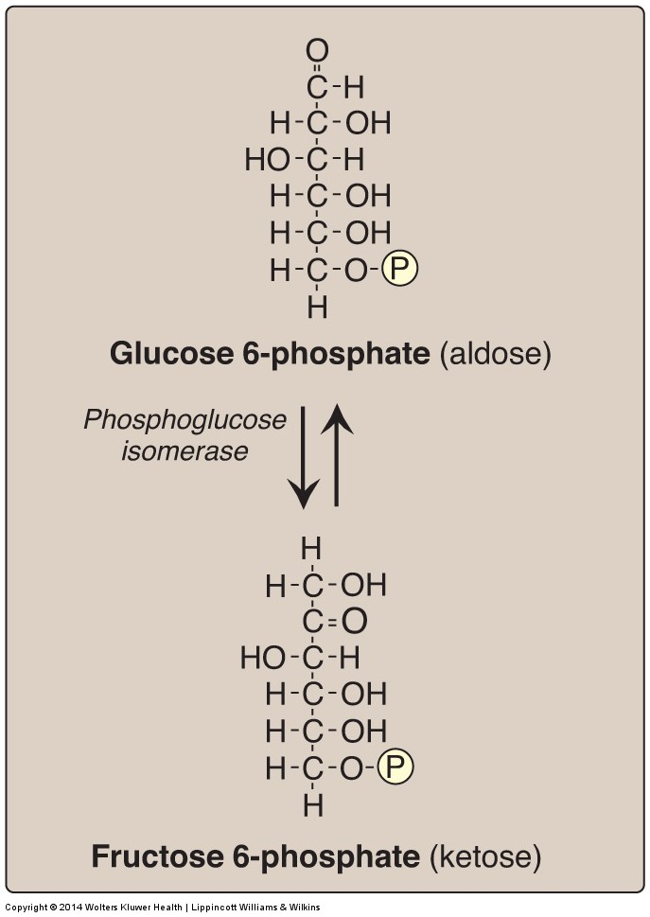
Aerobic glycolysis reactions (1st and 2nd)
ايش الحكمة من إضافة مجموعة الفوسفات ؟ ببساطة عشان تسجن الجلكوز جوا الخلية ،كيف؟ لأن البروتينات اللي موجودة Cell membrane وتنقل الجلكوز من برا لجوا الخلية ما راح تتعرف على الجلكوز إذا كان معه بالتركيب أي شيء ثاني مثل الفوسفات
Reaction 1 :
From Glucose to
Glucose 6-phosphate by hexokinase (in most tissues) or glucokinase (in liver), consuming 1 ATP.
Most tissues
Hepatocytes
Is irreversible and regulated step
Reaction 2 :
From Glucose 6-phosphate to Fructose 6-phosphate by phosphoglucose isomerase.
(isomerization)
No consumption of ATP.
*We will learn their regulation later ☺*
Is reversible and is not a rate-limiting or regulated step

Slide 5
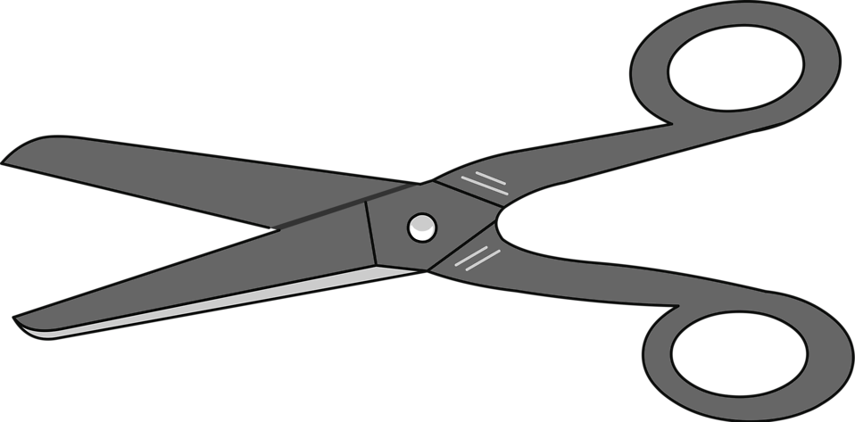
Aerobic glycolysis reactions (3rd – 5th)
Reactions 1-5 :
Energy consuming reactions
*Will be explained later*
Reaction 3 :
From Fructose 6-phosphate to
Fructose 1,6-biphosphate by phosphofructo-kinase-1
consuming 1 ATP.
Reaction 4 :
Fructose 1,6-biphosphate cleavage (split) into both Glyceraldehyde 3-phosphate and Dihydroxyacetone phosphate by aldolase
No consumption of ATP.
Reaction 5 :
From Dihydroxyacetone phosphate to Glyceraldehyde 3-phosphate
(total of 2 G3P in the reaction)
No consumption of ATP.
*reversible*
Is irreversible and regulated step
Notes ☺
The enzyme is called “aldolase” because it splits fructose 1,6-bisphosphate the “aldol” into
two 3C phosphates:
Di-hydroxy-acetone phosphate
Glycer-aldehyde 3-phosphate.
(isomers of each other)
Understand the molecules:
Acetone= the simplest ketone (3C)
Glyceraldehyde= 3C monosaccharide, the simplest aldose.
Is reversible and is not a rate-limiting or regulated step

Slide 6
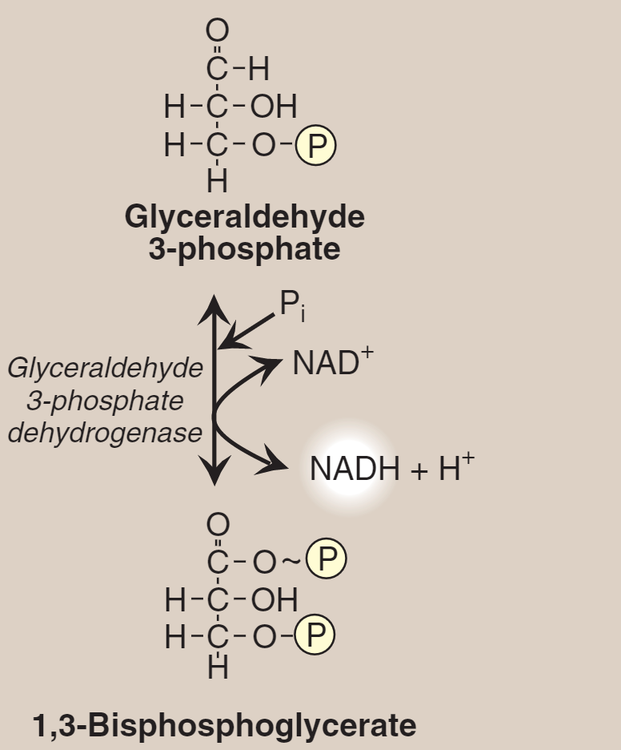
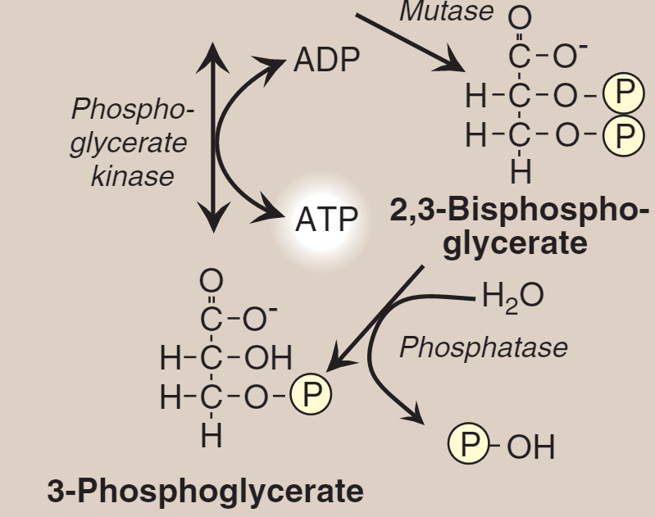
Aerobic glycolysis reaction (6th – 10th)
The first oxidation-reduction reaction of glycolysis
6th
Reactions 6-10 :
Every reaction is multiplied by 2, due to having 2 G3P (glyceraldehyde 3-phosphate)
*They’re Energy producing reactions*
6th Reaction : (Oxidative level)
Oxidation to the molecule NAD+ →NADH
this reaction adds Phosphate group to the molecule by Glyceraldehyde 3-Phosphate Dehydrogenase
*We’ll learn about this later in glycolysis in RBCs *
Understand the molecules involved:
Glyceraldehyde → when it’s oxidized it becomes Glycerate (an acid)
7th
7th Reaction : (Substrate-level)
Phosphate group add to ADP to become ATP.
By Phosphoglycerate kinase

Slide 7
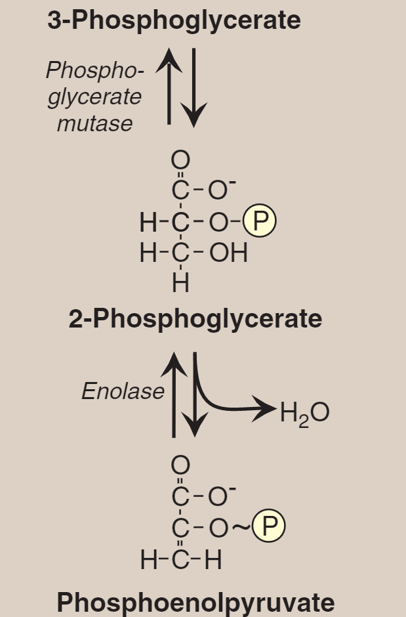
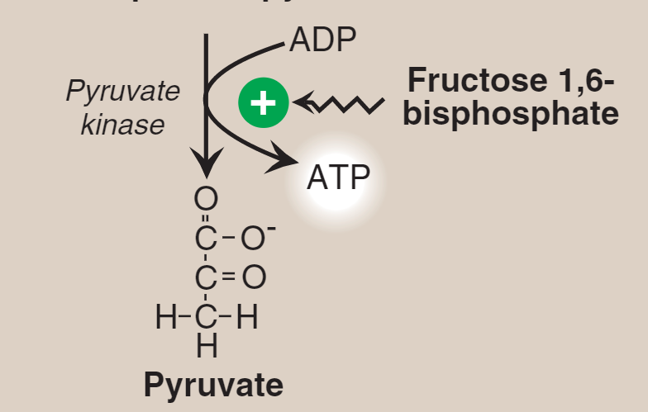
8th
8th Reaction :
It is isomer and what changes is : The P group change position from O in carbon-3 to O in carbon-2 by phosphoglycerate mutase
9th
9th Reaction :
Phosphoglycerate change to phosphoenolpyruvate by remove water by Enolase
10th Reaction : (Substrate-level)
Phosphoenolpyruvate → pyruvate by Pyruvate kinase . Fructose 1,6-bisphosphate formed in 3rd step , it will go to the last step (it is Allosteric)
Is irreversible and regulated step
10th
*End product of Glycolysis*

Slide 8
Regulation of glycolysis
Regulation of glycolysis:
Regulatory enzymes
The four regulatory enzymes are hexokinase, glucokinase, phosphofructokinase, and pyruvate kinase.
Mechanism of regulation:
Either short-term and rapid (we will learn this first- the next slides)
Or long-term and slow (slide #13)
2,3-BPG

Slide 9
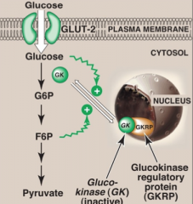
Regulation of
Hexokinase and Glucokinase
Regulation by: allosteric effectors.
Glucokinase: is an enzyme that facilitates phosphorylation of glucose to glucose-6-phosphate.
It is is an isozyme of hexokinase.
Regulation (تنشيط او تثبيط) of hexokinase (in most cells) and glucokinase (in liver)
Hexokinase : when Glucose 6-P (Fructose 6-phosphate is in equilibrium with it) is abundant it will indicate to the cell that it doesn’t need hexokinase anymore and it will be inhibited directly.
Inhibited indirectly by Fructose 6-P
Glucokinase (hexokinase type 4)
Stimulated indirectly by Glucose
In the presence of high Fructose 6-P, Glucokinase will translocate and tightly bind to GKRP (Glucokinase regulatory protein) in the nucleus making it inactive.
when glucose levels is high in blood and hepatocytes (GLUT-2), glucokinase is released from GKRP to the cytosol.
GLUT-2 is glucose transporter in liver

Slide 10
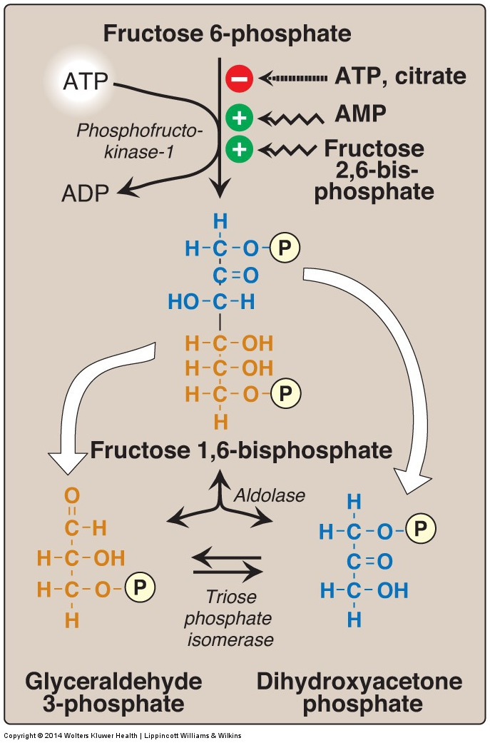
Regulation of PFK-1 (phosphofructokinase-1) Regulation by: allosteric effectors.
When ATP and Citrate are abundant (more than enough) they inhibit the reaction
N.B they are not involved in the chemical reaction they have allosteric effect
In contrast, AMP and Fructose 2,6-bisphosphate indicate low level of energy so when they’re abundant they will activate the reaction
N.B they are not involved in the chemical reaction, they have an allosteric effect
PFK-1 (phosphofructokinase-1)
N.B it's a rate-limiting enzyme
(because it can be inhibited which
will stop the glycolysis)

Slide 11
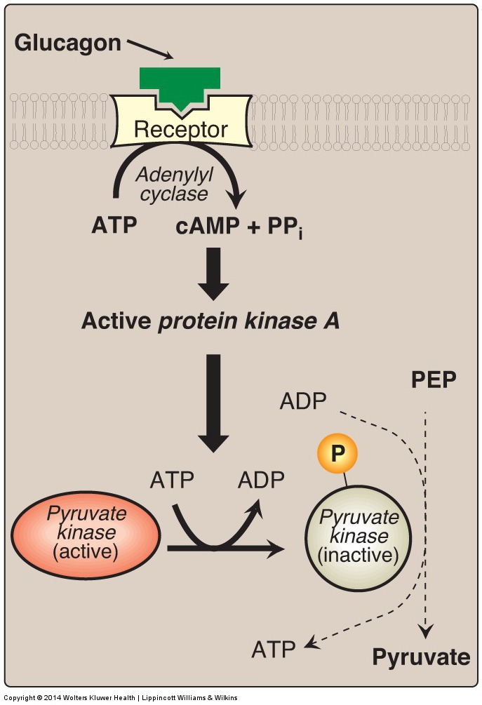
Pyruvate Kinase Regulation by: Covalent Modification
Pyruvate kinase is the enzyme that catalyzes the final step of glycolysis. It catalyzes the transfer of a phosphate group from phosphoenolpyruvate (PEP) to adenosine diphosphate (ADP), yielding one molecule of pyruvate and one molecule of ATP.
Covalent modifiers serve as regulators by controlling the phosphorylation and dephosphorylation of enzymes, resulting in the activation and inhibition of enzymatic activity.
Example: covalent modifiers activate protein kinase A which in turn phosphorylates, and deactivates pyruvate kinase.
*Remember:
Converting PEP (Phosphoenolpyruvate) to Pyruvate is the last step in glycolysis
Active Protein Kinase A inhibits the transformation to
pyruvate by phosphorylation of pyruvate kinase which leads to the inhibition of glycolysis.

Slide 12
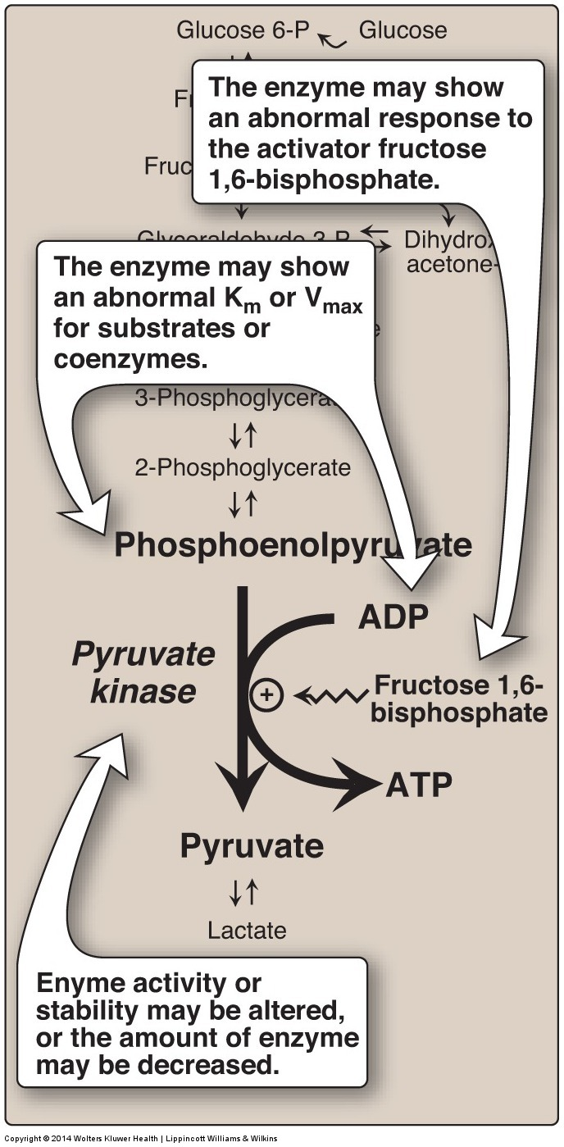
Pyruvate kinase deficiency:
hemolytic anemia
Pyruvate kinase deficiency is due to genetic mutation
(it affects the survival of red blood cells)
PK Mutation may lead to:
Altered enzyme Kinetics .
(inhibiting enzyme activity)
(mutation in other than the active site)
Altered response to activator.
(stopping enzyme activity)
(mutation in the active site)
Altered enzyme stability.
Decreased amount of the enzyme

Slide 13
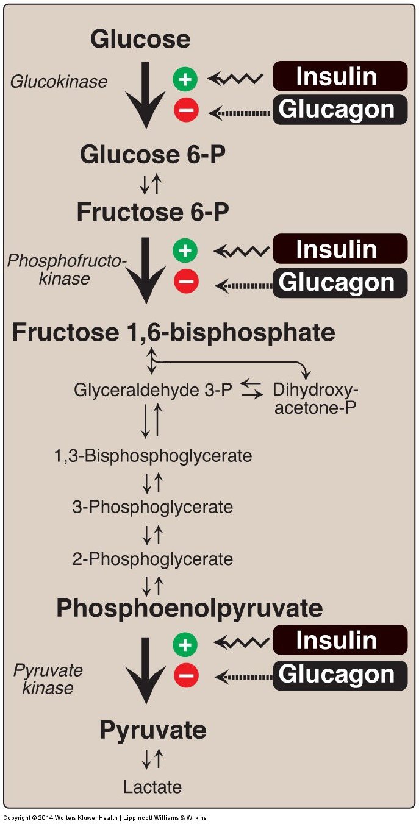
Long term Regulation (Hormonal)
Effect of insulin and glucagon
on the synthesis of key enzymes
of glycolysis in liver.
It is slow
Insulin: (+)
Glucokinase
Phosphofructokinase
Pyruvate Kinase
Glucagon: (-)
Glucokinase
Phosphofructokinase
Pyruvate Kinase

Slide 14
Substrate-level phosphorylation Vs. Oxidative phosphorylation
Simple explanation ☺
Substrate-level: production of ATP molecules via transfer of a phosphate group from an intermediate high-energy substrate directly to ADP. Oxidative: production of ATP molecules from the redox reactions of an electron transport chain
Gylcolysis and Krebs cycle use substrate-level phosphorylation. Electron transport chain uses oxidative phosphorylation.
Phosphorylation is the metabolic reaction of introducing a phosphate group into an organic molecule.
Oxidative phosphorylation | Substrate-level phosphorylation
The formation of high-energy phosphate bonds by phosphorylation of ADP to ATP | The formation of high-energy phosphate bonds by phosphorylation of ADP to ATP (or GDP to GTP)
the transfer of electrons from reduced coenzymes to molecular oxygen by ETC | cleavage of a high-energy metabolic intermediate (substrate).
mitochondria | cytosol or mitochondria
Substrate-level phosphorylation is really important for:
RBCs (they don’t have mitochondria)
Muscle cells in oxygen-depleted condition.

Slide 15
Aerobic Glycolysis: ATP Production
Each NADH = 3 ATP will be produced by ETC in the mitochondria.
ATP Consumed: 2 ATP
ATP Produced:
• Substrate-level: 2 X 2 = 4 ATP
• Oxidative-level: 2 X 3 = 6 ATP
Total: = 10 ATP
Net: 10 – 2 = 8 ATP

Slide 16
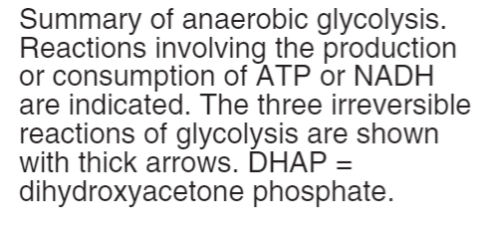
Anaerobic Glycolysis
From Lippincott
Overview:
Anaerobic glycolysis is the transformation of glucose to lactate when limited amounts of oxygen (O₂) are available. Anaerobic glycolysis is only an effective means of energy production during short, intense exercise, providing energy for a period ranging from 10 seconds to 2 minutes.
Anaerobic glycolysis less ATP production than aerobic.
The end product of anaerobic glycolysis is lactate “obligatory output”. (why?) Because if is not formed, All cellular NAD+ will be converted to NADH, with no means to replenish (fill again) the cellular NAD →Glycolysis stops →death of the cell
☺ Anaerobic Glycolysis is important in RBCs because they don’t have mitochondria *Will learn more in the next slides*

Slide 17
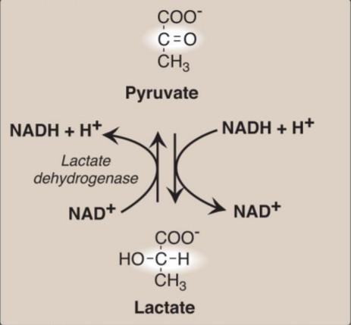
Anaerobic Glycolysis:
ATP production
Anaerobic Enzymes:
Lactate Dehydrogenase
An enzyme that catalyzes the conversion of lactate to pyruvic acid and back (reversible reaction)
ATP Consumed: 2 ATP
ATP Produced: • Substrate-level: 2 X 2 = 4 ATP • Oxidative-level: 2 X 3 = 6 ATP
Total: = 4 ATP
Net: 4 – 2 = 2 ATP
How? it converts NAD+ to NADH and back.
In Anaerobic glycolysis: Oxidative phosphorylation is cancelled, because the NADH molecules don't reach the ETC to produce ATP in anaerobic glycolysis.
NADH can NOT be used by ETC (oxidative-level) because:
there is no O2 and/or no mitochondria.
However, NAHD help in lactate production.

Slide 18
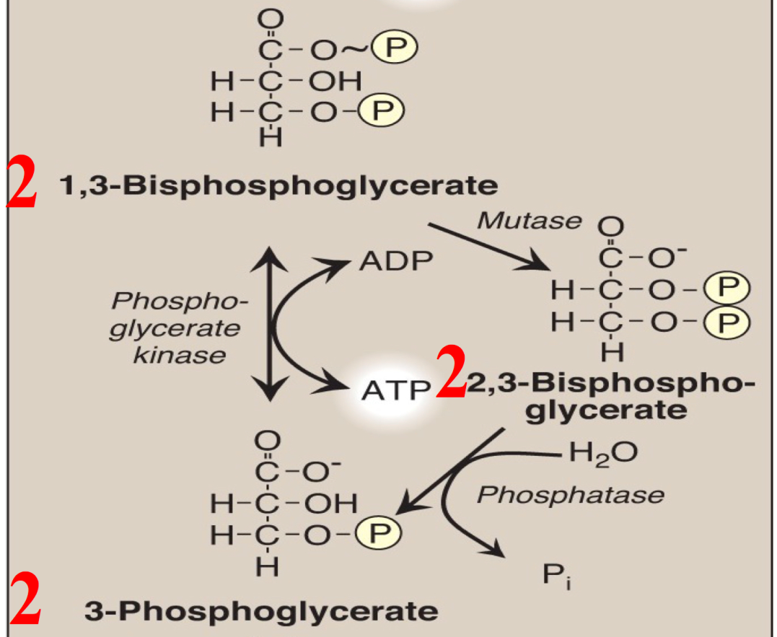
Anaerobic Glycolysis in RBCs
(2,3-BPG Shunt)
1,3-bisphosphoglycerate
2,3-bisphospoglycerate
3-phospoglycerate
Enzyme: Mutase *Next slide*
Enzyme: phosphatase
All the steps are the same with other anaerobic glycolysis except 2,3-BPG Shunt→ only present in RBCs.
2,3-BPG: 2,3bisphospoglycerate
**by adding water molecule and removing phosphate group

Slide 19
Anaerobic Glycolysis in RBCs
(2,3-BPG Shunt) Continued
Mutase enzyme :
It is important for association and dissociation between O₂ and hemoglobin.
Increase in “2,3-BPG” will help with loss of association between O₂ and hemoglobin and will release more O₂.
It usually occurs with people who live in high altitude.
Glycolysis in RBC : ATP Production
ATP consumed : 2 ATP
ATP produced :
Substrate-level 2X2= 4 ATP Without Shunt
Or 1X2= 2 ATP With Shunt
Total 4 ATP
Net : 4 – 2 = 2 ATP Without Shunt
Or 2 – 2 = 0 ATP With Shunt
Remember:
1- NO production of ATP in formation of “2,3-BPG”.
2- “2,3-BPG” comes back to “3-Phosphoglycerate” by Phosphatase enzyme

Slide 20
Summary: Aerobic glycolysis
Phosphorylation of glucose
Formation of pyruvate, producing ATP
Isomerization of glucose 6- phosphate
Dehydration of 2- phosphoglycerate
Phosphorylation of fructose 6- phosphate
Shift of the phosphate group
Cleavage of fructose 1,6- bisphosphate
Isomerization of dihydroxyacetone phosphate
Oxidation of glyceraldehyde 3- phosphate
Synthesis of 3- phosphoglycerate, producing ATP

Slide 21
Glycolysis in RBC : Summary
End product: Lactate
No net production or consumption of NADH
Energy yield: If no 2,3-BPG shunnt is formed: 2 ATP
If 2,3-BPG shunt occurs: 0 ATP
PK Deficiency hemolytic anemia depends on:
Degree of PK Deficiency
Compensation by 2,3-BPG

Slide 22
MCQs
1-Where does glycolysis occur ?
A-inner of mitochondria B-matrix of mitochondria C- cytosol
2-What is the final molecule product of glycolysis ?
A-lactate B-phosphoenolpyruvate C-pyruvate
3-Which of the following is the 3rd molecule in the glycolysis pathway ?
A- fructose-1,6-biphosphate B- 3-phosphoglycerate
C- fructose-6-phosphate
4-How many ATP are used up in glycolysis per glucose(the net) ?
A- 4 B- 2 C- 6 D-0
5-How many NADH are produced by glycolysis per glucose ?
A- 4 B-6 C-0 D-2
https://www.youtube.com/watch?v=hDq1rhUkV-g
https://www.youtube.com/watch?v=FE2jfTXAJHg
1-c
2-c
3-a
4-b
5-d

Slide 23
Girls team members:
1- روان سعد
2- نوره الشبيب
Boys team members:
1- محمد المهوس
2- طلال الطخيم
3- خالد القحطاني
4- فهد العتيبي
5- عبدالعزيز الصومالي
6- هشام القوسي
-Contact us:
Biochemistryteam436@gmail.com
twitter.com/436biochemteam
-Team leaders:
عبدالله المانع.
نوره السهلي.

