Slide 1
Oxidative Decarboxylation and Krebs Cycle
– Color Index:
Important.
Extra Information.
Doctors slides.
436 Biochemistry team

Slide 2
Objectives:
Of Oxidative Decarboxylation:
Recognize the various fates of pyruvate
Define the conversion of pyruvate to acetyl CoA
Discuss the major regulatory mechanisms for PDH complex
Recognize the clinical consequence of abnormal oxidative decarboxylation reactions
Of Krebs Cycle:
Recognize the importance of Krebs cycle.
Identify various reactions of Krebs cycle
Define the regulatory mechanisms of Krebs cycle
Assess the energy yield of PDH reaction and Krebs cycle’s reactions

Slide 3
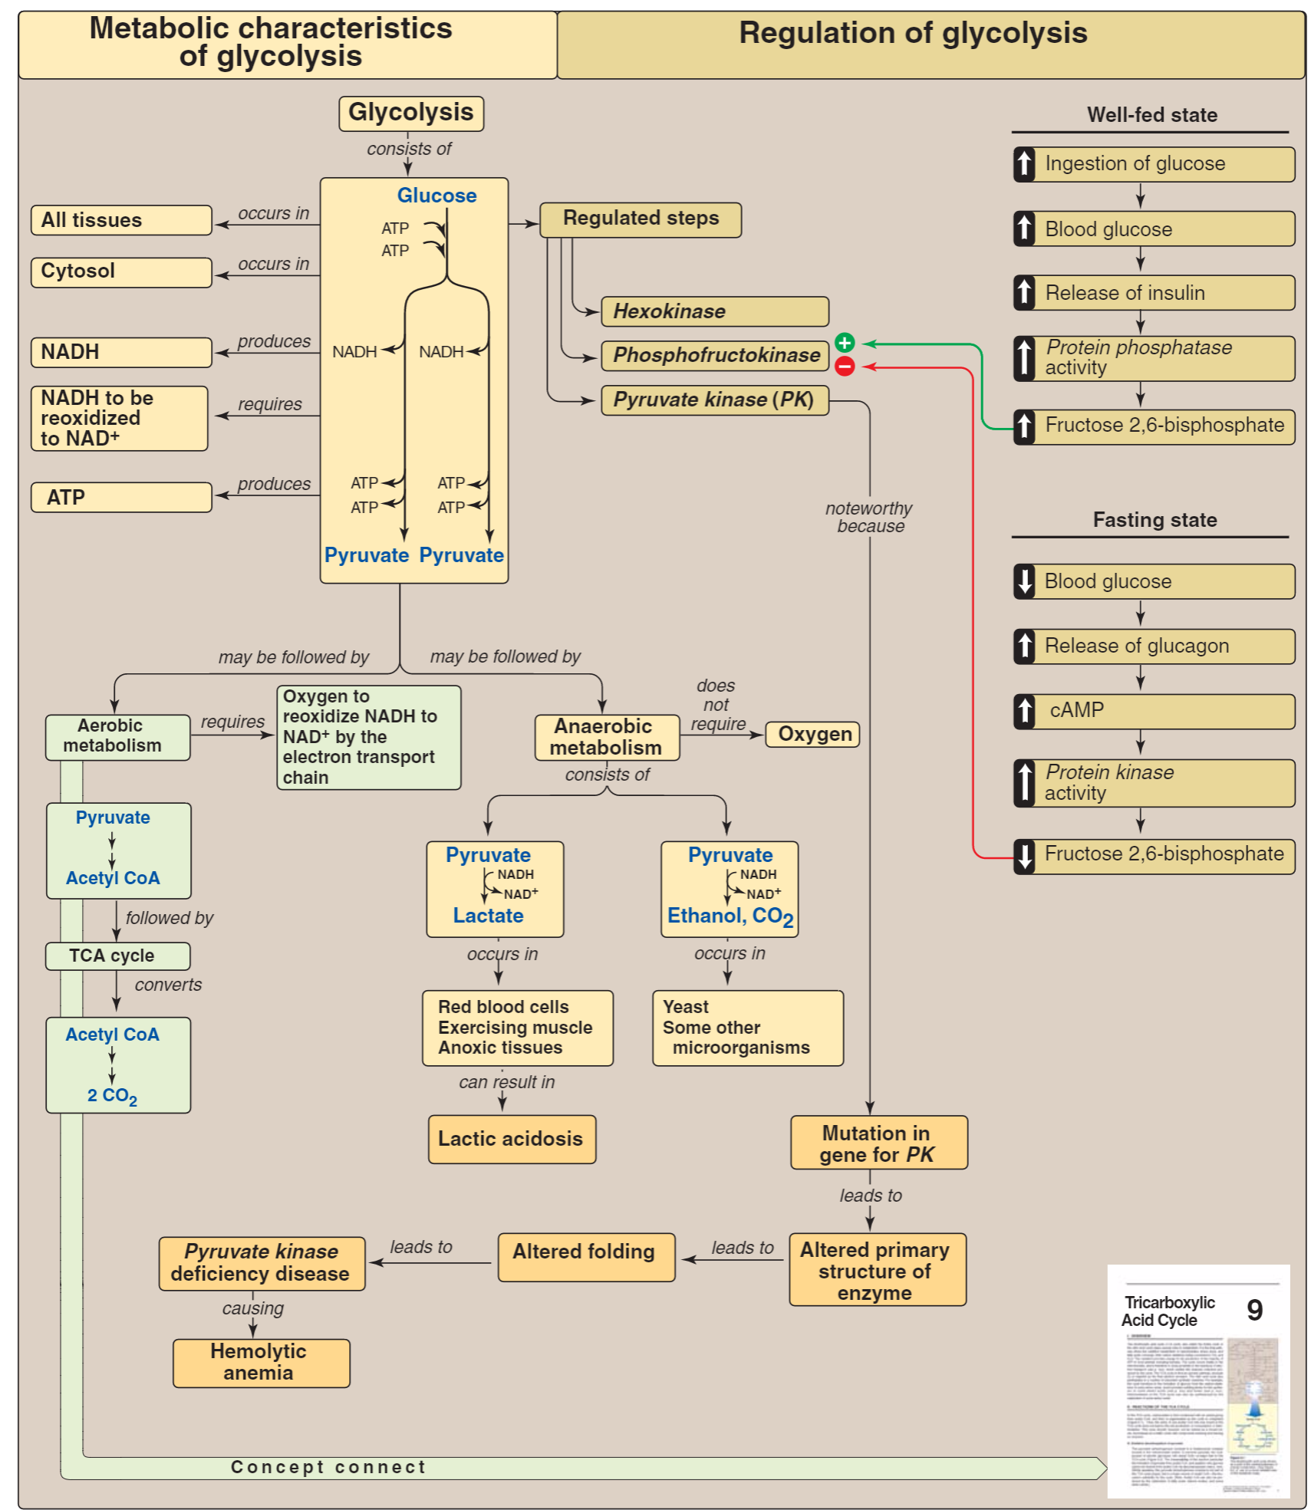
From Lippincott.
(Extra slide → to understand general concept) ☺
Overview of Krebs cycle:
The citric acid cycle – also known as the tricarboxylic acid (TCA) cycle or the Krebs cycle– is a series of chemical reactions used by all aerobic organisms to generate energy through the oxidation of acetyl-CoA derived from carbohydrates, fats and proteins into carbon dioxide and chemical energy in the form of adenosine triphosphate. In addition, the cycle provides precursors of certain amino acids as well as the reducing agent NADH that is used in numerous other biochemical reactions. The name of this metabolic pathway is derived from citric acid (a type of tricarboxylic acid) that is consumed and then regenerated by this sequence of reactions to complete the cycle. In addition, the cycle consumes acetate (in the form of acetyl-CoA) and water, reduces NAD+ to NADH, and produces carbon dioxide as a waste byproduct. The NADH generated by the TCA cycle is fed into the oxidative phosphorylation (electron transport) pathway. In eukaryotic cells, the citric acid cycle occurs in the matrix of the mitochondrion.

Slide 4
Fates of Pyruvates (Remember: Pyruvate is the end product of glycolysis)
Lactate
*in humans and some microorganisms “anaerobic”
Acetyl CoA
*in Krebs cycle
Alanine
Synthesis of non-essential amino acid using pyruvate + glutamine "essential”
*Done by Alanine transaminase enzyme “ALT”
• PLP = pyridoxal phosphate*
Oxaloacetate
*In Krebs cycle (it’s an intermediate)
* Activated by acetyl CoA
*Importance:
1. Replenishes intermediates of the TCA cycle.
2. Provide substrates for gluconeogenesis
3. An irreversible reaction
1-Glutamine ‘donating group ‘ will give NH2 to pyruvate (pyruvic acid)
2-Glutamine will transfer into alpha-keto glutamic acid , while pyruvate will transfer into alanine
Ethanol
*It occurs in yeast and some Bactria (including intestinal flora)(Anaerobic)
* Thiamine pyrophosphate-dependent pathway

Slide 5
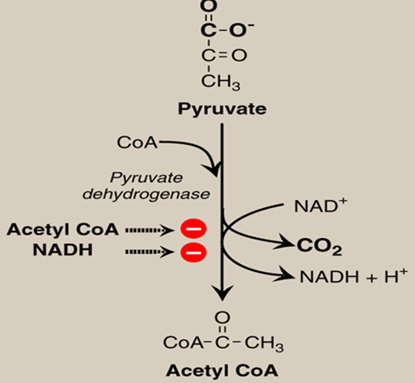
oxidative decarboxylation of pyruvate
‘pre Krebs cycle’
Understanding the pyruvate dehydrogenase complex (PDC).
It is made of three enzymes
One of them is Pyruvate Dehydrogenase
The pyruvate dehydrogenase complex contributes to transforming pyruvate into acetyl-CoA by a process called pyruvate decarboxylation. Acetyl-CoA may then be used in the citric acid cycle to carry out cellular respiration, so pyruvate dehydrogenase contributes to linking the glycolysis to Krebs cycle and releasing energy via NADH.
*More in the next slide*
It’s the process of making acetyl Co-A “mainly” & oxaloacetate from pyruvates by the enzyme: pyruvate dehydrogenase
Produces 2 NADH 6 ATP
Regulated by allosteric regulation of Acetyl coA and NADH
Increased amount of Acetyl CoA and NADH act as “Negative Feedback” inhibitors of their respective reactions.
NOTE☺
Kinase= enzyme adds P group “phosphorylates”
Phosphatase= enzyme that removes P group
Note: phosphorylation can either activate or inactivate, according to the enzyme.
How?
They activate “Pyruvate dehydrogenase kinase which phosphorylates and inactivates “Pyruvate dehydrogenase”

Slide 6
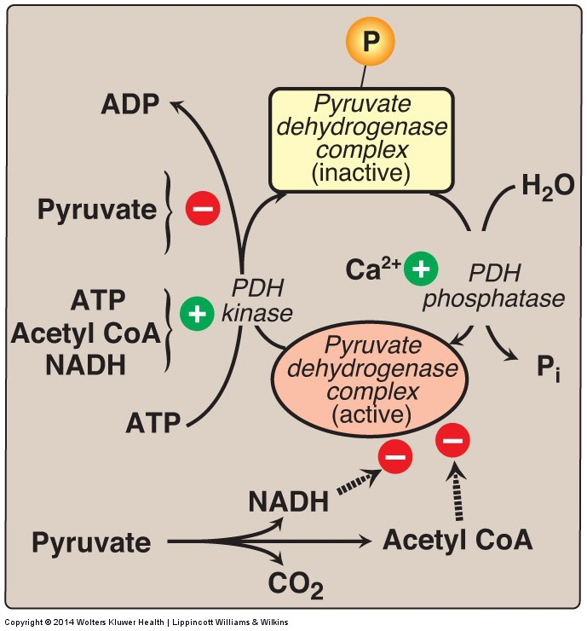
PDH Complex: Covalent Regulation
PDH : enzyme complex “3 enzymes joint together” that convert pyruvate into acetyl CoA .
*Pyruvate dehydrogenase complex (PHD) has two forms active and inactive. Regulated by co-enzymes.
*inactive form: regulated by PDH kinase
*active form: regulated by PDH phosphatase
*Those two enzymes are controlled by many factors
Regluation of PDH kinase
Regulation PDH phosphatase
↑ pyruvates
Inactivation of PDH kinase
Active form of pyruvate complex
PDH phosphatase +Ca
remove phosphates
active complex
↑ acetyl Co-A ,NADH ,CO₂
↑ ATP, acetyl co-A, NADH
Activation of PDH kinase
Inactive form of the complex
Direct regulation of the complex
↑ NADH, Co-2 and acetyl Co-A can directly inhibit the active form

Slide 7
PDH Reaction: Clinical application
PDH complex plays a important role in CNS
How?
Brain cells are unable to produce sufficient ATP if the PDH complex is inactive ‘no production of acetyl coA thus, no krebs cycle thus, no ATP’
*Thiamine and niacin are co-factors that helps PDH complex
*Deficiencies of them can cause serious CNS problems
Extra info:
Thiamine: vitamin B₁, a coenzyme in the catabolism of sugars and amino acids.
Niacin,: also known as vitamin B₃ A precursor of coenzymes called NAD and NADP, which are needed in many metabolic processes.
congenital lactic acidosis
PDH complex deficiency is the most common biochemical cause.
‘too many pyruvates leads to the use of anaerobic respiration which make lactate accumulate’
Wernicke-Korsakoff (encephalopathy-psychosis syndrome):
due to thiamine deficiency, may be seen especially with alcohol abuse.

Slide 8
Tricarboxylic Acid Cycle: Krebs Cycle
The tricarboxylic acid cycle (Krebs) shown as a part of the essential pathways of energy metabolism.
*has 8 reactions.
Properties of the cycle
Final common pathway for oxidation.
Exclusively in mitochondria
Major source for ATP
(24 ATP)
Mainly catabolic with some anabolic features
Synthetic reactions (anabolic features):
1-Glucose from amino acids
2-Nonessential amino acids
3-Fatty acids
4-Heme
CoA = coenzyme A.

Slide 9
Krebs Cycle Reactions (1) (1st → 3rd )
1st step:
Acetyl Co-A + Oxaloacetate citrate (6C)
2nd step:
Citrate iso-citrate
3rd step:
Iso-citrate α-Ketoglutarate (5C)
Joined by condensation
Citrate synthase:
H2O in
CoA out
1
6C
Aconitase
2
Oxidized by coenzyme NAD+
IsoCitrate Dehydrogenase:
NAD+ is reduced
Co2 is out
It is regulated “can be inhibited or activated”
(+)ADP, Ca2+
(-)ATP, NADH
Understanding the molecules ☺
NAD(H) = nicotinamide adenine dinucleotide
α-Ketoglutarate: It is the keto acid derivative of glutamate, and is an intermediate.
3
5C

Slide 10
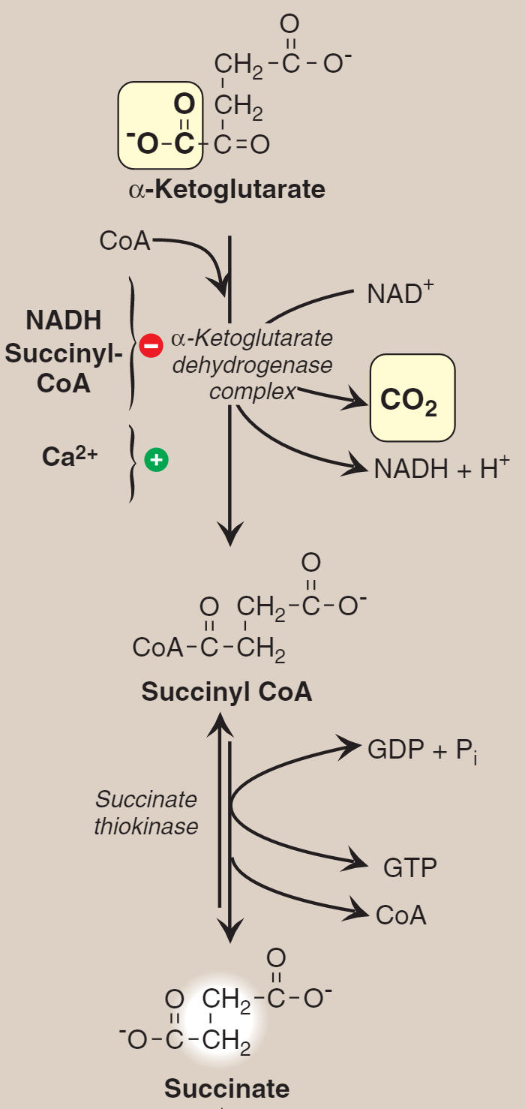
Krebs Cycle Reactions (2) (4th → 7th )
4th Step *oxidation and decarboxylation*
α-Ketoglutarate oxidized by co-enzyme NAD+
α-Ketoglutarate Dehydrogenase complex
NAD+ is reduced to NADH + H⁺
CO₂ is out
CoA is in
Succyinyl CoA
4
5C
It is regulated
It is activated by: Ca2+
Inhibited by: NADH and Succinyl CoA
5th Step *oxidation and decarboxylation*
Succinyl Co-A
Succinate Thiokinase
Co-A is out
GPD+Pi → GTP
High energy
4C
Succinate Thiokinase
The ONLY Substrate-Level
Phosphorylation
in Krebs
Understanding the molecules ☺
GDP = guanosine diphosphate.
5
4C

Slide 11
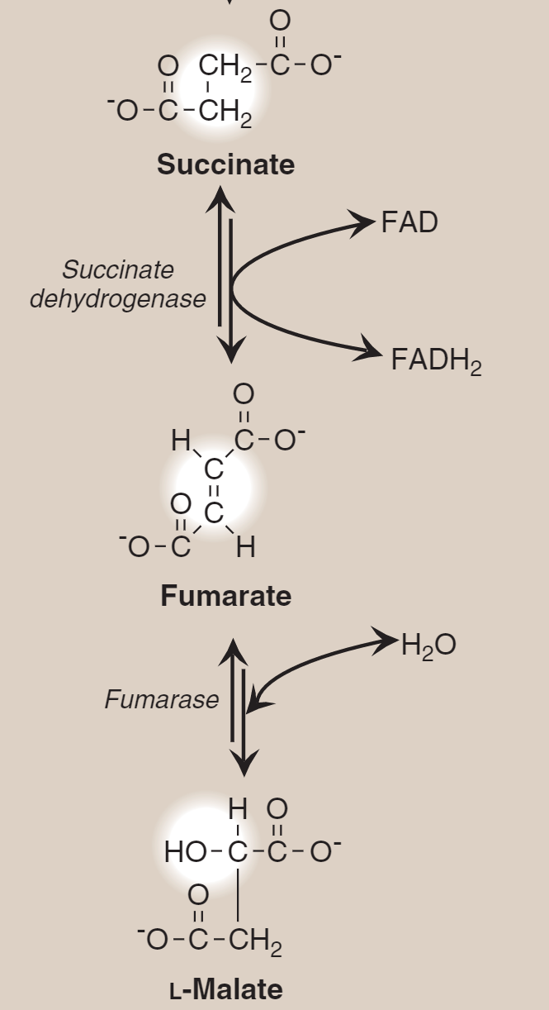
6th step *oxidation of succinate to fumarate*
Succinate Fumarate (4C)
Oxidized by co-enzyme FAD
Succinate Dehydrogenase:
FAD is reduced
6
7th step *hydration of fumarate to L-malate*
Fumarate L-Malate (4C)
Fumarase:
H2O is in
7
Understanding the molecules ☺
FAD(H₂) = flavin adenine dinucleotide.
Malate: is an organic compound with the molecular formula C4H6O5. It is a dicarboxylic acid that is made by all living organisms, contributes to the pleasantly sour taste of fruits, and is used as a food additive. The malate anion is an intermediate in the citric acid cycle.

Slide 12
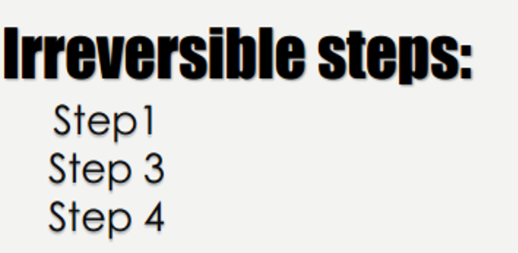
Krebs Cycle Reactions (3)
8th step:
L-Malate Oxalo-acetate (4C)
8
Oxidized by co-enzyme NAD+
Malate dehydrogenase:
NAD+ is reduced
Formation (regeneration) of oxaloacetate from malate.

Slide 13
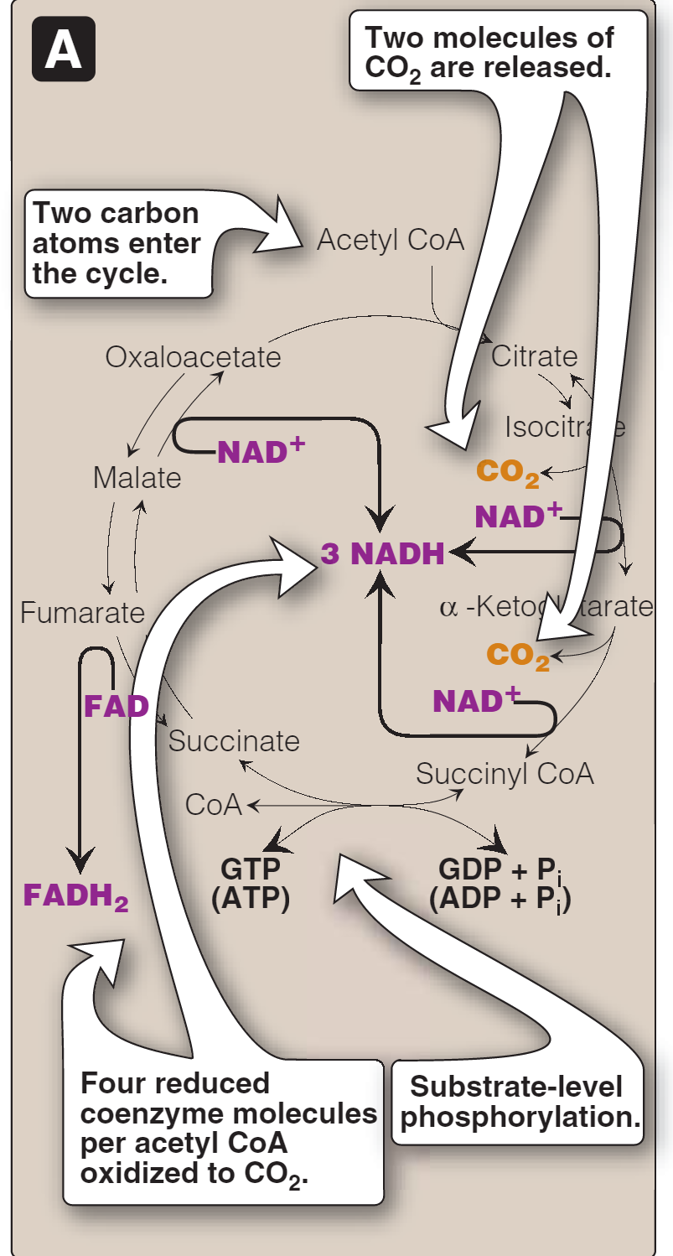
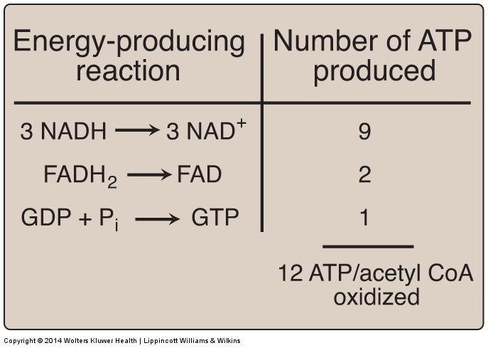
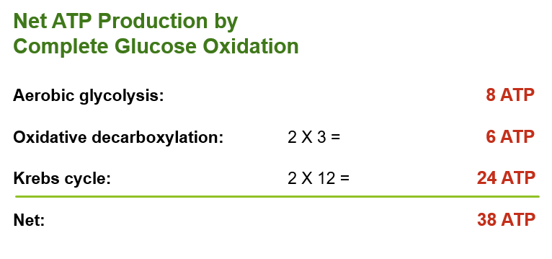
Krebs Cycle: Energy Yield
Number of ATP molecules produced from the oxidation of one molecule of acetyl coenzyme A (CoA) using both substrate-level and oxidative phosphorylation.
Krebs energy outcome
We get 3 NADH from:
Isocitrate → α-Ketoglutarate
α-Ketoglutarate → Succinyl CoA
Malate → Oxaloacetate
So, we get 24 ATP from 2 Acetyl CoA
We get 1 FADH from:
Succinate → Fumarate
Other outcome
Succinyl CoA “high energy compound” breaks down which leads to a substrate level phosphorylation of GDP to GTP, which means 1 ATP.
NADH = 3 ATP
FADH = 2 ATP
GTP = 1 ATP
We get 2 CO2 from:
Isocitrate → α-Ketoglutarate
α-Ketoglutarate → Succinyl CoA

Slide 14
Regulation of Oxidative Decarboxylation and Krebs Cycle
PDH complex and the TCA cycle are both up-regulated in response to a decrease in the ratio of
ATP : ADP
NADH : NAD⁺
TCA CYCLE
Activators
Inhibitors
ADP
Ca²⁺
ATP
NADH
PDH complex & TCA: make ATP & NADH IN LOW ENERGY CONDITIONS
PDH: The Pyruvate Dehydrogenase TCA: Tricarboxylic Acid

Slide 15
videos
Krebs cycle made simple
Krebs cycle حلقة كربس
MCQs
1\ Allosteric regulation in oxidative decarboxylation of pyruvate is done by:
A- Acetyl CoA
B- NADH
C- ATP
D- A & B
2\ PDH kinase is inhibited by:
A- Acetyl CoA
B- Pyruvate
C- ATP
D- ADP
3\ deficiencies of thiamine or niacin can cause serious problems in:
A- liver
B- kidney
C- CNS
D- GIT
4\ ADP AND Ca 2+ are:
A- TCA inhibitors
B- TCA activators
5\ net ATP production by oxidative decarboxylation is:
A- 8 ATP
B- 24 ATP
C- 6 ATP
D- 38 ATP
6\ net ATP production by complete glucose oxidation is:
A- 38 ATP
B- 24 ATP
C- 6 ATP
D- 8 ATP
1- D
2- B
3- C
4- B
5- C
6- A

Slide 16
Girls team members:
1- هيفاء الوعيل.
2- روان الوادعي.
3- زينة الكاف.
4- نجود العنزي.
5- نورة الشبيب.
-Contact us:
Biochemistryteam436@gmail.com
twitter.com/436biochemteam
-Team leaders:
نوره السهلي.
عبدالله المانع.

