Slide 1
Gluconeogenesis
– Color Index:
Important.
Extra Information.
Doctors slides.
436 Biochemistry team

Slide 2
Objectives:
The importance of gluconeogenesis as an important pathway for glucose production
The main reactions of gluconeogenesis
The rate-limiting enzymes of gluconeogenesis
Gluconeogensis is an energy-consuming, anabolic pathway

Slide 3
Gluconeogenesis
Gluconeogenic substrates
Glucogenic amino acids
pyruvate
Lactate
Glycerol
Gluconeogenesis is an energy consuming, anabolic pathway.
It is a metabolic pathway that results in the generation of glucose from certain non-carbohydrate carbon substrates .
Gluconeogenesis is important to provide the body with glucose when there is no external source of glucose (during prolonged fasting or starvation) .
Occurs in Liver mainly, and in Kidney
During Overnight fast: • 90% of gluconeogenesis occurs in liver
• 10% of gluconeogenesis occurs in Kidneys .
Gluconeogenesis occurs in both mitochondria and cytosol .
EXCEPTION! if gluconeogenesis starts by Glycerol, …… it will need only the cytosol
The glycerol backbone is found in all lipids known as triglycerides
Produced from pyruvate via the enzyme lactate dehydrogenase in a process of fermentation during normal metabolism and exercise.
a key intermediate in several metabolic pathways. Pyruvate can be made from glucose through glycolysis, converted back to glucose via gluconeogenesis
A glucogenic amino acid is an amino acid that can be converted into glucose through gluconeogenesis.
**Not all amino acids can make glucose there are certain types.
Our bodies will metabolize all glycogen stores within the first 18 hours of fasting, then will start looking for another source to make glucose

Slide 4
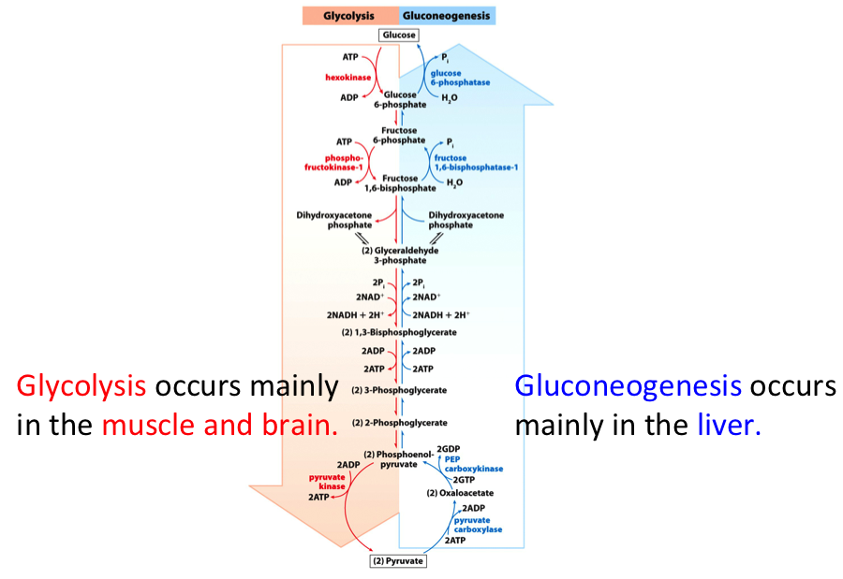
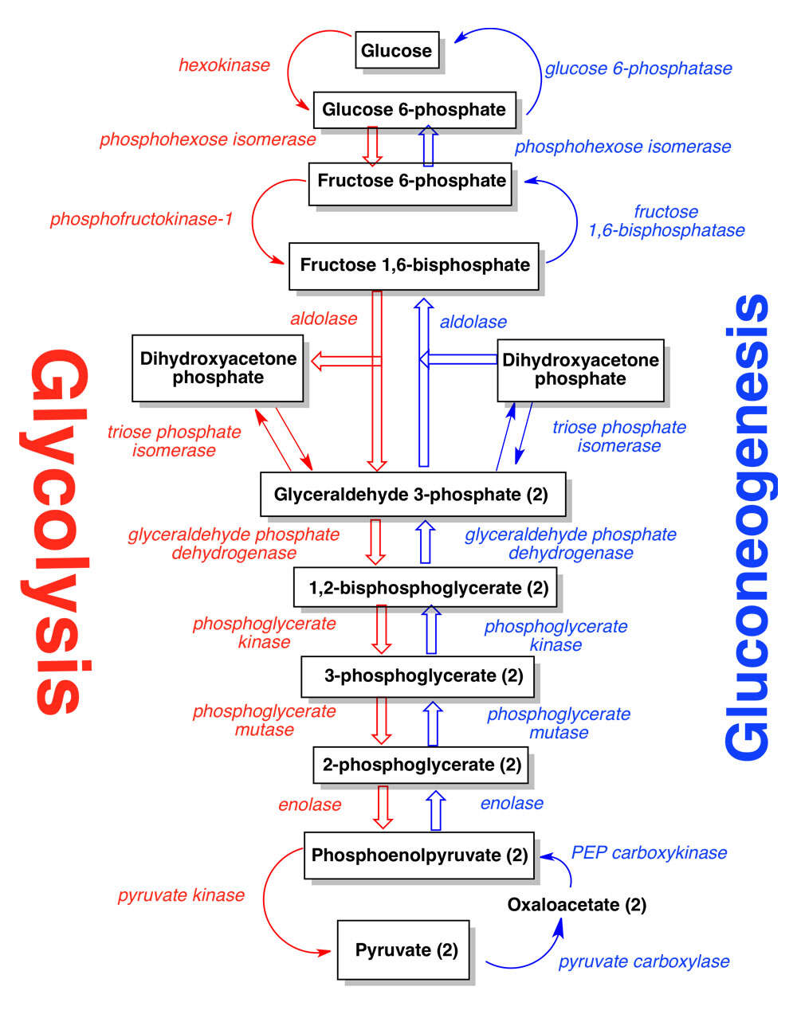
Gluconeogenesis
Seven glycolytic reactions are reversible and are used in the synthesis of glucose from lactate or pyruvate.
Three of the reactions are irreversible and must be reversed by four alternate reactions that energetically favor the synthesis of glucose .
The 4 alternate reactions in gluconeogenesis to the 3 irreversible glycolytic steps:
Glycolysis enzymes | Gluconeogenesis enzymes
Pyruvate kinase | 1) Pyruvate carboxylase 2) PEP-CK
PFK-1 | 3) Fructose 1,6 bisphosphatase
Glucokinase/Hexokinase | 4) Glucose 6-phosphatase
موضحة في الصورة باللون الأحمر
موضحة في الصورة باللون الأزرق

Slide 5
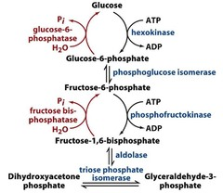
1. Glycerol:
Gluconeogenic precursors are (non-carbohydrates) molecules that can be used to produce a net synthesis of glucose.
Gluconeogenic Substrates:
Lactate
Glycerol
Glucogenic amino acids
Pyruvate
#Recall
Glycerol is released during the hydrolysis of triacylglycerol in adipose tissue and is delivered by the blood to the liver.
Important notes:
Glycerol kinase is only present in liver & kidneys
Gluconeogenesis of glycerol occurs only in the cytosol
Why can’t adipocytes phosphorylate glycerol?
Because they essentially lack glycerol kinase.
Glycerol Kinase
Glycerol 3-phosphate
Glycerol
ATP
ADP
NAD+
Glycerol 3-phosphate
dehydrogenase
NADH
Dihydroxyacetone phosphate

Slide 6
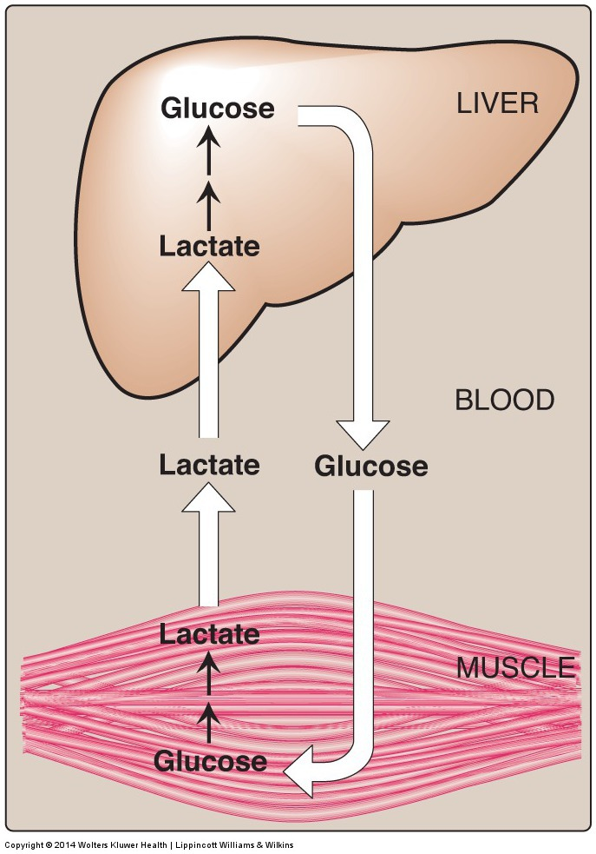
Gluconeogenic Substrates:
Lactate
Glycerol
Glucogenic amino acids
Pyruvate
2. Lactate:
Lactate is released into the blood by exercising skeletal muscle and by cells that lack mitochondria such as RBCs.
In the Cori cycle, bloodborne glucose is converted by exercising muscle to lactate, which diffuses into the blood. The lactate is taken up by the liver and reconverted to glucose, which is released back into circulation.
*Lactate is converted to pyruvate and then to glucose.

Slide 7
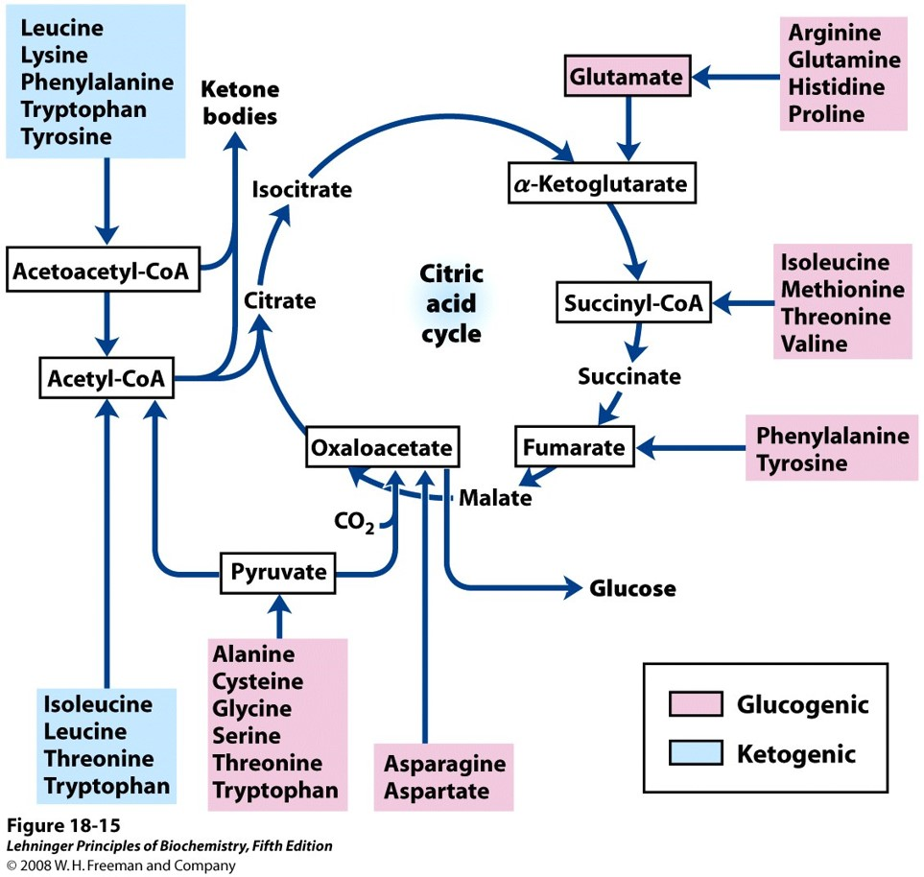
Gluconeogenic Substrates:
Lactate
Glycerol
Glucogenic amino acids
Pyruvate
*The amino acids in the red boxes must be MEMORIZED along with the intermediates they produce
3. Glucogenic Amino Acids:
The catabolism of glucogenic amino acids produces either:
pyruvate
Or one of the intermediates in the Krebs Cycle.
For example; catabolizing asparagine produces oxaloacetate (an intermediate) which can be converted later to glucose.
Pyruvate:
Alanine, Glycine
Intermediates: Glucogenic Amino Acid:
Oxaloacetate Asparagine, Aspartate.
Fumarate Phenylalanine, Tryosine.
Succinyl-CoA Methionine, Valine.
a-ketoglutarate Glutamine (after it’s converted to glutamate.)

Slide 8
Gluconeogenic Substrates:
Lactate
Glycerol
Glucogenic amino acids
Pyruvate
Pyruvate Carboxylation
The carboxylation occurs in the liver and kidney, exactly in Mitochondria .
So Pyruvate has to travel from cytoplasm to mitochondria why ?
Because Pyruvate carboxylase is only found in matrix of mitochondria .
General Idea ☺
Substrate: Pyruvate
Chemical Reaction: Carboxylation
Enzyme: Pyruvate Carboxylase
Co-Enzyme: Biotin
Product: Oxaloacetate *Intermediate*
Pyruvate carboxylase: is an enzyme of the ligase class that catalyzes (depending on the species) the physiologically irreversible carboxylation of pyruvate to form oxaloacetate (OAA).
Biton: coenzyme that makes CO2 more active to bind.
Pyruvate Carboxylase
Biotin
Pyruvate
Oxaloacetate
*To compare ☺*
In glycolysis:
to convert from PEP into Pyruvate we need just one enzyme which is
( Pyruvate Kinase ) .
In gluconeogenesis:
to convert Pyruvate into PEP we need two enzymes in two steps these enzymes are (Pyruvate carboxylase + PEP-CK)
CO₂
ATP
ADP + P_{i}
*Explained in next slide*

Slide 9
Explanation for the two steps
Mitochondria
الحين زي ما قلناPyruvate لازم يدخل الميتوكندريا ليش؟ عشان هناك راح يلقى الإنزيم Pyruvate Carboxylase اللي راح يحوله إلى Oxaloacetate ، طيب المشكلة إن هذا Oxaloacetate ما يقدر يطلع من الميتوكندريا بصورته هذي والحل طيب ؟ فيه إنزيم ثاني اسمه
Malate dehydrogenase
راح يحوله بشكل مؤقت إلى Malate بالاختزال نفس الإنزيم اللي كان موجود بكربس سايكل → هذي كلها الخطوة الأولى
الحين هذا Malate يقدر يطلع من الميتوكندريا ويروح للسيتوبلازم، ليش ؟ لأن الهدف من هذا كله هو إني أكون جلكوز وأنزله على الدم ويروح للخلايا الثانية تستخدمه وتنتج طاقة ، طيب في السيتوبلازم يصير له أكسدة بنفس الإنزيم
Malate dehydrogenase
ويرجع يتحول إلى Oxaloacetate وهذا اللي نبغاه ليش ؟ لأن فيه إنزيم مهم PEP-CK راح يحوله أخيراً إلى PEP اللي بدوره بيكمل السالفة → هذي هي الخطوة الثانية
Cytosol
الفرق بينهم
الإنزيم مهمة و وين موجودة
Phosphoenolpyruvate CarboxyKinase) PEP-CK (

Slide 10
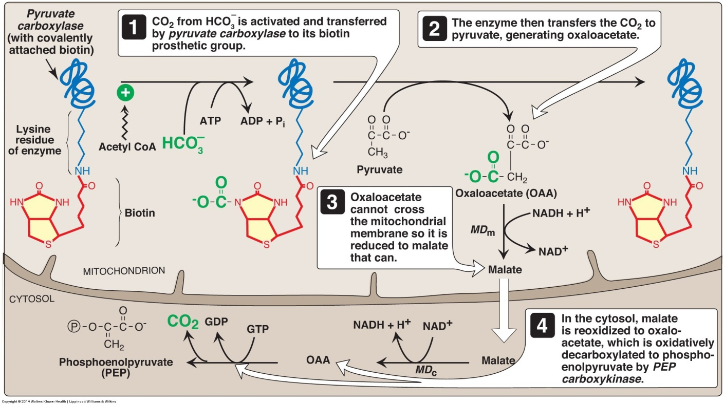
Pruvate Carboxylase and PEP-CK
Pyruvate carboxylase + PEP-CK = Pyruvate kinase
Pyruvate Carboxylase is induced by Acetyl-CoA
*meaning that Acetyl-CoA is an activator for the pyruvate carboxylation reaction*
What happens during fasting?
Acetyl-CoA is increased via fatty acid oxidation (FAO)

Slide 11
Mentioned in Boys’ Lecture Only
There are 3 ways for Oxaloacetate (OAA) to transport across the mitochondrial membrane:
OAA reduction to malate “as we mentioned previously”
OAA conversion to aspartate
OAA conversion to PEP (inside the mitochondria)
In the cytosol
OAA
PEP

Slide 12
Gluconeogenesis Regulation:
Overview:*EXTRA EXPLANATION* While most steps in gluconeogenesis are the reverse of those found in glycolysis, the 3 regulated and endergonic reactions in glycolysis are replaced.
Glycolysis: Hexokinase/glucokinase, phosphofructokinase, and pyruvate kinase enzymes
Gluconeogenesis:
PEP carboxykinase/pyruvate carboxylase.
Fructose-1,6-bisphosphatase
Glucose-6-phosphatase
These enzymes are typically regulated by similar molecules, but with opposite results.
For example, acetyl CoA and citrate activate gluconeogenesis enzymes, while at the same time inhibiting the glycolytic enzyme pyruvate kinase.
This system: reciprocal control
The majority of the enzymes responsible for gluconeogenesis are found in the cytosol; the exception is mitochondrial pyruvate carboxylase.
Global control of gluconeogenesis is mediated by glucagon (released when blood glucose is low);
Glucagon triggers phosphorylation of enzymes and regulatory proteins by Protein Kinase A (a cyclic AMP regulated kinase) resulting in inhibition of glycolysis and stimulation of gluconeogenesis.

Slide 13
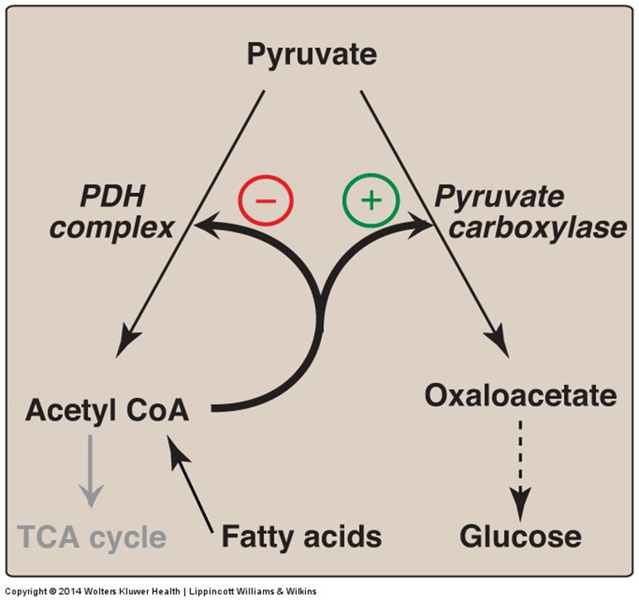
Regulation of Pyruvate Carboxylase reaction
Acetyl CoA diverts pyruvate away from oxidation in Krebs cycle and toward gluconeogenesis
How? High level of Acetyl-CoA will inhibit PDH complex and stop or reduce the Glycolysi.
And stimulate Pyruvate Carboxylase to start Gluconeogenesis.
Pyruvate dehydrogenase complex: is a complex of three enzymes
+ positive regulation
High Acetyl coA will stimulate the enzyme pyruvate carboxylase to make more oxaloacetate
Then, the oxaloacetate will produce more glucose
-negative regulation
High level of Avetyl-coA inhibit PDH complex.
PDH function: converts pyruvate carboxylase to Acetyl coA
Negative regulation: inhibition
Positive regulation: activation
NOTE ; Acetyl CoA diverts pyruvate away from oxidation
( by PDH complex to produce acetyl coA) and toward gluconeogenesis

Slide 14
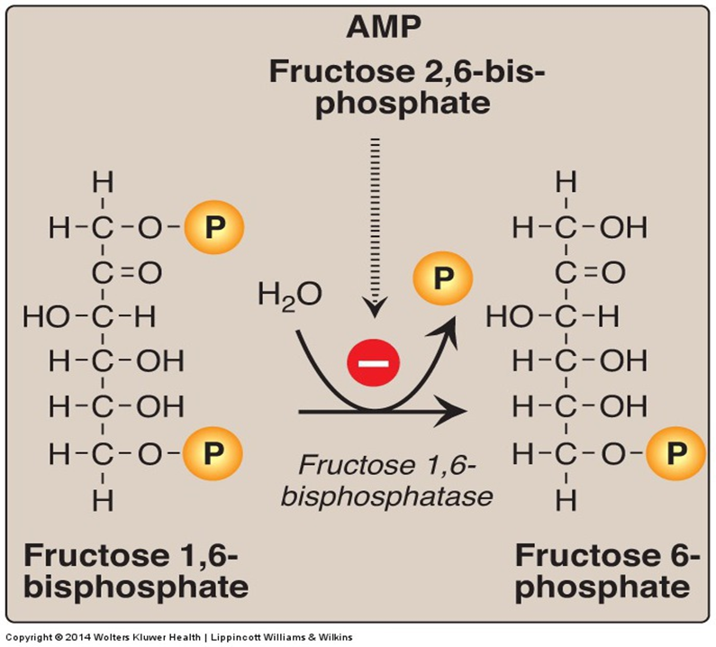
Fructose 1,6-Bisphosphatase
The precise regulation of PFK1 prevents glycolysis and gluconeogenesis from occurring simultaneously.
The rate of gluconeogenesis is controlled by key enzyme:
fructose-1,6-bisphosphatase
Fructose 1,6 bisphosphatase enzyme dephosphorylates (removes P group) Fructose 1,6 Bi-phosphate. Which turns it into Fructose 6-Phosphate.
( - negative regulation) What inhibits this process?
AMP and Fructose 2,6 bisphosphate
The reverse reaction
We took this in glycolysis: Phosphofructokinase-1 (PFK-1) is one of the most important regulatory enzymes of glycolysis. It is an allosteric enzyme controlled by many activators and inhibitors. PFK-1 catalyzes the important "committed" step of glycolysis, the conversion of fructose 6-phosphate and ATP to fructose 1,6-bisphosphate and ADP.
*Fructose bisphosphatase (Gluconeogensis) catalyzes the reverse of the reaction which is catalyzed by phosphofructokinase-1 (glycolysis)*

Slide 15
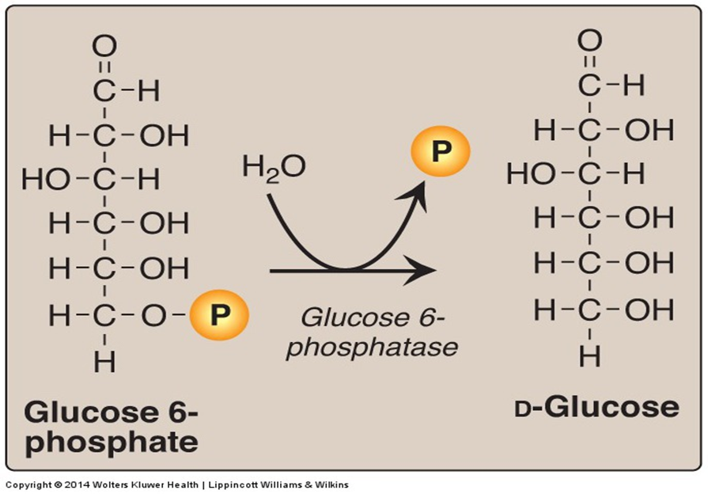
Glucose 6-Phosphatase
Glucose 6- phosphate → D-Glucose
Done by Glucose 6-phosphatase enzyme ( removal of phosphate group )
Dephosphorylation of glucose 6-phosphate allows release of free glucose from the liver and kidney into blood.
(when glucose is phosphylated they can not go outside the cell
So. They need to Dephosphorylation to go from cell to circulation in blood to maintain blood sugar level )
Glucose 6-phosphatase = Glucokinase
Glucokinase is an enzyme that facilitates phosphorylation of glucose to glucose-6-phosphate.

Slide 16
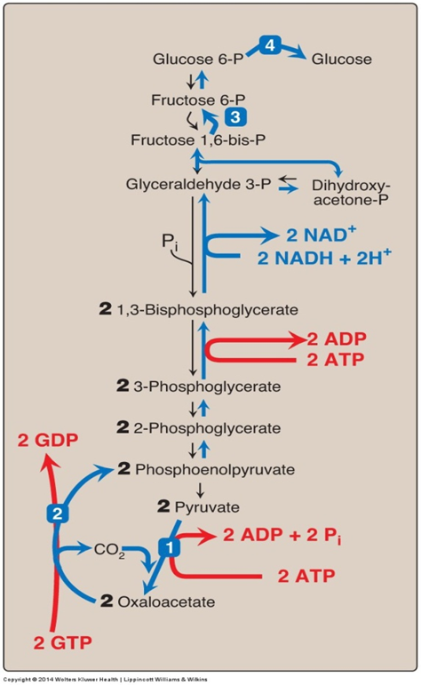
Gluconeogensis: Energy- Consumed
Six High-Energy Phosphate Bonds From Pyruvate to Glucose ( From purvate to Glucose )
2Purvate convert to 2 Oxaloacetate -2 ATP
2GTP convert to 2GDP -2ATP
2 (3-Phosphoglycerate ) convert to -2ATP 2(1.3bisphosphoglycerate)
2 NADH converted to 2 NAD 6ATP
NET : 0 ATP

Slide 17
Gluconeogenesis: Regulation.
Reciprocal control
Gluconeogenesis & Glycolysis
Allosteric:
Acetyl CoA + (Pyruvate carboxylase)
AMP - or ATP +
F 2,6-Bisphosphate -
Glucagon ( I/G ratio) stimulates gluconeogenesis
- Allosteric ( F 2,6-Bisphosphate)
- Induction (PEP-CK)
F 1,6-bisphosphatase
Important!!!
Pyruvate carboxylase is only found in matrix of mitochondria
Gluconeogenesis rate-limiting enzymes:
Pyruvate carboxylase
PEP-CK
(Insulin/Glucagon ratio) وش تعني؟
الجلوكاجون يهتم برفع مستوى الجلوكوز بالدم، بينما الأنسولين يسوي العكس..
فلذلك لتحفيز عملية (gluconeogenesis) نحتاج يكون المقام اكبر قيمة ”الجلوكاجون” من البسط “الأنسولين”..

Slide 18
Reciprocal control

Slide 19
MCQs + videos
The main site of gluconeogenesis is :
A- kidneys B- liver C- spleen D- lymph node
Which one of the following is not a gluconeogenesis substrate?
A- lactate B- glycerol C- triglycerides D- glucogenic amino acid
Gluconeogenesis and glycolysis are reciprocally uncontrolled
A- true B- false
Anabolic pathway consumes ATP for synthesis of glucose
A- true B- false
1- B
2- C
3- B
4- A
Reactions of glycolysis : https://youtu.be/hDq1rhUkV-g
Regulation of gluconeogenesis and glycolysis : https://youtu.be/0epBvl0HTeY

Slide 20
Girls team members:
1- سمية الغامدي.
2- شذا الغيهب.
3- روان سعد.
4-ربا السالم.
5- نورة الشبيب.
6- جومانا القحطاني.
Boys team members:
1- محمد المهوس
-Contact us:
Biochemistryteam436@gmail.com
twitter.com/436biochemteam
-Team leaders:
نوره السهلي.
عبدالله المانع.

