Slide 1


Biochemical markers
– Color Index:
Important.
Extra Information.
Doctors slides.
436 Biochemistry team

Slide 2
Objectives :
Comprehend the importance & diagnostic qualities of various biomarkers .
Understand the importance of different biomarkers in the diagnosis, treatment, & follow up of a disease .
Recognize the types of biomarkers & their use in specific diseases such as heart, cancer, liver, kidney, & pancreatic diseases .

Slide 3

What is biomarkers?
A biological molecule found in blood ,and other body fluids, or tissues that indicates a normal or abnormal process such as a disease or a condition .
A biomarker is measured to follow up a disease or treatment .
Diagnosis & Prognosis
Diagnosis: Identification of a disease from its signs and symptoms .
Prognosis: The future outcome of a disease .
*هناك إختلافات بين سلايدز الطلاب والطالبات.

Slide 4

Most common body fluids (Samples) for measurement of biomarkers are :
What is the difference between Serum and Plasma ?
They are the same , but plasma has coagulation factors and serum has no coagulation factors.
Serum
Plasma
Urine
Biomarkers can be either :
Plasma specific
Tissue specific
436 Biochemistry team

Slide 5
Plasma-specific Biomarkers:
Normally present in Plasma .
(can be present in tissues in low amount or totally absent ).
Perform their functions in blood.
High level of activity in plasma than in tissue cells .
Examples :
Blood clotting enzymes (thrombin), cholinesterase, etc.
Tissue-specific biomarkers:*
Present inside the cell .
A low concentration can be detected in plasma due to cellular turnover.
Released into body fluids in high conc. Due to :
Cell damage*.
Defective cell membrane.
*Cell damage can be due to:
1- Tissue inflammation, example:
-ALT* in liver disease (e.g. acute hepatitis)
-Amylase in acute pancreatitis
2- Ischemia → hypoxia → infarction →
↑ plasma [Troponin] in myocardial
Infarction
ALT*: alanine aminotransferase
When Tissue-specific biomarkers are released to body fluids , it will help us diagnose which part of the body has the problem (for example: if the patient has a heart attack or kidney failure)

Slide 6
Intracellular enzymes are present only in their cells of origin
Some are secretory enzymes are secreted by:
salivary glands, gastric mucosa and pancreas
In disease: plasma levels of secretory enzymes increase when their cells are damaged
The diagnosis of organ disease is done by measurement of enzymes of that tissue
( عند تشخيص المرض يتم قياس الانزيمات في الانسجة )

Slide 7
Factors affecting serum biomarker levels
Cell damage
Rate of biomarker synthesis and clearance
Enzyme inhibitors
Glucose deficiency
Localized Hypoxia (less oxygen)
Ischemia (obstruction of blood vessels)
Necrosis
Tissue infarction due to ischemic necrosis
Myocardial infarction

Slide 8
#Qualities of a good biomarker:
Able to accurately diagnose a disease
Able to accurately predict
prognosis of a disease
Compliant*
with treatment follow up
Easily obtainable from blood, urine, etc
*This means it changes after treatment which allows us to evaluate the progress (weather the treatment working or not) and predict prognosis
#Qualities (Criteria) of a good biomarker assay:
*Assay means a test, So a biomarker assay is a test that measures a biomarker
Rapid *Robust* to deliver results faster
Sensitive:
able to detect small quantities of a marker
Specific:
Able to detect only the marker of interest

Slide 9

Types of biomarkers
Enzymes
Proteins
Hormones
Enzymes as biomarkers
Enzymes are clinically used for the diagnosis and prognosis of various diseases
Enzymes include
Amylase
Alanine aminotransferase ( ALT)
Aspartate aminotransferase (AST)
Lipase
Proteins include
Cystatin C
BNP*
PSA**
$∝$-Fetoprotein***
∝-Fetoprotein***
Hormones include
AMH
*B-type natriuretic peptide (BNP)
**Prostate Specific Antigen (PSA) (tumor marker)
***$∝$-Fetoprotein is also (tumor marker)

Slide 10
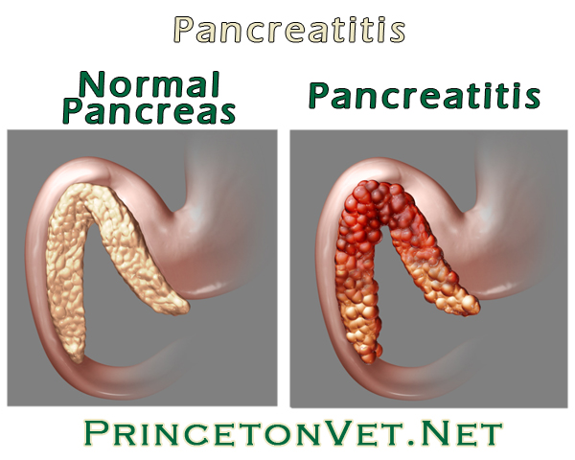
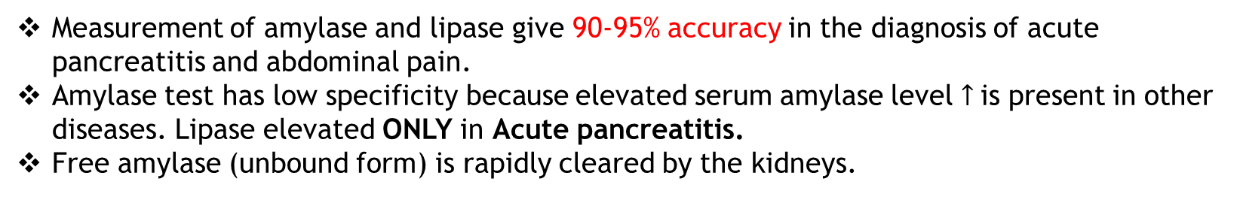
Enzymes: Amylase and Lipase
Cause of pancreatitis
Obstruction of the pancreatic duct
Gallstones
Alcohol abuse
Acute pancreatitis: the inflammation of pancreas
There is abnormal release and premature activation of pancreatic enzymes (for example amylase, lipase)
Diagnosis conducted by measuring pancreatic enzymes
During pancreatitis | Amylase | Lipase
Level in plasma compared to normal | 10 times | 2 times
Required time to appear in serum | 2-12 hour after abdominal pain (onset symptom) and returns to normal in 2-3 days | 4-8 hours and remain for 8-14 days
Specificity | low | high
Measurement of amylase and lipase give 90-95% accuracy in the diagnosis of acute pancreatitis and abdominal pain.
Amylase test has low specificity because elevated serum amylase level $↑$is present in other diseases. Lipase elevated ONLY in Acute pancreatitis.
Free amylase (unbound form) is rapidly cleared by the kidneys.
Gallstones are a common cause of pancreatitis. Gallstones, produced in the gallbladder, can block the bile duct, stopping pancreatic enzymes from traveling to the small intestine and forcing them back into the pancreas. The enzymes then begin to irritate the cells of the pancreas, causing the inflammation associated with pancreatitis.

Slide 11
Enzymes: ALT and AST
ALT (Alanine amino-transferase) and AST (Aspartate amino-transferase) are tissue-specific biomarkers. Which means they are normally found in the serum in LOW levels, when there is a condition or a disease in the liver (cell damage) “or any other tissues have those biomarkers“ there will be HIGH serum levels of ALT & AST.
High serum ALT and AST levels in liver diseases are due to:
Markers used in hepatocellular necrosis
AST | ALT
LOW SPECEFIC | HIGH SPECEFIC
Produced by: Heart, liver, skeletal muscle, kidney and small amount in RBC *erythrocytes*. | Produced by: Mostly in liver, small amounts in heart.
Major diagnosis *elevated in*: (High serum activity) liver, skeletal muscle, heart diseases and hemolysis. | Major diagnosis *elevated in*: liver diseases.
Alcohol abuse
Medication
Chronic hepatitis B and C
Malignancy
Wilson’s disease
α1-antitrypsin deficiency
Steatosis and steatohepatitis
Autoimmune hepatitis
Poisons and infectious agents
accumulation of copper in the liver.
Steatosis is ‘Fatty liver‘ a condition in which Fatty acid accumulates in the liver
Protease inhibitor
Hemolysis means the RBC’s lysis. As AST can be found in small amounts in RBC’S that means when RBC’S are lysed AST will be found in the serum

Slide 12
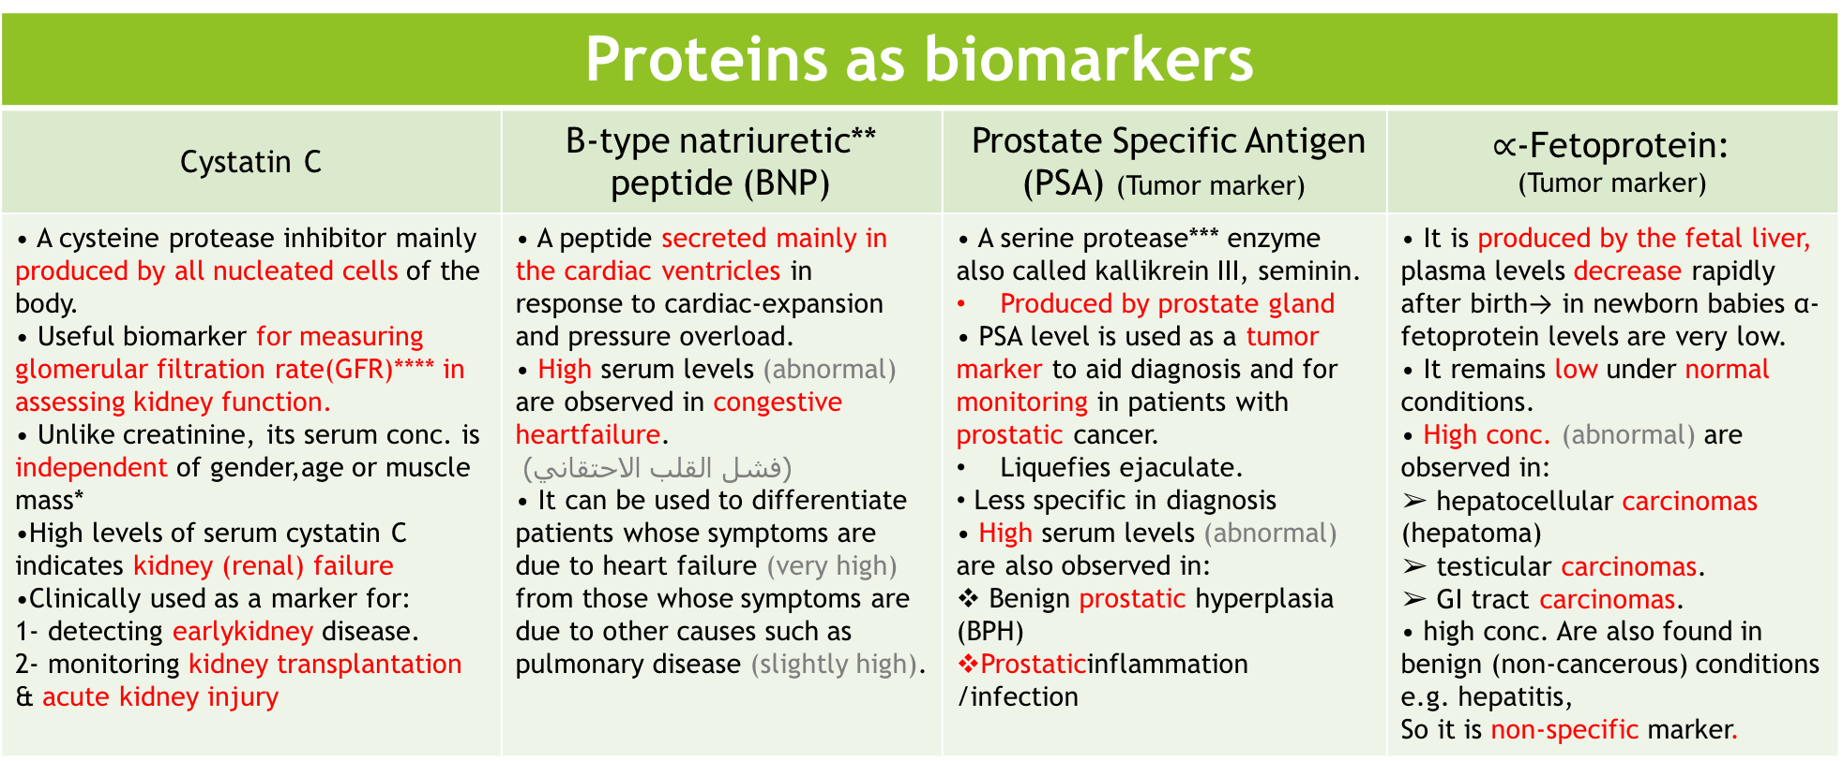
Proteins as biomarkers
Cystatin C | B-type natriuretic** peptide (BNP) | Prostate Specific Antigen (PSA) (Tumor marker) | $∝$-Fetoprotein: (Tumor marker)
• A cysteine protease inhibitor mainly produced by all nucleated cells of the body. • Useful biomarker for measuring glomerular filtration rate(GFR)**** in assessing kidney function. • Unlike creatinine, its serum conc. is independent of gender,age or muscle mass* •High levels of serum cystatin C indicates kidney (renal) failure •Clinically used as a marker for: 1- detecting earlykidney disease. 2- monitoring kidney transplantation & acute kidney injury | • A peptide secreted mainly in the cardiac ventricles in response to cardiac-expansion and pressure overload. • High serum levels (abnormal) are observed in congestive heartfailure. (فشل القلب الاحتقاني) • It can be used to differentiate patients whose symptoms are due to heart failure (very high) from those whose symptoms are due to other causes such as pulmonary disease (slightly high). | • A serine protease*** enzyme also called kallikrein ІІІ, seminin. Produced by prostate gland • PSA level is used as a tumor marker to aid diagnosis and for monitoring in patients with prostatic cancer. Liquefies ejaculate. Less specific in diagnosis • High serum levels (abnormal) are also observed in: Benign prostatic hyperplasia (BPH) Prostaticinflammation /infection | • It is produced by the fetal liver, plasma levels decrease rapidly after birth→ in newborn babies α-fetoprotein levels are very low. • It remains low under normal conditions. • High conc. (abnormal) are observed in: ➢ hepatocellular carcinomas (hepatoma) ➢ testicular carcinomas. ➢ GI tract carcinomas. • high conc. Are also found in benign (non-cancerous) conditions e.g. hepatitis, So it is non-specific marker.
*Muscle mass affects serum and urinary creatinine but not cystatin C; therefore, the use of cystatin may represent a more adequate alternative to assess renal function in healthy individuals.
**Natriuretic is release Na through urine.
All markers are low in normal condition and become high with disease *abnormal condition*
***Protease: enzyme that performs protein catabolism by hydrolysis of the peptide bonds
****glomerular filtration rate(GFR): the volume of fluid filtered from the renal (kidney) glomerular capillaries into the Bowman's capsule per unit time

Slide 13
Hormones as biomarkers:
Anti-Mullerian hormone (AMH)
A polypeptide hormone involved in sexual differentiation of male embryo
Appears to be a best marker for estimating egg cell reserve in the ovaries (ovarian reserve testing)
In females it is produced by ovaries
Plasma AMH levels strongly correlate with number of growing follicles
Only growing follicles produce AMH
Prevents premature depletion of ovarian follicles
Helps assess female fertility
Women are born with their lifetime supply of eggs, and these gradually decrease in both quality and quantity with age. Anti-Mullerian Hormone (AMH) is a hormone secreted by cells in developing egg sacs (follicles). The level of AMH in a woman's blood is generally a good indicator of her ovarian reserve

Slide 14
Anti-Mullerian hormone (AMH)
High levels in women with Polycystic ovarian syndrome (PCOS)
Low levels in women with ovarian dysfunction
Case:
A GP was called to see a 21-year-old female student who had been complaining a flu-like illness for two days, with symptoms of fever, vomiting and abdominal tenderness in the right upper quadrant. On examination she was jaundiced, moreover; the liver was enlarged and tender. A blood was taken for liver function tests which showed elevated ALT (alanine aminotransferase) and AST (aspartate aminotransferase)
❑ What is the most likely diagnosis?
Acute Hepatitis

Slide 15
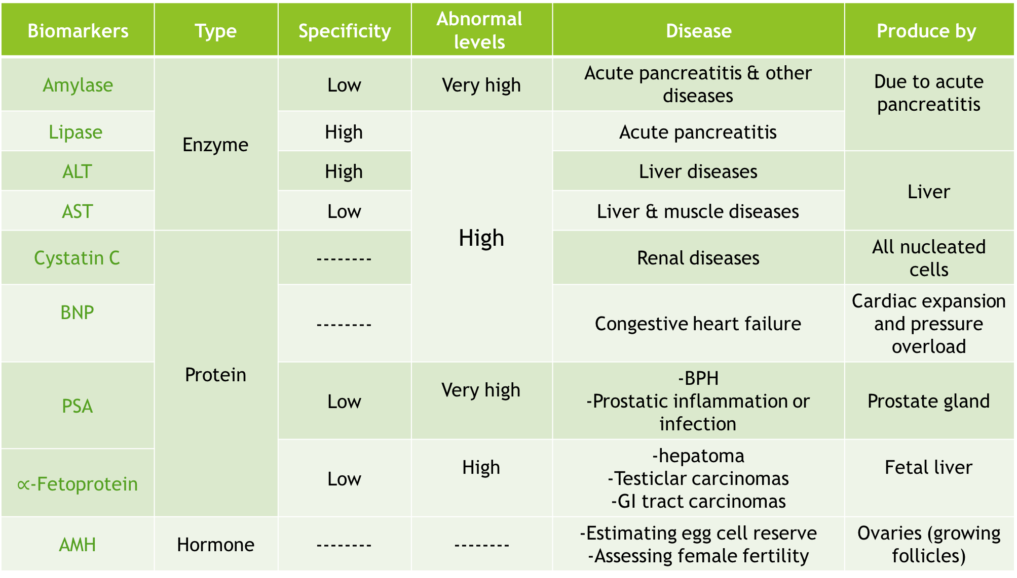
Produce by | Disease | Abnormal levels | Specificity | Type | Biomarkers
Due to acute pancreatitis | Acute pancreatitis & other diseases | Very high | Low | Enzyme | Amylase
 | Acute pancreatitis | High | High |  | Lipase
Liver | Liver diseases |  | High |  | ALT
 | Liver & muscle diseases |  | Low |  | AST
All nucleated cells | Renal diseases |  | -------- | Protein | Cystatin C
Cardiac expansion and pressure overload | Congestive heart failure |  | -------- |  | BNP
Prostate gland | -BPH -Prostatic inflammation or infection | Very high | Low |  | PSA
Fetal liver | -hepatoma -Testiclar carcinomas -GI tract carcinomas | High | Low
 |  |  |  |  | $∝$-Fetoprotein
Ovaries (growing follicles) | -Estimating egg cell reserve -Assessing female fertility | -------- | -------- | Hormone | AMH

Slide 16
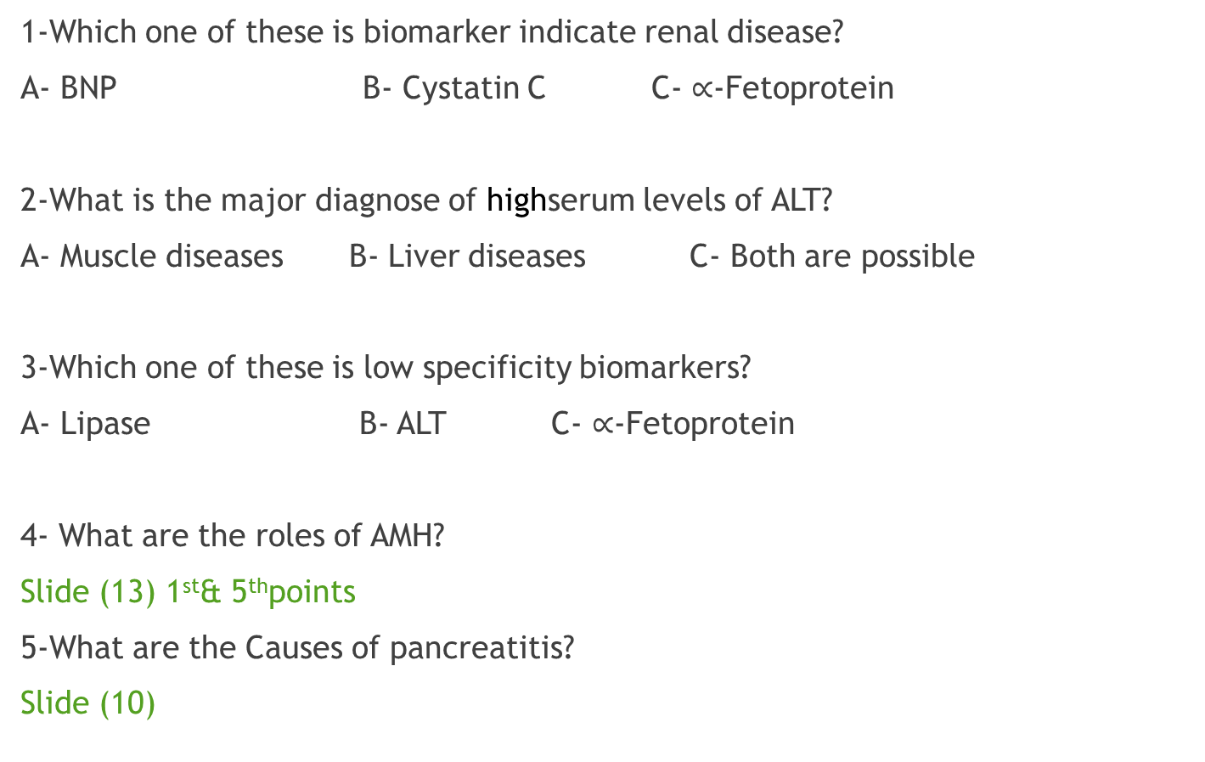
Quiz:
1-Which one of these is biomarker indicate renal disease?
A- BNP B- Cystatin C C- $∝$-Fetoprotein
2-What is the major diagnose of highserum levels of ALT?
A- Muscle diseases B- Liver diseases C- Both are possible
3-Which one of these is low specificity biomarkers?
A- Lipase B- ALT C- $∝$-Fetoprotein
4- What are the roles of AMH?
Slide (13) 1st& 5thpoints
5-What are the Causes of pancreatitis?
Slide (10)
1-B
2-B
3-C
نتمنى لكم التوفيق والنجاح!
436 Biochemistry team

Slide 17
Boys team members:
1- محمد المهوس
2- حمد الحسون
3-محمد حكمي
4- محمد حبيب
5- فهد العتيبي
6- هشام القوسي
7- عبدالعزيز الصومالي
8- محمد العسيري
- خالد القحطاني9
- طلال الطخيم 10
girls team members:
1- نوره الشبيب.
-Contact us:
Biochemistryteam436@gmail.com
twitter.com/436biochemteam
-Team leaders:
نوره السهلي.
عبدالله المانع.

