Slide 1
Molecular biology (1)
Revised by
شوق الأحمري & طراد الوكيل
– Color Index:
Important.
Extra Information.
Doctors slides.
436 Biochemistry team

Slide 2
Objectives:
Know the central dogma of molecular biology.
Understand the composition, types and structure of DNA and RNA.
Describe the organization of DNA in the chromosome and the role of histone proteins.
436 Biochemistry team

Slide 3
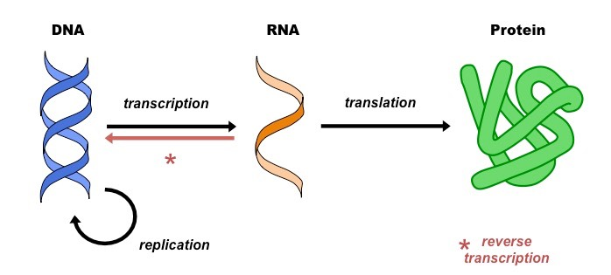
The central dogma of Molecular Biology
What is The Central dogma ?
The flow of information from DNA to RNA to Protein.
A portion of DNA, called a gene, is transcribed into RNA.
RNA is translated into proteins.
Gene: portion of DNA that transcribed into RNA.
Human genome contains about 35,000 genes
Which counts for 5% of total DNA
436 Biochemistry team

Slide 4
Nucleic acids
DNA (Deoxyribonucleic acid).
Nucleic acid (DNA and RNA) = Polymers of nucleotides (Adenylic acid, Guanlyc Acid, etc)
Nucleotides = Nucleoside (adenosine, Guanosine, etc) + phosphate
Nucleoside = nitrogenous base (Adenine, Guanine, etc) + ribose (sugar )
So.. many nucleoside with phosphate added to it gives us nucleic acid
the Building blocks of nucleic acids are nuclueoside triphosphates (nucleotides).
RNA (Ribonucleic acid).
required for the storage and expression of genetic information .

Slide 5
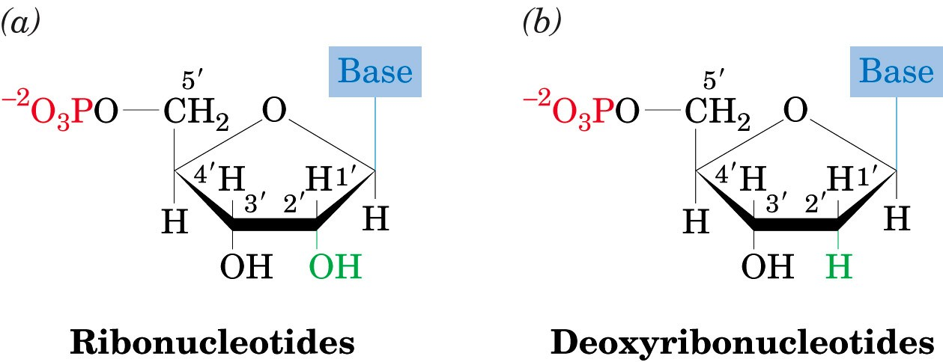
Nucleotides
Are composed of:
Nitrogenous base:
pentose: (Sugar
with 5 carbon ring):
Phosphate groups
Purines:
Pyrimidines:
Ribose (with –OH at C2).
Deoxyribose (with only H at C2)
Adenine (A) and
Guanine (G)
Cytosine (C),
Thymine (T)
and Uracil (U).

Slide 6
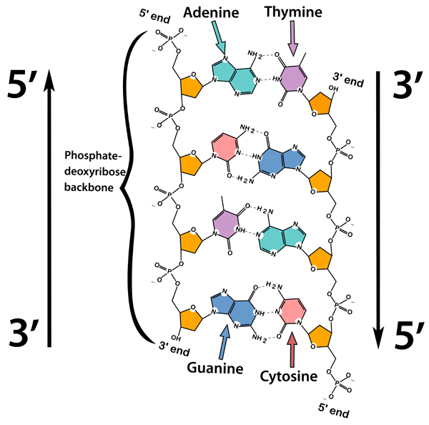
- The sugar carbon numbers are primed (1’ 2’ 3’ etc.), while the nitrogenous base atoms are unprimed.
- The nitrogenous base is bonded to C₁’ of sugar.
- The PO₄ group is bonded to C₃’ or C₅’ of sugar.

Slide 7
NOTICE:
Purines: 2 rings and 4 nitrogen inside the rings
Pyrimidines: 1 ring and 2 nitrogen inside the the ring
*You don’t have to memorize the structures
if an H was in X place it would be a base and ending in "ine"
if a ribose was in X place it would be a Nucleoside and ending in “osine”
if a ribose phosphate (ribose with a phosphate connected to it) was in place of X it would be a nucleotide and ending in “ylic acid”
AMP,GMP, is just an abbreviation

Slide 8
Chemical structure of DNA and RNA
-The PO4 bridges the 3’ and 5’ positions of ribose sugar.
-The PO4 and sugar bonding is the backbone of DNA structure.
-The linkage between the nucleotides is called phosphodiester bond
The linkage between nitrogen bases and ribose sugar is glycosidic linkage.
Glycosidic bond
*مهم جدا معرفة اسم الرابطة التي تربط بين النيوكليوتايدز
.(phosphodiester)
مهم معرفة كل كربون ايش مرتبط فيها ..- مثلا النيتروجين بيس مرتبطه بكاربون رقم 1
والفوسفات قروب يرتبط مع كربون 3 و/او 5.

Slide 9
FUNCTION OF NUCLEOTIDES
Polymers of nucleotides (as DNA or RNA) store and transfer genetic information.
Free nucleotides and their derivatives perform various metabolic functions not related to genetic information
Other nucleotides: FAD, NAD, CoA

Slide 10
THE DOUBLE HELIX DNA
The structure of DNA was first determined by James Watson and Francis Crick in 1953.
Commonly known as Watson-Crick structure.
Features of Watson-Crick DNA structure :
1- Two polynucleotide chains wind around a common axis to form a double helix.
2- The two strands are anti-parallel (run in opposite direction). From 5 ----------3
3- Each strand is a right-handed helix.
3-----------5
4- The nitrogenous bases are in the center of the double helix and the sugar-phosphate chains are on the sides .
5-The surface of the double helix contains 2 grooves: the major and minor grooves. Places for bonding to regulate transcription or replication.
6- complementary base pairing , Each base is hydrogen bonded to a base in the opposite strand to form a base pair (A-T and G-C)
7-The helix has 10 base pairs (bp) per turn.
Adenine (A) Thymine (T)
Guanine (G) Cytosine (C)
In RNA, Thymine is replaced by Uracil (U)

Slide 11
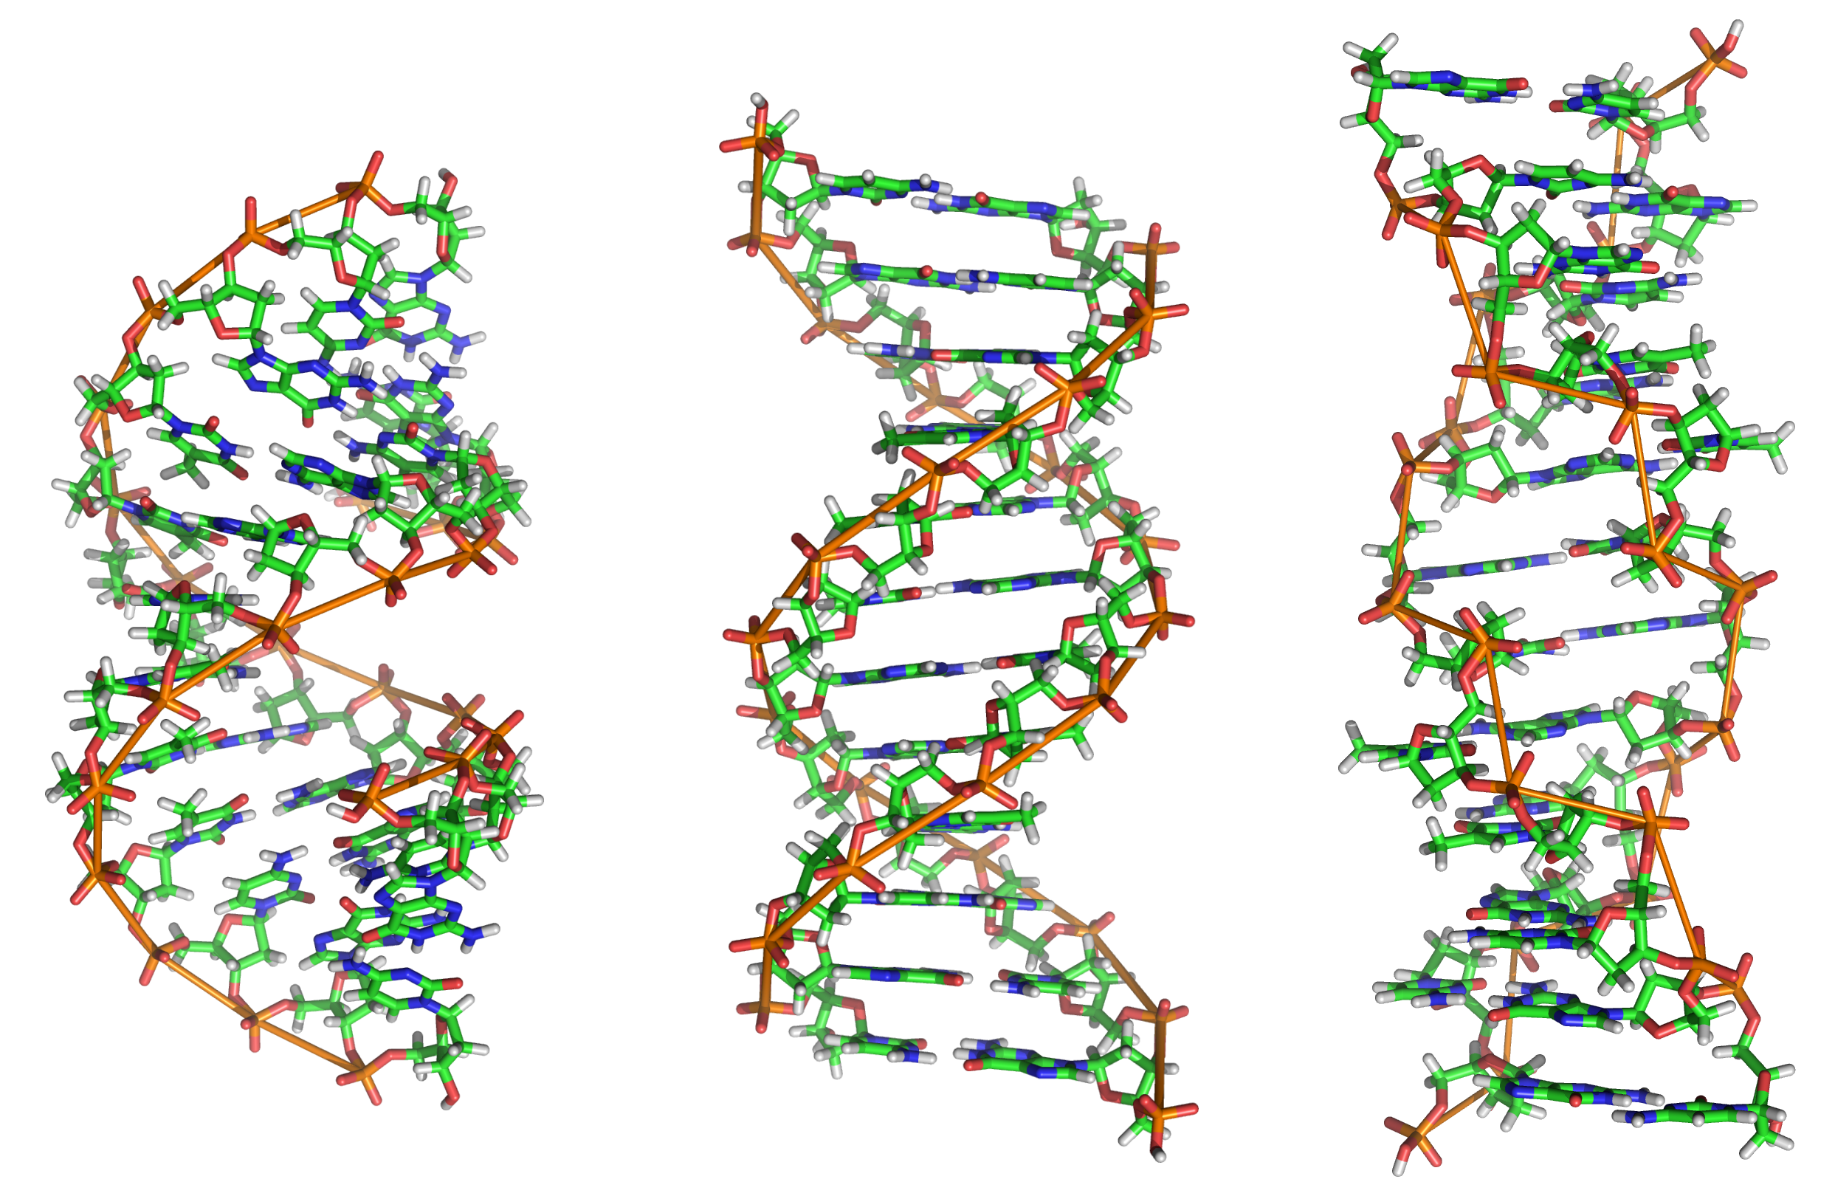
Types of DNA structure
 | A-DNA | B-DNA Watson-Crick model | Z-DNA
Direction | Right-handed | Right-handed | Left-handed
Helix length | Short | Elongated | More elongated
Major groove | Deep and narrow | Wide | Not real groove
Minor groove | Wide | Narrow | Narrow
Placement of bp | Displaced away from the helical axis | Centred over the helical axis | Zig-zag pattern (nearly perpendicular to the helical axis)
bp per turn | 11 | 10 | 12
Conformation of deoxyribose وين يمسك الـــ | C₃ | C₂ | G (C₂) ; C (C₃) مرة يمسك في رقم 3 ومرة في 2
Notes | يوجد في حالتين : 1- DNAنسخ ال 2- Non coding RNA | غالبية الموجود في الجسم على هذا الشكل | -

Slide 12
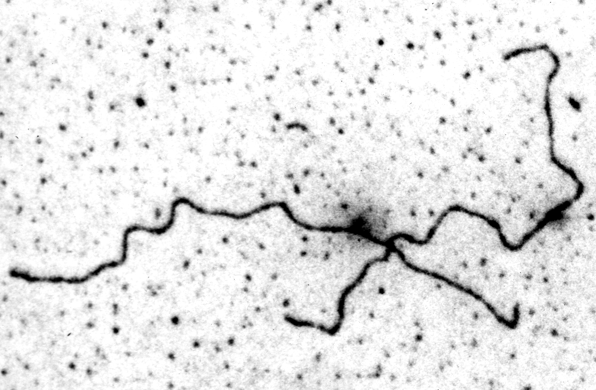
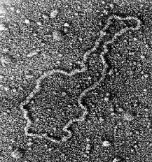
DNA supercoiling
The chromosomes of many bacteria and viruses contain circular DNA which is supercoiled.
The end of DNA of human is not connected like bacteria، It is separated.
DNA of bacteria | DNA of human

Slide 13
Melting temperature
The temperature at which the double-stranded DNA is separated into two single strands.
MT of DNA depends on nitrogenous base content (A-T and G-C).
G-C | A-T
Triple bond -more stable so needs higher MT- | Double bond - Less stable so needs lower MT- | Type of hydrogen bond
90-95 c° | 63-68 c° | Separated at
When reaches the MT only the hydrogen bonds between nitrogen bases are broken

Slide 14
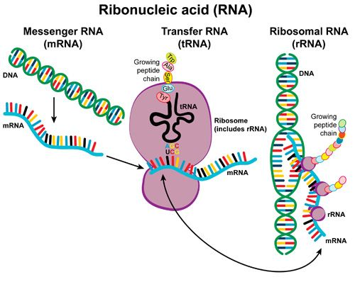
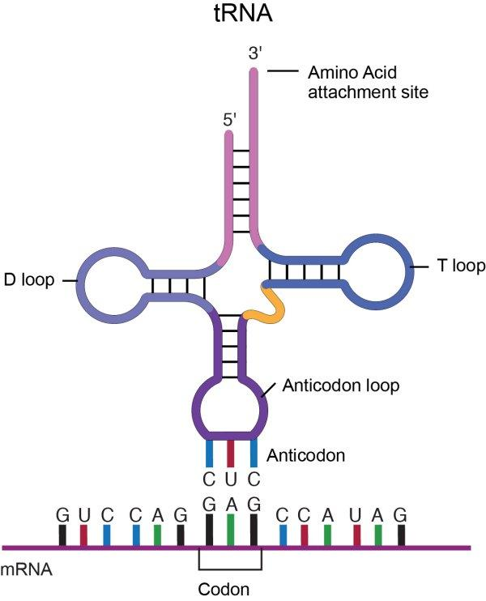
RNA (Types and function)
RNA is a single-stranded polymer of ribonucleotides.
Types of RNA :
Function | Type of RNA
Transcription process (from DNA to mRNA). | mRNA
Recognition and transferring. It recognizes amino acids’ codons and transfers the selected amino acids to the growing protein chain. | tRNA
Site of protein synthesis (factory). | rRNA

Slide 15
Nucleosomes
What are they?
Nucleosomes are the individual units of chromatin
(particles consisting of DNA and histones connected by thin strands of naked DNA)
They consist of a segment of DNA wrapped around a core called histone octamer
( 8 particles of histone protein )
Two particles of each histone ( H2A, H2B, H3 and H4 ) assemble to form the core
While the fifth type of histone H1 forms the bond between the core and the DNA.
( H1 binds to 2 complete helical turns of DNA.)

Slide 16
HOW DNA IS ORGANIZED IN A CHROMOSOME?
How DNA is organized in a chromosome
2- The DNA from single 23 human chromosomes have a length of 1 meter.
1- Each chromosome is a complex of a single linear DNA molecule and protein called chromatin.
3- 50% of chromatin consists of protein called Histones
4- The human genome contains 3.5 billion base pairs and more than 95% is non-coding or “junk” DNA.
* Note ; positively charged means ( polar basic ) – histidine is not included because it is a weak base -

Slide 17
MSQ’s
1- The linkage between the nucleotides is called :
Phosphate bond (b) phosphodiester bond (c) ester bond (d) phosphoester bond
2- how many bp per turn in Z-DNA ?
10 (b) 11 (c) 12 (d) 13
3- The most common DNA form in the body is :
A-DNA (b) B-DNA (c) Z-DNA (d) None
4- Conformation of deoxyribose in the Z-DNA form :
a) C3 (b) C4 (c) G (C2) ; C (C3) (d) None
1-
B
2-
C
3-
B
4-
c

Slide 18
Boys team members:
1- عبدالعزيز الشديد.
2- فهد العتيبي.
3- محمـد حبيب.
4- محمـد العسيري.
5- محمـد المهوس.
6- هشام القوسي.
.7- حاتم النداح
8- محمـد حكمي
-Team leaders:
نوره السهلي.
عبدالله المانع.
-Contact us:
Biochemistryteam436@gmail.com
twitter.com/436biochemteam

