Slide 1
Molecular Biology 2
– Color Index:
Important.
Extra Information.
Doctors slides.
Revised by
شوق الأحمري & طراد الوكيل
436 Biochemistry team

Slide 2
Objectives:
To understand DNA replication
To know the transcription of genetic material into messenger RNA
To get an idea about the translation of mRNA into a functional protein.

Slide 3
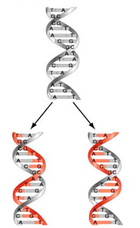
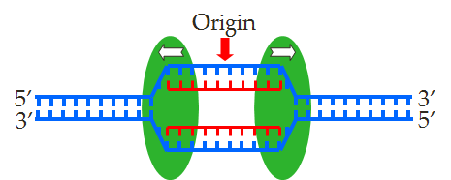
DNA is the genetic material, therefore :
1- it replicates faithfully.
2-has the coding ability (ability to transfer information) to produce proteins for all cellular functions.
Features of Eukaryotic DNA Replication
Daughter DNA molecule contains one parental
strand and one newly-replicated strand
1- Semiconservative
2- Bidirectional with multiple origins of replication
g
Origin of replication: is a particular sequence in a genome at which replication is initiated.

Slide 4
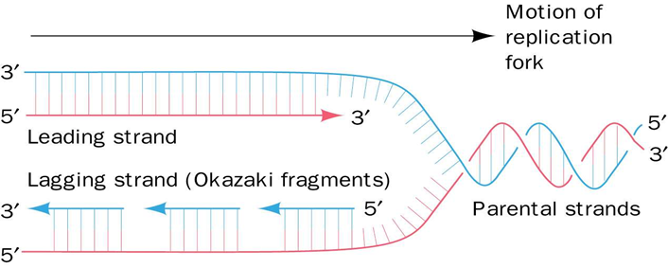
3- Primed by short stretches of RNA.
There must be a basic structure to build upon "a foundation”. The enzymes for replication can't start from scratch; therefore Primers (RNA nucleotides) are used (and they are later removed)
4- Semi-discontinuous
The leading strand is synthesized continuously and the lagging strand is discontinuous (in fragments)
The directions will always be 5' -> 3' (either away or into the fork).

Slide 5
Proteins involved in DNA replication
للتذكر: هل لك سبب تلوم بُه ؟ لا، توبه هو بريء
Name | Types | Functions
DNA Helicase | _____________________ | -An enzyme that binds to DNA sequences called Origins and unwinds DNA strands.
Single-stranded DNA binding proteins | _____________________ | Prevents single strands from winding.
DNA Primase | _____________________ | An enzyme that makes a short segment of RNA primer which is complementary to the DNA
DNA polymerases | α (Alpha) , β (Beta) , γ (Gamma) , δ (Delta) , ε (Epsilon). | An enzyme that adds DNA nucleotides to the RNA primer. -Proofreads bases added and replaces incorrect nucleotides.
DNA ligase | _____________________ | An enzyme that forms bonds between the sugar-phosphate backbone.
Topoisomerases | Topoisomerases I | (cut one of the DNA strands)
 | Topoisomerases II | (cut both of the DNA strands)
Telomerases | _____________________ | An enzyme that adds nucleotides to telomeres (a reign at the end of a chromosome)
Eukaryote enzymes are different than prokaryote enzymes.
***** The Pol α complex (pol α-DNA primase complex)

Slide 6
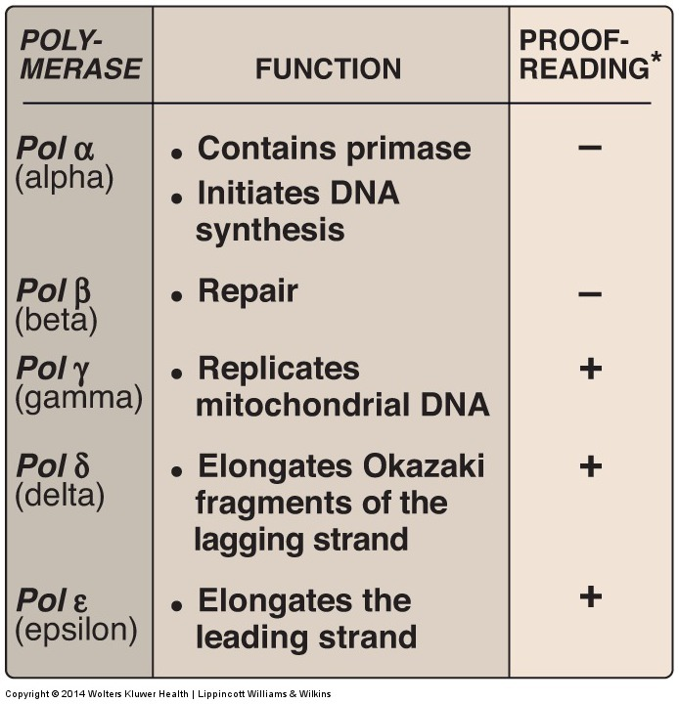
EUKARYOTIC DNA REPLICATION (continued)
Figure 29.23
Activities of eukaryotic DNA polymerase (pol) *3'→5' exonuclease activity.

Slide 7
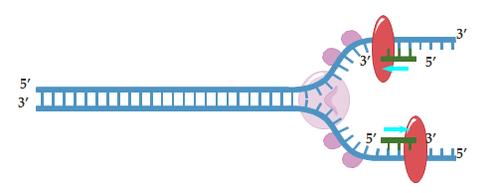
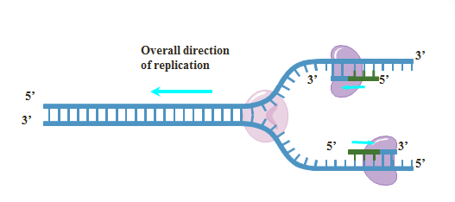
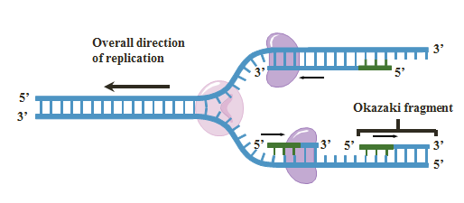
Steps in DNA replication
Why do we need Single-stranded binding proteins?
The DNA has a lot of hydrogen bonds between its base pairs, and because hydrogen bonds are very strong they may form back on their own, so we need those proteins to keep the two strands apart to prevent hydrogen bonds from forming and reconnecting the strands while replication is still happening.
Untwists DNA strands, making a fork-like structure → called replication fork
Helicase.
Prevents single strands from twisting again.
Single-stranded binding proteins.
Makes RNA primer.
Primase
يمسك كل شريطة على طرف بحيث يبعدهم عن بعض عشان ما يرجعوا يتصلوا
Adds nucleotides to the primer and checks if the bases added are correct or not, if not → removes incorrect nucleotides.
If there are multiple origins then there are multiple helicase.
The primer can only sit on the 3’.
DNA polymerase.
يضيف الوحدات وبعد كذا يتأكد من شغله و اذا سوا شيء خطا يمسحه.
Leading strand synthesis is continuous in a 5’ to 3’ direction.
Lagging strand discontinuous synthesis produces 5’ to 3’ DNA segments (okazaki fragments).
The two strands are antiparallel. However, DNA polymerase can ONLY work in a 5’ → 3’ direction so we are left with gaps where the DNA polymerase cant continue working. These fragments are called okazaki fragments

Slide 8
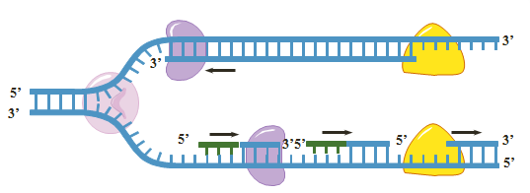
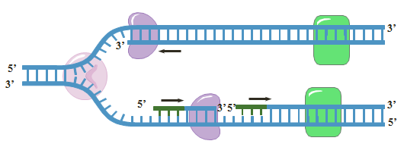
Continue:
Removes the RNA primers by exonuclease activity.
DNA polymerase.
Fills the gaps that we got after removing the RNA primers.
DNA polymerase.
Connects the okazaki fragments by forming bonds between the sugar-phosphate backbone.
Exonucleases are enzymes that remove nucleotides.
In the lagging strand
In the lagging strand.
Ligase
In the lagging strand
DNA Replication video

Slide 9
The central dogma of Molecular Biology
A portion of DNA, called a gene, is transcribed into RNA.
RNA is translated into proteins.

Slide 10
Transcription (mRNA synthesis)
A portion of DNA (a gene) is transcribed into messenger RNA (mRNA).
Only one of the DNA strands is transcribed (antisense strand).
The RNA polymerase II is responsible for this process.
The direction of transcription is 5’ → 3’.
Steps of mRNA synthesis
Chain initiation:
promoter region
RNA polymerase II binds to promoter region of DNA to start transcription.
Notes :
Ta-Ta box is in the promotor region

Slide 11
Steps of mRNA synthesis
Chain elongation:
A portion of DNA template unwinds (opens) at the point of RNA synthesis.
This forms a short length of RNA-DNA hybrid.
Chain termination:
DNA contains specific sites which stop transcription (at a sequence of 4-10 AT base pairs).
Note: in RNA we call it transcription bubble instead of replication fork

Slide 12
Post-transcriptional modification
Capping: Addition of
a methylated guanine nucleotide at 5’ end of mRNA
Polyadenylation: Addition of a poly(A) tail (a highly conserved
AAUAA sequence) at 3’ end of mRNA.
Functions:
To protect the mRNA from degradation
For ribosomal RNA recognition
Notes:
Tail: poly (A) tail helps with recognition
Function:
To prevent mRNA degradation by exonucleases.
It helps the transcript bind to the ribosome during protein synthesis.
Intron removal for releasing mature mRNA from nucleus
* Note:
Introns will be removed before the transcription , but Exons present.

Slide 15
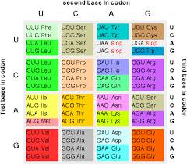
Translation (Protein synthesis)
It is a process of protein synthesis from mRNA
mRNA has genetic codes for amino acids present in proteins.
The genetic code is a dictionary that identifies the correspondence between a sequence of nucleotide bases and a sequence of amino acids.
Each individual word in the code is composed of three nucleotide bases (codons).
" الكودون هو ثلاثة نيوكليتايد على تكون شفرة لحمض أميني معين "
جملة لتسهيل حفظ كودونات التوقف:
"يُقال من يواعد يُواجه "
UGAl mn UAAed UAGeh
64 possible codons
One start codon (AUG)
3 stop codons UAA
UAG
UGA
61 codons specify 20 amino acids

Slide 16
mRNA
Amino acids
tRNA
Functionally competent ribosomes
Components required for Translation
ATP and GTP
Aminoacyl -tRNA synthetases
Protein factors
" An enzyme that attaches amino acid onto tRNA"

Slide 17
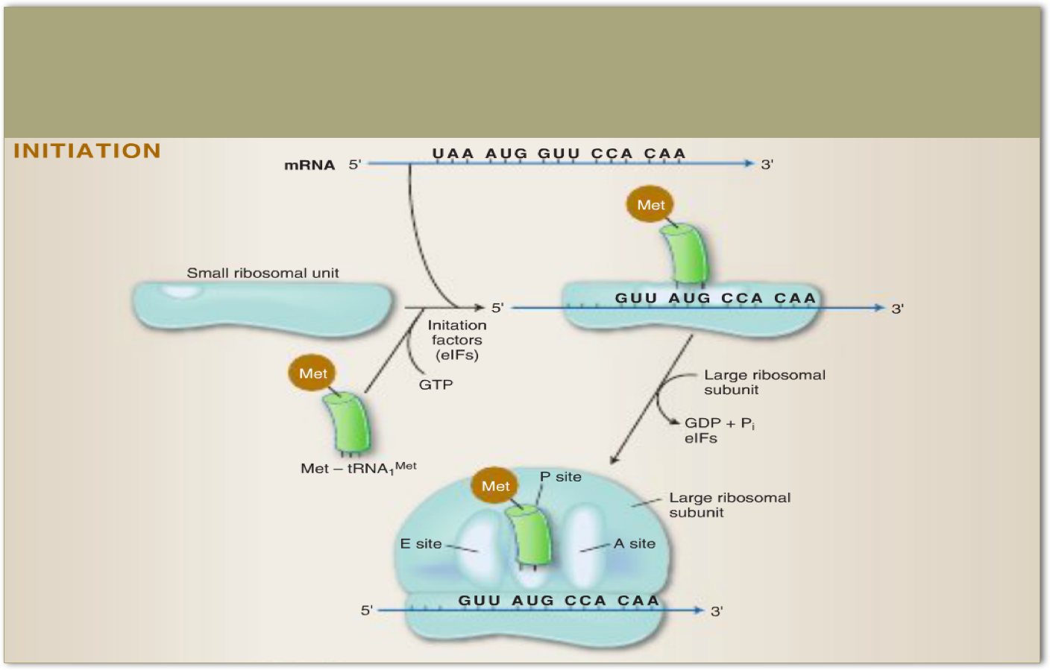
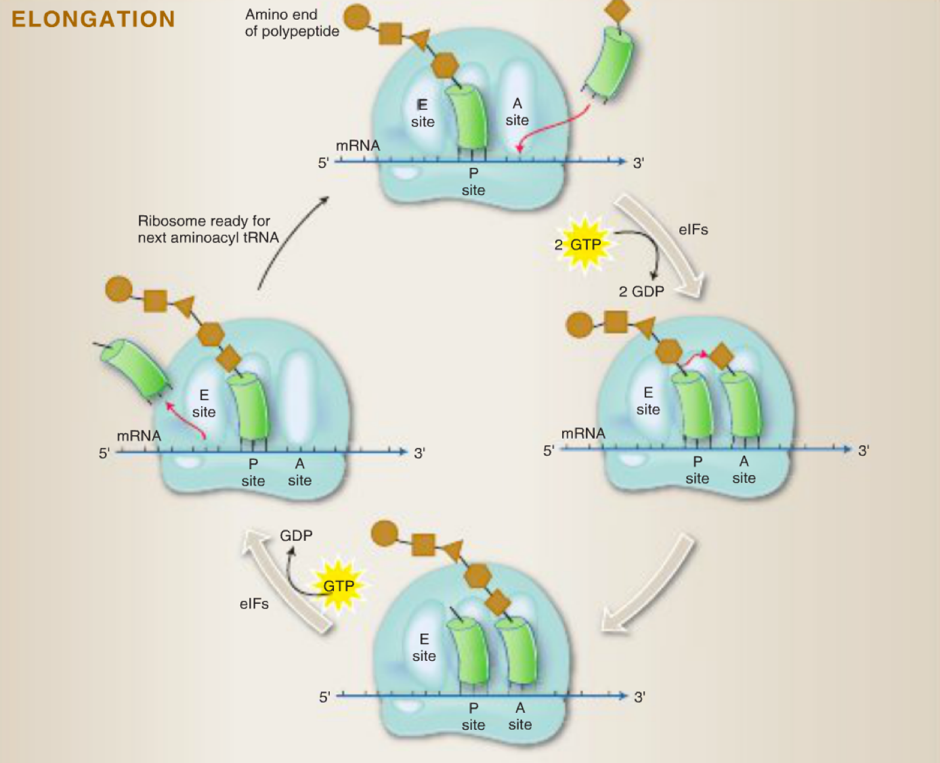
1. Initiation: in general it means {making complements}
Puts (ribosoms +tRNA+ mRNA} together and make it ready to start
Elongation: it happens until the termination (stop codon)
* P =peptide side, A=incoming amino acids, E= Exit site

Slide 18
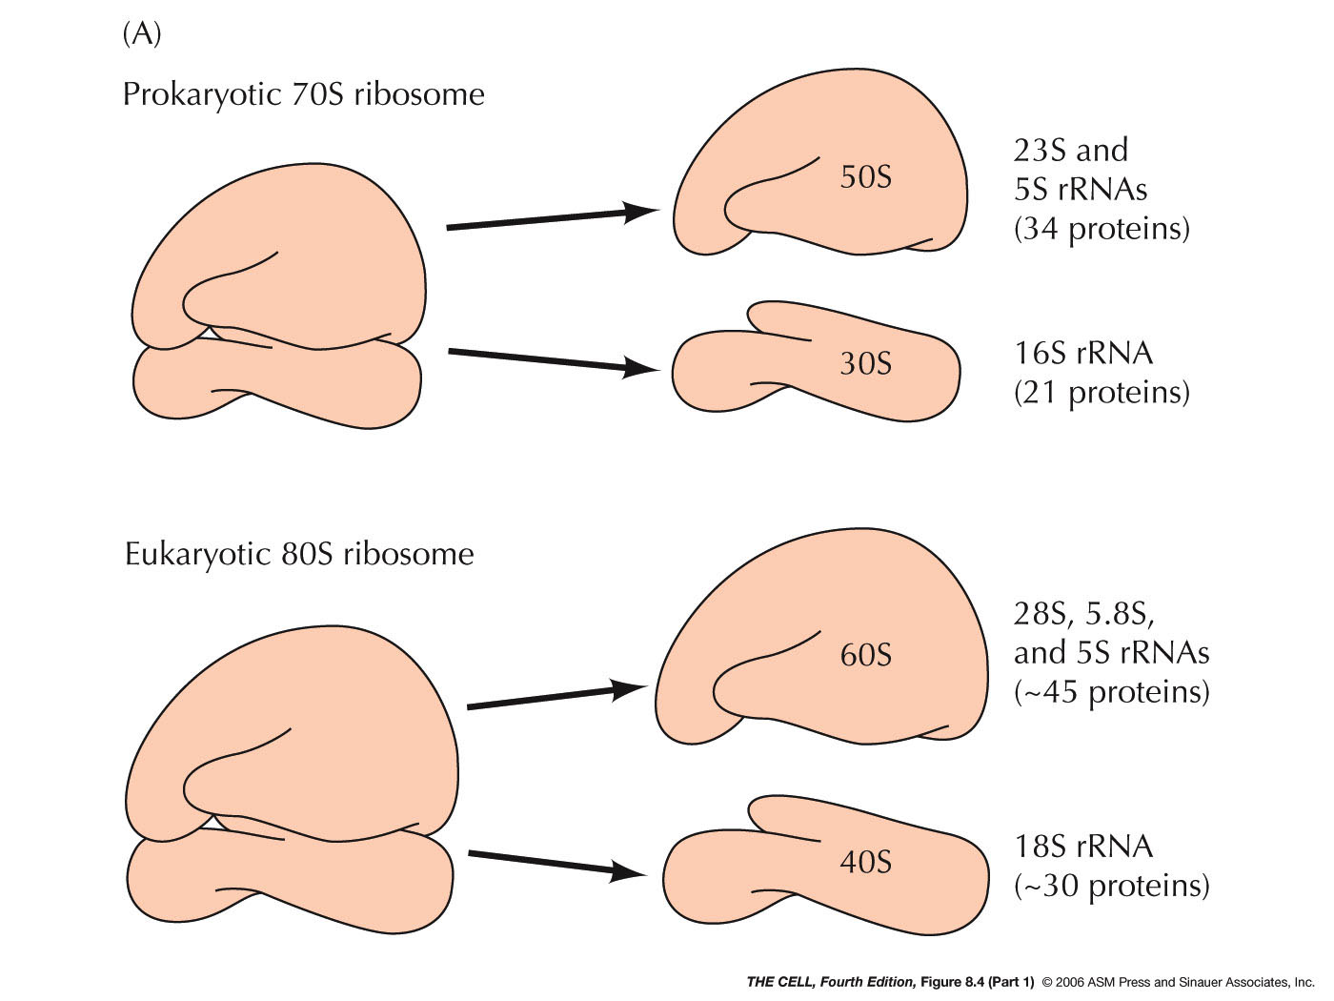
Mentioned in males lecture:
All prokaryotes have 70S ribosomes. 70S ribosome is made up of a large subunit (50S) and small subunit (30S)
Eukaryotes have larger ribosomes (80S) made up of 60S and 40S subunits.
S= Svedberg units to measure the size of the subunits
In humans the start codon is Methionine.
In bacteria the start codon might code with different codons.

Slide 19
*summary for all the lecture
DNA replication
DNA Helicase
Protein unwinds DNA strands
Single stranded
Protein prevent single strands from rewinding
Primase
Protein makes a short segment of RNA primer
DNA polymerase
Ligase
Protein adds nucleotides to RNA primer
Protein form bonds between sugar-phosphate backbone
Removes RNA primers
Fills the gabs
1- the rest of proteins involved in DNA replication A- topoisomerases I & II B- telomerase
2- leading strands synthesis continues in a 5 to 3 direction.
And the lagging strand discontinuous synthesis 5 to 3 ( okazaki fragments )
mRNA synthesis
( transcription )
Chain initiation
RNA polymerase II binds to promoter region of DNA to start transcription.
Chain elongation
A portion of DNA template unwinds at the point of synthesis and this will form short length of RNA-DNA hybrid.
Chain termination
DNA contains specific sites which stop transcription.
Post-transcriptional
modification
1- capping : at the 5 end of mRNA
2- polyadenylation : at 3 end of mRNA

Slide 20
Steps in protein translation
Components for translation
1- 61 codons specify 20 amino acids
2- AUG is the start codon
3- UGA UAG UAA are the stop codons
1- amino acids.
2-transfer RNA
There are 64 possible codons
Initiation
elongation
termination
Translation (protein synthesis)
*summary for all the lecture
3- aminoacyl - tRNA synthetases
4- mRNA
5- ATP and GTP
6- functionally competent ribosomes.
7-proteins factors

Slide 21
Videos
From DNA to protein
DNA Replication
Protein synthesis
DNA
QUIZ

Slide 22
Girls team members:
1- أسيل السليماني.
2- نوره الشبيب.
3- ريم السرجاني.
4- غادة المزروع.
5- سارة الشمراني.
6- نجود العنزي.
7- شهد السويدان.
8- هيفاء الوعيل.
9- منيرة الضفيّان.
10- لمى الفوزان.
11- بثينة الماجد.
-Contact us:
Biochemistryteam436@gmail.com
twitter.com/436biochemteam
-Team leaders:
نوره السهلي.
عبدالله المانع.

