Slide 1
Carbohydrates
Revised by
شوق الأحمري & طراد الوكيل
– Color Index:
Important.
Extra Information.
Doctors slides.
436 Biochemistry team

Slide 2
Objectives:
The structure of carbohydrates of physiological significance.
The main role of carbohydrates in providing and storing of energy.
The structure and function of glycosaminoglycans.

Slide 3
Carbohydrates
“hydrates of carbon”
Are the most abundant organic molecules in nature
Purpose
Provides and stores energy
Structural component in cell membranes
Empiric formula:
(CH₂O)n
“hydrates of carbon”
Some carbohydrate metabolism disorders:
Diabetes mellitus : a chronic disease associated with abnormally high levels of the sugar glucose in the blood.
Galactosemia : condition in which the body cannot process or 'metabolise' the sugar galactose. Which means High galactose level in the blood
Glycogen storage disease : is the result of defects in the processing of glycogen synthesis or breakdown within muscles, liver, and other cell types
Lactose intolerance : is the inability of adults and children to digest lactose

Slide 4
Classification
Monosaccharides
Simple sugar
Disaccharides
2 sugar units
Oligosaccharides
3-10 sugar units
Polysaccharides
>10 sugar units
Homopolysaccharides
Same sugar unit multiple copies
Heteropolysaccharides
Different sugar units multiple copies
Unbranched
-Single chain
Cellulose
(B-glycosidic polymer)
Branched
-One chain but it has a branch on it
glycogen and starch
(a-glycosidic polymer)

Slide 5
Monosaccharides Are further classified based on:
Carbonyl group at the end
Carbonyl group in the 2nd position (within the chain)
1- No. of Carbons
2- Functional Sugar group ( Aldose & Ketose )
 | Aldose | Ketose
Triose | Glyceraldehyde | Dihydroxyacetone
Pentose | Ribose | Ribulose
Hexose | Glucose | Fructose
The smallest Aldehyde is Glyceraldehyde.
Hexose is the most common functional group
Glucose -> Aldehyde group Fructose -> Ketone group

Slide 6
*You don’t have to memorize structures

Slide 9
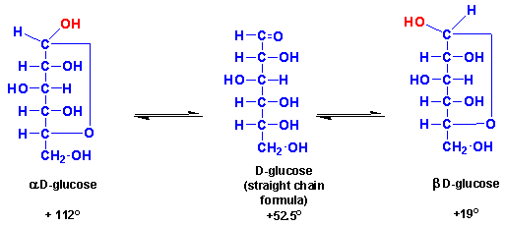
Mutarotation
*You don’t have to memorize structures + Temperature
In solution, the cyclic α and β anomers of a sugar are in equilibrium with each other, and can be interconverted spontaneously.
Alpha and beta are not fixed in the solution + converting from beta to alpha not required any energy or enzymes when
Sugar Isomers:
Aldo-Keto
Same : formula
Epimers
Same : formula
Different : configuration around a *single* carbon atom
D-and L-forms
α-and β-anomers
Different : functional Group
Same : molecular formula
Different : position of OH group on the *asymmetric carbon* farthest from carbonyl group
Same : molecular formula
Different : position of OH around anomeric carbon

Slide 10
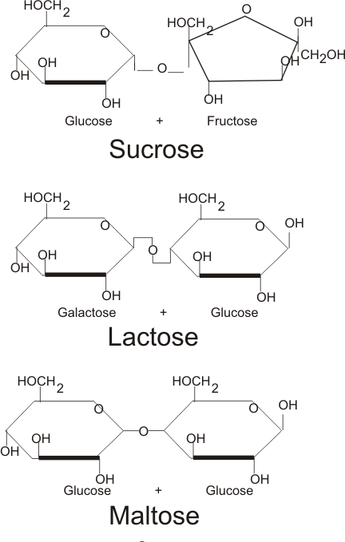
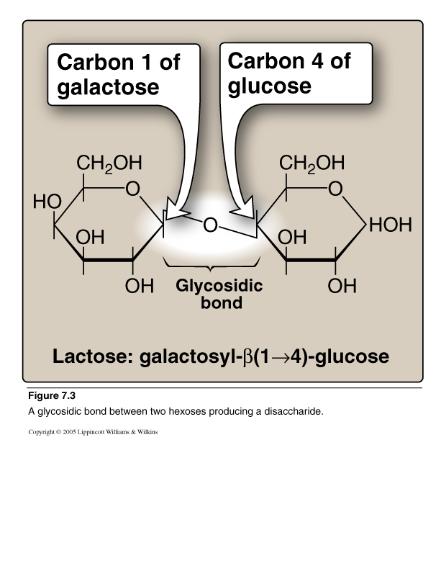
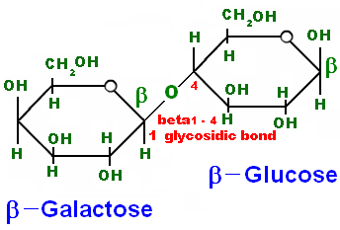
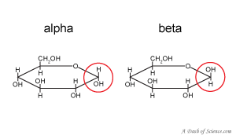
Disaccharides
*You don’t have to memorize structures
Joining of 2 monosaccharides by O-glycosidic bond .
Examples :
1-Maltose(α-1, 4)= glucose + glucose
2- Sucrose (α-1,2)= glucose + fructose
3- Lactose (β-1,4)= glucose + galactose
C1 of the first glucose
OH toward down
C4 of the second glucose
NOTE:
α= OH down Β= OH up

Slide 11
Polysaccharides
Homopolysaccharides
Heteropolysaccharides
Homo: same type of suger
Hetero: different type of suger
Examples :
Glycosaminoglycans
( GAGs)
Branched
Unbranched
Examples :
Glycogen and starch (α-glycosidic polymer)
Examples :
Cellulose
(β-glycosidicpolymer)

Slide 12
Reducing Sugars
Examples
Maltose
Monosaccharides
Lactose
If the hydroxyl group on the anomeric carbon of a cyclized sugar is not linked to another compound by a glycosidic bond, the ring can open. The sugar can act as a reducing agent, and is termed a reducing sugar. Such sugars can react with chromogenic agents (for example, Benedict’s reagent or Fehling’s solution) causing the reagent to be reduced and colored, with the aldehyde group of the acyclic sugar becoming oxidized.
If the O on the anomeric C of a sugar is not attached to any other structure (Free), that sugar can act as a reducing agent
Reducing sugars reduce chromogenic agents like Benedict’s reagent or Fehling’s solution to give a colored precipitate
Urine is tested for the presence of reducing sugars using these colorimetric tests
*Sucrose is non-reducing, Why?
Sucrose is the combination of cyclic structures of Glucose and Fructose and therefore does not have a free aldehyde or ketone group.
http://www.youtube.com/watch?v=Kj15mH5zB6Y&t=7m55s
الفيديو جدا رائع يفسر بطريقة جدا مفهومة وبسيطة

Slide 13
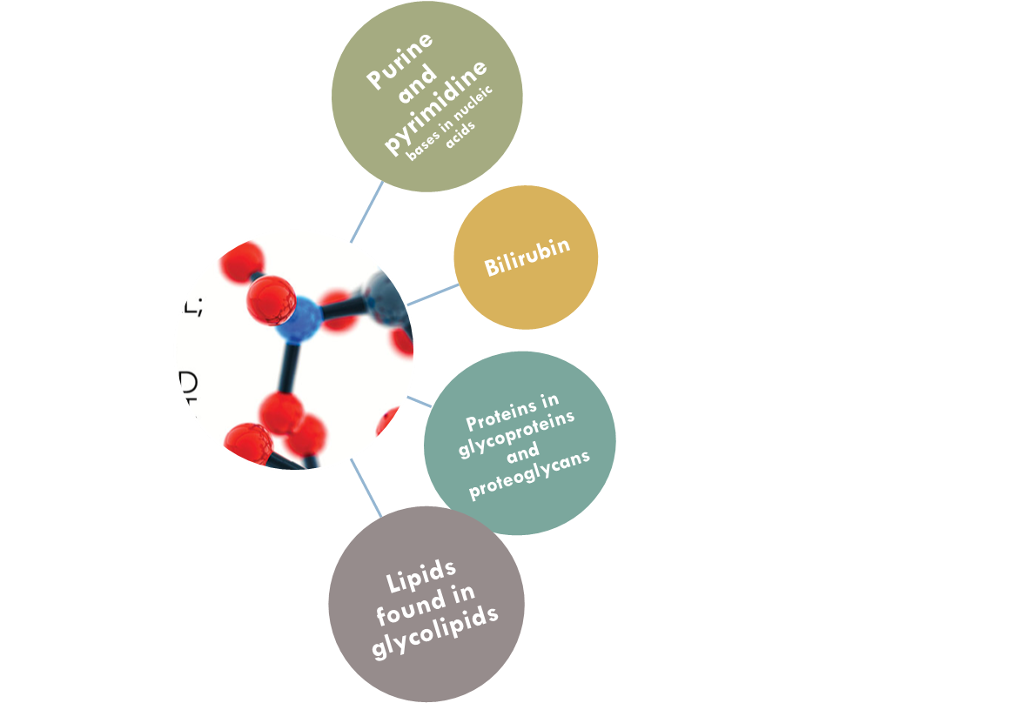
Complex Carbohydrates
Carbohydrates attached to non-carbohydrate structures by glycosidic bonds (O- or N-type).
Carbohydrates can be attached by glycosidic bonds to non-carbohydrate structures, including purine and pyrimidine bases
Glycoproteins; proteins that have some sugar attached to it.
Proteoglycans:carbohydrate having some protein attached to it.
Glycolipids: lipids that have some sugar attached to it

Slide 14
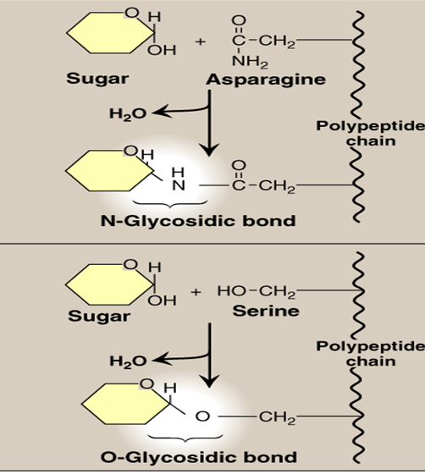
Glycosidic Bonds
N-Glycosidic
If the group on the non-carbohydrate molecule to which the sugar is attached is an –NH2 group, the structure is an N-glycoside and the bond is called an N-glycosidic link.
O-Glycosidic
If the group is an –OH, the structure is an O-glycoside, and the bond is an O-glycosidic link
Polar and charged

Slide 15
*Since it’s negatively charged it can form bonds with water

Slide 16
Resilience of GAGs

Slide 17
Carbohydrates (CH2O)
Monosaccharides
Can be classified according to:
Disaccharide Oligosaccharide
Polysaccharide
(more than 10)
(3-10) monosaccharide
NO.Of C atoms
Functional gr.
"2 Mono units"
Bond: O-glycosidic
*Sucrose= glucose+fructose
* Maltose= glucose+glucose
*Lactose= glucose+galactose
Homopolysaccharide
Aldoses Ketoses
Glyceraldehyde
Ribose
glucose
Trios
"3C"
Pentos
"5C"
Hexos
"6C"
Dihydroxyacetone
Ribulose
fructose
Branched Unbranched
*glycogen *cellulose *starch
Heteropolysaccharide
e.g: Glycosaminoglycan (GAG)
*it has a negative charge
*Linear
*forms Proteoglycan, it has 95% carbohydrates
*forms a Gel-like matrix
*forms viscous and lubricating the mucos (mucopolysaccharide)
*consists of repeated disaccharide units
Amino sugar (sulfated) Acidic sugar
D-glucosamine D-glucuronic acid
Or D-galactosamine L-iduronic acid

Slide 18
videos
Naming and classification
Cyclic structure of carbohydrates
Quiz

Slide 19
Girls team members:
1- زينة الكاف.
2- جومانا القحطاني.
3- ريم السرجاني.
4- شذا الغيهب.
5- سارة الشمراني.
6- لجين الزيد.
7- روان الوادعي.
8- هيفاء الوعيل.
9- روان القحطاني.
10- لمى الفوزان.
11- بثينة الماجد.
-Team leaders:
نوره السهلي.
عبدالله المانع.
-Contact us:
Biochemistryteam436@gmail.com
twitter.com/436biochemteam

