Slide 1


LIPIDS
– Color Index:
Important.
Extra Information.
Doctors slides.
436 Biochemistry team

Slide 2
Objectives
Define and classify lipids
Understand the physiological importance of lipids
List the examples of simple and complex lipids
Correlate implications of lipids in clinical conditions
436 Biochemistry team

Slide 3
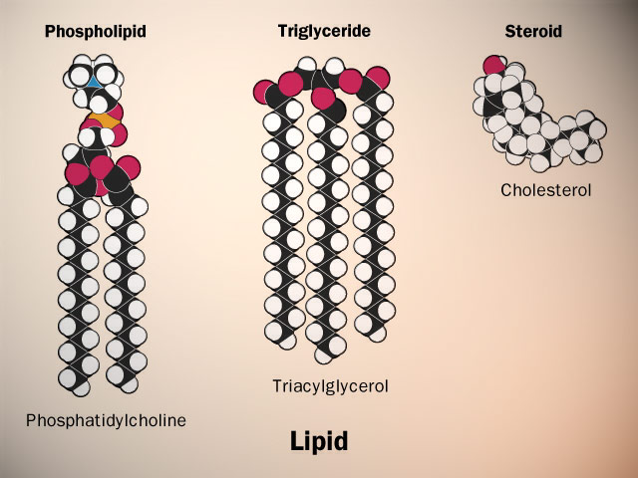
Lipids
What are the lipids ?
The functions of lipids
Lipids and disease
Heterogeneous group of hydrophobic (water–insoluble) organic molecules that are soluble in organic solvents .
Body lipids are compartmentalized (packed) in cell membranes, tissue and plasma.
Essential components of cell membranes
Lipids+hydrocarbon chains = energy stores
Cell signaling involves lipid molecules e.g : inositol triphosphate
Fat-soluble vitamins , steroid hormones and prostaglandins are formed of lipids
Disease that are strongly associated with abnormal in lipids metabolism:
Heart disease
Atherosclerosis
Coronary artery disease
Obesity
Metabolic syndrome
Hypertension
اللبيد تعطينا طاقة ضعف الكربوهيدرات

Slide 4
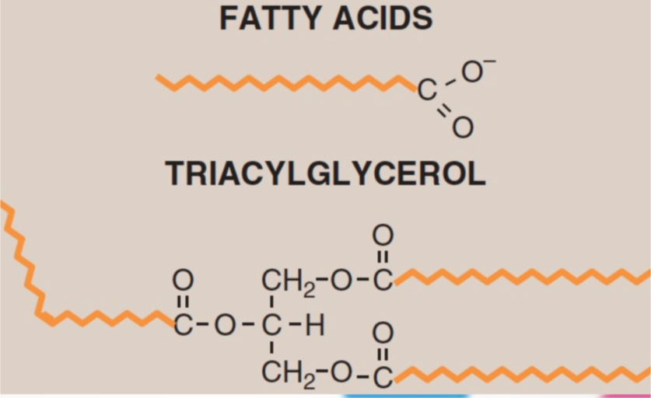
Simple lipids
Fatty acids
Triacylglycerol
Steroids
(cholesterol)
Complex lipids
Phospholipids
Sphingolipids
Glycolipids
Classification of lipids
The lipids compound is heterogeneous group
Glycolipids are lipids with a carbohydrate attached by a glycosidic bond.

Slide 5
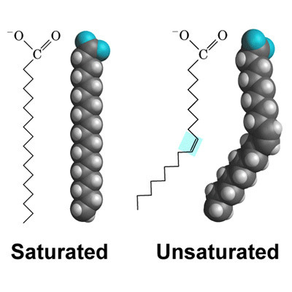
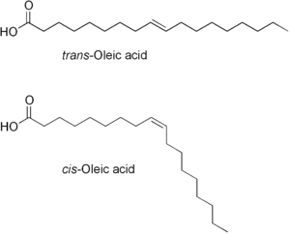
Fatty Acids (FAs)
FAs are carboxylic acid and long-chain of hydrocarbon.
Amphipathic (hydrophobic tails and hydrophilic head).
The hydrocarbon chain is hydrophobic.
The carboxylic group(COOH) is hydrophilic.
Insoluble in water.
FAs must be transported in plasma via proteins (Albumin is an example of fatty acid transporter).
The majority of plasma FAs are esters of (Triacylglycerol, Cholesterol, and Phospholipids).
The FAs chain length in mammals it differs from C16-C18
For example: palmitic, oleic and stearic acids
436 Biochemistry team

Slide 6
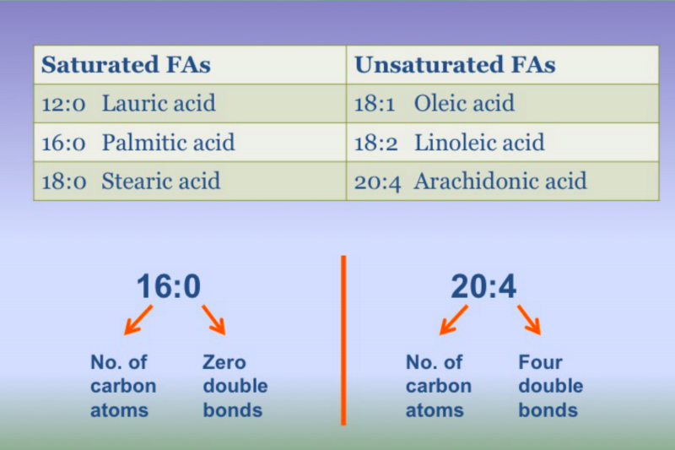
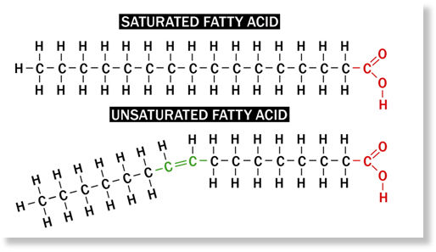
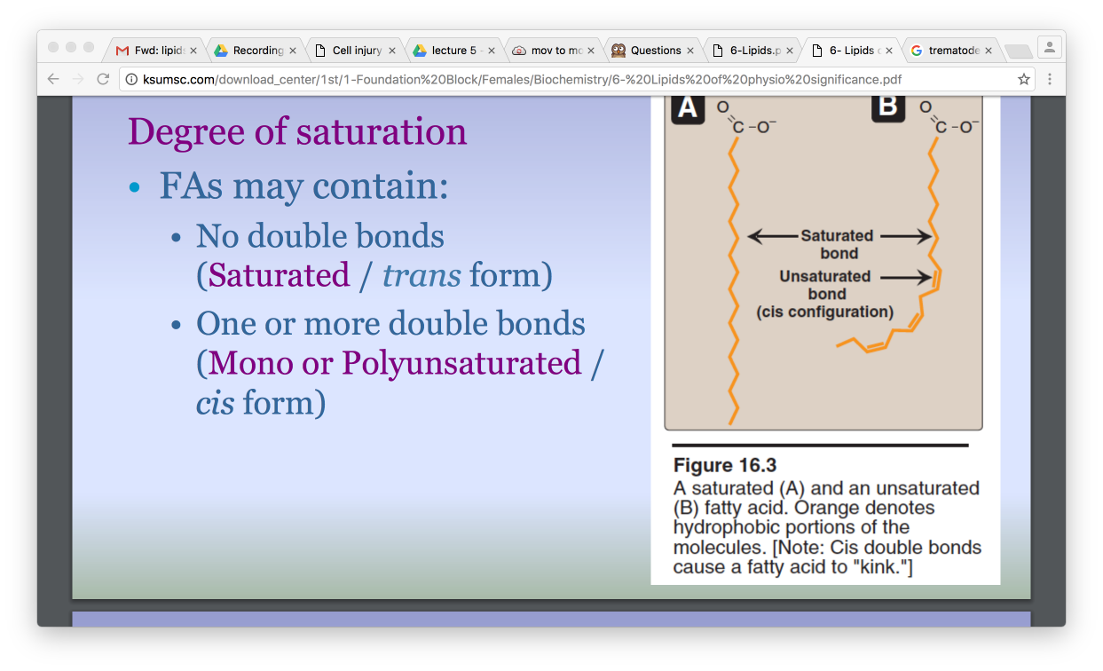
Degree of Saturation (مدى التشبع)
FAs may contain:
No double bonds ( saturated – trans form).
One or more double bonds (mono or poly unsaturated – cis form).
**Saturated fats are difficult to digest and break down.
لو كان عندي أكثر من رابطة ثنائية بالليبيد راح يكون بين كل وحدة واللي بعدها ثلاث كربونات بمعنى إذا كانت أول رابطة ثنائية عند كربونة 3 اللي بعدها تكون عند 6 وهكذا
دائما تكون (0) في حال كان الFA مشبع..
436 Biochemistry team

Slide 7
Essential Fatty Acids
There are two essential fatty acids that our bodies can not synthesize so they must be supplied in diets which are Linoleic acid and Alpha-Linolenic acid
Deficiency can cause dermatitis, membrane function loss .
Linoleic acid (precursor of arachidonic acid).
Arachidonic acid is essential where Linoleic acid is deficient in the diet
That means that Arachidonic acid is non essential so our bodies can produce it when Linoleic acid is present .
But actually Arachidonic acid is considered as conditional fatty acid because …
436 Biochemistry team

Slide 8
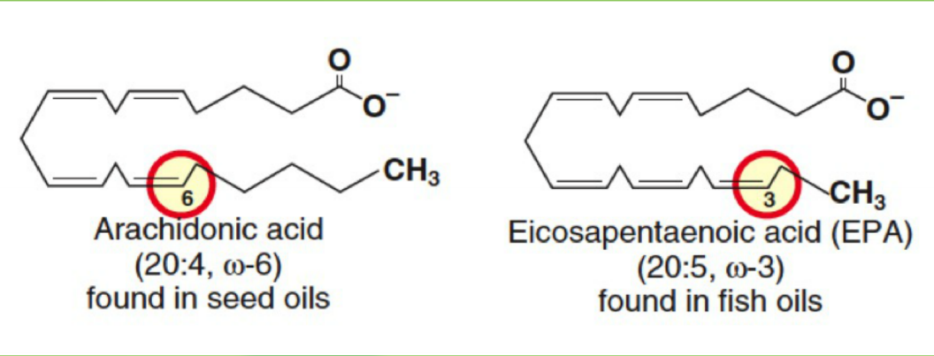
W-3 and W-6 Fatty Acids (w = omega)
W-3 | W-6
Long chain polyunsaturated FA’s with first double bond starting with third carbon from the methyl end | Long chain polyunsaturated with first double bond starting with the sixth carbon from the methyl end
They reduce serum triglycerides, blood pressure and risk for heart disease | They reduce serum cholesterol
Major source: fish | Major source: vegetable oil – nuts
Examples: Alpha-linolenic acid EPA (eicosapentaenoic acid) DHA (Docosahexaenoic acid) | Example: Linoleic acid 18:2
نبدأ البحث عن ذرة الكربون التي تحمل “Double bond” من الجهة البعيدة عن (C=O).
اذا كانت الذرة الثالثة ----> Omega-3
اذا كانت الذرة السادسة ----> Omega-6
436 Biochemistry team

Slide 9
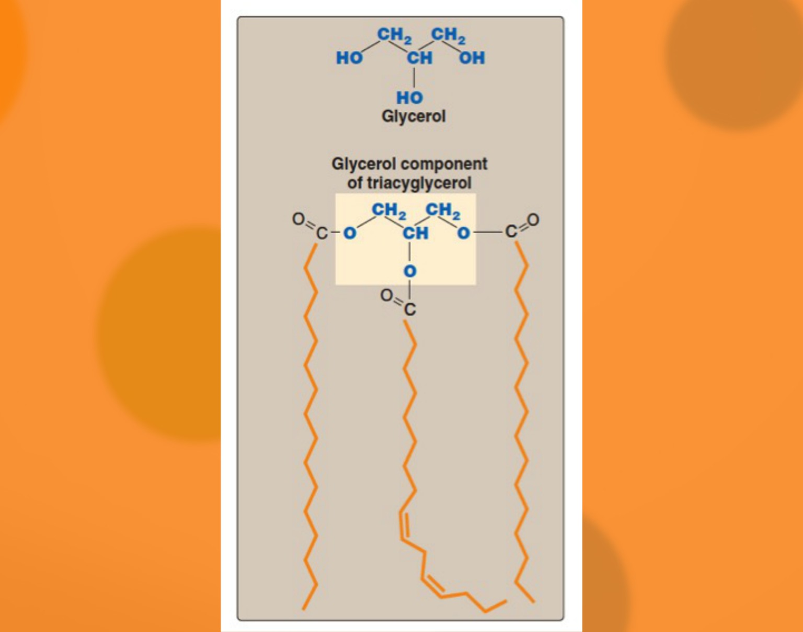
Triacylglycerols (TGs)
-Three fatty acids with a glycerol bonded are called triglyceride* (TGs) also known as fat.
-A triglyceride (TGs) Are tri-ester** of fatty acid With a glycerol molecule bounded to them.
-Constitutes majority of dietary:يعني معظم الدهون في غذائنا من هذا النوع
-stored in adipocyte (fat cells) as energy reservoir***
-not a component of cell membrane: ليس من احد مكونات الغشاء الخلوي
-subcutaneous layer of fats provides thermal insulation****
*also called triacylglycerol
**tri-ester means 3 ester, ester is a fatty acid with alcohol ( in this case the alcohol is glycerol )
***reservoir: مخزن
****تشكل طبقة تحت الجلد تعمل كعازل حراري تحمي الجسم من البرودة

Slide 10
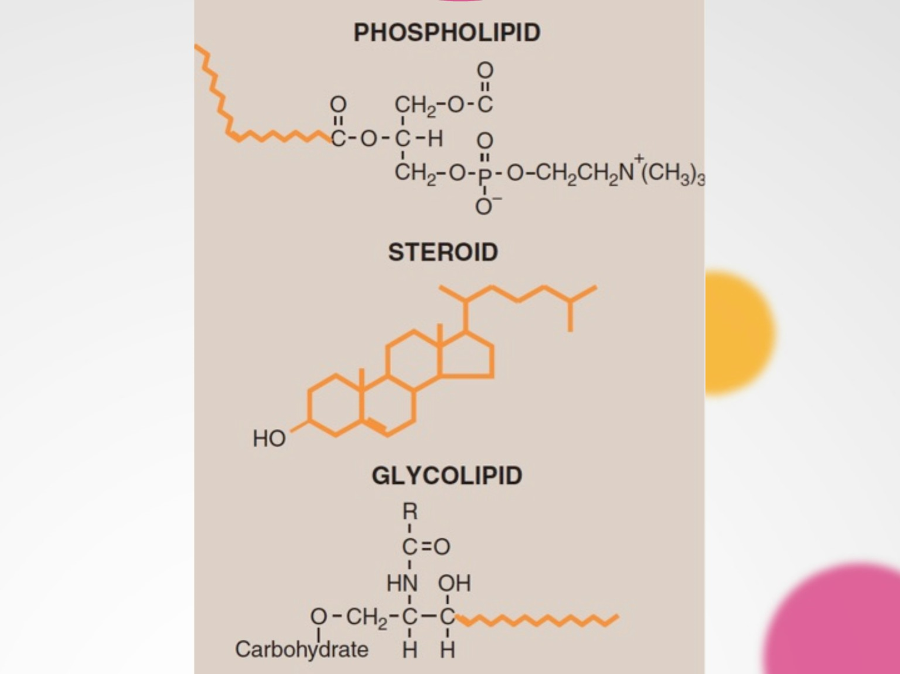
Steroids
Steroids with a hydroxyl group (OH) are called sterols
Consists of four fused rings called steroid nucleus with 8-carbon chain
are a derivatives of Cyclopentanoperhydrophenenthrene ring Or simply called steroid nucleus
- Cholesterol is a major sterol in humans and animal
- Cholesterol in plasma is bound to fatty acids called cholesteryl esters
- Cholesterol in cell membrane and bile is free (not bound to fatty acid)
Functions of cholesterol
Component of cell membranes
- Precursor for:
Bile acids / Bile salts
Vitamin D
Steroid hormones (Aldosterone, cortisol, testosterone, estrogen, progesterone)
- High levels of plasma cholesterol is strongly associated with coronary artery disease and atherosclerosis

Slide 11
Major components of biological membranes.
Examples:
Phosphatidic acid , phosphatidyl – choline and serine.
Phospholipids
Tow classes:
Glycerophospholipids
(Contain glycerol backbone)
Sphingophospholipids
(Contain Sphingosine)
Glycerol-3-PO4 is bonded to two fatty acid chains.
The PO4 group is linked to a hydrophilic group.
Amphiphilic in nature:
  Hydrophobic tail.
  Hydrophilic phosphoryl heads.
Long-chain fatty acids attached to sphingosine.
Example: Sphingomyelin.
*An important component of myelin that protects and insulates nerve fibers *axons*.
* Sphingomyelin is the only type of Sphingophospholipids in human.

Slide 12
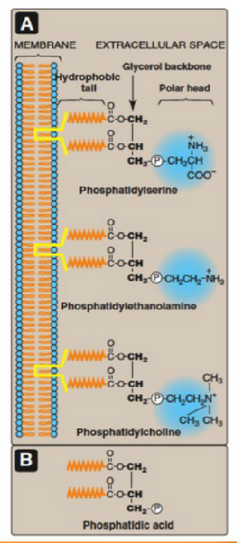
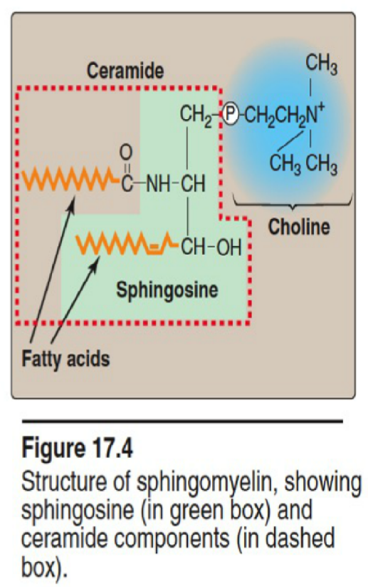
Glycerophospholipids
Sphingophospholipids
*You don’t have to memorize the structure
Serine
Ethanolamin
Choline

Slide 13
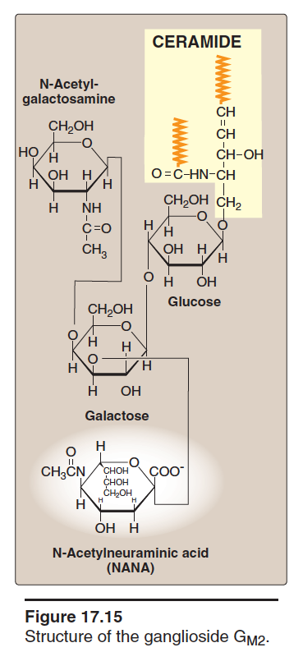
Glycolipids (glycosphingolipids)
Contain both carbohydrate and lipid components.
glycolipids are derivatives of ceramides ( A long-chain fatty acid is attached to the amino alcohol sphingosine. Also called glycoshpingolipids ).
Examples: Ganglioside, glactocerebroside.
Act as : blood group antigens , cell surface receptors for bacteria and viruses.
glycosphingolipids are essential components of all membranes in the body, but they are found in great amounts in nerve tissue

Slide 14
*Additional slide
Glycolipids
Two type
Acidic glycosphingolipids
(negatively charged)
example
Neutral glycosphingolipids
(uncharged)
example
Galactocerebroside
function
Gangliosides
function
Sulfatides
function
synthesis and degradation of the more complex glycosphingolipid
are found primarily in the ganglion cells of the CNS
found predominantly in the brain and kidneys

Slide 15
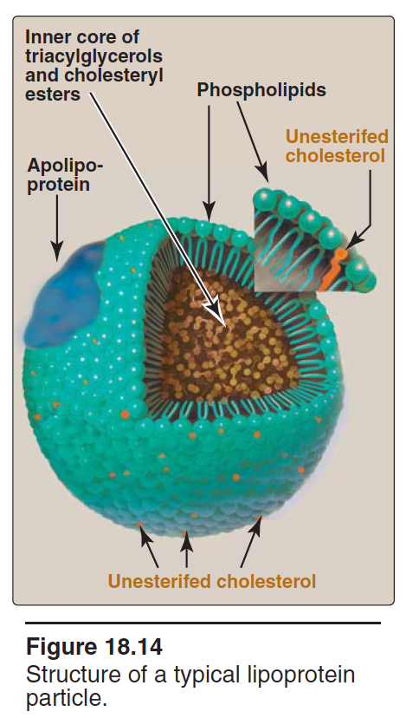
Transport of plasma lipids
Lipoproteins are composed of a neutral lipid core (containing triacylglycerol [TAG] and cholesteryl esters) surrounded by a shell of amphipathic apolipoproteins
definition
Plasma lipids are transported as lipoprotein particles (lipids + protein )
Lipid transport, enzymatic function, ligands for receptor
lipid part
Contains lipids of various types
Apolipoprotein
The apolipoproteins associated with lipoprotein particles have a number of diverse functions, such as providing recognition sites for cell-surface receptors and serving as activators or coenzymes for enzymes involved in lipoprotein metabolism.
Function
apolipoprotein A,B,C
examples
Protein part
Apoprotein or Apolipoprotein

Slide 16
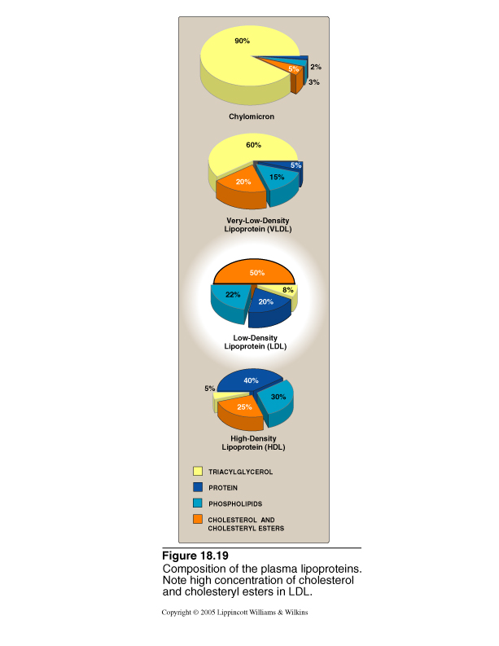
Types and function of lipoprotein
*You have to know the majority of every Lipoprotein
Lipoprotein | Transports | Majority
Chylomicrons | Dietary TGs | Triacylglycerol
Very low density lipoprotein (VLDL) | Endogenous TGs | Triacylglycerol
Low density lipoprotein (LDL) | Free cholesterol | Cholesterol
High density lipoprotein (HDL) | Cholesteryl esters | Protein
The more Triacylglycerol are there the size is bigger and the density is low.
Density is how viscous or how fatty the substance is.
HDL they are the heaviest and the highest density and the smallest in size. Chylomicron they are the biggest in size and the lowest density.

Slide 17
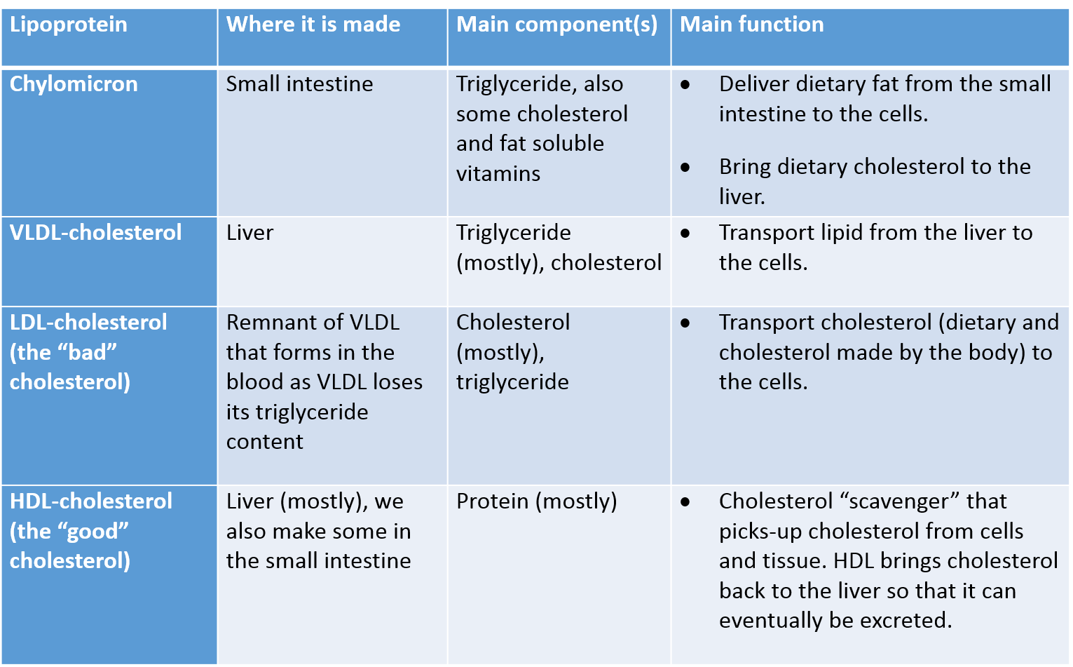
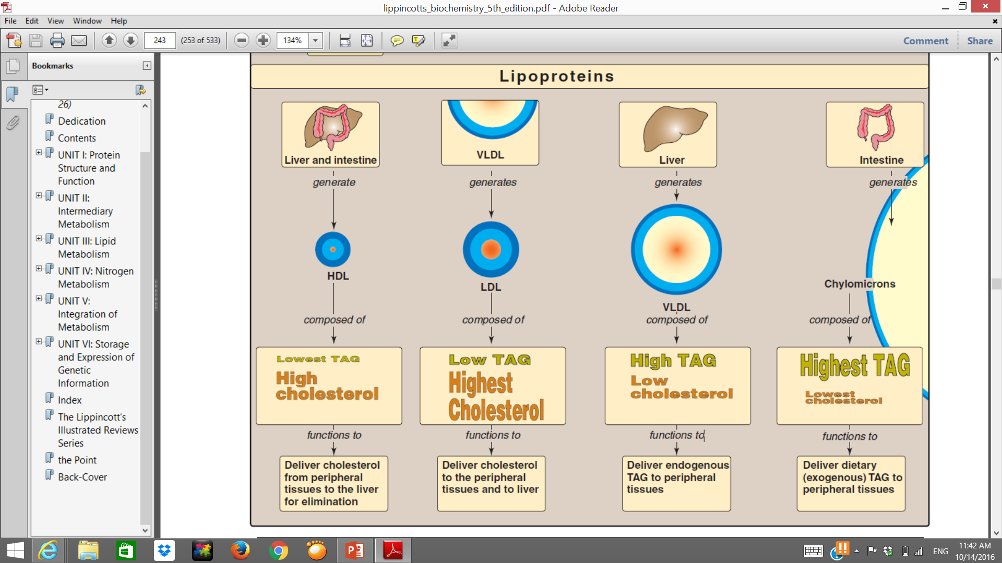
Types and function of lipoprotein
*Additional slide

Slide 18
MCQs + vedios
4-d
3-a
2-b
1-b
1- What statement from the following is false.
a. Atherosclerosis can be caused by lipids
b. The carboxylic group in fatty acids is hydrophobic
c. Lipids store energy d. Fatty acids are amphipathic
2- the fatty acid chain length in mammals varies between.
a. c12-c19 b. c16-c18 c. c17-c19 d. c14-c16
3- what is the major source of w-3 .
a. Fish b. Chicken c. Nuts d. Dairy products
4- What statement is false about lipoprotein’s functions.
a. Ligands for receptors b. lipid transport c. enzymatic functions d. lipid protection
https://youtu.be/H8WJ2KENlK0?t=6m56s
https://www.youtube.com/watch?v=O9lL2KStW9s

Slide 19
    Girls team members:
    1- روان القحطاني.
Boys team members:
1- محمد المهوس.
2- محمد حكمي.
3- خالد الراجح.
4- محمد حبيب.
5- فهد العتيبي.
6- هشام القوسي.
7- عبدالعزيز الصومالي.
8- محمد العسيري.
-Contact us:
Biochemistryteam436@gmail.com
twitter.com/436biochemteam
-Team leaders:
نوره السهلي.
عبدالله المانع.

