Slide 1
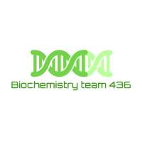

Enzymes and Coenzymes 1+2
– Color Index:
Important.
Extra Information.
Doctors slides.
436 Biochemistry team

Slide 2
Objectives:
Understand how enzymes are able to speed up the rate of biochemical reactions in the body.
Identify classes of enzymes based on the type of reactions they catalyze.
Comprehend the basic terms of coenzymes, isoenzymes
Understand enzyme activity and specificity
Understand factors affecting enzyme activity.
Understand the enzyme kinetics, types of inhibition and regulation of enzyme activity.
Discuss the clinical role enzymes in the diagnosis of diseases.

Slide 3
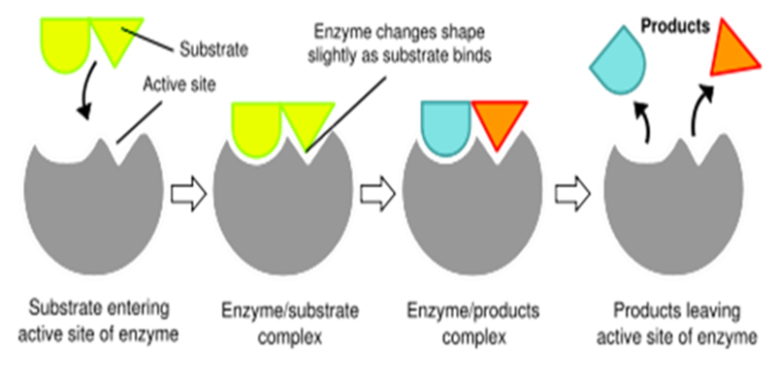
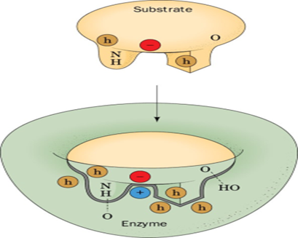
What are enzymes?
Enzymes are biological catalysts that speed up the rate of a reaction without being changed in the reaction.
Enzymes are non-consumable molecules.
All enzymes are protein in nature, but all proteins are not enzymes.
Some enzymes have both active and regulatory sites.
Substances upon which the enzymes act are called substrates.
Enzymes bind to their specific substrates to convert them to product(s).
Objective: Understand enzyme activity and specificity
Ways of Enzyme-substrate Binding
طريقة الارتباط بالانزيم.
1. Induct fit binding
After the binding of substrate the enzyme changes its shape to fit more perfectly with substrate “not fully complementary”
زي القفاز ياخذ شكل اليد بعد ماينلبس.
2. Lock and key binding
The enzyme has an active site that fits the exact dimensions of the substrate
Active site is complementary to the substrate
Properties of enzymes
Active site
Specificity
Regulation
It’s the region of enzyme that binds with the substrate and where catalysis occurs.
All enzymes have one or more active sites.
Enzymes bind to their specific substrates in the active site to convert them to product(s).
Catalyze only one type of reaction.
Enzymes can be activated or inhibited so that the rate of product formation responds to the need of the cell
highly specific, Interact with only one or a few of the substrates.
Consist of residues that form temporary bonds with the substrate (binding site) and residues that catalyze a reaction of that substrate (catalytic site).
Once the substrate is bound, catalysis takes place
1
2

Slide 4


Classification of enzymes
Objective: Identify classes of enzymes based on the type of reactions they catalyze.
They are classified into 6 types, according to the type of chemical reaction catalyzed.
Classification | Type of reaction catalyzed
1.oxidoreductases | Oxidation- reduction reaction
2.transferases | Transfer of functional group
3.hydrolases | Hydrolysis reaction
4.lyases | Group elimination to form double bonds
5.isomerases | isomerization
6.ligases | Bond formation coupled with ATP hydrolysis
Omar
Tried
Hard
Learning
International
Languages
ملاحظة: لازم نحفظهم بالترتيب!
enzyme Nomenclature (naming):
Example:
EC: 3.4.17.1 (carboxypeptidase A)
EC: Enzyme Commission (classification)
ملاحظة: الأرقام ليست للحفظ
It is based on the rules given by IUBMB (international union of biochemistry and molecular biology
Class.Subclass.Sub-subclass.Enzyme number

Slide 5
Objective: Comprehend the basic terms of coenzymes, isoenzymes
Some enzymes require non-protein groups to become active:
Apoenzyme (inactive) + (Cofactor/coenzyme) *non-protein part* = Holoenzyme (active)
Holoenzymes
The inactive form of enzyme without its non-protein part
Holoenzymes
(Active)
Apoenzyme
(Inactive)
Non-protein part
If the non-protein part is a small organic molecules, known such as NAD⁺
Cofactors
Coenzyme
If the non-protein part is a metal ion such as Cu2+, Fe3+, Zn2+, etc.
They also help an enzyme to catalyze a reaction.
1.Prosthetic Group
Coenzymes that are permanently associated with an enzyme e.g. FAD
2. Co-substrate
Coenzymes that only temporarily associate with an enzyme e.g. NAD

Slide 6
Ribozymes, Isoenzymes and zymogens
Ribozymes
are RNAs (Ribonucleic acid) with enzyme activity.
Isoenzymes
are enzymes that catalyze the same chemical reaction but they have slightly different structures.
Zymogens
are inactive enzyme precursors that require a biochemical change to become active e.g. cleavage of a peptide blocking the active site.
They are activated when needed.
Why do they exist?
To cover the excessive body’s demand of this chemical reaction in some situations..
RNA or antibodies could act as enzymes.
Inhibitors are structurally similar to enzymes → to control
the action.

Slide 7
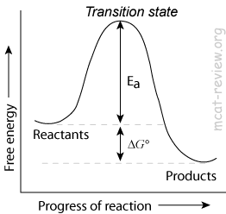
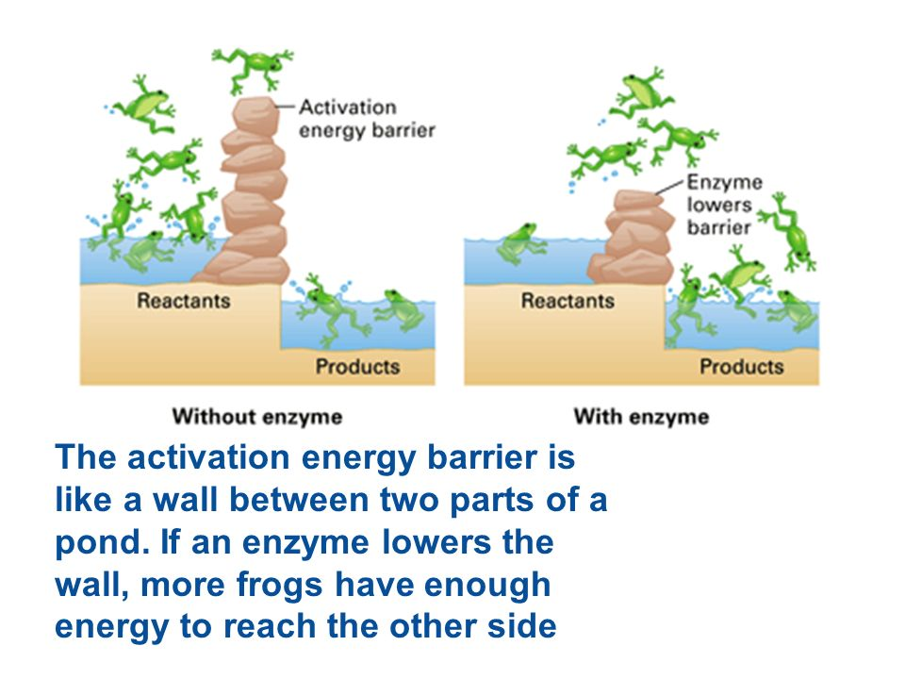
Understanding Activation Energy
In every chemical reaction, the reactants pass through a transition state that has greater energy than that of the reactants or products alone (the highest point as shown in the figure, it’s also called high-energy intermediate)
activation energy (Ea): The difference in energy between the reactants and the transition state.
If the activation energy is available then the reaction can proceed forming products
For molecules to react, they must contain sufficient energy to overcome the energy barrier of the transition state. In the absence of of enzyme, only a small amount of molecules may posses enough energy to achieve the transition state between reactants and products.
So, the lower activation energy, the more molecules have sufficient energy to pass through the transition state, and therefore, the faster the rate of the reaction.
Enzyme induction → increases enzyme activity.
Enzyme inhibition → decreases enzyme activity.

Slide 8
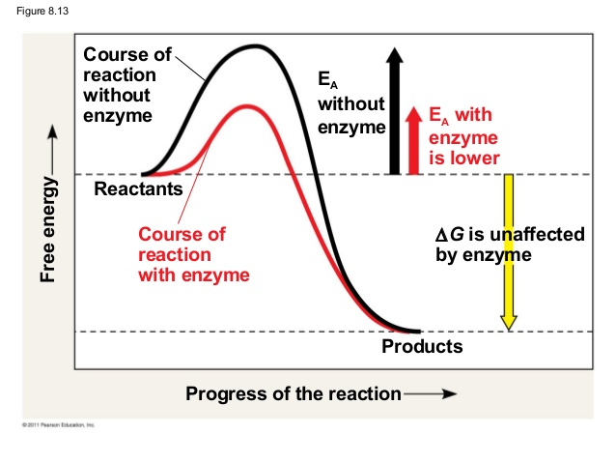
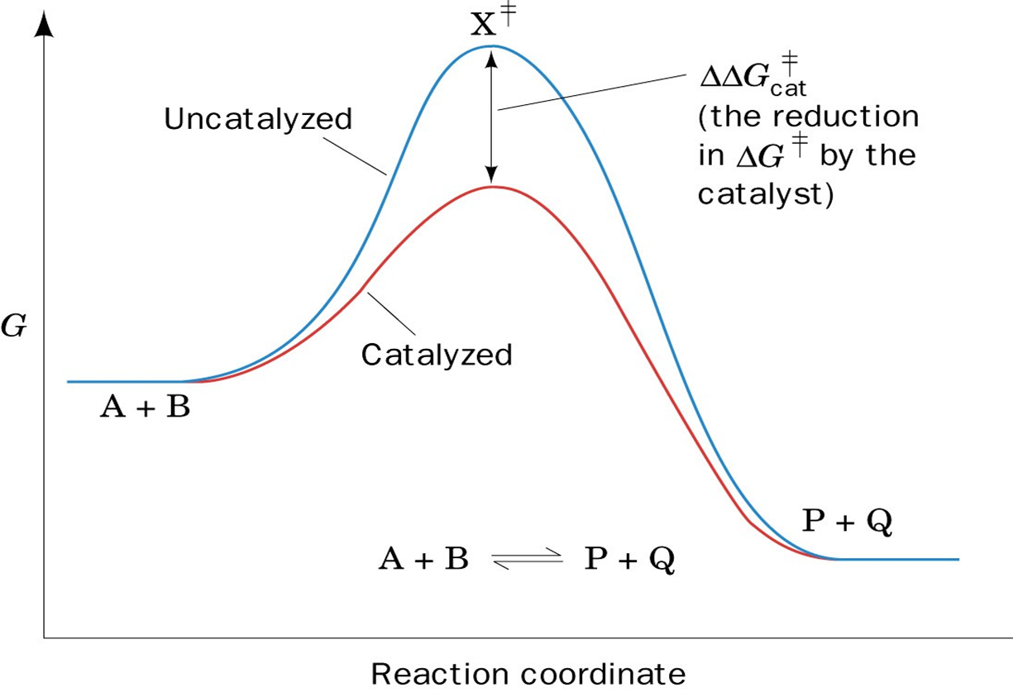
How do enzymes work?
Objective: Understand how enzymes speed up the rate of biochemical reactions in the body
An enzyme reduces the activation energy required for a reaction
It provides an alternative transition state of lower energy called the enzyme-substrate complex and thus speeds up the reaction.
Enzymes decrease the activation energy but they do not alter the change in the free energy (∆G)
(it remains the same) and it does not change the equilibrium of the reaction. It does however accelerate the rate by which equilibrium is reached.
The difference between Activation energy (EA) and free energy (∆G)
Activation energy is reduced.
Free energy remains the same.
Notes:
Enzymes operate by lowering the amount of energy needed to get a reaction going (the activation energy). When this energy is lowered, the nature of the bonds is changed, so they are more easily broken.
Therefore, the lower activation energy required, the faster rate of the reaction.
عندما يعمل الأنزايم فإن الترانسيشن ستايت راح تقل طاقتها وعليه:
1 - طاقة التنشيط ستقل (لأنها الفرق بين طاقة المتفاعلات وطاقة
الترانسيشن ستايت، وطاقة الترانسيشن ستايت قلّت!)
2 - لن يحدث أي تغيير في دلتا جي (لأنها الفرق بين طاقة المتفاعلات
وطاقة النواتج ولم يحدث أي تغيير فيهم)
Velocity is the rate of a reaction catalyzed by an enzyme.
It is expressed as $μ$moles *mmoles* (*girls slides*) of product formed in min/mg enzyme.
It is expressed as 𝝁moles *mmoles* (*girls slides*) of product formed in min/mg enzyme.
Enzyme velocity
Enzyme activity
The effect of a catalyst on the transition state diagram of a reaction.

Slide 9
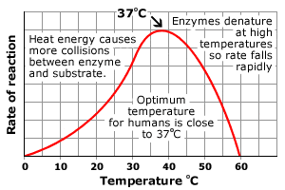
1. Effect of temperature
Factors that affect enzyme activity:
Objective: Understand factors affecting enzyme activity.
Temperature
PH
[E] and [S]
Every enzyme has an optimal temp for catalyzing a reaction
(In humans: most enzyme have an optimal temperature of 37 C. )
The rate of an enzyme reaction initially increases (in velocity) with rise in temperature until it reaches a specific temperature that is considered
too high for the enzyme to work because it denatures the enzyme, After about 40c.
( الشيء اذا زاد عن حده ينقلب ضده )
Every enzyme has an optimal temperature for catalyzing a reaction
In humans, most enzymes have an optimal temperature of 37c
At high temperatures, enzymes are denatured and become inactive.
#Remember
Denaturation is a process in which proteins or nucleic acids lose the quaternary structure, tertiary structure and secondary structure which is present in their native state, by application of some external stress.
In Summary

Slide 10
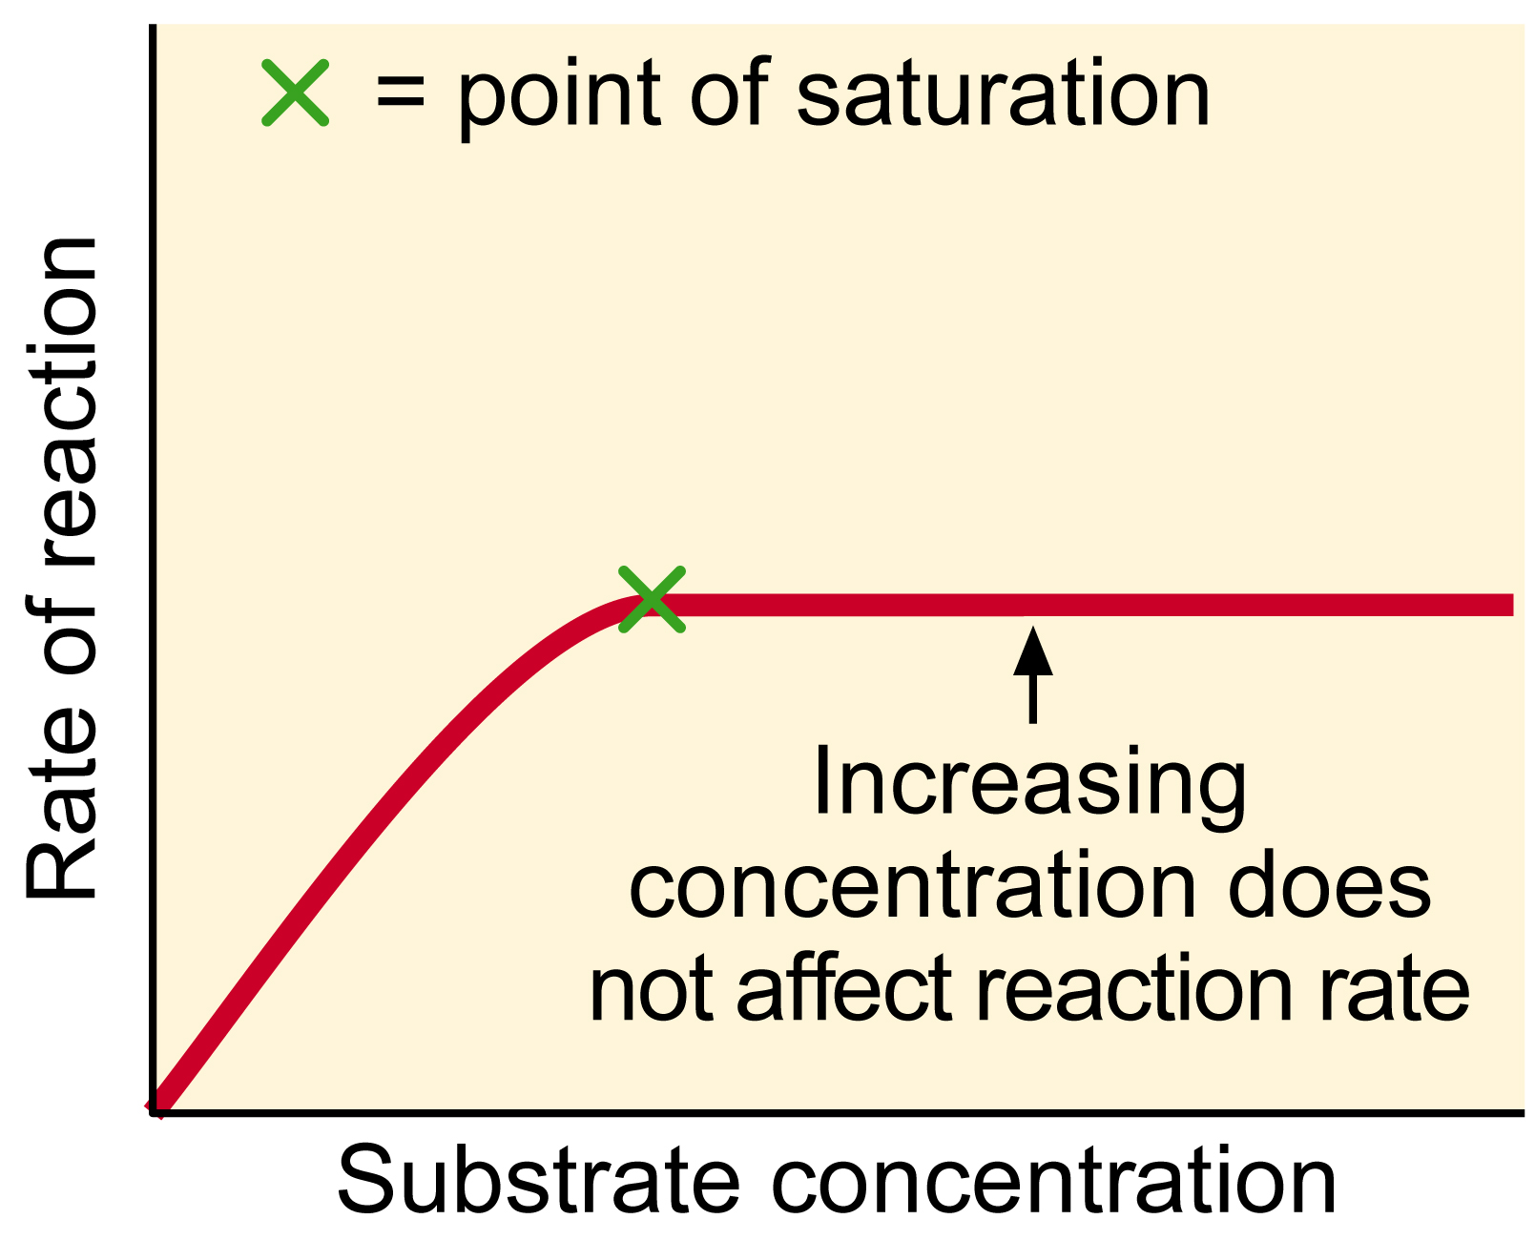
2.Effect of pH
3. Effect of [E] and [S]
Every enzyme has an optimal pH for catalyzing a reaction.
Most enzymes have highest activity between pH 6 and pH 8
Pepsin (digestive enzyme in the stomach) has highest activity at pH 2
Higher than
*If [S] > enzyme → the rate of enzyme reaction will be directly proportional to the concentration of enzyme.
Until excess substrate causes the reaction velocity to be constant *Further addition of substrate has no effect on enzyme velocity (v)* (because enzyme is saturated).
*At low [S] → the reaction rate is proportional to [S]
Effect of pH
on the ionizable groups in the active site of enzyme
Affects catalysis
in the substrate
Affects catalysis
The reaction velocity increases initially with increasing [S]
The ionizable groups which on the side chain of amino acid
[S] substrate concentration.
[E] enzyme concentration.
(the bell-shaped curve)
Effect of pH on the initial rate of the reaction catalyzed by most enzymes
( Enzyme activity )

Slide 11
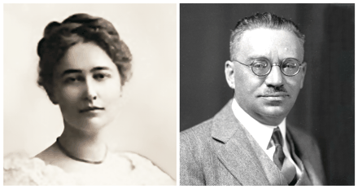

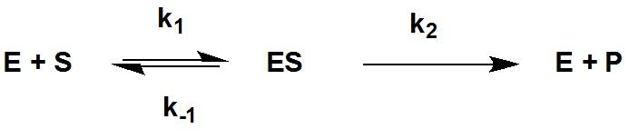
Enzyme Kinetics
Initial rate of enzyme reaction
Pre-steady state kinetics
Steady state kinetics
Objective: Understand the enzyme kinetics
The model of enzyme kinetics was first proposed by Michaelis and Menten in 1913 and later modified by Briggs and Haldane.
The equation of Michaelis Menten describes the relationship of: Initial rate of enzyme reaction to [S]
1. Pre-steady state:
Enzyme + high concentration of substrate → an initial short period of time (a few hundred microseconds) during which intermediates of products gradually build up. NO PRODUCT DURING THIS PHASE.
2. Steady state reaction: occurs after initial state: when the reaction rate and the concentration of intermediates change slowly with time.
An intermediate changes into steady state when the rate of its synthesis becomes equal to its rate of degradation.
The rate of formation of ES = the breakdown of ES to (E+S) & (E+P)
*يعني سرعة تكونES تساوي انحلاله وتفككه.
Notes:
Pre-steady-state kinetics is concerned with the formation and consumption of enzyme–substrate intermediates until their steady-state concentrations are reached.
reactive intermediate: a short-lived, high-energy, highly reactive molecule. When generated in a chemical reaction, it will quickly convert into a more stable molecule.
*مهم
Rate concentration
Enzyme
Enzyme
substrate
Enzyme-substrate complex
products
Notes:
Michaelis–Menten kinetics is one of the best-known models of enzyme kinetics.
What does the equation describe? the rate of enzymatic reactions.
How? by relating reaction rate v
to [S] the concentration of a substrate.

Slide 12
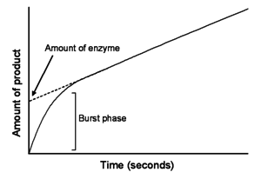
Explanation
Pre-steady state kinetics
مرحلة إرتباط الإنزايم بالسبستريت عشان
ES يتكوّن لي ال
وهو ليس برودكت إنما
“انزايم مرتبط مع سبستريت ”
(Enzyme-substrate complex)
- هذه الخطوة تعتبر قصيرة جداً لأن كمية السبستريتس اكبر بكثير من كمية الانزايم فبالتالي تصبح نسبة ارتباط هذه السبستريتز بالانزايم قليلة.
Steady state kinetics
بعد ما تكوّن عندي
ES (Enzyme-substrate complex)
سيصبح تركيزه يزداد بشكل ثابت مع الوقت (نلاحظ إن الميل في الصورة يزداد بثبات)

Slide 13
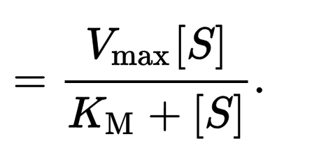
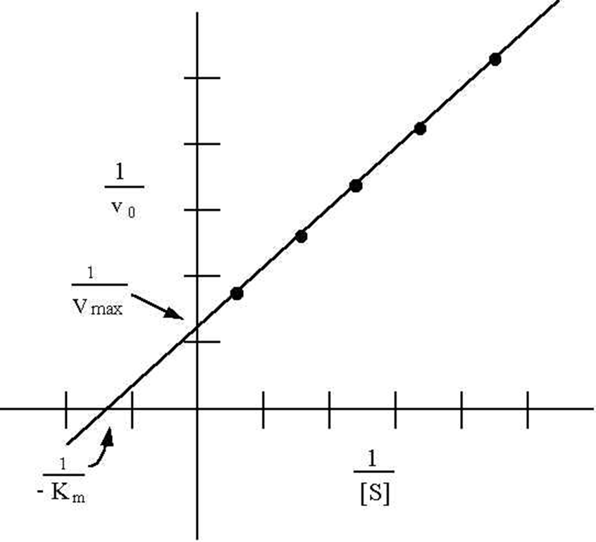
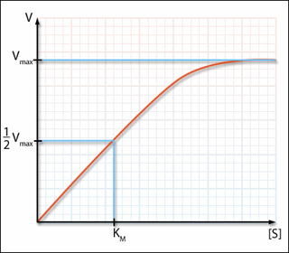
Michaelis Menten Equation
Lineweaver-Burk plot (double-reciprocal plot)
It measures the initial velocity (v_{o}) of an enzyme reaction.
Note: initial velocity is also described as “rate of a reaction.”
v_{o}
[S] = Substrate concentration
K_{m} = Michaelis constant
The constant K_{m} is a measure of how efficiently an enzyme converts a substrate into product.
V_{max} = Maximum velocity achieved by the system when the enzymes will be saturated & full up with substrate, and won’t able to react anymore quickly..
K_{m}: a substrate concentration where the initial rate is half of the maximum rate (½ V_{max})
Meaning: It is the [S] required to saturate half of all of the active sites of an enzyme
obtained by taking reciprocals of the Michaelis Menten equation
It is plotted to:
*calculate the Km and Vmax values
*determine the mechanism of action of enzyme inhibitors
The K_{m} value of a substrate depends on its affinity with the enzyme
  High K_{m} → low affinity with enzyme
  (Therefore higher concentration of substrate is needed to saturate the enzyme)
  Low K_{m} → high affinity with enzyme
  (less substrate needed to saturate the enzyme)
  Note: The meaning of affinity is “natural liking.”
Initial velocity v_{o} of a Simple Michaelis –Menten reaction versus the substrate concentration [S]
#للرّبط
Saturation
High Km:
مثل لما يكون الشخص صاحب مستوى عالي بمنصب أو غيره ومشغول طول الوقت هنا يصير إحتكاكه مع أصدقائه أقل (Affinity)
فلذلك يحتاج إنه يقوّي علاقته أكثر فيحتاج سبستريتس أكثر عشان يتشبّع.
Low Km:
هنا العكس اللي يكون منصبه بسيط فبكذا عنده وقت أكثر وإحتكاكه مع أصدقائه عالي فبيحتاج عدد أقل من السبستريتس عشان يتشبّع الإنزايم
نشكر رانيا العيسى على التشبيه

Slide 14

Summary
3 Properties of Enzymes:
Active site
region of binding and catalyzing
Specificity
Enzymes bind to their specific substrates in the active site.
Regulation
Enzymes control the rate of product formation responds to the need of the cell
Reacts with to form
Enzyme
Substrate
Products
Enzymes are biological catalysts that speed up the rate of a reaction without being changed in the reaction
All enzymes are protein in nature
Apoenzyme (inactive) + nonprotein part = Holoenzyme (active)
  Initial rate of enzyme reaction:
Michaelis Menten Equation:
Pre-steady state kinetics
initial short period of time which intermediates gradually build up
  Steady state kinetics
the reaction rate and
the concentration of intermediates
change slowly with time
  $$V_{o}=\frac{V_{max} [S]}{K_{m}+[S]}$$
Factors that affect enzyme activity
pH
Temperature
[E] and [S]
High Km
low affinity with enzyme (more substrate needed to saturate the enzyme)
Low Km
high affinity with enzyme (less substrate needed to saturate the enzyme)
Holoenzymes
Cofactor
Metal ions
Coenzyme
Organic molecules

Slide 15
MCQs + Videos
Test
https://youtu.be/j00Ep0Byu0Y
https://youtu.be/7u2MkbsE_dw
https://youtu.be/X_YXTWU2maY

Slide 16
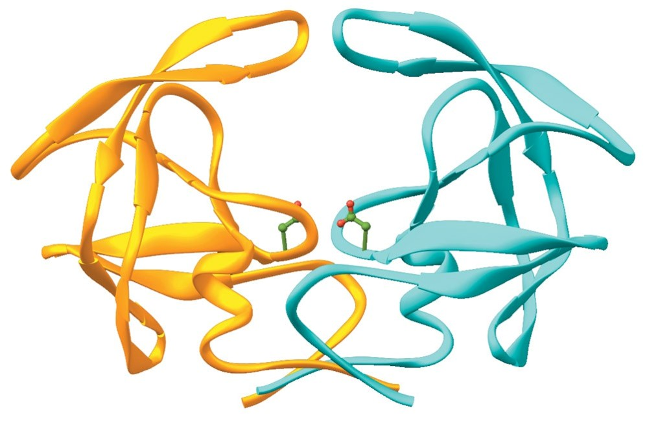
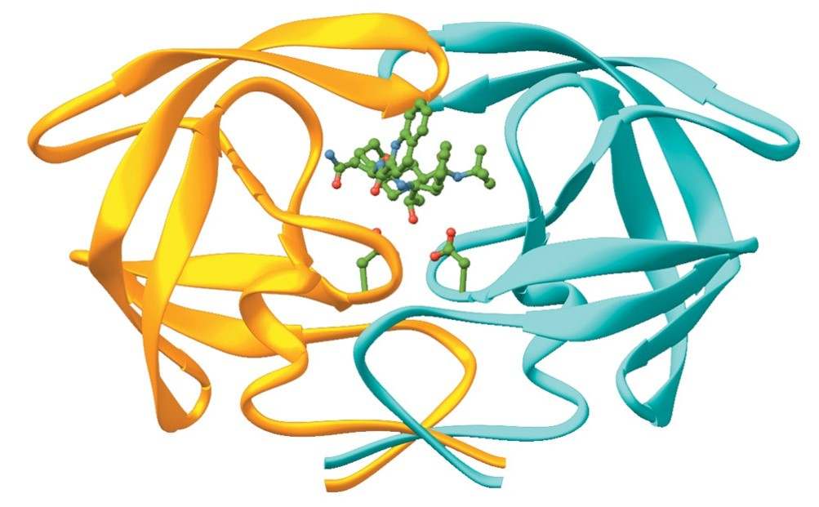
Enzyme inhibition
To inhibit means to stop the enzyme activity
Objective: Understand types of inhibition
There are three types of enzyme inhibition:
Competitive
- Inhibitor has a similar structure to substrate
- It competes with substrate for binding to active site of enzyme.
Noncompetitive
- Inhibitor does not have similar structure to substrate
-No competition exists between inhibitor and substrate
Uncompetitive ( this type of inhibition was only mentioned in boys slides).
- Inhibition is a process in which the enzyme
activity is regulated or controlled or stopped.
- Ki ( inhibitor constant ) is a measure of the affinity of the inhibitor
for the enzyme. Also, known as dissociation constant.
An enzyme without inhibitor
An enzyme with inhibitor
Note:
-affinity is the tendency of a molecule to associate with another.
-if enzymes worked randomly, our whole system will be damaged.
436 Biochemistry team

Slide 17
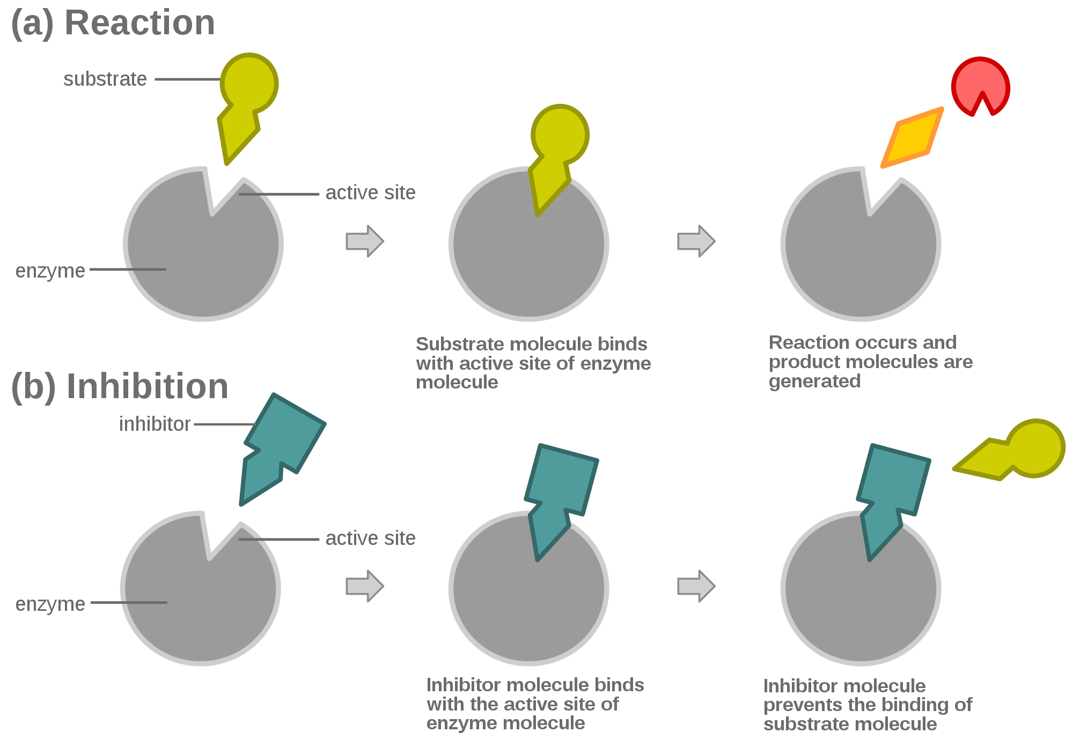
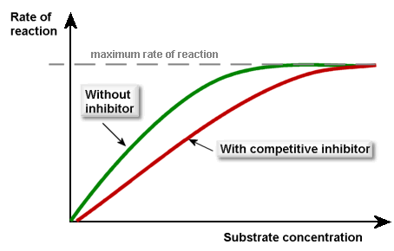
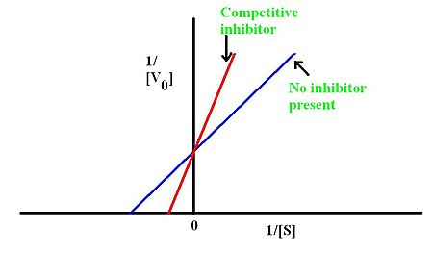
COMPETITIVE INHIBITION
The inhibitor is a structural analogue (similar) *to the substrate* that competes with the substrate for binding to the same active site of enzyme (competitive). Thus prevent the enzymatic reactions .
Competitive inhibition is always reversible reaction.
Vmax → unchanged in the presence and the absence of inhibitor.
Km → increased, because Substrate and Inhibitor compete for binding at the same site.
*A higher concentration of substrate is required to achieve half-maximal velocity*
Two reactions are possible:
Enzyme + Substrate ⇿ ES complex →Product + Enzyme (active)
OR
Enzyme + Inhibitor ⇿ EI (inactive)
Which means : The competitive inhibition prevents the reaction by preventing the substrate from binding to the active site.

Slide 18
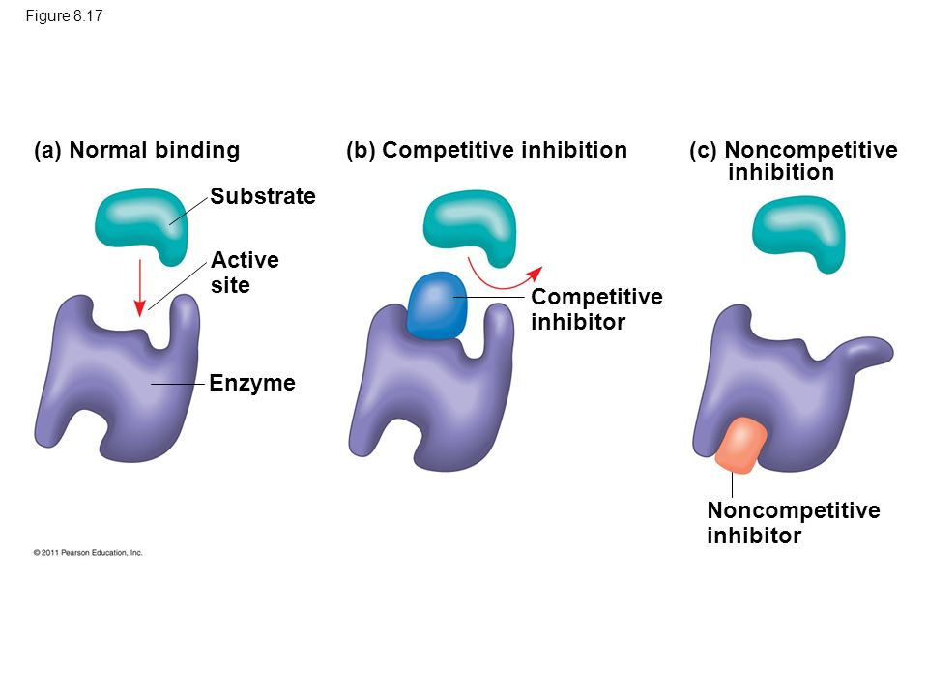
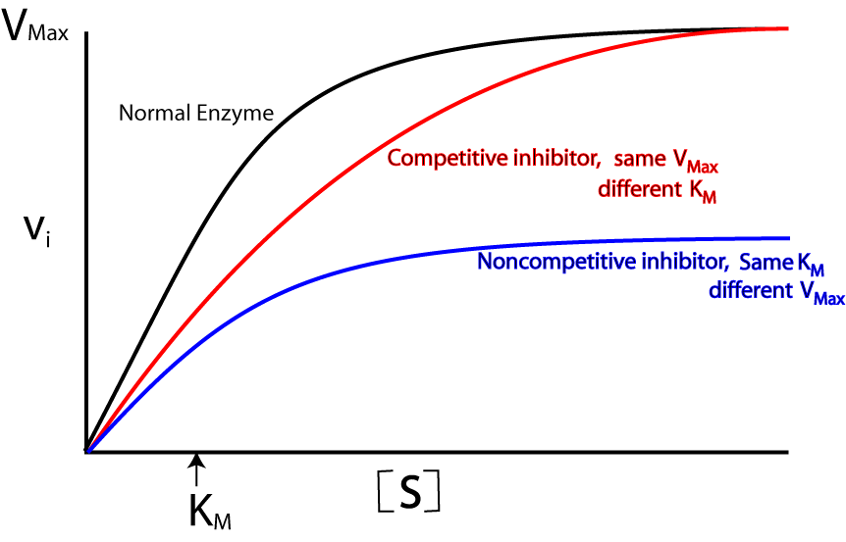
NON-COMPETITIVE INHIBITION
اقتباس من TEAM435:
على عكس الـ competitive يعمل الـ inhibitor هنا دون منع الـ substrate من الارتباط بالانزيم , بمعنى أنه ممكن أن نجد الـ
enzyme-substrate complex موجود بشكله الطبيعي ولكن غير فعال! وذلك لأن فعالية الـ inhibitor تكمن فقط في ارتباطه هو شخصياً وليس بالتدخل في ارتباط الـ substrate
Inhibitor doesn’t have a similar structure to the substrate.
It binds somewhere other than the active site.
Non-competitive inhibition could be irreversible or reversible.
The inhibitor can bind to: a free enzyme or to an enzyme-substrate complex. In both cases the complex is catalytically inactive
Vmax → decreased by the inhibitor.
Km → unchanged because the affinity of Substrate for Enzyme is unchanged
Further Explanation
Remember: *No competition exists between the inhibitor and the substrate*
Two reactions are possible:
ES + I ⇿ ESI (inactive)
Or
E + I ⇿ EI (inactive)
اقتباس من TEAM435:
الـ Km (وهي قابلية الانزيم على جذب الـsubstrates لنفسه) لا تتغير, بينما الذي يتغير ويقل هو الـ Vmax (أقصى فعالية ممكن أن يصلها الانزيم), وهذا يؤكد أن الفعالٌية هي وحدها التي تتغير في الـ non-competitive inhibition

Slide 19
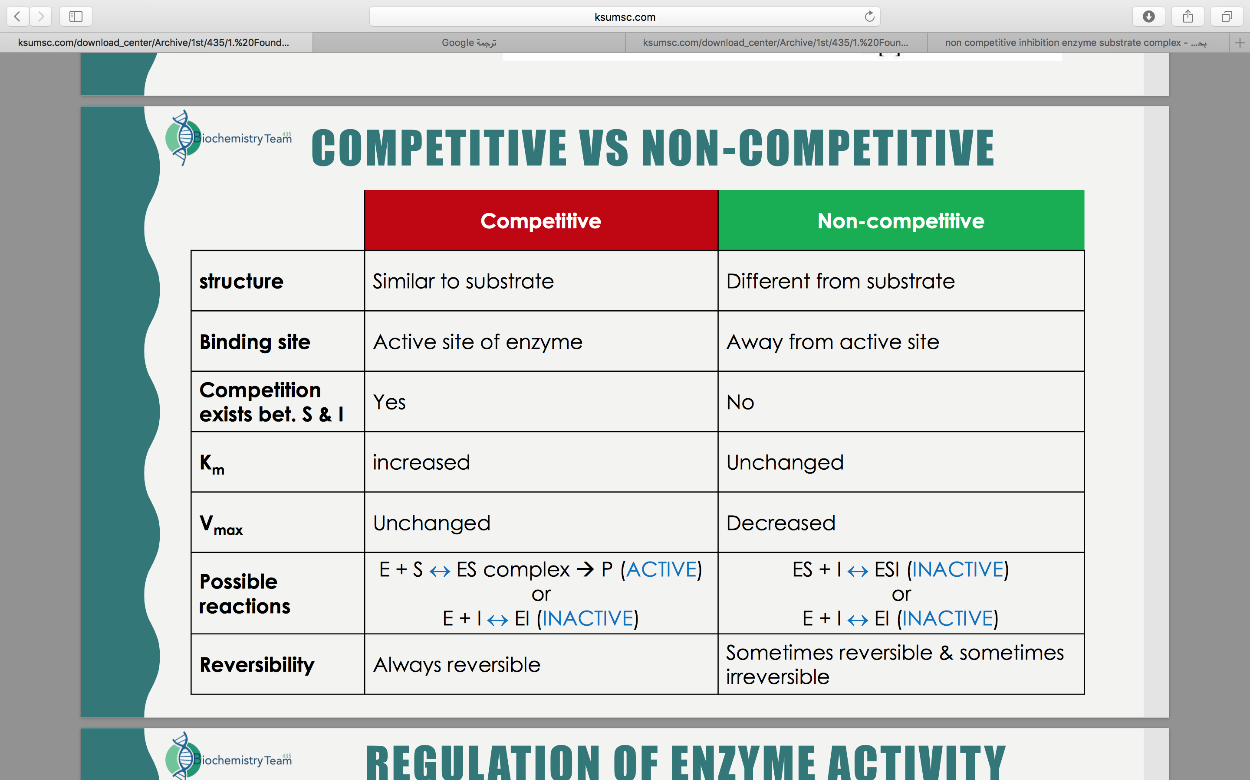
مُقتبس من تيم ٤٣٥

Slide 20
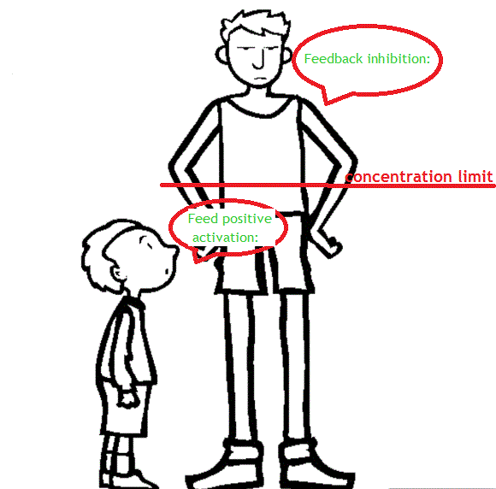
Regulation of enzyme activity
عمل الإنزيمات في أجسامنا دقيق جداً بحيث يحفظ لنا الإتزان الداخلي.
فالزيادة في المتفاعلات تؤدي لتحفيز الإنزيم للعمل وتحولها لنواتج, وزيادة النواتج تثبط الإنزيم لوقف التصنع!
Objective: understand regulation of enzyme activity.
Feedback inhibition
Regulatory enzymes usually catalyze first or an early reaction in a metabolic pathway.
They catalyze a rate-limiting reaction (slowest step) that controls the overall pathway.
They may also catalyze a reaction unique to that pathway known as committed step.
After the committed step reactants in the pathway become committed and will end up as the final product of the pathway.
Notes:
-The overall rate of a reaction is often determined by the slowest step, known as the rate-limiting step.
-The committed step is an effectively irreversible enzymatic reaction.
When the end product of a metabolic pathway exceeds its concentration limit, it inhibits the regulatory enzyme to normalize the pathway
MED435
Feed positive activation
When the end product of a metabolic pathway is below its concentration limit, it activates the regulatory enzyme to normalize the pathway.
أحد التطبيقات العملية على الإنزيمات هي كونها من أهم أجزاء الـ pathways metabolic التي تتم في أجسامنا على مدار الثانية. الإنزيمات تحفز أو تثبط التفاعلات بشكل عام, ولكن بشكل خاص هناك جزء من الإنزيمات تسمى enzymes Regulatory وهو المنظم الأساسي لاتجاه سير التفاعل (كإشارة المرور في الطرقات) وعدم توفره يعني عدم وجود الـ pathway من الأساس
MED435

Slide 21
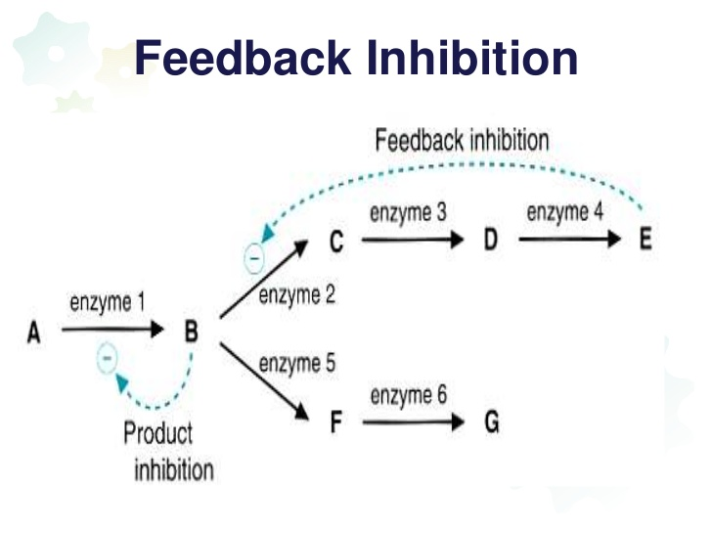
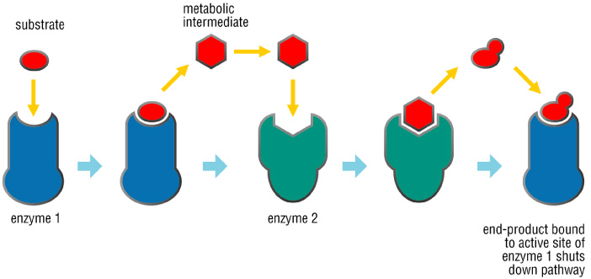
Still can’t get it ?
-Feedback Inhibition of biochemical pathways :
https://www.youtube.com/watch?v=n3i7XMQTZ_s
Feedback Inhibition or End Product Inhibition of Enzymes:
https://www.youtube.com/watch?v=bRGsmNLMn4I

Slide 22
REGULATION OF ENZYME ACTIVITY
Allosteric enzyme regulation
Cooperative binding
Homotropic: Effect of one ligand on the binding of the same ligand
(a regulatory enzyme modulated by its own substrate).
When the substrate itself serves as an effector the effect is said to be homotropic.
Most often, an allosteric substrate functions as a positive effector. In such a case, the presence of a substrate molecule at one site on the enzyme enhances(+) the catalytic properties of the other substrate-binding sites—that is, their binding sites exhibit cooperativity.
1.Heterotropic effectors
Next Slide
2.Homotropic effectors
Heterotropic: Effect of one ligand on the binding of a different ligand.
The effector may be different from the substrate, in which case the effect is said to be heterotropic
https://youtu.be/qgHr0dWKhSc?t=2m1s (2:00-4:20)
Regulation of allosteric enzymes
The term “allosteric” came from Greek word “allos” meaning “other”
Allosteric Enzymes:
The enzymes in metabolic pathways whose activities can be regulated by certain compounds (ligand) that bind to enzyme other than the catalytic site (active site)
-NOTE : Allosteric enzymes are regulated by molecules called effectors (also called modifiers) that bind non-covalently at a site other than the active site. These enzymes are usually composed of multiple subunits, and the regulatory (allosteric) site that binds the effector may be located on a subunit that is not itself catalytic. The presence of an allosteric effector can alter the affinity of the enzyme for its substrate , or modify the maximal catalytic activity of the enzyme, or both.
Definition: a ligand is an ion or molecule (functional group) that binds to a central metal atom to form a coordination complex.

Slide 23
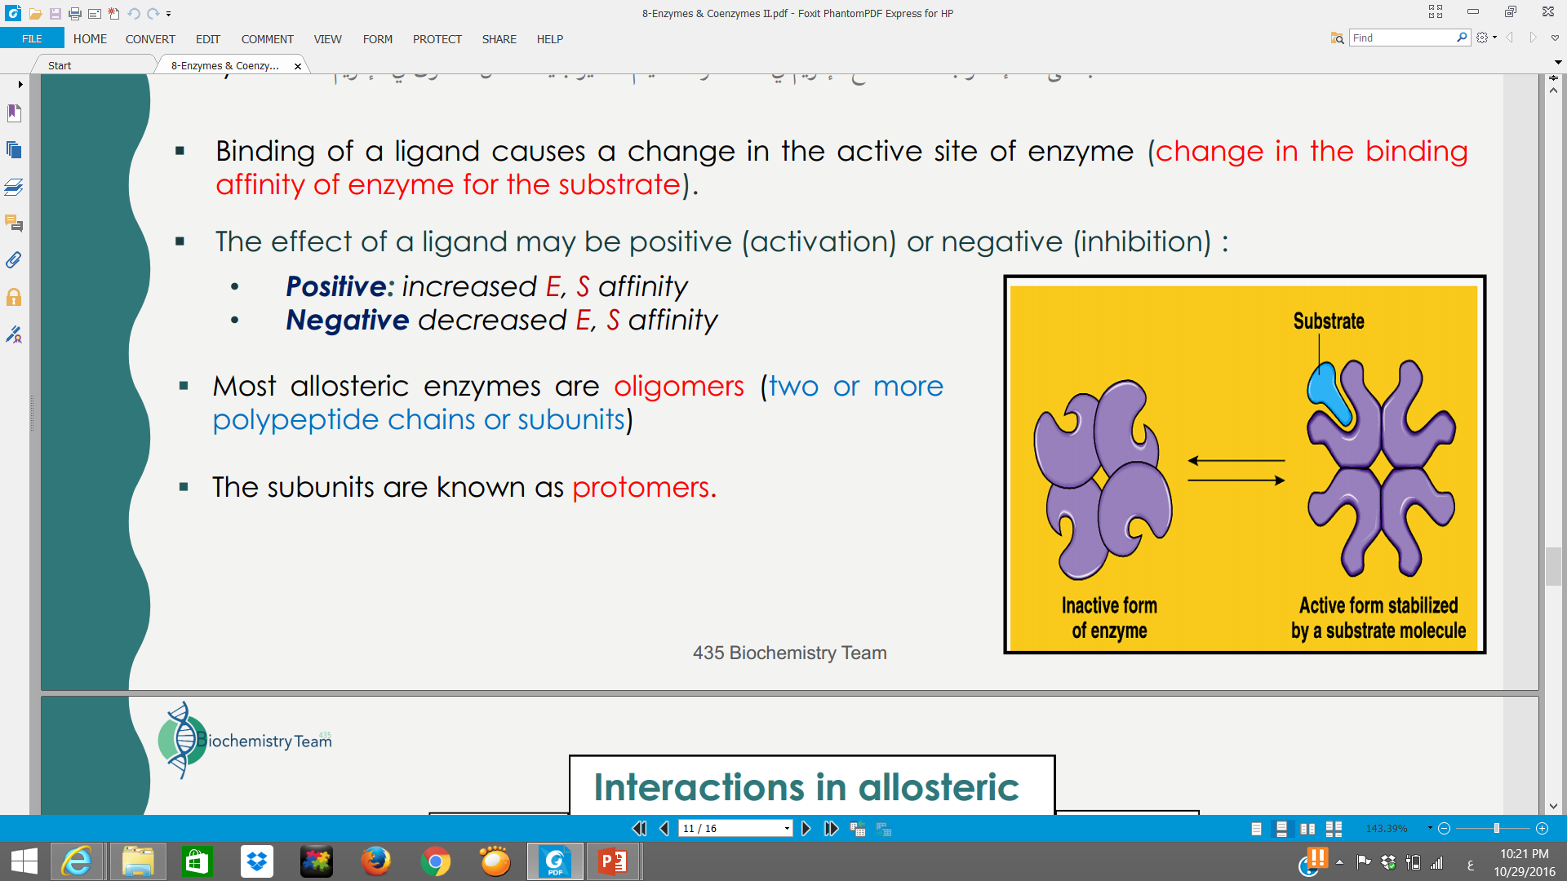
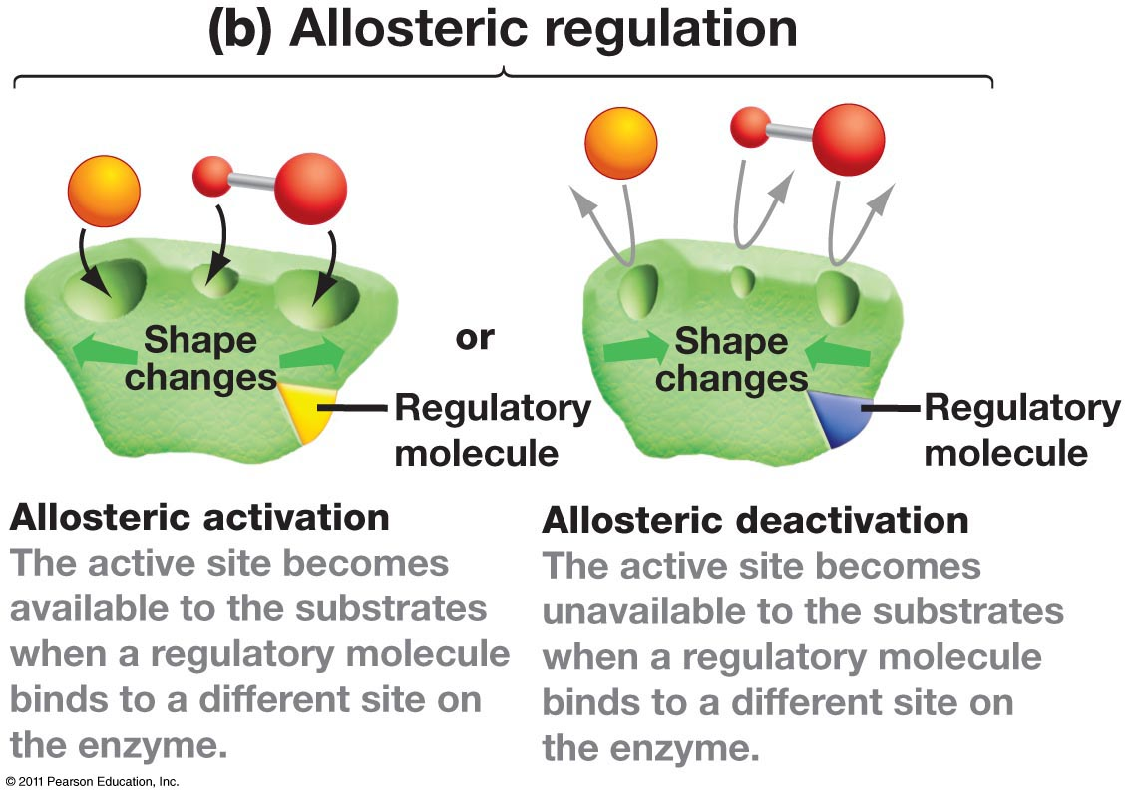
Cooperative binding
  It is the process by which binding of a ligand to a regulatory site affects binding of the same or of another ligand to the enzyme. بمعنى ارتباط المادة مع الانزيم في منطقة وحدة يحفّز المناطق الأخرى بنفس الإنزيم.
  Binding of an allosteric modulator causes a change in the conformation of the enzyme
  This causes a change in the binding affinity of enzyme for the substrate
  The effect of a modulator may be positive (activation) or negative (inhibition)
  Positive: increased E, S affinity
  Negative decreased E, S affinity
  Most allosteric enzymes are oligomers (two or more polypeptide chains or subunits)
  The subunits are known as protomers
Effectors that inhibit enzyme activity are termed negative effectors,
whereas those that increase enzyme activity are called positive effectors.

Slide 24
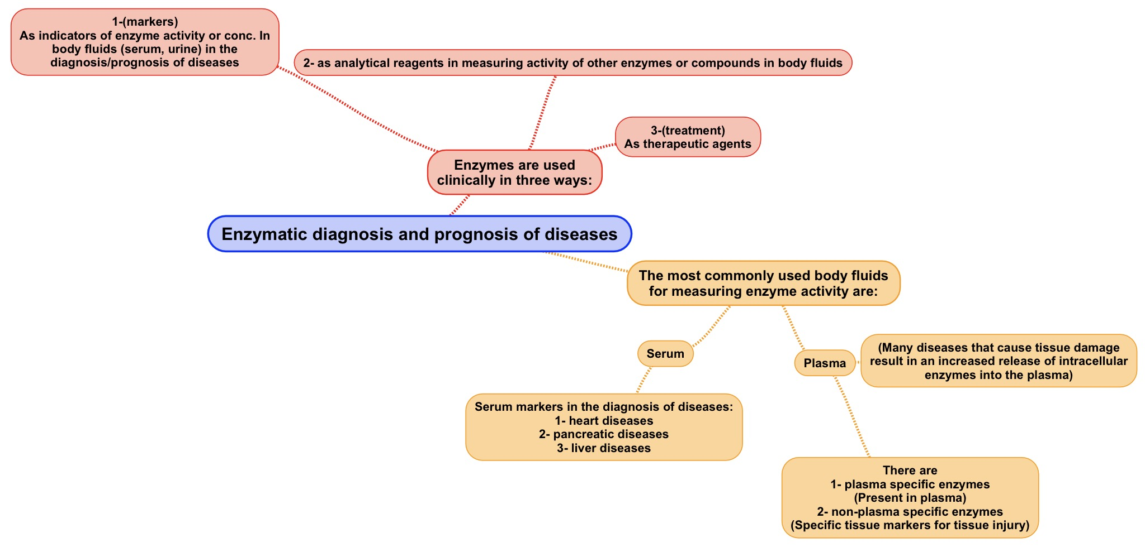
Between brackets: doctor's notes
Extra information from the book.
بعض الإنزيمات توجد بشكل طبيعي في البلازما لكن كثرتها أو قلتها الغير طبيعية دليل على وجود مرض والبعض الآخر من الإنزيمات لا
يتواجد في البلازما أو يتواجد بنسبة قليلة وغالباً ما تكون تلك النسبة ثابتة فلو وجد فهذا دليل على المرض.
- أٌيضاً نسبة هذه الإنزيمات تحدد في أي مرحلة من المرض يمر بها المريض.
*مثال: يوجد إنزيمات خاصة في الكبد بنسبة ثاتبة في الدم لكن في حالة شخص يعاني من مرض بالكبد ترتفع هذه النسبة ويمكن ملاحظة ذلك عن طريق أخذ عينة من المريض. وهذا المثال ينطبق على الإنزيمات الخاصة بأعضاء أخرى.

Slide 25
Summary
 | Competitive inhibition | Noncompetitive
meaning | similar to the structural of the substrate and competes with it for binding at the active site | The inhibitor does not have structural similarity to the substrate.The inhibitor binds to the enzyme at a site away from the substrate binding site
V_{max} | V_{max} is unchanged in the presence and the absence of inhibitor | The value of V_{max} is decreased by the inhibitor
K_{m} | K_{m} is increased because substrate and inhibitor compete for binding at the same site | K_{m} is unchanged because the affinity of S for E is unchanged
-Regulatory enzymes usually catalyze the first or an early reaction in a metabolic pathway.
-There are two types of regulation allosteric enzyme regulation and cooperative binding
  -Feedback inhibition inhibits the regulatory enzyme to normalize the pathway (feedback inhibition) while the feedback positive activiation
  activates the regulatory enzyme to normalize the pathway.
-Two types of interactions occur in allosteric enzymes:
Homotropic: Effect of one ligand on the binding of the same ligand .
Heterotropic: Effect of one ligand on the binding of a different ligand.
Enzymes are used clinically in three ways.

Slide 26
MCQs + Videos
Most commonly used body fluids for measuring enzyme activity are :
A- serum B- interstitial C-plasma D-A&B E-A&C
Heterotropic: Effect of one ligand on the binding site of the same ligand
A- TRUE B- FALSE
Ki is a measure of affinity of the inhibitor for the enzyme
A- TRUE B- FALSE
In competitive inhibition ..… is unchanged in the presence and the absence of inhibitors
A- Kmax B- Vmax C- Vavg D- V
Competitive inhibition
Ki ( dissociation constant )
Allosteric enzyme regulation
Cooperative binding
1- E
2- B
3- A
4- B

Slide 27
Girls team members:
1- زينة الكاف.
2- هيفاء الوعيل.
3- ريم السرجاني.
4- سمية الغامدي.
5- لمى الفوزان.
6- مها الغامدي.
7- نورة الشبيب.
8- أسيل السليماني.
9- شهد السويدان.
10- جومانا القحطاني.
11- نجود العنزي.
12- شذا الغيهب.
13- سارة الشمراني.
14- لجين الزيد.
15- روان الوادعي.
16- منيرة الضفيّان.
17- بثينة الماجد.
Boys team members:
1- محمد المهوس.
-Contact us:
Biochemistryteam436@gmail.com
twitter.com/436biochemteam
-Team leaders:
نوره السهلي.
عبدالله المانع.

