Slide 1
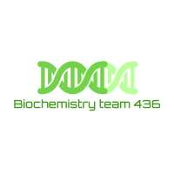
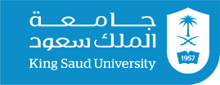
METABOLISM: Anabolism and Catabolism
– Color Index:
Important.
Extra Information.
Doctors slides.
436 Biochemistry team

Slide 2
OBJECTIVES :
Understand the concept of metabolic pathways .
metabolic pathways (anabolic and catabolic).
Identify ATP as the energy source for cells .
436 Biochemistry team

Slide 3
Metabolism: All the chemical reactions taking place inside a cell are collectively known as METABOLISM .
It consists of:
Glycolysis
Anabolic(بناء) :
energy consuming Pathways.
Endergonic function.
(مستهلك للطاقة )
Catabolic(هدم) :
energy producing Pathways.
Exergonic function.
(منتج للطاقة )
#Metabolic Pathway:
A multi-step sequence of chemical reaction. A product of first reaction becomes a substrate for second reaction.
#Integrated pathway: Metabolism (Work together for one purpose)
A pathway has many steps for example: A is converted B(product) then B(substrate) is converted to C …
- Glycolysis is an example of a metabolic pathway
#Metabolic Map: Different pathways can intersect (تقاطع) to form an integrated and purposeful network of chemical reactions
- Cycles: Pathways that regenerate a component.
Metabolic Map

Slide 4
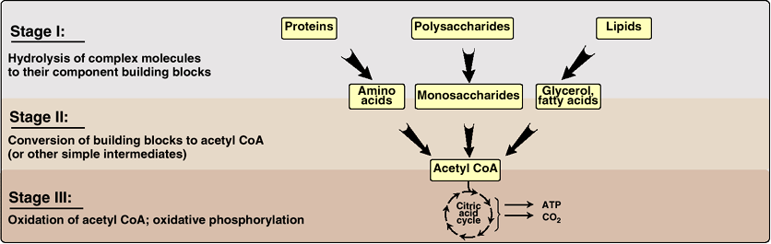
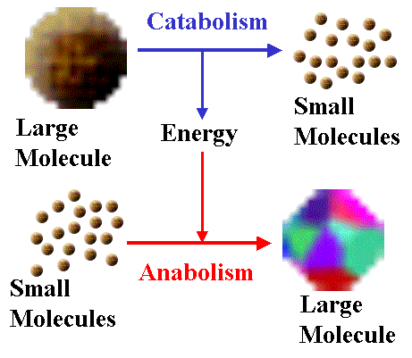
Anabolism takes the energy from catabolism to build large molecules.
Metabolic Pathways Classification
Anabolic
mainly
Catabolic
Precursor molecules ➤ complex molecule
Endergonic reactions (require ATP)
A divergent process (few precursors form more complex products)
Energy-yielding nutrients ➤ energy-poor products

Slide 5
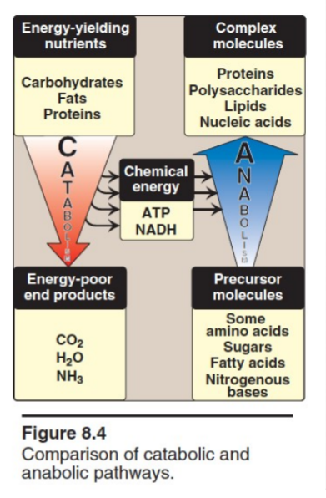
CATABOLISM VS ANABOLISM
Anabolic | Catabolic
Simple to complex molecules | Complex to simple molecules
Endergonic (ماص للطاقة) | Exergonic (مطلق للطاقة)
Involves reduction | Involves oxidation
Requires NADPH | Requires NAD+
Divergent process (عملية متشعبة) | Convergent process (عملية متقاربة)
During catabolism process, the energy is released (broken down) as ATP and NADH, this is why it is exergonic.
Then this energy is used in anabolism process, this is why it is endergonic.
#للربط
Exergonic= Exit energy
Endergonic= Enter
Amphi = Dual (مزدوج), amphibolic: dual pathway (contains Both catabolic and anabolic) (يحتوي على عمليات هدم وبناء)
- Example:
Krebs cycle is mainly a catabolic cycle, but with some anabolic features.
(e.g., part of Krebs cycle is used for the synthesis of glucose from amino acids)
Therefore, Krebs cycle is amphibolic. Krebs cycle is used for synthesis of glucose from amino acids.

Slide 6
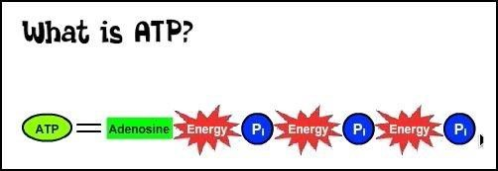
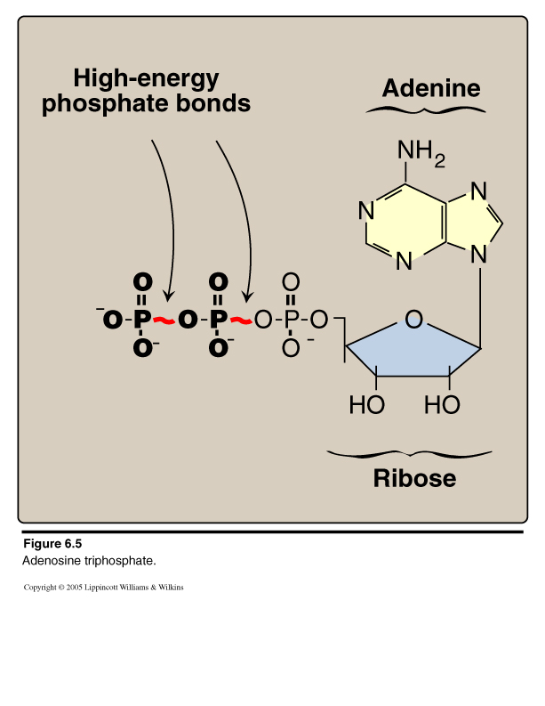
ENERGY CURRENCY: ATP
ATP + H2O ADP +Pi
Hydrolysis
Team434
This ATP-ADP cycle is the fundamental mode of energy exchange in biological systems:
1- The free energy liberated (generated) by the hydrolysis of ATP is used to drive the endergonic reactions.
2- ATP is formed from ADP and Pi when fuel molecules are oxidized.
(ADP +Pi ATP)
oxidation
Notesتلخيص للكلام :
- ATP is the source of energy in the anabolism reactions by breaking down the phosphate bond *they are known as high energy phosphate bonds* (endergonic).
- Endergonic: the absorption of energy.
ATP ADP +Pi
- Catabolism reactions generate energy in the form of ATP by linking the phosphate to the ADP (exergonic).
- Exergonic: is the release of energy.
*ADP +Pi ATP
- This is a point where we will have reaction coupling because endergonic and exergonic are directly linked ☺: endergonic requires energy from ATP and exergonic produces energy in the form of ATP.
Adenosine Triphosphate (ATP)
Δ Gº -7.3 kcal/mol/bond

Slide 7
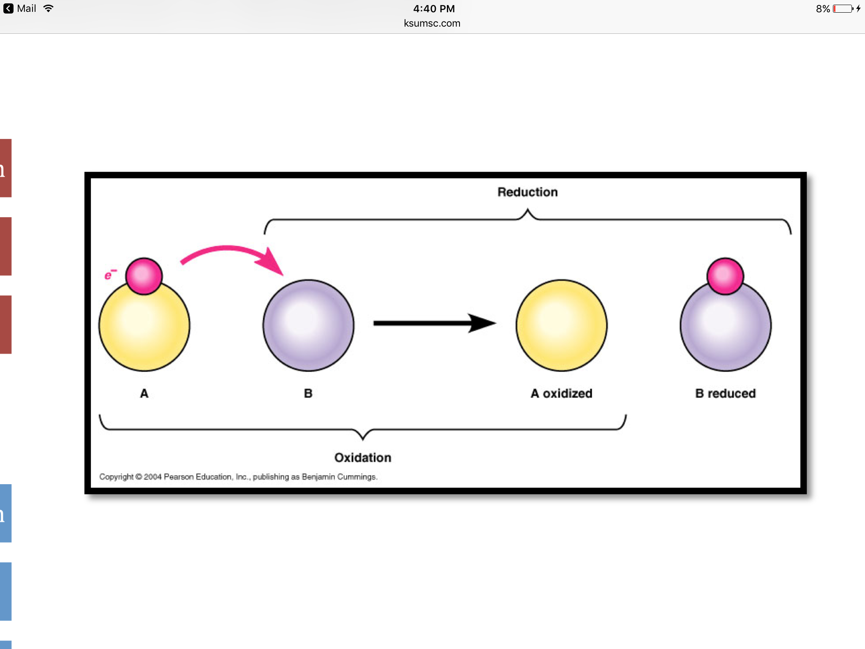
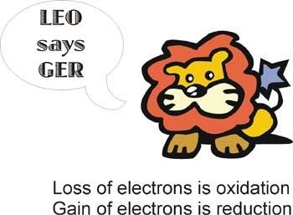
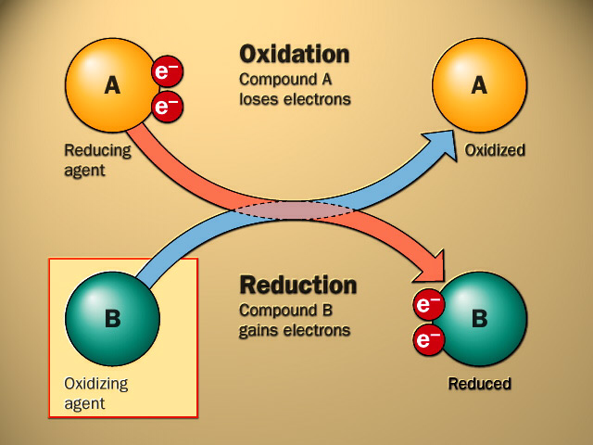
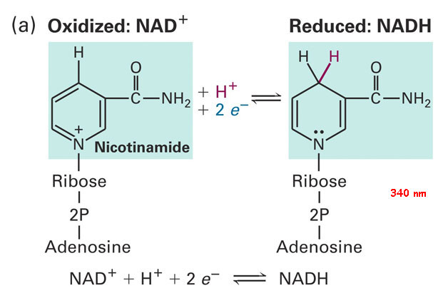
Oxidation & Reduction in metabolism
Oxidation: Loss of hydrogen Loss of electrons.
Reduction: Gain of hydrogen Gain of electrons.
- Energy rich compounds:
carbohydrates, fatty acids, amino acids.
ال energy rich compounds نحصلها غالباً من الغذاء.
- Catabolic is OXIDATION pathway, and Anabolic is REDUCTION pathway.
- In oxidation energy-rich compounds are oxidized (broken down).
Team434
Energy rich compounds are oxidized and they lose their electron.
When coenzymes NAD + is reduced ( gains hydrogen ) it’ll become NADH
في عمليات الأيض(metabolism) يحدث نقل للإلكترونات من الغذاء (oxidized) إلى الكوإنزايمز.(reduced)
Reducing agent: Foodيسبب اختزال الكوانزايمز .
Oxidizing agent: coenzymes يسبب أكسدة الغذاء .
NAD: Nicotin-amide adenine di-nucleotide.

Slide 8
REGULATION OF METABOLISM
to control metabolism we should have signals these signals could be
Intracellular signals
“inside the cell”
Intercellular communications
“between cells”
Substrate availability
(if the substrates needed are available in cell)
Product inhibition
(a type of enzyme inhibition: it is ability of the products to control the metabolism)
- Allosteric activators or inhibitors (allosteric regulation is the regulation of enzymes or other
proteins by the binding of an effector molecule at the protein's allosteric site; that is, a site other than the protein's active site
-Chemical signaling (hormones: first messenger)
-Second messengers*:
(cAMP, cGMP)
(Ca++/phosphatidylinositol
Explanation of the concept ☺
Metabolic regulation allows organisms to respond to signals and interact actively with their environments.
the regulation of an enzyme in a pathway is how its activity is increased and decreased in response to signals.
*a substance whose release within a cell, promoted by a hormone and which brings about a response by the cell

Slide 9
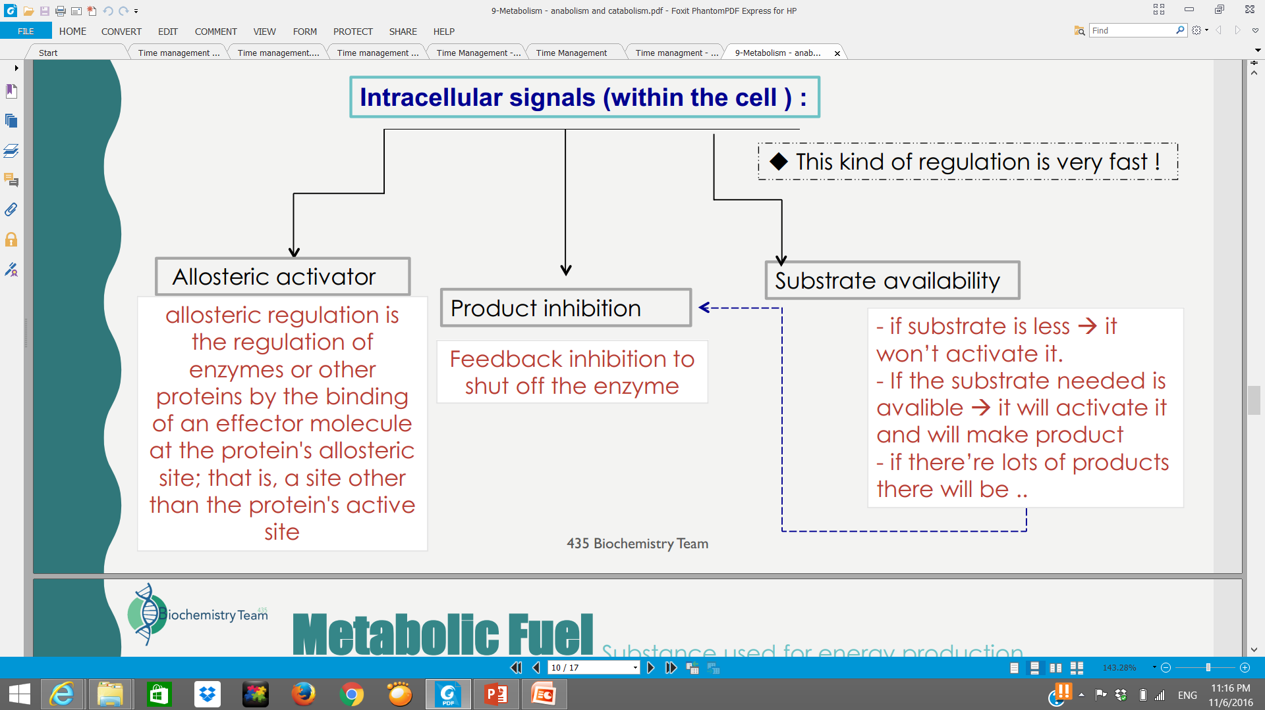

Slide 10
METABOLIC FUEL
Carbohydrates and lipids (mainly) and proteins (little extent) are used for energy production*
Glucose, fatty acids and Amino acids are major source of energy
#Glucose is the major metabolic fuel of most tissues
CARBOHYDRATES → LIPIDS → PROTEINS (little existent)
الكربوهيدرات و الدهون هي المصدر الأساسي المستخدم لإنتاج الطاقة. البروتينات تستخدم أيضًا لكن بشكل أقل.

Slide 11
Take home massage
Metabolism is the sum of all biochemical pathways that occur inside the cells.
A metabolic pathway is a multistep sequences of enzyme-catalyzed reactions.
Catabolism is a convergent process that provides energy to cells in the form of ATP.
Anabolism is a divergent process that consumes energy for the synthesis of complex molecules.
Metabolic pathways are tightly regulated and highly integrated.
ATP is the energy currency of the cells

Slide 12
Girls team members:
نوره الشبيب
Boys team members:
١- محمد الحبيب
٢- خالد الراجح
٣- خالد القحطاني
٤- عبدالعزيز الصومالي
٥- محمد المهوس
٦- طلال الطخيم
٧-هشام القوسي
٨- حمد الحميدان
٩- محمد حكمي
١٠- حمد الحسون
Online quiz
-Contact us:
Biochemistryteam436@gmail.com
twitter.com/436biochemteam
-Team leaders:
عبدالله المانع.
نوره السهلي.

