Slide 1
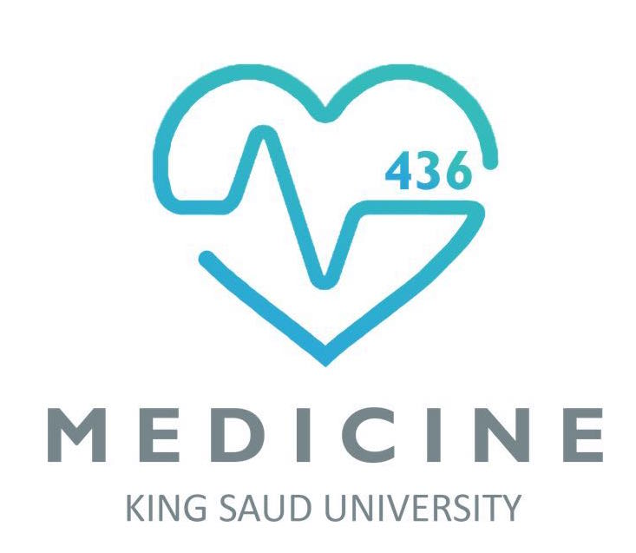
The Fundamentals of Embryology
GAMETOGENESIS & FEMALE CYCLES
@Embryology436
Embryology436@gmail.com

Slide 2
OBJECTIVES:
By the end of the lecture, you should be able to:
Describe the female cycles (Ovarian & Uterine).
Define gametogenesis.
Differentiate the types of gametogenesis.
Describe the process of spermatogenesis.
Describe the process of oogenesis.

Slide 3
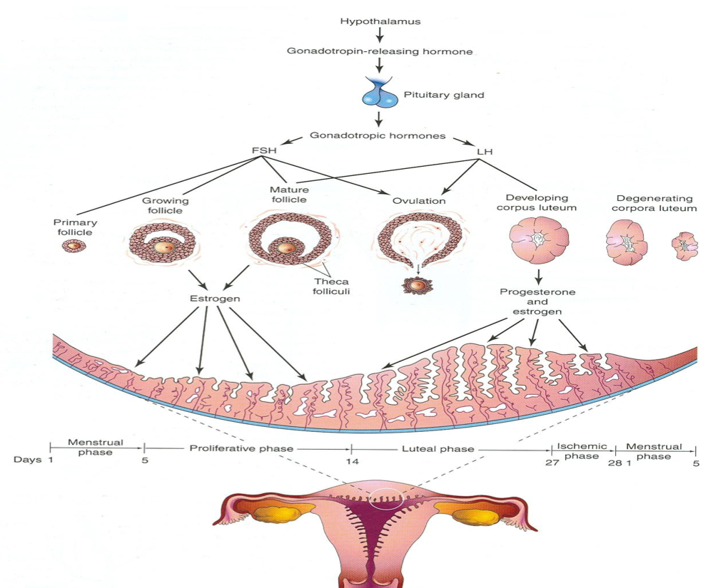
OVARIAN AND UTERINE CYCLES:
Hypothalamus
The Pituitary gland (anterior lobe)
It has neurosecretory cells that synthesize Gonadotrophin-releasing hormone (GnRH)
stimulates it to release two Hormones that act on ovaries
It starts at puberty and normally continues until the menopause.
Reproductive cycles depend upon activities & coordination of:
Hypothalamus
Pituitary gland
Ovaries
Mammary glands
Uterus
Uterine tubes
Vagina
GnRH is carried to
LH
FSH

Slide 4
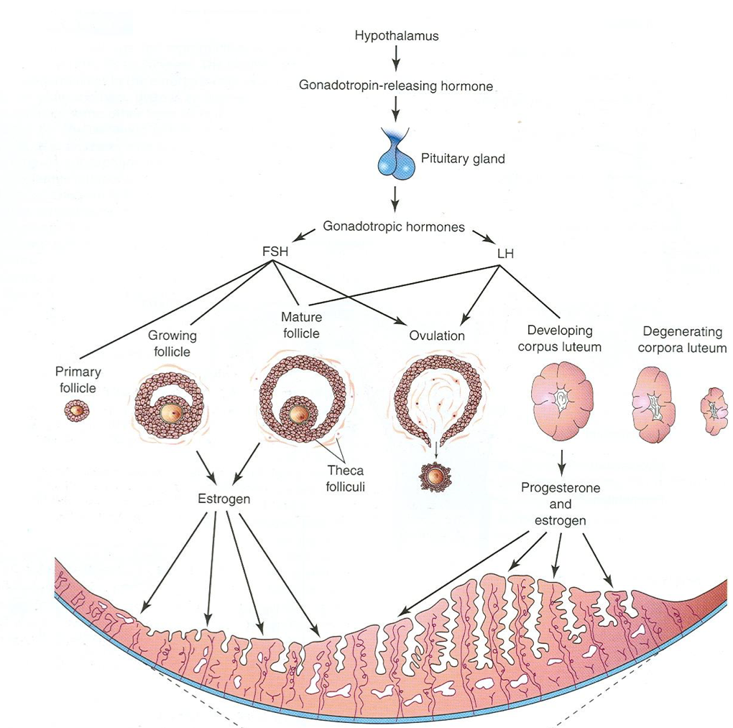
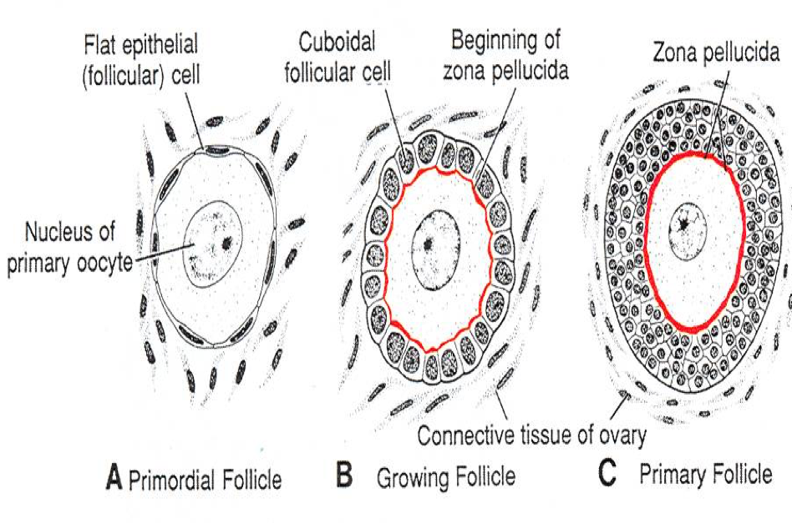
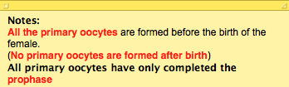
THE OVARIAN CYCLE:
The ovarian cortex contains hundreds of thousands of primordial follicles (400,000 to 500,000).
Each primordial follicles consists one of primary oocyte encircled by single layer of flat follicular cells.
The ovarian cycle is under the control of the Pituitary Gland, and it has three phases: (FOL)
1- Follicular (FSH)
2- Ovulatory (LH)
3- Luteal (LH)

Slide 5
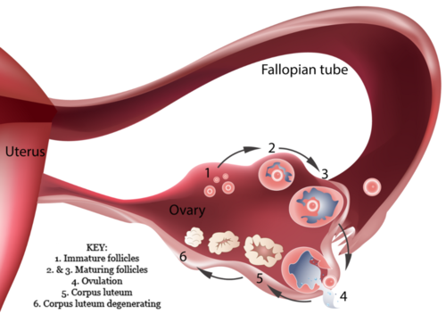
THE OVARIAN CYCLE:
Follicular Phase
FSH:
Follicle- Stimulating Hormone.
Ovulatory Phase
The follicle becomes enlarged until it gets maturity. It produces swelling on the surface of the ovary.
Luteal Phase
The remaining of the ruptured follicle is now called corpus luteum.
• FUNCTIONS:
1- It stimulates the ovarian primary follicles to develop and become mature.
2- Production of Estrogen by the follicular cells.
FSH makes the simple flat follicular cells become cuboidal, then columnar then forming many layers around the oocyte forming primary follicle.
*check out the previous image
Growing follicles produce estrogen which regulates the development and functions of the reproductive organ.
LH:
Luteinizing Hormone.
• FUNCTIONS:
1- It serves as the trigger for ovulation.
2- Stimulates the follicular cells.
3-Stimulate corpus luteum to produce Progesterone.
It secretes Progesterone and small amount of Estrogen.
These 2 hormones stimulate endometrial glands to secrete and prepare endometrium for implantation of fertilized Ovum (Blastocyst).
If the oocyte is fertilized the Corpus Luteum enlarges and remains till the 4th month of pregnancy.
If the oocyte is not fertilized the corpus luteum involutes and degenerates in 10-12 days.
FSH | LH
Early development of ovarian follicle is induced by FSH. | Final stages of maturation require LH. LH causes ovulation (rupture of the mature follicle).

Slide 6
Uterine or Menstrual Cycle:
Phases of the menstrual cycle:
What is it? | Cyclic changes in the endometrium of the uterus.
What cause it? | Caused by estrogen & progesterone.
It’s average days? | An average menstrual cycle is 28 days (the ideal number of days), but it ranges between 23 and 35 days in 90% of women.
What else you need to know about menstrual cycle? | Day one is the day when menstrual blood flow begins. It varies by several days in normal women and It sometimes varies in the same woman.
1-Menstrual Phase
2- Proliferative or Follicular Phase
3- Luteal Phase
4- Ischemic Phase

Slide 7
1- Menstrual Phase: - Starts with 1st day of menstrual cycle. - Lasts for 4-5 days. - Functional layer of the endometrium is sloughed off and discarded with the menstrual flow. - Blood discharge from vagina is combined with small pieces of endometrial tissue. | 2- Proliferative Phase: - Is a phase of repair and proliferation. - Lasts for 9 days. - Coincides with growth of ovarian follicle. - So it is controlled by Estrogen secreted by the follicular cells. - Thickness of the endometrium is increased into 2-3 folds. - The glands increase in number and length and the spiral arteries elongate.
4- Ischemic Phase: - Degeneration of corpus luteum leads to decrease the levels of estrogen & progesterone. - Loss of interstitial fluid. - Marked shrinking of endometrium. - Spiral arteries become constricted. - Venous stasis & Ischemic necrosis. - Rupture of damaged vessel wall. - Blood seeps into the surrounding connective tissues. - Loss of 20-80 ml of blood. - Entire compact layer and most of the spongy layer of endometrium is discarded. | 3- Luteal Phase: - Is a Secretory of Progesterone phase. - Lasts about 13 days. - Coincides with the formation, growth and functioning of the Corpus Luteum. - Glandular epithelium secretes glycogen rich material. Endometrium thickens under the influence of estrogen and progesterone. What happens to the endometrium in this phase? - The spiral arteries grow into the superficial layer. - Arteries become increasingly coiled. - Large venous network develops. - Direct arterio-venous anastomoses are the prominent features.

Slide 8
FOR YOUR UNDERSTANDING:
1
This is the functional layer of the endometrium which slough off and discarded in (Menstrual Phase).
2
1
3
5
2
This is the endometrium which increase in thickness during (Proliferative Phase).
Also in (Luteal Phase) this endometrium thickens under the influence of progesterone and estrogen, but it shrink in (Ischemic Phase).
4
3
This is the gland which increase in number and length during (Proliferative phase)
4
The spiral arteries which elongate during (Proliferative )
Also it grow into the superficial layer during (Luteal Phase).
In (Ischemic Phase) this spiral arteries become constricted.
5
This is the venous network that develops during (Luteal Phase).

Slide 9
Definition: It is the production of mature male & female gametes (Sperms & Ova).
Gametogenesis
Spermatogenesis:
It is the series of changes by which the primitive germ cells (spermatogonia) are transformed into mature sperms.
Oogenesis:
Sequence of events by which the primitive germ cells (oogonia) are transformed into mature oocytes.
Note :Mature sperm contain little cytoplasm comparing to mature oocyte
Note:
Spermatogonium (mitosis)
Spermatogonia (grows)
Video summarizing Gametogenesis

Slide 10
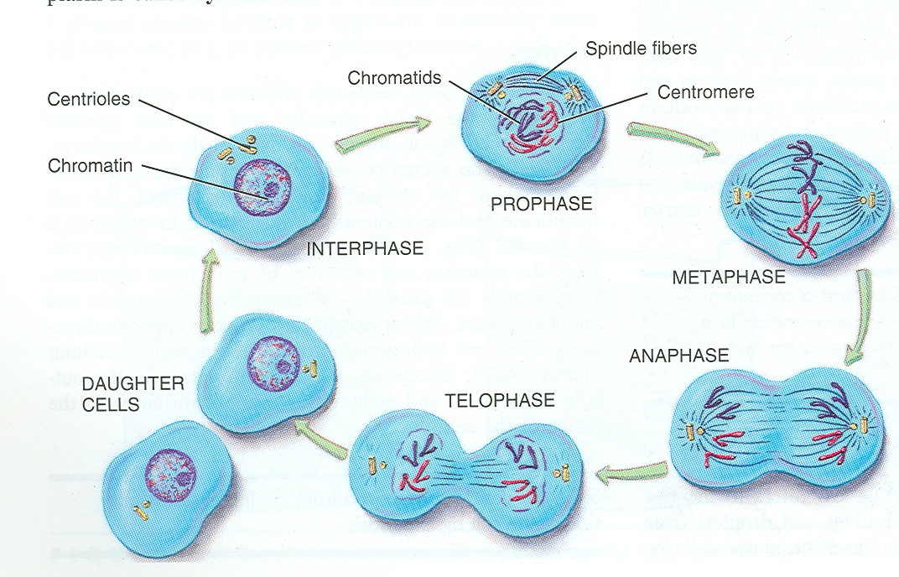
Meiosis
It is the cell division that takes place in the germ cells to produce male & female gametes.
It consists of two cell divisions, meiosis I & meiosis II during which the Diploid number of chromosomes (46) is reduced to Haploid number (23).
First Meiotic division
At the beginning of meiosis I, (prophase) male & female germ cells replicate their DNA so that each of the 46 chromosomes is duplicated into sister chromatid.
By the end of the first meiotic division, each new cell formed (Secondary Spermatocyte or Secondary Oocyte) has haploid (half) number of chromosome.
It is half number of chromosomes of the Primary Spermatocyte or primary oocyte.

Slide 11
WHAT IS THE DIFFERENCE BETWEEN MITOSIS & MEIOSIS?
DIPLOID
HAPLOID

Slide 12
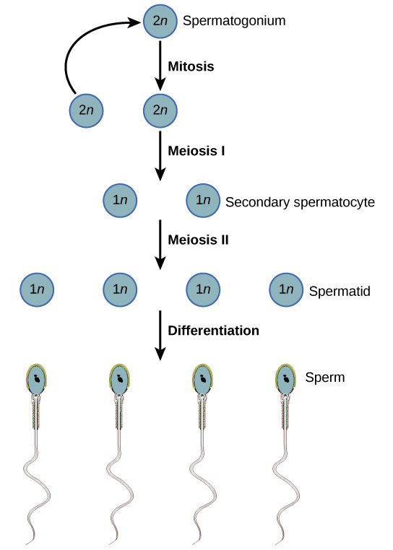
SPERMATOGENESIS:
AIM: Formation of sperms with haploid number of chromosomes.
SITE: Seminiferous tubules of the testis.
TIME: From puberty till old age.
DURATION: About two months
N.B. Sperms are stored and become functionally mature in the Epididymis.
Each daughter Spermatogonia grows to give primary spermatocyte (46).
Primary spermatocyte undergoes meiotic division to give 2 secondary spermatocyte (22+ x) or (22+y).
Secondary spermatocytes undergo 2nd meiotic division to form 4 haploid spermatids (half size).
Spermatids are transformed into 4 mature sperms by a process called spermiogenesis.
Video summarizing the spermatogenesis

Slide 13
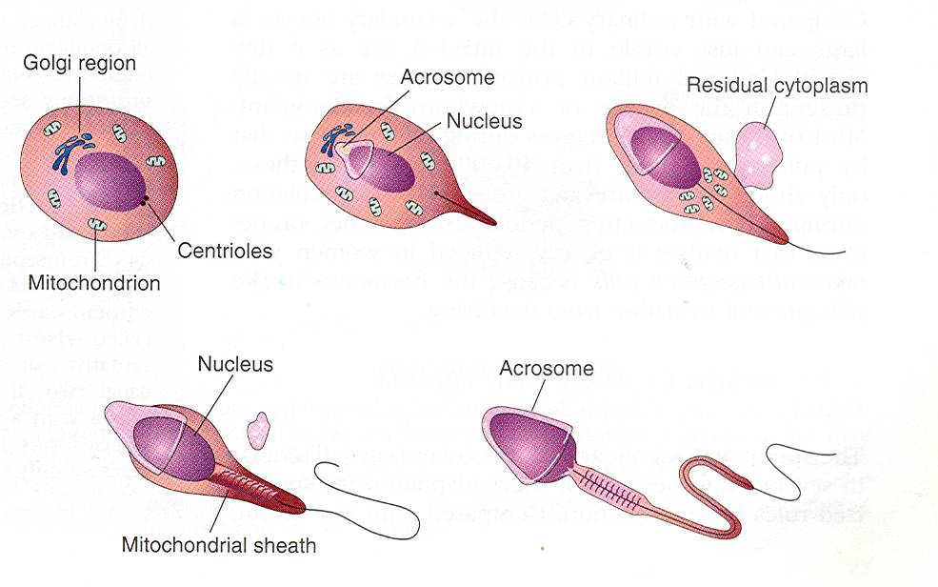
SPERMIOGENESIS:
It is change in shape (metamorphosis) through which Spermatids are transformed into mature Sperms:
Nucleus is condensed and forms most of the head.
Golgi apparatus forms the Acrosome.
Mitochondria forms a spiral sheath.
Centriole elongates to form the axial filament

Slide 14
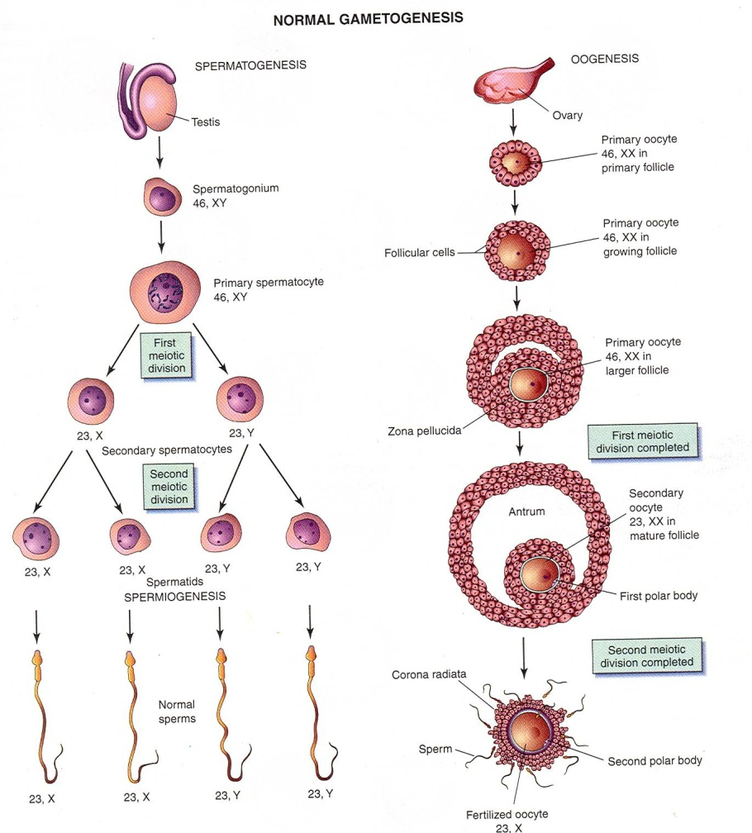
Oogensis:
Sequence of events by which the primitive germ cells (oogonia) are transformed into mature oocytes | Definition
Formation of secondary oocytes with haploid number of chromosomes. | Aim
Cortex of the ovary | Site
Starts during fetal life becomes completed after puberty continues until menopause. | Time
It occurs monthly except during pregnancy. | Duration

Slide 15
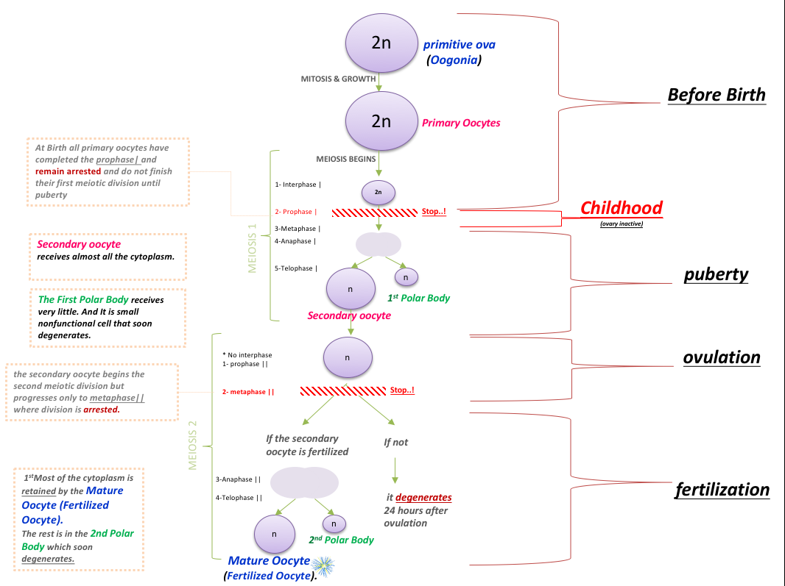

Slide 16
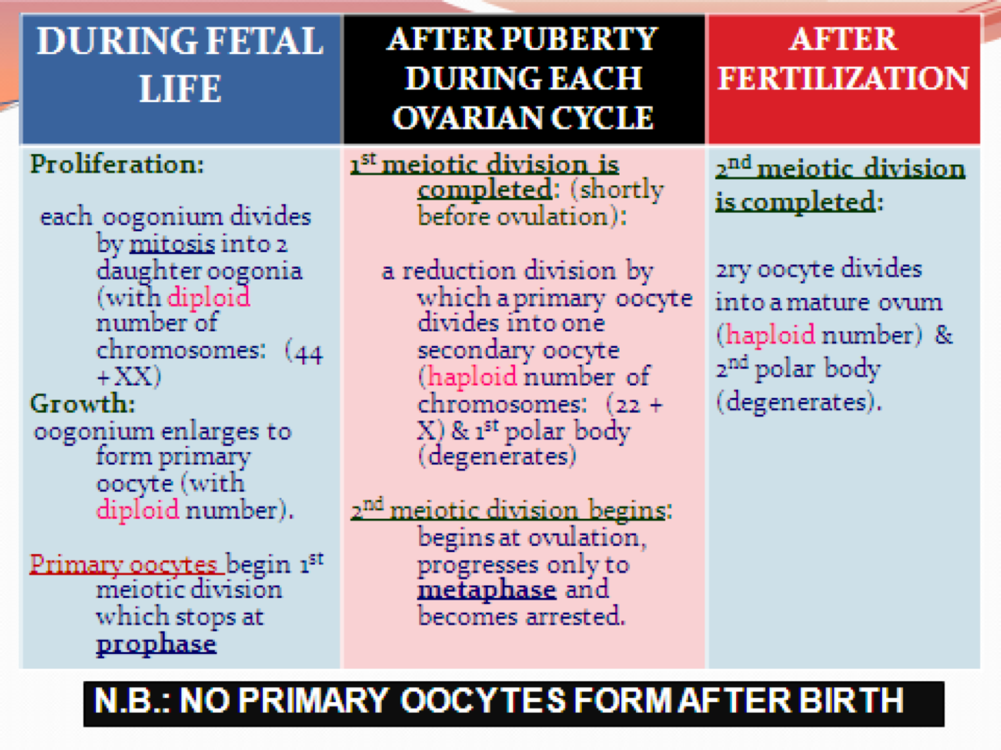
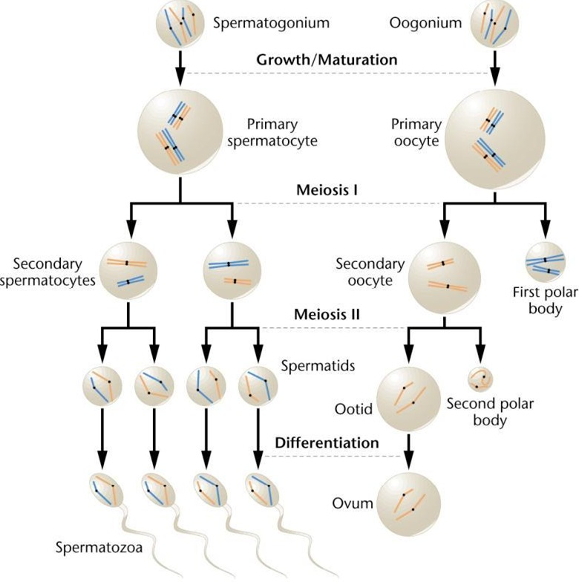

Slide 17
Important notes:
1- Meiosis II, during which the Diploid number of chromosomes (46) is reduced to Haploid number (23).
2- GnRH is synthesized by neurosecertory in the hypothalamus
3- FSH and LH are secreted by pituitary glands.
4- LH hormone makes ovulation.
5- Growing follicles produce (estrogen).
6- If the secondary oocyte is fertilized, the second meiotic division is completed.
7- At ovulation the nucleus of the secondary oocyte begins the second meiotic division.
8-All primary oocytes have completed the prophase.
9- Each of the 46 chromosomes is duplicated into sister Chromatid.

Slide 18
Useful Videos:
Spermatogenesis and Oogenesis
Khan Academy: Reproductive System
Quizzes:
Gametogenesis & Female Cycles 1
Gametogenesis & Female Cycles 2

Slide 19
Credits
Team members:
Maha AlGhamdi
Laila Mathkour
Ghadah Almazrou
Rana Almanaa
Haneen Alsubki
Nada Alyousef
Ghadah Alothaim
Team leaders:
Sumaya AlGhamdi
@Embryology436
Embryology436@gmail.com

