Slide 1
The Fundamentals of Embryology
FERTILIZATION & IMPLANTATION AND TWINNING
@Embryology436
Embryology436@gmail.com

Slide 2
OBJECTIVES:
By the end of the lecture, you should be able to:
Identify fertilization and its sites
List the phases of fertilization
Describe the results of fertilization
Describe formation of blastocysts
Identify implantation and its sites
Describe the mechanism of the implantation
List the common sites of ectopic pregnancies

Slide 3
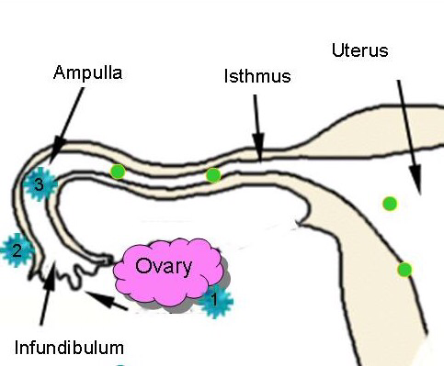
Fertilization
Fertilization: a male gamete (sperm) + a female gamete (oocyte) =a single cell called the (ZYGOTE).
It is a complex process which begins with a contact between the sperm & ovum and it ends up with intermingling (mixing) of the maternal and paternal chromosomes.
*Chemical signals from the oocyte attracts the sperms.
Where Does Fertilization Normally Occur?
Usually in the ampulla (the widest part of the tube) of uterine tube.
Fertilization may occur in any other part of tube.
But it never occurs in the uterine cavity.

Slide 4
Phases of Fertilization
Sperm pass through corona radiata by the effect of:
1-hyaluronidase enzyme secreted from the sperm 2-By movement of its tail
Penetration of the zona pellucida by acrosine (substance secreted from acrosomal cap)
Fusion of the plasma membranes of the oocyte and the sperm
Union of the 2 pronuleii
Formation of the female pronucleus and male pronucleus
Completion of the second meiotic division of the oocyte & formation of the female pronucleus.
1-
Passage
2-
Penetration
3-
Fusion
4-
Completion
5-
Formation
6-
Union

Slide 5
Chromosomes
Zygote: is genetically a unique structure.
half of its chromosomes comes from the father and the other half comes from the mother.
New combination is formed which is different from either of the parent.
This mechanism forms biparental inheritance and leads to variation of the human species.
Sex of the Embryo
Embryo's chromosomal sex is determined
at the time of fertilization by genetic studies.
Sex is determined by the type of sperm
(X or Y) that fertilizes the oocyte (X or X).
So, it is the father whose gamete decides the sex.
Zonal reaction: it is a change in properties of zona pellucida that makes it impermeable to other sperms. (it happens when a sperm gets inside the oocyte, so there is no need to another one. Zona pellucida prevents the other sperms to get in).

Slide 6
Results of fertilization:
1. Stimulates the penetrated oocyte to complete its 2nd meiotic division which was arrested at metaphase.
2. Restores the normal diploid number of chromosomes. (23 of the sperm and the same of the oocyte = 46)
3. Determines the sex of the embryo.
4. Initiates cleavage of the zygote (cell division).

Slide 7
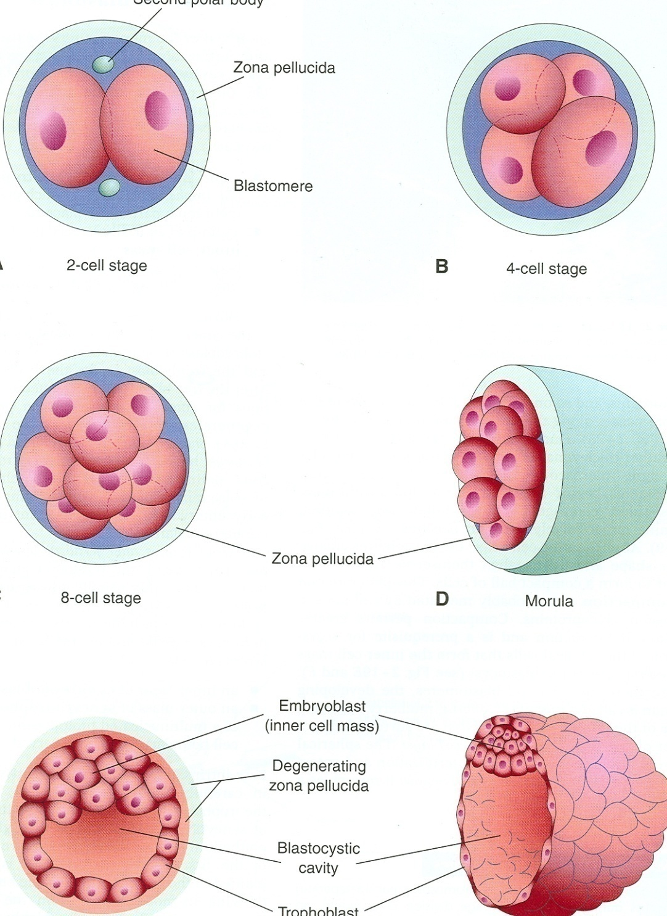
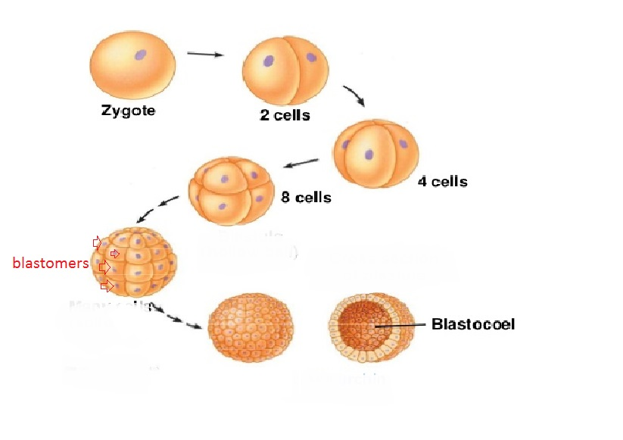
Cleavage of Zygote
Now once we knew that the zygote is about a single cell formed of the union of 2 pronuclei (the paternal pronucleus and the maternal pronucleus)
This single cell will undergo a multiple “mitotic” division to form (Blastomeres).
After 30 hours of fertlizition , the cleavage begins.
So, Cleavage of Zygote : is the repeated mitotic divisions of the zygote which normally occurs in the uterine tube.
Rapid (high speed) increase in the number of the cells that divided from the single cell (Zygote) to a sequence of 2 cells, then 4,8 and 16…. And so on.
These smaller embryonic cells are now called: Blastomeres.
During cleavage, these cells will be surrounded by thick zona pellucida , which is translucent (شفاف) membrane under the microscope.
Zygote migrates (travels) in the uterine tube during cleavage from its lateral end to its medial end.
(until it reaches the uterine cavity).
Blastomeres

Slide 8
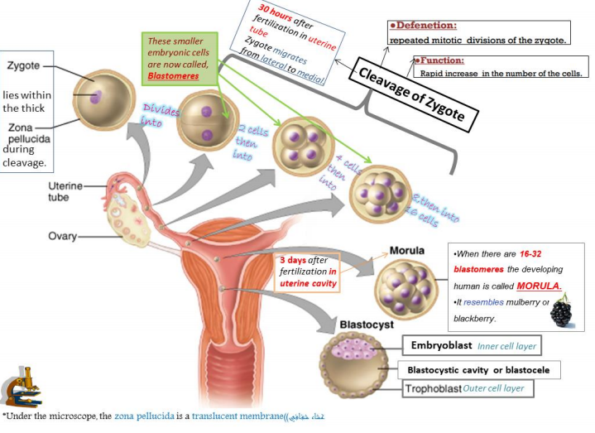
Summary
*from team 435

Slide 9
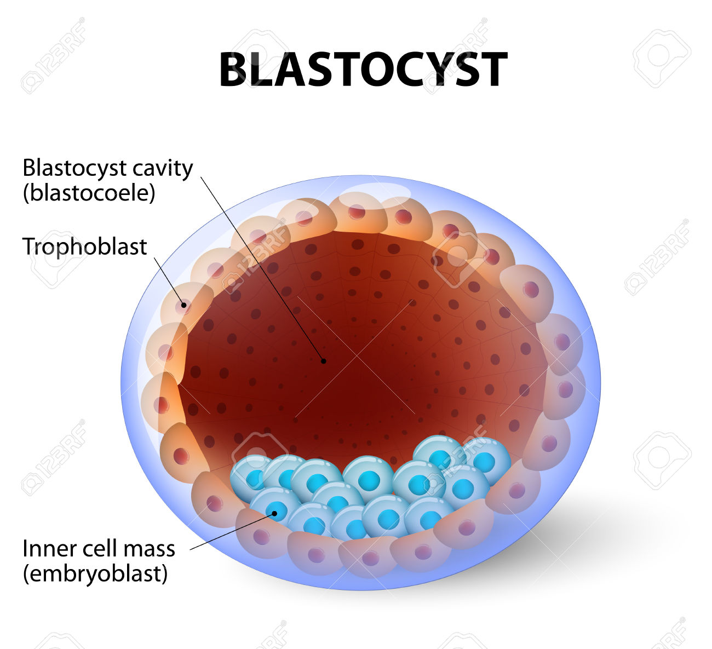
Morula
When there are 16 - 32 blastomeres the developing human is called MORULA.
The Morula reaches the uterine cavity at this stage.
Spherical Morula is formed about the 3rd day after fertilization.
It resembles mulberry or blackberry and it reaches the uterine cavity by the 4th day.
Blastocyst
A cavity appears within the morula dividing its cells into 2 groups:
1- Outer cell layer called trophoblast.
2- Inner cell layer (mass) called Embryoblast attached to one of the poles of the blastocyst.
The cavity is called blastocystic cavity or blastocele.

Slide 10
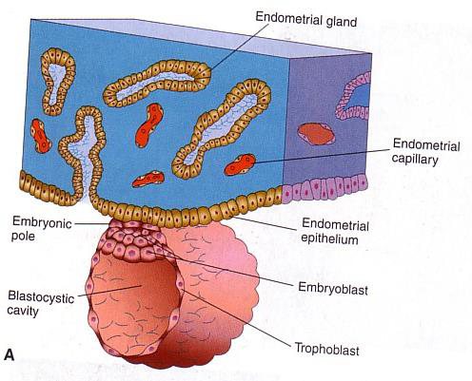
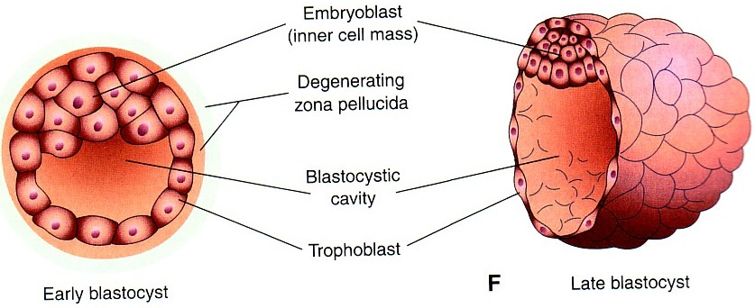
Definition: It is the process by which the Blastocyst penetrates the superficial (compact) layer of the endometrium of the uterus.
IMPLANTATION
Mechanism:
*The Morula reaches the uterine cavity by the 4th day after fertilization and it remains free within the uterine cavity for one or two days.
*Fluid passes from uterine cavity to the Morula.
*Now the Morula is called Blastocyst, its cavity is called blastocystic cavity or blastocele, and its cells divided into Embryoblast & Trophoblast.
Site :The normal site of implantation is the posterior wall of the body of the uterus near the fundus.
Time: It begins about the 6th day after fertilization.
It is completed by the 11th or 12th day

Slide 11
Summary
5th Day
Zona pellucida degenerates & disappears to allow the Blastocyst to increase in size and penetrate the endometrium.
The Embryoblast projects into the blastocystic cavity, while the trophoblast forms the wall of the blastocyst.
6th Day
Blastocyst begins implantation & adheres to the endometrium.
Penetration results from proteolytic enzymes e.g.(cox-2) produced by the trophoblast
7th Day
Trophoblast is differentiated into
A- Cytotrophblast: inner layer, mitotically active.
B- Syncytiotrophoblast: outer multinucleated mass with indistinct cell boundary.
8th Day
Blastocyst is superficially embedded in the compact layer of the endometrium.
10th or
11th Day
Syncytiotrophoblast erodes the endothelial lining of the maternal capillaries which is known as sinusoids.
Blood Filled Lacunae appear in the Syncytiotrophoblast which communicate forming a network.
11th or
12th Day
Blood of maternal capillaries reaches the lacunae so Uteroplacental circulation begins.
13th Day
Proliferation of Cytotrophblast cells produce extension inside the Syncytiotrophoblast to form the primary chorionic villi.

Slide 12
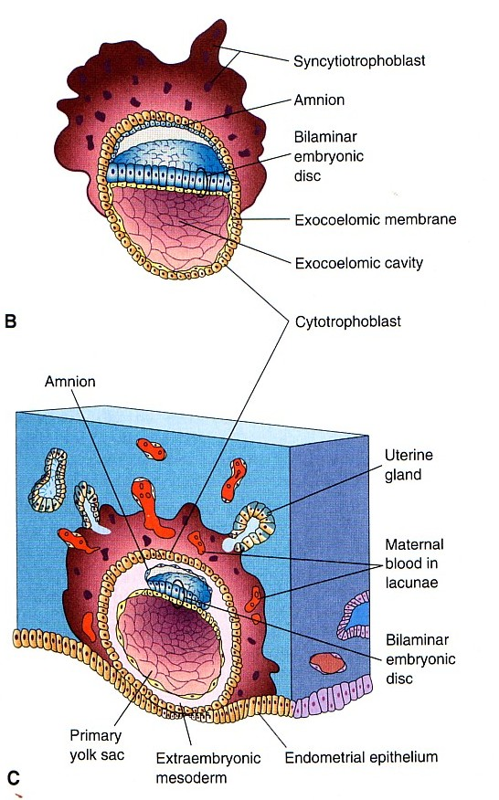
Endometrial cells undergo a process called apoptosis (programmed cell death) to facilitates invasion of endometrium by the Syncytiotrophoblast.
The syncytiotrophoblast engulf these degenerated cells for nutrition of the embryo.
Implantation can be detected by:
1- Ultrasonography.
2- hCG (human chorionic gonadotrophin) a hormone which id secreted by the Syncytiotrophoblast about the end of 2nd week. (excreted In the mother’s urine)
Early Pregnancy Factor
The early pregnancy factor is an immunosuppressant protein which is secreted by trophoblast cells and it appears in maternal serum within 24--48 hrs after implantation.
It is the basis for EPT (Early pregnancy test) in the first 10 days of development.

Slide 13
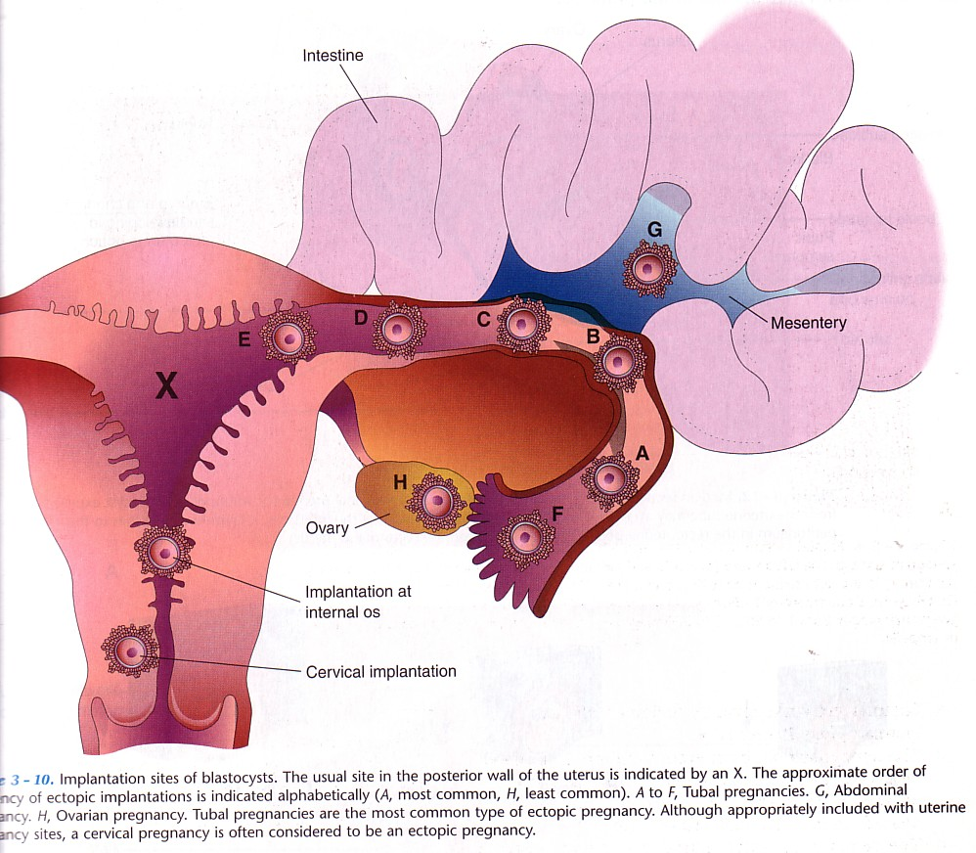
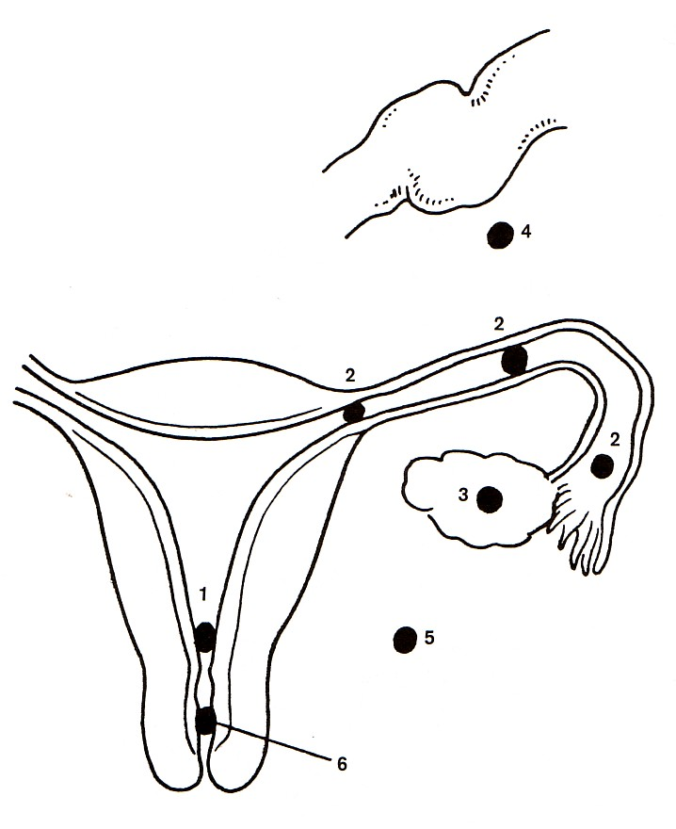
Ectopic Implantation (pregnancy)
It means implantation outside the uterine cavity.
95 to 97% of ectopic pregnancies occurs in the uterine tube.
Most are in the ampulla & isthmus.
Placenta previa:
Implantation occurs in the lower uterine segment.
Ectopic Pregnancy:
1- Placenta Previa.
2- Tubal.
3- Ovarian.
4- Abdominal.
5- Pelvic.
عنقي6- Cervical.
Tubal pregnancy is the most common type of ectopic pregnancy (A).
Ovarian pregnancy is the least common type of ectopic pregnancy (H).
The usual site of implantation is the posterior wall of the body of uterus (X).

Slide 14
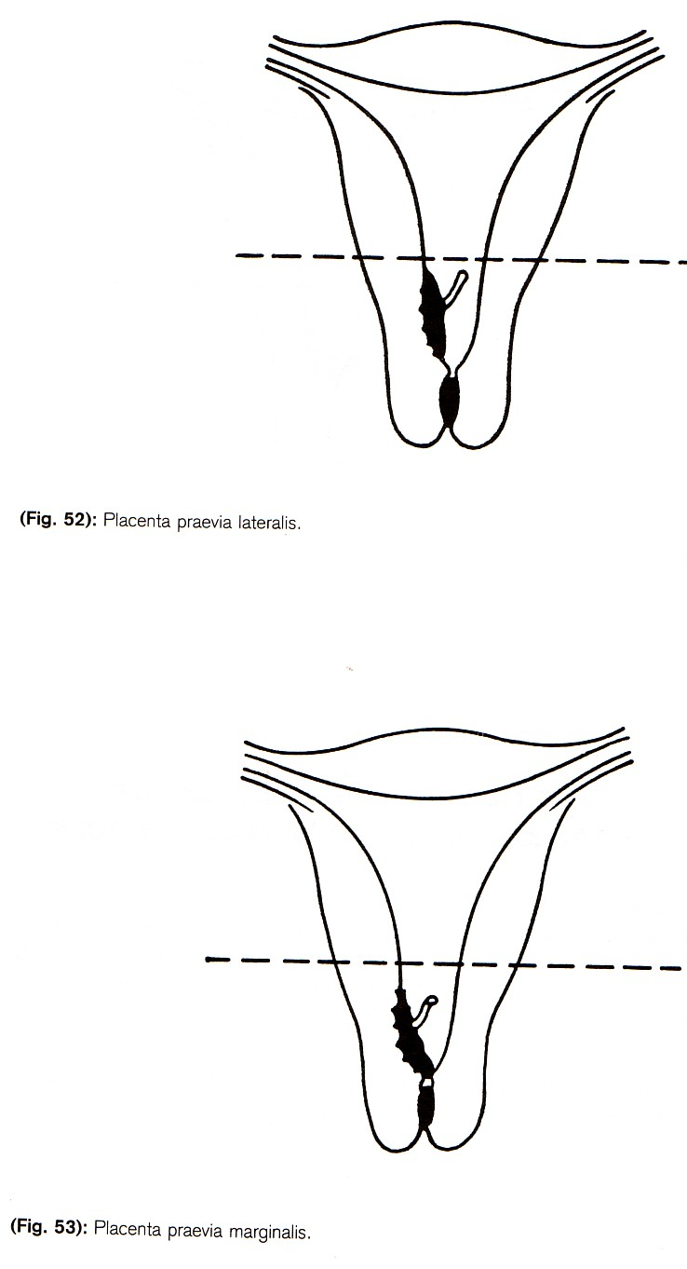
Ectopic Implantation (pregnancy) cont’d
Placenta previa lateralis
Placenta previa marginalis
Placenta previa centralis

Slide 15
Credits
Team members:
Khalid Alhusainan
Abdulrahman Alrasheed
Jehad Alsadhan
Abdulrahman Alharbi
Abdulkarim Alharbi
Faris Alrajhi
Abdulrahman Alarifi
Mosea Alnowaiser
Rayan AlQarni
Maha AlGhamdi
Laila Mathkour
Ghadah Almazrou
Rana Almanaa
Haneen Alsubki
Nada Alyousef
Ghadah Alothaim
Team leaders:
Sumaya AlGhamdi
Saad Alrushud
@Embryology436
Embryology436@gmail.com

